Slide 1



Flow Equations for MBL
Dynamics and Dimensionality
Steven J. Thomson and Marco Schiró
Institut de Physique Théorique, CEA Paris-Saclay
  Phys. Rev. B 97, 060201(R) (2018)
@PhysicsSteve

Slide 2
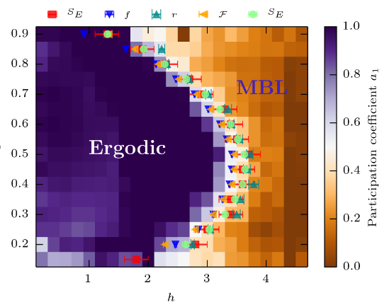
Many-Body Localisation
In d=1, localisation at finite energy density in the presence of interactions.
(Basko et al. Ann. Phys 321, 1126 (2006); reviews by Huse & Nandkishore, Annu. Rev. Cond. Mat. Phys. 6, 15 (2015) and Alet & Laflorencie, Comptes Rendus Physique 19, 6 (2018))
We’ll focus on spinless, interacting fermions:
with
MBL phase for
(e.g. Luitz et al., PRB 91, 981103 (2015))

Slide 3
The Flow Equation Method
Main idea: use a continuous unitary transform to diagonalise the Hamiltonian:
The flow of the Hamiltonian is given by:
Key point: choose to diagonalise as
Kehrein, STMP 217, 11-41 (2006)

Slide 4
A Toy Example
For non-interacting spinless fermions:
With , the flow equations are:
Quito et al. PRB 94, 104202 (2016)
Monthus, J. Phys. A. Mat. Theor. 49, 305002 (2016)

Slide 5
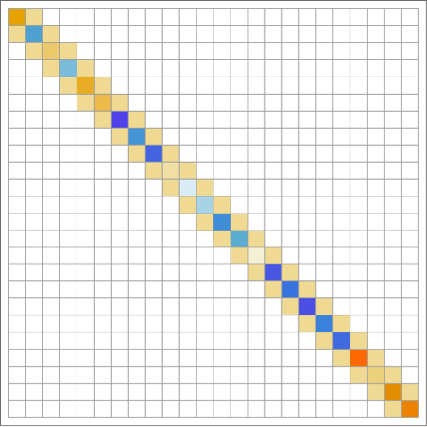
A Toy Example

Slide 6
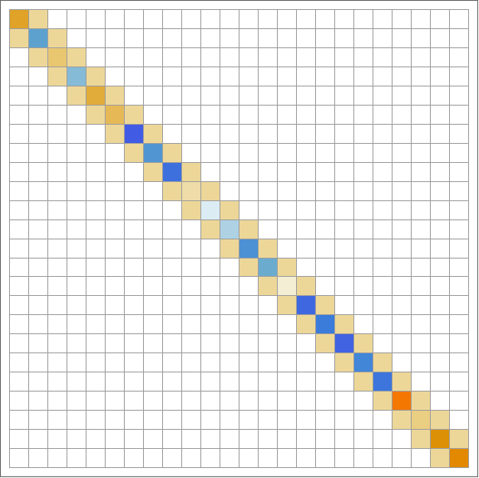
A Toy Example

Slide 7
Interacting Fermions
“Wegner’s choice” of maps the interacting Hamiltonian onto the l-bit model:
  Problem: generates (many…) new couplings
Solution: truncate the running Hamiltonian
  Restricts us to the strong disorder limit
  Expect to describe the MBL phase well
  (Alternatively, implement exactly on very small systems: Pekker et al., PRL 119, 075701 (2017))

Slide 8
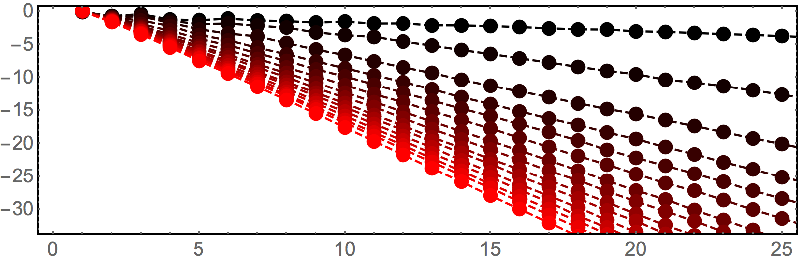
Decay of l-bits in 1D
  SJT & M. Schiró, PRB 97, 060201(R) (2018)
  [cf. L. Rademaker et al. Ann. Phys. 529, 1600322 (2017)]

Slide 9
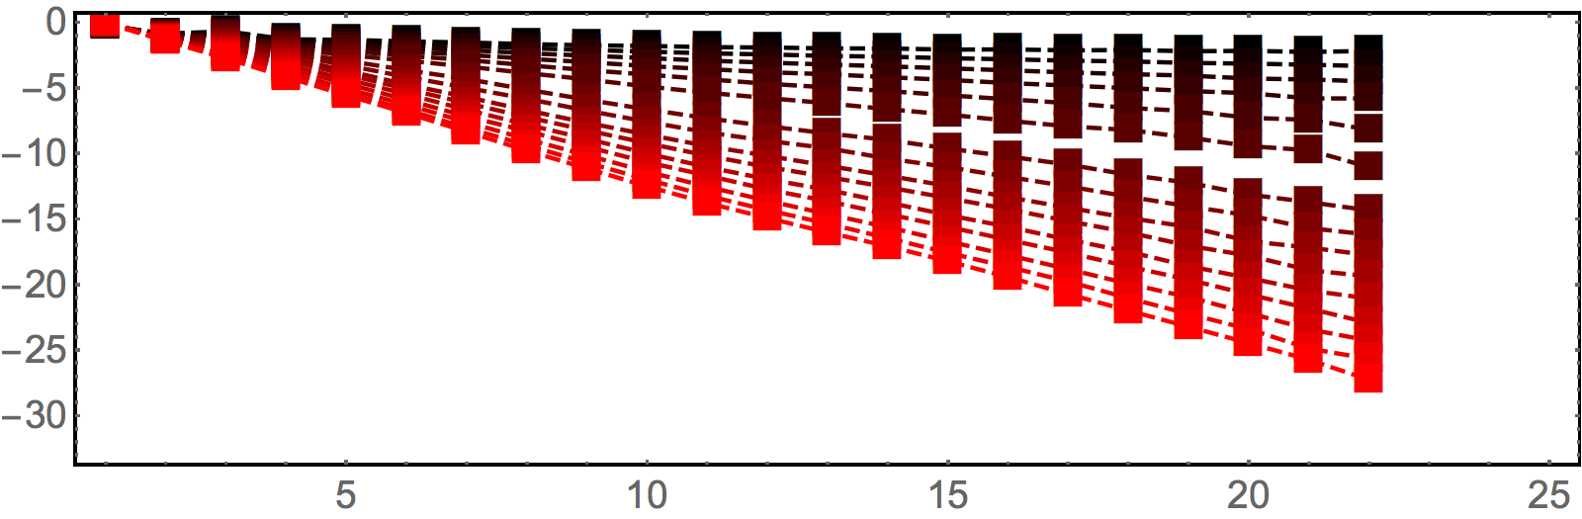
Decay of l-bits in 2D
  SJT & M. Schiró, PRB 97, 060201(R) (2018)
  [cf. T. Wahl et al. Nature Physics 15, 164 (2019)]

Slide 10
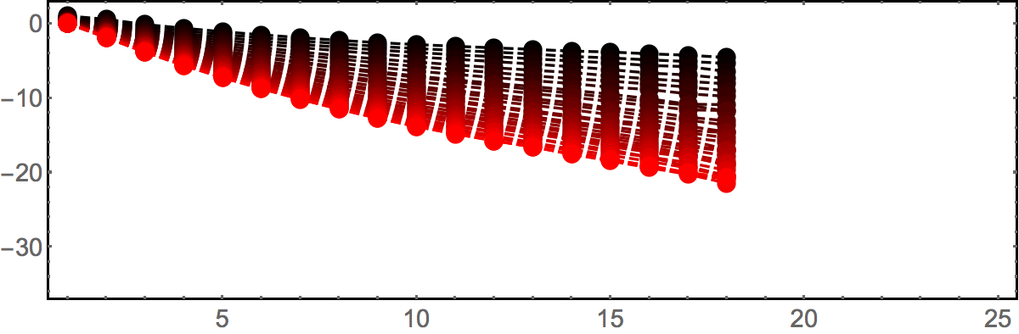
Decay of l-bits in 3D
WORK IN PROGRESS!
NB: these results use a different normal-ordering convention than d=1 and d=2.

Slide 11
Non-Equilibrium Dynamics
Transform the operator into the same basis as the Hamiltonian, time-evolve, then transform back again.
see, e.g., Hackl & Kehrein, J. Phys: Cond Mat 21, 1 (2008)

Slide 12
Quench Dynamics in 1D
  SJT & M. Schiró, PRB 97, 060201(R) (2018)

Slide 13
Density Dynamics in ‘Real Time’
1D Anderson (localised)
1D with power-law hopping (delocalised)
1D with power-law hopping (critical)
Power-law hopping + interactions (delocalised)
Power-law hopping + interactions (MBL)
Data taken for single disorder realisations on chains of lengths L=24-48. Colour shows value of <n> on each site.

Slide 14
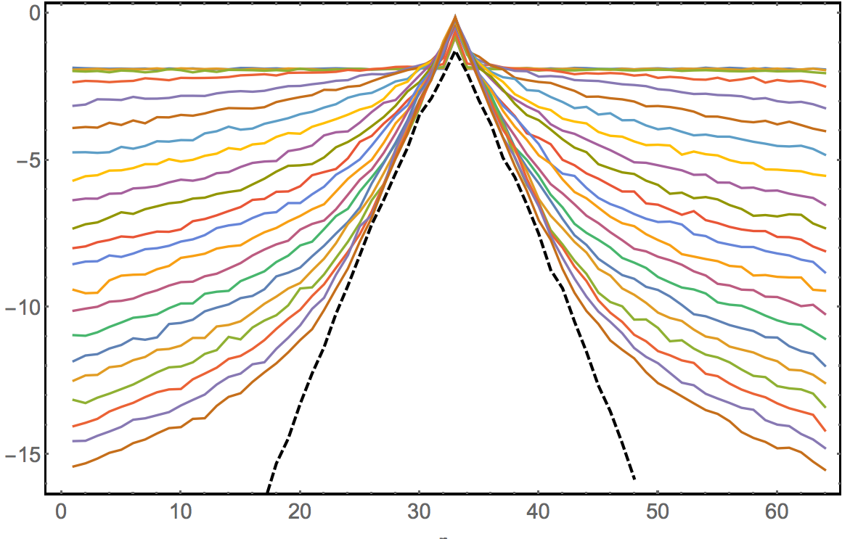
Correlation Functions
Non-interacting fermions with power-law distributed random hopping:
transition
Anderson limit

Slide 15
Flow equations are good for:
Large, strongly disordered systems:
  computational cost independent of geometry/dimensionality
  N > 300 sites (newest data: N=1000)
Non-sparse models:
  long-range hopping/interactions
Non-equilibrium dynamics
  correlation functions, spectral functions, OTOCs…?
Future/on-going work:
  Spinful fermions
    Spin and charge disorder generate very different flows.
  Transition and delocalised phase
  Drive and dissipation
    Applied to open systems (arXiv:1902.11295) and Floquet (arXiv:1808.01697).
  Topological systems – localised edge modes? (e.g. arXiv:1901.02891)

