Slide 1
Twenty Questions for Librarians
(and others) regarding
Expert Finder Systems
Michael Conlon, PhD
Emeritus Faculty Member
Health Outcomes and Biomedical Informatics
University of Florida
https://doi.org/10.6084/m9.figshare.7777391.v2
https://orcid.org/0000-0002-1304-8447

Slide 2

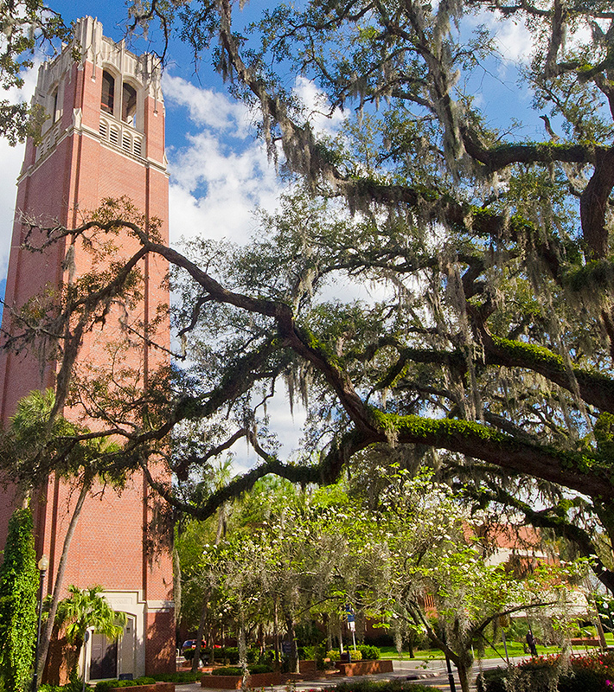
My University
University of Florida (UF), Gainesville, Florida, USA
Public, state-supported, grant funded
Free tuition for Florida students with high marks
Annual budget $7B
55000 students, 6000 faculty, 16 colleges, 2000 acres, 10750 active projects, 7000 research papers per year. Nine hospitals, 67 agricultural offices, 25 research centers across the state

Slide 3


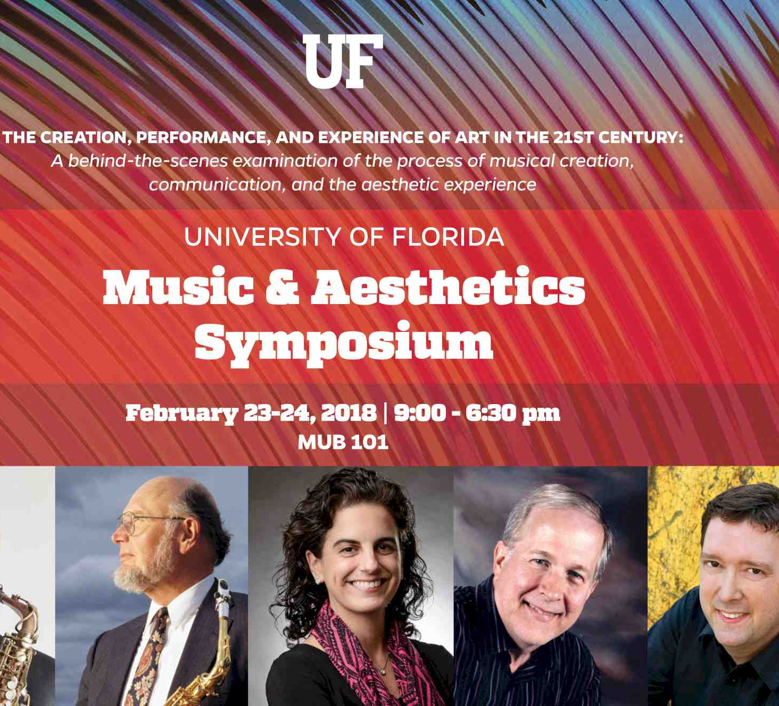
Who is an Expert?
Notes:
Universities are in the business of certifying expertise. We grant degrees to students, we grant tenure to faculty, we celebrate the achievements of our scholars through their works and activities. But who is an expert? Who decides? What evidence of expertise is there? Traditional evidence includes lead authorship of peer-reviewed papers in the discipline, as well as grants received, and books published. But many other forms of evidence exist. Assessment of expertise varies by discipline.

Slide 4

What is Expert Finding?
Notes:
The process at UF was “Ask Pete” It became “Ask Mike” Local systems, national systems, international systems? Google? LinkedIn?

Slide 5
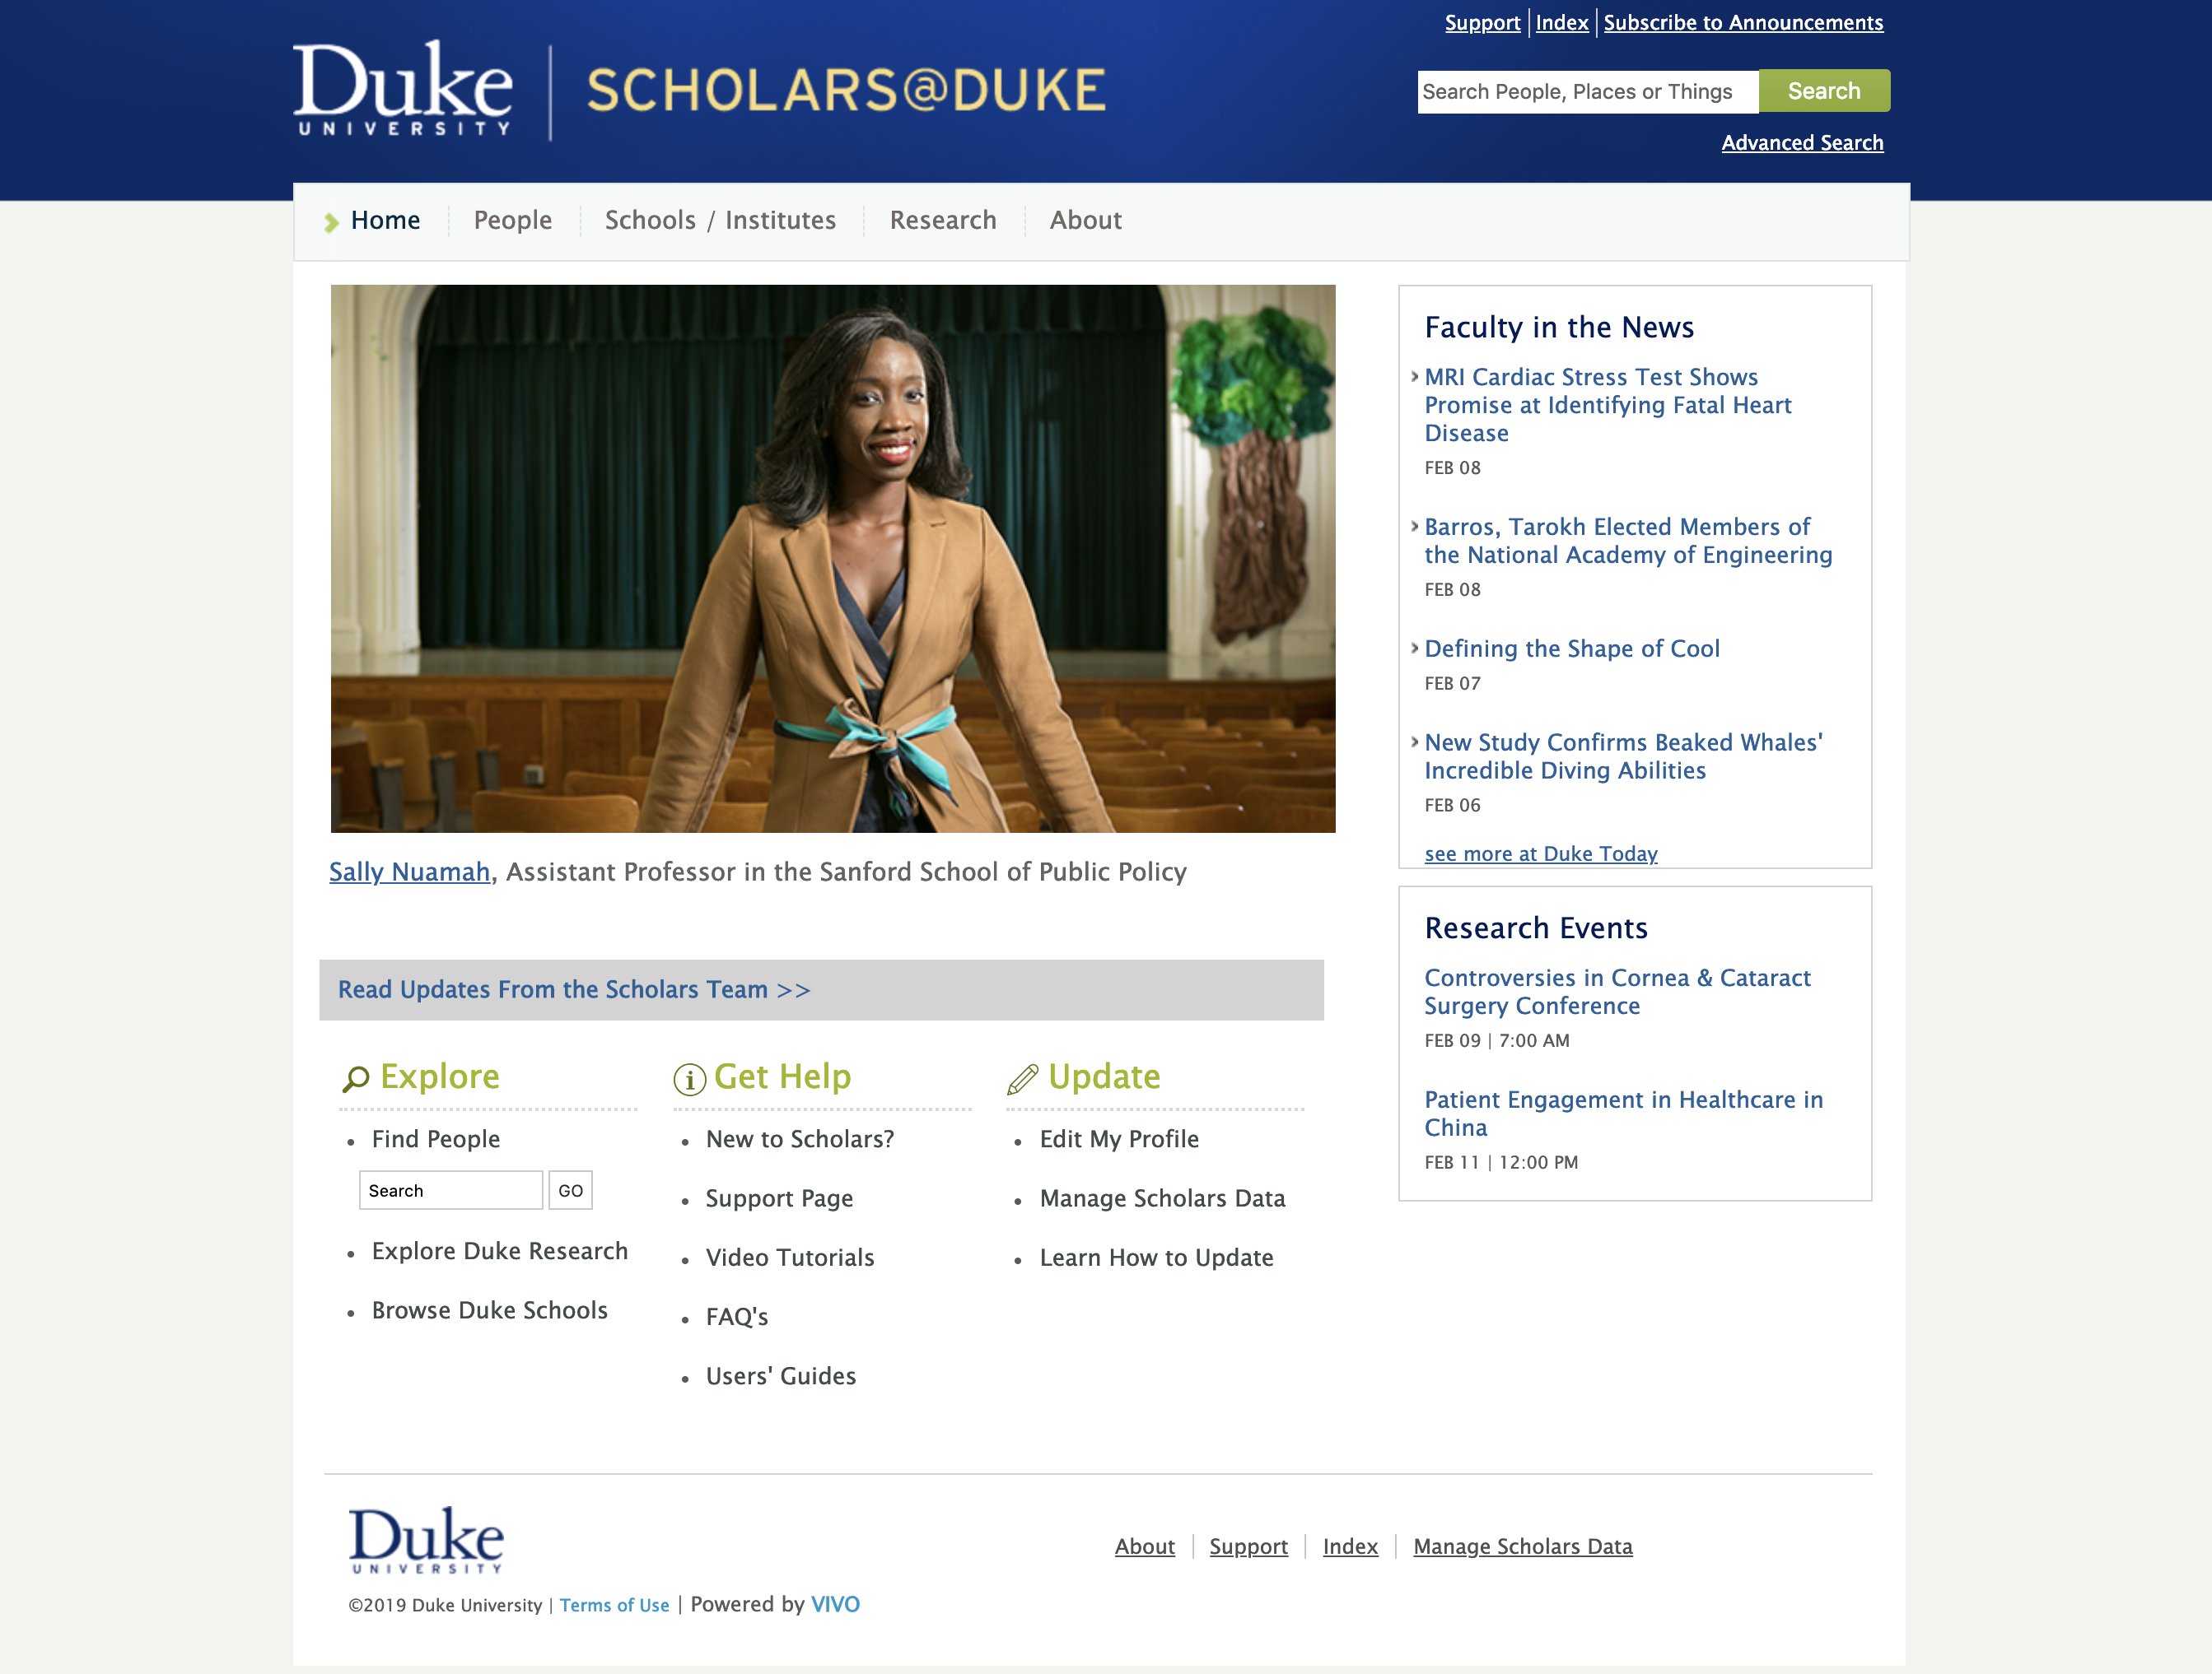
What is an Expert Finding System?
Notes:
Is it a profile system? A faculty reporting system? A research information management system? A system to showcase scholarship / the faculty / the university? Is it a system that does multiple things, one of them is expert finding? Is it a system at all, or rather a process by which expertise is identified and recorded and then used for “finding”

Slide 6
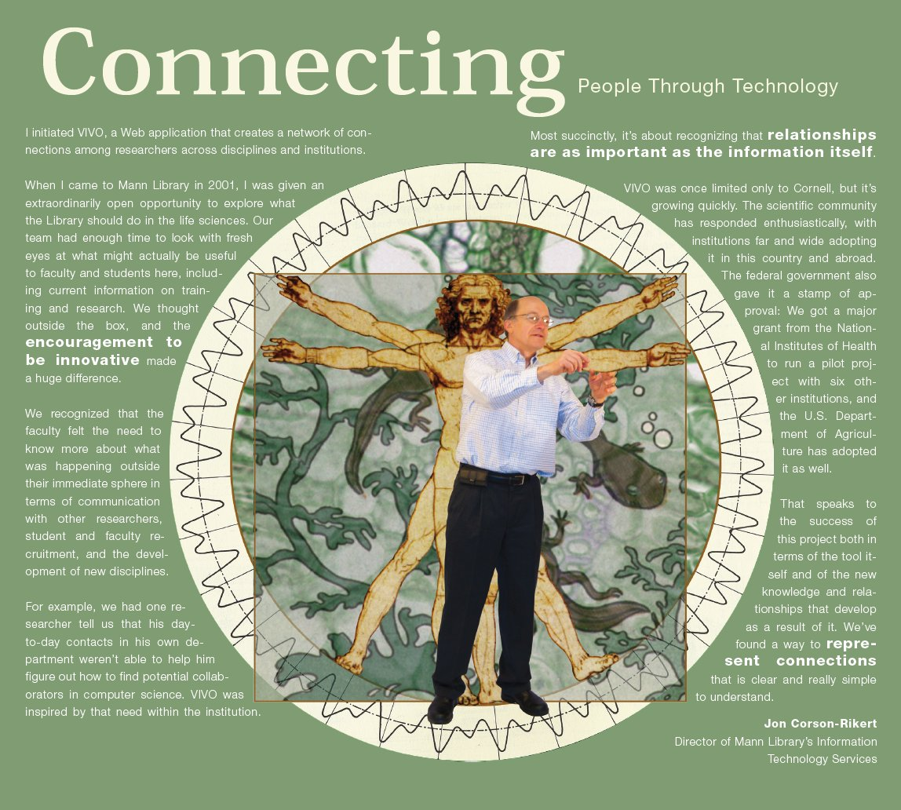
Who is Jon Corson-Rikert?
Notes:
Jon was Director of Information Technology Services for the Mann Agricultural Library at Cornell University. He had the idea of representing expertise in a system focused on connections, and building a system that could be used to connect people through their common work and interests. That system became VIVO.

Slide 7

Why the Library?
Why
the
Library?
Notes:
Why the library? What is the library bringing to the table? Will they be responsible for the site? For its data? For a service? Why not the provost’s office? The office of research? 38% of VIVO sites are managed by libraries, 24% in provost’s offices, 21% in offices of research, 17% in other offices.

Slide 8
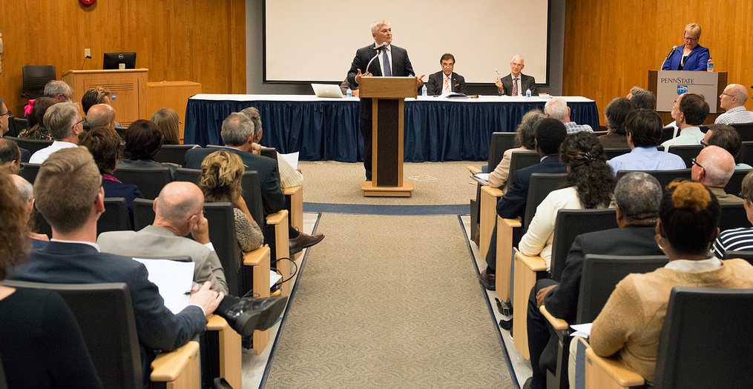
Who else is involved?
WHO
ELSE IS
INVOLVED?
Notes:
Who are the stakeholders for an expert finder system? How will they be engaged / participate? Through new mechanisms, existing mechanisms? VPR, Provost, Faculty Senate?

Slide 9
How did the information about expertise get into the system?
Reports
Expert
Finding
Organization
People
Projects
EFS
Curricula
Vitae
Network
Analysis
Papers, Books
Datasets, Software
Performances, exhibits
Web
Profiles
Teaching
Adhoc
Queries
Service
Visualizations

Slide 10
What’s an ORCiD?
Notes:
Google knows the answer. “Connecting Research and Researchers”
We forgot to disambiguate. Approaches based on authority records are focused on works. Expert finding needs approaches focused on experts.
The real question about ORCiD is “why is it important” “what is my university doing”
ORCiDs will help connect data. But people need to have and use them.
Enough about systems, back to experts ….
The library must be the place to get these answers

Slide 11
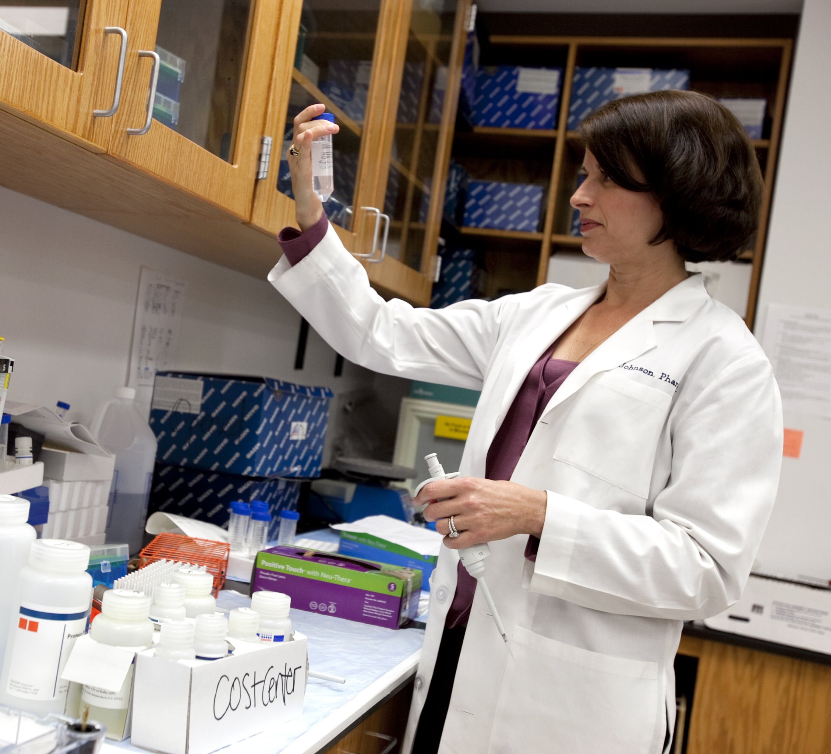
Who needs to find an expert?
Notes:
Faculty looking for collaborators? Faculty looking for employment? Students looking for advisors? Students looking for a university? Fund raisers? News and Public Affairs?

Slide 12
Does the expert need to be at my institution?

Slide 13
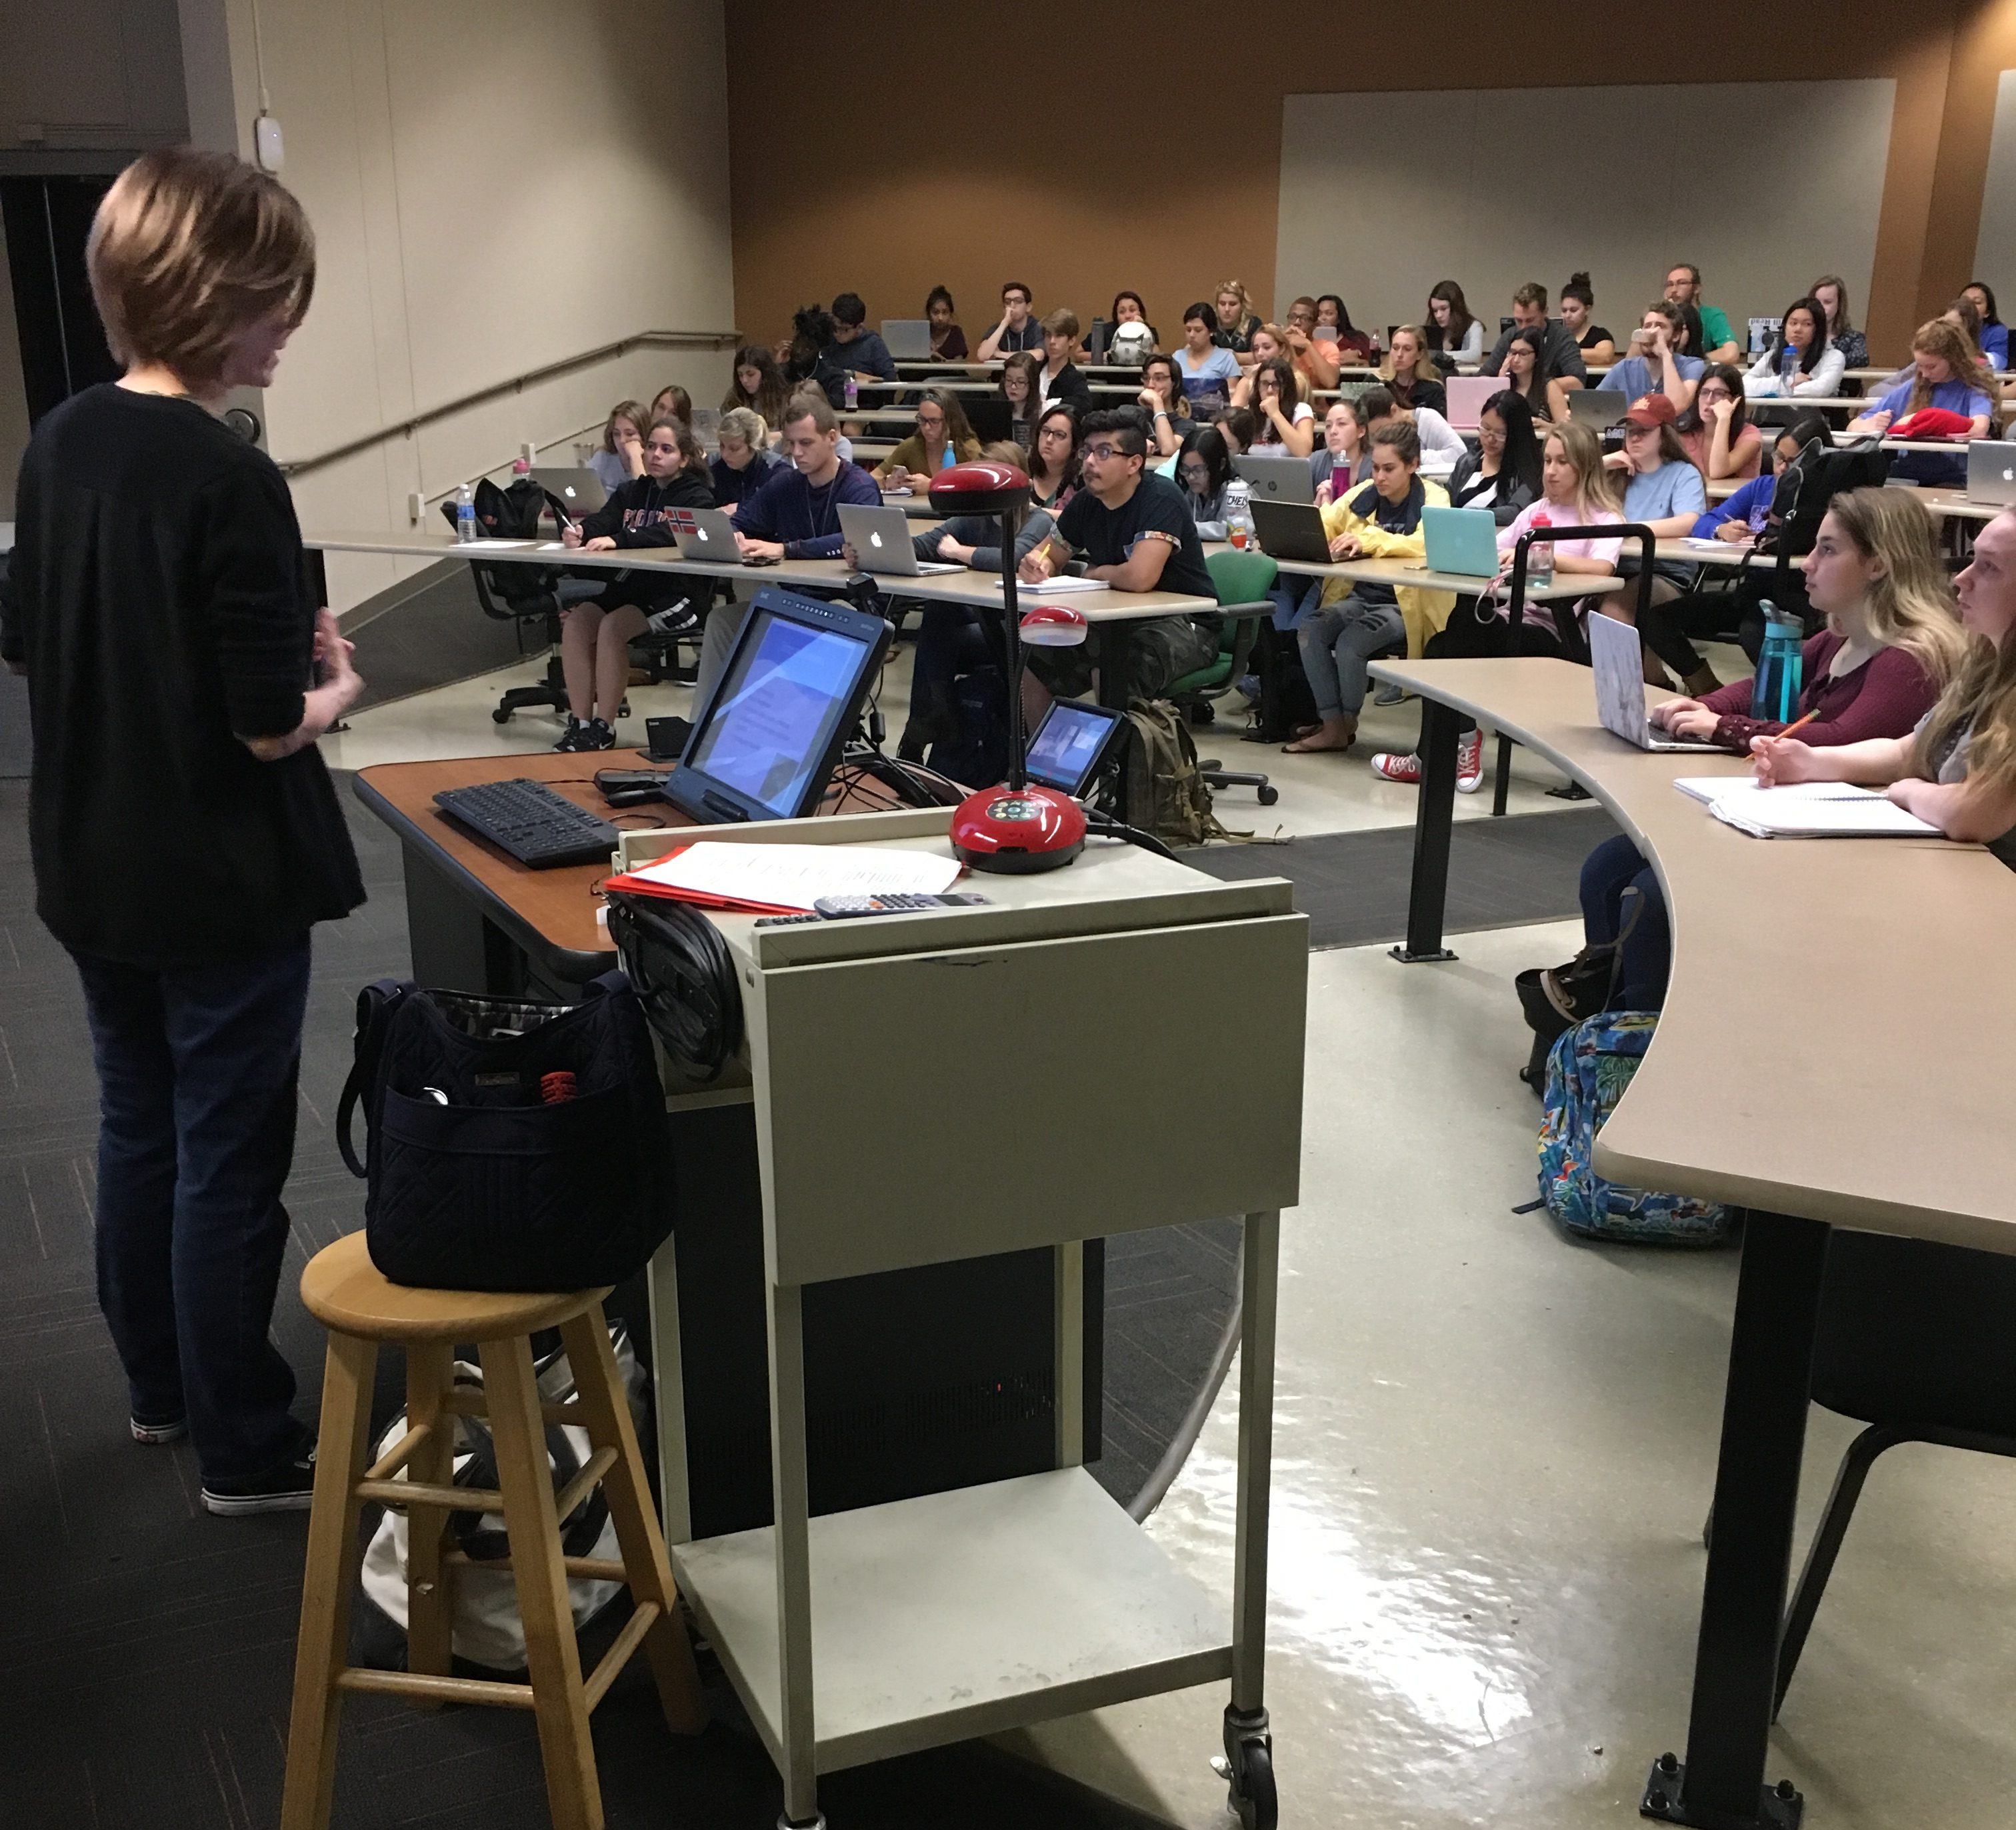
What are students looking for?
Notes:
Someone they can work with, someone with related academic interests, someone whose students have done well. Does a system help them find someone they can work with?

Slide 14

Is finding an expert similar to finding a book?

Slide 15
How do researchers meet researchers?
Notes:
At lunch. At meet-ups. At talks. At events – concerts, symposia, museums. On committees, task forces (ugh).

Slide 16
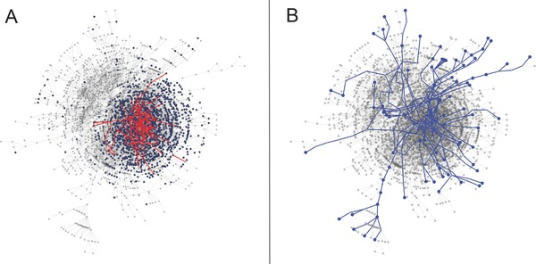
Vacca, R, McCarty, C, Conlon, M, and Nelson, D. Designing a CTSA‐Based Social Network Intervention to Foster Cross‐Disciplinary Team Science
Clin Transl Sci. 2015 Aug; 8(4): 281–289.
Published online 2015 Mar 19. doi: 10.1111/cts.12267
WHO WANTS TO MEET WHOM?
Co-author network of the University of Florida, 2013
A) shows new connections via induction. Health Center Faculty in blue. Pilot awardees and new connections in red
B) shows new connections via alteration

Slide 17
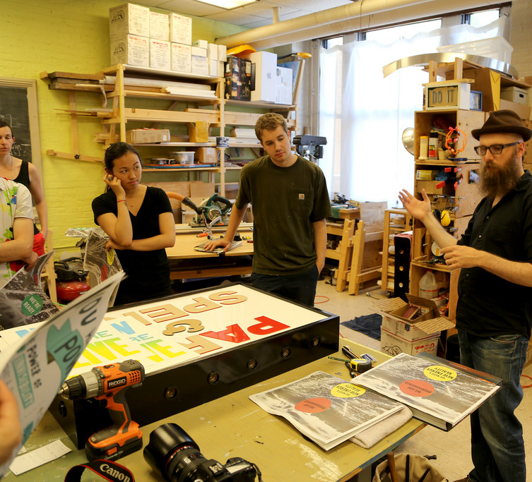
How do researchers write a grant?
Notes:
They try and fail. They try and fail. They take a course. They try and fail. They talk other others. They try and fail. Shared risk – I work on your grant without pay, because I will be on the grant if it is successful.

Slide 18
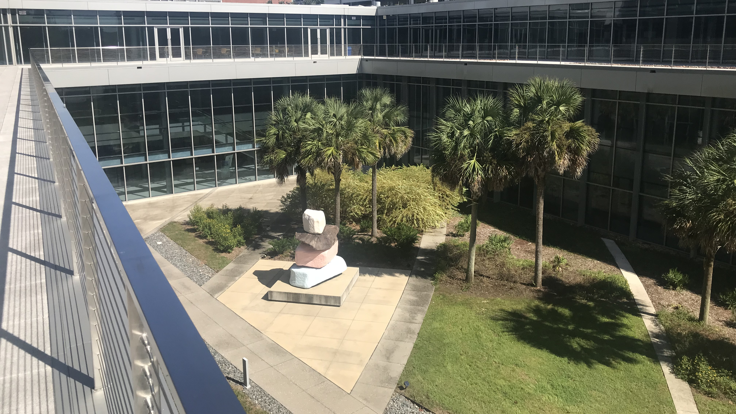
HOW/WHEN DO LIBRARIANS MEET RESEARCHERS?
Notes:
The same way.

Slide 19
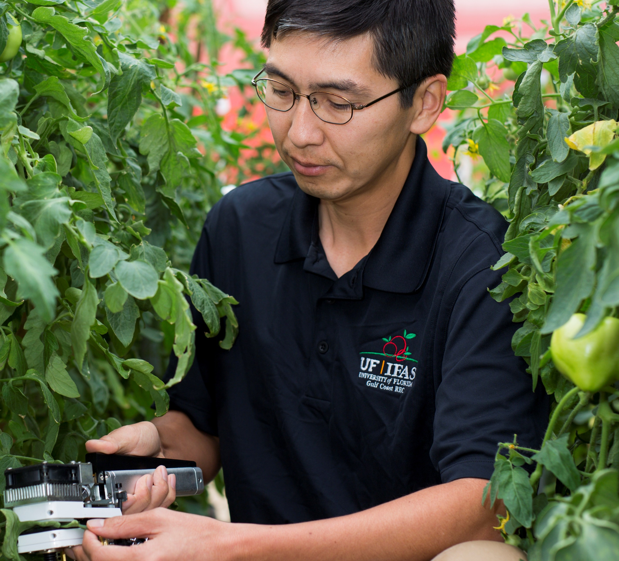
Can THE LIBRARY Help Me?
Notes:
Does the library do protocols, ontologies, software, mouse strains, satellites, workflows, datasets, artistic performances, agricultural extension, clinical trials? How can the library interact with information flows to acquire information regarding expertise?

Slide 20
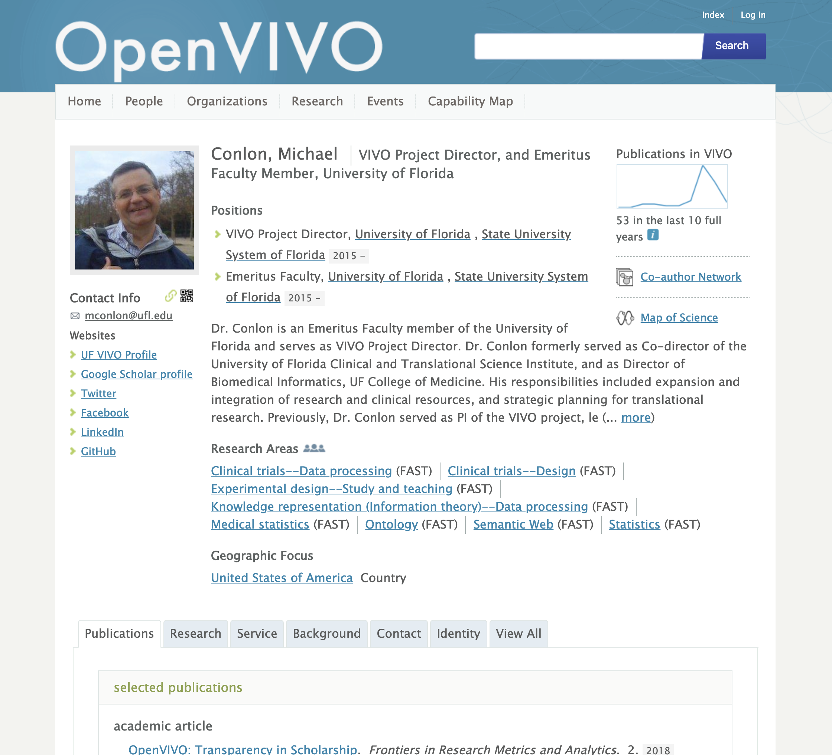
Who can help me with my profile?
Notes:
Not me, but faculty in general. Is this being offered? Which pieces of information come from the faculty member? Which from existing information sources, which from new flows, putting information where it can be used for expert finding?

Slide 21

What’s instrumenting research?
Notes:
How can we help research? How can we help them help others? Our researchers are everywhere, studying everything. How is the research process improved by expert finding? How do we help our researchers learn more? Schoolgirls in Bamozai Pakistan, Wikipedia

Slide 22
What’s the next step for you?

Slide 23
Thank You
VIVO Conference, September 4-6, 2019. Podgorica, Montenegro.
  http://vivoconference.org
VIVO
  http://vivoweb.org
  @vivocollab
Michael Conlon
  https://orcid.org/0000-0002-1304-8447
  mconlon@ufl.edu
  @mconlon17

