Slide 1
The importance of Education and Training in Laboratory Animal Science
Jan van der Valk
3Rs-Centre Utrecht Life Sciences
Dept. Animals in Science & Society
Fac. Veterinary Medicine, Utrecht University
Chair Dutch working group on E&T
Vice-Chair EU Platform on E&T in LAS

Slide 2
The successful implementation of the Three Rs heavily depends upon the education and training of those persons involved in research and testing.
The Three Rs: The Way Forward, The Report and Recommendations of ECVAM Workshop 11. ATLA 23, 838-866, 1995.

Slide 3
Altex 27, Special Issue, 2010, pp. 169-175

Slide 4
The need for the education and training of scientists in the principles of laboratory animal science and the 3Rs is generally acknowledged.
Education and Training in the 3Rs. Altex 27, Special Issue, 2010, pp. 169-175

Slide 5
The final goal will be to minimize the use and suffering of laboratory animals by raising awareness of the opportunities that 3Rs methods offer.
This will not only benefit the animals but also improve the quality of science.
Education and Training in the 3Rs. Altex 27, Special Issue, 2010, pp. 169-175

Slide 6
Who?
Art 24
(a) be responsible for overseeing the welfare and care of the animals in the establishment;
(b) ensure that the staff dealing with animals have access to information specific to the species housed in the establishment;
(c) be responsible for ensuring that the staff are adequately educated, competent and continuously trained and that they are supervised until they have demonstrated the requisite competence.
Art 20.2 person responsible for ensuring compliance with the provisions of this Directive
Art. 25 Designated veterinarian
Art 26 Members of the Animal-welfare body
Art 38 Members of the competent authority carrying out the project evaluation
DIRECTIVE 2010/63/EU OF THE EUROPEAN PARLIAMENT AND OF THE COUNCIL
of 22 September 2010 on the protection of animals used for scientific purposes

Slide 7
Who?
2. The staff shall be adequately educated and trained before they perform any of the following functions:
(a) carrying out procedures on animals;
(b) designing procedures and projects;
(c) taking care of animals; or
(d) killing animals.
Article 23 DIRECTIVE 2010/63/EU OF THE EUROPEAN PARLIAMENT AND OF THE COUNCIL
of 22 September 2010 on the protection of animals used for scientific purposes

Slide 8
Competence
The welfare of the animals used in procedures is highly dependent on the quality and professional competence of the personnel supervising procedures, as well as of those performing procedures or supervising those taking care of the animals on a daily basis.
Recital nr. 28: DIRECTIVE 2010/63/EU OF THE EUROPEAN PARLIAMENT AND OF THE COUNCIL
of 22 September 2010 on the protection of animals used for scientific purposes

Slide 9
Guidance document
The common education and training framework facilitates and assures the competence of all persons involved in the use, care and breeding of animals for scientific procedures, and assists the free movement of personnel.
http://ec.europa.eu/environment/chemicals/lab_animals/pdf/Endorsed_E-T.pdf

Slide 10
Competence
a standardized requirement for an individual to properly perform a specific job
A cluster of related abilities, commitments, knowledge, and skills that enable a person (or an organization) to act effectively in a job or situation.

Slide 11
Qualified Competent
Qualified: successfully completed a course
Competent: after experience on the job.

Slide 12
Attitude
It was agreed that a major objective of education and training is the development of a proper attitude, based on respect for animals and consideration of 3Rs alternatives.
Education and Training in the 3Rs. Altex 27, Special Issue, 2010, pp. 169-175

Slide 13
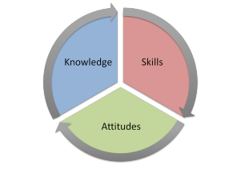
http://contextualresearch.wordpress.com/category/uncategorized/

Slide 14
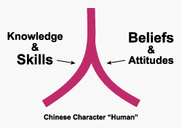
http://www.isixsigma.com/implementation/change-management-implementation/making-good-change-agents-attitude-knowledge-skills/

Slide 15
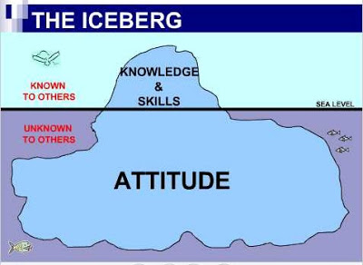
http://vrraghy.blogspot.nl/2012/03/objection-should-overrule.html

Slide 16
Attitude
An attitude is an internal state that can be inferred from a behaviour; therefore, attitudes can be measured by the choices an individual makes
(Gagne and Briggs, 1979)

Slide 17
Attitude
Changes in attitudes are stimulated by acquiring information and increasing skills, but they are reinforced by interaction with peers.
A GUIDE FOR DEVELOPING INSTITUTIONAL PROGRAMS
Committee on Educational Programs in Laboratory Animal Science Institute of Laboratory Animal Resources Commission on Life Sciences National Research Council 1991

Slide 18
Attitude directed by:
Intrinsic value
Respect for animals (empathie)
3Rs –
Replacement
Reduction
Refinement

Slide 19
LAS Education can be an effective way to develop and examine the attitude towards animals
Notes:
But, among others, not the only way.

Slide 20
Conclusions 1
The need for the education and training of scientists in the principles of laboratory animal science and the 3Rs is generally acknowledged.
It was agreed that a major objective of education and training is the development of a proper attitude, based on respect for animals and consideration of 3Rs alternatives.
Education and Training in the 3Rs. Altex 27, Special Issue, 2010, pp. 169-175

Slide 21
Conclusions 2
In addition some form of hands-on training is essential. Live contact between the scientist and laboratory animals in the form of animal handling and observations was mentioned as the minimum that courses should provide.
Education and Training in the 3Rs. Altex 27, Special Issue, 2010, pp. 169-175

Slide 22
Education on LAS - EC
Member States shall publish, on the basis of the elements set out in Annex V, minimum requirements with regard to education and training and the requirements for obtaining, maintaining and demonstrating requisite competence for the functions set out in paragraph 2.

Slide 23
What?
ANNEX V
LIST OF ELEMENTS REFERRED TO IN ARTICLE 23(3)
1. National legislation in force relevant to the acquisition, husbandry, care and use of animals for scientific purposes.
2. Ethics in relation to human-animal relationship, intrinsic value of life and arguments for and against the use of animals for scientific purposes.
3. Basic and appropriate species-specific biology in relation to anatomy, physiological features, breeding, genetics and genetic alteration.
4. Animal behaviour, husbandry and enrichment.
5. Species-specific methods of handling and procedures, where appropriate.
6. Animal health management and hygiene.
7. Recognition of species-specific distress, pain and suffering of most common laboratory species.
8. Anaesthesia, pain relieving methods and killing.
9. Use of humane end-points.
10. Requirement of replacement, reduction and refinement.
11. Design of procedures and projects, where appropriate.

Slide 24
What?
Non-binding guidelines at the level of the Union concerning educational requirements would, in the long run, promote the free movement of personnel.
Recital nr. 28: DIRECTIVE 2010/63/EU OF THE EUROPEAN PARLIAMENT AND OF THE COUNCIL
of 22 September 2010 on the protection of animals used for scientific purposes
http://ec.europa.eu/environment/chemicals/lab_animals/pdf/Endorsed_E-T.pdf

Slide 25
What?
Core Modules - Functions A, B, C & D
1 National legislation
2 Ethics, animal welfare and the Three Rs (level 1)
3.1 Basic and appropriate biology – species specific (theory)
4 Animal care, health and management – species specific (theory)
5 Recognition of pain, suffering and distress - species specific
6.1 Humane methods of killing (theory)

Slide 26
What?
Function Specific (Prerequisite) Modules - Function A
3.2 Basic and appropriate biology – species specific (practical)
7 Minimally invasive procedures without anaesthesia – species specific (theory)
8 Minimally invasive procedures without anaesthesia – species specific (skills)
Function Specific (Prerequisite) Modules - Function B
7 Minimally invasive procedures without anaesthesia – species specific (theory)
9 Ethics, animal welfare and the Three Rs (level 2)
10 Design of procedures and projects (level 1)
11 Design of procedures and projects (level 2)

Slide 28
Mutual acceptance
Framework for mutual acceptance
Principles for a mutual Approval / Accreditation framework are required as the basis for mutual acceptance of training carried elsewhere.
Confidence in training standards and outcomes is required, but trust and improved communications will need to be established to deliver mutual recognition between Member States.
http://ec.europa.eu/environment/chemicals/lab_animals/pdf/Endorsed_E-T.pdf

Slide 29
EU Platform for E&T
EU Platform for E&T
MS
Course providers
Accreditation approval bodies

Slide 30
EU Platform E&T
Proposal for an EU Platform and Information Portal on Education & Training
An EU Platform should be established for a modular training framework to enable information sharing and communication between:
Approval / Accrediting Bodies
Course Providers
Member State authorities
http://ec.europa.eu/environment/chemicals/lab_animals/pdf/Endorsed_E-T.pdf

Slide 31
Platform purposes
The purpose of this EU Platform would be to:
1. Establish criteria for Approval / Accrediting Bodies;
2. Recognise and maintain a list of Approval /Accrediting Bodies and courses;
3. Maintain criteria for modules and evolve these as required;
4. Share information on standards for supervision and assessment;
5. Share information on standards and templates for recording training and assessment;
6. Provide contact details for liaison.
http://ec.europa.eu/environment/chemicals/lab_animals/pdf/Endorsed_E-T.pdf

Slide 32
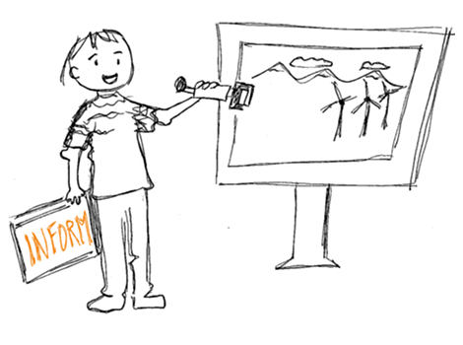
EU Platform E & T
The EU Platform is simply there to facilitate and inform.
Contact
Mrs. Beverley Marczycha – Secretary
Email: b.s.marczycha@leeds.ac.uk

Slide 33
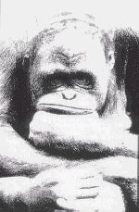
Final conclusion
Good laboratory animal science education and training leading to competence and gaining an attitude towards animals will not only benefit the animals but also improve the quality of science.

Slide 34
Final conclusion
Good laboratory animal science education and training leading to competence and gaining an attitude towards animals will not only benefit the animals but also improve the quality of science.

Slide 35
Final conclusion
Good laboratory animal science education and training leading to competence and gaining an attitude towards animals will not only benefit the animals but also improve the quality of science.

Slide 36
Final conclusion
Good laboratory animal science education and training leading to competence and gaining an attitude towards animals will not only benefit the animals but also improve the quality of science.

Slide 37
Final conclusion
Good laboratory animal science education and training leading to competence and gaining an attitude towards animals will not only benefit the animals but also improve the quality of science.

