Slide 1
Software Engineering Guidelines for Scientists A Practical Handout for the Developing Researcher
Carina Haupt (@caha42)
German Aerospace Center (DLR), Simulation and Software Technology
2019 SIAM Conference on Computational Science and Engineering
Scientific Software: Practices, Concerns, and Solution Strategies

Slide 2
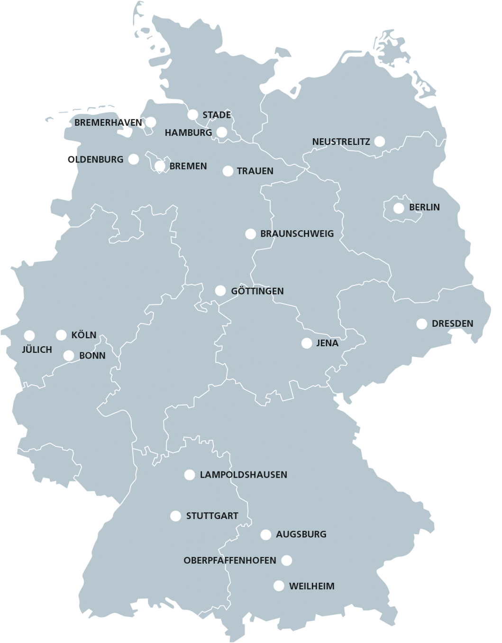
Software development at the German Aerospace Center (DLR)
Numbers
More than 8000 employees
~20% of DLR employees involved in software development
Some Characteristics
Variety of
Fields
Maturity
Software technologies
Team sizes
Backgrounds
We started a Software Engineering Initiative for DLR because we believe that our research results profit from better software!

Slide 3
SEI @ DLR
Software Engineering Initiative for DLR
Networking and Collaboration
Guidelines and Tools
Trainings and Consulting
Knowledge and Experience Exchange

Slide 4
The DLR Software Engineering Guidelines Topics
Guidelines support research software developers to self-assess their software concerning good development practices.
Guideline document & Checklists
Joint development with focus on good practices, tools, and essential documentation
77 recommendations give advice in different fields of software engineering:
Requirements Management
Software Architecture
Design & Implementation
Change Management
Software Testing
Release Management
Automation & Dependencies
https://zenodo.org/record/1344612 (EN)
https://zenodo.org/record/1344608 (DE)

Slide 5
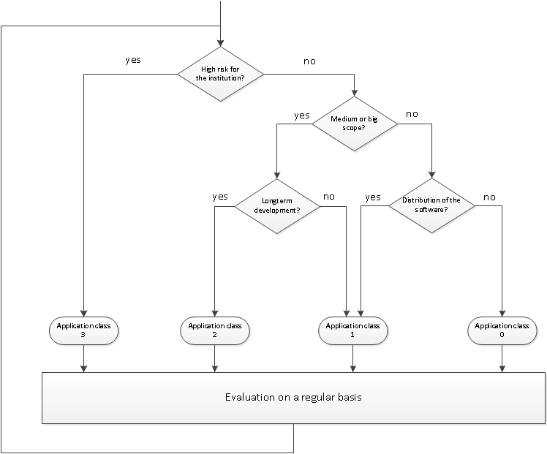
The DLR Software Engineering Guidelines Tailoring Checklists
An application class provides an initial starting point. Recommendations can be added and removed to fit the context.
simplicity over perfectionism
Application class 1
„small“, but other use it
Application class 2
„medium – large“, other use it, long-term support
Application class 3
„products“, critical for success of department or institute
Application class 0
Personal „use“ (intentionally left blank)
Classification may change over time!
Notes:
An application class provides an initial starting point. Recommendations can be added and removed to fit the context.

Slide 6
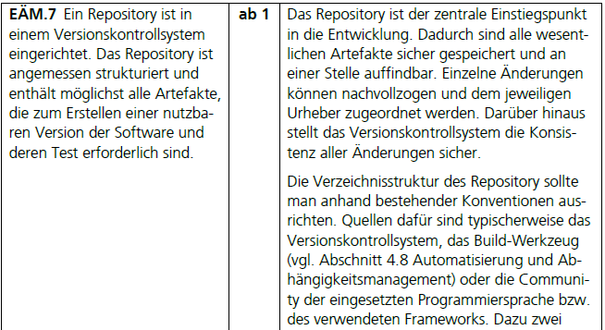
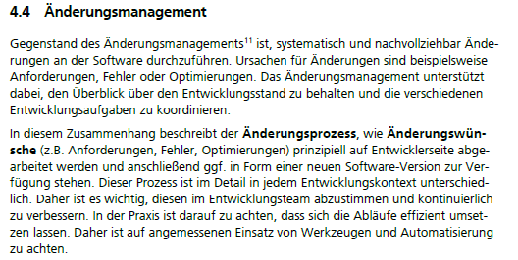
The DLR Software Engineering Guidelines Using Checklists
Check List
Concrete Guideline
Topic Overview

Slide 7
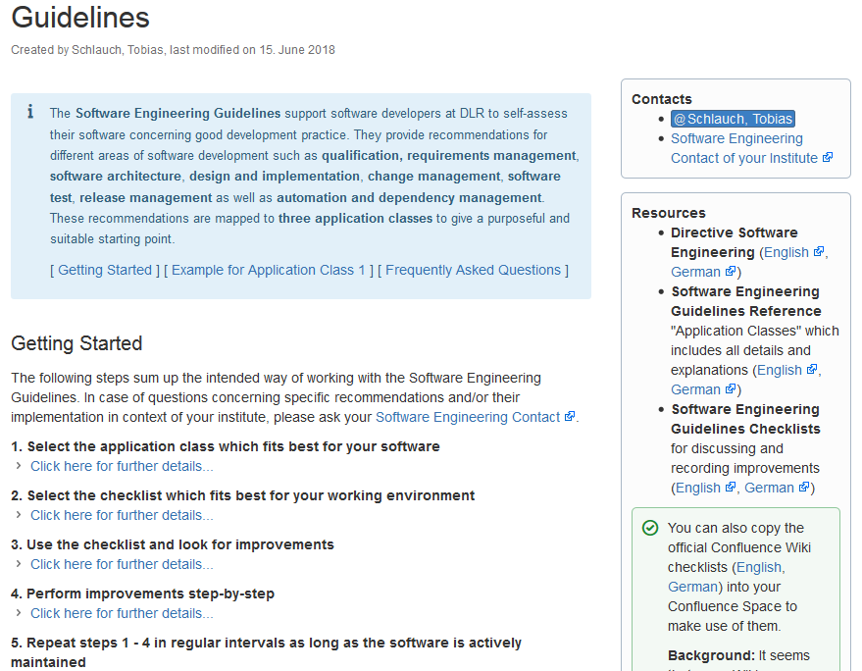
How do we use the guidelines?
Main use cases:
Find out about the current status
Identify improvements
Example situations:
Find initial start point in new or legacy software projects
Ongoing improvement
Supporting hand-over
Convince others
Indicate applied practices to a third-party

Slide 8
Two recent examples…

Slide 9
Example 1: Support researchers improving a legacy Matlab code
Context:
Matlab toolbox for image processing and analysis
Legacy code base, one researcher + students ► close to class 1
Involvement of our RSE group:
Make it “production-ready”, team development ► class 2
Consulting: Set up processes and tools, training, no feature development
Challenges: (legacy) Matlab, RSEs and developers at different sites

Slide 10
Example 1: Support researchers improving a legacy Matlab code (cont.)
Approach:
Moving to GitLab
Iterative process refinement
Improving documentation and testing
Experiences:
Checklists worked pretty well ► focus, discussions, status
Remote consulting ► hard to assess “real” status
Legacy code ► harder to make the right judgement
Notes:
Initial analysis and planning: moving to Git/GitLab, Git training
Ongoing usage to re-plan details: re-iterating Git workflow, issue tracking for feature planning, approached documentation and unit testing

Slide 11
Example 2: New development of a metrics calculation tool for satellite performance
Context:
Originally: New development of a metrics tool in Python 3
But: Python 3 legacy code re-use required
Involvement of our RSE group:
Develop a “production-ready” tool ► class 2/3
Development and consulting: Feature development, set up processes and tools, supporting individual developers
Challenges: (legacy) Python, scattered development team, many partners, hard time constraints

Slide 12
Example 2: New development of a metrics calculation tool for satellite performance (cont.)
Approach:
Involve all partners
Establish professional development process and environment early
Iterative process refinement
Refactor legacy Python code as needed
Experiences:
Checklists worked pretty well ► status, discussion
Unforeseen effort ► “hidden” dependencies, environment
Missing priority hints ► harder to set focus
Notes:
Initial analysis and planning: establish and discuss basic working environment consisting of process and tools (e.g., Git, GitLab, continuous integration, issue tracker, reviews on merge requests).
Ongoing usage to re-plan details: changing regular meetings from mandatory to optional, automation of architecture generation, using at least some principles to refactor legacy Python code

Slide 13
Lessons learnt / Next steps
Guidelines help to find out about the status, to discover improvements as well as to focus activities and discussions but … … are not the solely solution to increase software quality. … are no beginners tool and some details require improvements:
Better indicate priorities
Make dependencies more transparent
Direct links to (more) practical examples
Supportive environment is key!
Community, team culture, mentors
Tools and trainings
Notes:
Supportive environment in a broader sense within your research organization
=> Network of experienced people that can support you
=> easy, simple access to good tools

Slide 14
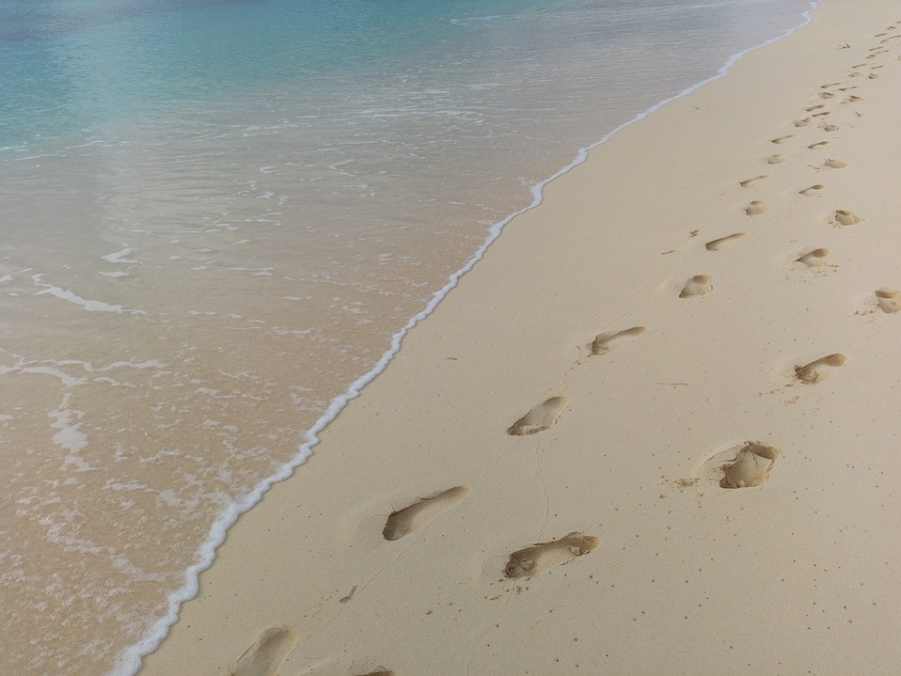
Next steps
Improving guidelines
Collect and analysis further feedback
Content adaptations
Clearer priorities and dependencies
Improving culture and environment
Community building
Tooling
Examples
Interested in sharing ideas about minimal practice for research software and making effects of best practice measurable? Please let us discuss!

Slide 15
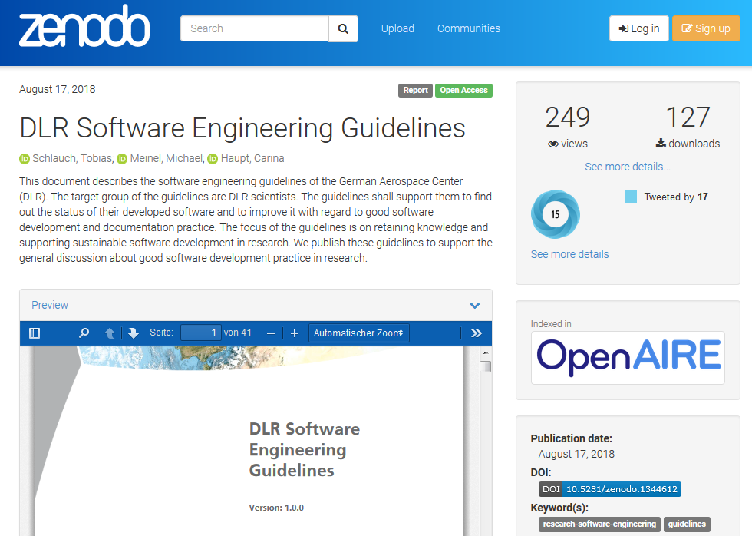
Do you want to find out more?
RSE17 talk “Helping a friend out – Guidelines for better software”
We published the reference guides:
German version: https://doi.org/10.5281/zenodo.1344608
English version: https://doi.org/10.5281/zenodo.1344612
https://rse.dlr.de
Source: Zenodo, https://zenodo.org/record/1344612

