Slide 1
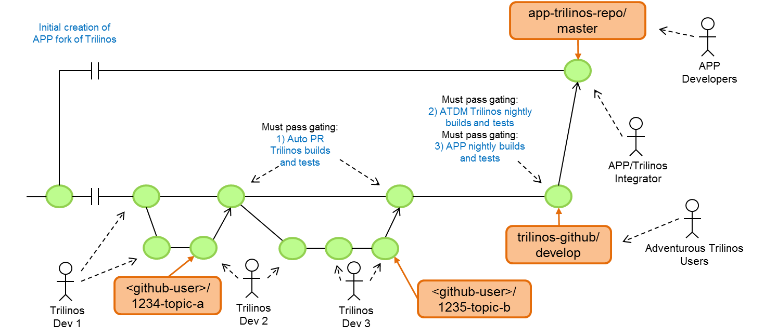
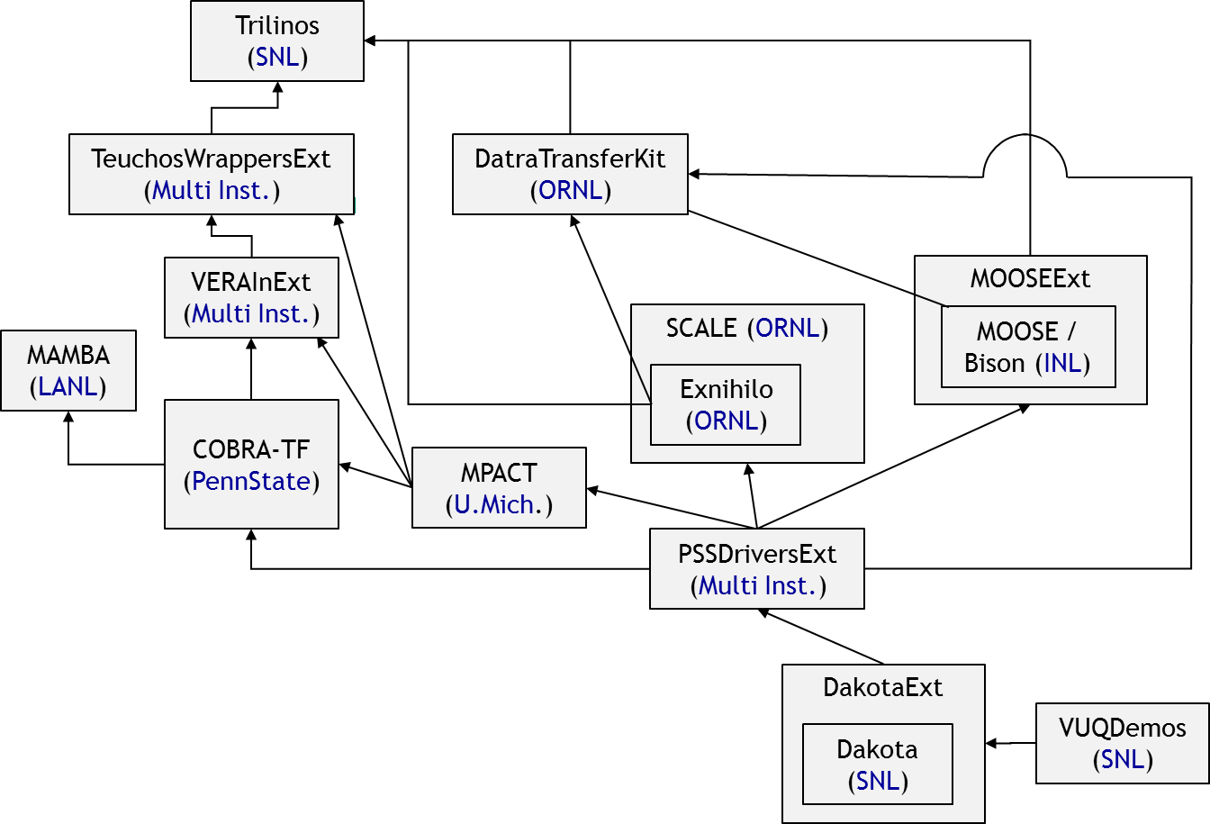
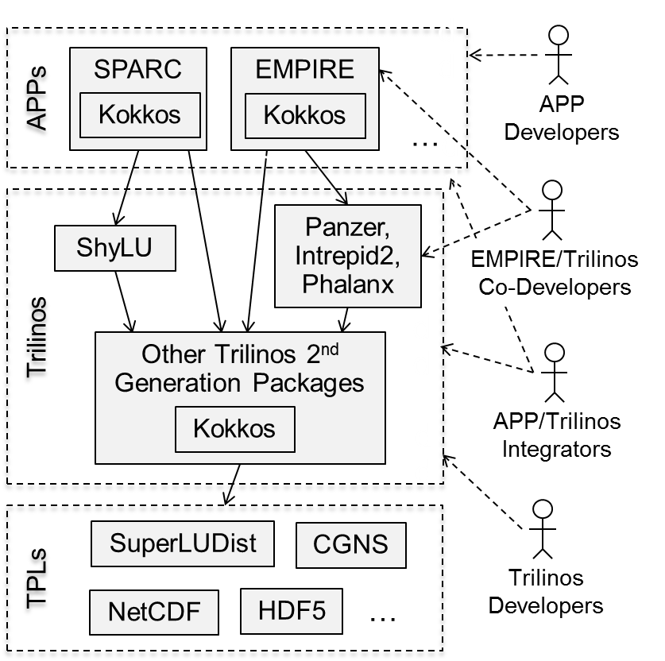
Development and Integration Workflows for Large Complex Distributed CSE Software Efforts
Roscoe A. Bartlett, Ph.D.
Dept. Software Engineering & Research
https://bartlettroscoe.github.io
SAND2019-2092 C

Slide 2
Overview of CASL
CASL: Consortium for the Advanced Simulation of Lightwater reactors
DOE Innovation Hub including DOE labs, universities, and industry partners
Goals:
Advance modeling and simulation of lightwater nuclear reactors
Produce a set of simulation tools to model lightwater nuclear reactor cores to provide to the nuclear industry: VERA: Virtual Environment for Reactor Applications.
Phase 1: July 2010 – June 2015
Phase 2: July 2015 – June 2020
Organization and management:
ORNL is the hub of the Hub
Milestone driven (6 month plan-of-records (PoRs))
Focus areas: Physics Integration (PHI), Thermal Hydraulic Methods (THM), Radiation Transport Methods (RTM), Advanced Modeling Applications (AMA), Materials Performance and Optimization (MPO), Validation and Uncertainty Quantification (VUQ)
Roscoe Bartlett was PHI software engineering and integration lead for CASL from 2010-2016.

Slide 3
CASL VERA Development & Integration Overview (≈2016)
VERA development is complicated!
VERA Currently Composed of:
21 different repositories on casl-dev.ornl.gov (some git clones of other repos) most with a different access list (NDAs, Export Control, IP, etc.)
Integrating development efforts from many teams from 9+ institutions
Large single CMake build system using TriBITS CMake Framework:
Very large full source code base:
55K source and script files
12M lines of code (not comments)
2,700 CMakeLists.txt files
229 packages + subpackages enabled (out of 496 total) ≈ 46% of full code base
Most CMake developer reconfigures take place in less than 30 seconds!
VERA Software Development Process:
VERA integration maintained by continuous and nightly testing:
Pre-push CI testing: checkin-test-vera.sh, cloned VERA git repos
Post-push CI testing: CTest/CDash, all VERA git repos
Nightly testing: MPI and Serial builds, Debug and Release builds, …
Maintain 100% passing builds and tests most days!
Many internal and external repository integrations on daily basis
VERA releases are taken off of stable ‘master’ branches on casl-dev git repos.
Low maintenance cost of the infrastructure

Slide 4
(Selected) CASL VERA Git Repositories (≈2015)
Trilinos (SNL)
TeuchosWrappersExt
(Multi Inst.)
DatraTransferKit
(ORNL)
VERAInExt
(Multi Inst.)
MOOSEExt
SCALE (ORNL)
MOOSE / Bison (INL)
MAMBA (LANL)
Exnihilo (ORNL)
COBRA-TF
(PennState)
MPACT (U.Mich.)
PSSDriversExt
(Multi Inst.)
Primary/originating institution shown in Blue
Most codes being contributed by multiple institutions
All direct dependencies are NOT shown
Dependencies between repos are though TriBITS package dependencies
CAS maintains compatible git repo forks of all these repos
DakotaExt
VUQDemos
(SNL)
Dakota (SNL)

Slide 5
Overview of SNL ATDM (2019)
Advanced Technology Development & Mitigation (ATDM) Project
Started in FY14 under DOE Advanced Simulation and Computing (ASC) Program
Consumed into the larger DOE Exascale Computing Project (ECP) in FY16
Background/Motivation:
Exascale computers coming in 2023 using new programming models and hardware that current generation of ASC CSE codes will not run.
Rapidly developing/changing pre-exascale hardware and system software
Mission of ATDM:
Design next-generation exascale CSE codes unconstrainted by software.
Leverage components and advanced algorithms for sensitivity analysis, design optimization, calibration, inversion, UQ/QMU, etc.
Sandia National Labs (SNL) ATDM Project:
Two Primary SNL ATDM Codes:
EMPIRE – ElectroMagnetic Plasma In Radiation Environments
SPARC - Sandia Parallel Aerodynamics and Reentry Code
Leveraging & co-developing 2nd Trilinos packages built on Kokkos abstraction layer for on-node and on-GPU performance, Tpetra for node/GPU aware distributed memory linear algebra data-structures, and solvers built on these.

Slide 6
SNL ATDM Development and Integration Overview (2019)
Development & Integration Overview
Core functionality provided by SNL 2nd generation Trilinos (Kokkos, Tpetra, etc.)
SNL ATDM APP requirements drive Trilinos development.
Each SNL ATDM APP maintains its own fork of Trilinos that is updated periodically.
Challenges
Very long and expensive builds for templated Kokkos-based C++11 code.
Limited computer testing resources.
APPs needing frequent updates of Trilinos without getting new defects
Keeping Trilinos & APPs working on changing ATDM/ECP platforms and environments.
Defects in system software (e.g. compilers, MPI) slipping through system testing and instead being detected in Trilinos and APPs.
Pushing for higher production-quality software from Ph.D. researchers.

Slide 7
Challenges in the Early Years of SNL ATDM (pre 2018)
Trilinos Stability Problems:
No testing requirement before Trilinos developers pushed changes to the main ‘develop’ branch.
Many nightly builds submitting to CDash dashboard had many failing builds and failing tests that persisted for long periods of time.
=> Made it hard to see new defects
Little-to-no automated testing of Trilinos suite on ATDM pre-exascale platforms.
ATDM APP developers and other staff members directly pulled from the main Trilinos ‘develop’ branch:
APP developers and other staff members often experienced broken builds.
Some important builds (e.g. CUDA on GPUs) often broken for significant lengths of time.
Impact:
Lower ATDM APP developer productivity.
Lower confidence in Trilinos.
Avoidance depending on more Trilinos packages that absolutely required.

Slide 8
Development & Integration Challenges: CASL & ATDM
Common challenges in CASL VERA and SNL ATDM:
Balancing speed of integration vs. stability of updates
Coordination of different development teams
Keeping build and testing infrastructure working both in external repos/projects and internal to the project
Different primary challenges in CASL VERA vs. SNL ATDM:
CASL VERA:
Coordination of different development teams for multiple institutions.
Maintaining integrated build, test, and deployment from many different external projects.
SNL ATDM:
Productive development and integration on many unstable buggy changing pre-exascale platforms.
Maintaining portability on wide range of ATDM/ECP platforms
Fast integration.

Slide 9
Multi-Team
Multi-Repository Testing & Integration
Basics

Slide 10
What Not to Do
Project Developers Directly Pulling from the External Repos
pull
push
External
Repo1
PkgA
PkgB
External
Repo1 Devs
pull
pull
push
External
Repo2
pull
PkgC
PkgD
External
Repo2 Devs
pull
push
Why is this so bad?
Lack of test coverage in the external repo’s native test suite to cover project’s needs.
External repo developers not testing against the project’s code and tests.
External repo may be broken w.r.t. to the project for long period of time.
Project developers frequently pull code that does not even configure or build.
Broken code frequently interrupting the work of project developers.
Project Repos
Project
Devs
Project Native
Repo3
PkgE
PkgF

Slide 11
Managing Internal and External Development & Integration
pull
and/or
push
pull
and/or
push
Project Repos
pull
push
External
Repo1
Project Copy
Repo1
PkgA
PkgB
Repo1 Integrator
External Repo1 Devs
pull
and/or
push
PkgA
PkgB
pull
and/or
push
pull
push
External
Repo2
Project Copy
Repo2
PkgC
PkgD
pull
push
Repo2 Integrator
External
Repo2 Devs
pull
push
PkgC
PkgD
Project must keep consistent clones of every external repo and carefully sync updates!
Issues that need to be addressed:
Flexibility for development inside and outside of the project.
Providing a flow of frequent stable updates of the software.
Maintaining the stability of the software to keep project developers productive.
Making non-backward compatible changes across many repos.
Full tracking of changes and updates.
Repo2 / Project
Co-developer
Project Native
Repo3
pull
push
PkgE
PkgF
Project Devs
pull
Project Releaser

Slide 12
Basic Parts to Development & Integration Process
Git Workflows:
How git repositories and branches are set up, how merges occur, what git commands are run, etc.
Different git workflows used for external repo developers, Project developers, and repo/project co-developers.
Testing gates for workflows:
Gating test suites can/should be run before each “merge” in the workflow.
Gating tests can be run manually or automated, daily or “every-so-often”.
Important test suites:
RepoX build & tests: Gates updating the main RepoX development branch.
Project builds & tests: Gates all updates of the project’s repos.
Detection, triage and fixing of new failing builds and tests:
Detection and notification of new failures.
Triage failures.
Address failures.
Manage & follow-up.

Slide 13
Single External Repo
Project Integration
Trilinos => ATDM APP

Slide 14
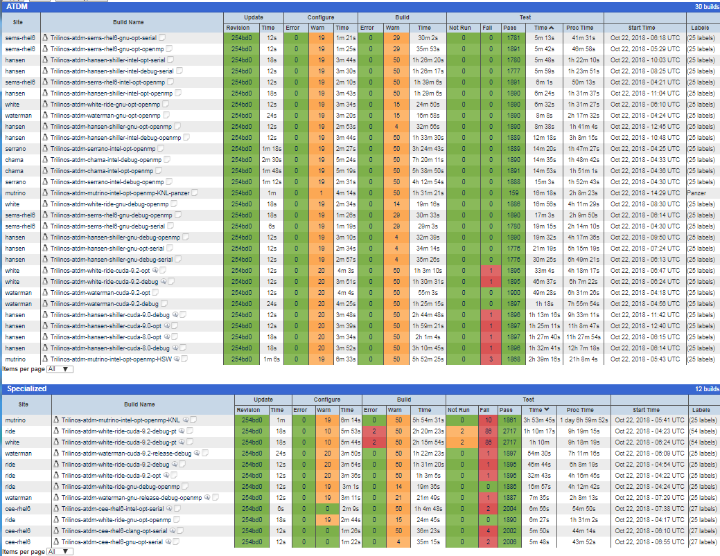
2) ATDM Trilinos Nightly Builds & Tests (CDash)
Build and run native Trilinos test suite on all the ATDM platforms.
First step in providing stable portability on many pre-exascale platforms.
Builds are too expensive to run more than one set per 24-hour day.
Frequent random system failures make detection of new code-related failures difficult.

Slide 15
ATDM Trilinos Development and Integration Workflows
Initial creation of APP fork of Trilinos
app-trilinos-repo/
master
APP
Developers
Must pass gating:
2) ATDM Trilinos
builds & tests
3) APP nightly
builds & tests
Must pass gating:
1) Auto PR Trilinos
builds & tests
APP/Trilinos
Integrator
Trilinos/Empire
Co-Developers
github-trilinos/
develop
Adventurous Trilinos Users
<github-user>/
1234-topic-a
<github-user>/
1235-topic-b
Trilinos
Dev 1
Trilinos
Dev 2
Trilinos
Dev 3
Legend for Git Workflow Diagrams
direct commit on <main-branch>
link to ancestor commit
(explicit) merge commit
<main-branch>
commits on branch
branch
references
link to merge ancestor
Unspecified git graph/history
<topic-branch>
Person creating commit
Time

Slide 16
Injecting New Failures and Fixing Failures: A Race!
Mean-time to fail: Average time (in days) for when a new failure shows up in ‘develop’ branch in one or more promoted ATDM Trilinos builds.
Mean-time to fix: Average time (in days) to discover, triage and fix a failure on the Trilinos ‘develop’ branch in the promoted ATDM Trilinos builds.
The core problem: If “mean-time to fail” is less than “mean-time to fix”, then the ATDM Trilinos builds on ‘develop’ on average will ALWAYS be broken (and therefore block updates of Trilinos to the APP customers)!
Mean-time to fix
<
Mean-time to fail
# Failures
Time (days)
100% clean allowing Trilinos APP updates
Mean-time to fix
>
Mean-time to fail
# Failures

Slide 17
Reducing Time to Detect, Triage, and Address New Failures
ATDM Trilinos Builds & Tests

Slide 18
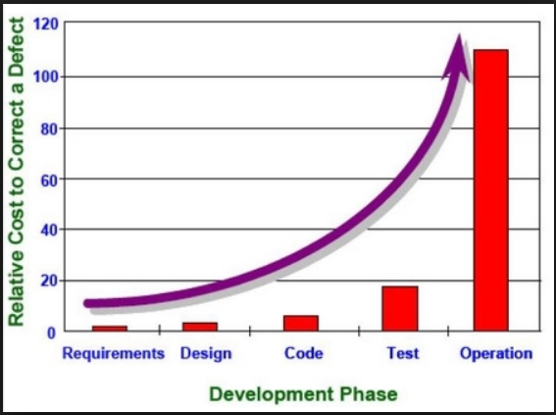
General SE Principles for Defects
Cost of a defect goes up (significantly) the longer it takes to detect and correct a defect.
Lean/Agile SE Practices for dealing with defects:
Strong automated testing (have tests help new detect defects)
Continuous testing (reduce the time to detect new defects caught by tests)
Continuous integration (reduce time to detect conflict defects)
STOP THE LINE when a new defect gets into the main development branch
Fixing defects in previously working software is higher priority than developing new features!

Slide 19
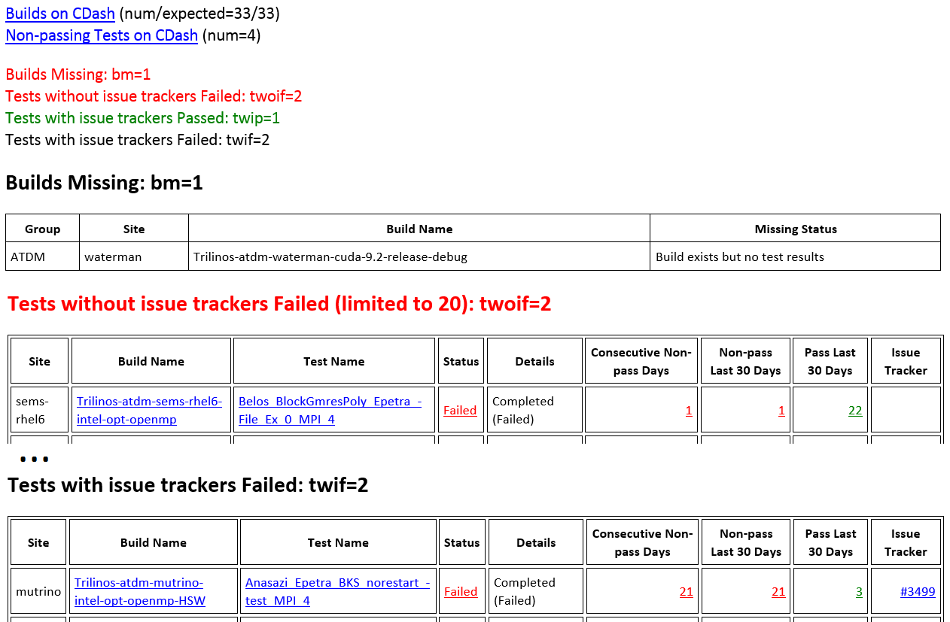
Detecting New Failures/Missing Results: CDash Email
Failures in red may require triage!
Missing test results!
Failing tests without issue trackers!

Slide 20
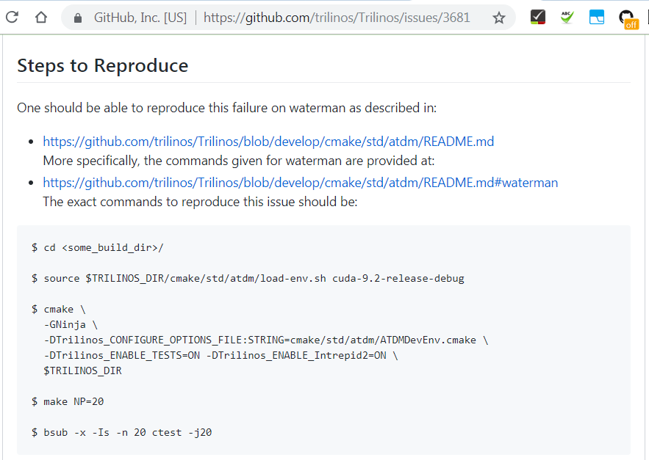
Reproducing ATDM Trilinos Builds: GitHub Issue

Slide 21
How to Address Failures?
Already cleaned-up promoted builds clean:
Fix the failures => Best option!
Mark failing tests as “allow to fail” and not trigger global FAIL:
Only for non-blocking issues
Allows us to watch test run but not block updates of Trilinos to APPs
Best for when someone is working to fix non-blocking failures.
(Temporarily) disable failing tests:
Only for non-blocking issues
Best for cases where no-one is going to work on fixing the failures soon.
Revert the commit(s) (or PR merge) causing the failure:
Best for critical/blocking failures that can’t be fixed ASAP.
Initial failures setting up new platforms:
Fix the failures
(Temporarily) disable failing tests
Mark failing tests as “allow to fail” and not trigger global FAIL
NOTE: Reverting commits is NOT an option for cleaning up failures that occur when setting up new builds on new platforms or envs on existing platforms.

Slide 22
Conclusions and Lesions Learned CASL & SNL ATDM
Projects must set up their own forks of external repos that must be frequently updated and define integration testing workflows
Detecting, Traiging, and Addressing New Failures:
Running tests using similar configurations on different systems and compilers helps to speed up detection of new software defects.
Effective detection and triaging requires an analysis tool that takes a broad view of build and tests results to show trends, commonality, and history.
Likely 90-95% of failing (Trilinos) tests don’t indicate a problem impacting a specific customer but they hide the 5-10% that do.
Must carefully scrutinize every failing test to detect new defects.
Must not allow existing failures to hide new failures!
Build and Test Systems:
Heterogenous build and test systems significantly increase development and maintenance costs and slow/delay integrations.
Homogenous build and test systems across teams and software reduce development and maintenance costs and speeds integrations. (i.e. CASL)
One of biggest impediments to improving development and integration workflows is developer inability/unwillingness to learn git!

