Slide 1
From a ‘replication crisis’ towards a ‘credibility revolution’
James Montilla Doble UNIVERSITY OF THE PHILIPPINES DILIMAN PHILIPPINE RESEARCHERS FOR OPEN SCIENCE (PROSCIENCE)
osf.io/jvbwu
@lysanderjames
cmdoble@up.edu.ph

Slide 2
Talk outline
The reproducibility crisis
The producibility crisis in the Philippines
The impact of a (re)producibility crisis
Towards a credibility revolution

Slide 3
The reproducibility crisis
in psychology

Slide 4
Reproducibility
The ability of a researcher to repeat their own work or the work of another researcher (replication)

Slide 5
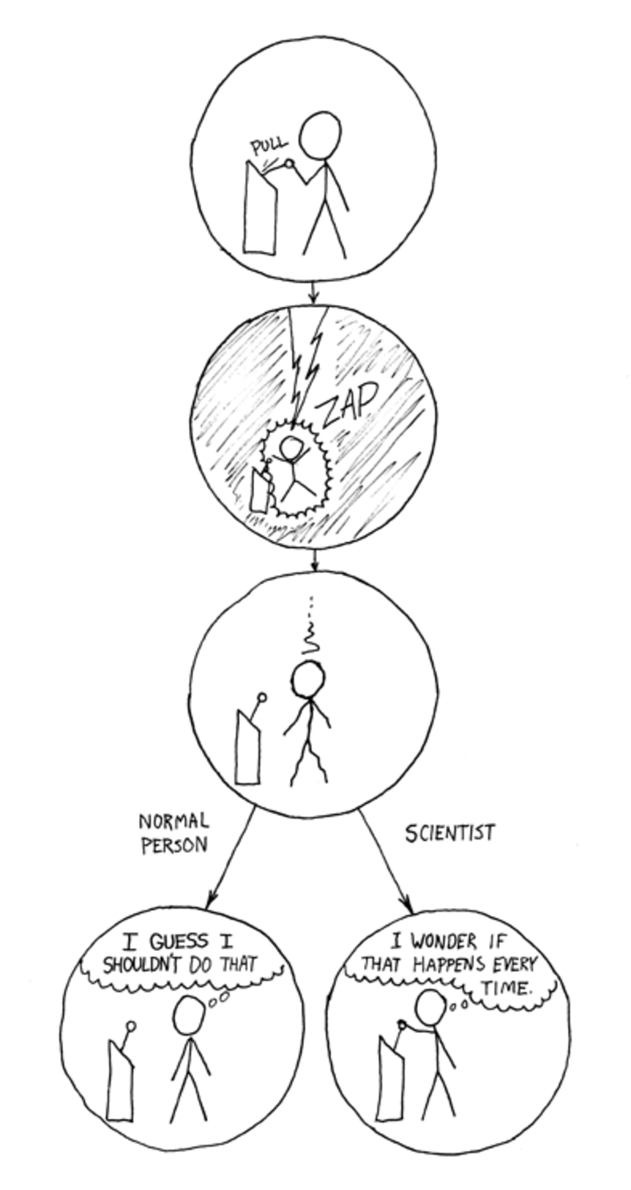
https://xkcd.com/242/

Slide 6
https://xkcd.com/242/

Slide 7
Generate and specify hypothesis
Design study
Conduct study and collect data
Analyze data and test hypothesis
Publish and/or conduct next experiment
Integrate results
The scientific method
(Munafo et al., 2017)

Slide 8
Generate and specify hypothesis
Design study
Conduct study and collect data
Analyze data and test hypothesis
Publish and/or conduct next experiment
Integrate results
Lack of replications
Bias
Only reporting or publishing studies with “significant” results (file drawer effect, publication bias)
Small sample sizes
Changing hypotheses to match results (HARK-ing)
Threats to the scientific method
Poor quality control
Collecting and analyzing data until results are “significant” (cherry picking, p-hacking)
(Munafo et al., 2017)
Notes:
Lack of replications

Slide 9
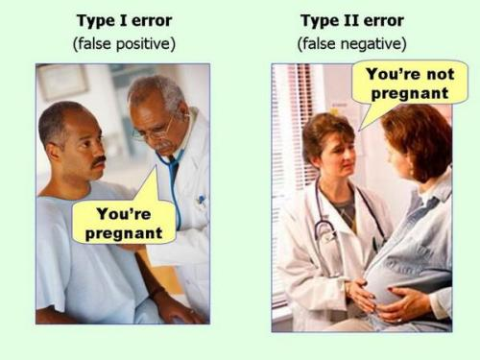
(Simmons et al., 2011)

Slide 10
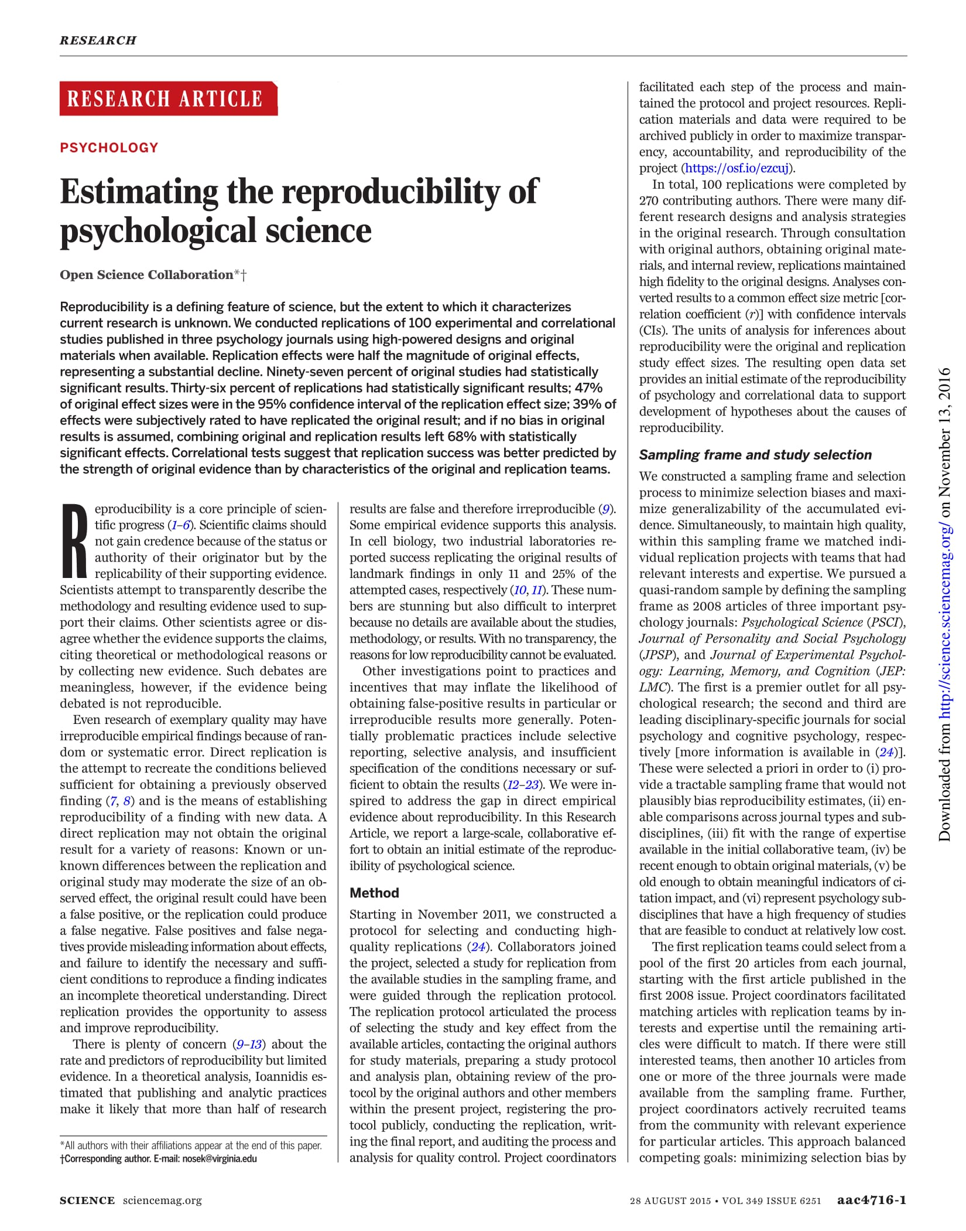
(OSC, 2015)

Slide 11
Notes:
Ask audience

Slide 12
Cumulative replication evidence
RP: Psychology (2015) 36 of 100 (36%)
Many Labs 1 (2014) 10 of 13 (77%)
Many Labs 2 (2018) 14 of 28 (50%)
Many Labs 3 (2016) 3 to 10 (30%)
Nature/Science (2018) 13 of 21 (62%)
(COS)

Slide 13
The producibility crisis
in the Philippines

Slide 14
The state of psychology research in the Philippines
Most psychology research publications are descriptive (Bernardo, 1997)
“Absence of a research culture”
Lack of resources
Attitudes towards research
Extends to Philippine higher education institutions (Salazar-Clemeña & Almonte-Acosta, 2007)

Slide 15
Questionable research conduct
Low research competence and efficacy
Negative attitudes towards research
Lack of resources
Low research producibility
Misconceptions about science and research
(Montilla Doble et al., 2018)

Slide 16
The impact
of a (re)producibility crisis

Slide 17
Cumulative replication evidence
RP: Psychology (2015) 36 of 100 (36%)
Many Labs 1 (2014) 10 of 13 (77%)
Many Labs 2 (2018) 14 of 28 (50%)
Many Labs 3 (2016) 3 to 10 (30%)
Nature/Science (2018) 13 of 21 (62%)
Average replication rate of large-scale replication projects in psychology 76 of 172 (44%)
(COS)

Slide 18
Cumulative replication evidence
Economics (2015) 22 of 67 (33%)
Exp’l economics (2016) 11 of 18 (61%)
Exp’l philosophy (2018) 28 of 40 (70%)
Microarray gene expression analysis (2009) 8 of 18 (44%)
Oncology and cardiovascular medicine (2011) 14 of 67 (20%)
RP: Cancer Biology* (mixed results)
(COS)

Slide 19
What happened? (Baker, 2016)
Publish-or-perish culture
Only reporting or publishing studies with “significant” results (file drawer effect, publication bias)
Poor research design
Insufficient oversight (mentoring, peer review)
Unavailable data and materials used for data collection and analysis (closed science)
Fraud
Notes:
Narrow down

Slide 20
Published in 2005 at PLoS Medicine

Slide 21
Published in 2016 at Slate

Slide 22
Published in 2016 at The Atlantic

Slide 23
Towards a
credibility revolution

Slide 24
How should we consume, produce, and teach research?

Slide 25
Consuming research
Producing research
Teaching research

Slide 26
Is the study pre-registered? (cos.io/prereg)
Take note of sample sizes, p-values, and effect sizes
Has the effect demonstrated in the study been replicated? (curatescience.org)
Consuming research
Producing research
Teaching research
(Chopik et al., 2018)

Slide 27
Consuming research
Producing research
Teaching research
More robust design
Better understanding and teaching of statistics
Better mentoring
More within- and external-lab validation
Incentives for better practice and formal reproduction
Journals enforcing standards (cos.io/our-services/top-guidelines)
(Baker, 2016)

Slide 28
Consuming research
Producing research
Teaching research
Increase psychology students’ research competence and efficacy
Instill and enforce:
Ethical research conduct
Positive attitudes towards research
Better understanding of research and science
(Montilla Doble et al., 2018)
Notes:
Increase psychology students’ research competence and efficacy
Research design and methods curricula
Mentoring opportunities
Continuing education

Slide 29
How else can we improve overall (re)producibility and make psychological science better and more credible?

Slide 30
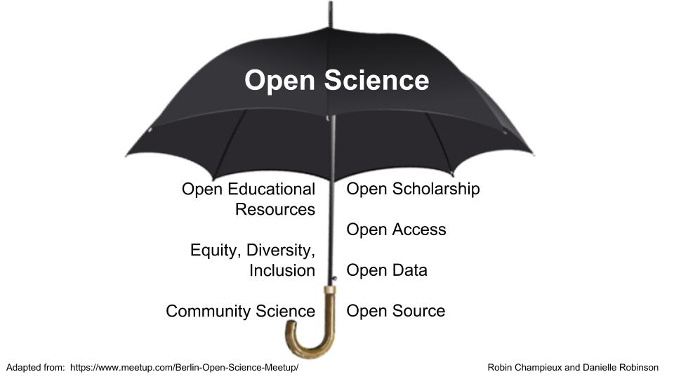
The open science umbrella (Robinson, 2018)

Slide 31
Generate and specify hypothesis
Design study
Conduct study and collect data
Analyze data and test hypothesis
Publish and/or conduct next experiment
Integrate results
Lack of replications
Bias
Only reporting or publishing studies with “significant” results (file drawer effect, publication bias)
Small sample sizes
Changing hypotheses to match results (HARK-ing)
Threats to the scientific method
Poor quality control
Collecting and analyzing data until results are “significant” (cherry picking, p-hacking)
(Munafo et al., 2017)
Notes:
Lack of replications

Slide 32
Generate and specify hypothesis
Design study
Conduct study and collect data
Analyze data and test hypothesis
Publish and/or conduct next experiment
Integrate results
Registering the study/analysis before data collection (pre-registration)
Pre-prints
Two-stage peer review (Registered reports)
Team and open science
Initiatives / possible solutions for reproducible science
Pre-registration
Pre-registration
Reporting and protocol checklists
Team and open science
Pre-registration
(Munafo et al., 2017)
Notes:
Link

Slide 33
Questionable research conduct
Low research competence and efficacy
Negative attitudes towards research
Lack of resources
Low research producibility
Misconceptions about science and research
(Montilla Doble et al., 2018)

Slide 34
Questionable research conduct
Open science practices
Low research competence and efficacy
Negative attitudes towards research
Collaborative laboratory networks
Pre-print sharing
Science communication
Open science practices
Lack of resources
Low research producibility
Misconceptions about science and research
Open access
Open materials, data, code
Collaborative laboratory networks
(Montilla Doble et al., 2018)

Slide 35
Lack of resources
Low research competence and efficacy
Open science practices
Better teaching and consumption of research
More credible psychological science
High research (re)producibility
Low research competence and efficacy
Questionable research conduct
Negative attitudes towards research
Misconceptions about science and research
(and more)

Slide 36
From a ‘replication crisis’ towards a ‘credibility revolution’
James Montilla Doble UNIVERSITY OF THE PHILIPPINES DILIMAN PHILIPPINE RESEARCHERS FOR OPEN SCIENCE (PROSCIENCE)
osf.io/jvbwu
@lysanderjames
cmdoble@up.edu.ph

