Slide 1
Sizing up the samurai wasp for BMSB control
Tom Saunders
Greg Holwell
Gonzalo Avila
Oregon Department of Agriculture
@TomSaundersNZ

Slide 2
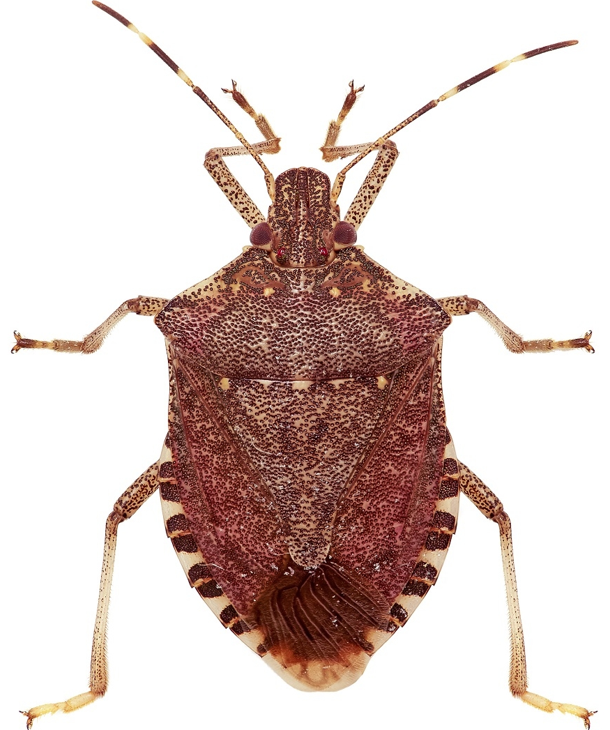
BMSB
Halyomorpha halys Stål, 1855
Native to East Asia
300+ host plants
Aggregations cause a nuisance
Taints wine if crushed
US, EU, Canada, Chile
Hard to kill with pesticides
Classical biocontrol?
Image courtesy Kiwifruit vine Health

Slide 3
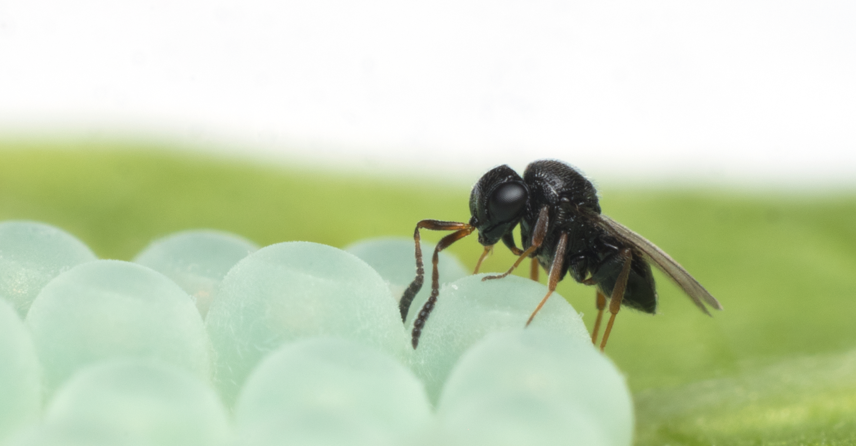
Samurai wasp
Trissolcus japonicus (Ashmead, 1904)
Attacks 2 families of shield bugs (only 1 in NZ)
50-80% parasitism against BMSB in native range
Female-biased sex ratio, short generation times
Found in US (2014), now in 11 states
Oregon Department of Agriculture

Slide 4
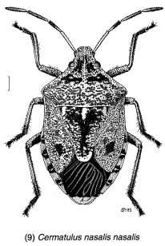
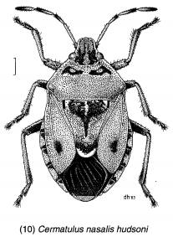
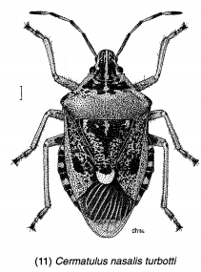
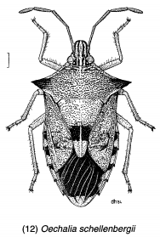
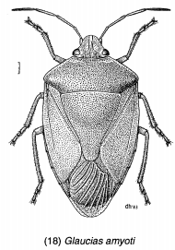
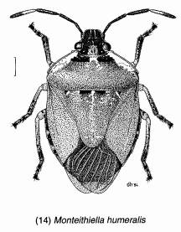
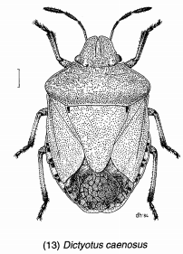
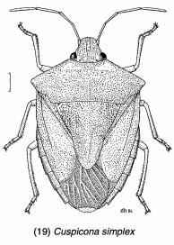
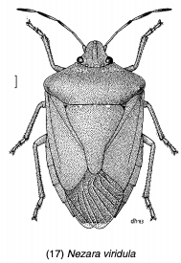
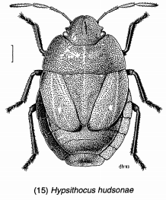
NZ Stinkbugs
Images by Des Helmore © Landcare Research (CC-BY 4.0)

Slide 5
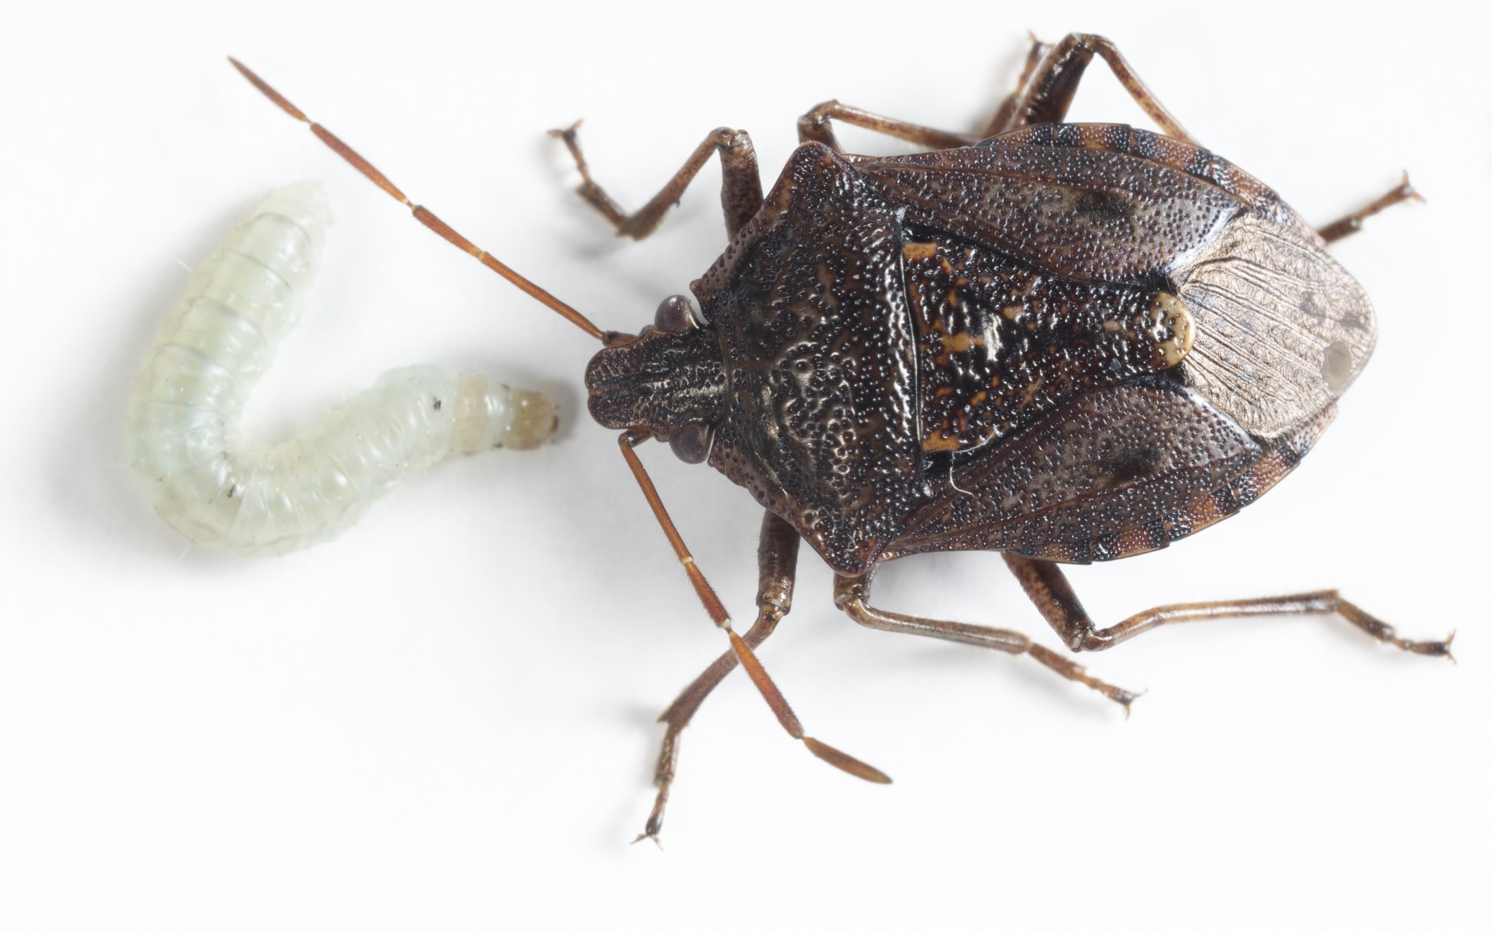
Aims
Will T. japonicus attack non-target stink bugs?
No-choice oviposition test
Y-tube olfactometer tests
Electrophysiology tests
Cage tests
Rearing on NT hosts
Cermatulus nasalis
Image © Plant & Food Research

Slide 6
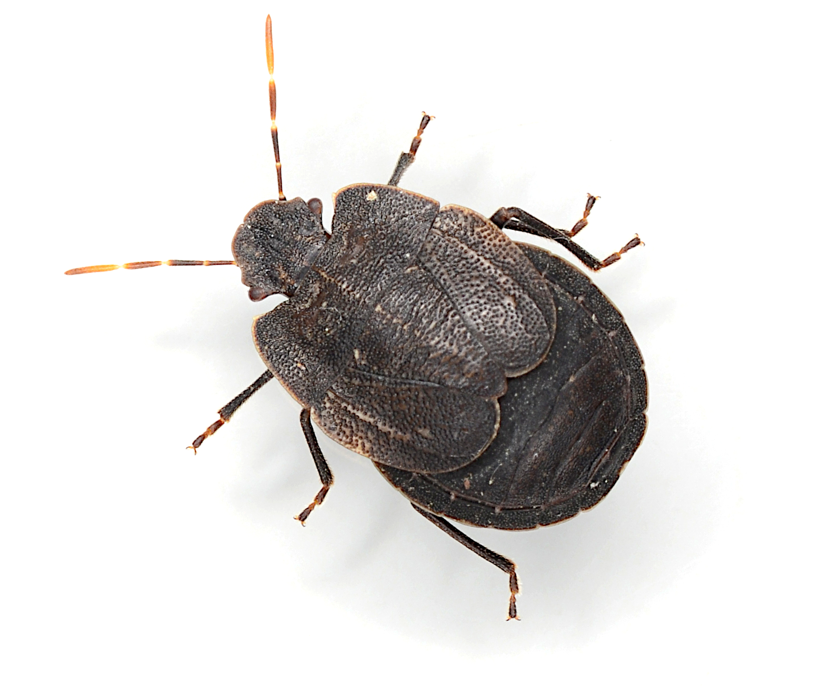
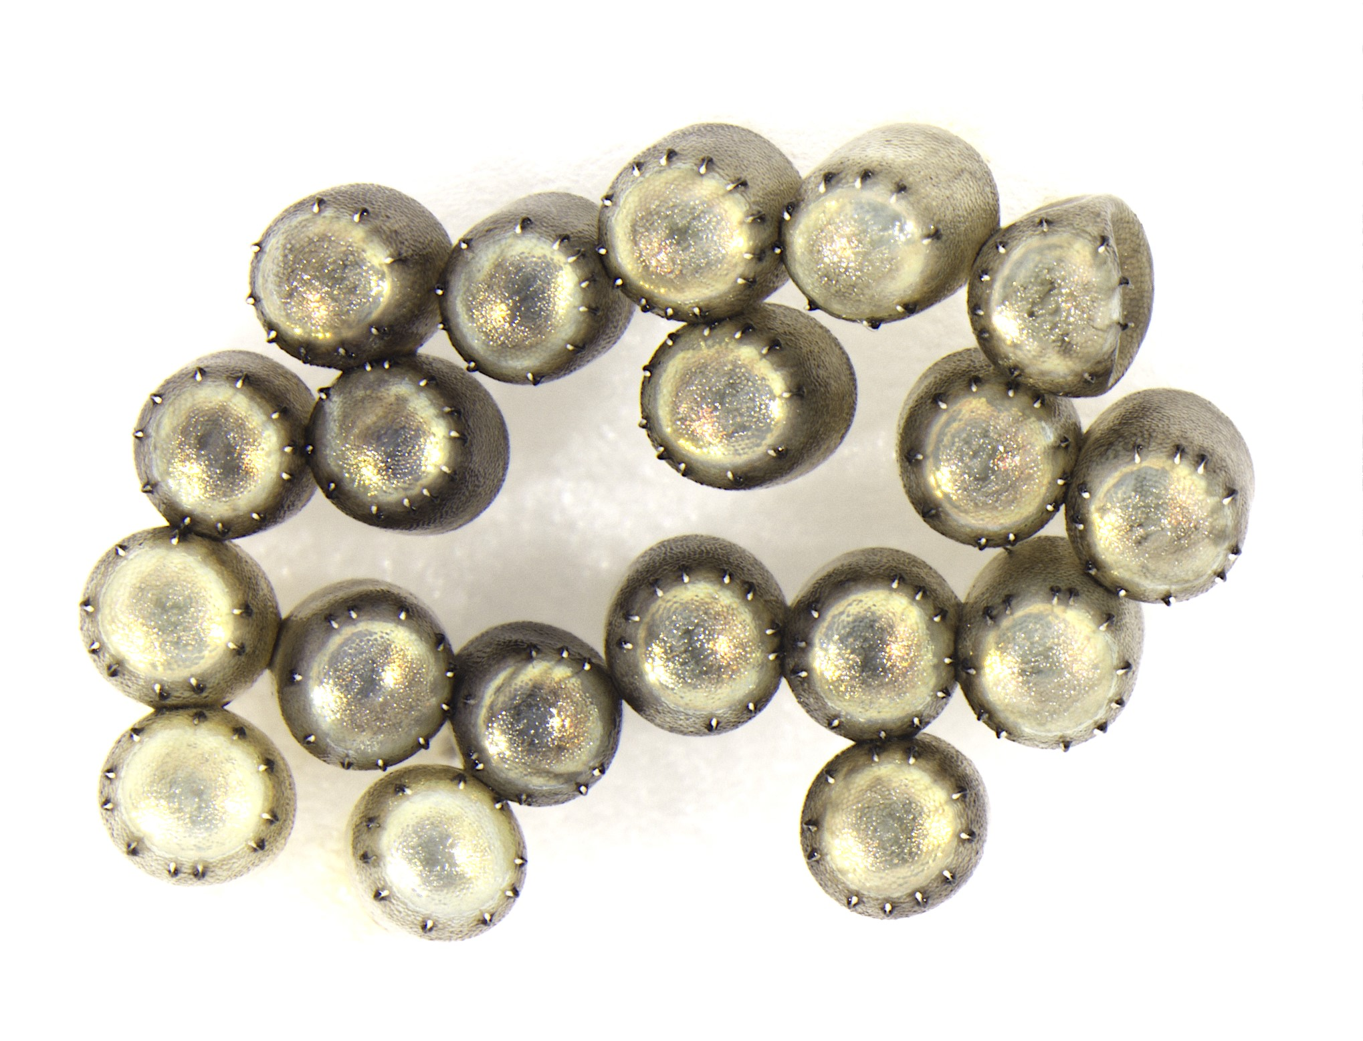
1) No choice
Physiological host test – Successful reproduction?
Confine eggs + wasp
Record behaviour + emergence
Cermatulus nasalis hudsoni eggs
© Tom Saunders (CC-BY 4.0)
Hypsithocus hudsonae
Taken by Nick Martin © Plant & Food Research

Slide 7
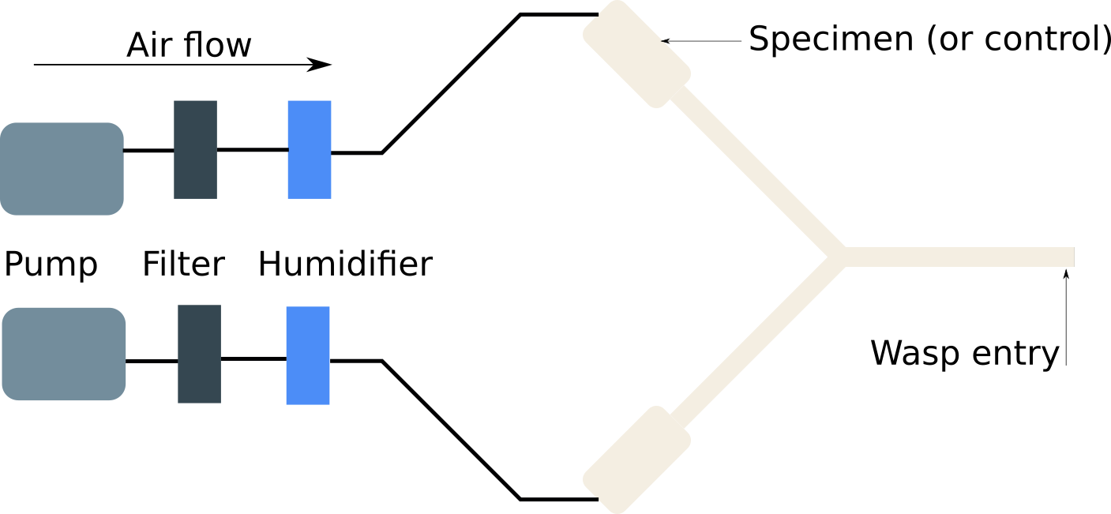
2) Y-tubes
Measure odour preferences
Flow rate, decision, duration, etc
Female adult + egg mass + host plant

Slide 8
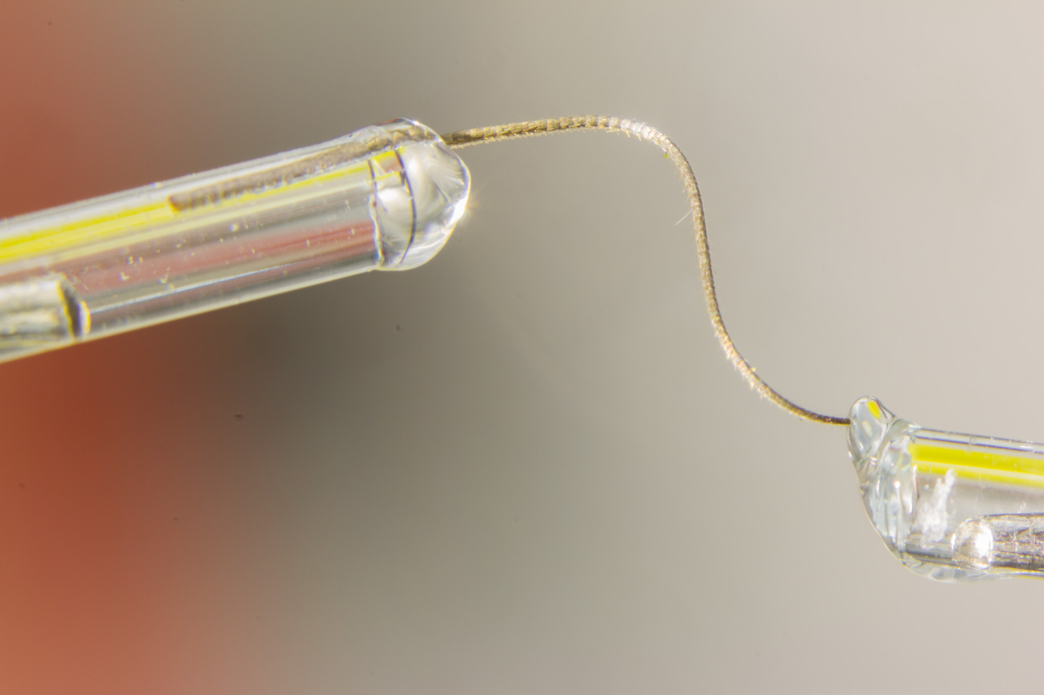
3) Electrophys.
GC-EAD: Which compounds elicit nervous response?
Do NZ stink bugs share compounds with BMSB?
Y-tube tests confirm response as attractive, repulsive, or neutral

Slide 9
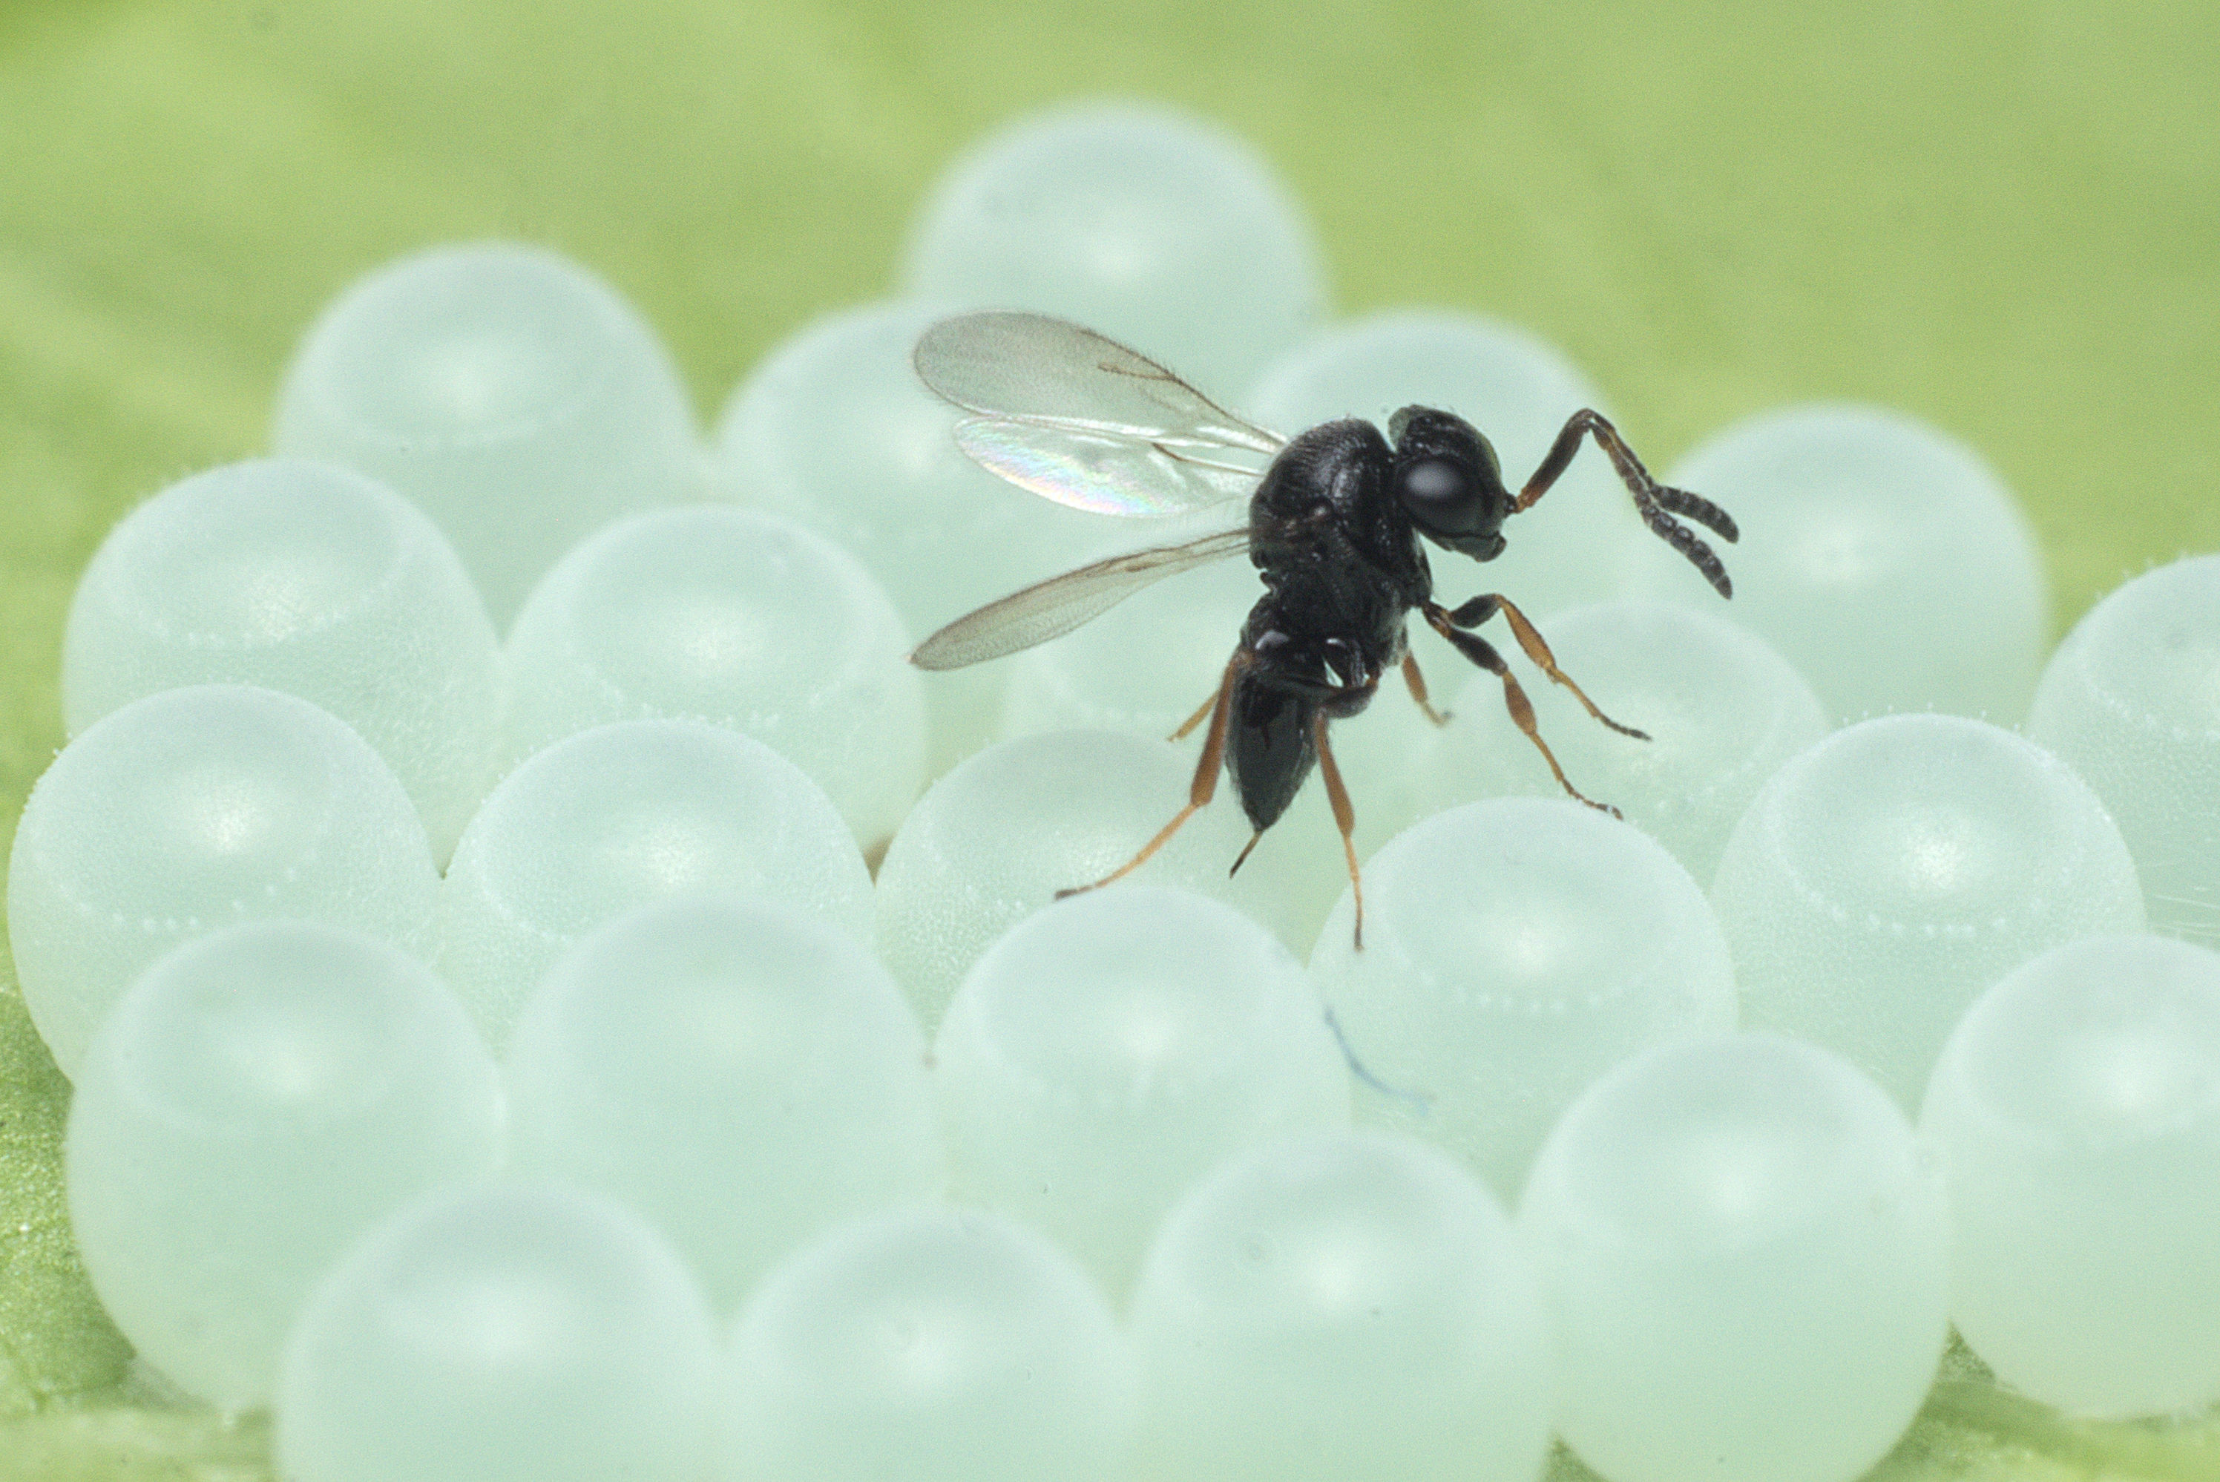
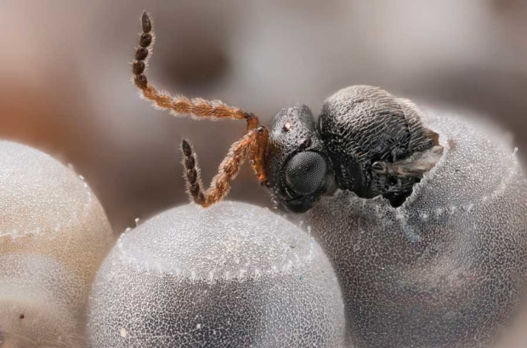
4) Cage trials
Expose T. japonicus to non-target egg masses + infertile BMSB eggs in a mesh cage (in quarantine).
What does it choose? Are its choices consistent with results from oviposition and olfactometer tests?
Oregon Department of Agriculture
Oregon Department of Agriculture

Slide 10
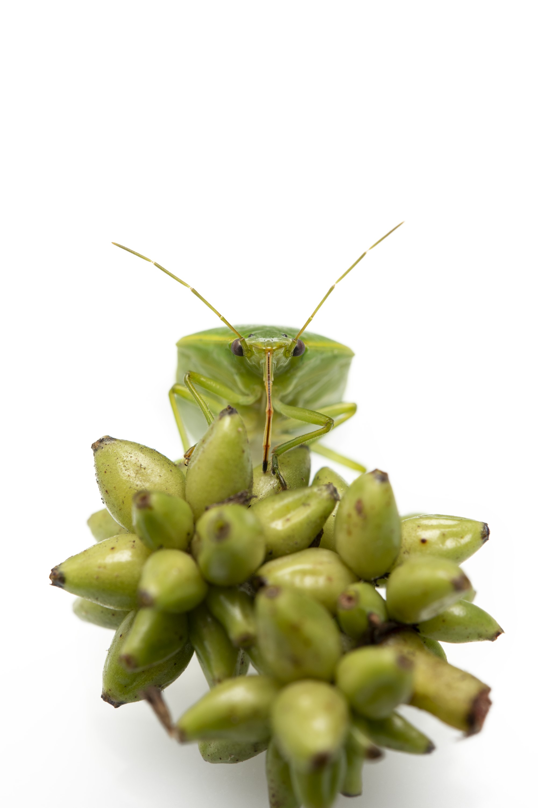
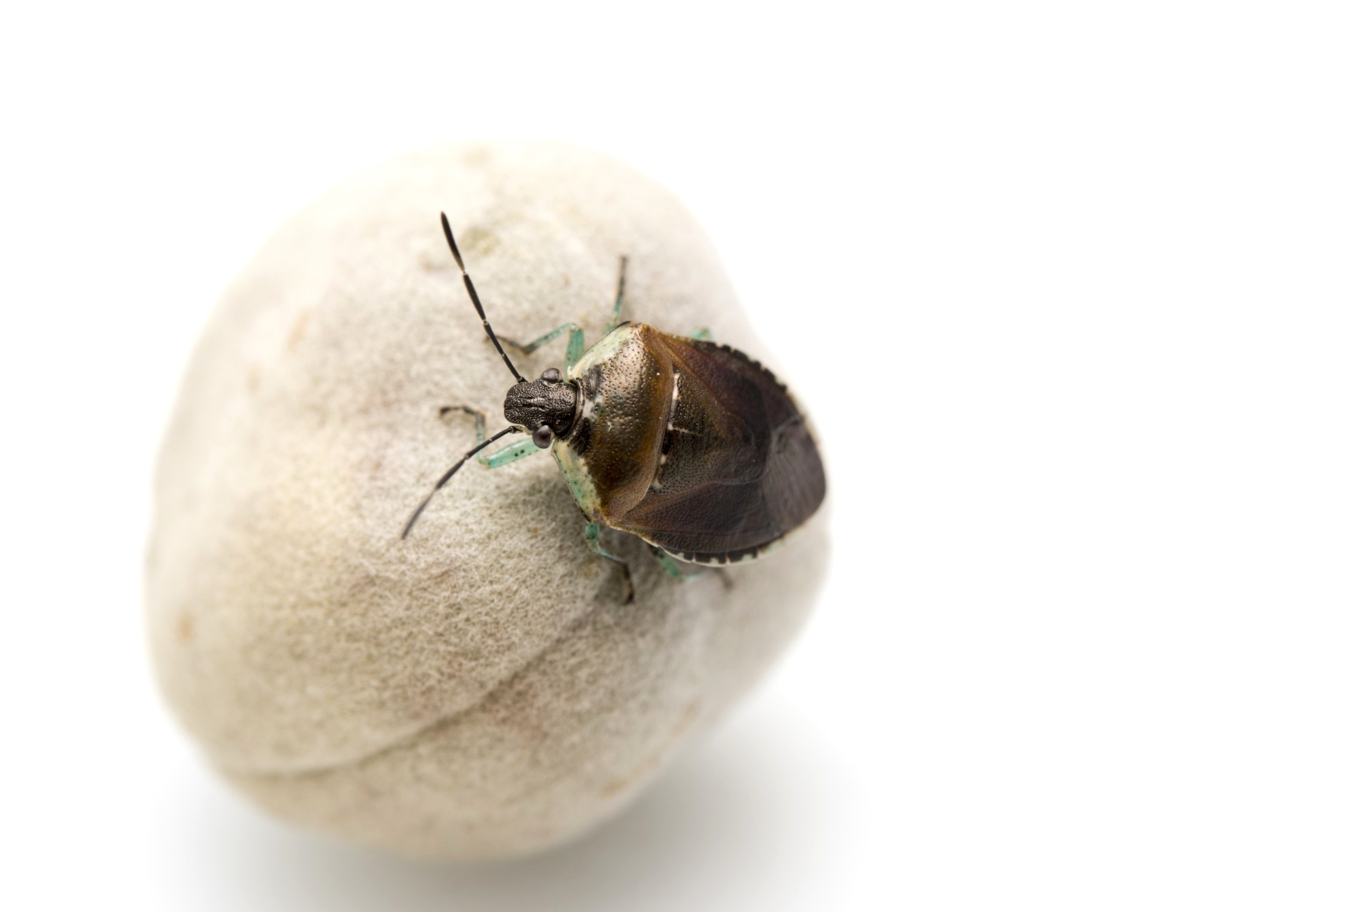
5) NT hosts
When T. japonicus is reared on non-target hosts:
Do its host preferences change, and if so how many generations does it take?
Are offspring less fit?
Is the sex ratio different?
Monteithiella humeralis
Image © Plant & Food Research
Glaucias amyoti
Image © Plant & Food Research

Slide 11
Thanks!
TomSaunders.co.nz / @TomSaundersNZ
GregHolwell.com
@GonzaloAvilaNZ

