Slide 1
What is a Librarian For?
Anton Angelo University of Canterbury Library Carpentry Instructor & Maintainer

Slide 2
Can you tell me
?
Who owns the data you work with?
Can you give me your data?
Can I give you my data?
Will your data be available to scholars in 1, 10, 100, 1000 years time?
Can other people parse or interpret your data?
What are your moral, legal and ethical obligations in your research?

Slide 3
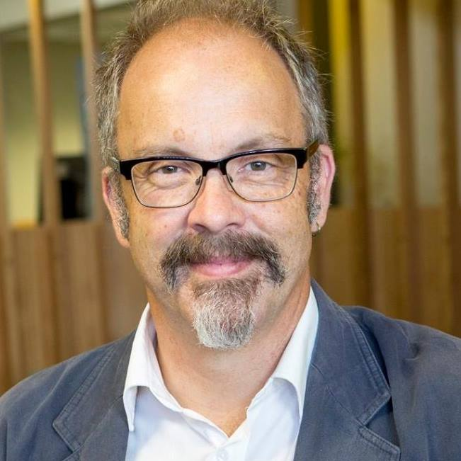
Me
IT Guy
Helpdesk
Developer (python, cold fusion, web stack)
Trainer (Macromedia – Flash & Dreamweaver)
Business Development (web cafes never make money)
Project Manager (you don’t have to be a jerk, but it helps)
Generalist
Anthropology and Psychology
Interests in History, Spaceships, Technology, Cats, Dungeons and Dragons

Slide 4
What, a Librarian?
Offered redundancy in 2012
Interviewed 6 Librarians
Completed Masters of Information Studies (endorsed in LIBRARY SCIENCE!)
Too many people define a librarian as a person who works in a library. ... Librarians are defined by their mission, their methods, and their values. The mission of librarians is to improve society through facilitating knowledge creation in their communities. David Lankes Oct 25, 2017

Slide 5
All about Books, innit?
Things I knew
Early adopters of networking (DIALOG)
Project Gutenberg
Things I learned
Library budgets are 10/90 physical/digital split
Canterbury spends 6.5m on digital resources, .5m on books
Everything is online (in STEM, anyhow)
Research data publishing and archiving is the Next Big Thing.

Slide 6
What Libraries did and what they are going to do

Slide 7
The Research Lifecycle
Develop Ideas
Gaps in literature
Funding & Proposals
Data Management Plans
Find & Manage Information
Training, Products and Service
Do the thing
Storing working data – using other peoples’
Publish & Share
Research Impact
Scholarly Publishing – Library as publisher
The fight against simplistic metrics

Slide 8
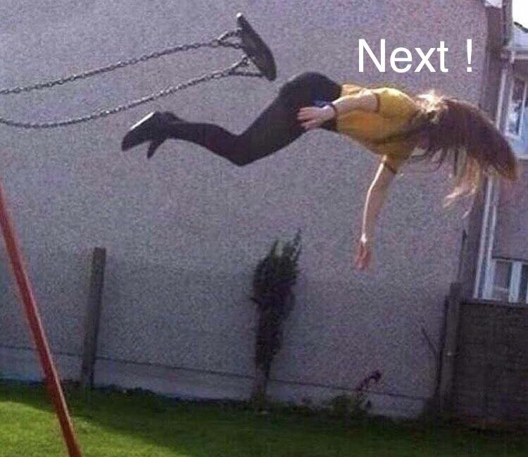
What’s Next
Data Management Plans
Library Publishing Platforms
Articles
Data
Layer Journals

Slide 9
Can you tell me
?
Who owns the data you work with?
Can you give me your data?
Can I give you my data?
Will your data be available to scholars in 1, 10, 100, 1000 years time?
Can other people parse or interpret your data?
What are your moral, legal and ethical obligations in your research?

Slide 10
Credits
Library by Jaime Serra from the Noun Project
Globe by Evon Mbon from the Noun Project
global by Dinosoft Labs from the Noun Project
Anton Angelo – anton.angelo@canterbury.ac.nz

