Slide 1
Wait a bit! Why do we care about software preservation? Slides: https://doi.org/10.6084/m9.figshare.7701494 12th February 2019, Making Research Reproducible, Glasgow Neil Chue Hong (@npch), Software Sustainability Institute ORCID: 0000-0002-8876-7606 | N.ChueHong@software.ac.uk
Supported by:
Slides licensed under CC-BY where indicated:
Notes:
Introduction to software preservation
Why do we

Slide 2
“Lack of access to effective software continues to be a major hindrance to scientific progress and therapeutic discovery. […] For the benefit of all society, we need to pursue new and complementary approaches to the creation and dissemination of scientific software.” – Warren Lyford DeLano, creator of PyMOL, in 2003
Notes:
http://www.wired.com/2014/09/man-quest-open-source-cancer-research/

Slide 3
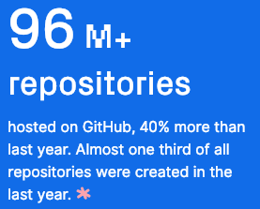
How much? Let’s look at GitHub
Pytorch was the second fastest growing project
Universities were 5 of the top 10 contributing organisations
Literally billions of lines of code
https://octoverse.github.com/ (2018)
Notes:
NCAR CESM model is 1.2m lines of code
LHC root software is 3.5m lines of code

Slide 4
Sharing is key to reproducibility
Improves transparency
Improves understanding
Elimination of errors
Encourages collaboration
Easier on-ramping
Improves trust
“Deep intellectual contributions now encoded only in software" – Stodden
“Scholarship is the full software environment, code and data, that produced the result” - Claerbout

Slide 5
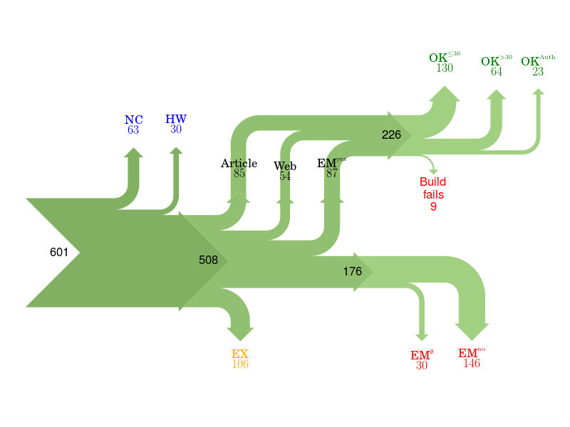
Of 601 papers in ACM Computer Science journals and proceedings, only 85 provided a link to software.
For 176 the software could not be obtained.
Collberg, Proebsting, Warren, University of Arizona TR 14-04, 2015
http://reproducibility.cs.arizona.edu/v2/RepeatabilityTR.pdf
Notes:
NC Paper excluded due to results not being backed by code.
HW Paper excluded due to replication requiring special hardware.
EX Paper excluded due to overlapping author lists.
EMno Author responds that the code cannot be provided.
EMØ Author does not respond to email request within 2 months.
Article Code is found from link in the article itself.
Web Code is found from a web search.
EMyes Code is provided by author after email request.
OK≤30 We succeed in building the system in ≤30 minutes.
OK>30 We succeed in building the system in >30 minutes.
OK>Author We fail to build, but the author says the code builds with reasonable effort.
Fails We fail to build, and the author doesn't respond to survey or says code may have problems building.

Slide 6
Culture change is hard
In 2011 Science changed its editorial policies:
“We require that all computer code used for modeling and/or data analysis that is not commercially available be deposited in a publicly accessible repository upon publication.”
“After publication, all reasonable requests for data, code, or materials must be fulfilled.”
Stodden, Seiler, Ma. An empirical analysis of journal policy effectiveness for computational reproducibility
https://doi.org/10.1073/pnas.1708290115
Notes:
https://doi.org/10.1073/pnas.1708290115
http://www.sciencemag.org/authors/science-journals-editorial-policies
Implemented February 11, 2011.

Slide 7
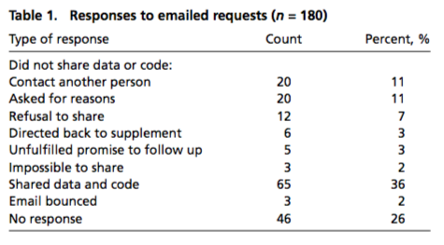
Culture change is hard
Stodden, Seiler, Ma. An empirical analysis of journal policy effectiveness for computational reproducibility
https://doi.org/10.1073/pnas.1708290115
Notes:
https://doi.org/10.1073/pnas.1708290115
http://www.sciencemag.org/authors/science-journals-editorial-policies
Implemented February 11, 2011.

Slide 8
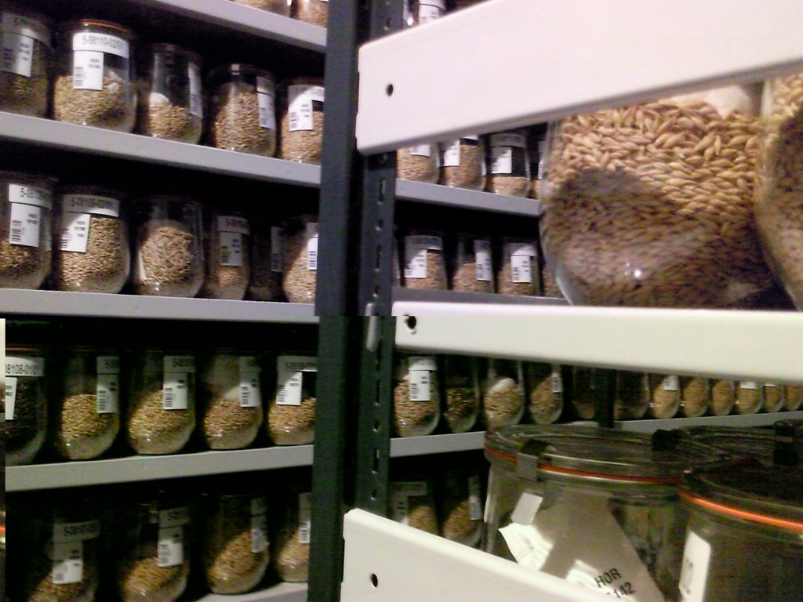
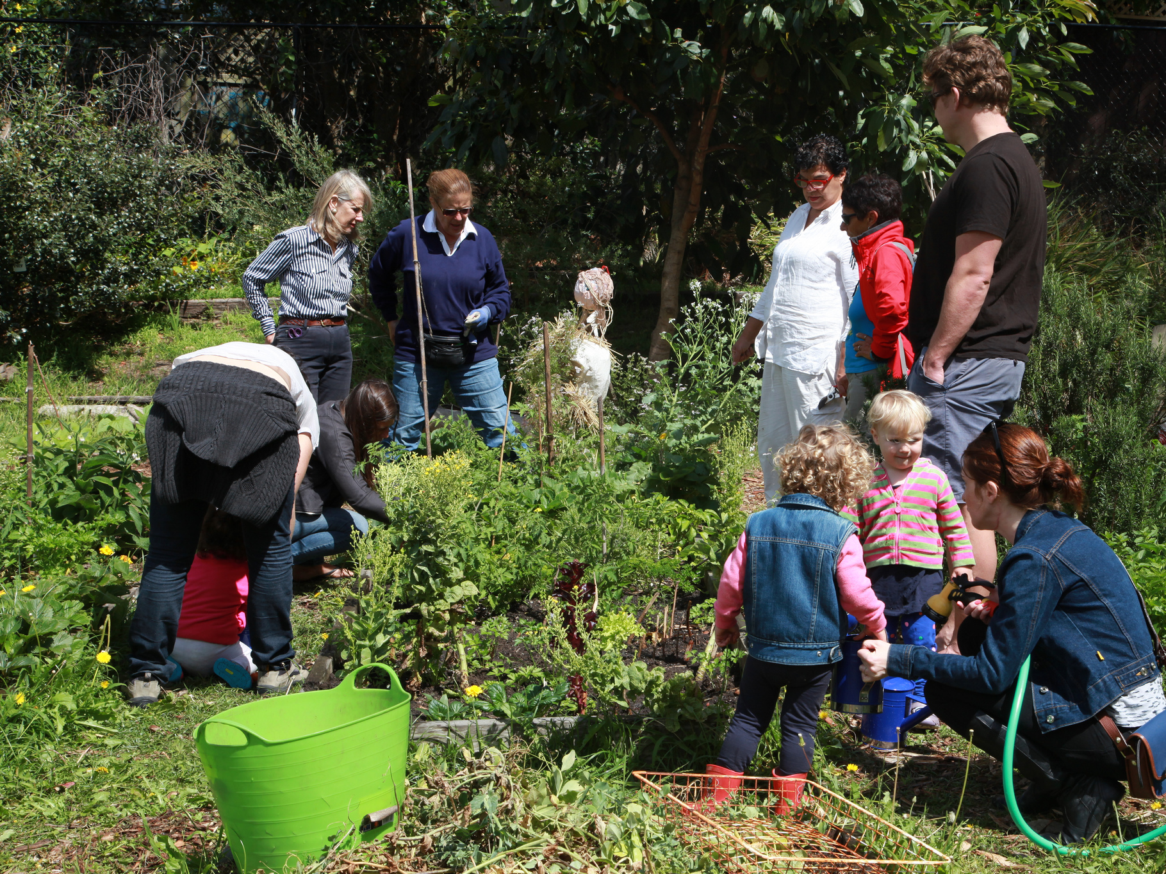
Preservation vs Sustainability
“IPK Gatersleben cold storage” by Dag Terje Filip Endresen
“1 Waverley Community Garden” by d-olwen-dee
Notes:
When I talk about software preservation, I’m thinking about the storage of source code and binaries, as opposed to the passing on of skills.
Photo Credits:
“IPK Gatersleben cold storage” by Dag Terje Filip Endresen under CC-BY
“1 Waverley Community Garden” by d-olwen-dee uynder CC-BY

Slide 9
Purposes of preservation
Purpose
Achieve legal compliance
Enable continued access to data and services
Encourage software reuse
Create heritage value
e.g LOTAR (aerospace)
e.g. Salman Rushdie archive (literature)
e.g. aphid database (biosciences)
e.g. DOE Code (general)
Chue Hong et al. (2010). Software Preservation Benefits Framework (Version 1.0). Zenodo. http://doi.org/10.5281/zenodo.2561972

Slide 10
Software repository lifecycle
Code repository
GitHub
Digital repository
Zenodo
Archival repository
Archivematica
Bitbucket
GitLab
Mercurial
Subversion
Figshare
Dryad
DSpace
EPrints
Fedora
Preservica
Software Heritage
Internet Archive
Emphasis on collaboration
Contents rapidly changing
Individual / Project
Emphasis on sharing
Contents slowly changing
Community
Emphasis on integrity
Contents rarely changing
Organisation / Institution
Notes:
These overlap

Slide 11
What about the R-word?
Reputation?
Most software preservation is aimed at reducing risk in some way
Reproducible?
Reproducibility adds extra burden on the developer
Research?
Ultimately, this is about enabling research

Slide 12
Software Management Plans
Much research software development is not formally planned
Developed to solve a research question
Evolved rather than planned
Even larger research software projects tend to be driven by a single person to start
Software Management Plans are a way of thinking through the process of running a research software development project

Slide 13
SMP Checklist
What software will you develop?
Who are the intended users of your software?
How will you make your software available to your users?
How will you support those who use your software?
How will your software contribute to research?
How will you measure your software’s contribution to research?
Where will you deposit your software to guarantee its long term availability?
The Software Sustainability Institute. (2018). Checklist for a Software Management Plan (Version 1.0). Zenodo. http://doi.org/10.5281/zenodo.2159713

Slide 14
Depositing your software
Will you deposit releases of your software into a digital repository?
What digital repositories are appropriate for you to use?
Has your funder or publisher recommended or mandated a digital repository to use?
Does the digital repository give you a unique persistent digital identifier for your deposit?
Can the digital repository accommodate the size of your deposit?
Are the policies of the digital repository acceptable to you?
Is the longevity of the digital repository acceptable to you?
Is the digital repository free or do you have to pay a fee? If there is a fee, is this a one-off payment and can you afford it?
The Software Sustainability Institute. (2018). Checklist for a Software Management Plan (Version 1.0). Zenodo. http://doi.org/10.5281/zenodo.2159713

Slide 15
Why deposit software?
Michael Jackson. (2018). Software Deposit: Why deposit software (Version 1.0). Zenodo. http://doi.org/10.5281/zenodo.1327333

Slide 16
When to deposit software?
Michael Jackson. (2018). Software Deposit: When to deposit software (Version 1.0). Zenodo. http://doi.org/10.5281/zenodo.1327331

Slide 17
Where to deposit software?
Michael Jackson. (2018). Software Deposit: Where to deposit software (Version 1.0). Zenodo. http://doi.org/10.5281/zenodo.1327329

Slide 18
What to deposit?
Michael Jackson. (2018). Software Deposit: What to deposit (Version 1.0).
Zenodo. http://doi.org/10.5281/zenodo.1327325

Slide 19
How to review a deposit?
Michael Jackson. (2018). Software Deposit: How to review a software deposit (Version 1.0). Zenodo. http://doi.org/10.5281/zenodo.1327314

Slide 20
Research software is changing

Slide 21
What else is going on?
The Turing Way
https://www.turing.ac.uk/research/research-projects/turing-way-handbook-reproducible-data-science
Software Heritage
https://www.softwareheritage.org/
Software Preservation Network
https://www.softwarepreservationnetwork.org/
Software Citation Repository Best Practices Taskforce
https://github.com/force11/force11-sciwg/issues/59
PyRDM
https://github.com/pyrdm/pyrdm
CodeMeta
https://codemeta.github.io/
WholeTale
https://wholetale.org/

Slide 22
What can we do (now / next)?
Preserving source code has become easier – with tools to automate deposit
Policy changes have not hugely improved deposit rates – we need to champion more
Research software is changing – address implications for institutional deposit and archiving of containers and notebooks
Slides: https://doi.org/10.6084/m9.figshare.7701494

Slide 23
Acknowledgements
The SSI team/alumni:
Aleksandra Nenadic
Aleksandra Pawlik
Alexander Hay
Arno Proeme
Carole Goble
Claire Wyatt
Clem Hadfield
Dave De Roure
Devasena Prasad
Giacomo Peru
Graeme Smith
Iain Emsley
James Graham
John Robinson
Les Carr
Malcolm Atkinson
Malcolm Illingworth
Mario Antonioletti
Mark Parsons
Mike Jackson
Olivier Philippe
Priyanka Singh
Raniere Silva
Rob Baxter
Robin Wilson
Shoaib Sufi
Simon Hettrick
Stephen Crouch
Tim Parkinson
Toni Collis
Plus the SSI Fellows and RSE community
Scientific software:
Dan Katz
Heather Piowowar
James Howison
Jeff Carver
Jennifer Schopf
Kaitlin Thaney
Martin Fenner
Victoria Stodden
WSSSPE community
Software/Data Carpentry
Greg Wilson
Jonah Duckles
Tracy Teal
Instructor Community
Supported by the UK Research Councils through grants EP/H043160/1, EP/N006410/1 and EP/S021779/1 . Additional project funding received from Jisc.

Slide 24
About the Institute

Slide 25
Software Sustainability Institute
A national facility for cultivating better, more sustainable, research software to enable world-class research
Software reaches boundaries in its development cycle that prevent improvement, growth and adoption
Providing the expertise and services needed to negotiate to the next stage
Developing the policy and tools to support the community developing and using research software
Supported by the UK Research Councils through grants EP/H043160/1, EP/N006410/1 and EP/S021779/1
Notes:
The Software Sustainability Institute can help with: software reviews and refactoring, collaborations to develop your project, guidance and best practice on software development, project management, community building, publicity and more…
Drawing on pool of specialists to drive the continued improvement and impact of research software developed by and for researchers
Providing services for research software users and developers
Developing research community interactions and capacity
Promoting research software best practice and capability

Slide 26
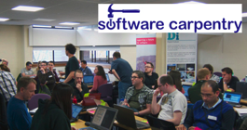
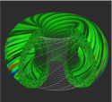
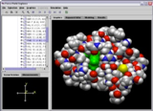
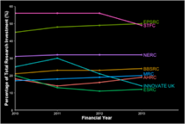
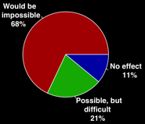
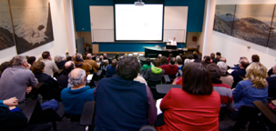
Software
Training
Helping the community to develop software that meets the needs of reliable, reproducible, and reusable research
Delivering essential software skills to researchers via CDTs, institutions & doctoral schools
Outreach
Exploiting our platform to enable engagement, delivery & uptake
Collecting evidence on the community’s software use & sharing with stakeholders
Bringing together the right people to understand and address topical issues
Policy
Community

Slide 27
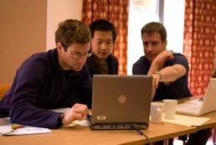
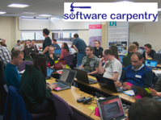
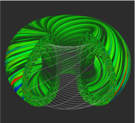
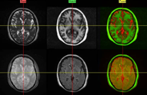
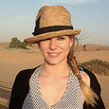
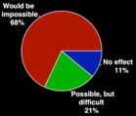
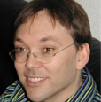
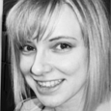
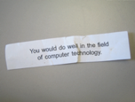
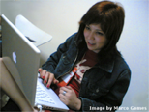
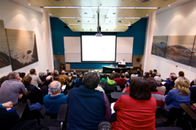
Software
Training
Advice
Courses
35+ UK SWC workshops
1000+ learners
Consultancy
50+ projects
130+ evaluations
4 surgeries
Guides
Outreach
80+ guides
50,000 readers
Website & blog
150+ contributed articles
20,000 unique visitors per month
3,000 Twitter followers
Research
740 researchers 50,000 grants analysed
Campaigns
Workshops
Fellowship
61 domain ambassadors
300+ RSEs engaged
2100 signatures
13 issues highlighted
Policy
Community
20+ workshops organised

