Slide 1
Data Nomination Tool dataAtRisk.org
Reid Boehm
Johns Hopkins University, Data Services

Slide 2
Another Tool?
In this case, Yes!
There is a need for a resource which provides a mechanism for individuals to submit earth science data sets and request help with them.

Slide 3
Our Goals
To connect folks with data needs to folks with data rescue expertise.
To streamline community efforts.
To provide unaffiliated support with low barrier to entry.
To collect data about community needs.

Slide 4
How the tool works:
Data Minion
Data Hero
Data Submitter
Minion checks,
shares
Submitter approves
Works behind the scenes to facilitate processing of data requests.
Participates in data rescue activities
Submits data in need of rescue services
Request submitted
Minion approves and sorts
Outcomes archived - data informs future!
Heroes search,
select, work
Notes:
Katie
It is a web- based application that allows users to request help in performing data rescue related tasks for any reason.
Examples include: migrating formats, fostering a data collection at risk of being lost until a new host is found
Submitters - the individuals who submit new requests - they can be guest users or they can register
Data Heroes- register to be involved in data rescue - they can pick from data sets to be worked on - and in many cases may have data sets sent to them given their expertise.
Data Minions- facilitators working to process submissions, link them with Data Heroes, and confirm completion of tasks with submitter

Slide 5
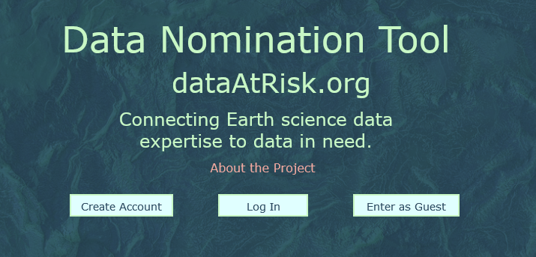
Simple Web Application
Hashing function: uniquely identifies requests, allows submissions from guest users, and maintains data integrity.

Slide 6
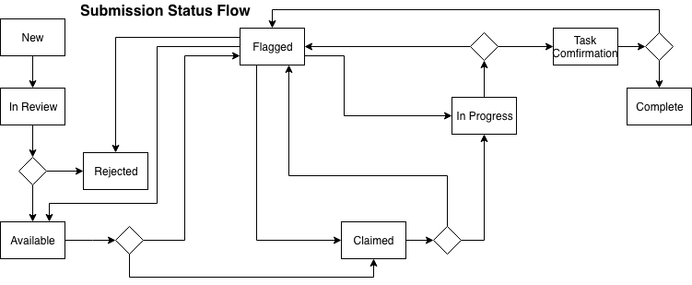
Internal Processing
Diagram by Ruth Duerr

Slide 7
What’s next?
Usability Testing: AGU and ESIP
Huge thank you to Sophie Hou!
Getting the word out – using and assessing
Business Plan for future
Sustainability discussions
Please get in touch if you’d like to be involved!
rboehm@jhu.edu

Slide 8
Thank you to the team!
Joan Saez and Cloudbirst, LLC (Development)
Sophie Hou
Ruth Duerr
Denise Hills
James Ng
Mara Blake
Katie Mika
Natalie Meyers

