Slide 1
Enabling FAIRness with PIDs Pidapalooza 24 January 2019
Shelley Stall, Program Manager &
Director of Data Programs; American Geophysical Union
sstall@agu.org
https://orcid.org/0000-0003-2926-8353
Eric Olson
Engagement and Partnerships Lead, North America;
ORCID
e.olson@orcid.org
https://orcid.org/0000-0002-5989-8244

Slide 2
Our Agenda
Project Overview – Enabling FAIR Data Across the Earth and Space Sciences
Project Overview – PARSEC
Activity!
Sharing and Questions

Slide 3
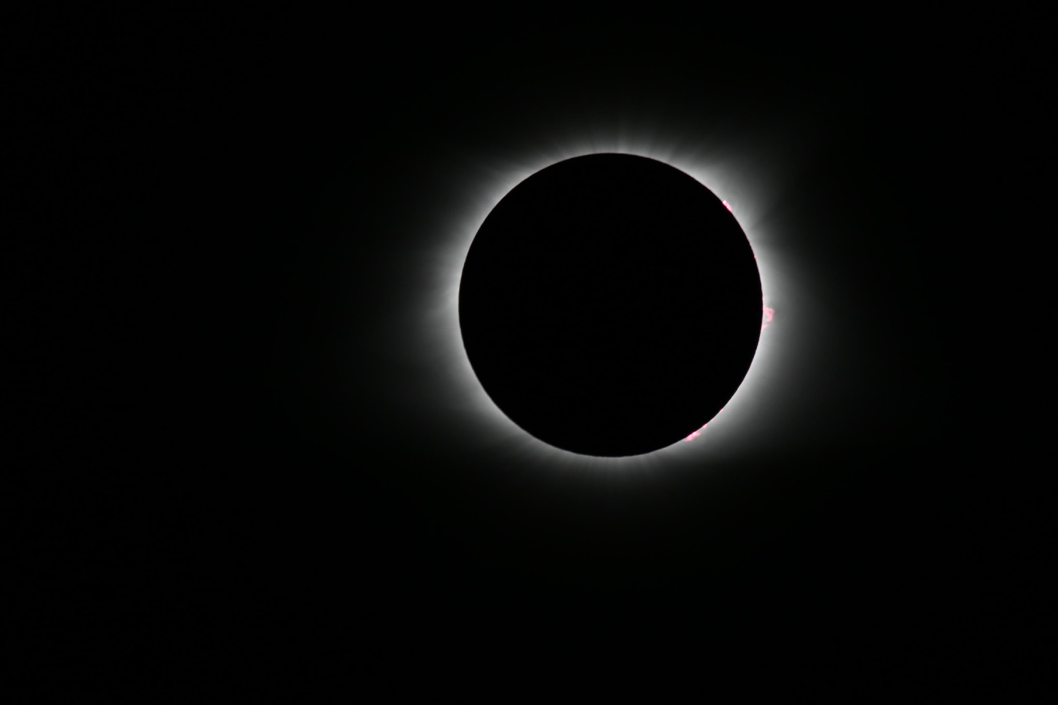
AGU’s position statement on data affirms that
“Earth and space sciences data are a world heritage. Properly documented, credited, and preserved, they will help future scientists understand the Earth, planetary, and heliophysics systems.”
https://sciencepolicy.agu.org/files/2013/07/AGU-Data-Position-Statement-Final-2015.pdf
Notes:
Photo by Rick Meyers on Unsplash, Smith County I-40 Rest Area, Lancaster, United States

Slide 4
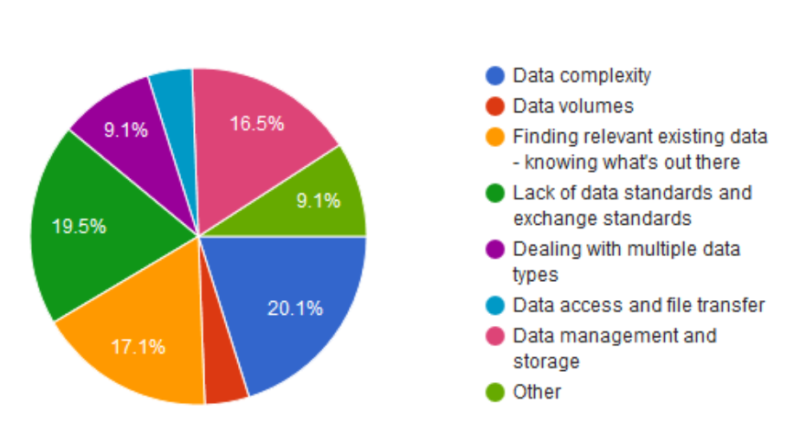
Researcher Challenges with Data Use
The top four issues accounted for 73% of respondents
20.1%
17.1%
19.5%
16.5%
Data Management Skills Gap Analysis, April 7, 2017
http://bfe-inf.org/document/skills-gap-analysis

Slide 5
AGU received a grant from Laura and John Arnold Foundation (LJAF)
Project Statement:
Develop and implement best practices and standards
that will connect researchers, publishers, and data repositories in the Earth and space sciences
to enable FAIR data.
This will accelerate scientific discovery and enhance the integrity, transparency, and reproducibility of this data.

Slide 6
Enabling FAIR Data Project - Objectives
FAIR-compliant data repositories will add value to research data, provide and link identifiers and landing pages for discoverability, and support researchers with documentation guidance, citation support, and data curation.
FAIR-compliant Earth and space science publishers will align their policies to establish a similar experience for researchers. Data will be available through citations that resolve to repository landing pages. Data are not placed in the supplement; they are “first class” research contributions.

Slide 7
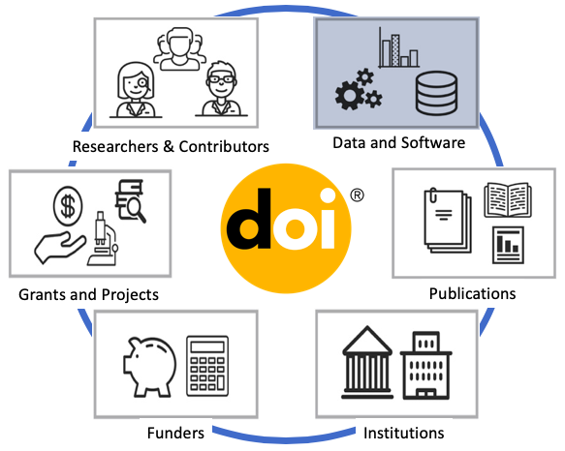
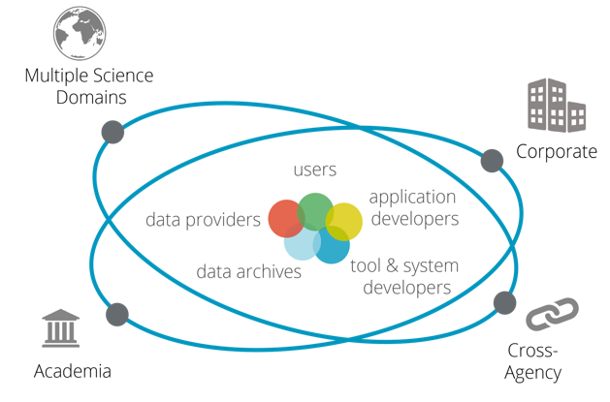
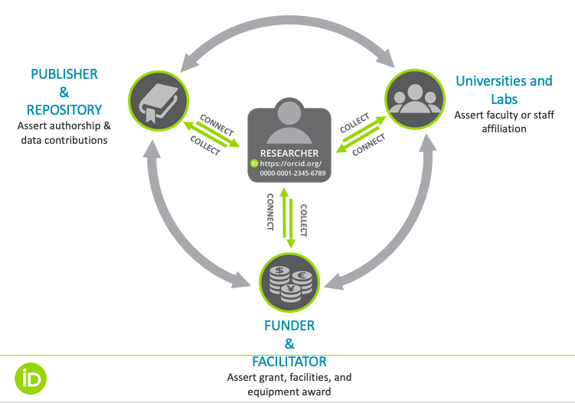
Cross-Sector Actors
Other Roles:
Research Labs
Service providers to the ecosystem (e.g. PID providers like DataCite, github/Zenodo, ORCID CrossRef, FundRef, Scholix)
Research offices -- not at institutions (e.g. Ronin)
Make Data FAIR
Open and Persistent Data Store

Slide 8
Community-Driven Project – Partnership Includes:
Science Data Communities
AGU
Earth Science Information Partners (ESIP)
Research Data Alliance (RDA)
EarthCube / Council for Data Facilities (CDF)
Publishers
AGU
Proceedings of the National Academy of Sciences (PNAS)
Nature
Science/AAAS
Elsevier
PLOS
International Repositories & Registries
DataCite
ORCID
CrossRef
National Computational Infrastructure (NCI)
AuScope
Australian National Data Service (ANDS)
Center for Open Science
CHORUS
Scholix
And More!!

Slide 9
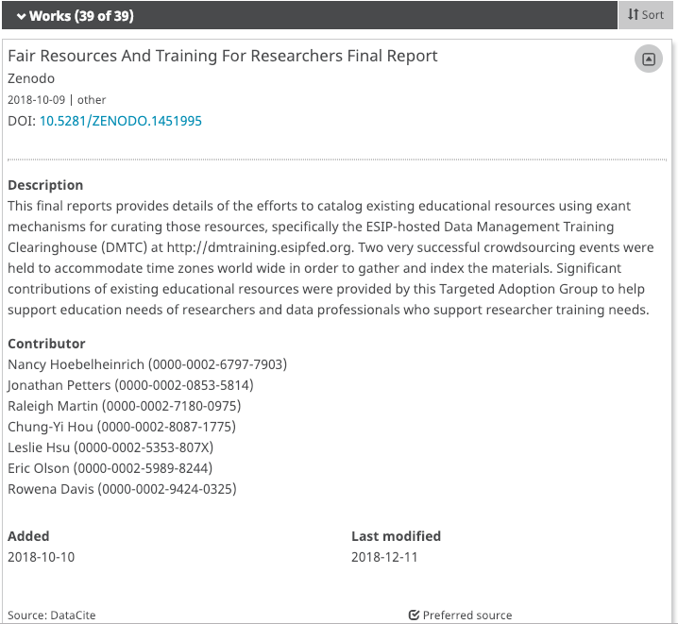
Targeted Adoption Groups (TAGs)
TAG A/D - Repository Guidance for Researchers
Repository FAIR Assessment Instrument
TAG B - Publishers in the ESS team
TAG C - FAIR Resources and Training for Researchers
TAG E - Data and DOI Workflows and Handoffs
Enabling Fair Data Commitment Statement

Slide 10
PARSEC
Building New Tools for Data Sharing and Re-use through a Transnational Investigation of the Socioeconomic Impacts of Protected Areas (PARSEC)
Belmont Forum Collaborative Research Action (CRA) on Science-Driven e-Infrastructures Innovation (SEI) for the Enhancement of transnational, interdisciplinary, and transdisciplinary data use in environmental change research.
Funded for 4 years

Slide 11
Who is participating in PARSEC?
American Geophysical Union (US)
Research Institute for Humanity and Nature (JP)
SciELO (BR)
Foundation for Biodiversity Research (FR)
Universidade de São Paulo (BR)
National Computational Infrastructure (AU)
Institut de Recheche pour le Développement (FR)
Université Toulouse III (FR)
National Institute of Information and Communications Technology (JP)
French National Center for Scientific Research (FR)
University of California, Santa Barbara (US)
British Geological Survey (UK)
ReImagine Impact International (US)
National Institute for Space Research (BR)
Southern Oregon University (US)
University of Montpellier (FR)
Institut National de la Recherche Agronomique (FR)
DataCite (DE)*
ORCID (US)*

Slide 12
What does PARSEC hope to achieve?
Determine the influence of marine and terrestrial natural protected areas (PAs) on the socioeconomics of local communities
Improve future environmental decision-making by providing the most recent, open, well-described and relevant scientific research and data and by increasing and facilitating data interoperability
Improve the adoption of ORCID by the repository infrastructure community for authoritative data attribution
Provide tools for researchers to view how the data they have deposited is cited and reused

Slide 13
How Does PARSEC Work?
The synthesis-science team will examine the socioeconomic effects of natural protected areas (PAs) on local communities.
The data-science team (data management, infrastructure) will develop leading practices on data citation, attribution, credit, and reuse.
The two teams will collaborate in real-time toward the goal of observing and improving research outcomes and data sharing.
In parallel, an outreach strategy will share the experiences and practices developed throughout the project with the broader Earth, space, and environmental science community, including strongly encouraging and demonstrating the application of PIDs in data repositories

Slide 14
Stay Tuned for More on PARSEC!

Slide 15
Method to be applied to 1 assumption per group:
Activity: Assumption Wrangling
Step 1: Specifying assumptions (How does this assumption evolve? What are the related assumptions?)
Step 2: Action recommendations
What can you or your community do that would help shift the assumption?
Sample action steps could include:
Targeted workshops at professional meetings … Curated educational resources … Mentor matches on data work … Stakeholder map identifying how the assumption is viewed by different fields and disciplines

Slide 16
Assumption Wrangling Breakout Groups
Assumption 1: Publishers, editors, reviewers, and authors will recognize and utilize PIDS and apply appropriate standards for FAIR data
Assumption 2: With access to PIDs, repositories will be able to ingest and curate all the data cited in publications and will have the resources to do so
Assumption 3: PIDs enable clear, measurable impact of the FAIR data efforts by publishers and repositories

Slide 17
Assumption 1
Session participants arranged in three groups to discuss one assumption each.
Thank you to all of the attendees for driving such a great discussion!
Additional or Alternative Assumptions:
The utility and application to FAIR is highly dependent on the type of PID
Actions:
Publishers, editors, reviewers, and authors need to know why they are being asked or compelled to utilize PIDs.
Define standards for PIDs
Cohesive outreach
Move from FAIR principles to FAIR standards
Education of policies for editors and reviewers

Slide 18
Assumption 2:
Additional or Alternative Assumptions:
All repositories can accept all types of data
Cost of licensing
Data will be there behind the PIDs
Data migrations are possible and affordable
Incomplete metadata (is it domain specific?)
Repositories are only valued relative to their service to publications
Who mints the PID?
Actions:
Get more funding!
Agree on metadata standards
Repository finder tool
Agree on a priority list for repositories, relying on communities of practice

Slide 19
Assumption 3:
Additional or Alternative Assumptions:
All kinds of impact can be measured
We know what impact is
We recognize cause and effect
Researchers will use an IR to get data
Actions:
Define success in more detail
Get more funding!
Define FAIRness standards in more detail

Slide 20
Thank you!!!
Shelley Stall, Program Manager &
Director of Data Programs; American Geophysical Union
sstall@agu.org
https://orcid.org/0000-0003-2926-8353
Eric Olson
Engagement and Partnerships Lead, North America;
ORCID
e.olson@orcid.org
https://orcid.org/0000-0002-5989-8244

Slide 21
Enabling FAIR Data – Project Orientation Material
Article describing the Enabling FAIR Data Project:
https://eos.org/editors-vox/enabling-findable-accessible-interoperable-and-reusable-data
Outcome of the initial Stakeholder Meeting from Nov 16-17, 2017:
https://eos.org/agu-news/enabling-fair-data-across-the-earth-and-space-sciences
DataONE webinar recording:
https://www.dataone.org/webinars/enabling-fair-data
Join the Email List (hosted by RDA):
https://www.rd-alliance.org/groups/esipagurda-enabling-fair-data-coordination-group

