Slide 1
The Limits of Reproducibility: Strategies for Transparent Qualitative Research
TU Delft, January 28, 2019
Sebastian Karcher
Qualitative Data Repository, Syracuse University

Slide 2
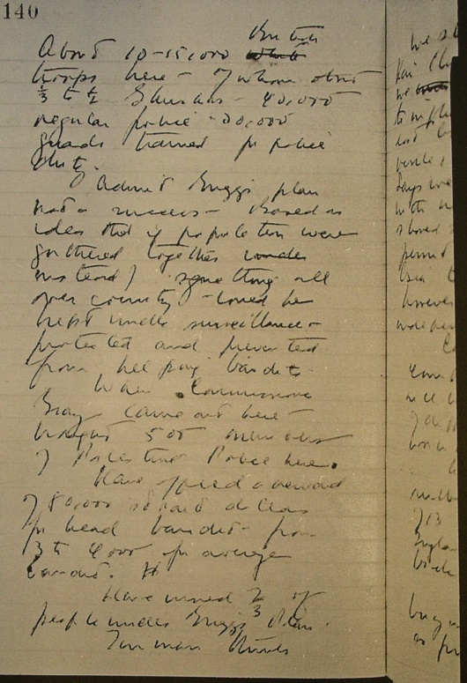
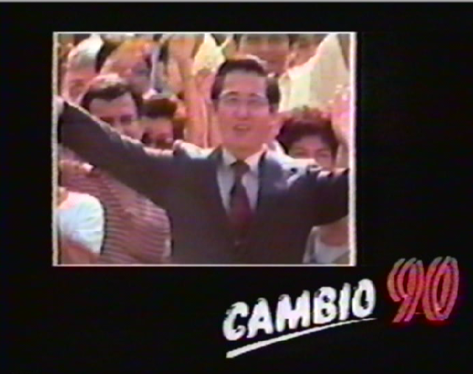
What Is QDR?
Online since 2014: qdr.syr.edu, NSF funded
QDR curates, stores, preserves, publishes, and enables the download of digital data generated through qualitative and multi-method research in the social sciences.
HQ at Syracuse; other team members at Georgetown and UW Seattle
Originated in political science: International and interdisiplinary
Currently 50 data projects published

Slide 3
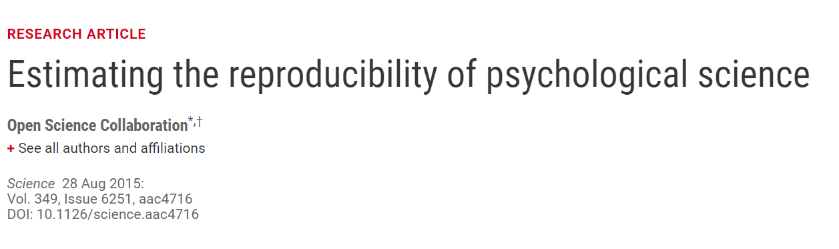
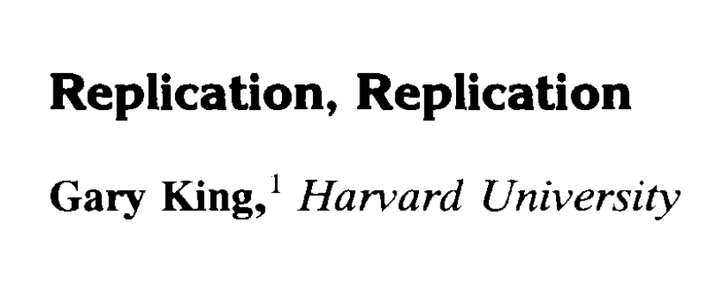
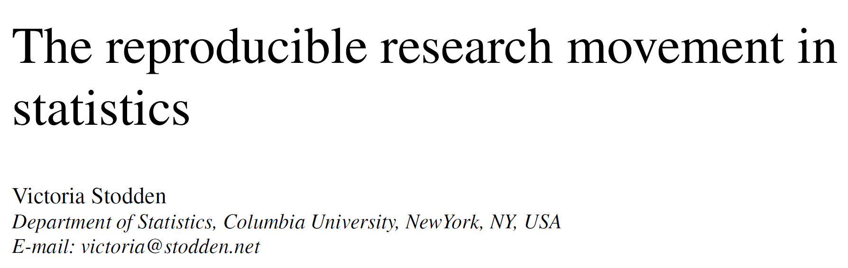
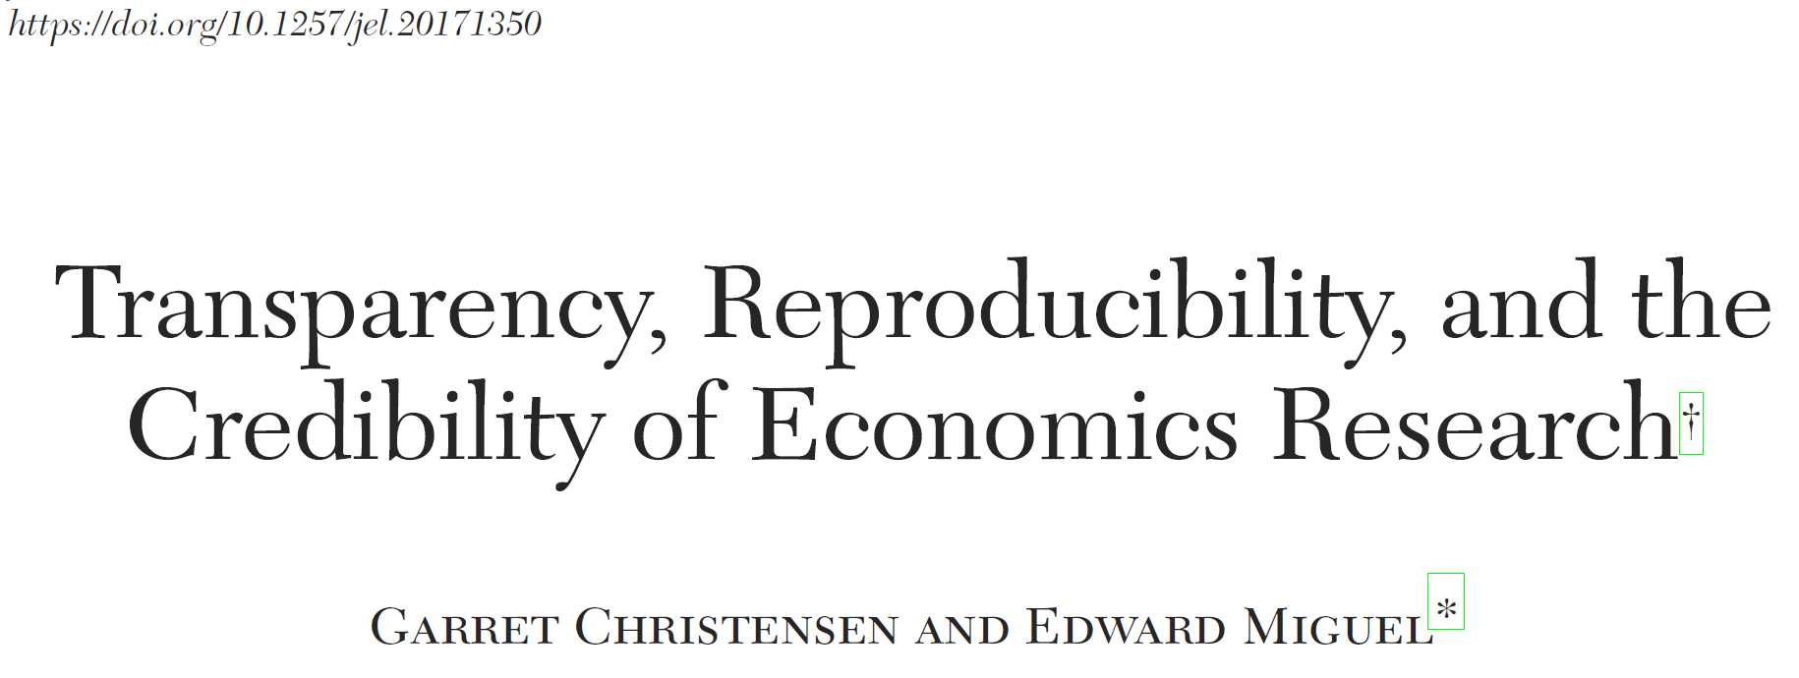
The Reproducibility Revolution in the Social Sciences
Notes:
Researchers must develop, enhance and professionalize their research data management skills to meet these challenges.

Slide 4
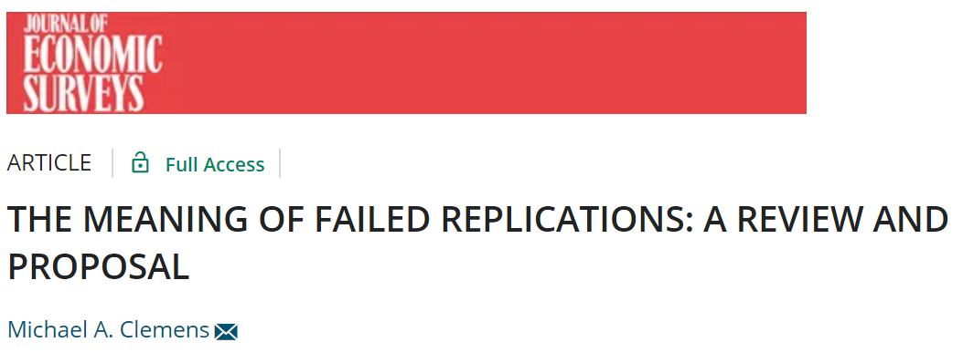
The Reproducibility Revolution
Has a Terminlogy Problem
Replication = same data, same code
Reproducibility = running the same experiment in different labs. Also refer to it as replication
Reproducibility = same data, same code
Replication has sub-categories:
Reproduction: Running the same experiment in different labs.
Verification: Running same code + data

Slide 5
Conceptual Clarity for the Next 45mins
Reproducibility
Same data, same methods → same results
Replicability
Same methods different data/sample → same results
Transparency
Provide all information necessary to evaluate fully

Slide 6
Replicability vs. Transparency in Qualitative Research
Replicability has strong basis in philosophy of science, but only applicable to small part of qualitative research
Replicability
Solipsism: Only author can understand their own data
Positivism: Search for universal laws
Transparency

Slide 7
Why Do We Care about Reproducibility?
He means reproducibility…
The replication standard holds that sufficient information exists with which to understand, evaluate, and build upon a prior work if a third party could replicate the results without any additional information from the author. (King, 1995)
The scientific method’s central motivation is the ubiquity of error—the awareness that mistakes and self-delusion can creep in absolutely anywhere and that the scientist’s effort is primarily expended in recognizing and rooting out error. (…)
[I]f everyone on a research team knows that everything they do is going to someday be published for reproducibility, they’ll behave differently from day one. Striving for reproducibility imposes a discipline that leads to better work. (Donoho et al. 2009)

Slide 8
Types of Transparency
Production Transparency
Analytic Transparency
Data Access
APSA 2012

Slide 9
Transparency in Practice

Slide 10
Whither Qualitative Transparency?
Costs / Logistics
Ethical / Legal
Epistemic / Ontological

Slide 11
Costs / Logistics: Ways Forward
Funding for data preparation
Lowering costs with good research practices
Lowering costs with technology

Slide 12
Lowering Costs: Data Management
Data Management Plans
Documentation “as you go”
Organize with eye towards sharing from the start (file naming, metadata, etc.)
All of these don’t just benefit transparency. Your principal re-user is future you.

Slide 13
Ethical / Legal: Ways Forward
Not all data can or should be shared
De-identifying qualitative data is (often) possible
Explicit consent for data sharing
Access controls

Slide 14
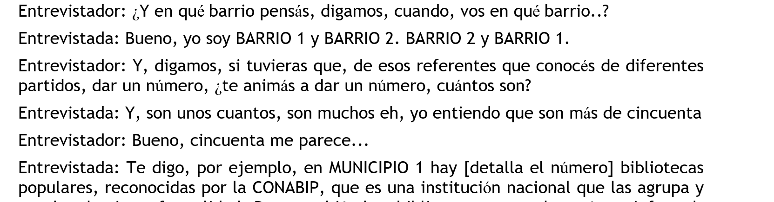
De-identifying qualitative data

Slide 15
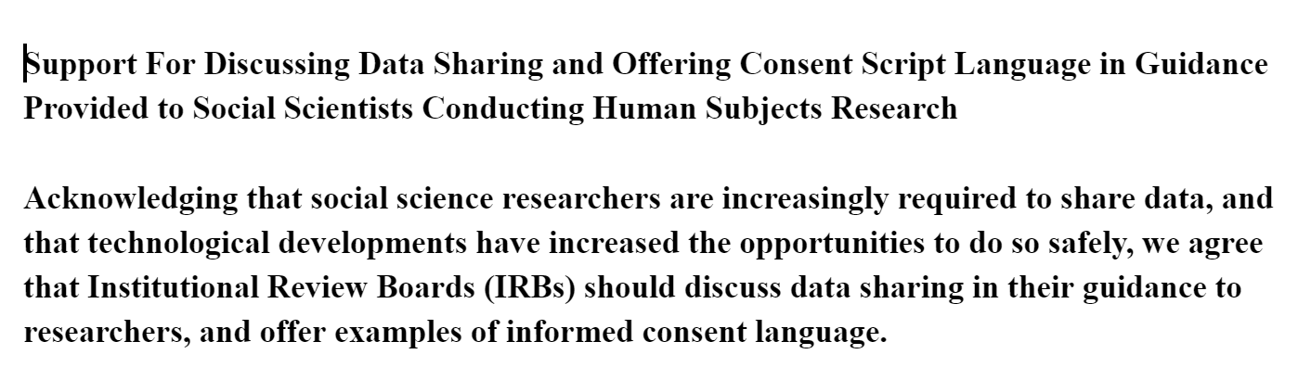
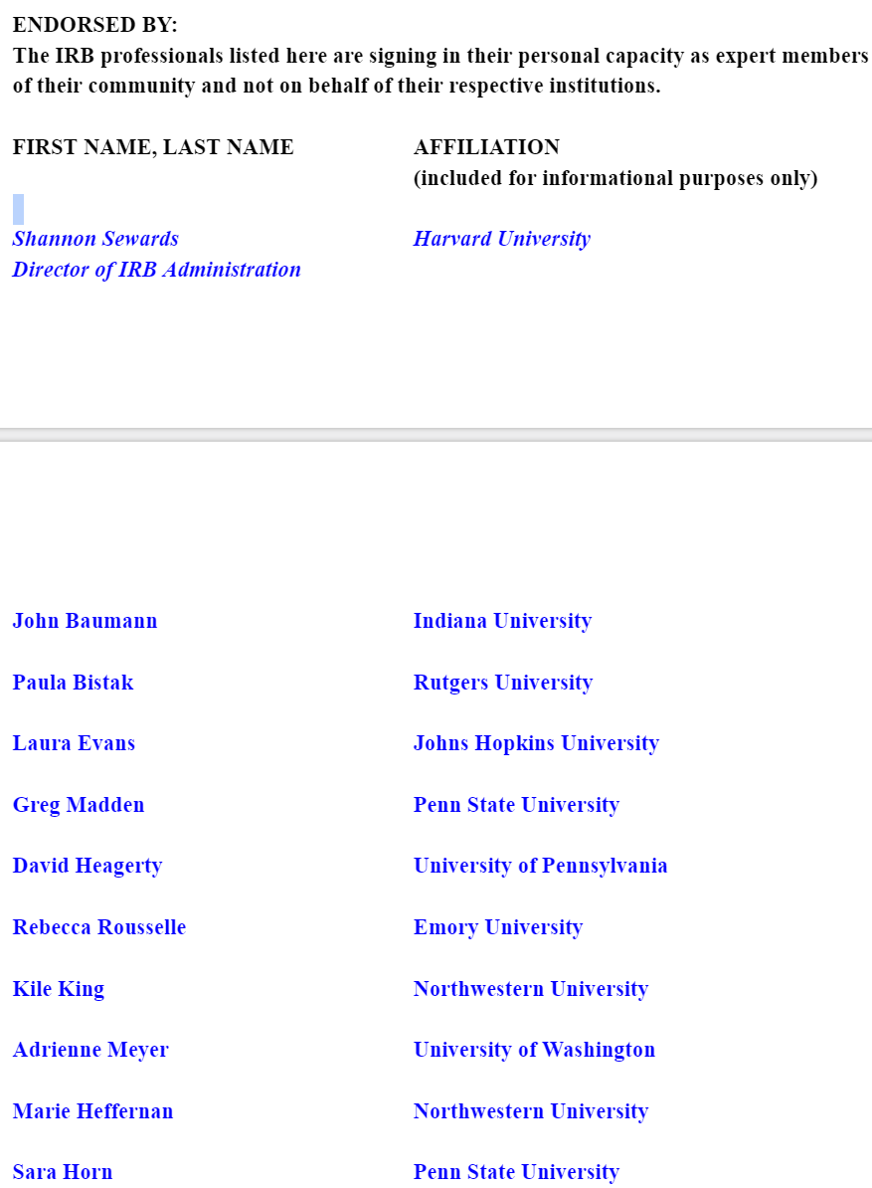
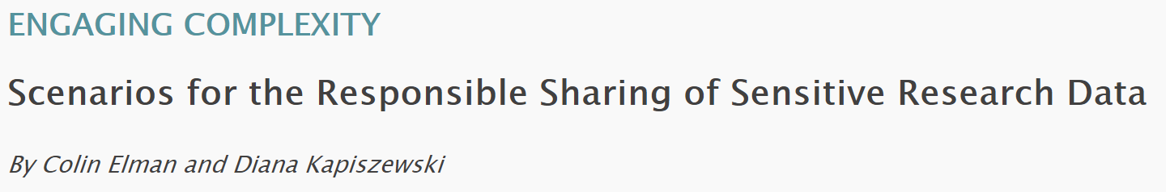
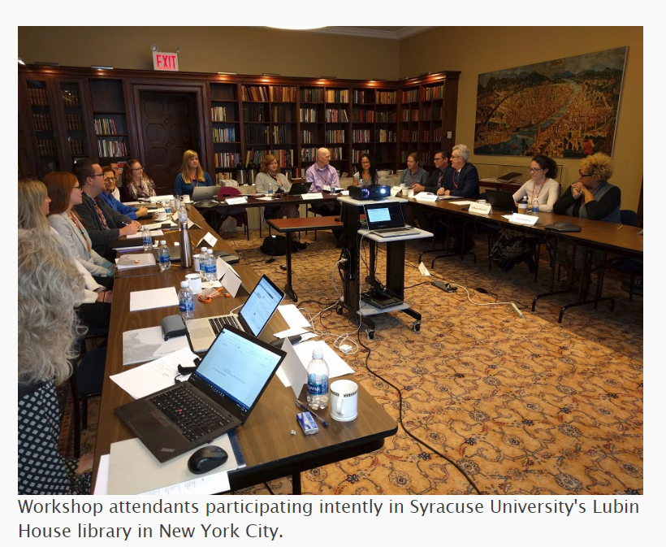
Getting consent right

Slide 16
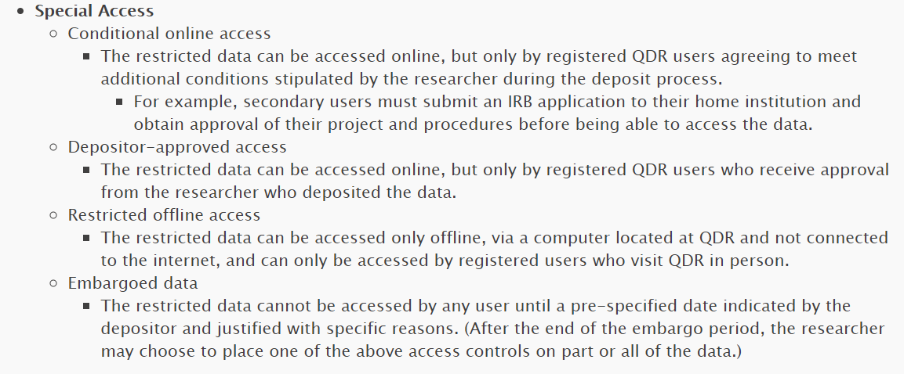
Control access where needed

Slide 17
Epistemic / Ontological: Ways Forward
Find language appropriate for research tradition
Consultative approach to data sharing
Methods suitable for qualitative research tradition

Slide 18
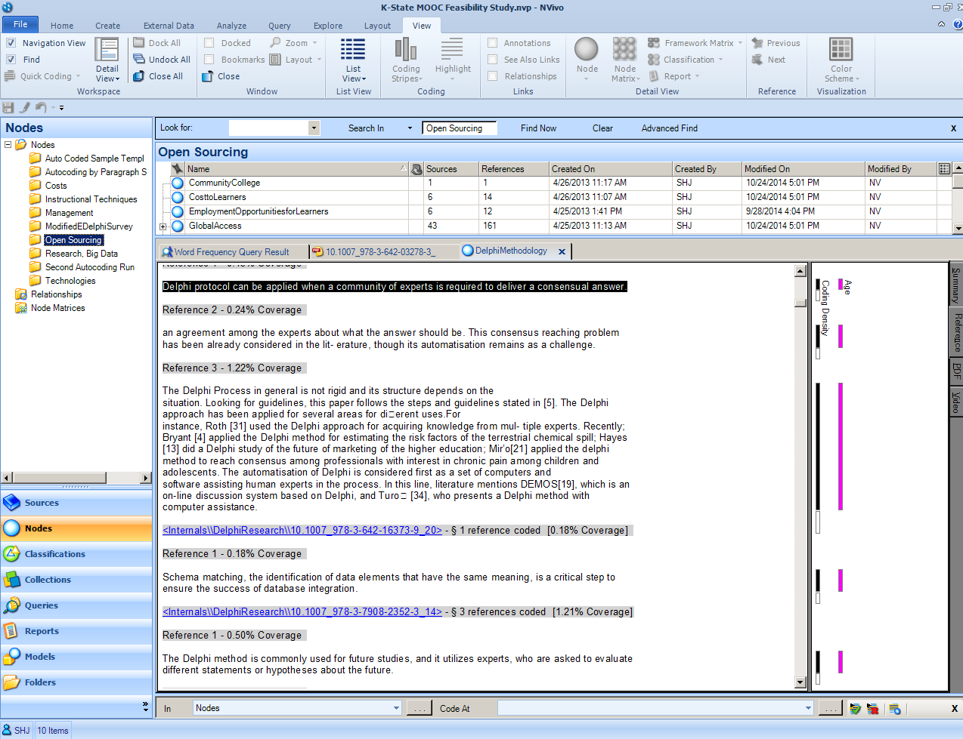
Sharing QDA Data
Meaningful units with file/unit level metadata
Consistent and meaningful file naming
Consider de-identification & human participant concerns Annotate coding decisions (e.g. code for de-identification during analysis)
Include general documentation such as coding guidance
Create copy of project and provide two exports:
  Generally readable (RTF, PDF, Excel, or similar)
  Proprietary (.npv) and as complete as possible
Ongoing work on exchange/archive format
Notes:
Challenge…Does an equivalence table exists between applications?
Let’s consider our three examples
ATLAS.ti, Nvivo, Dedoose

Slide 19
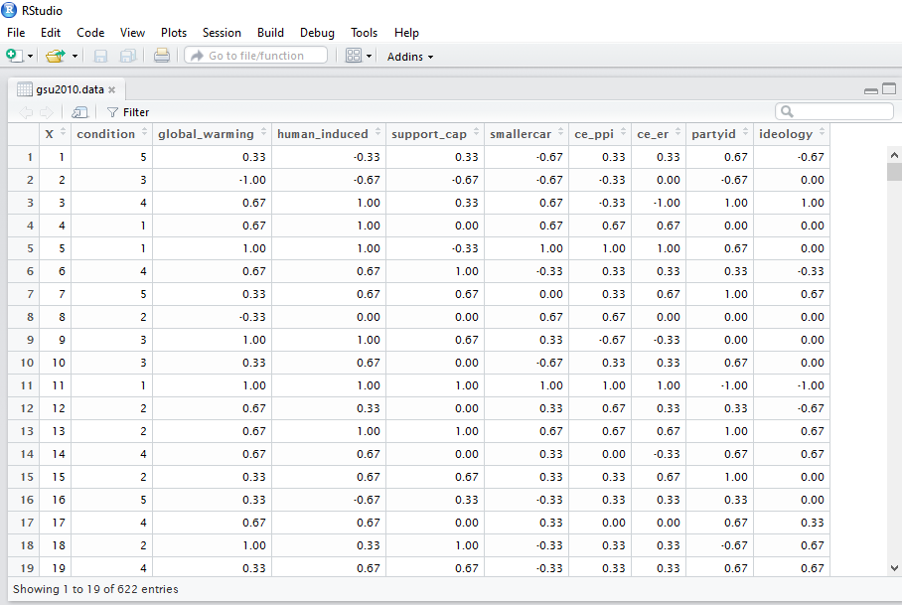


Quantitative Research: Matrix Data
Open Science
Toby Bolsen, Thomas J. Leeper, and Matthew Shapiro. 2014. “Doing What Others Do: Norms, Science, and Collective Action on Global Warming.” American Politics Research 42(1): 65–89.

Slide 20
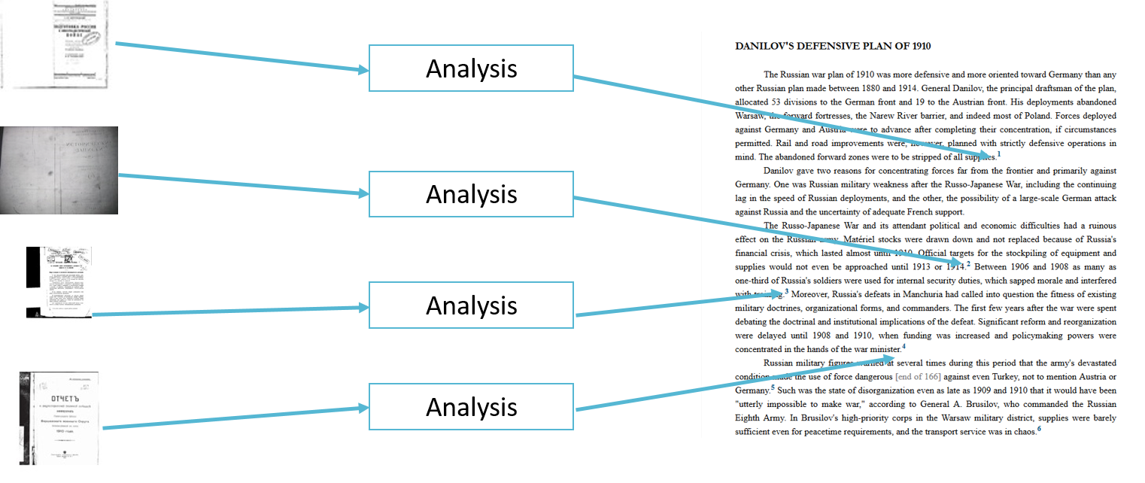
Qualitative Research: Granular Data

Slide 21
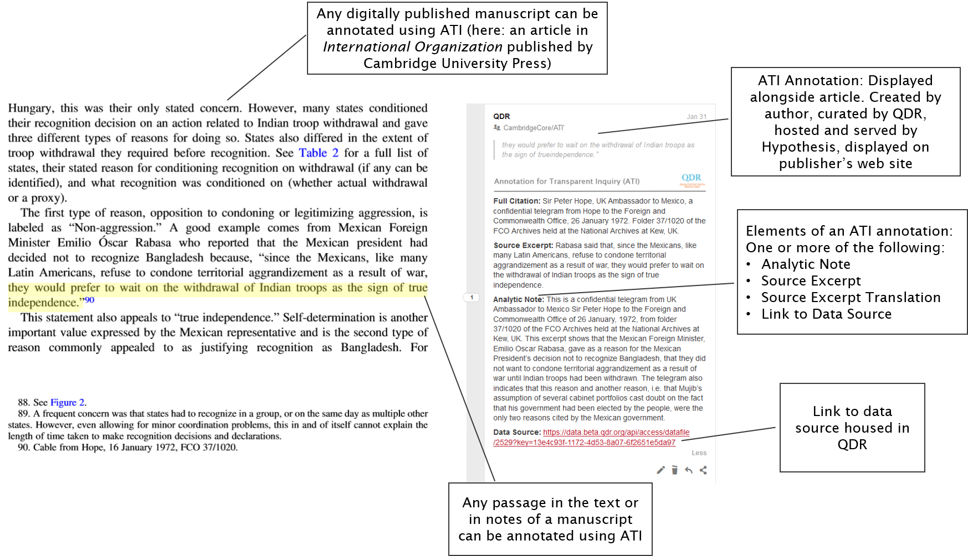
Annotation for Transparent Inquiry (ATI)
See more on qdr.syr.edu/ati
Example: bit.do/qdr-ati-omahoney

Slide 22
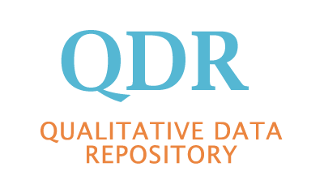

Questions? Comments?
Please stay in touch:
https://qdr.syr.edu
@adam42smith (Sebastian)
@qdrepository (QDR)
Email: skarcher@syr.edu
qdr@syr.edu

