Slide 1
ESIPLab Project Geoweaver: a web-based prototype system for managing compound geospatial workflows of large-scale distributed deep networks
Ziheng Sun, Liping Di
George Mason University
Jan 16 2019
ESIP Winter
Notes:
Some images come from Internet. No responsibility claimed.

Slide 2
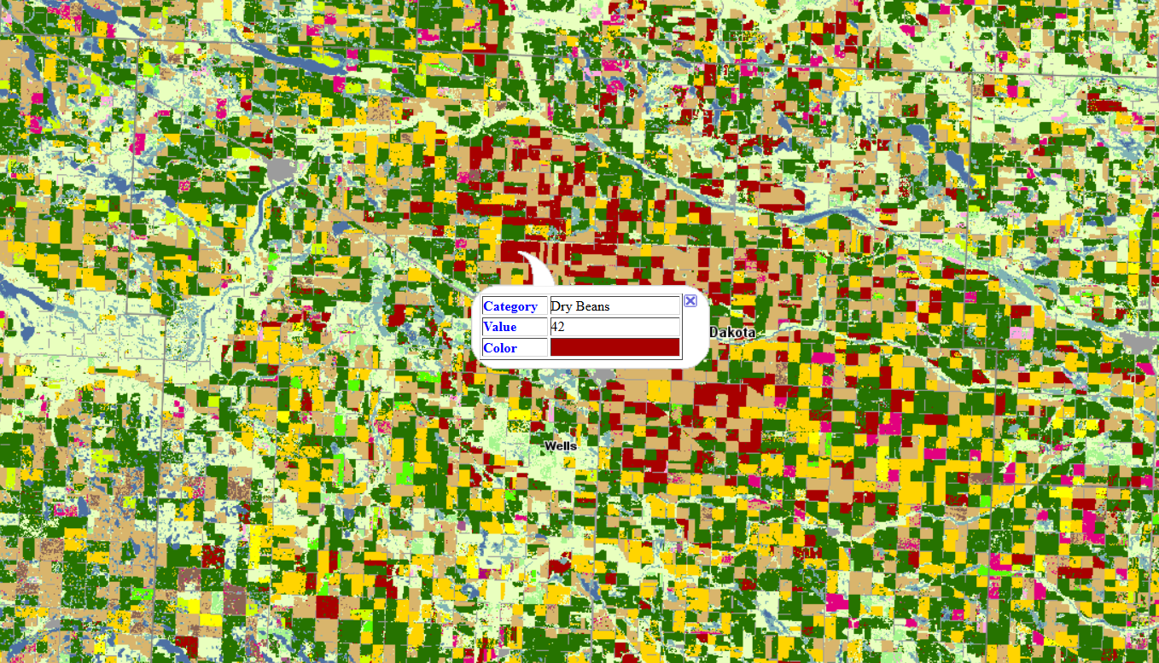
Background: Deep learning Cropland Mapping
Current: One Layer A Year – After Season
Our Goal: Multiple Layers A Year – In Season

Slide 3
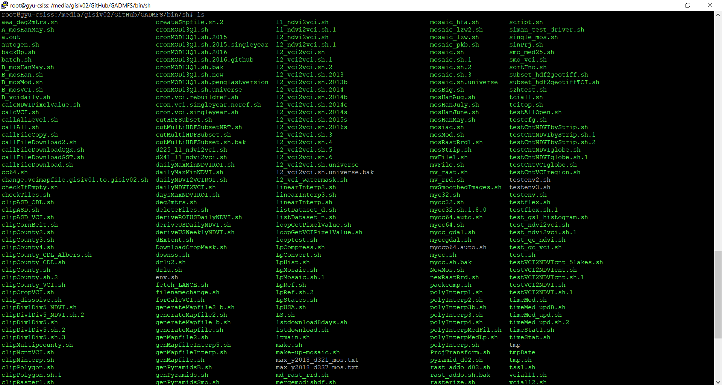
Challenge I
Legacy, chaos, no-annotation, essential data processing steps..
Sadly, this is common evitable situation for many of us.

Slide 4
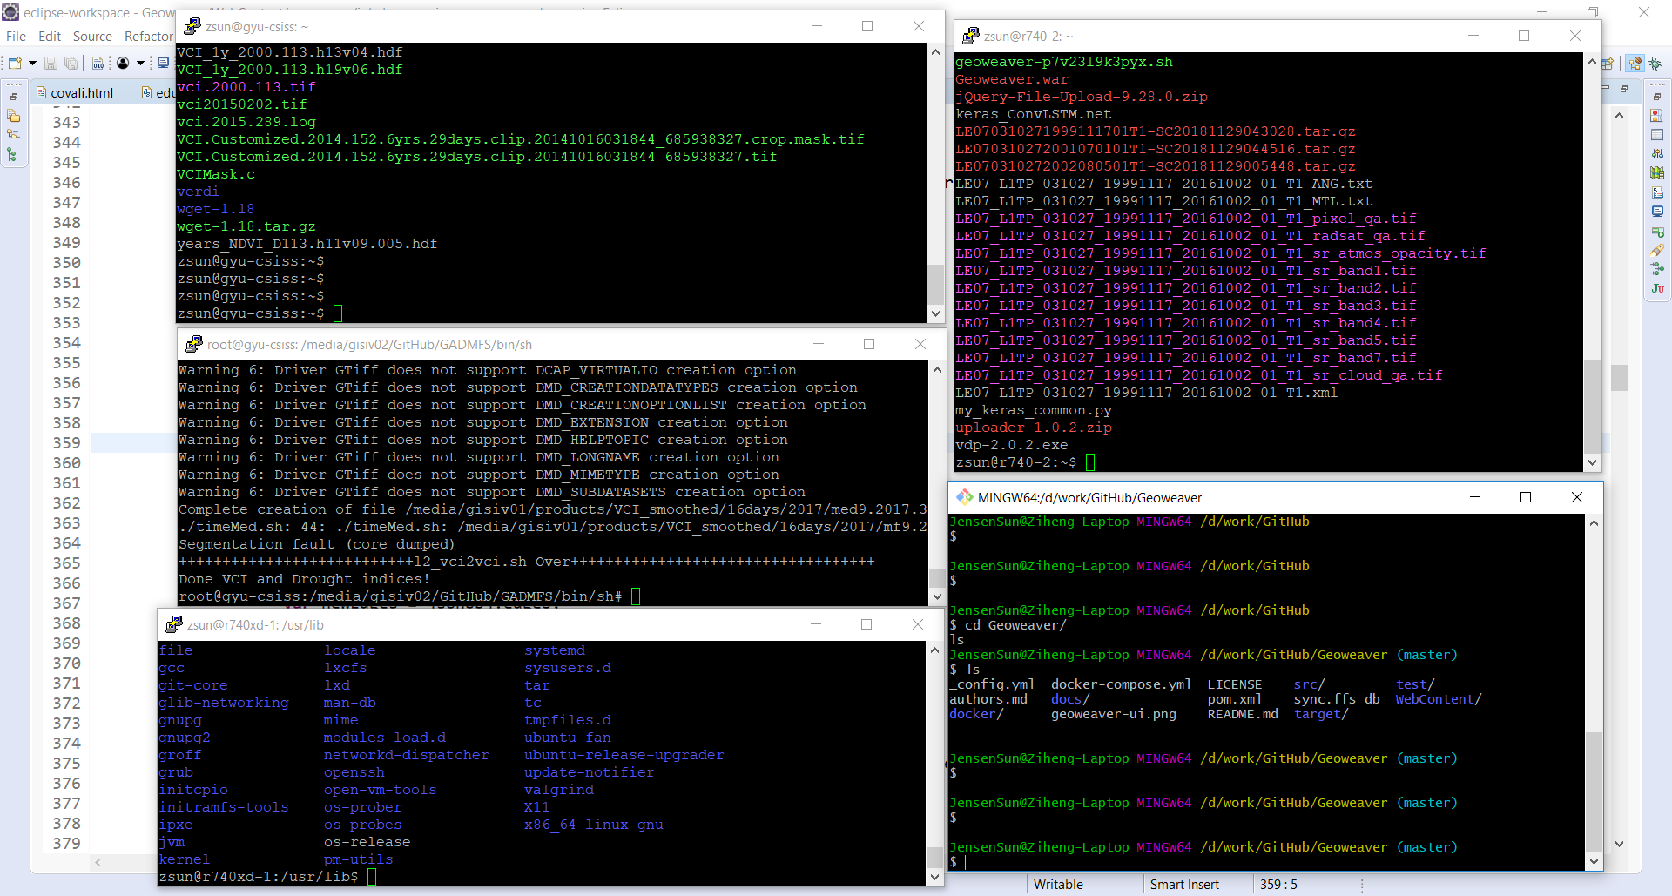
Challenge II
Multiple servers, distributed datasets, limited GPU, large-scale networks

Slide 5
Challenge III
Many fantastic community tools, e.g., PanGeo, Jupyter, are not options in this case.
Reason I: data here is not cloud native!
Reason II: language is not python or R!
Reason III: they are not light-weight tools

Slide 6
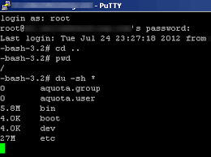
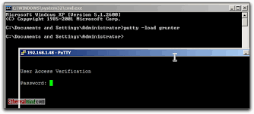
Target Problems
Too many headaches in managing deep learning workflow
Too much time spent on pre- /post- processing
Too much confusion in versions of the results
Too many libraries, software, and incompatible issues
Too many WINDOWS!!
Notes:
Superman Image Credit @Abhishek Singh http://thestrongbuddha.com/eating-moving-fasting/

Slide 7
Geoweaver Solution
Create a tool that can:
Be light-weight and able to be installed anywhere
Compose and save deep learning workflows
Run commands (e.g. bash) on distributed multiple servers
Allow users to upload and download files to/from the servers
Save provenance for follow-up query
Share results among scientists easily
Eliminate the needs for Multi-Thread working mode!!!
n Servers = n Windows
5 Servers = 1 Window
n desktop software
1 web app in browser
n process steps
1 workflow

Slide 8
Implementation
Fantastic cutting-edge libraries
d3.js - BSD 3-Clause
graph-creator - MIT License
bootstrap - MIT License
CodeMirror - MIT License
JQuery Terminal - MIT License
Programming language:
Java
Javascript

Slide 9
Demo

Slide 10
Demo

Slide 11
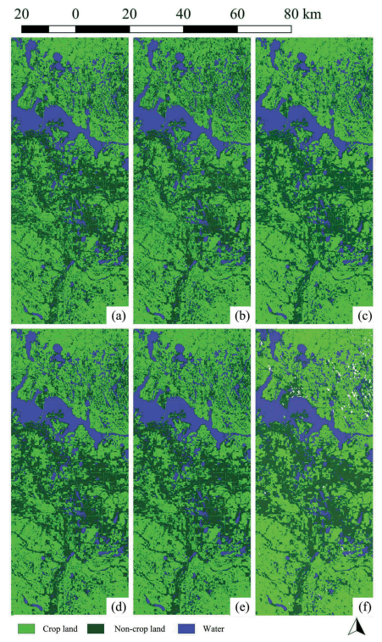
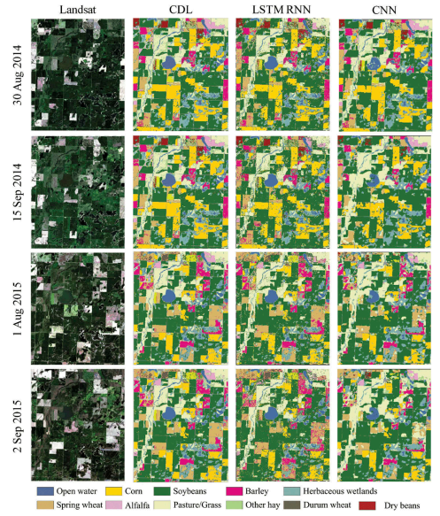
Result
>97%
>88%

Slide 12
Download and Installation
Open source under MIT
Latest Release: v0.6.10
Installation:
Docker,
Tomcat,
VM template (qcow2)
Tested: Windows, Linux (Debian, Ubuntu), Mac
Landing page: https://esipfed.github.io/Geoweaver/

Slide 13
Sustainability Plan
We will keep develop and support this program
short term goal: v1.0.0 (first official stable version)
We will look for funding opportunities
We will use Geoweaver to produce both historical and in-season agricultural land use maps
We will promote Geoweaver in peer research domains and keep finding our users
We will closely collaborate with ESIP community

Slide 14
Thank you!!!
ESIPLab Project
Contact: Ziheng Sun zsun@gmu.edu;
Liping Di ldi@gmu.edu;

