Slide 1
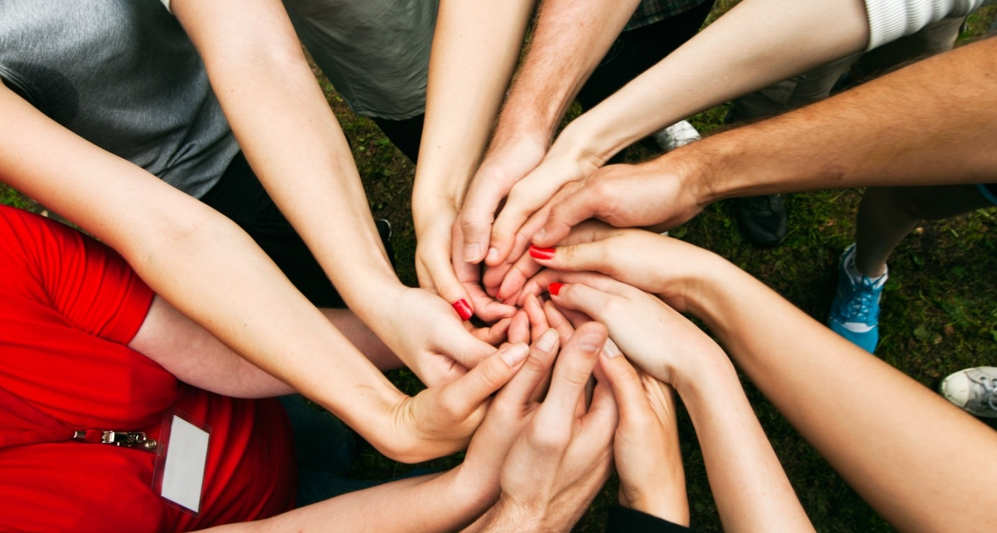
Community Resilience for Earth Science data institutions and place-based communities
Arika Virapongse
Middle Path EcoSolutions & Ronin Institute
av@middlepatheco.com
ESIP winter meeting 2019, Bethesda, MD, January 15, 2019

Slide 2
Session Co-organizers:
Arika Virapongse, Middle Path EcoSolutions & Ronin Institute
Jonathan Blythe, Bureau of Ocean Energy Management
Rupu Gupta, New Knowledge
Ruth Duerr, Ronin Institute

Slide 3
Outline
Background
Goals of the session
Presentations
Break out groups
Report back

Slide 4
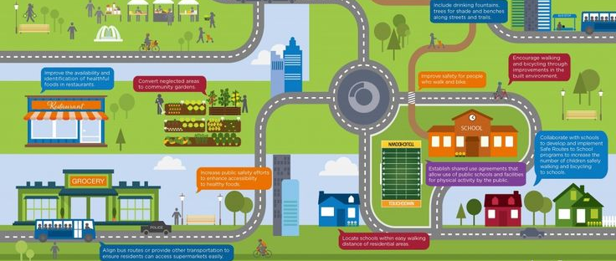
Background
Organizational Resilience: the ability of an organization (businesses, government agencies, institutions) to survive a crisis, thrive in a world of uncertainty, as well as have the foresight and situation awareness to prevent potential crises from emerging, and an ability to turn crises into a source of strategic opportunity (Resilient Organisations)
Place-based community resilience: the capacity of a community’s (physical, geographically-defined entity) to utilize available resources and respond to disturbances by recovering rapidly, adapting to change, and building back better (bouncing forward), and improving their quality of life. (NIST, RAND, PHE)
Notes:
Place-based community resilience has emerged as a national and global priority for its potential to:
improve human livelihoods
address environmental change
prepare communities and households to cope with hazards and disasters
and many other social and environmental benefits

Slide 5
ESIP winter 2018 session
Goals were to seek out:
Linkages between data-driven community resilience and other ESIP work, as well as with the overall Earth Science data community
Specific ways that ESIP can contribute to place-based community resilience
Results:
Help communities access the right tools and information
Document place-based community resilience use cases to help enable the development of useful data and information products, processes, and tools
Develop and share conceptual and technical tools that enable transdisciplinary collaboration and community resilience
Blog: http://esipfed.org/collaboration-updates/the-socioeconomic-value-of-earth-science-data-for-community-resilience
White paper: https://tinyurl.com/y6vl4oev
Peer-reviewed paper: Virapongse, A., R. Duerr, E.C. Metcalf (in press). Knowledge mobilization for community resilience: Perspectives from data, informatics, and information science. Sustainability science.

Slide 6
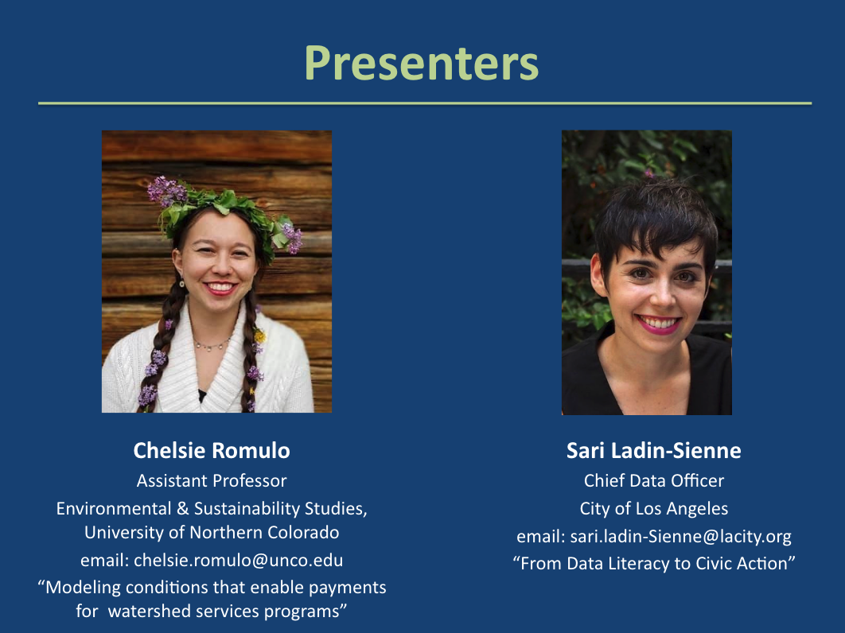
ESIP summer 2018 session
Goals were to:
Partner with other ESIP clusters (semantics)
Present use cases with a solution-seeking approach
Notes:
Partner with other ESIP clusters to host a data-specific community resilience session at an upcoming ESIP meeting, and/or documenting community resilience use cases by obtaining input from agencies or other stakeholders as to how data is being used.
Create an actionable framework within ESIP that aims to connect place-based community end users (e.g., city planners) and data practitioners.
Capture the process of our workflow on an open source site to serve as a template for broader place-based community resilience and data community collaborations.

Slide 7
Community Resilience Cluster
Objective:
To enhance community resilience through culturally meaningful improvements to data accessibility and informatics tools.
Long-term goals:
Expand and improve the connections between data/informatics and community resilience practitioners
Define transdisciplinary knowledge frameworks that help support community resilience
Explore the role of data in advancing equitable community resilience efforts

Slide 8
Goals of the session
Introduce a broad landscape of community resilience from an earth science data perspective
Gain an understanding of the session participants’ interests/experiences with community resilience.

Slide 9
Presentations
Jonathan Blythe, Bureau of Ocean Energy Management (BOEM): “When are data management best practices not sufficient to support agency processes? An institutional perspective on community resilience and the role of data in federal decision making.”
Lauren Showalter, The National Academies of Science, Engineering, and Medicine: “Large scale data management and its role in improving community resilience in the Gulf of Mexico”
Rupu Gupta, New Knowledge: “Balancing data and community needs in collaborative resilience efforts”
Natasha Udu-gama, Thriving Earth Exchange, AGU: “Data Sharing and Management for Community Resilience: Insights from Community Science”
Ranalda Tsosie, University of Montana - “Using Modern Technologies to Inform a Diné Community About Water Quality Issues”

Slide 10
Break out groups
Guiding questions
What are your experiences with community resilience?
What is the community in your context?
What is community resilience in your context?
What are barriers that you come across in your working relationships regarding community resilience?
What role could an Earth Science data community (like ESIP) play in overcoming these challenges?
Short link to notes: goo.gl/kqaX43

Slide 11
Ideas for Next steps
Contact Arika: Av@middlepatheco.com

