Slide 1
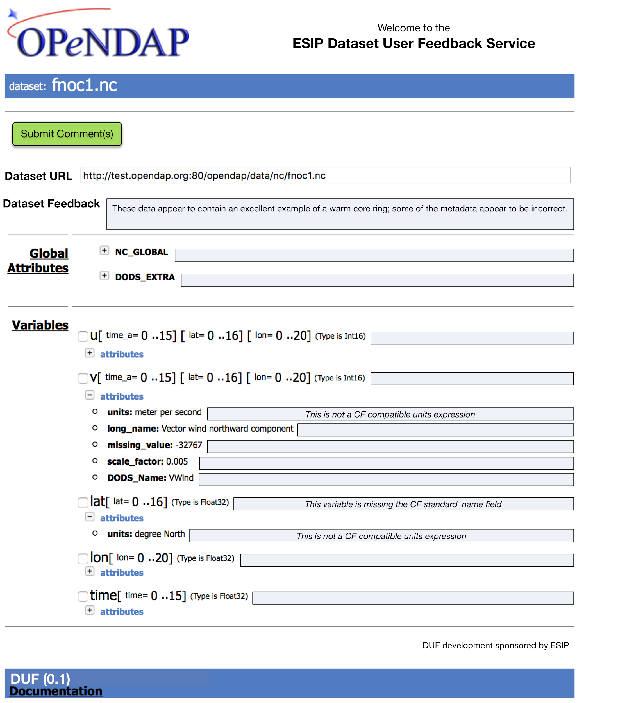
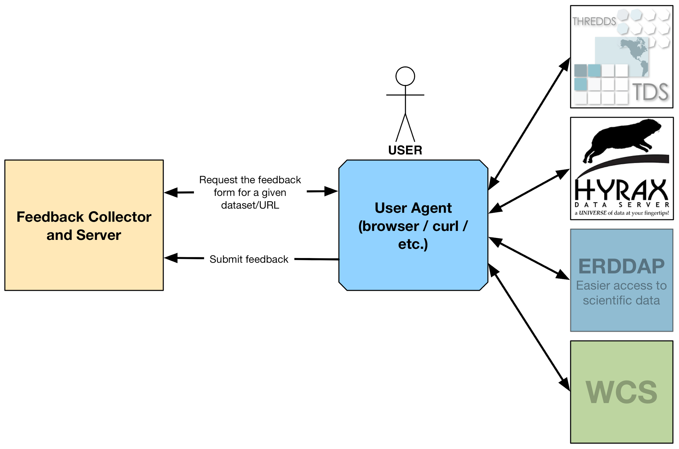
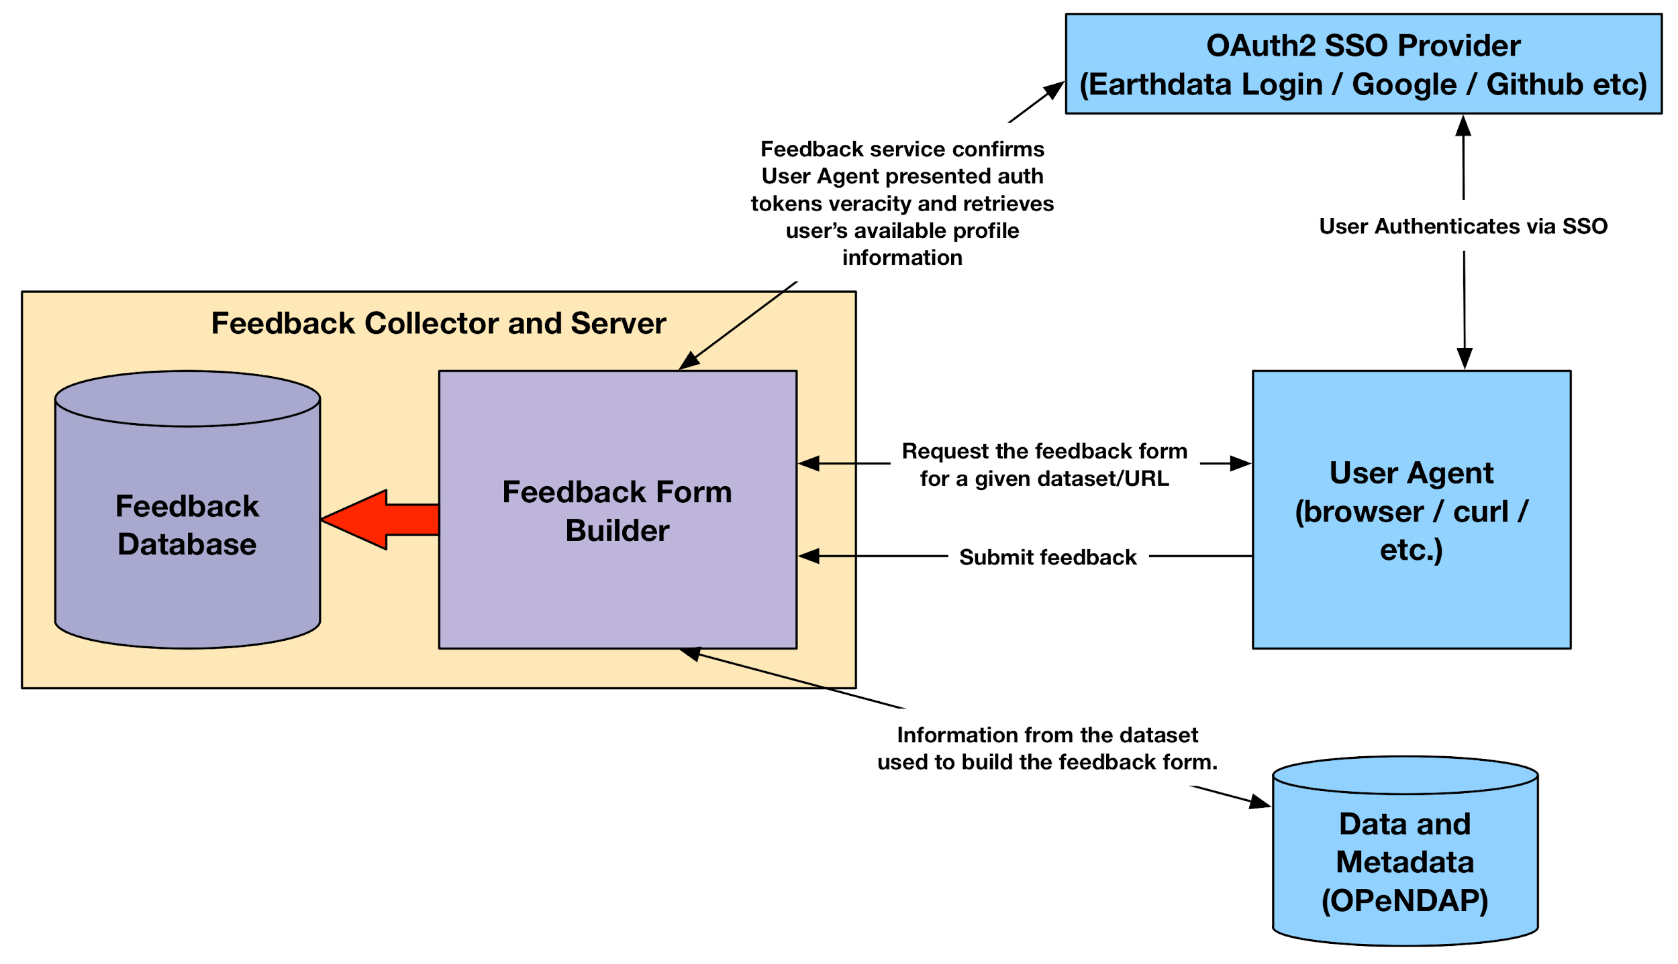
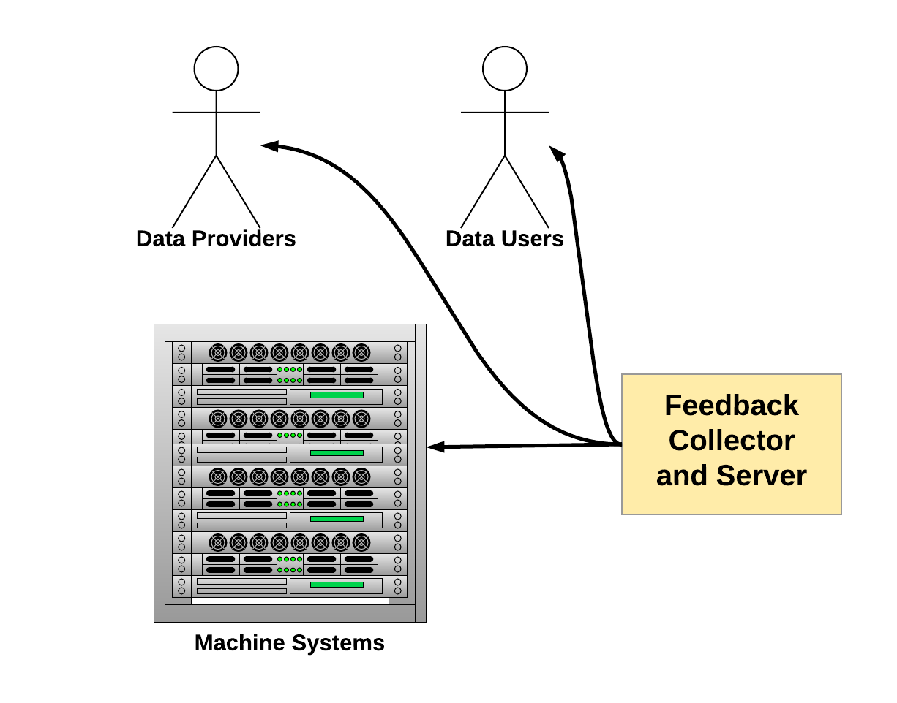
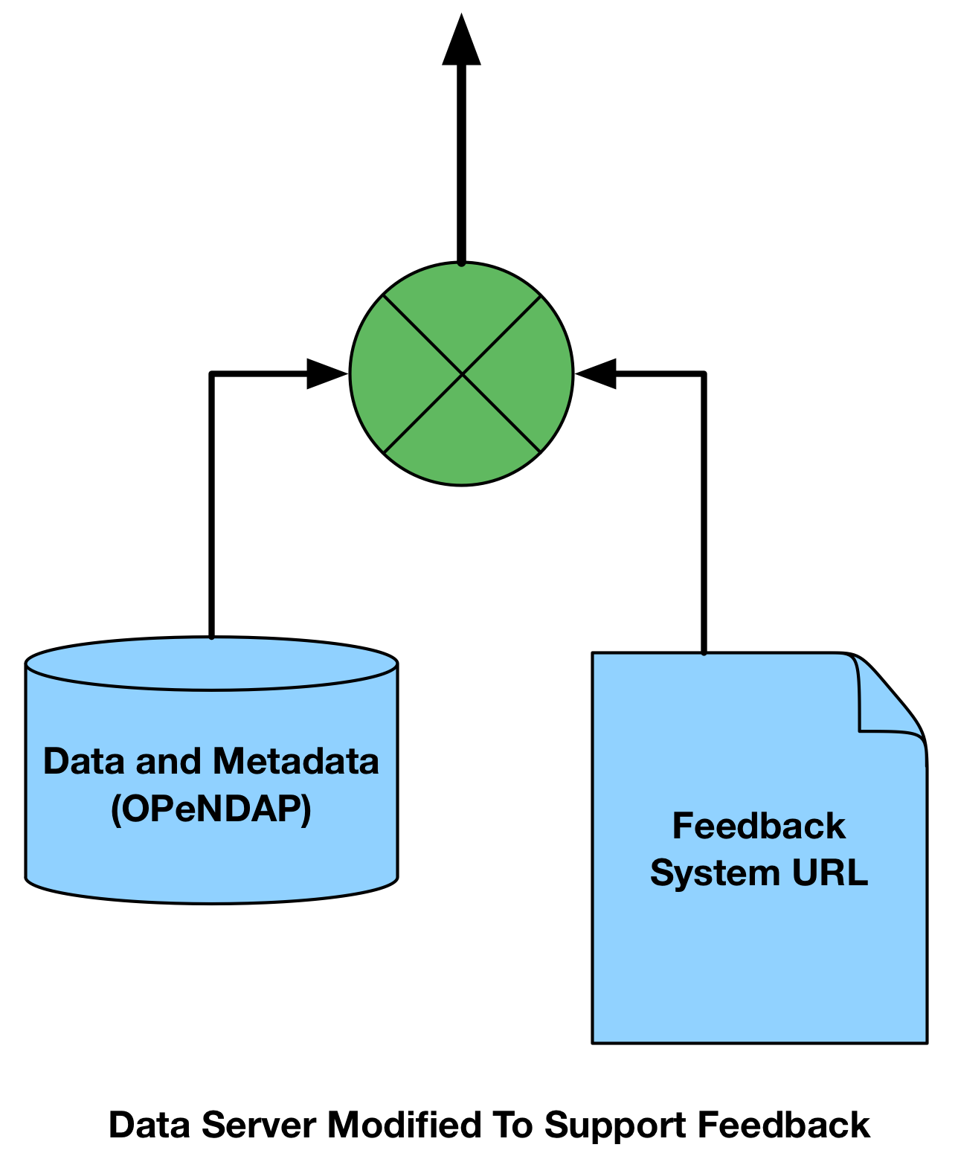
Data Use Feedback
James Gallagher,* Nathan Potter,* Peter Cornillon,* Bob Simons†
*OPeNDAP, †NOAA
The Idea
A Prototype Interface
Future Work
OPeNDAP has developed a proof-of-concept system that people can use to provide feedback on scientific datasets. Although this system is coupled with OPeNDAP compatible data servers, it has been implemented as a stand alone system and is neither dependent on any particular OPeNDAP server nor is the concept dependent on OPeNDAP itself. The system could be extended to work with data accessible using a variety of online access protocols so long as sufficient understandable metadata for the datasets is also available online.
Annotation Standards
A
B
C
The Feedback system can be used by lots of different servers and can accommodate protocols besides OPeNDAP.
The Data User Feedback interface is built using metadata from the dataset.
The form provides a user interface with fields to comment on the entire dataset (A), individual variables (B) and also individual metadata attributes (C). In this way the feedback comments can be unambiguously associated with particular components of the dataset without requiring the user to do that work, allowing them to focus on expressing their thoughts.
The feedback provided by users can be used in many ways.
How you can help: Work with us to continue this development. <support@opendap.org>
We see this project sharing much in common with both the DataONE and W3C annotation projects. Ideally we will find future alignment and synergy between the three.
The Feedback system can be incorporated into a number of user Interfaces.
Web interfaces bundled with data server can provide 'Feedback' buttons;
Users can access the Feedback URL using Python, Matlab, ...; and
Standalone software can be modified to work with the system.
Data servers are modified to include the URL to the Feedback system.
ESIP Winter 2019 - Bethesda, MD
This project was started using a Funding Friday grant from ESIP.

