Slide 1
Global Change Master Directory (GCMD) Keyword Management Process and Lifecycle
ESIP Winter Meeting 2019
Tyler Stevens
EED-2 Senior Discipline Engineer
Tyler.B.Stevens@nasa.gov
This work was supported by NASA/GSFC under Raytheon Co. contract number NNG15HZ39C.
This document does not contain technology or Technical Data controlled under either the U.S. International Traffic in Arms Regulations or the U.S. Export Administration Regulations.

Slide 2
Outline
What Are the GCMD Keywords?
Transparency in Process and Change
GCMD Keywords in Action
Learn More
Questions/Roundtable Discussion

Slide 3
I. What Are the GCMD Keywords?

Slide 4
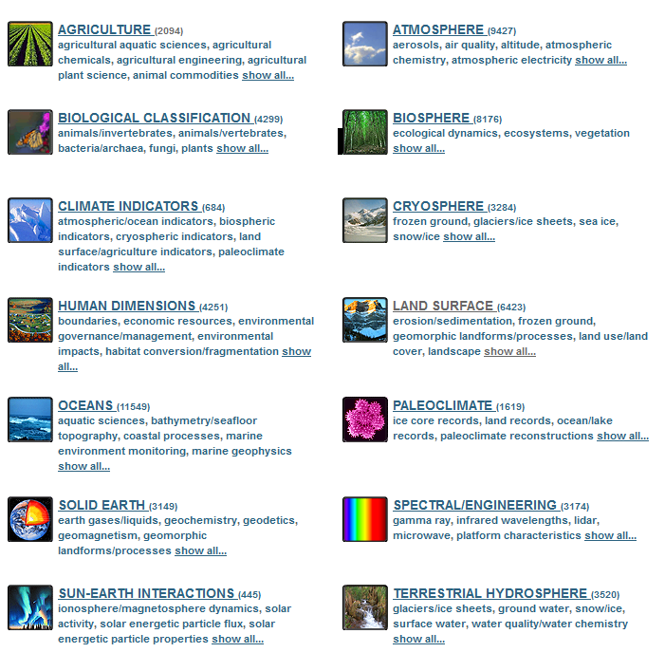
GCMD Keywords
GCMD Earth Science Keywords
A hierarchical set of controlled vocabulary covering Earth science disciplines that have been evolving for over 25 years.
Helps describe Earth science data and services in a consistent and comprehensive manner.
Allows for the precise searching of collection metadata and subsequent retrieval of data.
Follows a governance process for keyword changes and additions.

Slide 5
Keyword Examples

Slide 6
II. Transparency in Process and Change

Slide 7
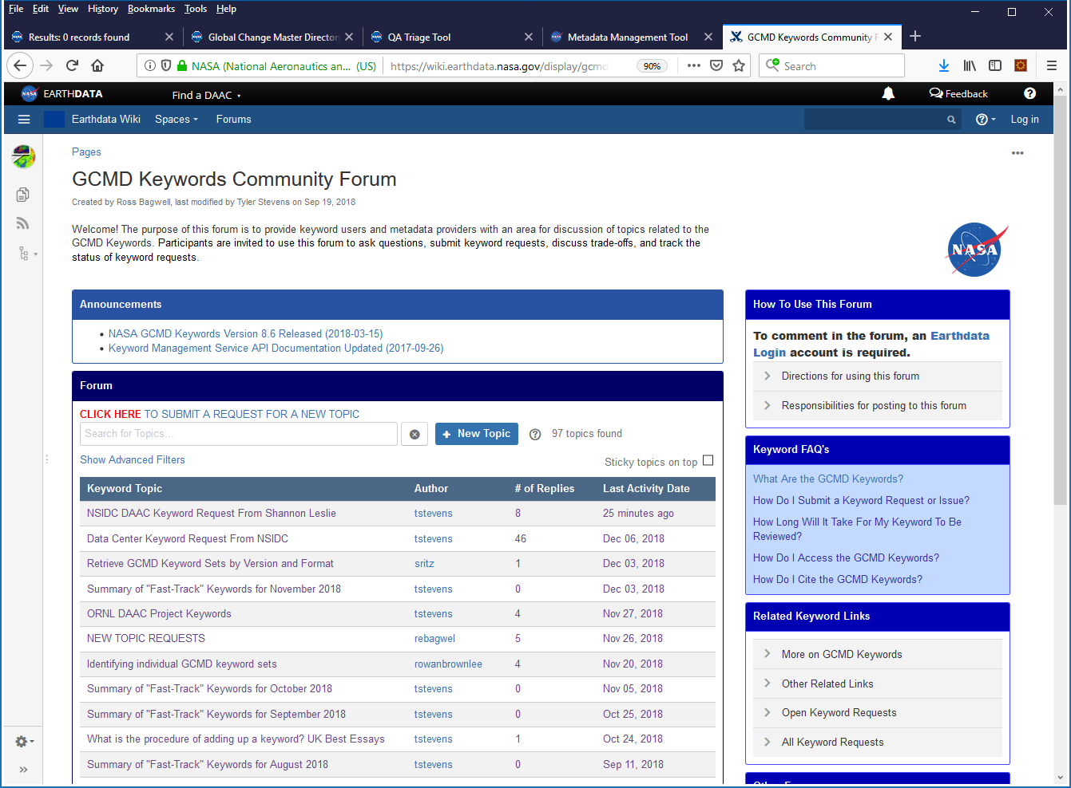
GCMD Keyword Community Forum
The GCMD Keywords Community Forum provides keyword users and metadata providers with a transparent area for discussion of keyword topics. Participants are invited to use the forum to ask questions, submit keyword requests, discuss trade-offs, and track the status of keyword requests. See https://earthdata.nasa.gov/gcmd-forum

Slide 8
Who Makes Changes
CMR System
GCMD Team: Keyword Changes
Metadata Changes (IDN DIF)
ARC Team: Recommends Metadata Changes
CMR Team: Metadata Model (UMM) Changes
Community:
DAACs
IDN Providers
Teams:
Global Change Master Directory (GCMD)
Analysis and Review of CMR (ARC)
Common Metadata Repository (CMR)
International Directory Network (IDN)

Slide 9
Contributing Keyword Changes
Keyword Forum
Email (support@earthdata.nasa.gov)
Slack #curation Channel

Slide 10
Rationale for Keyword Changes
Fix Errors
User Requests
Keyword Backlog
Align With Common Terminology
Record Examination
Keyword Gap Analysis
User Search Behavior
Notes:
* Fix Errors: Errors in keywords as identified by users and/or science coordinators (ex: incorrect name for a keyword).
* User Requests: Request from users and metadata providers for keyword additions, deletions, and/or modifications.
* Keyword Backlog: Historical changes that were in-progress and then put on-hold in order to complete CMR integration.
* Align w/ Common Terminology: Keyword is consistent with current literature or publications (ex: AMS glossary of meteorology or project mission page).
* Align w/ ECHO/ISO Keywords: Keyword is consistent as to what is described in ECHO and ISO standards (ex: ISO location keywords).
* Record Examination: 'Uncontrolled' keyword in detailed variable, ancillary keyword, or other field in metadata record is considered a candidate to be controlled.
* Keyword Gap Analysis: Keyword is considered to be a candidate for inclusion based on identification of common term missing from the controlled keyword list.
* User Search Behavior: Keyword is considered to be a candidate for inclusion based on keyword search usage and discovery in a search interface.

Slide 11
Keyword Review Types
Fast Track
  Impact is none to minimal
  Small number of changes
  Shorter turn around time (< a week)
  Example: “I would like to add a new Project keyword
  HMA > High Mountain Asia”.
Full Review
  Impact is major
  Large number of changes
  Longer turn around time (yearly)
  Example: “I would like to add and revise all keywords under Terrestrial Hydrosphere > Water Quality/Water Chemistry”.

Slide 12
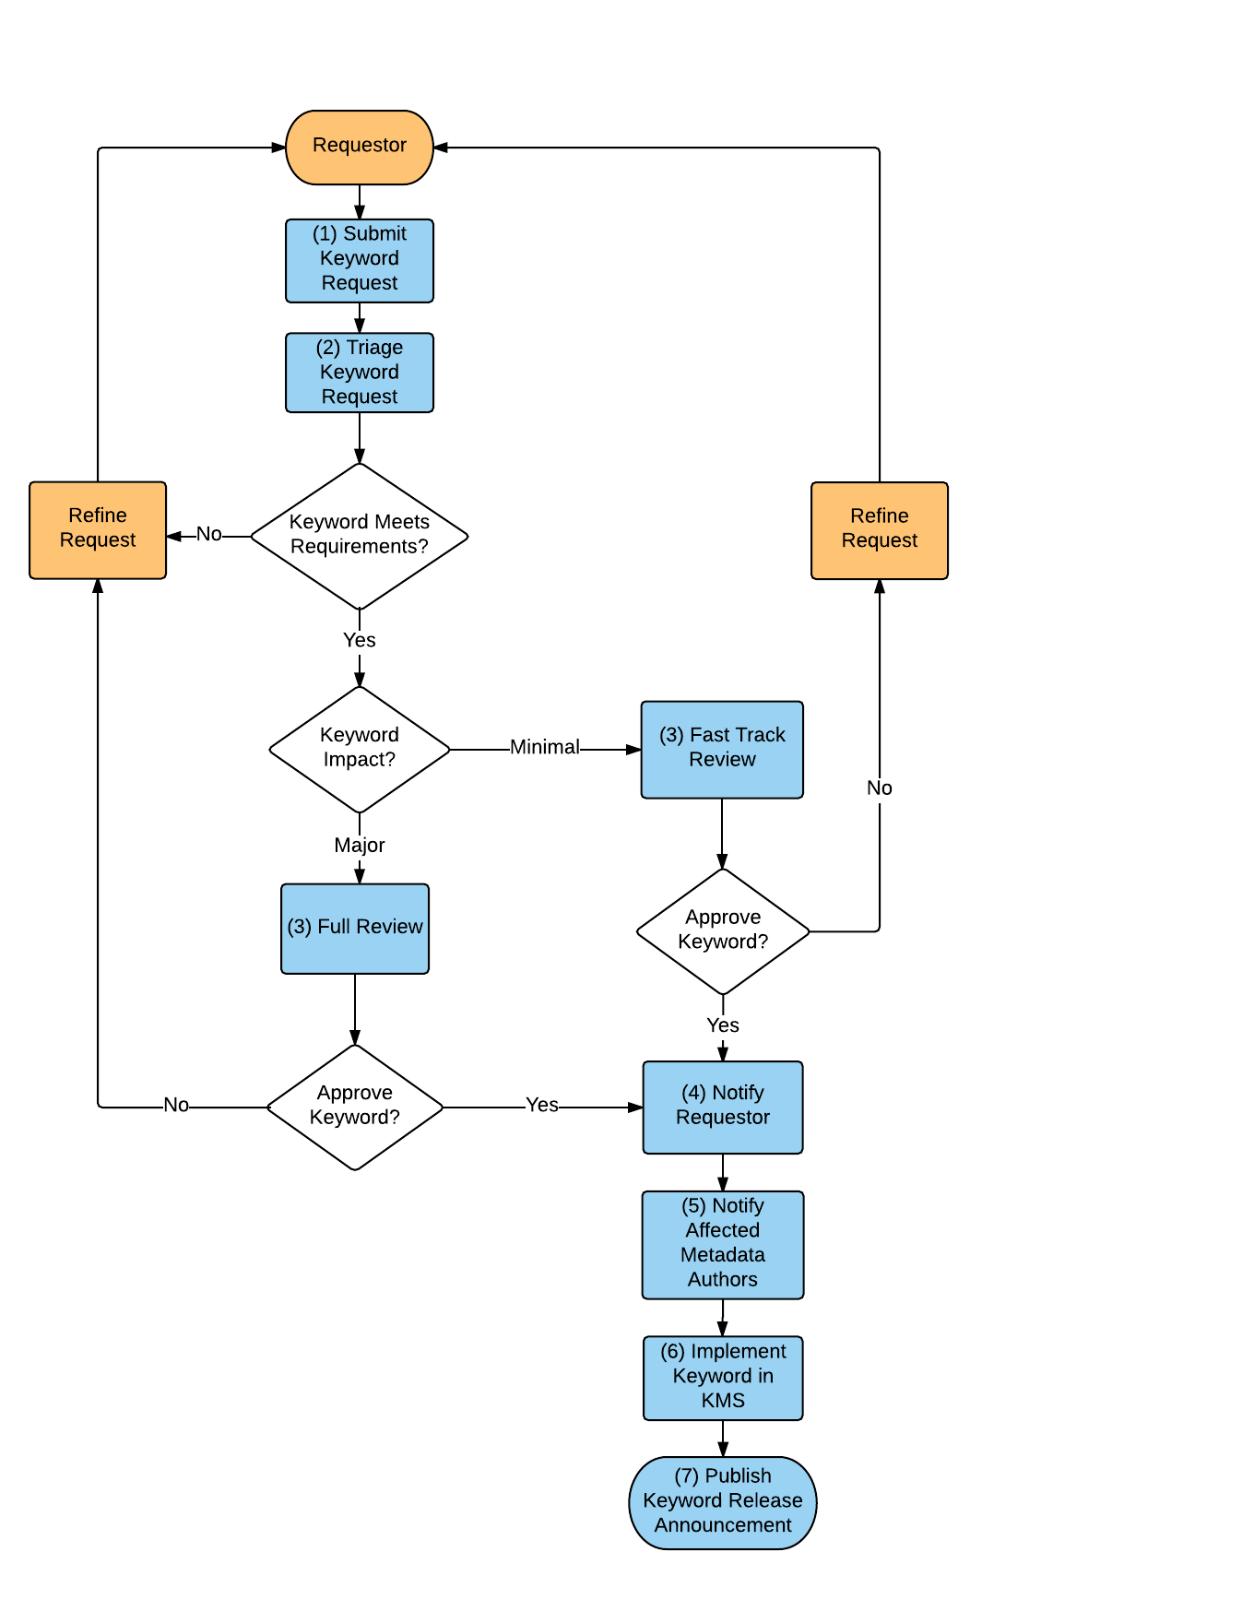
Keyword Review Process (1 of 2)
Continues On
Next Slide

Slide 13
Keyword Review Process (2 of 2)
]

Slide 14
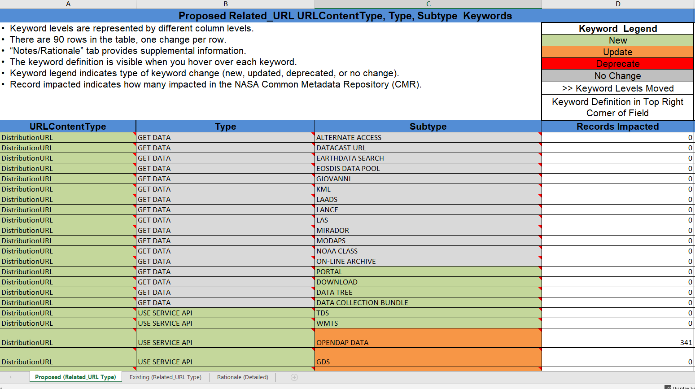
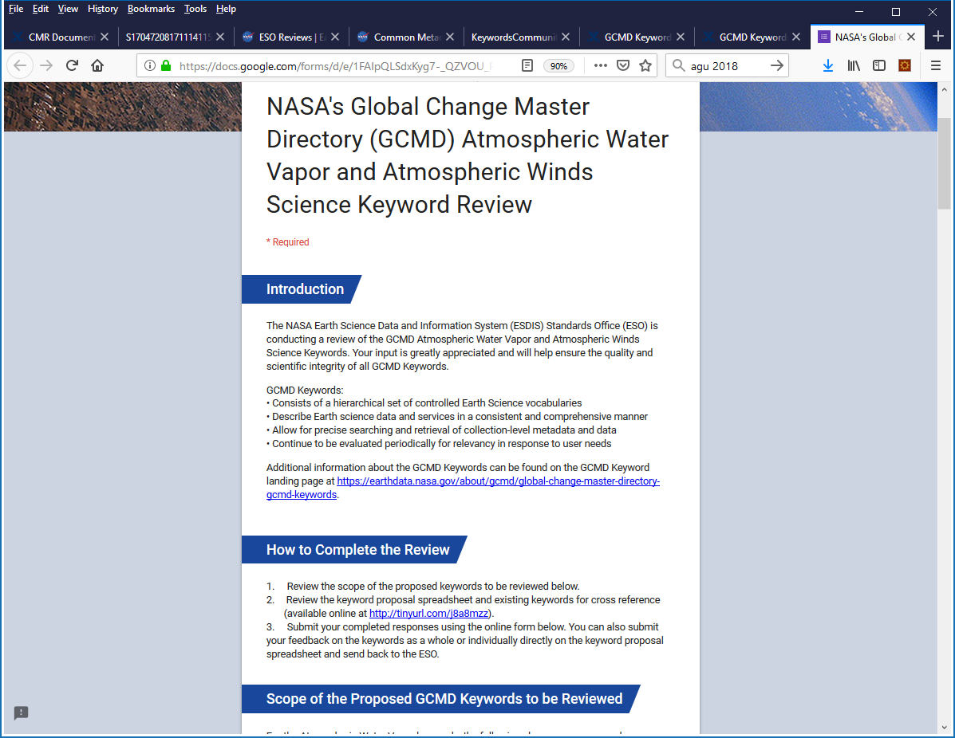
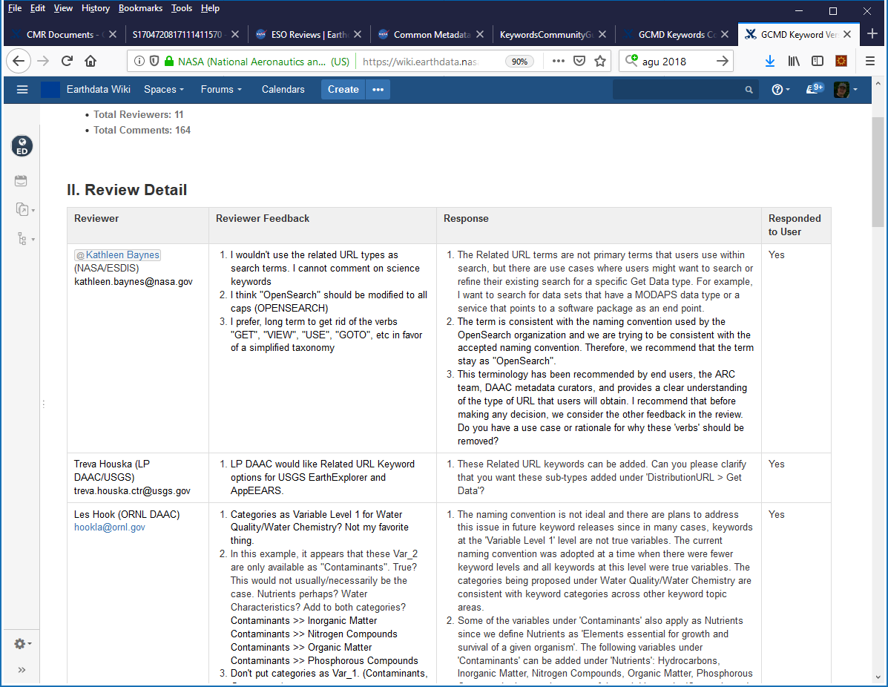
Keyword Review Documents
Keyword Review Spreadsheet:
Conveys keyword changes to reviewers
Keyword Review Survey:
Reviewers rate the keyword changes
Keyword Review Feedback: Conveys all feedback received from keyword reviewers

Slide 15

How You Can Participate in Keyword Change Reviews
The GCMD Keyword review is facilitated by the NASA ESDIS Standards Office (ESO).
Keyword reviewers will review proposed keywords and complete a online questionnaire to provide their feedback.
If you are interested in becoming a keyword reviewer, please contact the ESO at eso-staff@lists.nasa.gov.
We need your science expertise!!

Slide 16
III. GCMD Keywords In Action

Slide 17








Authoritative Vocabulary, Taxonomy, or Thesaurus
Organizations that have adopted the GCMD keywords use them to describe their Earth science data in a consistent and comprehensive manner.

Slide 18
Foundation for Building Ontologies in SWEET and Other Ontologies
SWEET
GCMD Science Keywords (Earth Realm)
Data Realm
Space Realm
Other Topics (Realms)
Ontologies, including the Semantic Web for Earth and Environmental Terminology (SWEET) and Sea Ice, are using the GCMD keywords as a “low-level” source of keywords (knowledge base) for building broader domain specific ontologies.

Slide 19
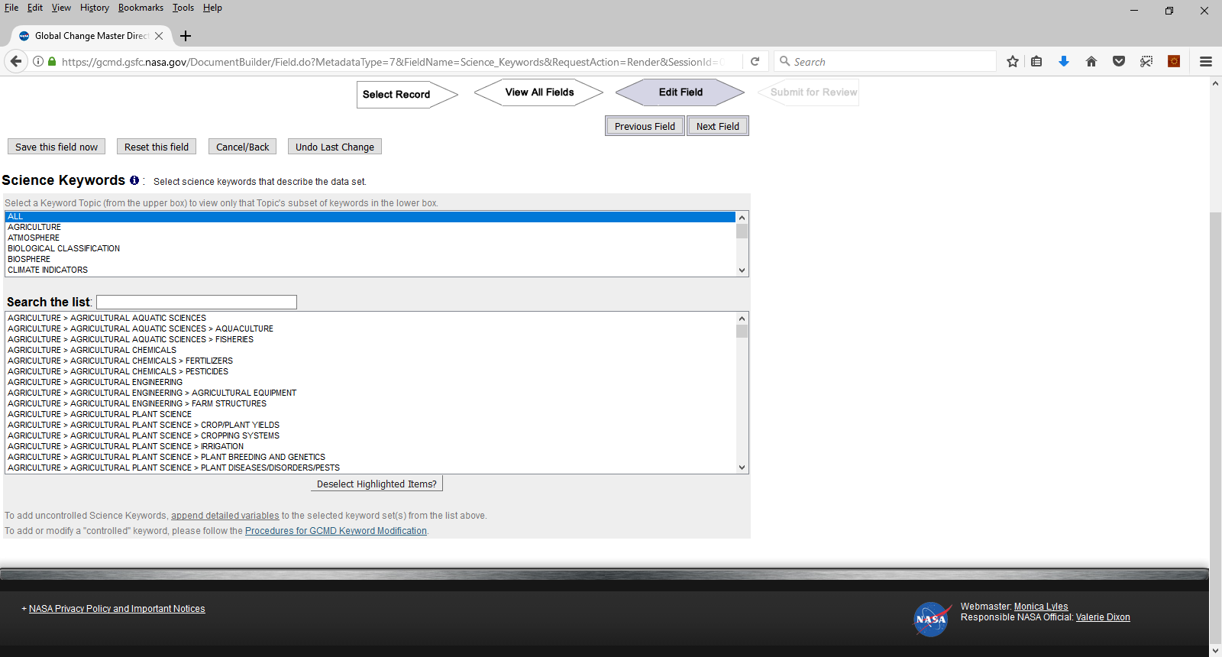
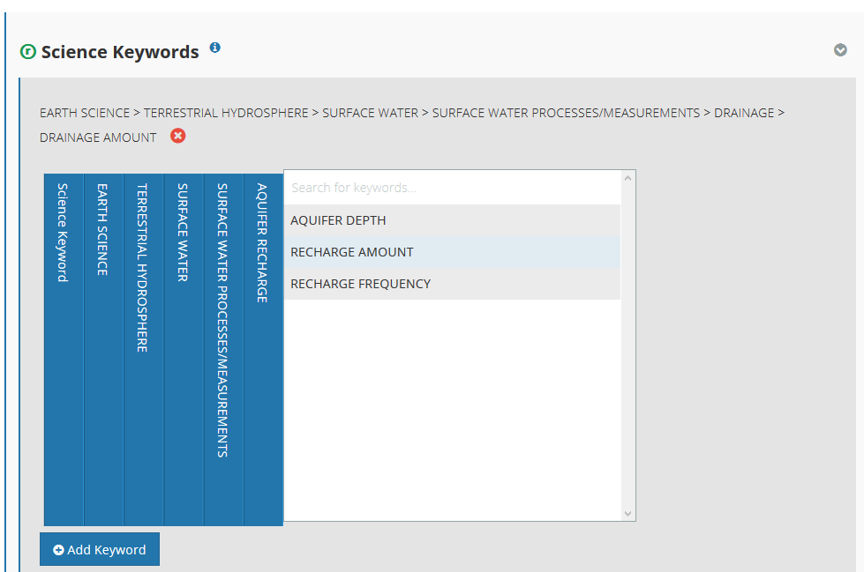
Integration Within Metadata Curation Tools
CMR metadata providers are required to use the GCMD keywords to describe their data.
CMR metadata team reviews science keywords in records for consistency and makes recommendations as needed for additional keywords to better describe providers’ data.
docBUILDER
Metadata Management Tool
Keyword Pick-List From GCMD Keyword Management System (KMS)

Slide 20
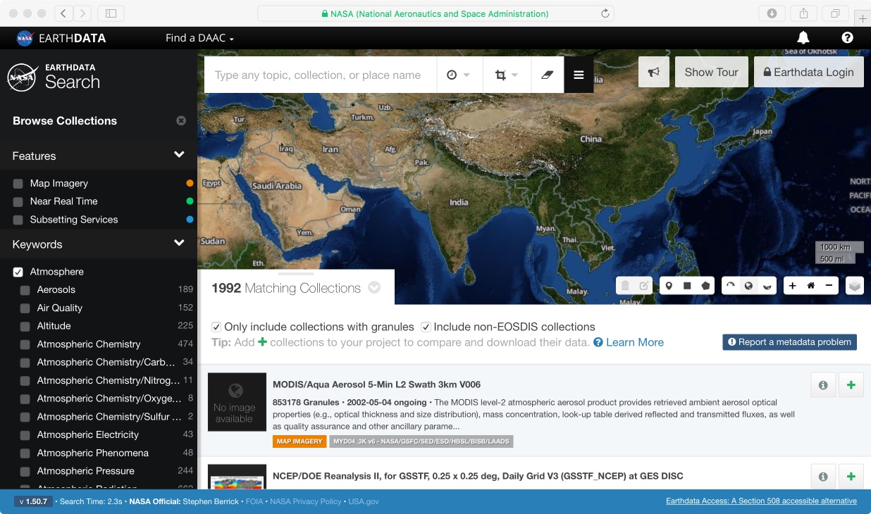
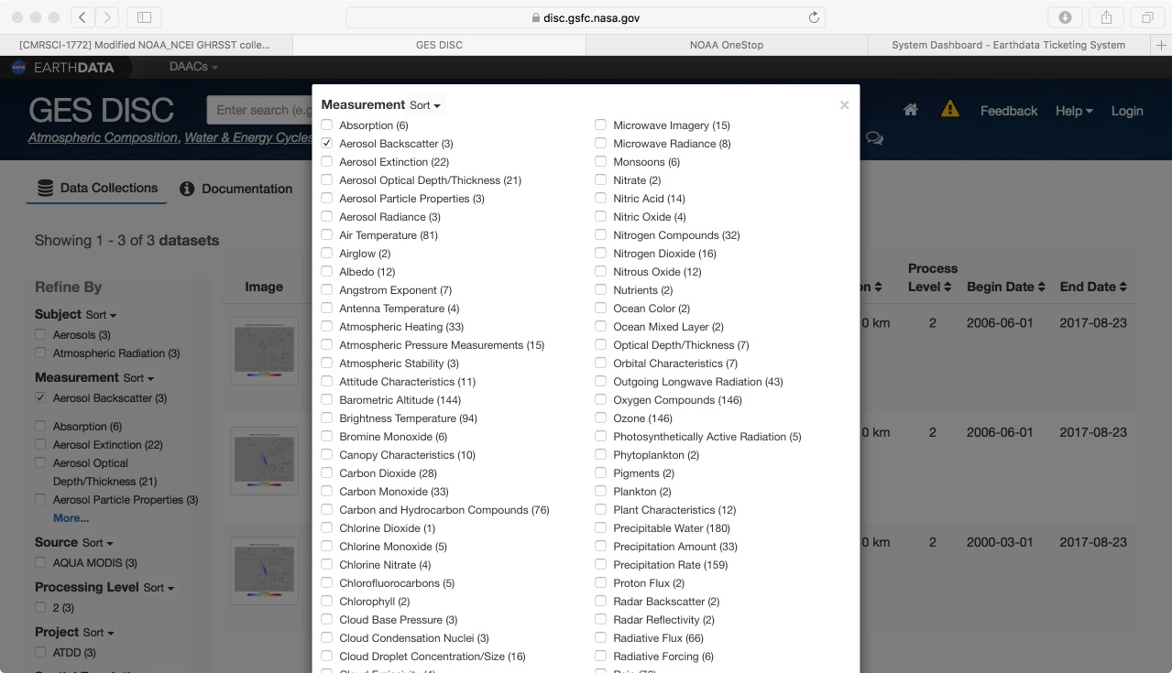
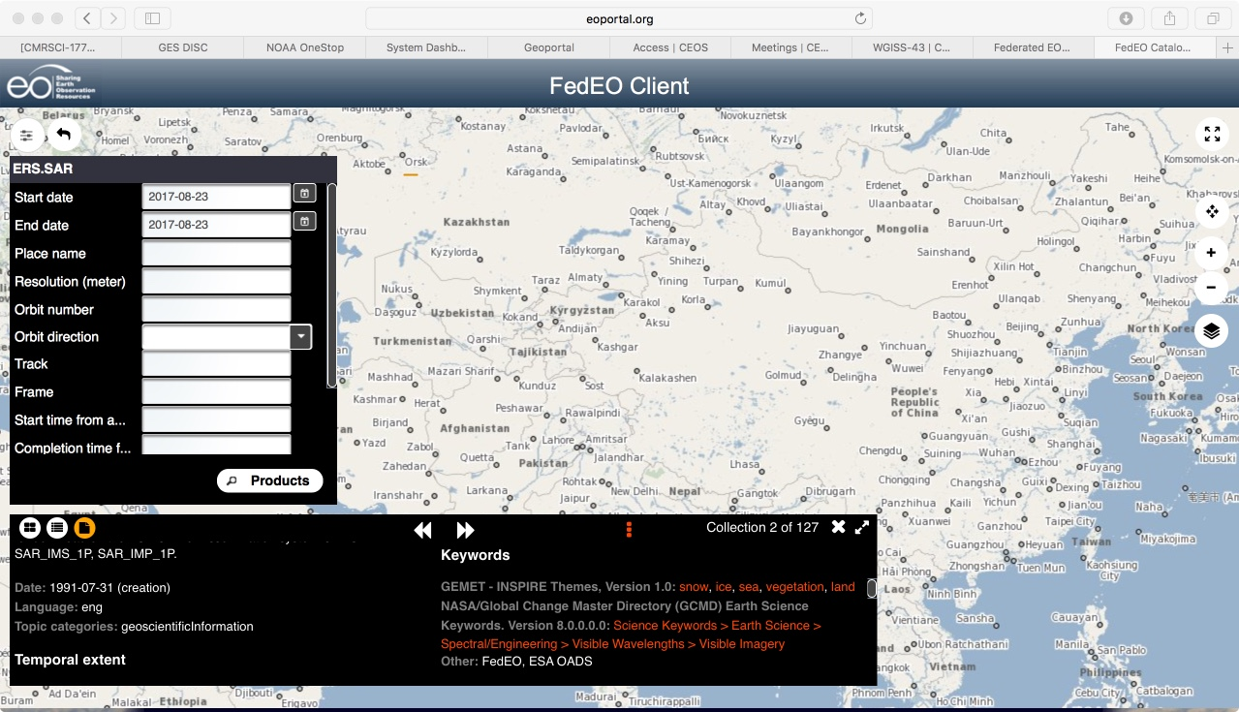
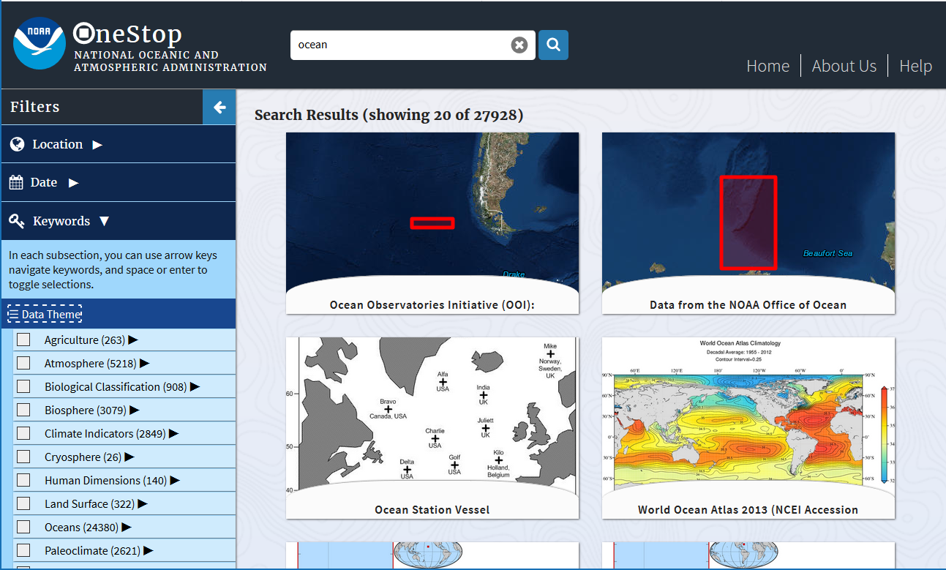
Integration Within Metadata Catalogues for Search and Discovery
NASA Earthdata
NASA GES DISC
FEDEO
NOAA One Stop

Slide 21
IV. Learn More

Slide 22
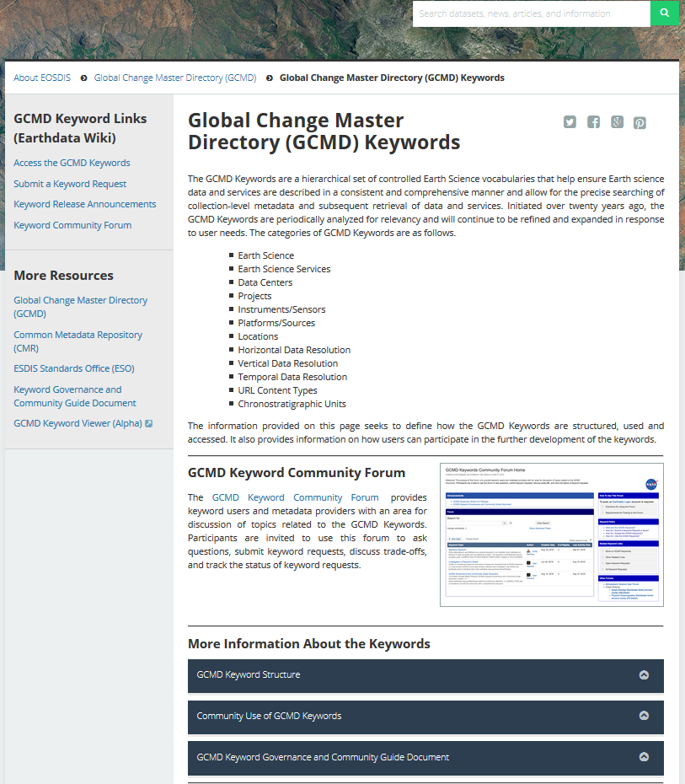
Keyword Landing Page
Learn More about the Keywords
Access the GCMD Keywords
Submit a Keyword Request
See Keyword Release Announcements
Review the Keyword Governance Document
https://earthdata.nasa.gov/about/gcmd/global-change-master-directory-gcmd-keywords

Slide 23
Utilizing the KMS API
The Keyword Management Service (KMS) is a RESTful web service for maintaining and accessing the keywords.
  Retrieve the keywords as SKOS Concepts (RDF, JSON, OWL), XML, and CSV
  Retrieve previous versions
  Retrieve in different case (Native, Title Case, Upper Case, Lower Case)
  Search by keyword pattern (i.e. Search by ‘Terra’)
Help Documentation
  https://wiki.earthdata.nasa.gov/x/gwxNBQ

Slide 24
V. Questions/Roundtable Discussion

Slide 25
Questions for Audience Interaction Activity
Document Questions At
  https://tinyurl.com/y9w7suym

Slide 26













This work was supported by NASA/GSFC under Raytheon Co. contract number NNG15HZ39C.
in partnership with

Slide 27
Backup

Slide 28
Evolution of Keyword Review Process
Keyword Governance Document Published
(1990-2010)
Internal review and public reviews with IDN representatives.
(2010-2015)
Internal review and informal public reviews with SMEs.
(2015-Present) Formal reviews by SMEs in coordination with the NASA ESDIS Standards Office.
Increased Transparency and Improved Process For a Curated Keyword List

Slide 29
Tracking All Changes Across CMR
(1) Change Proposed
(2) Change Tracked and Documented
(3) Change Impact Assessment
(4) Change Community Reviewed
(6) Change Implemented
(5) Changed Approved
Continuous Improvement and Evolution
Notes:
The CMR Life Cycle Process begins with proposed recommendations for changes, additions, deprecations, or deletions to any element of the CMR. Once submitted, change requests are entered into a tracking system where they are evaluated in terms of benefits and cost, and impact assessments are documented. The proposed changes that are determined to be beneficial to the user community or improve the CMR system are then implemented and the approval status of the request is communicated to the requestor and all stakeholders. In cases of significant, nonroutine changes where an ESO review is required, request and approval status will be posted on the ESO-CMR Reviews webpage
https://earthdata.nasa.gov/about/esdis-proiect(esdis-standards-office-eso/eso-
cmr-reviews) and is also likely to be documented on the Wiki.

