Slide 1
Metadata 2020@ESIP
Ted Habermann
2019

Slide 2
Defining the issues

Slide 3
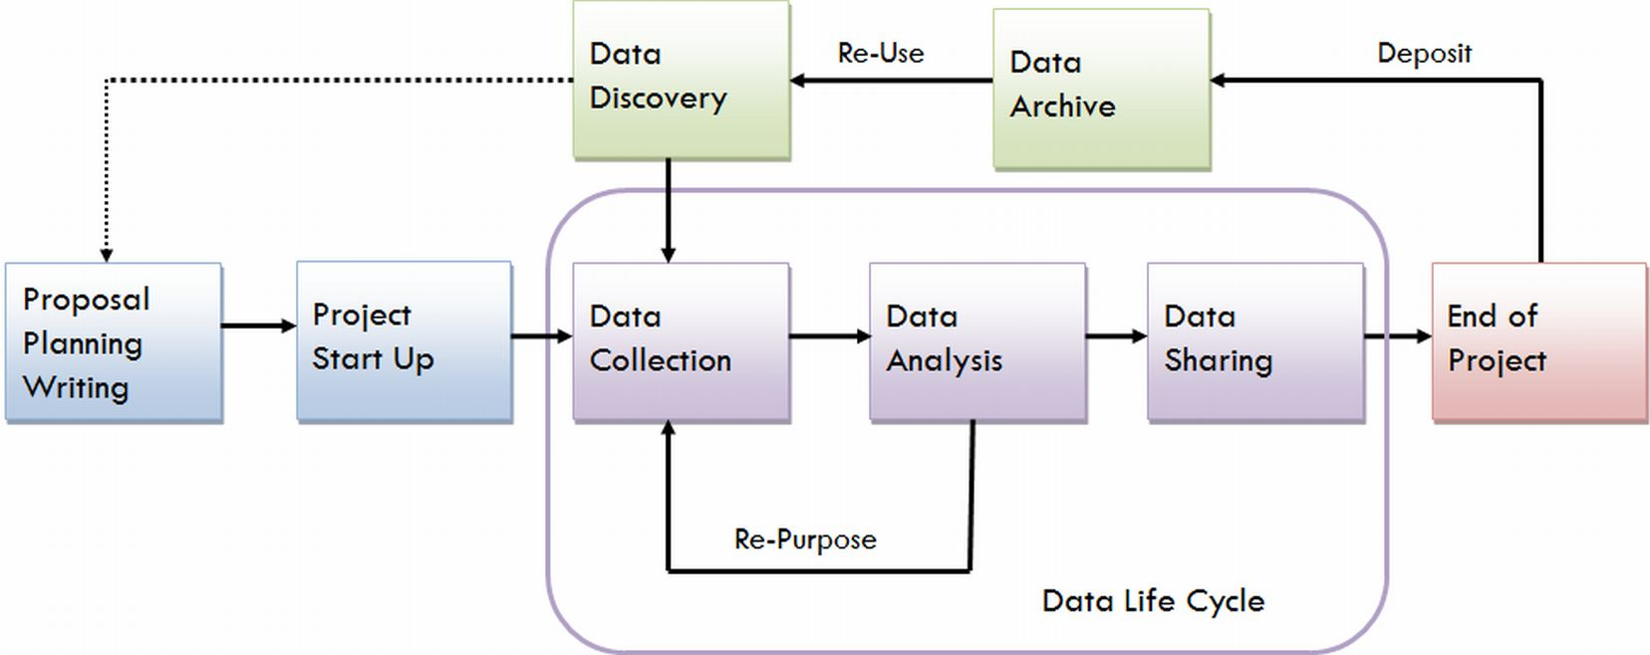
Science Life Cycle
M e t a d a t a
& Publication
& Publication
University of Virginia, Steps in the Data Life Cycle, http://data.library.virginia.edu/data-management/lifecycle/, Retrieved 2018-01-16.

Slide 4
Communities have similar problems and similar solutions available if they collaborate
Efforts have been made to address challenges within each community, but few efforts have been truly cross-community
We hope to increase effectiveness and efficiency and minimize duplication

Slide 5
Breaking down silos and getting stuff done

Slide 6
Project 1:
Researcher Communications
Group Leads: Alice Meadows, ORCID; Michelle Urberg, Proquest
Purpose: Exploring ways to align efforts between communities who aim to increase the impact and consistency of communication with researchers about metadata.

Slide 7
Project 2:
Metadata Recommendations and Element Mappings
Group Lead: Jim Swainston, Emerald Group Publishing
Purpose: To converge communities and publishers towards a shared set of recommended metadata concepts with related mappings between those recommended concepts and elements in important dialects.

Slide 8
Project 3:
Defining the Terms We Use About Metadata
Group Lead: Scott Plutchak, University of Alabama at Birmingham (retired)
Purpose: In order to communicate effectively about anything, a common language must be acknowledged, tacitly or purposefully. In the metadata space, there is not agreement on what words like property, term, concept, schema, title refer to. This project will develop a glossary of words associated with metadata, both for core concepts and disciplinary areas.

Slide 9
Project 4:
Incentives for Improving Metadata Quality
Group Lead: Fiona Counsell, Taylor & Francis
Purpose: To highlight downstream applications and value of metadata for all parts of the community, telling real stories as evidence of how better metadata will meet their goals.

Slide 10
Project 5:
Shared Best Practices and Principles
Group Leads: Howard Ratner, CHORUS; and Jennifer Kemp, Crossref
Purpose: To build a set of high level best practices for using metadata across the scholarly communication cycle, in order to facilitate interoperability and easier exchange of information and data across the stakeholders in the process.

Slide 11
Project 6:
Metadata Evaluation and Guidance
Group Lead: Ted Habermann, HDF Group
Purpose: To identify and compare existing metadata evaluation tools and mechanisms for connecting the results of those evaluations to clear, cross-community guidance.

Slide 12
Metadata 2020 Thread
Supporting the entire metadata life cycle
Incentives for Improving Metadata Quality
Metadata
Recommendation and Element Mappings
Metadata Evaluation and Guidance
Communities
Create
P2
P6
P4
Recommendation
Conceptual Mapping Between
Recommendations
Researcher
Communication
Metadata
P1
Dialect
Implementation Mapping Between
Representations
Shared Best Practices and Guidance
P5
P3
Consistent Terminology – Names for Concepts

Slide 13
Getting to know each other, working together, and identify common challenges
The Metadata Game

Slide 14
Questions

Slide 15
Can you help?
Contribute to Metadata 2020 projects! Email Laura Paglione at lpaglione@metadata2020.org
for details, or sign up here.
Help promote our efforts to the wider community through your organizations, word of mouth, and social media
Find us on @Metadata2020 Twitter, Facebook, LinkedIn, and at metadata2020.org

Slide 16
Thank you!
Metadata2020.org @metadata2020 info@metadata2020.org

Slide 17
Community Groups
Researchers Chair: Cameron Neylon, Curtin
Funders Chair: Ross Mounce, Arcadia Fund
Librarians Chair: Juliane Schneider, Harvard Catalyst
Service Providers & Platforms and Tools
Data Publishers and Repositories Chair: John Chodacki, California Digital Library
Publishers Chair: Dan Shanahan, Cochrane

