Slide 1
Establishing Trust in Centralized Repositories
2019 ESIP Winter Meeting, January 17 Rockville, Maryland
Sean Gordon, Kaylin Bugbee, Sophie Hou, Rebecca Koskela

Slide 2
Vetting non-fiction resources in collections

Slide 3
Ways we facilitate trust
internal curation efforts focused on evaluation and improvement based on community agreed upon recommendations
guidance and tools for the data producers
external certifications of quality

Slide 4
Questions
How do you manage a diverse collection?
Do you improve records when metadata is invalid or inconsistent, how much do you involve the original data providers, or the data users?
What do they never include that you wish they would?
How is versioning handled?
Is there a metadata lifecycle plan?
Do you employ any external services to evaluate and vet the repository?

Slide 5
The Alchemy of Centralized Repositories
Kaylin Bugbee, Adam Sisco, Jeanne le Roux

Slide 6
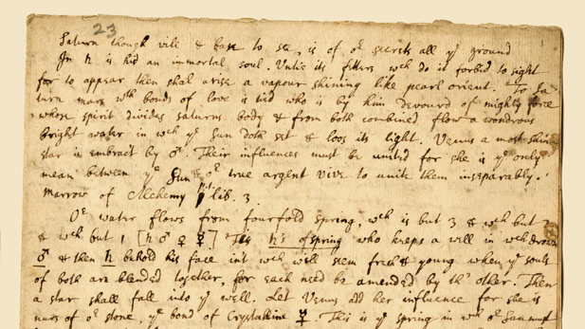
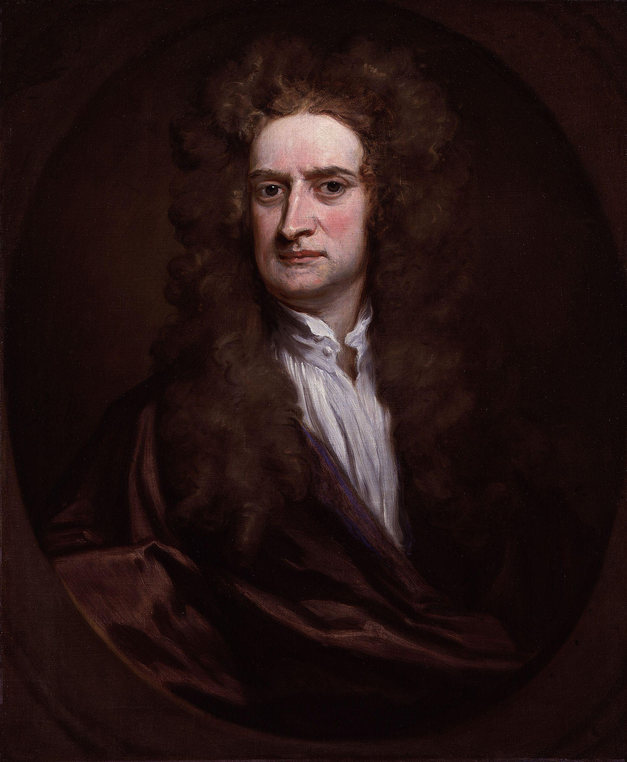
Why Alchemy?
Goal of alchemy: purify, mature, and perfect certain objects
Alchemists searched for the philosopher’s stone -
A legendary alchemical substance capable of turning base metals such as mercury into gold or silver
Pursuits to discover the philosopher's stone were known as the Magnum Opus
Centralized repositories are potentially a philosopher’s stone for data
Notes:
Magnum Opus - ‘great work’
Isaac Newton, Robert Boyle
https://www.pbs.org/wgbh/nova/physics/newton-alchemy.html
https://en.wikipedia.org/wiki/Isaac_Newton#/media/File:Sir_Isaac_Newton_by_Sir_Godfrey_Kneller,_Bt.jpg

Slide 7
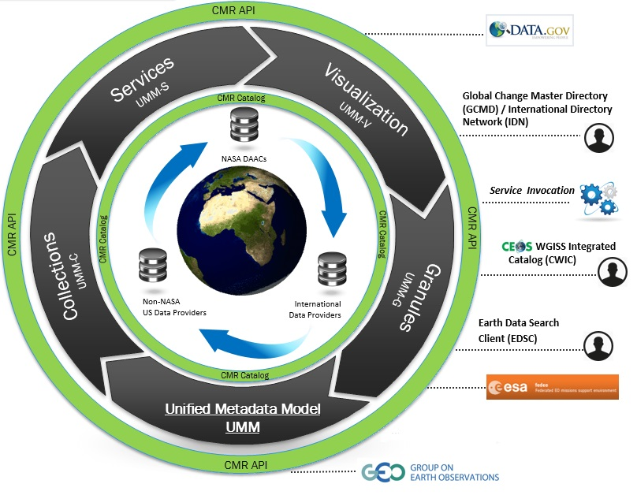
Trusted Centralized Repositories: Our Collaborations
Climate Data Initiative
ARC Team

Slide 8
Best Intentions…..

Slide 9
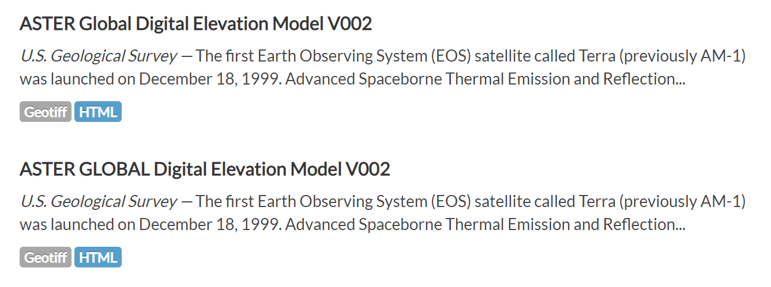
Trust, but Verify: Duplication of Information
Information is sometimes duplicated in a centralized repository
Metadata duplication may be caused by:
Interagency datasets being provided to the same repository by both agencies
Dataset accidentally duplicated by the same agency
Multiple versions of the same dataset due to harvest errors by catalog
How does a user know which record is the authoritative record?
Global vs. GLOBAL
USGS
NASA

Slide 10
Trust, but Verify: But What About Unique Identifiers?
Unique identifiers (e.g. DOIs) can be used to reduce duplication in a centralized repository
Data.gov now requires some sort of unique identifier
NASA strongly encourages the adoption of unique identifiers
However, there are still some potential loopholes:
Thousands of legacy datasets do not have identifiers
Ongoing debate over what types of data receive DOIs
Provisional, non-science quality, etc…
Some legitimate data sources don’t have identifiers due to this debate
Both Data.gov and NASA require the data provider or agency to assign unique identifiers
Debate over whether centralized repositories should assign unique identifiers
Notes:
Magnum Opus - ‘great work’
Isaac Newton, Robert Boyle
https://www.pbs.org/wgbh/nova/physics/newton-alchemy.html
https://en.wikipedia.org/wiki/Isaac_Newton#/media/File:Sir_Isaac_Newton_by_Sir_Godfrey_Kneller,_Bt.jpg

Slide 11
Context, Context, Context
Metadata often curated within community or domain specific context
Assumptions about knowledge does not translate well into a global context
Examples:
Keywords
Abstracts
Many NASA datasets have historically used only “TB” in dataset titles and abstracts, rather than spelling out “Brightness Temperature.”
Cryptic titles
Notes:
Magnum Opus - ‘great work’
Isaac Newton, Robert Boyle
https://www.pbs.org/wgbh/nova/physics/newton-alchemy.html
https://en.wikipedia.org/wiki/Isaac_Newton#/media/File:Sir_Isaac_Newton_by_Sir_Godfrey_Kneller,_Bt.jpg

Slide 12
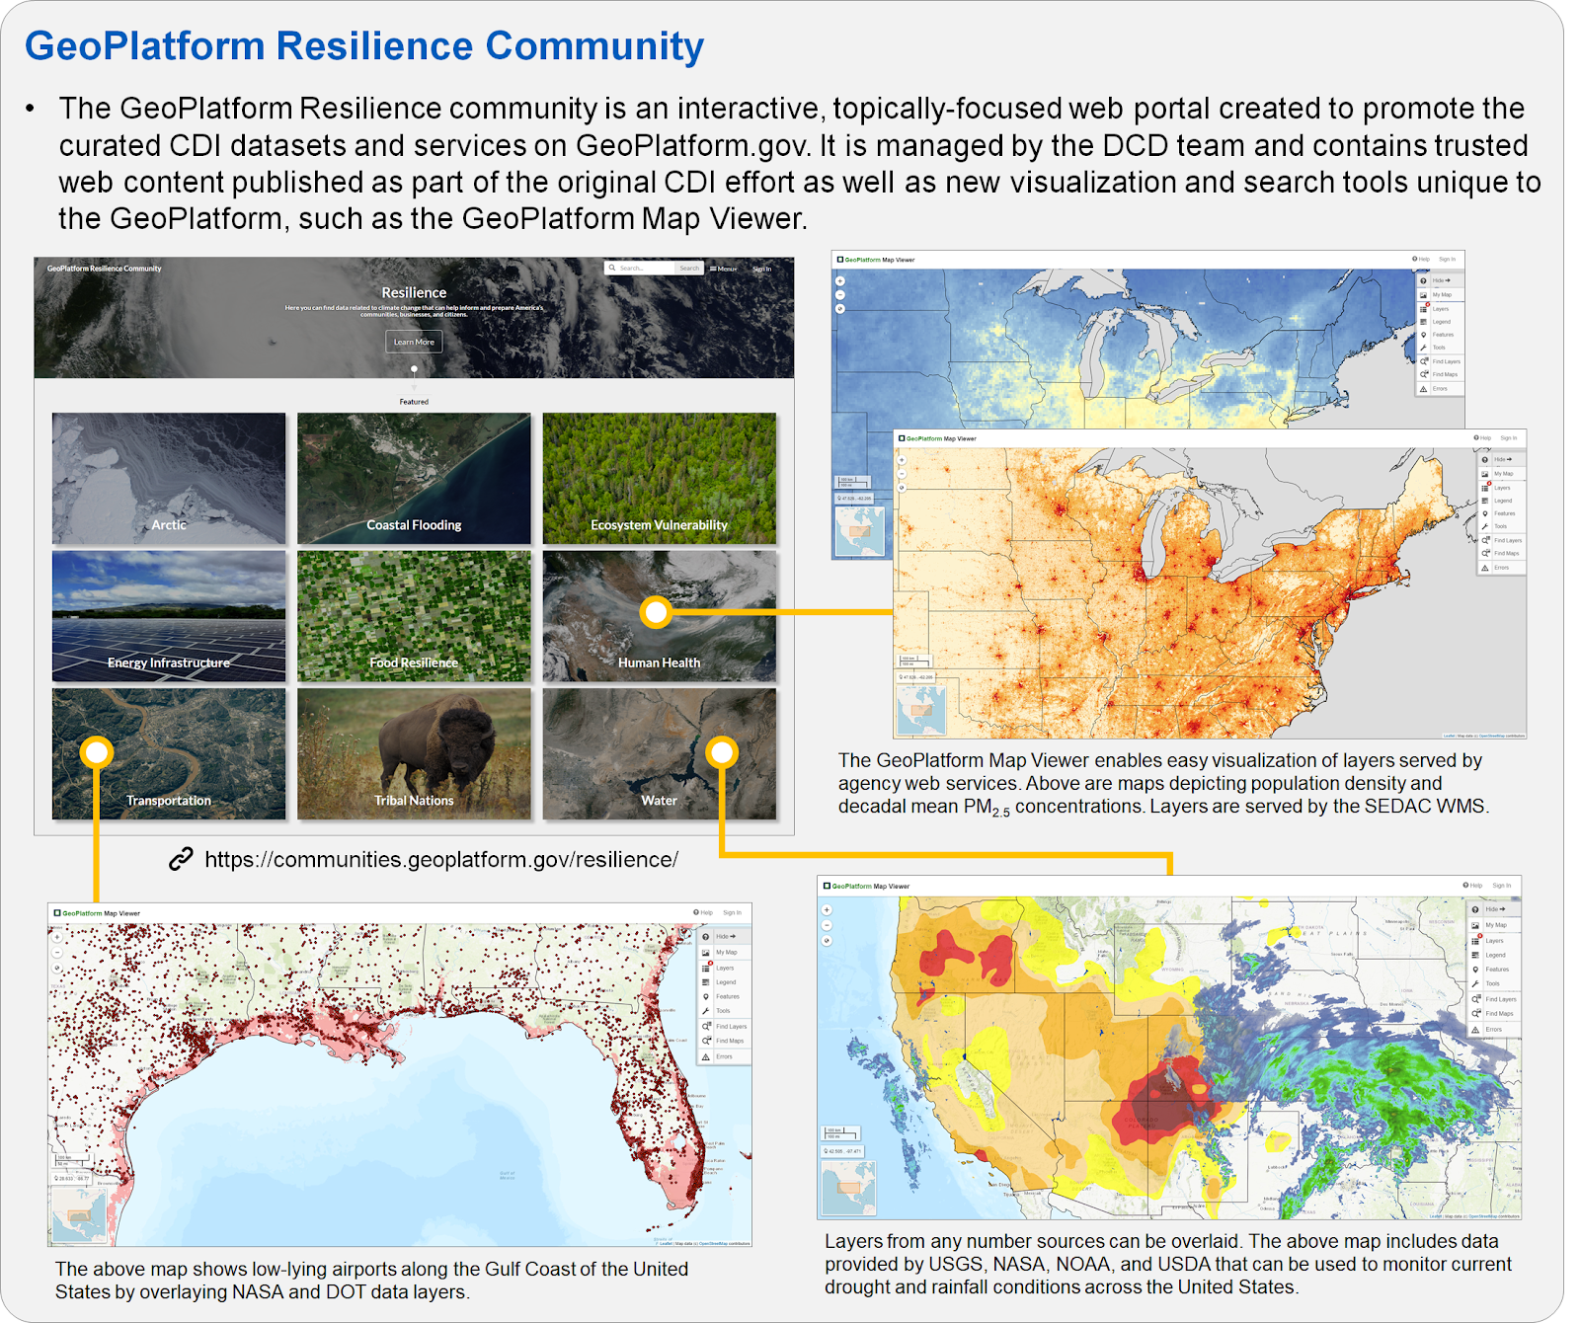
Alchemy in Action
One stop for data access increases the likelihood of data being reused for new applications
Excellent environment for curating information across agencies, domains, data centers
Climate Data Initiative collection
Curated maps at Geoplatform.gov
Notes:
Magnum Opus - ‘great work’
Isaac Newton, Robert Boyle
https://www.pbs.org/wgbh/nova/physics/newton-alchemy.html
https://en.wikipedia.org/wiki/Isaac_Newton#/media/File:Sir_Isaac_Newton_by_Sir_Godfrey_Kneller,_Bt.jpg

Slide 13
Data observation network for earth
Session: Establishing Trust in Centralized Repositories
Rebecca Koskela
ESIP Winter Meeting
17 January 2019

Slide 14
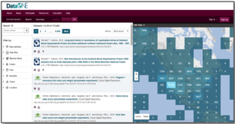
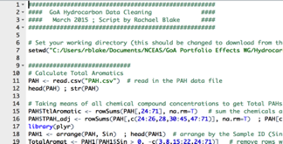
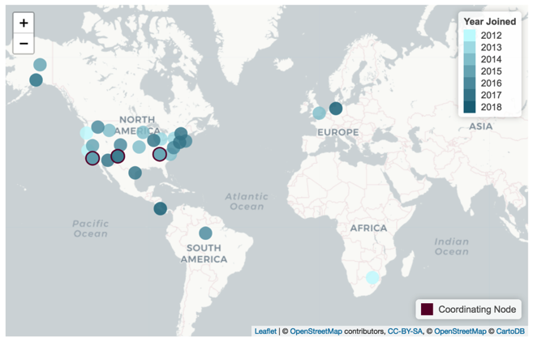
DataONE: A Federation of Earth Science Repositories
Core Cyberinfrastructure
CN
CN
CN

Slide 15
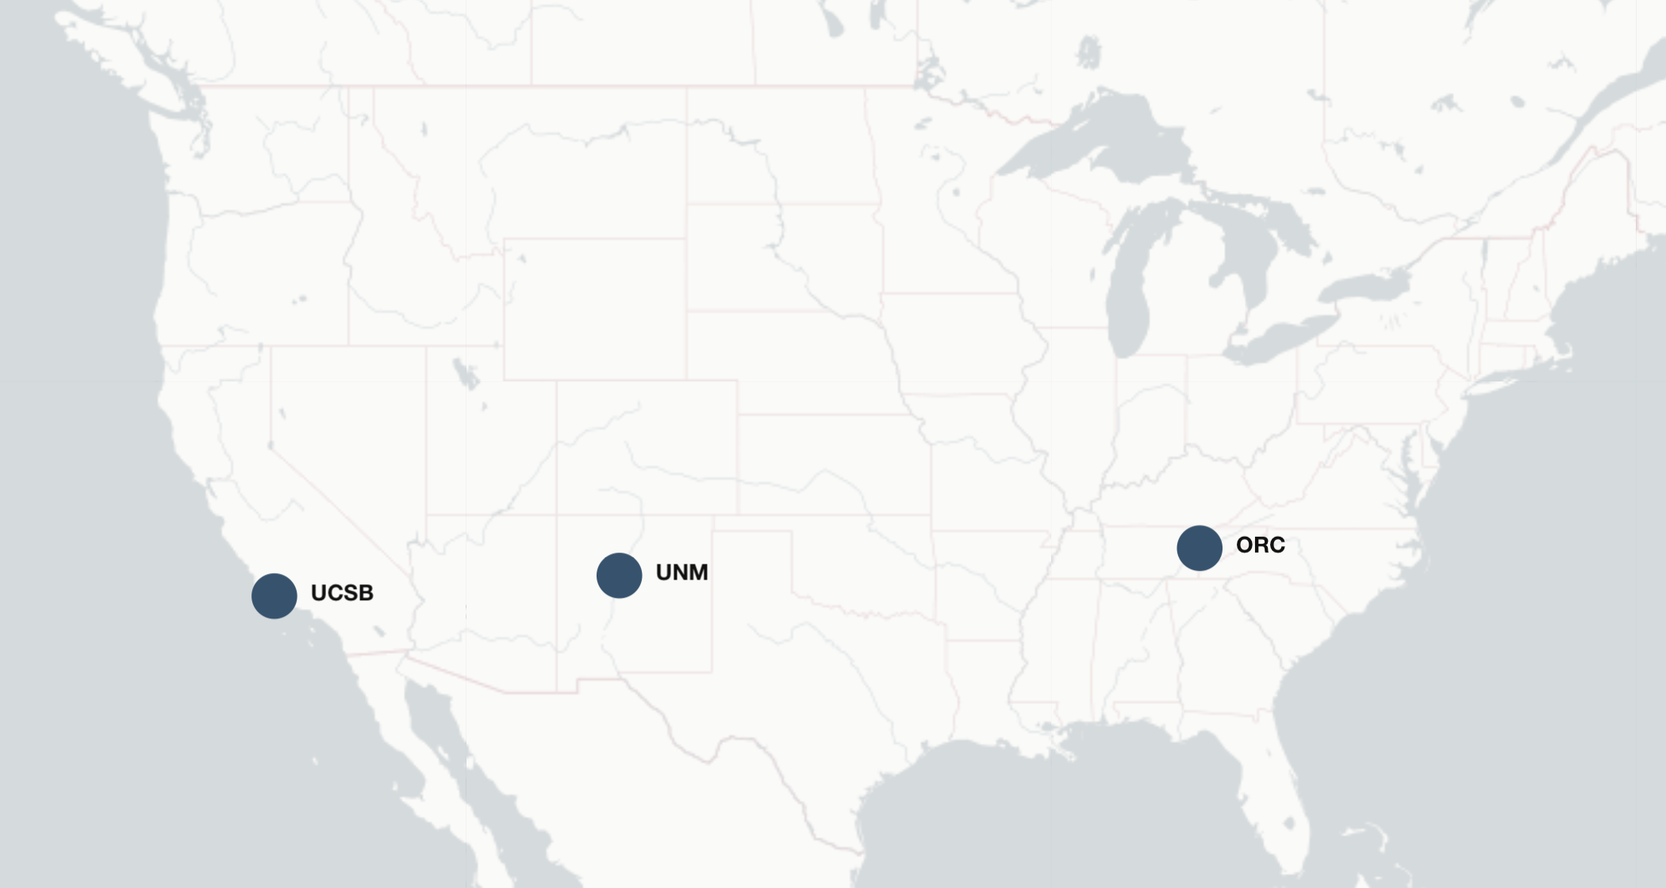
Network-wide services
Metadata search catalog
Citation and usage
Reproducibility and provenance
Replication and Audit
Provenance and Quality services
Coordinating Nodes
www.dataone.org/coordinating-nodes

Slide 16
Metadata
Who is responsible for improving the metadata?
Rules for modifying metadata?
Invalid/incompatible/inconsistent content
Should a repository accept bad metadata as is?
Managing a diverse collection
Information consistently not provided

Slide 17
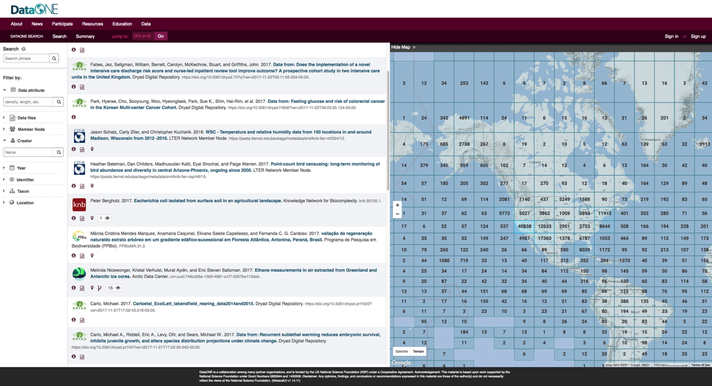
Federated Search Across Repositories

Slide 18
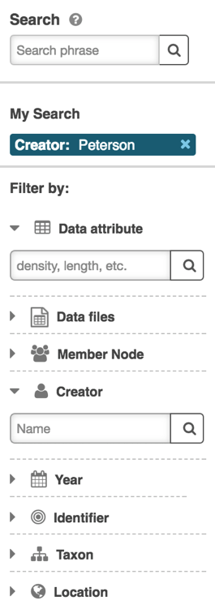
Federated Search Across Repositories

Slide 19
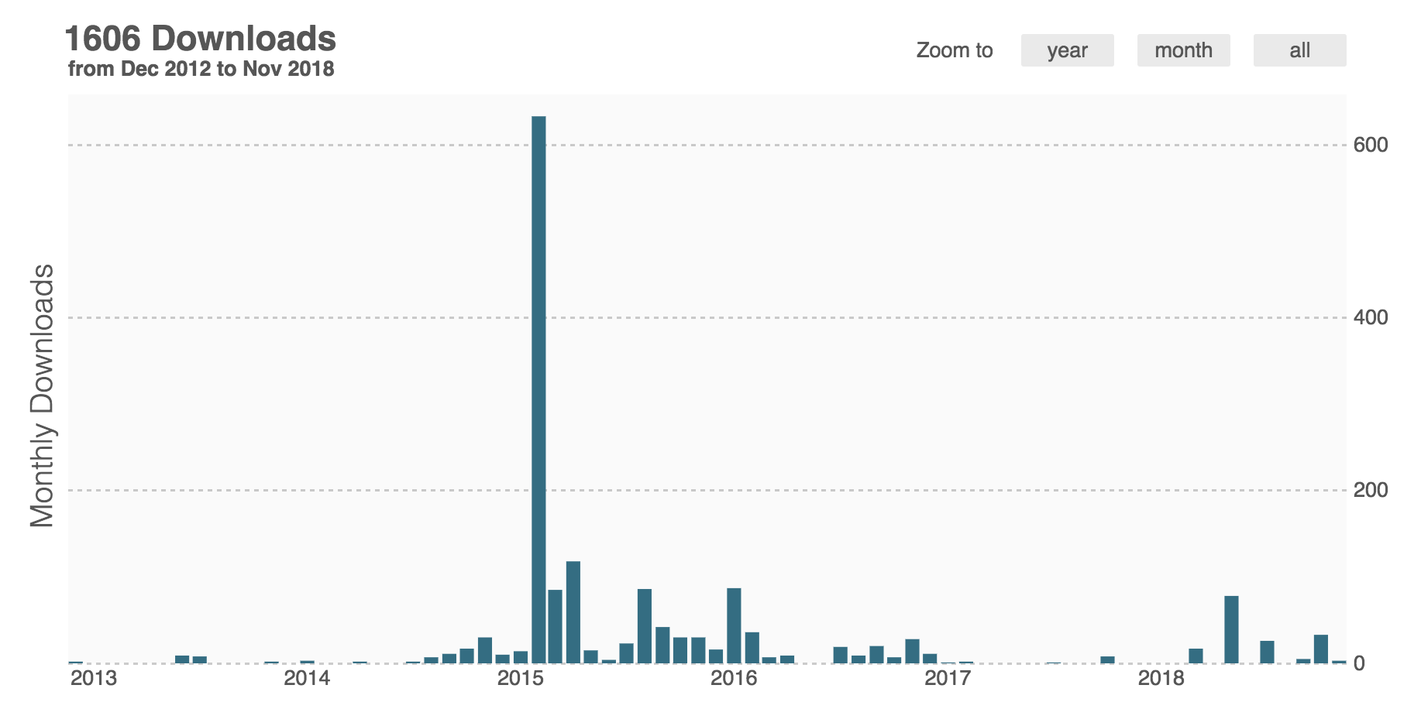
Data usage and citation

Slide 20
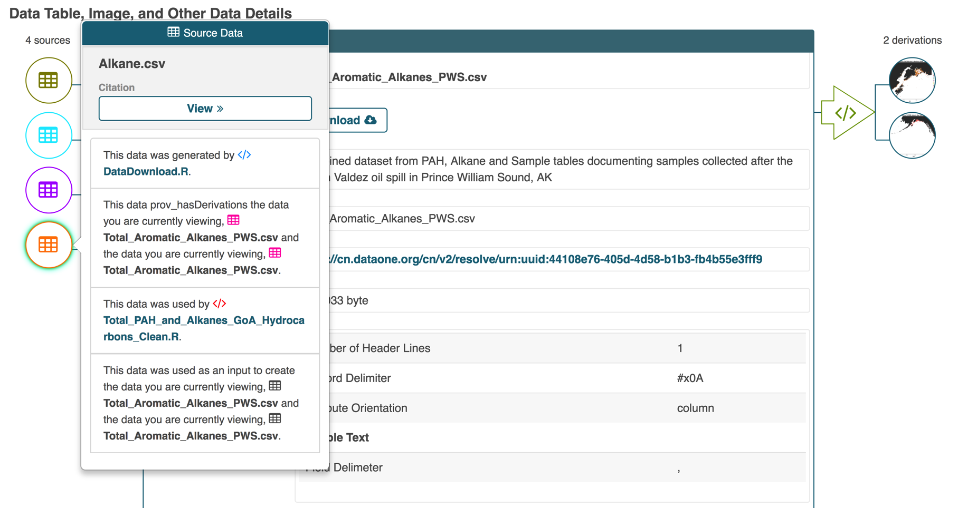
Reproducibility and Provenance

Slide 21
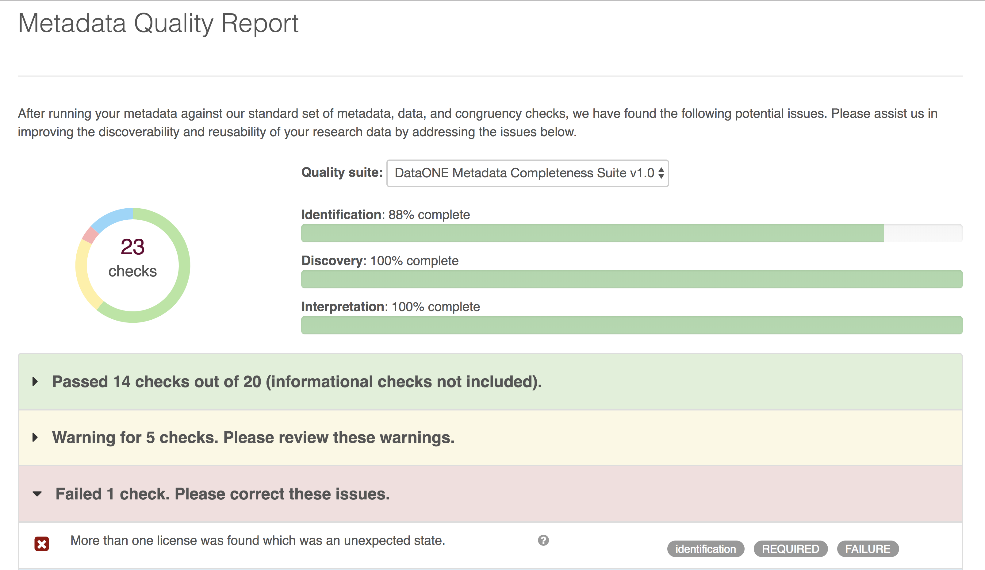
Metadata Quality Improvement

Slide 22
CoreTrustSeal Cohort
A cohort of data repositories is being assembled to apply for CoreTrustSeal certification as part of the American Geophysical Union Coalition Enabling FAIR Data Project. CoreTrustSeal certification demonstrates to a repository’s users and funders that they have been evaluated by an independent authority and endorsed for their trustworthiness.

Slide 23
CoreTrustSeal Requirements
https://www.coretrustseal.org/why-certification/requirements/
Licenses
Continuity of Access
Confidentiality/Ethics
Organizational Infrastructure
Expert guidance
Data integrity and authenticity
Appraisal
Documented storage procedures
Preservation plan
Data quality
Workflows
Data discovery and identification
Data reuse
Technical infrastructure
Security

Slide 24
Data Integrity and Authenticity
R7. The repository guarantees the integrity and authenticity of the data.
Guidance:
The repository should provide evidence to show that it operates a data and metadata management system suitable for ensuring integrity and authenticity during the processes of ingest, archival storage and data access.
Integrity ensures that changes to data and metadata are documented and can be traced to the rationale and originator of the change.
Authenticity covers the degree of reliability of the original deposited data and its provenance, including the relationship between the original data and that disseminated, and whether or not existing relationships between datasets and/or metadata are maintained.

Slide 25
Data Quality
R11. The repository has appropriate expertise to address technical data and metadata quality and ensures that sufficient information is available for end users to make quality-related evaluations.
Guidance:
Repositories must work in concert with depositors to ensure that there is enough available information about the data such that the Designated Community can assess the substantive quality of the data. Such quality assessment becomes increasingly relevant when the Designated Community is multidisciplinary, where researchers may not have the personal experience to make an evaluation of quality from the data alone. Repositories must also be able to evaluate the technical quality of data deposits in terms of the completeness and quality of the materials provided, and the quality of the metadata.
Data, or associated metadata, may have quality issues relevant to their research value, but this does not preclude their use in science if a user can make a well-informed decision on their suitability through provided documentation.

Slide 26
Crowdsourcing Metadata
Permissions
Expertise

Slide 27
DSET/DASH
air • planet • people
A Community Informed and Driven Data System:
Digital Asset Services Hub - DASH
Sophie Hou
hou@ucar.edu Data Curation & Stewardship Coordinator
National Center for Atmospheric Research (NCAR)
University Corporation for Atmospheric Research (UCAR)
ESIP Winter 2019
Thursday, January 17th, 2019

Slide 28
NCAR

Slide 29
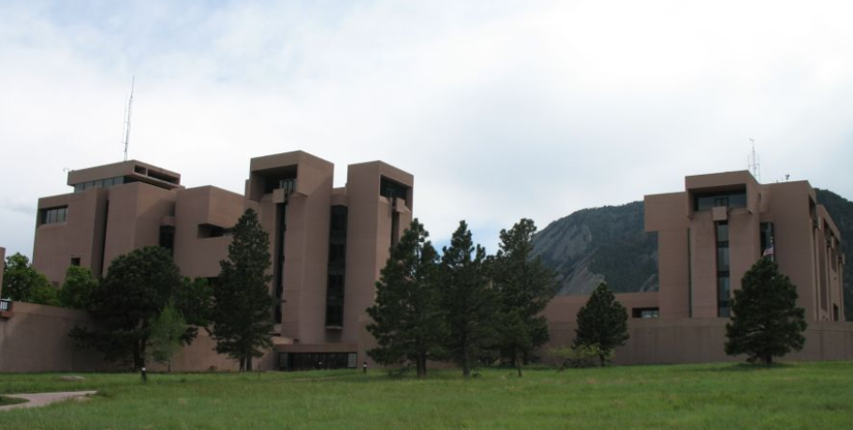
National Center for Atmospheric Research - NCAR (Boulder, CO) https://ncar.ucar.edu/who-we-are/labs
Federally funded research and development center by NSF.
7 distinct laboratories plus scientific programs that have diverse research areas and associated outputs.

Slide 30
NCAR DASH

Slide 31
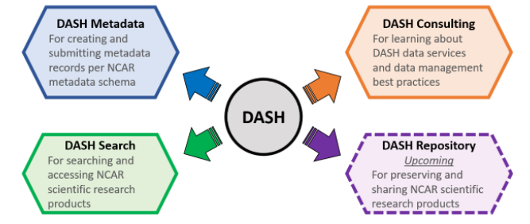
Digital Asset Services Hub (DASH)

Slide 32
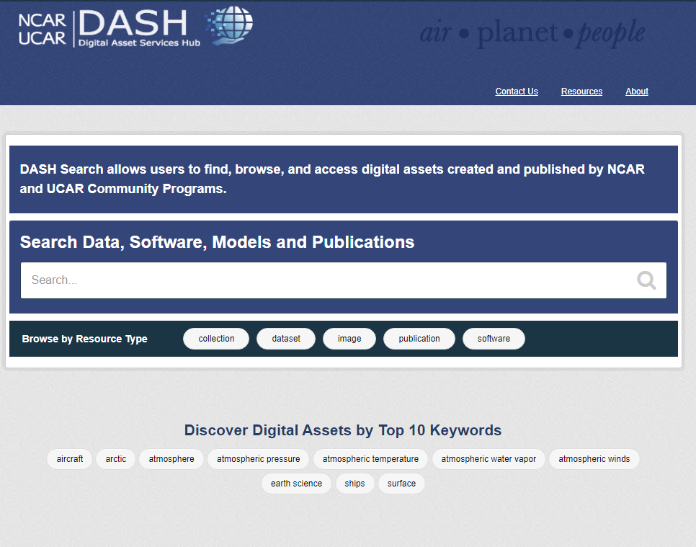
DASH Search
https://data.ucar.edu/

Slide 33
DASH Metadata

Slide 34
DASH Metadata
Challenges and Successes:
ISO 19115 Adaptation
Local Requirements vs. Community Recommendations
2003 Version vs. 2014 Version
Detail vs. Usability
NCAR Dialect

Slide 35
DASH Metadata - Continued
Challenges and Successes:
Metadata Submission Tool
Stand-alone vs. Web-based
Self-helped vs. Assisted
Distributed vs. Centralized
Open-source editor and
Google Form

Slide 36
DASH Metadata - Continued
Challenges and Successes:
Best Practices
Quality vs. Quantity
Machine-actionable vs. Human-based
Breadth vs. Depth
NCAR Dialect Worksheet

Slide 37
DASH Metadata - Continued
Going Forward:
Record updates
Quality improvements
Metadata completeness
Outreach and education
Roles and responsibilities
Policy integration

Slide 38
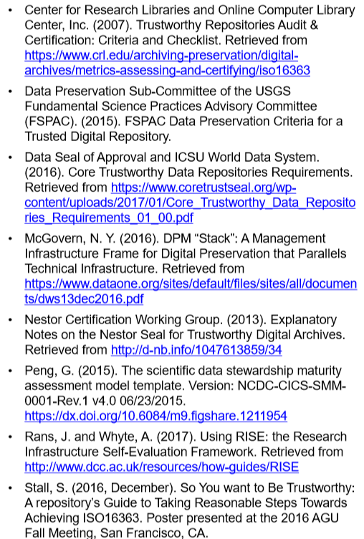
DASH Repository

Slide 39
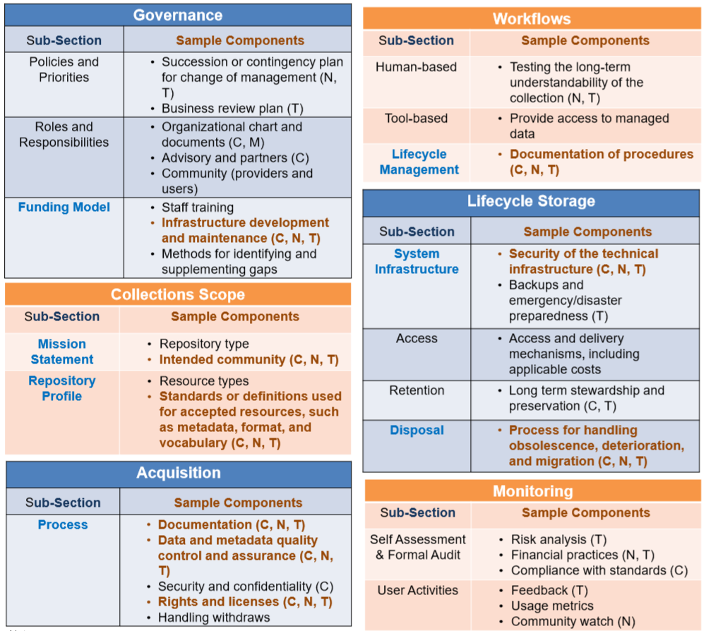
DASH Repository - Continued

Slide 40
Acknowledgement
Many thanks to UCAR/NCAR for their
support for DSET and DASH’s efforts, as well as the many
NCAR and UCAR staff who have contributed to the DSET
activities.

Slide 41
Thank You! Questions? Comments? Sophie Hou (datahelp@ucar.edu, hou@ucar.edu)

Slide 42
Questions
How do you manage a collection that is so diverse?
Is a centralized repository responsible for improving the metadata submitted into their system?
Should a repository accept bad metadata as is?
What (if any) are the rules for modifying metadata when it's in your system?
What does the repository do when content is invalid/incompatible/inconsistent?
How is versioning handled in centralized repositories?
How heavy is the lift when you have to modify content for consistency?
Is there a trade-off between enforcing consistency and losing content relevancy?
What if any external services analyze your catalogs?
What information is consistently never provided and why?
Does your aggregated catalog have a metadata lifecycle plan?
In what ways are you willing to crowdsource metadata curation in aggregated catalogs?

