Slide 1
Understanding the impacts of compound and cascading events on water resources management Presented by: Kate White, PhD, p.e. USACE Lead for Climate preparedness and Resilience Co-Authors: Thomas Wahl, Civil, Environmental & Construction Engineering and National Center for Integrated Coastal Research, University of Central Florida Ariane O Pinson, USACE Albuquerque District, Albuquerque, NM Will Veatch, USACE New Orleans District, New Orleans, LA Gabriele Villarini, University of Iowa, Civil and Environmental Engineering, Iowa City, IA
11 Dec2018 | American Geophysical Union | Washington, DC
Notes:
This 12-minute brief is part of a panel discussion at the AGU Session NH-023, Compound and Cascading Events: An Emerging Challenge for Natural Hazard Risk Assessment and Management, Invited paper # 407719
Title: Understanding the impacts of compound and cascading event on water resources management. Invited Paper 407719
Abstract: Water resources management agencies in the US such as the US Army Corps of Engineers (USACE) have addressed various impacts of climate change including rising sea levels and changes in drought or flood occurrence and severity. The USACE has also encouraged the consideration of cascading impacts related to both climate hazards and the management actions taken to prepare or respond to these hazards. Recent analyses have highlighted several types of compound events impacting USACE water resources management. Among these are coastal storm surge associated with heavy precipitation causing riverine flooding, atmospheric river events occurring during drought, and the combination of heat, drought, desertification, wildfire, and intense precipitation that increases flooding and alters sedimentation processes impacting reservoir storage. Advances in understanding compound events and cascading impacts can improve climate preparedness and response and help to avoid adverse unintended consequences of management actions. Although still a relatively recent topic area this paper provides an overview of current USACE activities related to compound events and cascading impacts. Based on lessons learned from these experiences, we identify progress and opportunities for improvement for water resources management agencies dealing with compound events.
The panel discussion is from 1400-1412 on Tuesday 11 Dec 2018 at the Washington Convention Center, Washington.

Slide 2
Water Resources Management is a System of Systems
Notes:
Water resources management is a system of systems, coverall all aspects of the hydrologic cycle and of the socio-economic and ecosystem systems within which we work.
The broad nature of our work and thus is susceptible to climate change impacts, including rising sea levels and changes in drought or flood occurrence and severity. The USACE has also encouraged the consideration of cascading impacts related to both climate hazards and the management actions taken to prepare or respond to these hazards.
This graphic highlights some of the major water resources infrastructure that the USACE deals with in the US, and also the elements of the hydrologic cycle for which variability causes challenges.
Water resources infrastructure is highly interconnected, as you can see from this illustration of Corps Civil Works missions.
For example, channel and port dredging may provide material for aquatic ecosystem restoration projects or coastal storm risk management projects. Multipurpose reservoirs provide storage for flood risk reduction, water supply, recreation, hydropower, and environmental flows.
It’s a dynamic and flexible system that provides adaptive capacity to variability within and outside the system, for example to natural hazards, man-made hazards and other disruptions, such as economic, social, or political.
Clearly there are a lot of opportunities for compound and cascading events.

Slide 3
Compound events are common Water resources Challenges
IPCC, 2012:
(1) two or more extreme events occurring simultaneously or successively;
(2) combinations of extreme events with underlying conditions that amplify the impact of the events; or
(3) combinations of events that are not themselves extremes but lead to an extreme event or impact when combined - the contributing events can be of similar (clustered multiple events) or different type(s)
Leonard et al., 2014:
A compound event is an extreme impact that depends on multiple statistically dependent variables or events
Zscheischler et al., 2018:
The combination of multiple drivers and/or hazards that contributes to societal or environmental impacts

Slide 4
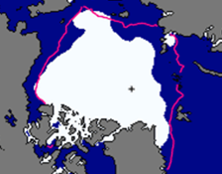
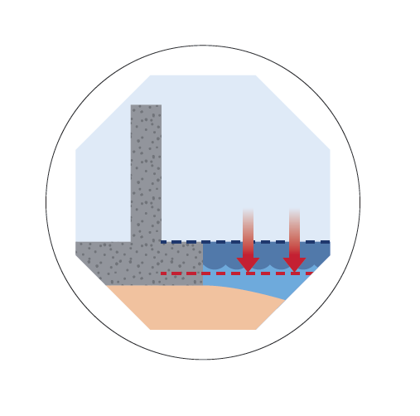
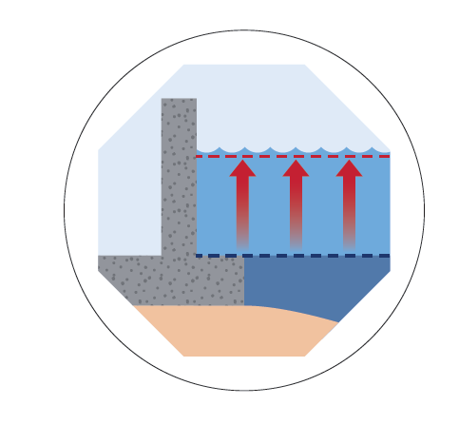
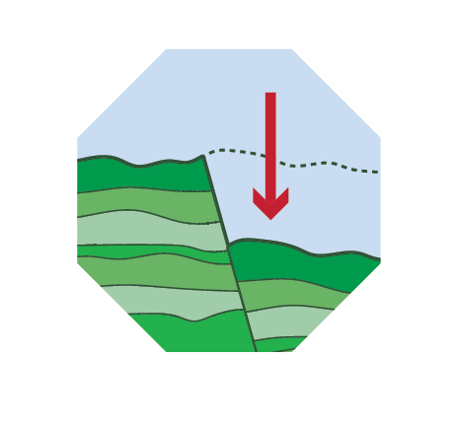
Compound and cascading events – Coastal
Notes:
So lets imagine a couple of coastal compound events that are pretty common.
Lets start with falling local relative sea levels, say in Alaska. Combined with surge, and waves, especially where we are experiencing thinner or no ice covers, we’ll get shoreline erosion. OK, not much surprise there. But add in thawing permafrost, and now we have an amplifier for erosion.
Case 2, the more typical rising local relative sea level. Lets add changing land subsidence, surge, and waves, and we will also have shoreline erosion. But we will also increase the likelihood of flooding. Now, add in temperature or salinity impacts that encourage invasive species in a wetland marsh that previously provided some attenuation. Or how about ocean acidification that alters metal mobilization and also impacts habitat? Again, these are amplifiers.
Finally, what if the local populations are also vulnerable – with little adaptive capacity?
Last, the potential for nonstationarity in any of these factors, or combnations of factors, and we have a typical water resources challenge.

Slide 5
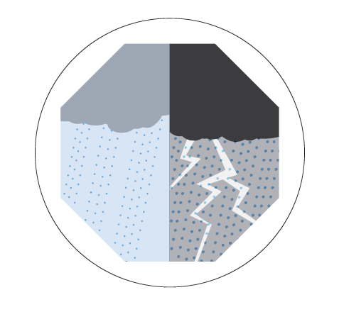
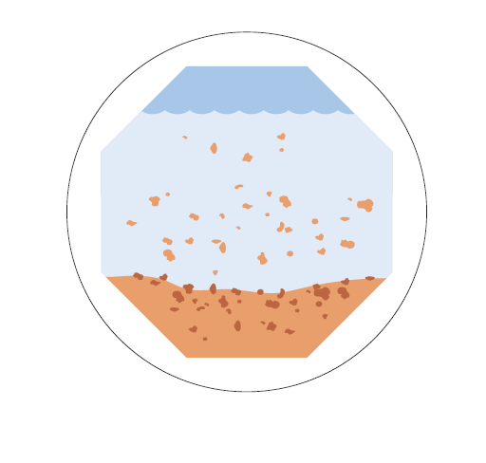
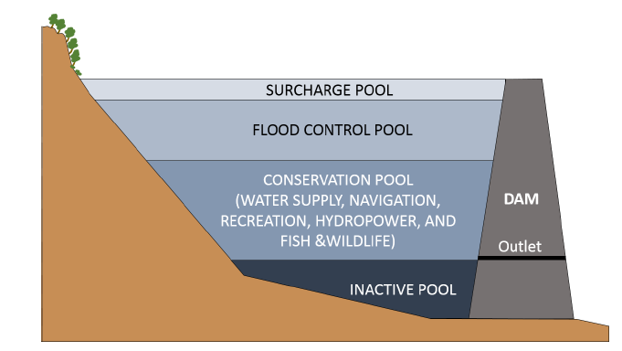
Compound and cascading events – Inland
Notes:
Alright, moving inland, we have example 2. Let’s start with drought and add in desertification like we are currently experience in in the Southwest. These changing vegetation conditions can enhance wildfires, even more so when winds are high. The we get fast moving and very hot wildfires. Since warming temperatures also bring heavy precipitation, we can add this into the mix, which causes flooding at the same time it changes our erosion and sedimentation patterns. For reservoirs, this means sediment deposits which alter the available storage volumes for multiple uses. So at the same time we are needing more flood storage volume to deal with heavy precipitation, and more water supply storage to deal with increasing demand, we are also losing reservoir volume. Add in vulnerable populations and nonstationarity, and you get an idea of the complexities of water resources as a system.

Slide 6
Decision-Makers perspective – Actionable science, not necessarily latest or most complex science Approach
“All models are wrong; some are useful.” George EP Box
Decision-makers especially need to consider surprises or cases where a weak signal could result in large consequence – these are situations where models provide only part of needed information
Decision-makers begin with the requirements for acceptable performance and reliability of their asset/project/system and then
ID the impacts or combinations of impacts that increase vulnerability and decrease performance and reliability
Assess likelihood of occurrence
Use this knowledge to plan and implement measures to prepare, absorb, recover wisely, and adapt or transform to reduce future occurrences
The information supporting the assessment does not necessarily have to be complex but it does have to be actionable
Notes:
Whereas standard methods have evolved to analyze compound events using the historical record of stream flow, runoff, storm surge and other variables, we all know climate change is moving the goal posts.
Nonstationarity – the changes in magnitude, variation, and timing of stream flow, flood flows, storm surges and other phenomena compared to the historic condition – renders our historic perspective incomplete; but we don’t have estimates of future conditions that would tell us the precise and accurate performance characteristics to incorporate into infrastructure we build today so that it still performs as designed or better 50 years from now. We see imperfectly through an ensemble of GCMs downscaled and routed through earth surface models to yield a range of uncertain estimates of future runoff and stream flow. Future compound events are particularly challenging to model for decision makers.
In this context, the old statistician’s saying that “All models are wrong; some are useful,” is particularly apt. No model captures 100% of the phenomena of interest, and the most complex models may not outperform simpler models.
Because of the large uncertainties and ranges of variation in model ensemble predictions of single and compound events, modeling these in detail for a given location does not guarantee either more precise or more accurate forecasts of future conditions. For a given decision, decision-makers need model and datasets that reliably capture whether and how the major climate drivers are likely to change, and how this impacts project performance or project vulnerability. If we don’t know enough to build it differently now, we can use this information to identify thresholds change in performance that would trigger design changes or upgrades.
What decision makers need ….[slide content]

Slide 7
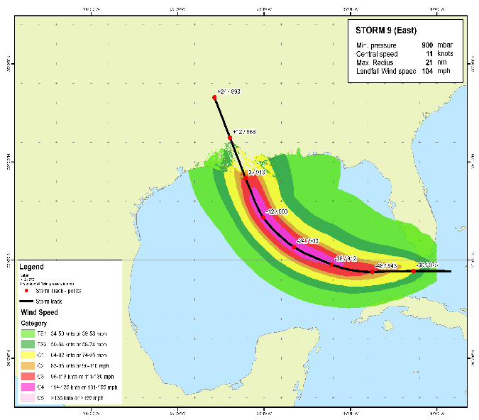
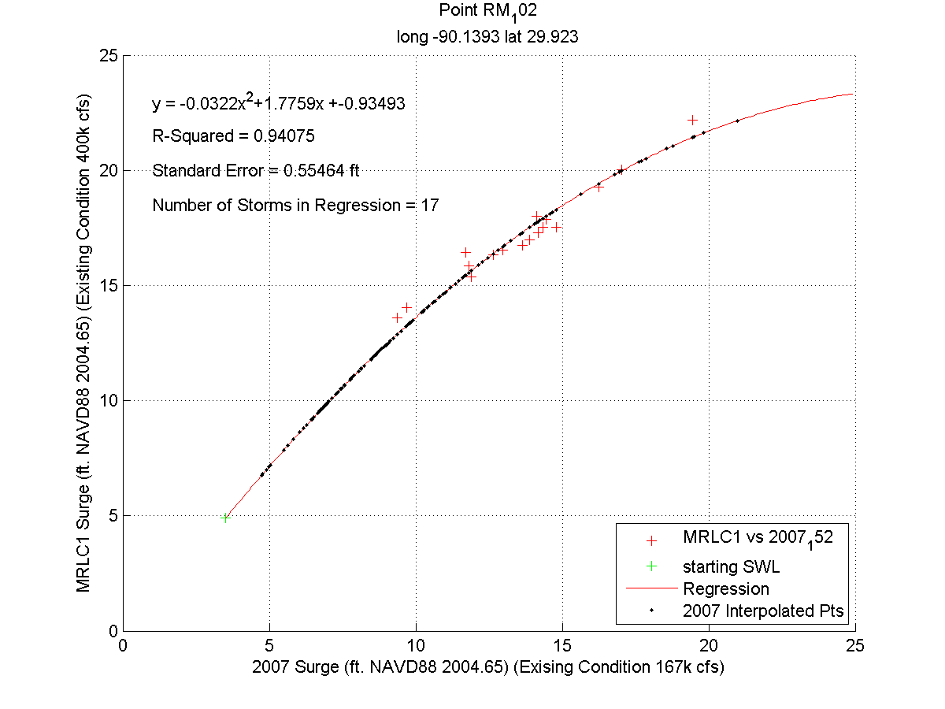
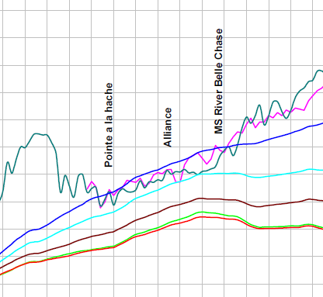
When does combined storm surge and runoff impact levee performance? Simple evaluation
Storm causing surge
Simple flow relationship
Notes:
Now, while the types of compound and cascading events are complex, the information that supports decision-making may not be.
One way to deal with the role of compound events in creating extreme flood events is to consider the worst possible storm over the largest possible portion of the study area, moving in a way that maximizes the amount of precipitation that falls in a watershed, and produces coincident flood peaks for all the tributaries in study area.
Sea level rise and increased storm intensity have the potential to significantly increase flood risk in coastal areas where larger floods could get backed up behind higher storm surges. Although there are many ways to get that this type of compound event, here’s an common approach USACE already uses to identify how such compound event might impact a proposed levee.
Say we want to know under what conditions a levee will overtop. This example depicts a hypothetical case where “Storm 9” surge information is combined with a simple surge-streamflow relationship to obtain flowlines for storm surge combined with different levels of streamflow.
Here we can see that the levee performs under most river conditions (red, green, brown, cyan), but will overtop in one location under very high discharge (blue) conditions.
Now, we have information that will help us assess how likely this is to occur, and what measures might be appropriate to manage this risk.
Of course, we would look at the full range of storm-runoff combinations for design, including changes to future conditions due to relative sea level change.

Slide 8
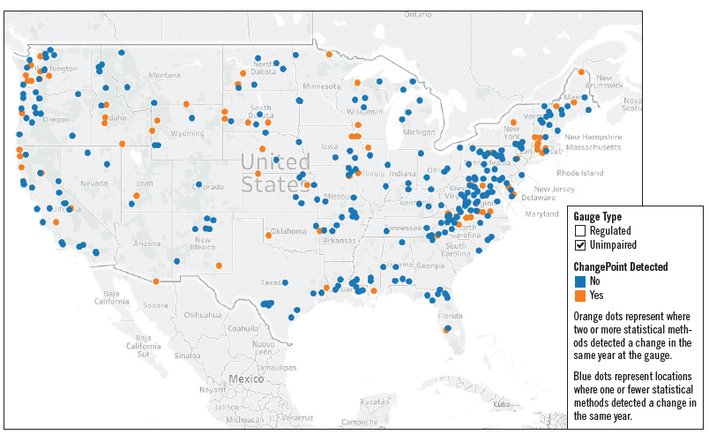
Where might we see changing runoff? Nonstationarity of Unimpaired Stream Gauges
Dataset
Stream data was pulled from USGS (the Gages II data) and reduced to just those streams which are defined to be unimpaired.
For each stream in the data set, annual instantaneous peak flow was used as a measure of stream behavior
Stream were flagged as having a nonstationarity if two or more statistical methods detected a change in the same year at that gauge
This is shown in the plot below, where blue gauges did not have a nonstationarity with consensus and the orange did
The resulting data set held a variety of features, but the analysis here focused on presence of nonstationarity, and latitude / longitude
Next, we wanted to know if any of the nonstationarities represented an unusual condition.
Objective
While identifying nonstationarities at specific gauges is of critical importance in the analysis of that gauge, it is also of importance to understand global trends and relationships in nonstationarities across multiple gauges.
Here, particular attention was paid to the relationship between geographic location of the gauge and the tendency of that gauge to have a nonstationarity.
While many different predictors were considered, using a variety of models and techniques, the small sample size limited the significance of predictive conclusions using non-geographic features.
Tool for single streamgage analysis: https://www.usace.army.mil/corpsclimate/Public_Tools_Dev_by_USACE/Climate-Impacted_Hydrology/
Notes:
Nonstationarity, the changes from historical conditions, is becoming a significant and measurable problem for USACE. We build durable infrastructure with use-lives in excess of 50 or 100 years, and we can already detect significant changes in runoff across the US that might
combine with other factors to cause combined or cascading events with magnitudes in excess of the historical record.
To assist in decision-making, the USACE employs an online tool that enables its hydrologists to detect nonstationarities in historical streamflows to aid in the assessment of what, if any, the change means for the vulnerability of an existing project, or how it might be used in the design of a new project. Understanding how peak stream flows on multiple tributaries might affect estimated peak flows in a project area is an example of how this approach would help with compound events.
This web tool uses 12 different statistical methods to detect a nonstationarity, and then allows us to explore the trends before and after that change. So here we have applied it to data collected by the US Geological Survey for the subset of unregulated streamgaging stations in the US. We normally do this one by one, but it is also useful to visualize on a national basis. The orange dots have nonstationarities, while the blue don’t. This is useful because it tells us where we may not yet see changes that would require nonstationary analyses. The orange dots tell us where we have observed nonstationary changes
The USACE is currently expanding this tool to enable analysis of a wider range of data relevant to project planning and construction.

Slide 9
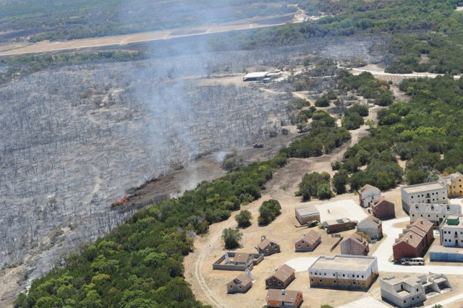
Where might we see increasing Wildfire RISK? Weighted order weighted average approach
Drivers: Increase in temperature, evaporation; changes in precipitation frequency
Hazard: Dry vegetation due to low soil moisture
Exposure: Flammable wildland vegetation and infrastructure in or next to it (wildand-urban interface and intermix)
https://www.army.mil/article/65007/fort_hood_battles_11380_acres_of_wildfires
INDICATOR | RANKING
Extremely dry weather for weeks or months (KBDI>600) [Keetch and Byram 1968] | 1.7
Fuel (wildland vegetation) [Radeloff et al 2017; Stein et al 2013] | 1.6
Infrastructure at risk (interface/intermix development) [Radeloff et al 2017; Stein et al 2013] | 1.1
Machado and Ratick (2017) https://doi.org/10.1007/s11027-11017-19775-11027.
Runfola et al. (2017) https://doi.org/10.1007/s11027-11015-19674-11028.
Notes:
One of the benefits of this approach is it allows USACE to consider a range of other factors that might be relevant to its water resources management mission. Wildfire is not only a ecological and human tragedy, it is also a major hydrologic disaster for many watersheds with long term impacts to water resources. Our approach readily incorporates data from other agencies, and produces an analysis that provides insights for managing our reservoir portfolio.
Climate change will increase the frequency and intensity of drought at all scales, from seasonal “flash droughts” in the Midwest and East to long-term aridity increases in the SWUS.
Increases in temperature and evaporation → dry fuels (increases as a problem if drought alternates with wet periods of fuel growth) for larger portions of the year
Dry fuels+ human activity or lightning → wildfire (the drier the fuels, the more intensely the fire burns, shifting from a beneficial ground fire to a destructive canopy fire.
Infrastructure, housing, and human activity mixed with wildland vegetation → risk of damages and loss of life – the more dense the infrastructure, the more likely the fire will be intensively managed rather than being permitted to burn.
INDEX EXPERT RANKING
Extremely dry weather for weeks or months (KBDI>600) [Keetch and Byram 1968] 1.7 (dry conditions are required)
Fuel (wildland vegetation) [Radeloff et al 2017; Stein et al 2013] 1.6 (fuel is a critical accelerant)
Infrastructure at risk (interface/intermix development) [Radeloff et al 2017; Stein et al 2013] 1.1 (it’s less of a problem if people are not there (e.g., most boreal fires burn unchecked))
Don’t know if you need this:
Wildfire may pose a significant risk to military installations [Beavers, 2007, Figure 3]. They can impact the timing and type of training activities at a given installation [Galbraith, 2011], and can divert military resources to firefighting activities [FireFighterNation, 2013]. Table 1 outlines fire risk categories and training restrictions. There are numerous examples of live-fire training igniting wildfires during dry conditions with both on- and off-base impacts [e.g., Panzino, 2018; Galbraith, 2011]. Finally, managing smoke from prescribed and wildland fires both on and off base is a significant concern [Mickler, 2014].

Slide 10
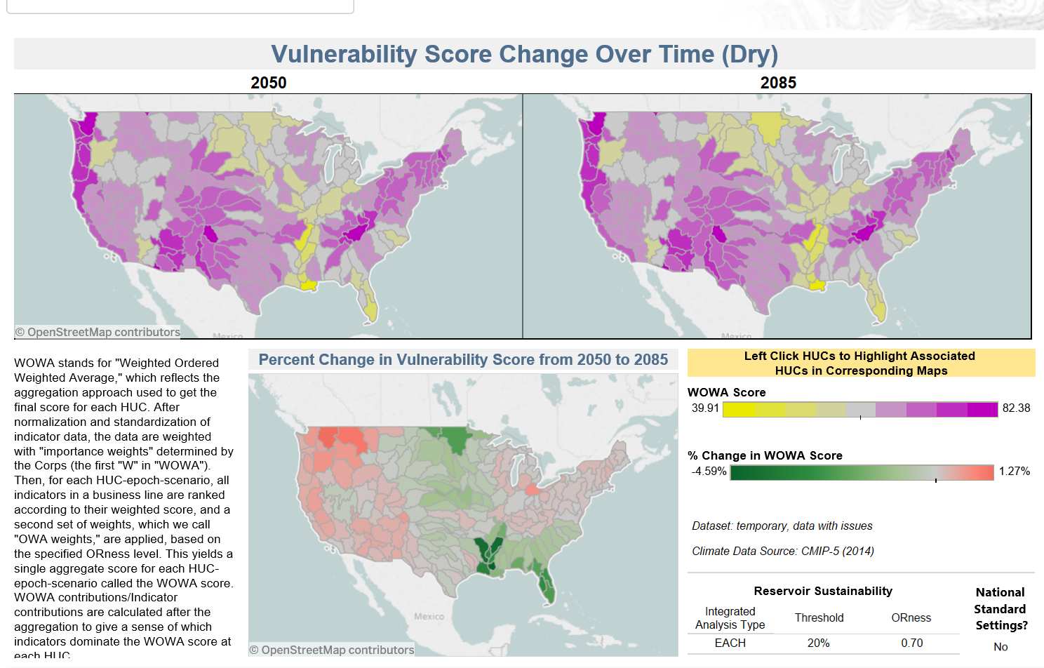
How might changing conditions impact reservoir sedimentation? WOWA approach
10% AEP Discharge
Soil Loss
Stream Sed. Load
Notes:
To make a first-order assessment of compound events, the USACE has developed the Vulnerability Assessment Tool. The Vulnerability Assessment Tool has two purposes: 1) broad comparisons at the national scale to understand vulnerability across the USACE portfolio AND 2) vulnerability at the HUC 4 level (which is constrained by the scale of the information in the database).
The Vulnerability Assessment Tool uses a Weighted Order-Weighted Average decision criteria applied to normalized data to capture both the relative importance of a given variable to a problem, as well as the risk tolerance of the decision-maker. Higher values mean greater risk.
In this example, the maps are showing modeled reservoir vulnerability to changes in sedimentation, based on a RUSLE model of soil loss, a CMIP5-driven, daily timestep VIC model of runoff and stream flow, and a measurement that estimates stream sediment load from watershed characteristics. Through this tool, we can begin to assess which regions of the nation are likely to be most at risk in the future for increases in reservoir sedimentation (threatening water supply, flood risk management, and other authorized purposes) and where this problem may be less. In this case, it shows declining sedimentation risk in the upper Missouri and Platte River basins, where sedimentation is currently a significant problem, and increases West of the Rocky Mountains.
Key stationary or climate-driven hazards identified
Current and future hazards calculated
Expert-assigned weighting of the relative contribution of each hazard to vulnerability of a USACE business line
WO=weight*normalized hazard value for each hazard
Determine risk tolerance for USACE business line:
How much emphasis on exposure to dominant hazard vs. multiple hazards
Based on risk tolerance level, for each location:
Order hazard by WO score (WO₁, WO₂, WO₃,…)
Apply risk weighting (a, b, c…)
Compute Average
WOWA = $\frac{\text{aWO}\text{1}\text{+}\text{bWO}\text{2}\text{+}\text{cWO}\text{3}}{3}$

Slide 11
Key Takeaways
We can't afford to wait for better data; we must focus on robust decision making with the best available science
Developing conceptual models of the important processes allows us to imagine surprise amplifiers or cascades
Conceptual models can capture the direction and ~ magnitude sufficiently to indicate the kinds of measures needed to ensure the long-term performance of the Nation's water resources infrastructure
Socio-economic issues that impact adaptive capacity are the ultimate reason we need to analyze potential events
There is no one right approach - various methods and simple approaches should be considered
Notes:
Here are the key takeaways:

