Slide 1
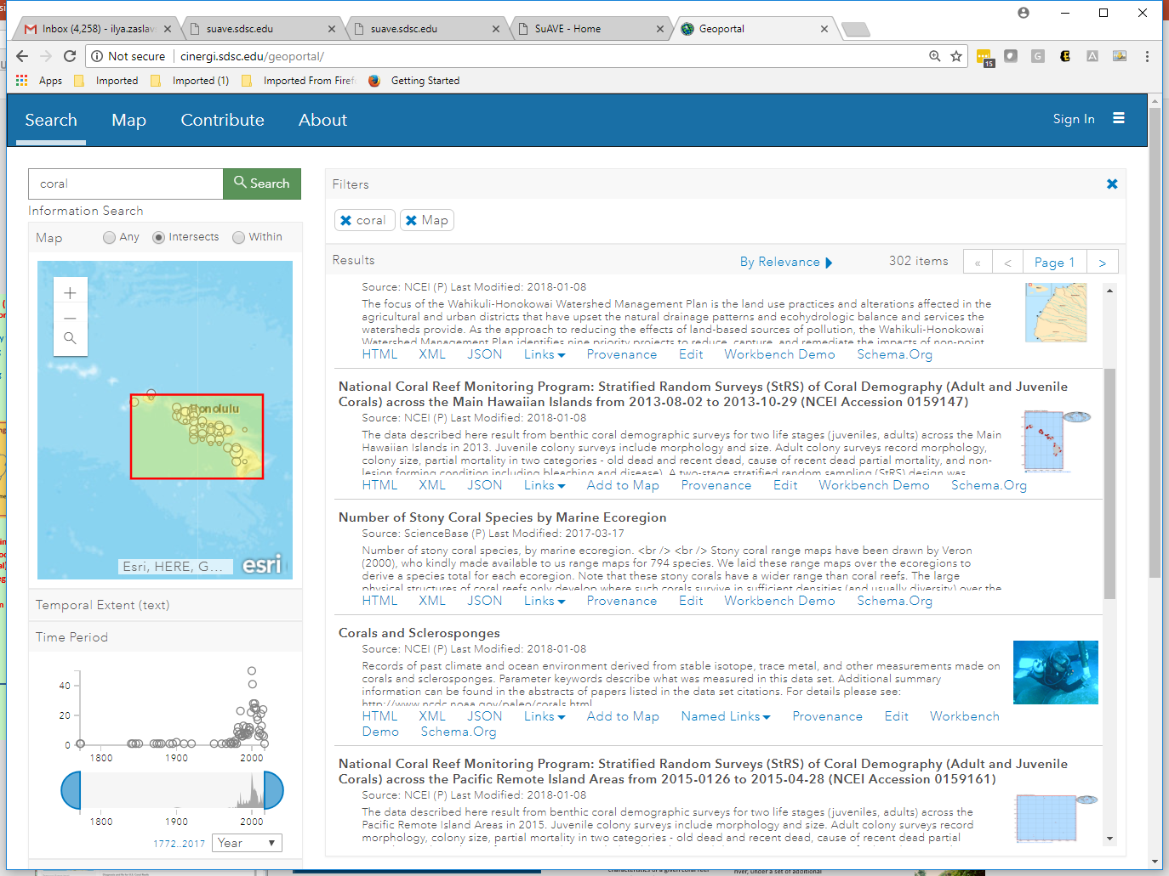
Linking Geoscience Resource Discovery and Exploration using Jupyter Notebooks: the EarthCube Data Discovery Studio
Ilya Zaslavsky
San Diego Supercomputer Center
University of California San Diego
Stephen Richard
Columbia University and the US Geoscience Information Network
Ouida Meier
University of Hawaii
2019 ESIP Winter Meeting

Slide 2
EarthCube
“EarthCube is a community effort to promote interdisciplinary geoscience by enabling technology, organization, and culture that facilitates connectivity through standards and protocols to existing and emerging resources.”
NSF & GEOSCIENCE COMMUNITY PARTNERSHIP
Geoscience community involvement in decision-making processes

Slide 3
The Many Challenges of Geoscience Resource Discovery …
Incomplete and poorly formatted metadata
Variety of resource types across domains in Earth observations and the geosciences complicate cross-domain search
Different formats and interface conventions
Underdeveloped or poorly aligned semantic models
Different levels of granularity
Discovery portals typically separate from data integration, analysis, usage reporting
Many discovery portals and APIs

Slide 4
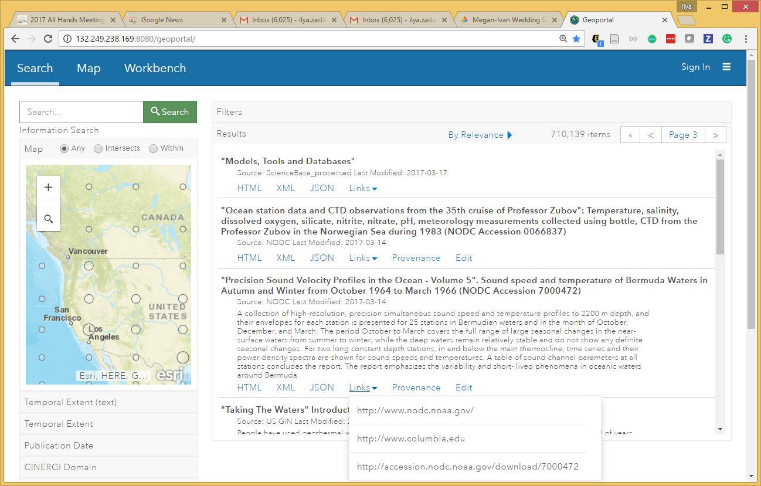
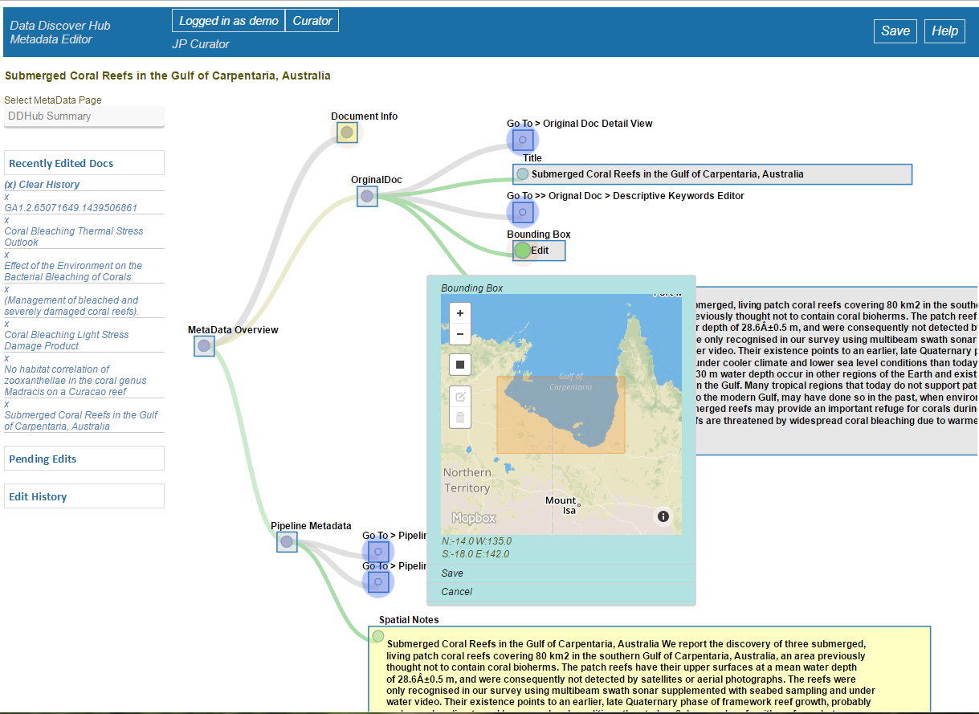
EarthCube Data Discovery Studio
Over 1.6 million records
From 40+ repositories and EC contributions
Provenance tracing
Metadata editing
Automated semantic processing and indexing
Faceted search
New: interfacing with EC Workbench
Metadata automatically enhanced through CINERGI

Slide 5
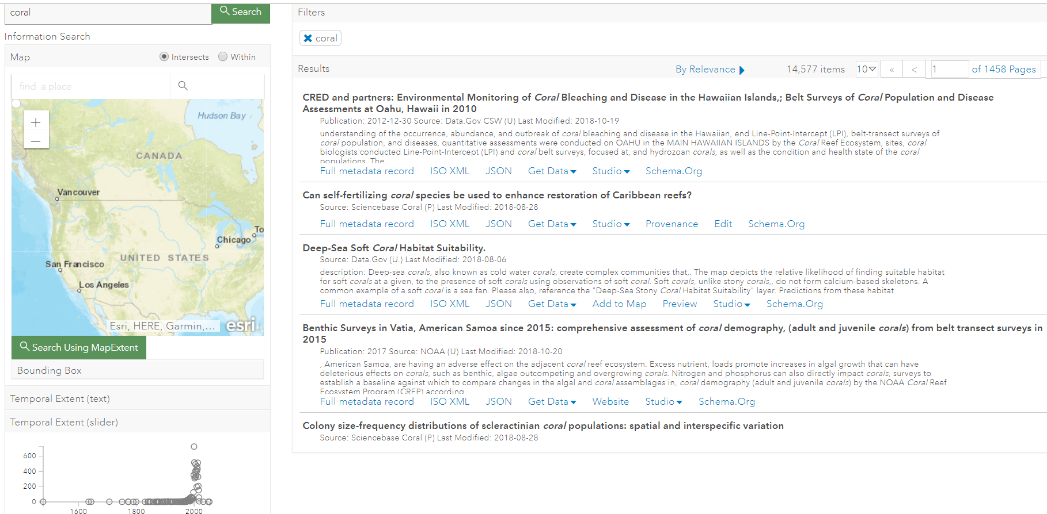
DEMO 1
http://datadiscoverystudio.org

Slide 6
Metadata Sources in Data Discovery Studio
USGS
NOAA/NCEI
CUAHSI
Data.gov
USGIN
NGDS
CZO
NCDC
CORIS
DataCite
Re3data/databib
EarthCube projects
RCNs: C4P, SEN, ECOGEO, CRESCYNT
Model catalogs (NOAA, EPA, TESS)
Geoscience Australia
OpenTopography
IEDA (MGDS, ECL, MetPetDB)
EarthRef MagIC
CINERGI Cyberinfrastructure resources
DDH use cases

Slide 7
Data Discovery Studio -
Coral reef research
as a representatively diverse and complex disciplinary use case

Slide 8
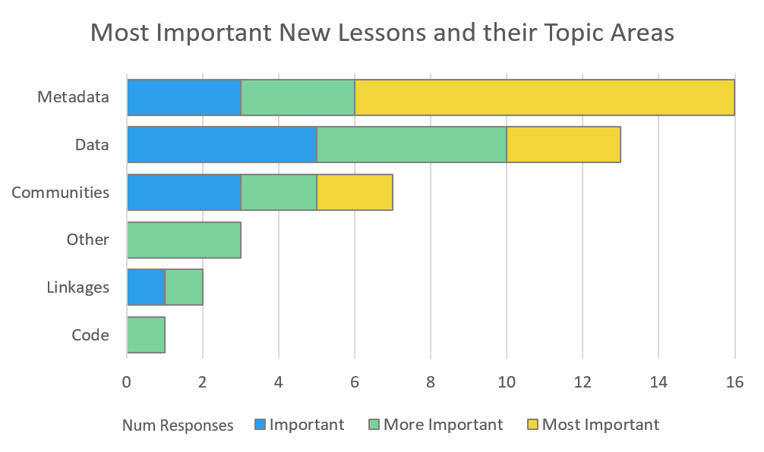
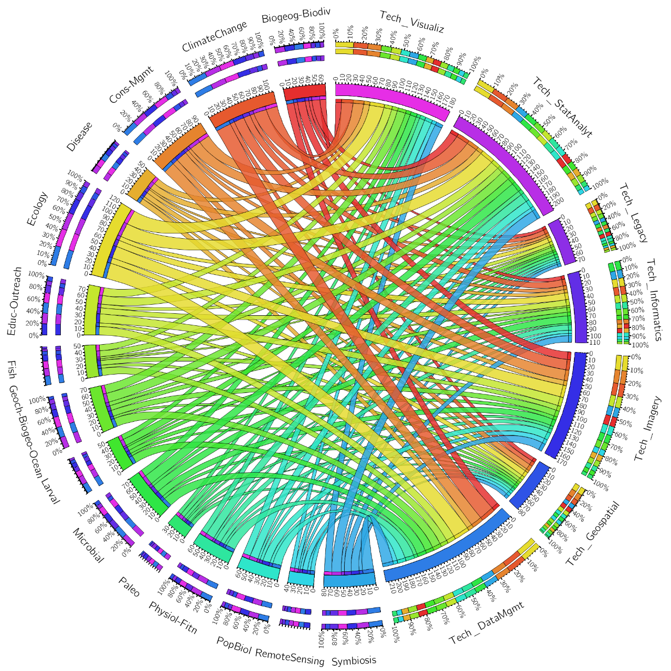
Coral reef research spans multiple scales of space and time, and uses and produces many different data types
_____________ Disciplines ___________ ___________ Technologies ________

Slide 9
Coral reef scientists self-identify as multidisciplinary
with multiple technological needs
_____________ Disciplines ___________ ___________ Technologies ________

Slide 10
Coral reef data resides in many formal (and informal) repositories
…so finding, storing, and sharing data are challenges

Slide 11
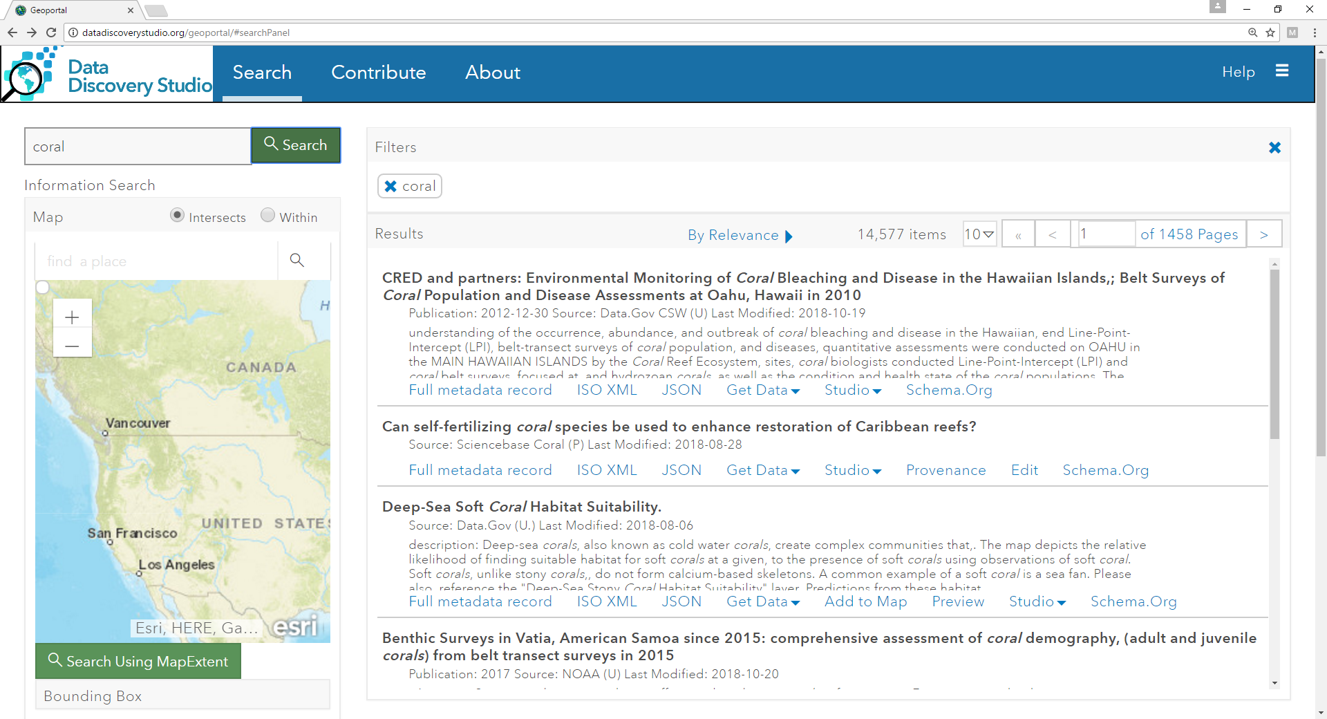

Slide 12
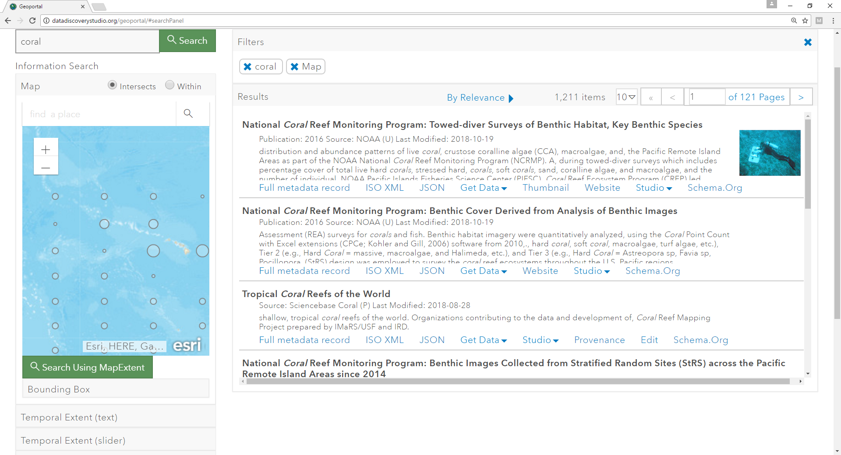

Slide 13
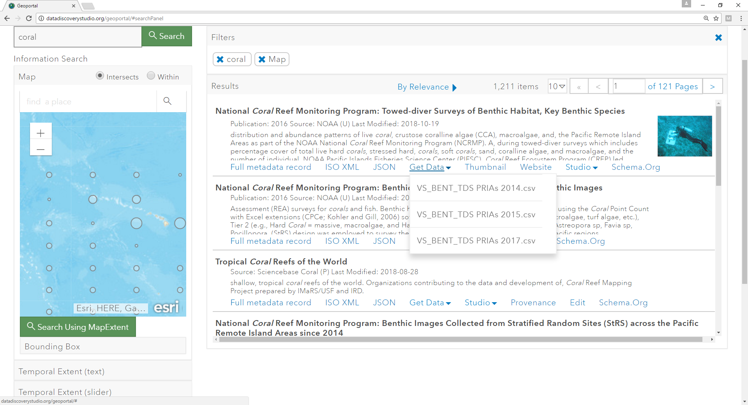

Slide 14
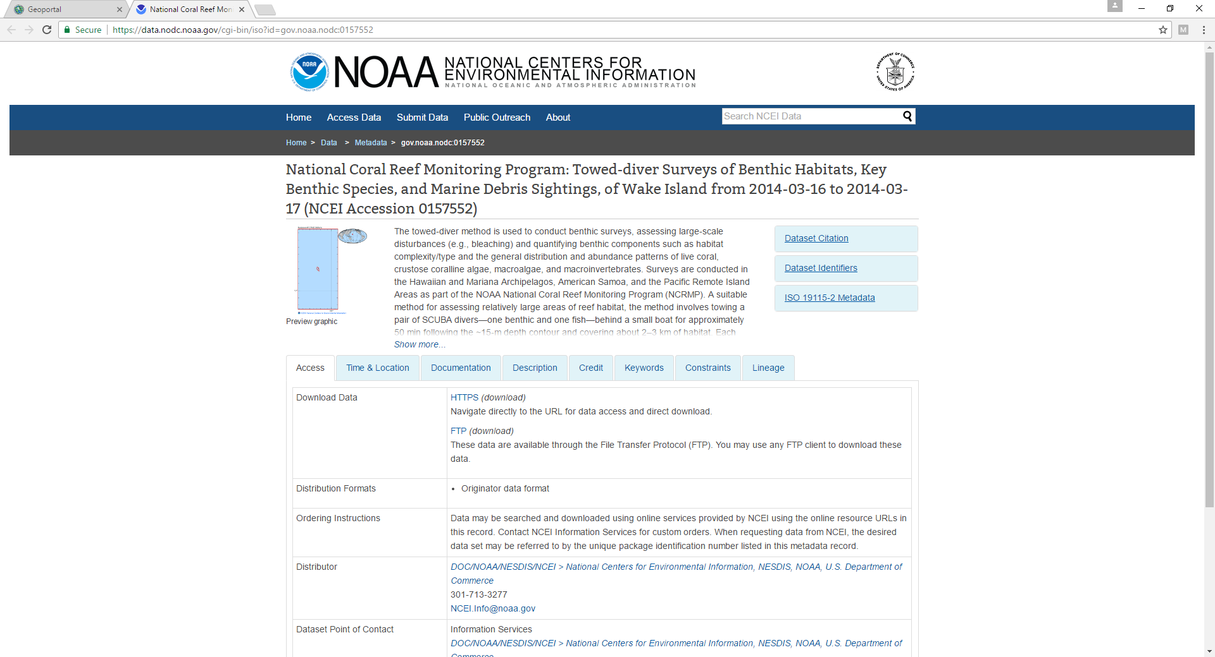

Slide 15
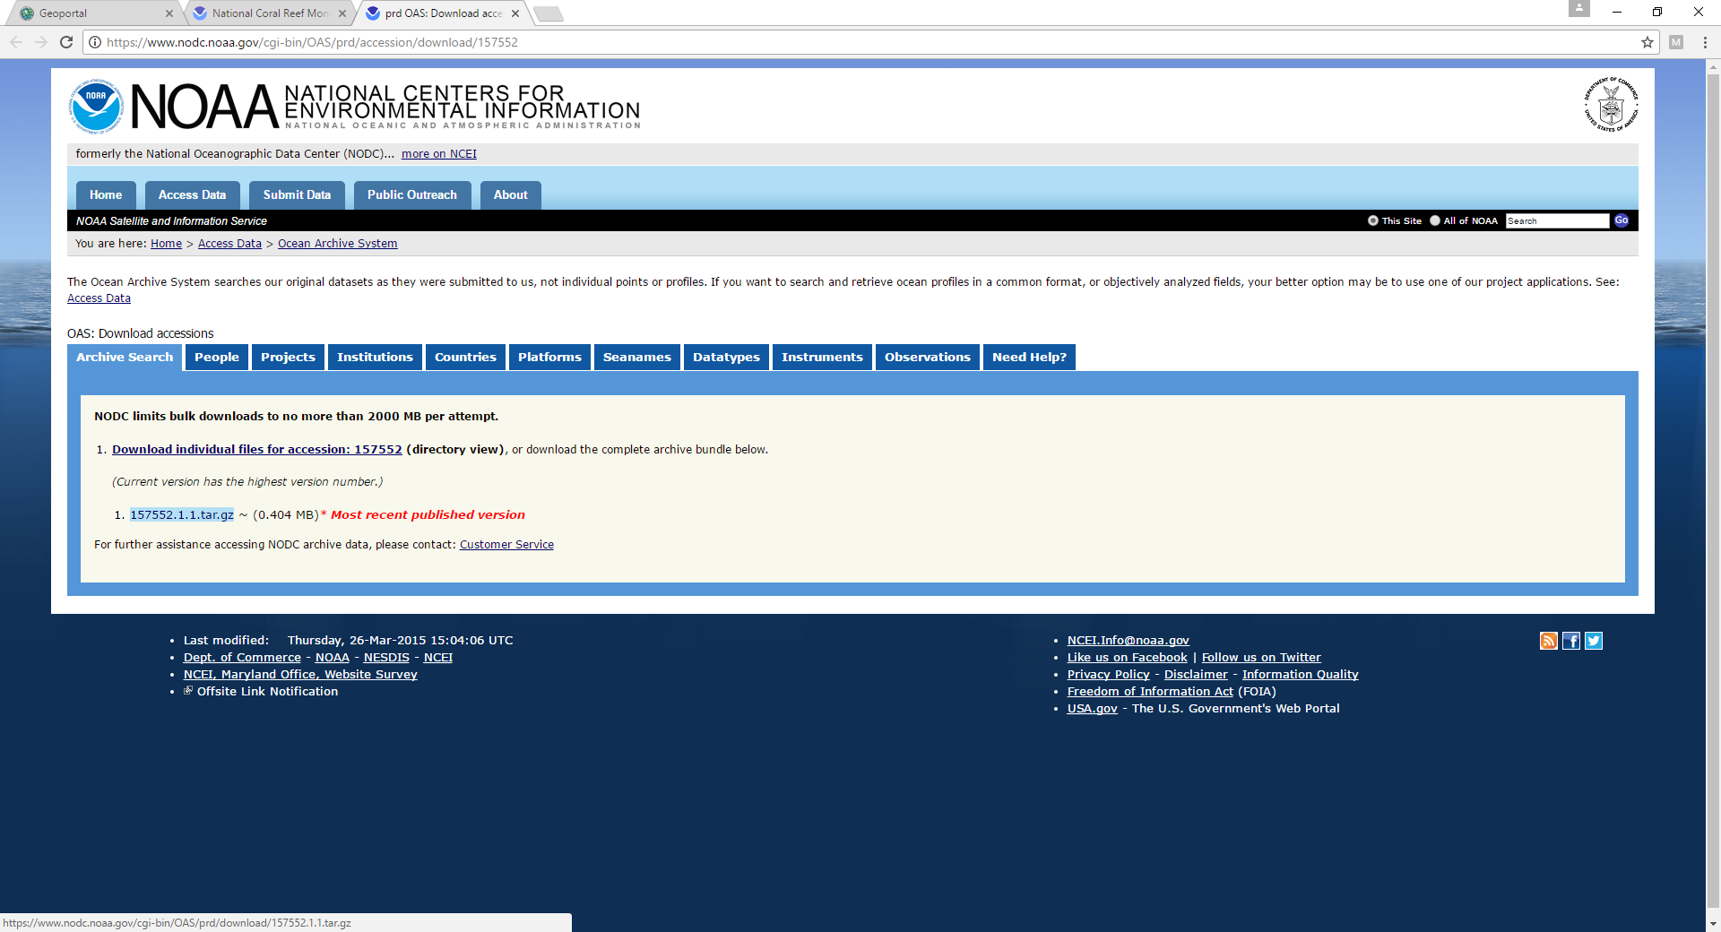

Slide 16
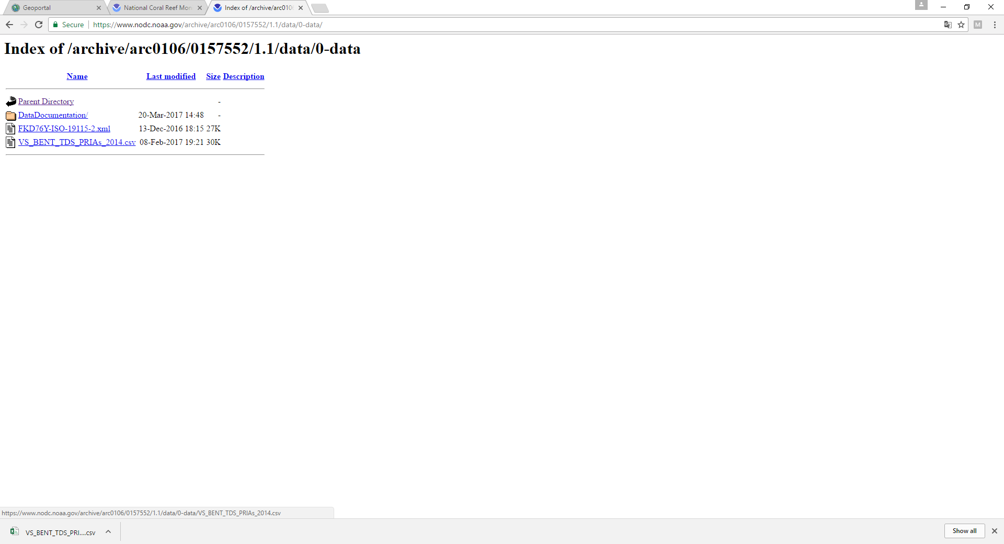

Slide 17
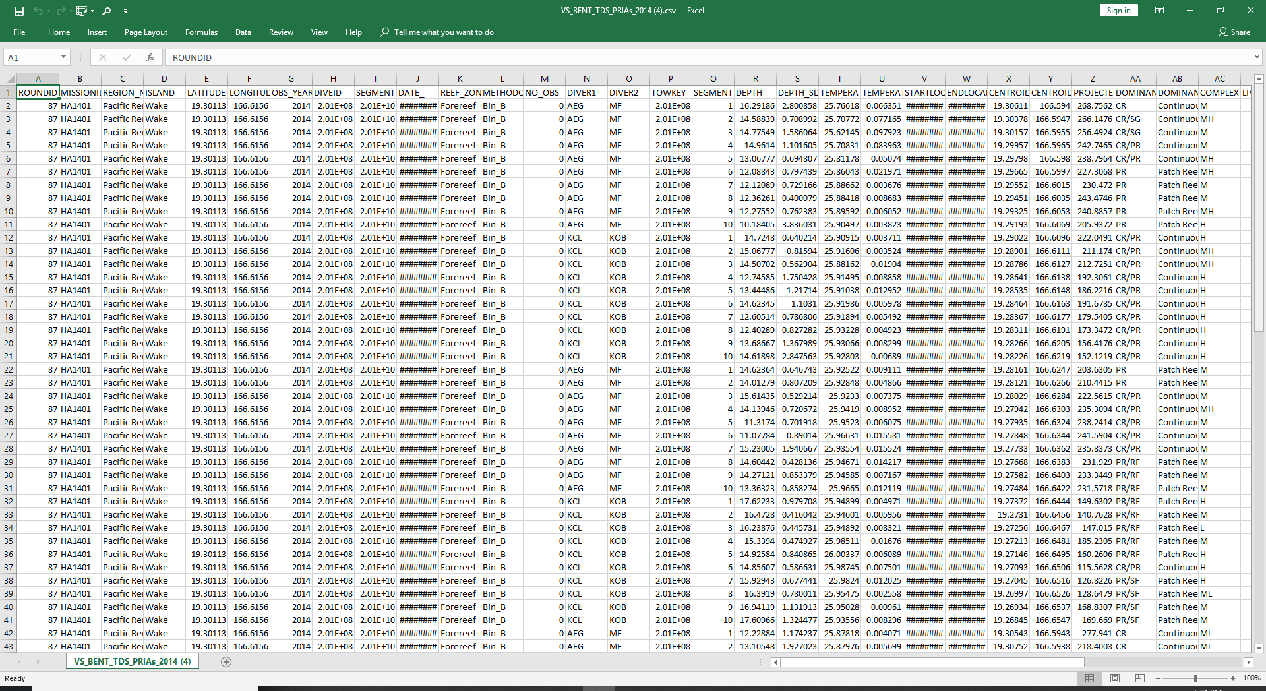

Slide 19
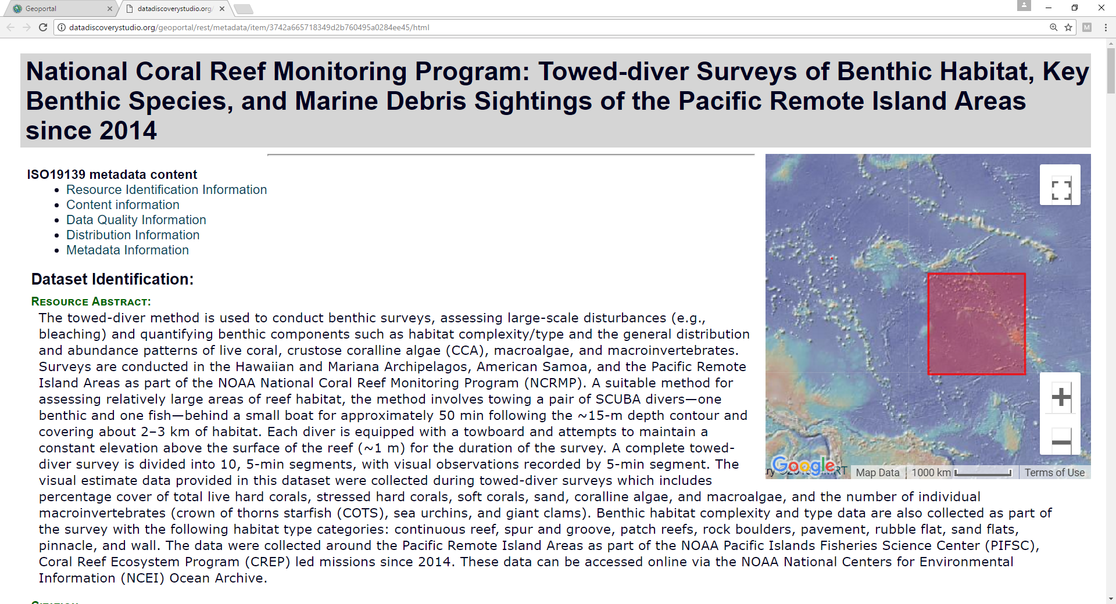

Slide 20
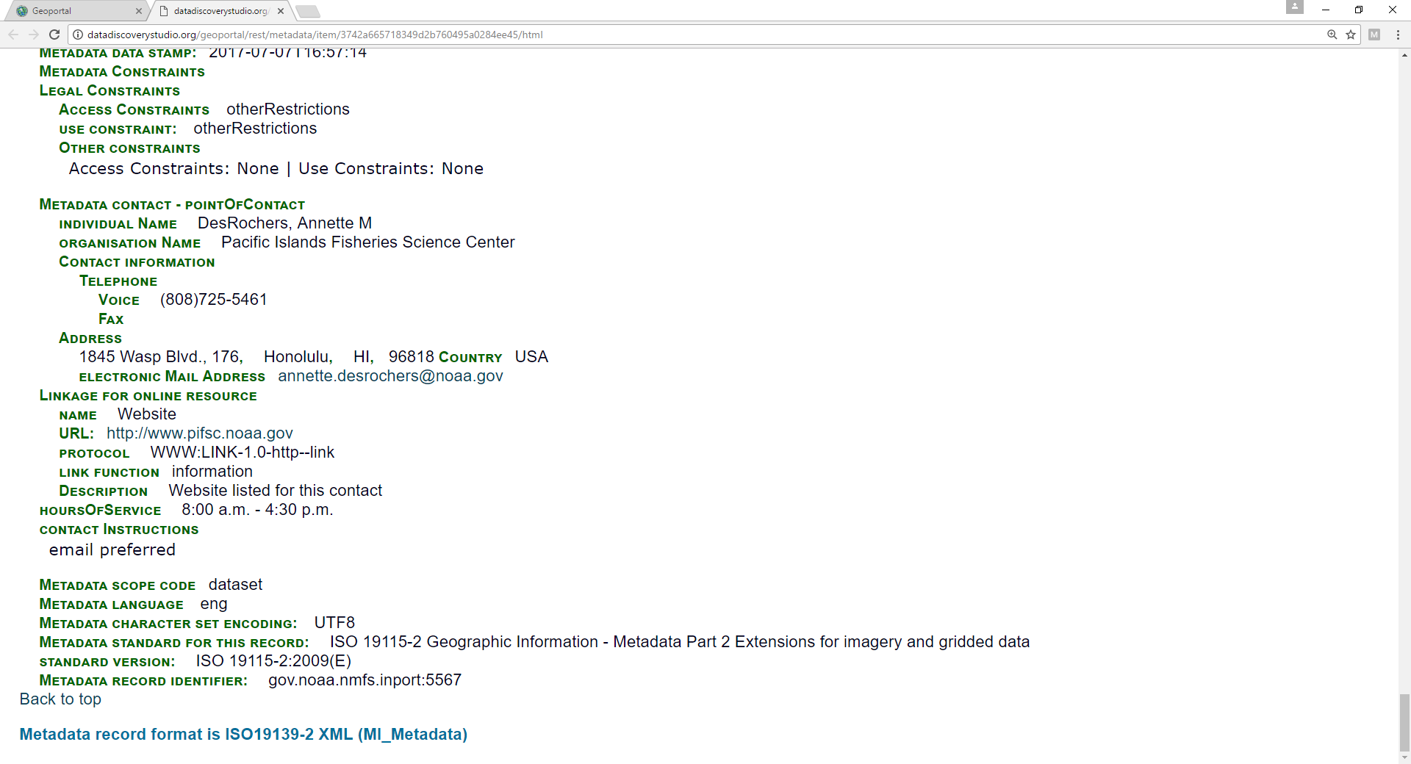

Slide 21
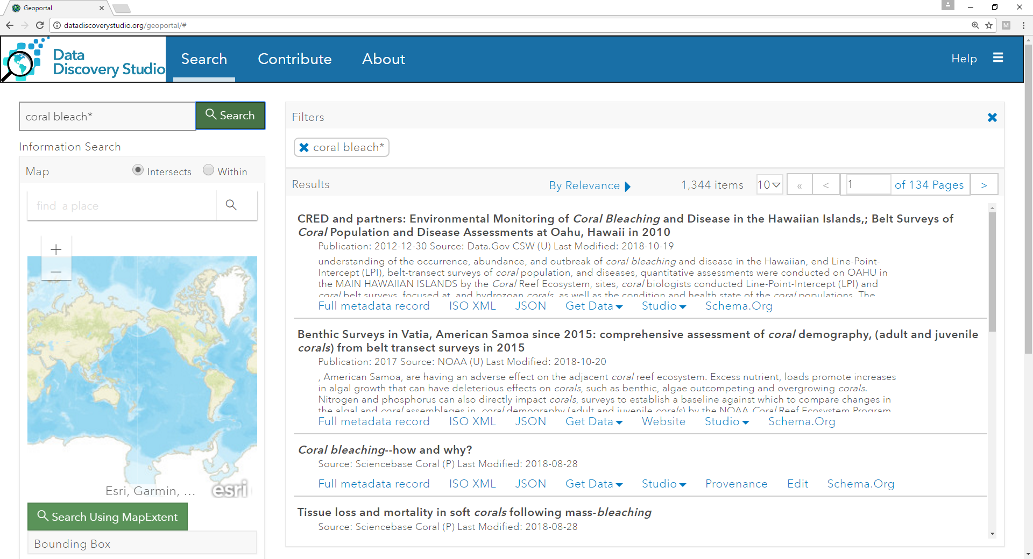

Slide 22
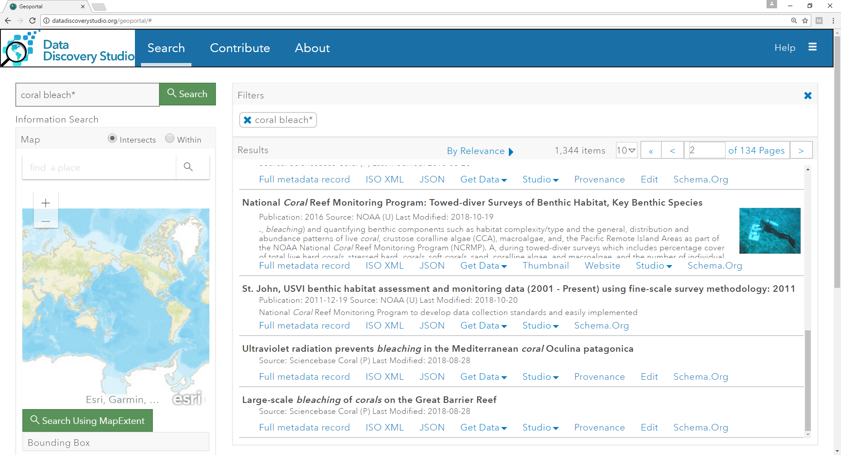

Slide 23
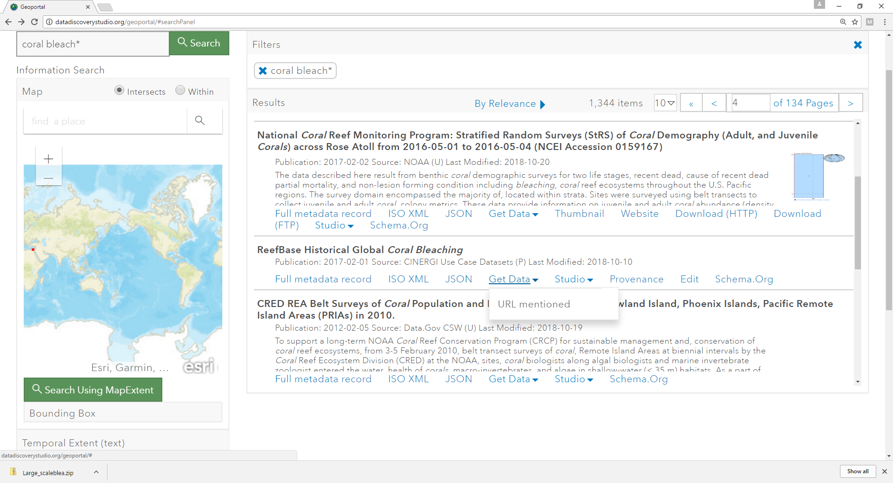

Slide 24
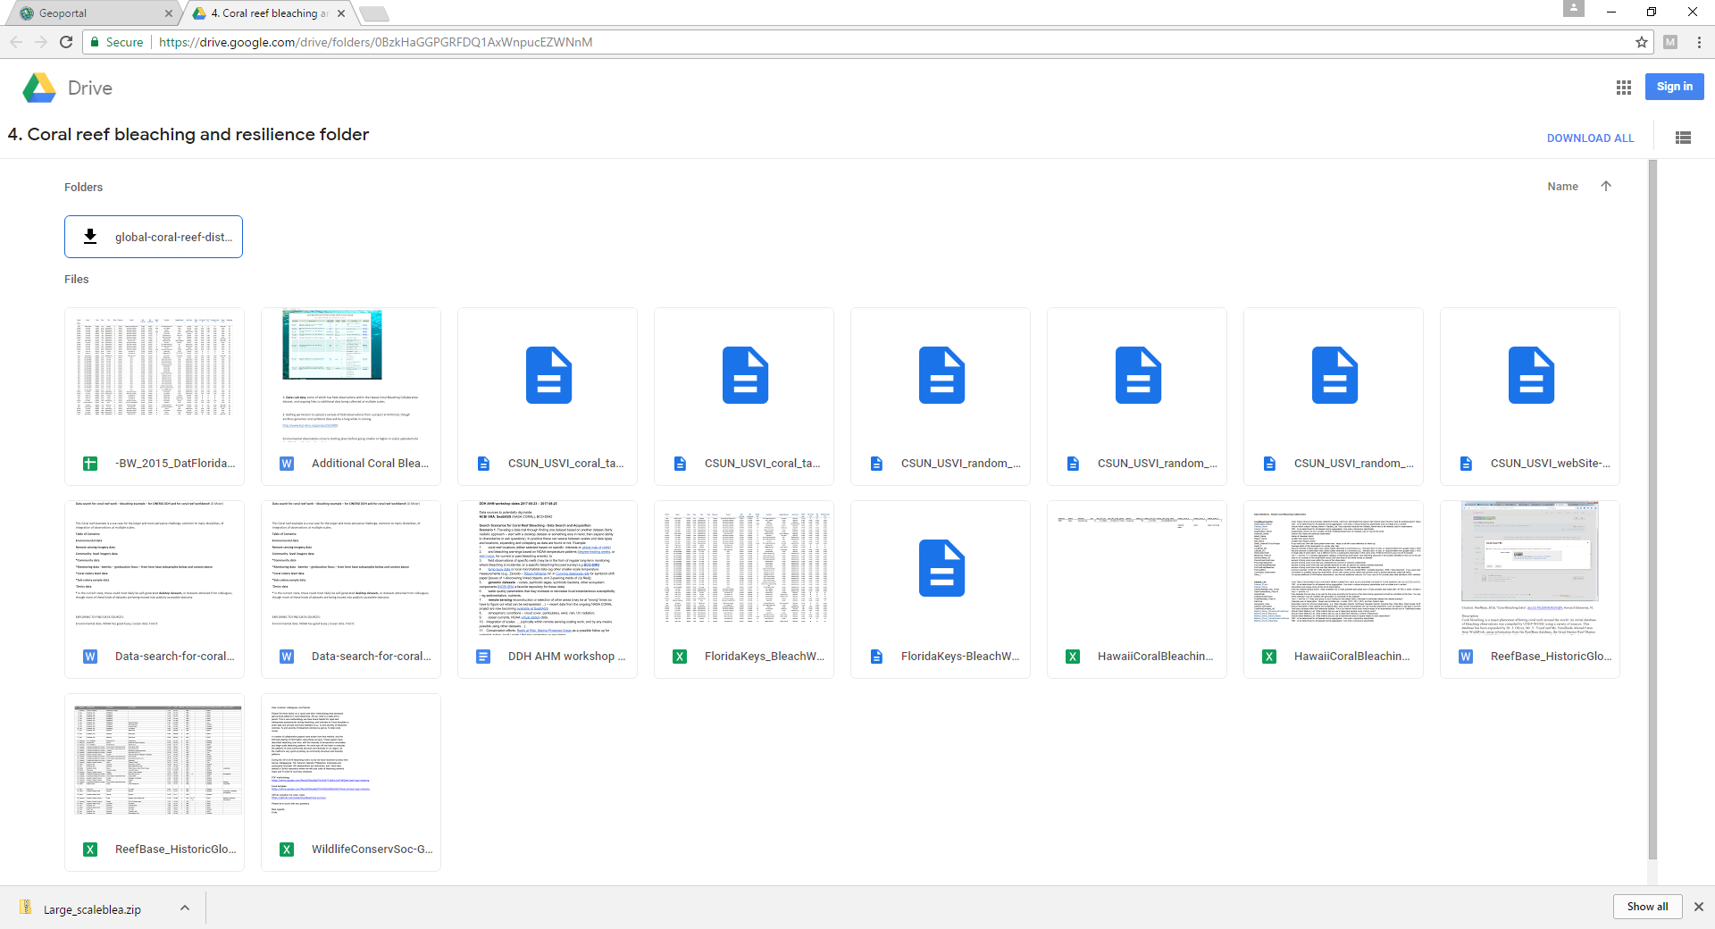

Slide 25
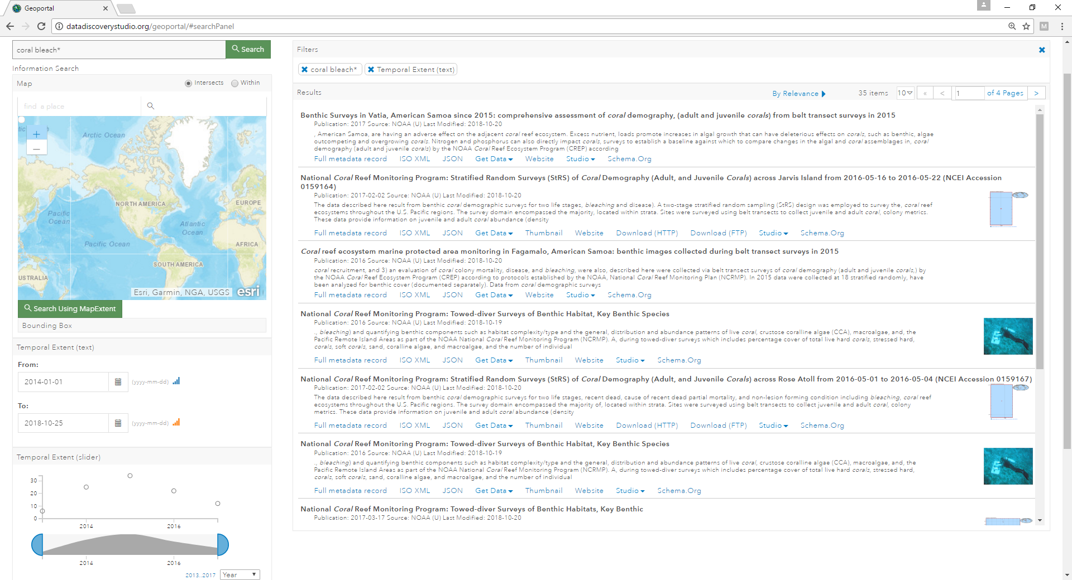

Slide 26
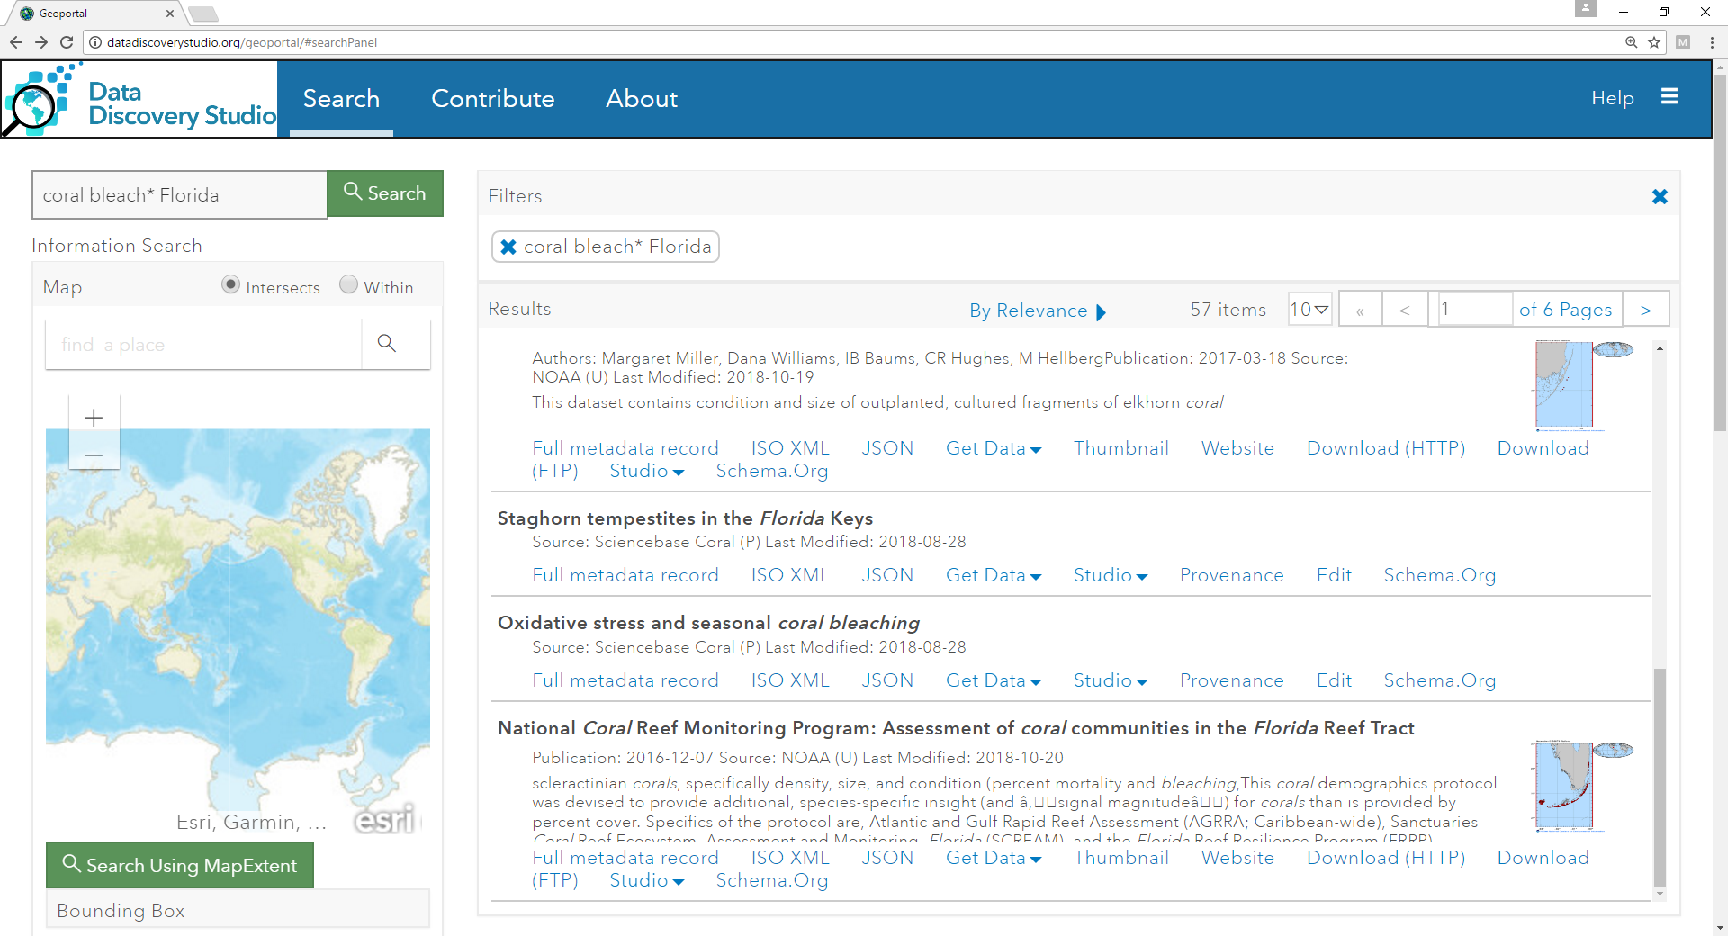

Slide 27
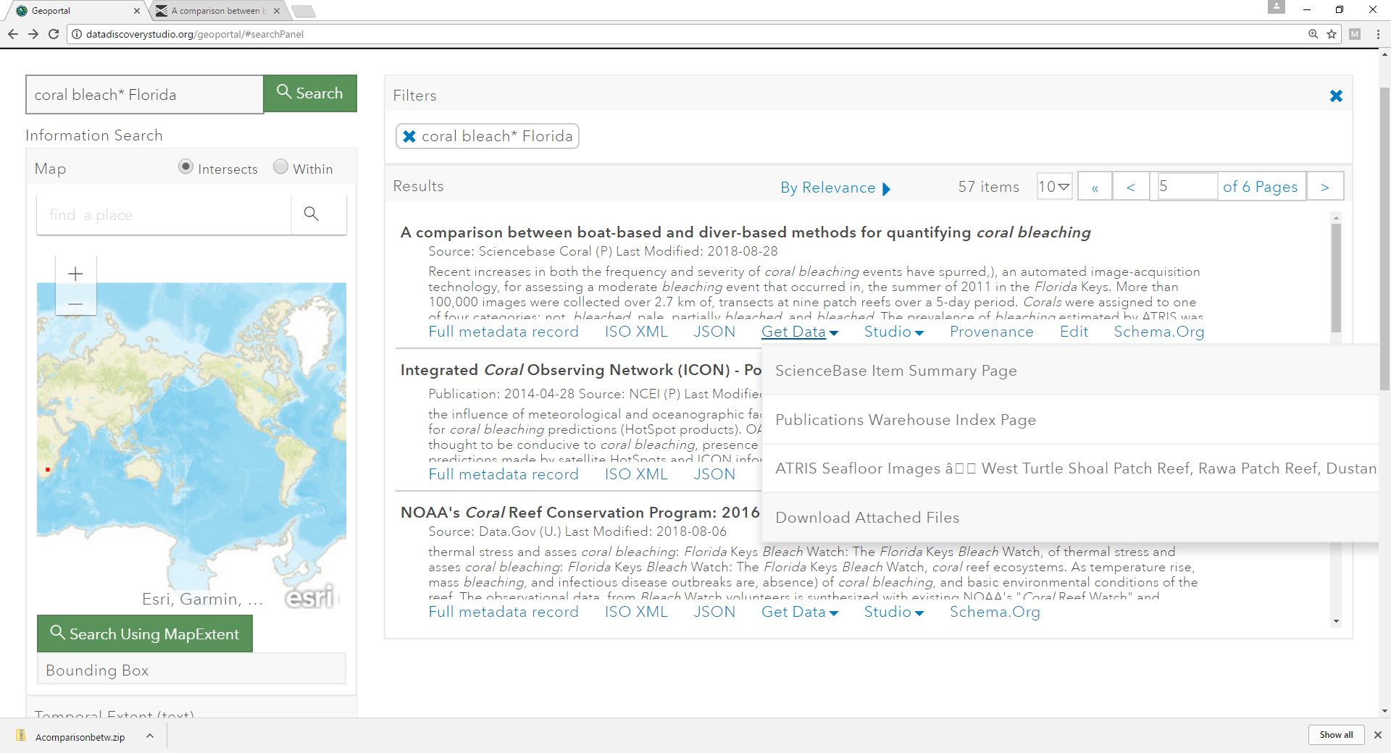

Slide 28
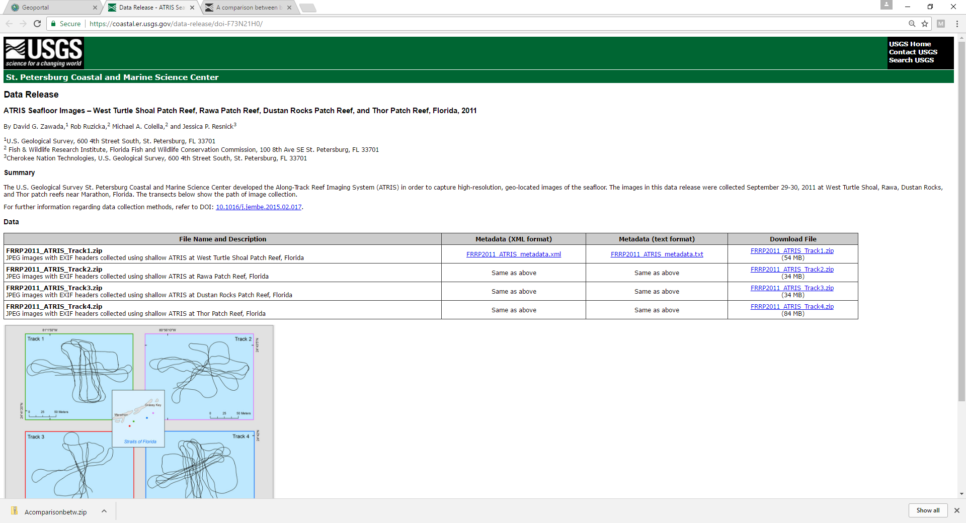

Slide 29
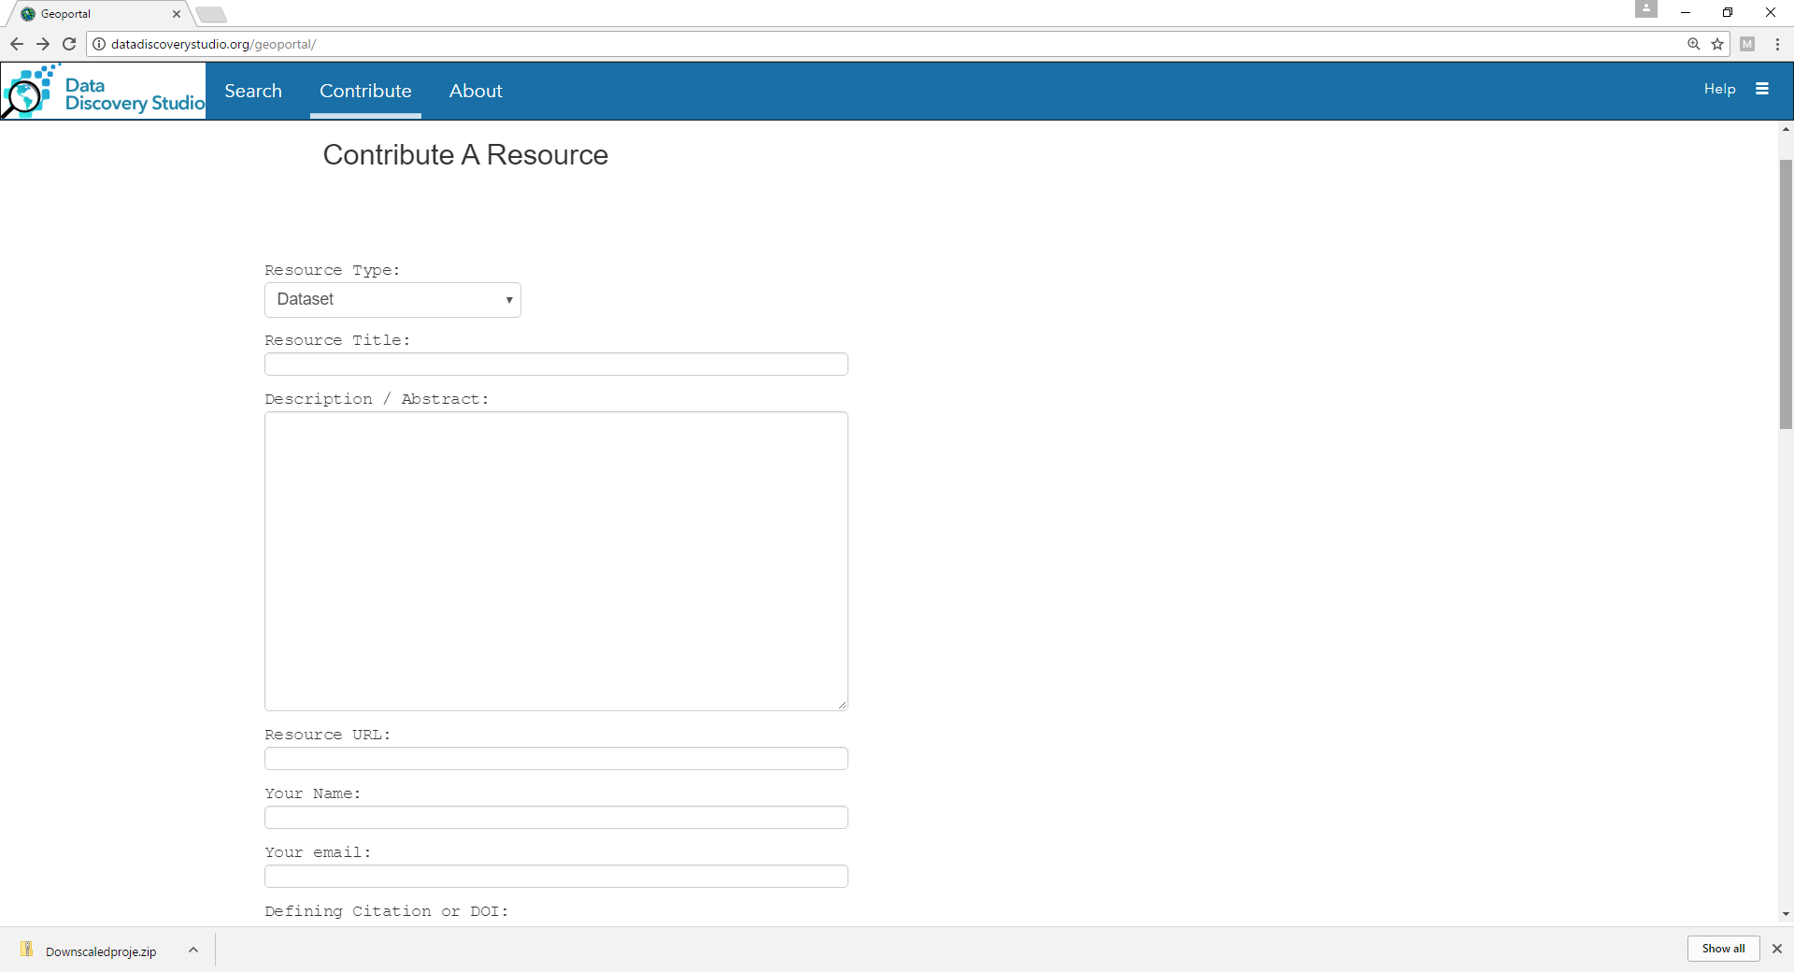

Slide 31
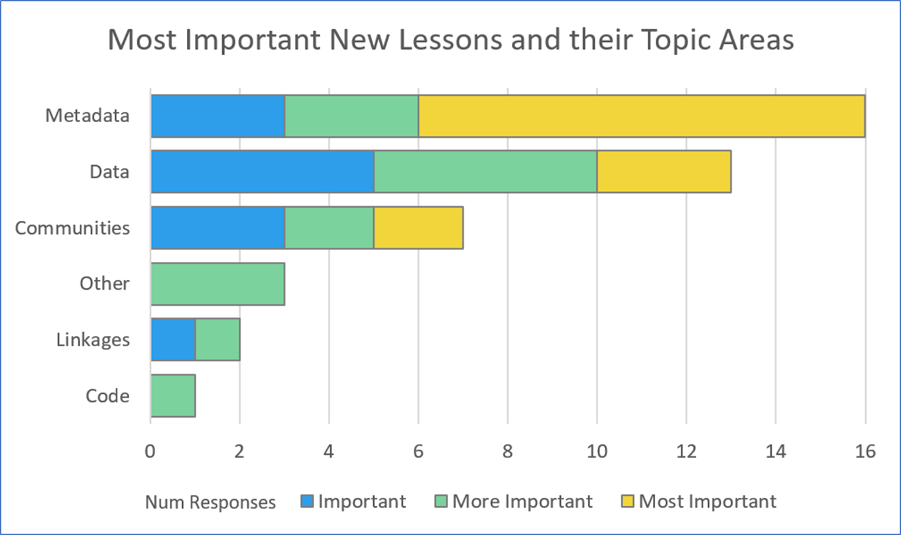
Coral reef researchers are growing to appreciate the power of metadata to maximize data sharing and integration.
The Data Discovery Studio is a research tool that helps harness the power of metadata for richer targeted data access and exploration
– beyond discovery.

Slide 32
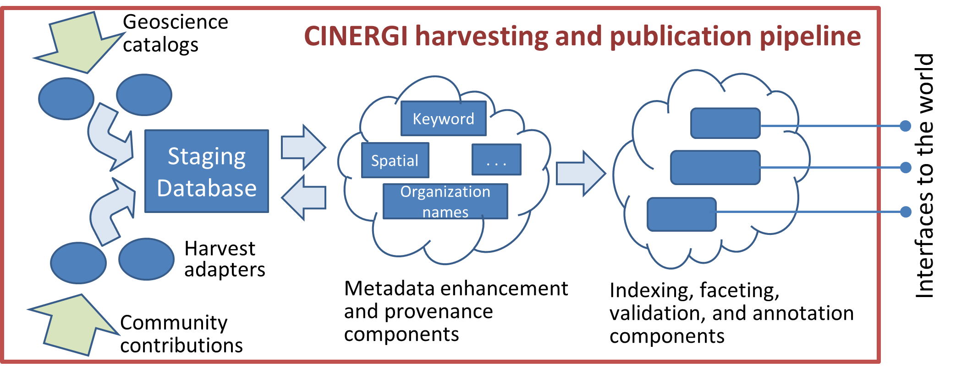
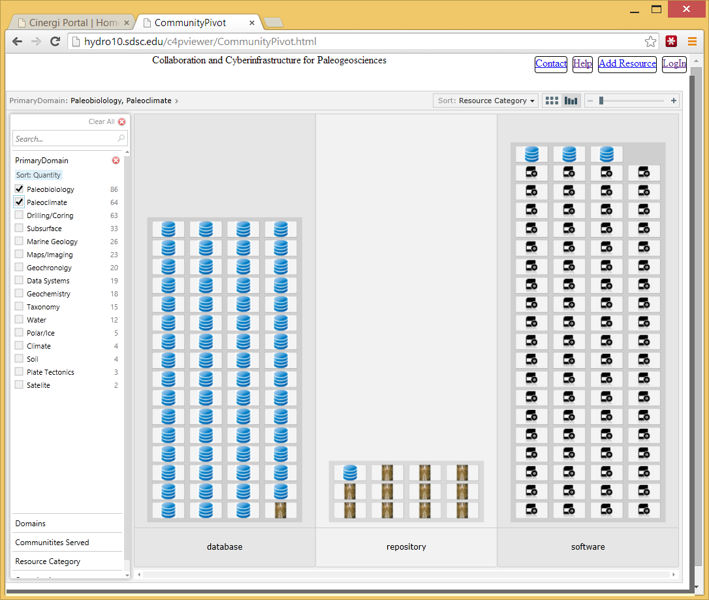
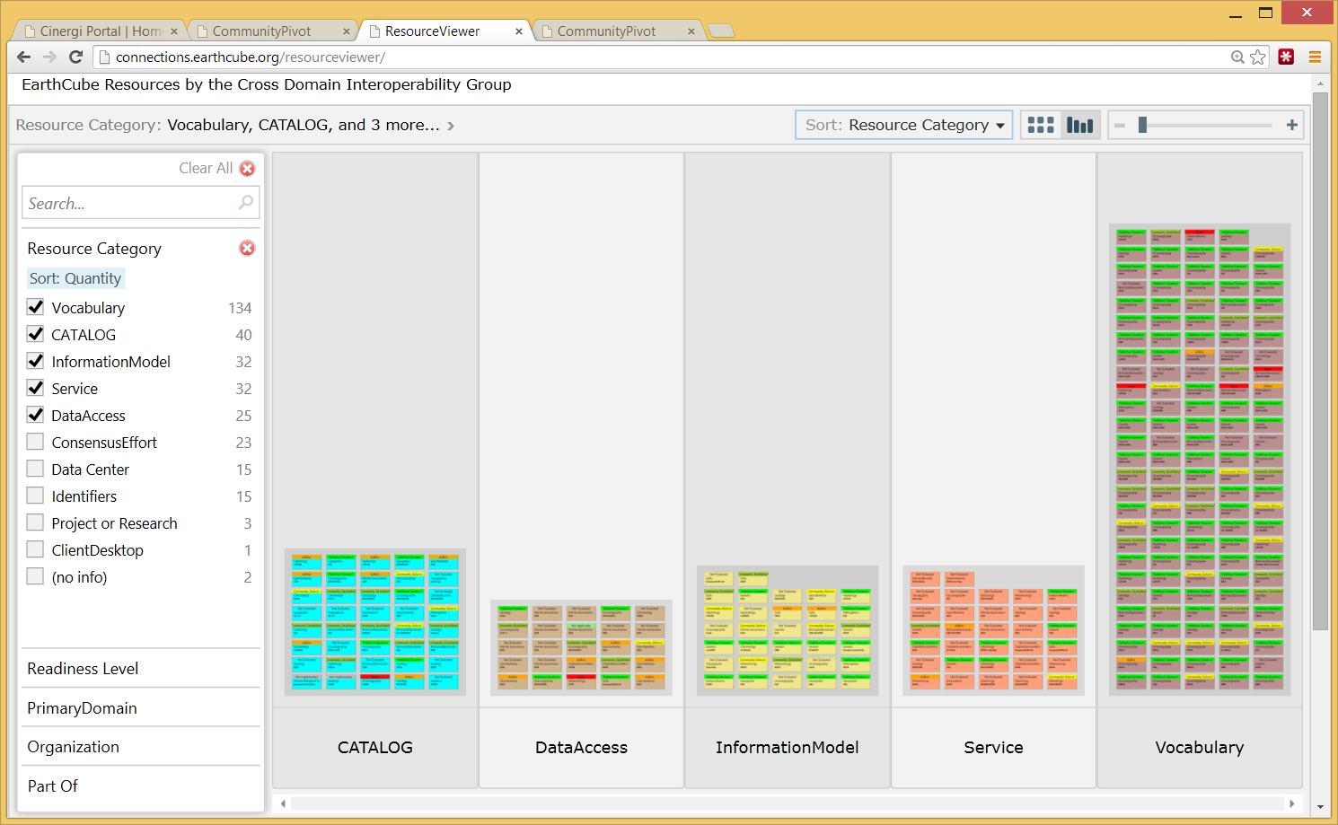
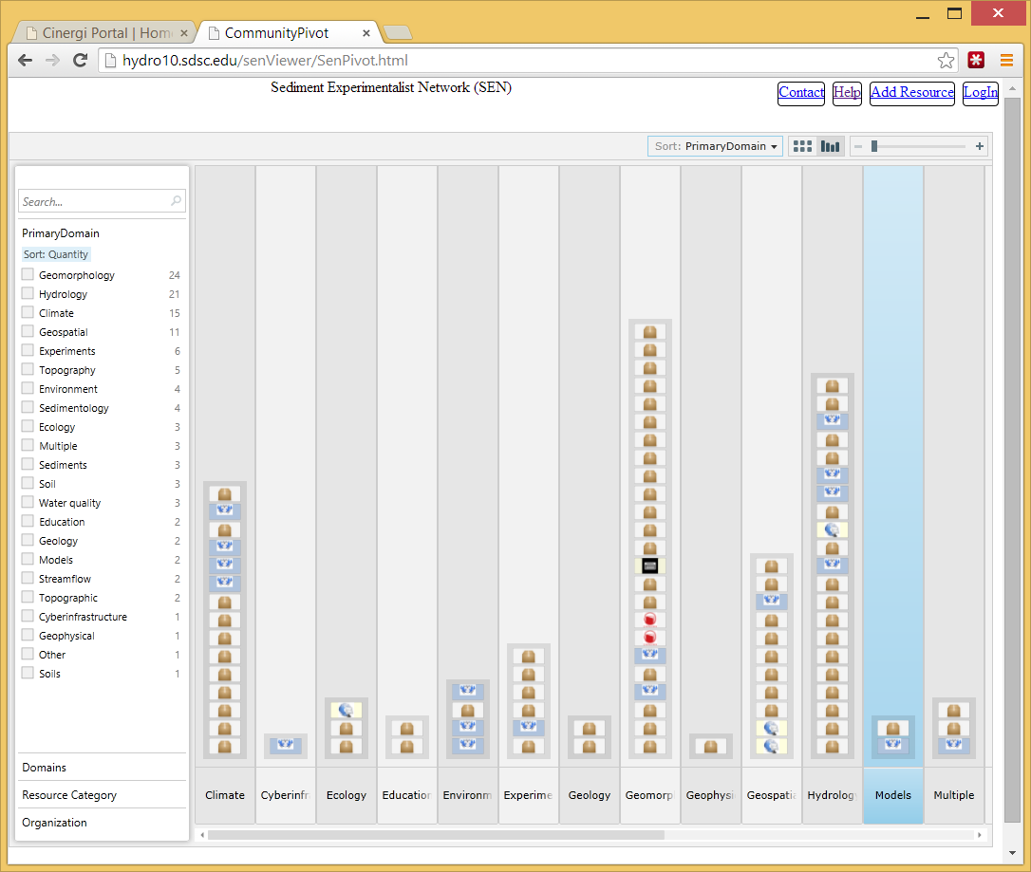
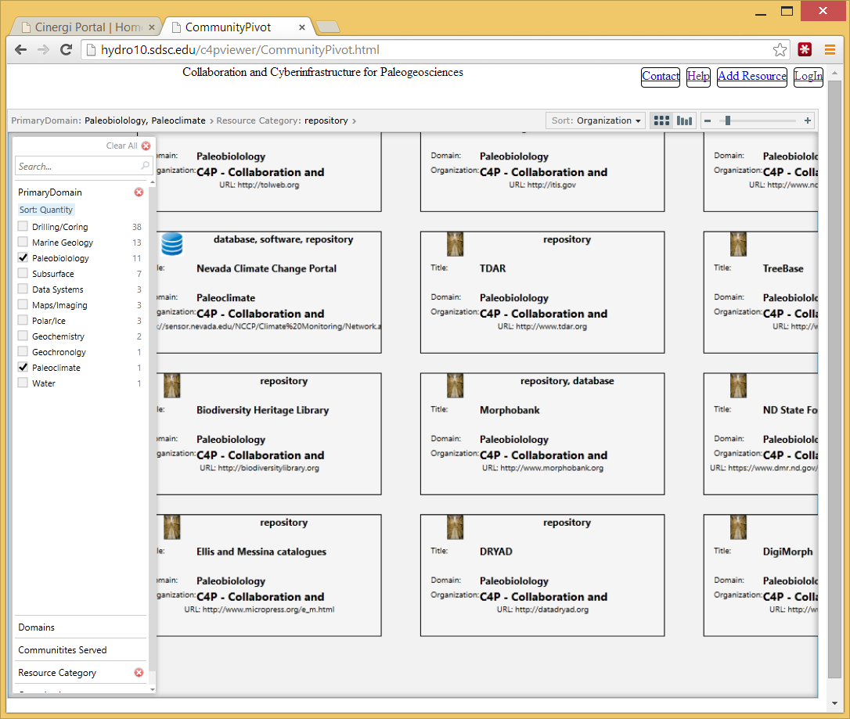
The CINERGI Metadata Pipeline CINERGI: Community Inventory of EarthCube Resources for Geoscience Interoperability
Domain Inventories
Domain workshops
Content enhancement
High-level assets
RCN (Research Coordination Networks)
http://cinergi.sdsc.edu/

Slide 33
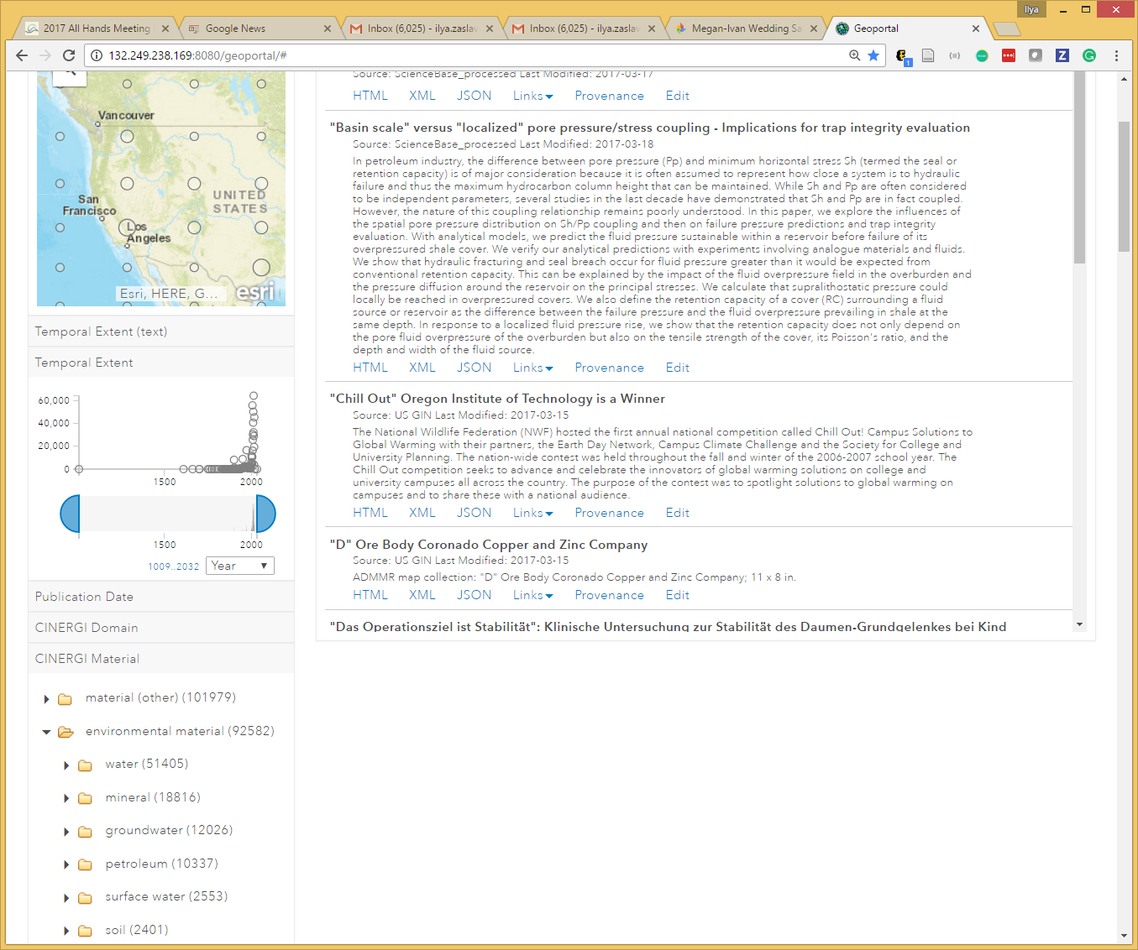
Content Enhancement Components
Common enhancer API
Provenance recording: W3C PROV and Neo4J
Spatial enhancer (bounding boxes)
Keyword enhancer
Materials; Processes; Equipment; Methods; Features; Activities; Science Domains; Geologic age; Organizations; Resource types
Organization Enhancer
Associate with Virtual Authority Identifiers
Collection Enhancer
Add keywords to a metadata collection
Schema validation

Slide 34
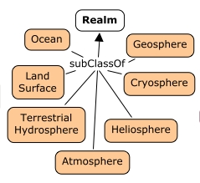
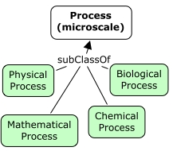
GeoSciGraph and Ontologies
GeoSciGraph ontology management system provides semantic infrastructure.
It relies on a cross-domain ontology of geoscience terms, amalgamating several independently developed ontologies or taxonomies
Some included ontologies:
SWEET
ENVO
CHEBI
YAGO (geo features)
NASA GCMD (equipment, providers)
GeoSciML
Geochronology
EDAM Bioinformatics (software terms and operations)
Also: VIAF
Added annotation properties for combining ontology fragments
(cinergiFacet, cinergiParent)
Metadata editor
Approve or discard
semantic annotations

Slide 35
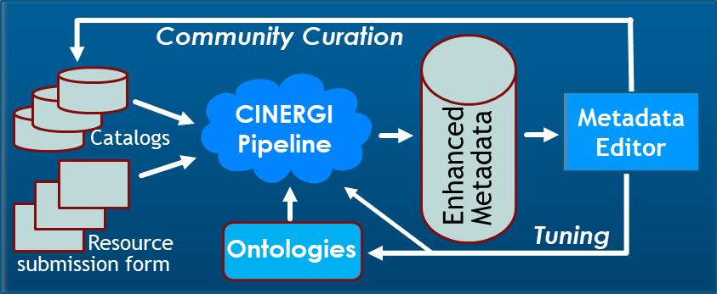
Towards a New Curation Model

Slide 36
Beyond Search: Data Discovery Studio
Trace provenance
Enhance and validate metadata
Retrieve and explore data
Workbench integration
Text
Spatial
Temporal
Facets
Register additional resources
Edit metadata
Republish to Google Search

Slide 37
Beyond Search: Data Discovery Studio
Trace provenance
Enhance and validate metadata
Retrieve and explore data
Workbench integration
Text
Spatial
Temporal
Facets
Register additional resources
Edit metadata
Republish to Google Search

Slide 38
DEMO 2
http://datadiscoverystudio.org

Slide 39
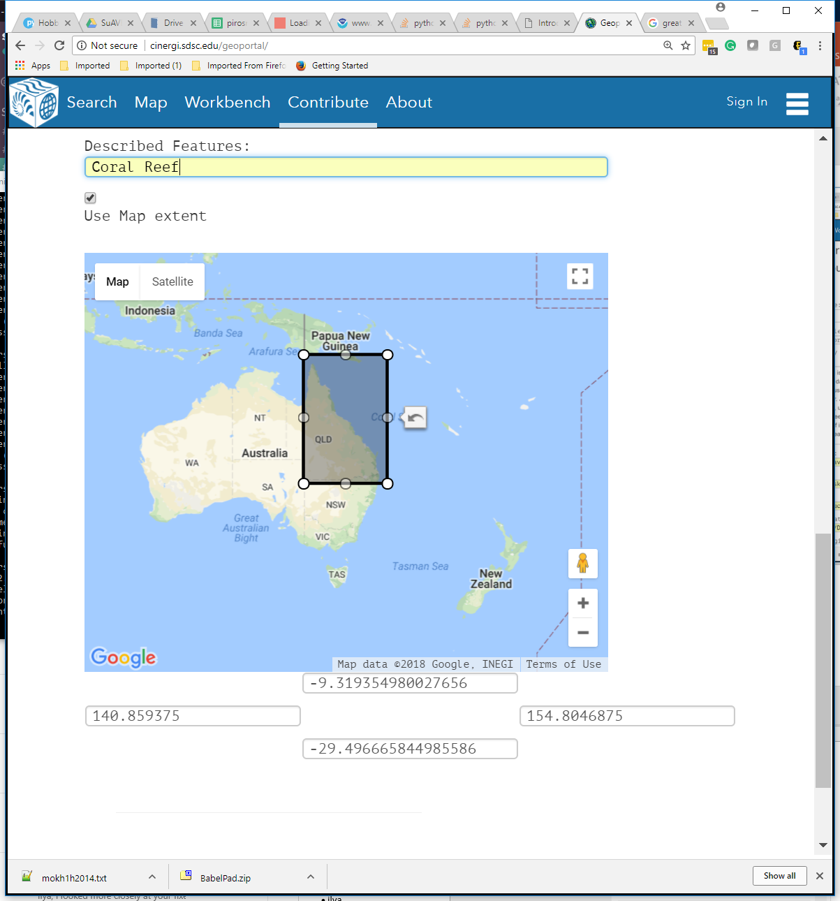
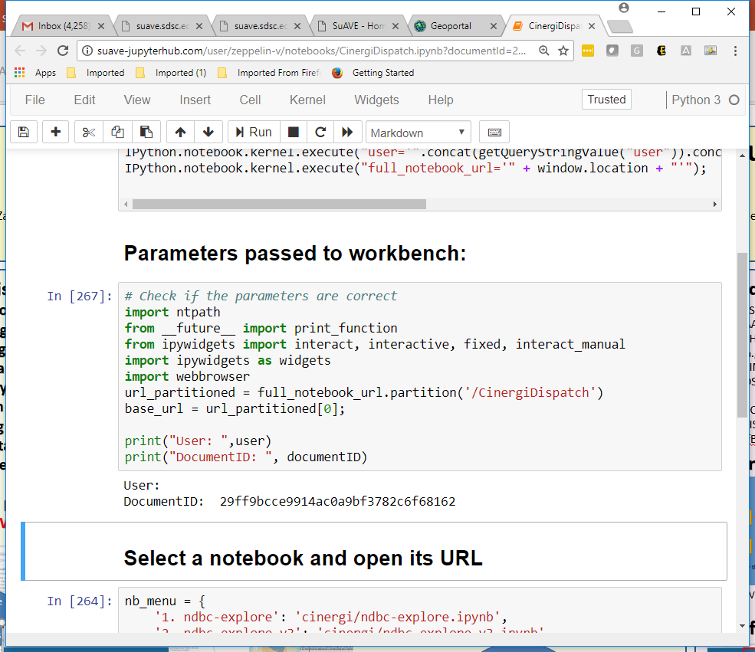
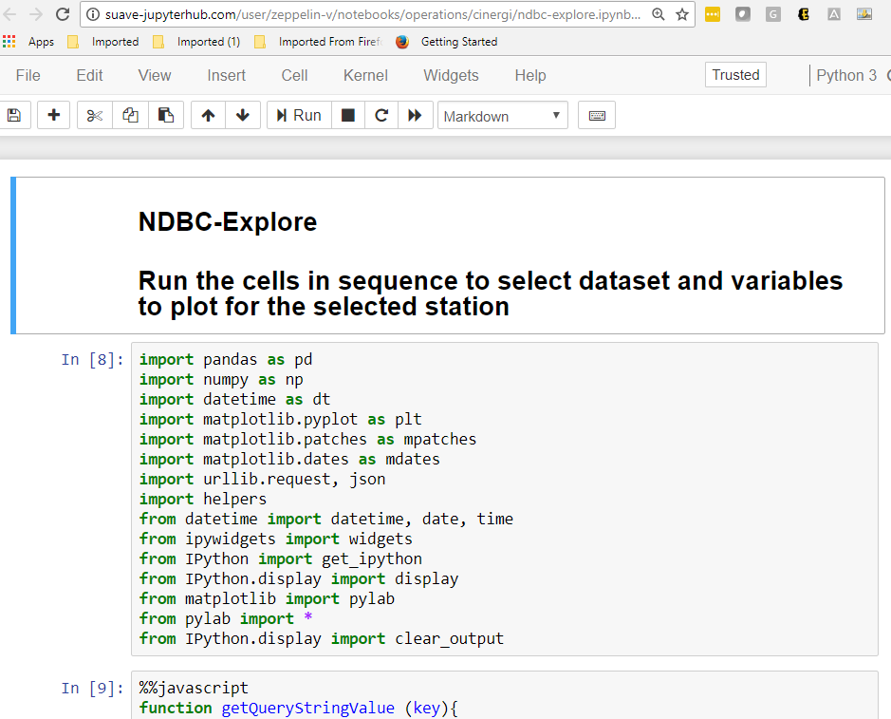
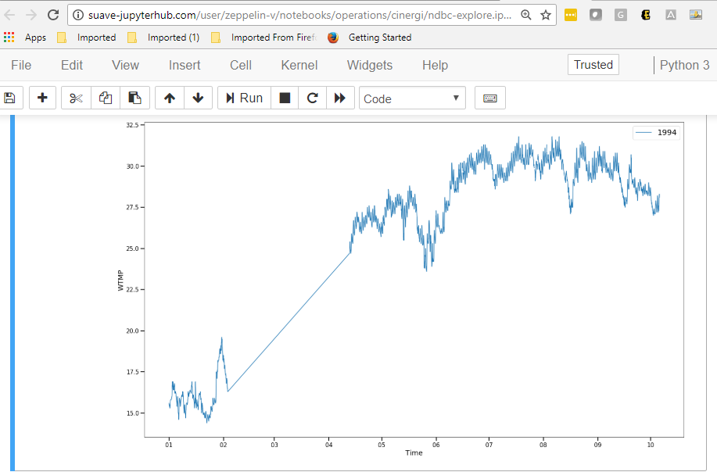
From Data Discovery to Research Workflows in EarthCube
Document IDs
Data Discovery
Workbench
Usage metadata
Community contributions
Metadata editing and validation
Provenance
DDS “dispatcher” notebook
Workbench Integration
1.6+ mil registered and semantically enhanced metadata records from 30+ sources
“Operational” notebooks
Schema.org vocabularies
http://datadiscoverystudio.org
Notes:
To summarize, this is what we have now

Slide 40
Data Discovery to Research Workflows
GOAL: minimize the effort (clicks, forms, software) required to get from choosing a dataset in search results to using it for research.
Components:
How are data accessed
What software does it work with
Client applications

Slide 41
Data Type Registry
Define data types used to serialize data for online access
File format
Information model
Serialization scheme
Vocabulary used
Assign identifiers for these

Slide 42
Examples:
OneGeology GSML lite geologic unit;
IRIS GeoCSV earthquake hypocenter,
NWIS RDB groundwater levels
Observations:
A steward organization defines profile details– vocabularies, encoding details (date format…), conventions for alternate approaches
File format is serialization scheme
Feature or observation type– the information model

Slide 43
Data Access Workflow
Include identifier for Data Type for distribution
Protocol defines interface for accessing the data type
Registry provides binding between data type, protocol and applications

Slide 44
Frictionless Access
Metadata content needs machine-actionable links for dataset distribution
ISO metadata elements:
URL
Name
Description
Function: controlled vocabulary {information, download, search, offlineAccess, order, fileAccess}
Protocol
Appliction Profile

Slide 45
Analysis of Distribution Links: Protocol
group | count
HTTP | 1180883
FTP | 13680
WMS | 2288
KML | 1821
OpenDAP | 786
WFS | 580
THREDDS | 517
ESRI | 282
WCS | 153
err | 114
ECWS_REST | 34
LAS | 24
AWS S3 | 2
GridDAP | 2
 | 1201166
~1.4 million distribution links from ~500,000 records
Protocol 13 useful values
Mostly HTTP-- Landing pages, information page

Slide 46
Analysis of Distribution Links: Application Profile
group | count
browser | 708284
ftp | 13601
openDAP | 1095
err | 1019
function | 410
tool | 51
THREDDS | 49
Google Earth | 36
kml | 21
REST | 10
wms | 7
ESRI client | 4
wfs | 4
ERDDAP | 2
 | 724593
Only ~ half of records have
12 useful values
Mostly web browser

Slide 47
Analysis of Distribution Links: Function
group | count
information | 1159718
download | 229499
err | 4238
search | 3963
offlineAccess | 1787
order | 53
fileAccess | 34
 | 1399292
6 useful values
Mostly web browser

Slide 48
How to Improve Metadata Content
Enhancer to parse URL:
Parse name and description content
File extensions
Local path structure
Parameters
Follow links to web pages and extract information?

Slide 49
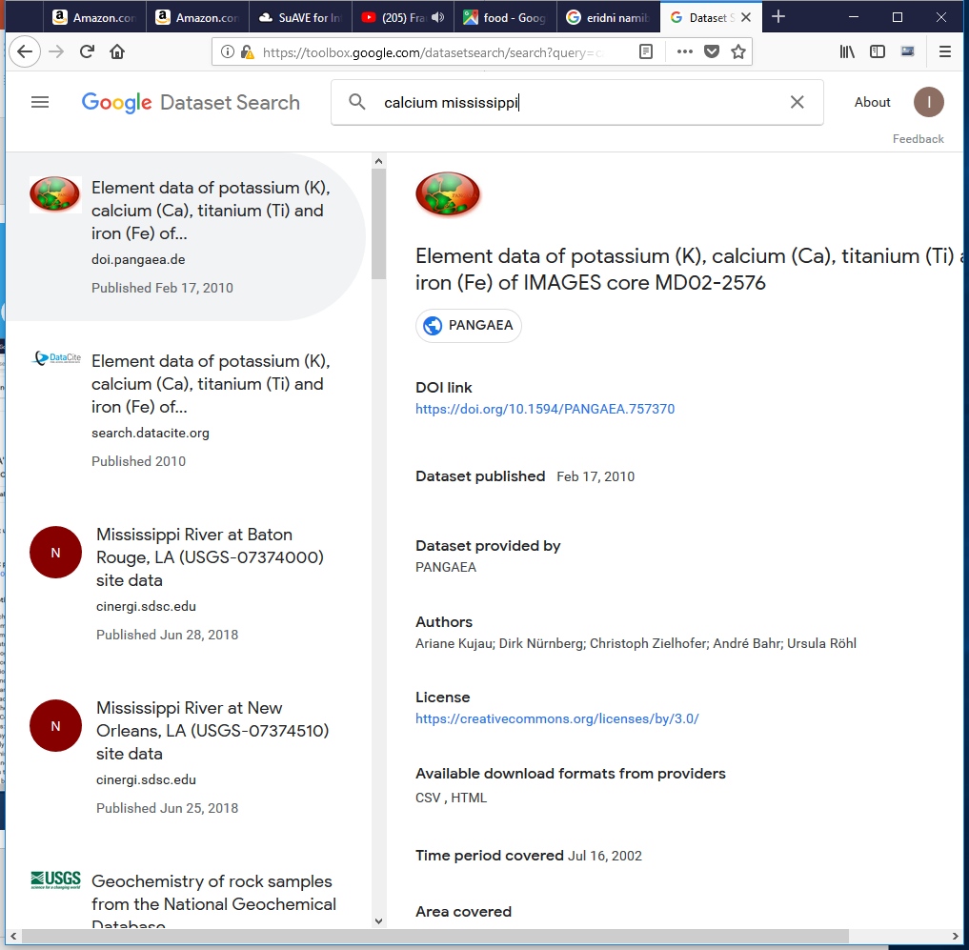
Connection with Google Dataset Search
https://toolbox.google.com/datasetsearch
Schema.org markup is created on the fly for all records
If you don’t yet publish your datasets in schema.org – you may do so through the Data Discovery Studio
Our resources are indexed by Google dataset search
The records are semantically-enhanced via the pipeline

Slide 50
Data Discovery Science Competition (a pre-announcement)
DDS: Learning from data to improve data discovery, understanding and re-use… Beyond common data search
Category 1: assemble a collection of resources addressing a research question (also, edit resource descriptions to make them easier to discover for this use; contribute and describe missing resources)
Category 2: contribute a Jupyter notebook to explore an additional resource type (Instructions)
Submission by May 1
Awards: TBD
Email datadiscoverystudio@gmail.com if you have questions

Slide 51
Acknowledgements
The DDS team: Ilya Zaslavsky, David Valentine, Karen Stocks, Jeffrey Grethe, Amarnath Gupta, Burak Ozyurt (UCSD); Stephen Richard (Columbia Univ and USGIN), Gary Hudman (AZGS), Ouida Meier (Univ of Hawaii), Bernhard Peucker-Ehrenbrink (WHOI)
Science Gateways Community Institute:
Claire Stirm
Ilya Shunko
Nayiri Mullinix
NSF awards: ICER 1639764, 1639775, 1639557 (EarthCube Building Blocks: Collaborative Proposal: EarthCube Data Discovery Hub)

Slide 52
Call for Contributions
Which additional resources would you want to see indexed by the system?
Additional workflows (implemented as notebooks?) to integrate, working with your favorite data types or sources
Or use other mechanisms besides notebooks
Which data types or data sources are a priority?
Help review and curate metadata from your favorite repositories or in your area of expertise
Questions?

