Slide 1
NASA Archives and Data Stewardship in the Cloud with Cumulus
2019 Winter ESIP
Lauren Frederick
Cumulus Lead
lauren@element84.com
This work was supported by NASA/GSFC under Raytheon Co. contract number NNG15HZ39C.
This document does not contain technology or Technical Data controlled under either the U.S. International Traffic in Arms Regulations or the U.S. Export Administration Regulations.

Slide 2
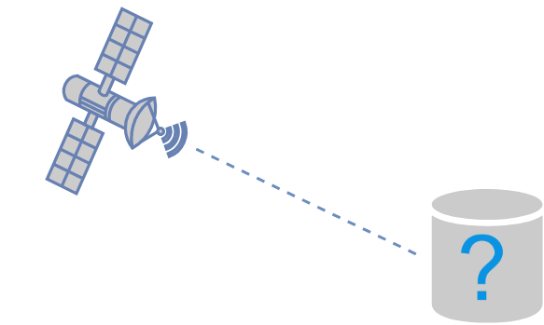
The Problem
Notes:
Icons free from draw.io
Have a satellite sending data down and the data needs somewhere to go

Slide 3
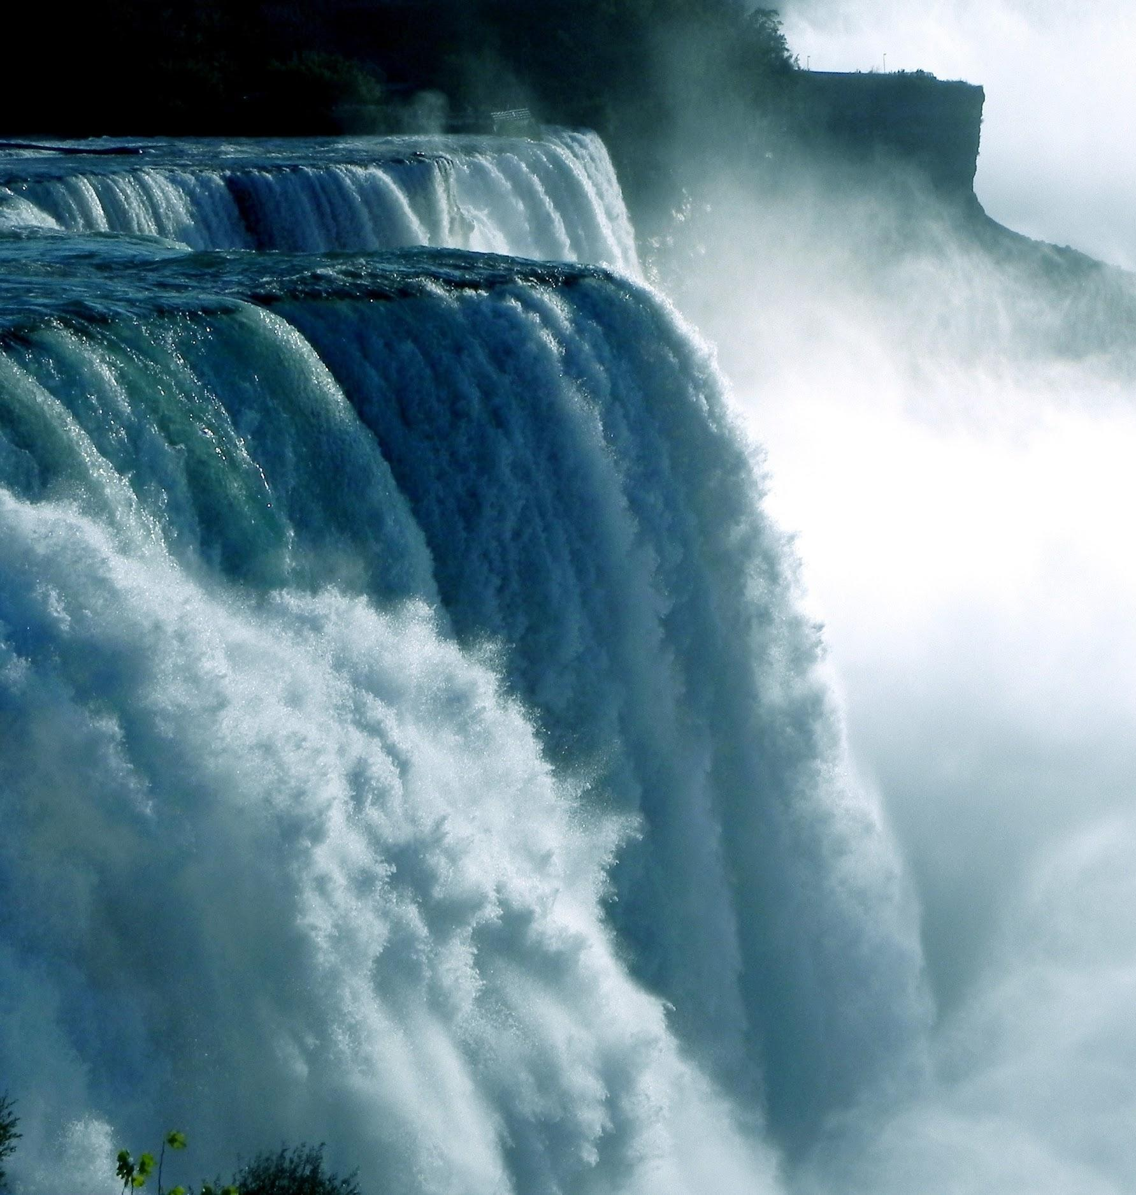
Notes:
Unprecedented amount of data
https://www.pexels.com/photo/waterfalls-during-daytime-62627/
https://www.pexels.com/photo/water-falls-illustration-149605/

Slide 4
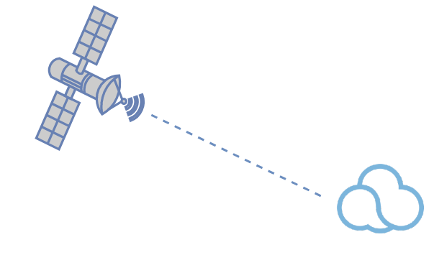
Notes:
Icons free from draw.io
Cumulus - a common set of code and services

Slide 5
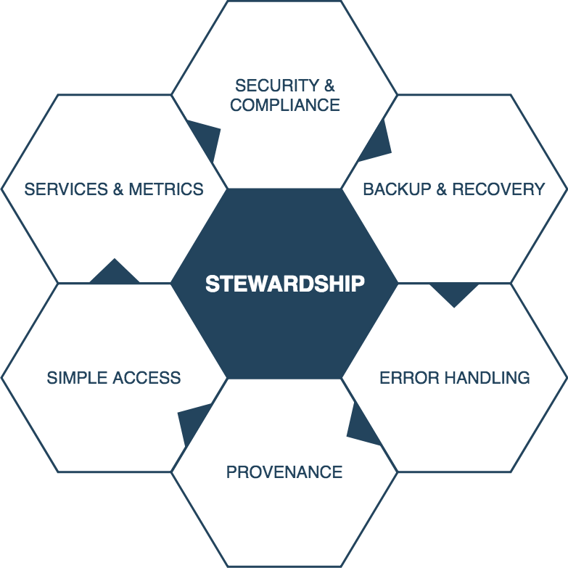
More than just storage
Notes:
What does it mean to have a science archive in the cloud?
Not just an S3 bucket, science data from billion-dollar missions that is irreplaceable and valuable

Slide 6
DAAC NGAP Account
Notes:
Icons free from draw.io
Cumulus is not a system that lives out there, you configure it and put it in your own AWS account
NASA-Compliant General Application Platform

Slide 7
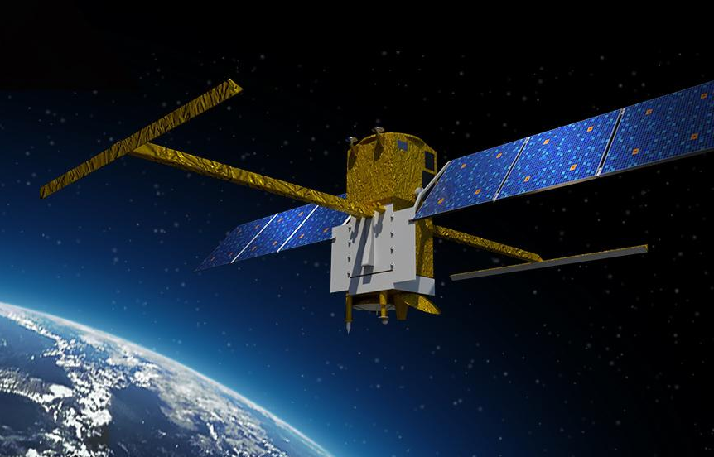
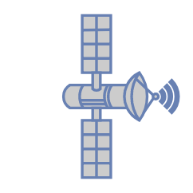
PO.DAAC NGAP
DAAC NGAP
Notes:
http://www.asc-csa.gc.ca/eng/satellites/swot.asp
https://nisar.jpl.nasa.gov/
Icons free from draw.io

Slide 8
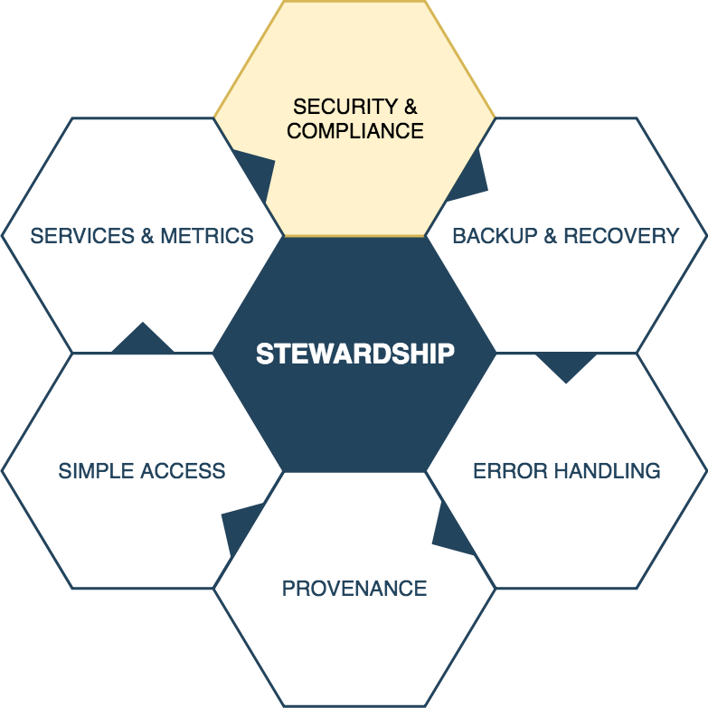
Notes:
Handled by NGAP

Slide 9
DAAC NGAP Account
Notes:
Icons free from draw.io

Slide 10
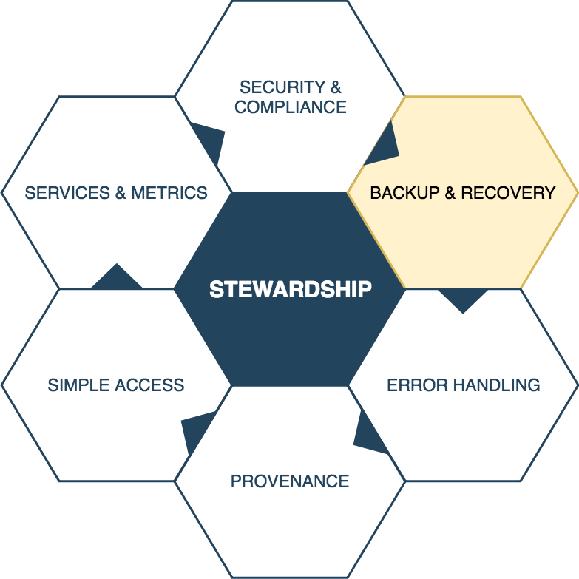
Notes:
EDPA = Earthdata (or EOSDIS data) preservation archive - backs up data
Cumulus backs up metadata, but not actual data

Slide 11
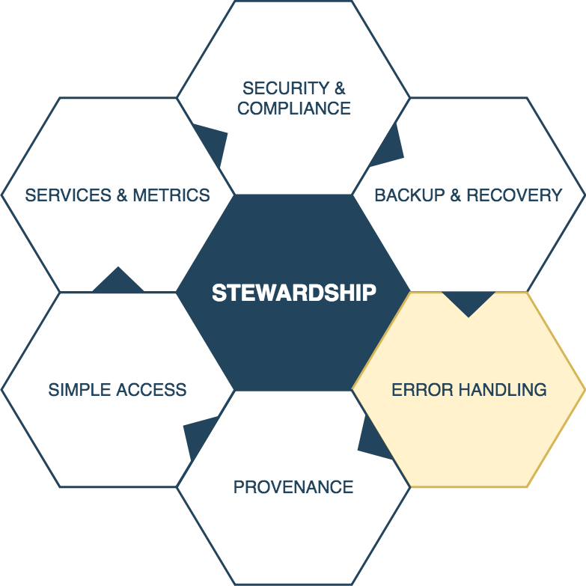

Slide 12
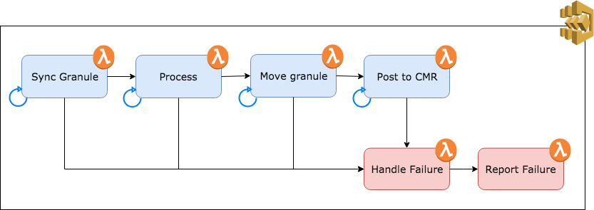
Dealing with Ingest Failures
Notes:
Can configure retries, exception handling, a failure branch
Icons free from draw.io, I created the diagram

Slide 13
Failures to Trigger Ingest
Notes:
Dead letter queues configured to handle failures when triggering ingest
Icons free from draw.io, I created the diagram

Slide 14
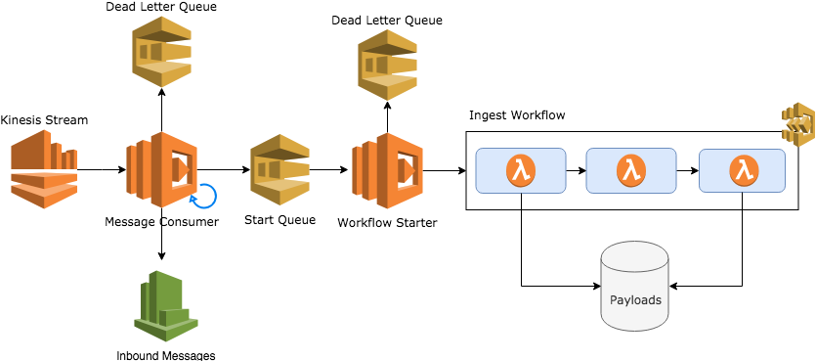
Kinesis Failures
Notes:
Failures specific to Kinesis streams
We record all inbound messages to CW
Original/final payloads are kept so we don’t rely on the SF API keeping them around
SNS works the same way
Icons free from draw.io, I created the diagram

Slide 15
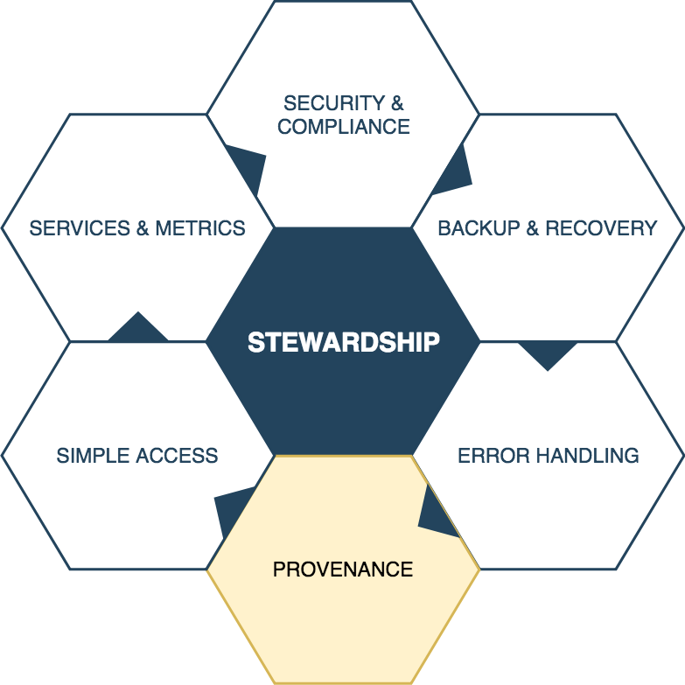

Slide 16
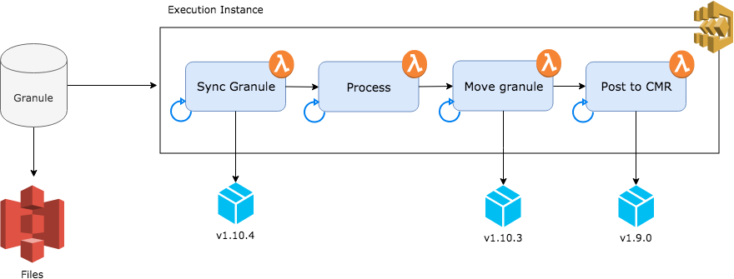
Data Provenance
Notes:
How Cumulus tracks provenance
Execution instance points to versioned packages
Icons free from draw.io, I created the diagram

Slide 17
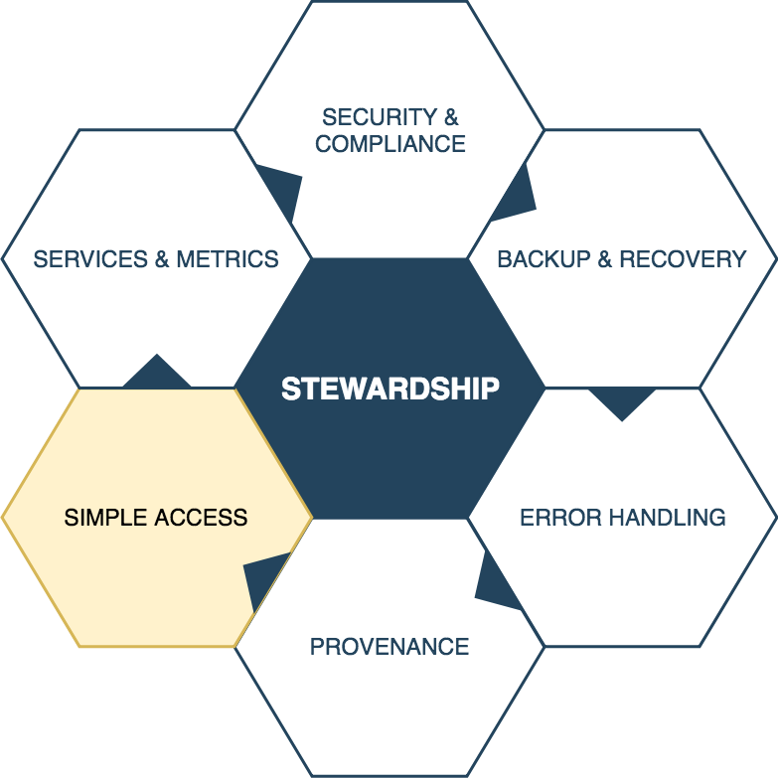

Slide 18
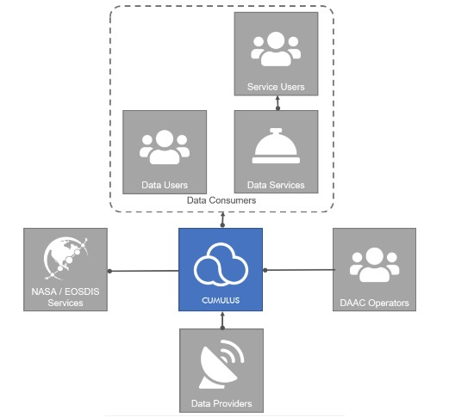
Notes:
Data providers ingest data
Data consumers - distribution API
Operators - operator API and operator dashboard
Icons free, Patrick Quinn created this diagram for a presentation given at the 2018 SE TIM in August
DAAC operators monitoring data ingests
Interfaces with NASA/EOSDIS services - CMR
Data consumers - distrubution API

Slide 19
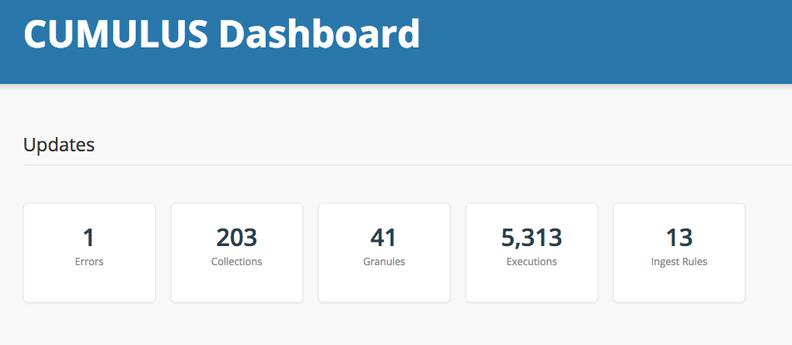
Operator Dashboard
Notes:
Screenshot from my Cumulus dashboard

Slide 20
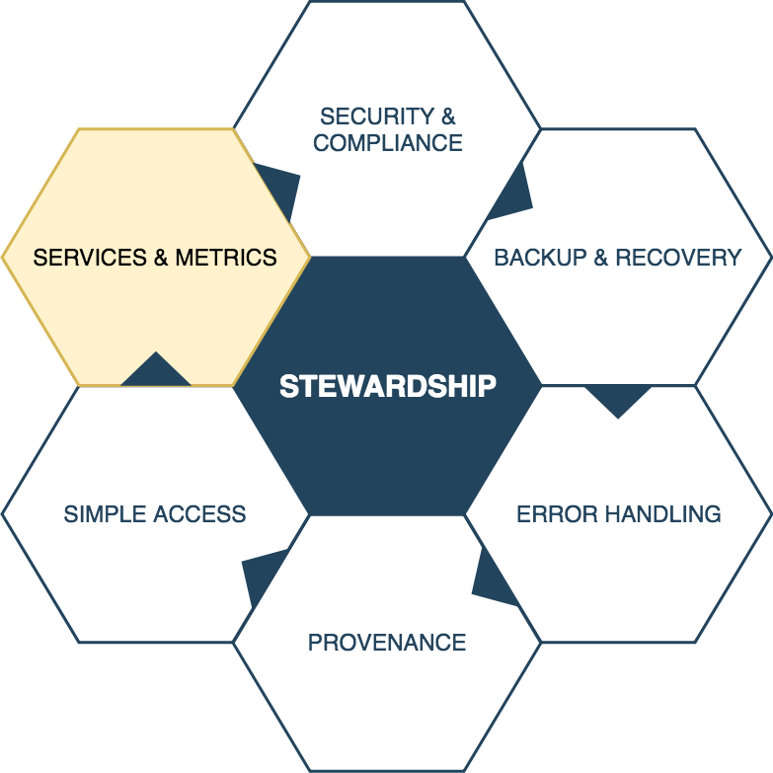
Notes:
EMS reports generated nightly

Slide 21
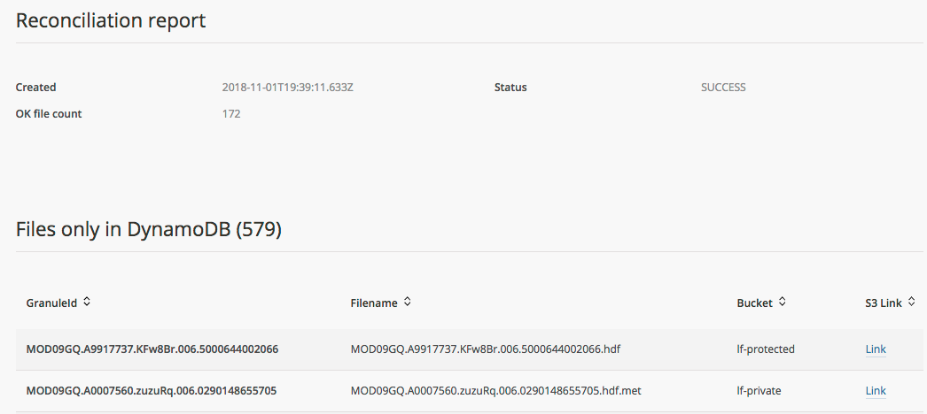
Granule Reconciliation
Notes:
Screenshot from my Cumulus dashboard

Slide 22
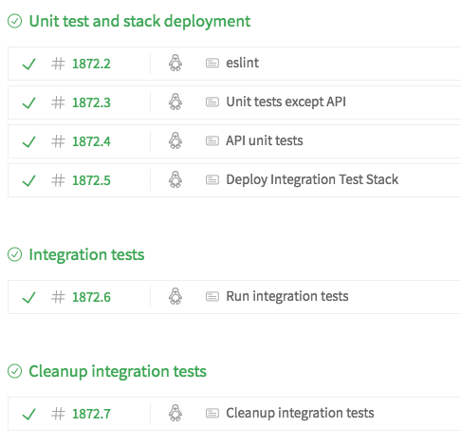
Validation
Notes:
Open source and in active development
Screenshot from Cumulus’ travis CI

Slide 23
Come Find Us
Check us out on github!
https://github.com/nasa/cumulus
Read up
https://nasa.github.io/cumulus/
Use our packages
https://www.npmjs.com/org/cumulus
Notes:
Icons free from draw.io

Slide 24
Questions?

Slide 25
Thank You!
Lauren Frederick
lauren@element84.com

Slide 26
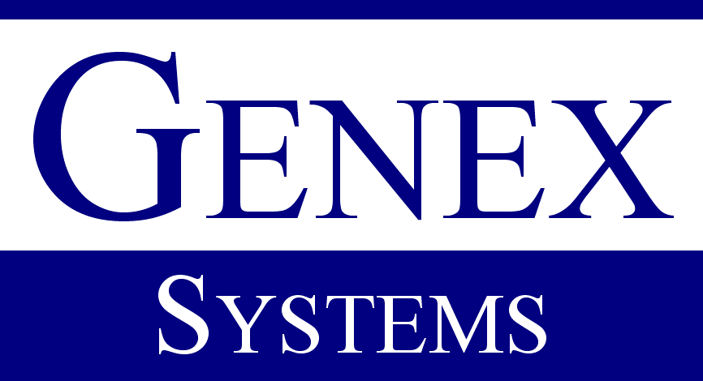
This work was supported by NASA/GSFC under Raytheon Co. contract number NNG15HZ39C.
in partnership with

