Slide 1
Orcid: generating VALUE now, and in the future
Ivo Wijnbergen
Manager, EMEA Engagement
i.wijnbergen@orcid.org
orcid.org/0000-0001-5540-748X
Eurocris meeting, warsaw| November 2018

Slide 2
Before we begin…

Slide 3
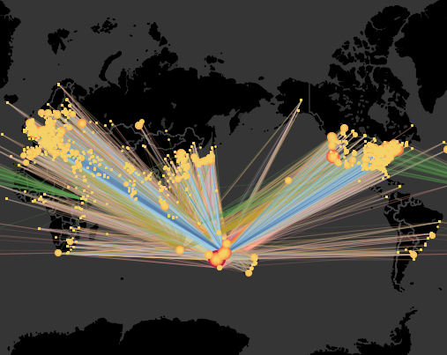
An invitation
Our colleagues at Research Graph in Australia are exploring ways to map international researcher collaboration networks.
Notes:
Research Graph is an open project emerging from work at the Australian Research Data Commons, which uses open data points to create graphs representing different kinds of connections between entities..

Slide 4
An invitation
They are using ORCID iDs in research information systems as a way to map connections.
They would like to invite euroCRIS+ORCID members to participate in their new project:
http://researchgraph.org/rgcs-pilot/
Notes:
The Research Graph platform transforms disconnected research information into a connected graph..
..by collecting information from various sources that include ORCID, Crossref, Scholix, Datacite and other persistent identifier providers to establish connections between researchers, research datasets, publications and grants across global infrastructures. What we did is use that information along with a researchers’ ORCID ID to establish a collaboration score between different institutions.
The next step is to do a follow up collaborative project using university Research Information Management Systems (RIMS) to find detailed information, however this would be possible only with collaborative partners who have an ORCID integration.

Slide 5
What is ORCID?
An identifier for researchers
A registry
A set of standard procedures for connecting researchers to their affiliations and activities
A committed community building connectors
An international-scale open research effort
Notes:
And what it is not. E.g. the final source of truth / a platform / another profile page to maintain

Slide 6
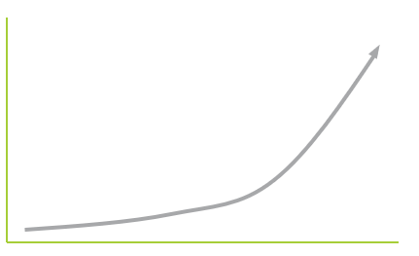
Current Worldwide ORCiD Adoption*
Over 5.6 million registered users
Over 930 Member Organizations
* As per November 2018
Notes:
2018 was the year that we passed 5m users and 900 members. 2019 will be another year of first’s for us, as we are set to become self-sustaining as an organisation financially, and we will pass 1000 members and 6m users mark, potentially even 7m users.
We’re very proud to be part of this community and being in a position where we are contributing to a more open, transparent and efficient research community.
~100k registered users from Poland with a .pl address

Slide 7
What’s next at ORCID?

Slide 8
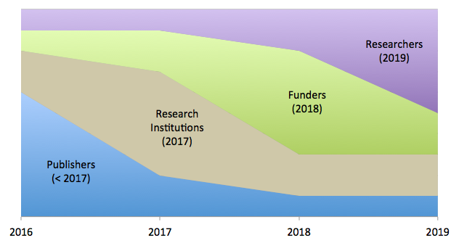
BUILDING VALUE BY SECTOR
Notes:
Change of focus over time @ORCID

Slide 9
2019: THE YEAR OF THE RESEARCHER
In 2019 we will:
Encourage the re-use of data in ORCID records by helping data “re-users” to assess the trustworthiness of assertions. (→ OBO)
Explore ways of easing reporting to funders and supporting organizations. (→ ORBIT)
Enhance ORCID records to show more activities, contributions, and affiliations. (→ UI/API updates)
Enable researchers to display richer pictures of more kinds of career. (→ UI/API updates)

Slide 10
Trust & Assertion Assurance

Slide 11
Understanding assertions
A person adds something directly to his/her record
The person is the source of the assertion AND the data.

Slide 12
Understanding assertions
2. A person selects items associated with him/her, and the organization adds the info to his/her record
The person is the source of the assertion, but the organization is the source of the data.
Notes:
the source of the assertion is obscured.

Slide 13
Understanding assertions
3. A person interacts with an “originating” organization that then provides info to his/her record
The organization is the source of the assertion AND the data.

Slide 14
Understanding assertions
4. A person interacts with an “originating” organization that then asks a “helper” organization to add the info to the record
The originating organization is the source of the assertion, but the helper organization is the source of the data.
Notes:
the source of the assertion is obscured.

Slide 15
(NOT) Understanding assertions
2. A person selects items associated with him/her, and the organization adds the info to his/her record
4. A person interacts with an “originating” organization that then asks a “helper” organization to add the info to the record
In both of these cases:
the source of the assertion is obscured.

Slide 16
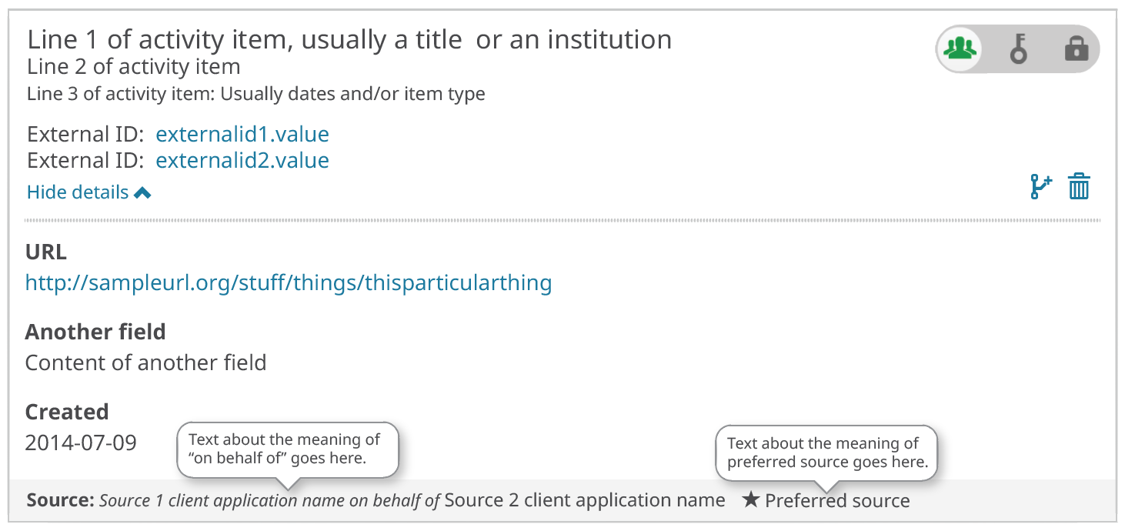
SHOWING WHO DID WHAT…
We are piloting new ways to handle update permissions which help us to show who is responsible for the data quality. For example:
CrossRef (item source)
ORCiD
(assertion origin)

Slide 17
How does OBO help researchers?
Transparency creates trust
Trust enables re-use and automation
Re-use and automation save researchers time and effort, leading to a better user experience.
OBO offers an assurance of trustworthy data, from trusted sources, shared by researchers.

Slide 18
ORCID
Reducing
Burden and
Improving
Transparency

Slide 19
Orbit: an overview
ORBIT is our flagship funder engagement project. We have assembled global working groups of 30 funders and research information and policy experts.
The groups oversee the project, build and test ORCID integration in funding workflows, and help to find shared solutions to common problems.

Slide 20
Orbit: an overview
This year we have been:
Automatically populating funding applications with CV and career information
Sharing grant funding information via the ORCID registry
Extending the availability of research information, and making it easier to re-use

Slide 21
What’s next?
A funders “open letter”
Quantified evidence of the benefits of identifiers in funding workflows
A long term communication strategy to share the results of the project, pathfinders, and share best practice
Engage with policy makers to ensure more consistency in ORCID adoption and use
Use ORCID iDs to make reporting and evaluation more efficient

Slide 22
What’s next?
We will explore data collection processes for research reporting and evaluation, using a survey, currently being designed in conversation with our ORBIT funder partners.
We’ll publish the results next year.
Please, help us to share this survey with the funder(s) in your life!

Slide 23
Academia and beyond.

Slide 24
ACADEMIA AND BEYOND
Our vision is inclusive. We want to meet the needs of all who participate in research, scholarship and innovation.
We will:
Analyze existing uptake of ORCID across communities and disciplines.
Work with key communities and champions
Identify and tackle barriers to adoption – technical and cultural
Implement communication campaigns for our key communities

Slide 25
KEY COMMUNITIES
The initial focus is on:
Arts and Humanities – with a focus on facilities, special collections and non-publication outputs
Life Sciences and Pharma – with a focus on conflicts of interest, funding and patents.
We need to replace assumptions with evidenced understanding of how well ORCID is serving our community.

Slide 26
KEY COMMUNITIES
These will leverage new sections in the ORCID record.
See:
https://orcid.org/blog/2018/03/01/expanding-affiliations-orcid-update
And:
https://orcid.org/blog/2018/04/10/acknowledging-research-resources-new-orcid-data-model
Adoption Analysis
See: https://doi.org/10.5281/zenodo.841777
Notes:
Added: Invited Positions and Distinctions
Membership & Service

Slide 27
API 3.0

Slide 28
Pilot Programs
API 3.0_rc1 is available now and supports new affiliation types and section for research resources. Test program launched in October
API 3.0_rc2 will support On Behalf Of workflows (User and Token Delegation). Soliciting interest in pilot project Q4 2019
https://orcid.org/content/api-v3-beta-tester-request
Notes:
Much easier to adopt than 1.2. to v2

Slide 29
Current Worldwide ORCiD Adoption*
Over 5.6 million registered users
Over 930 Member Organizations
* As per November 2018
Notes:
2018 was the year that we passed 5m users and 900 members. 2019 will be another year of first’s for us, as we are set to become self-sustaining as an organisation financially, and we are set to surpass 1000 members and probably 7m users.
We’re very proud to be part of this community and being in a position where we are contributing to a more open, transparent and efficient research community.
Current .pl registries: ~100K

Slide 30
euroCRIS believes in collaboration and interoperation between systems via CERIF.
ORCID identifies researchers and connects them to their contributions and affiliations.

Slide 31
euroCRIS and ORCID are both focused on sharing research information and improving its quality.

Slide 32
Together we add value to the research information ecosystem and serve the goal of better research.

Slide 33
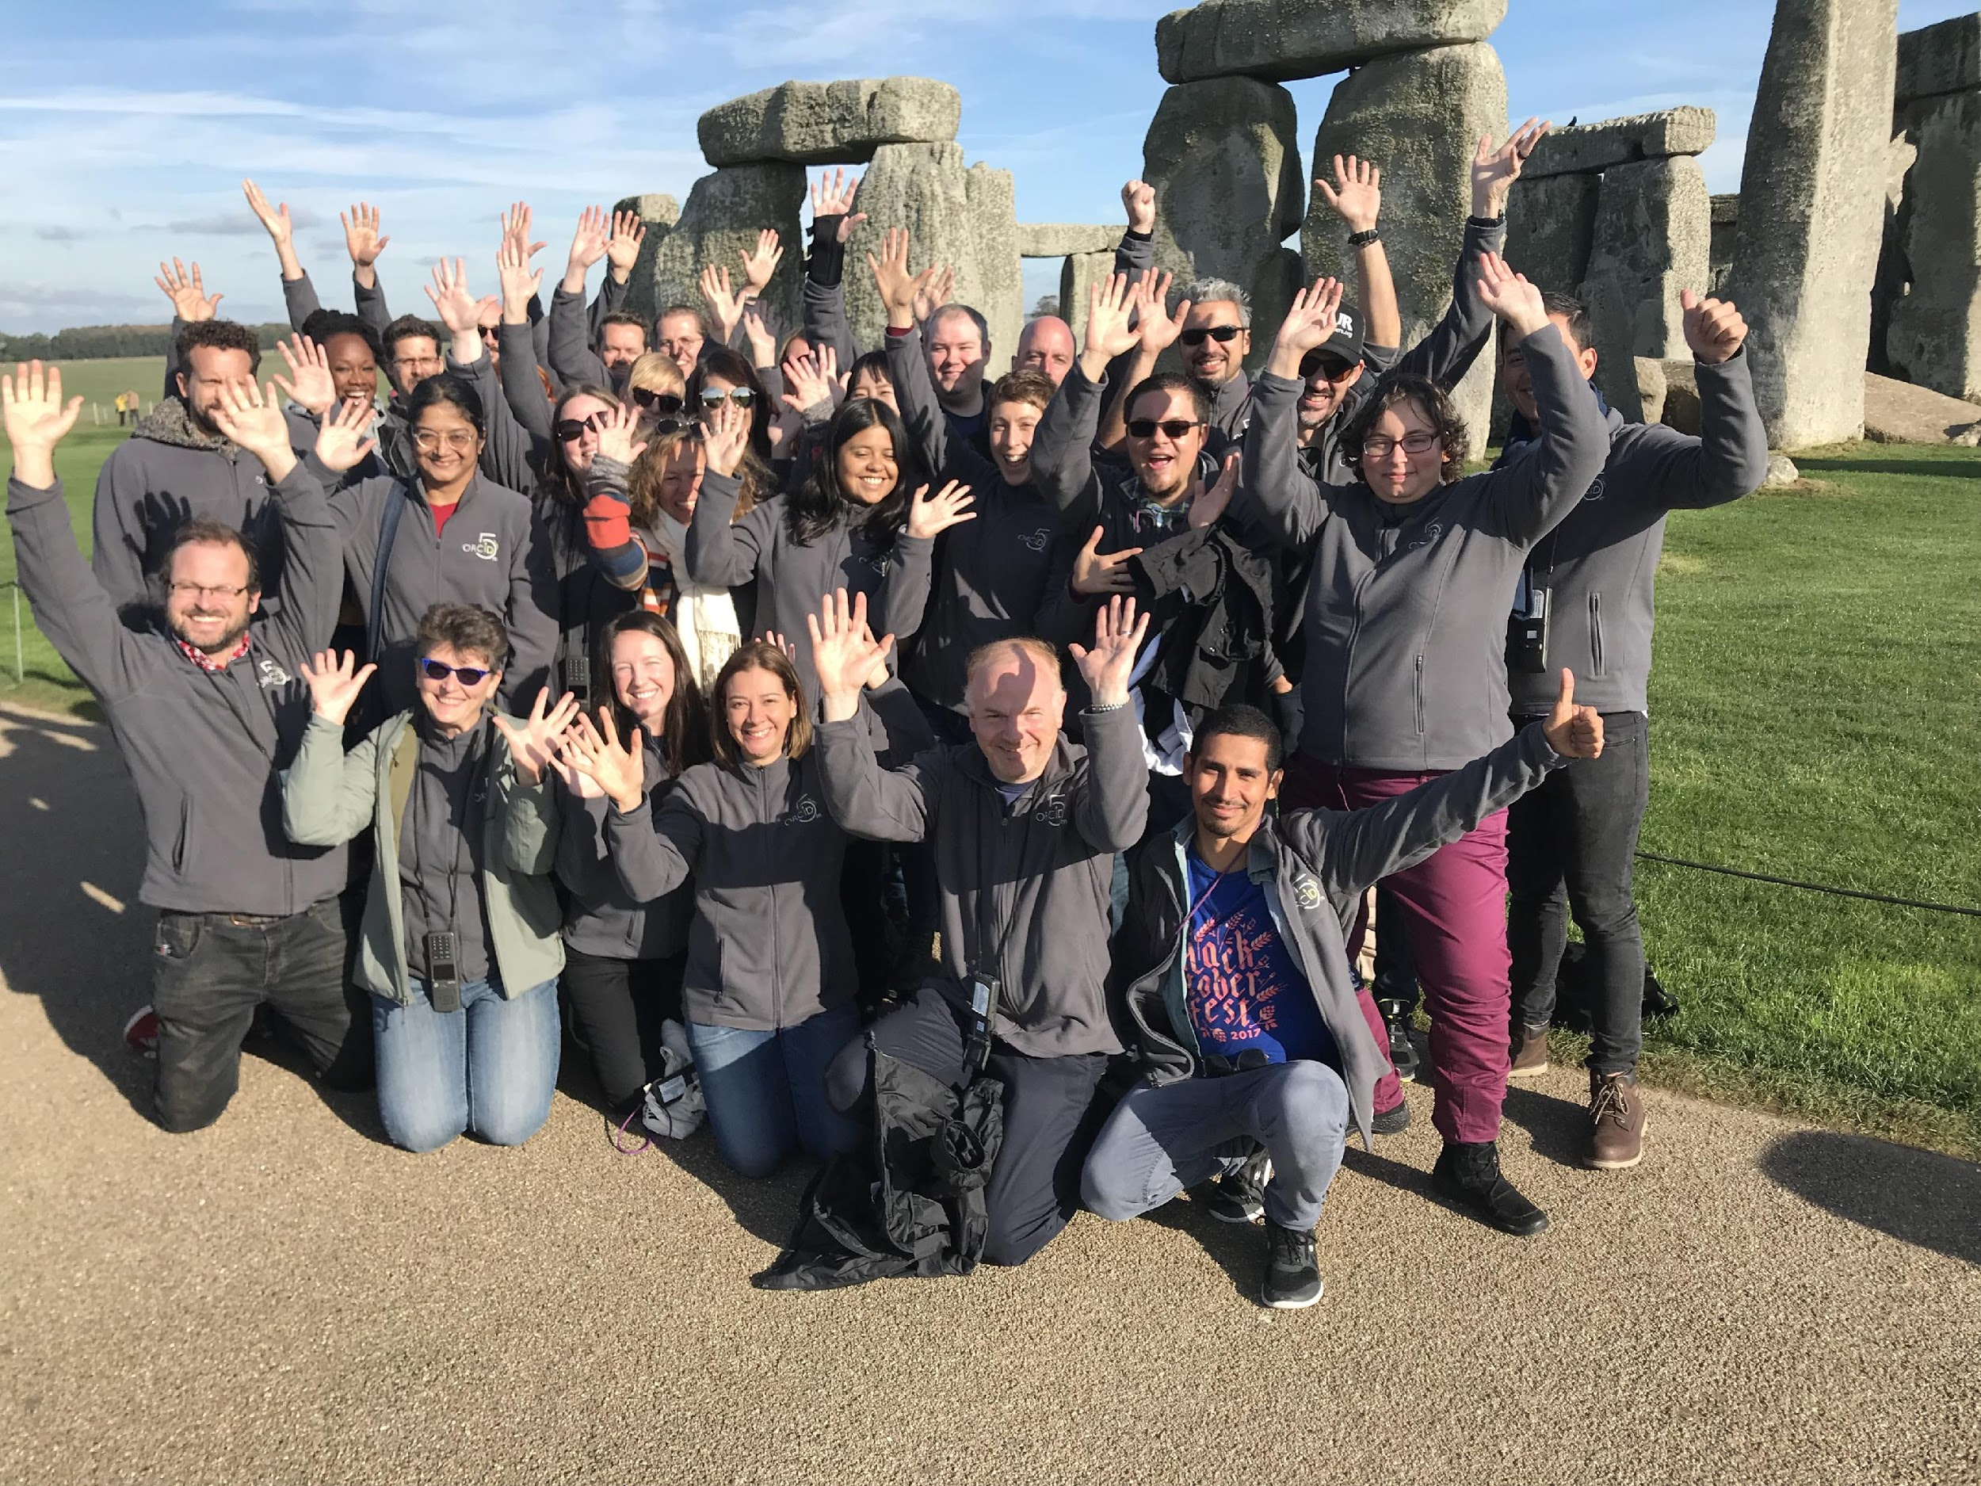
THANK YOU!
Notes:
Ending with Special thanks from all the ORCID, 32 people serving more than 5.5 million user in a way or another. So a big thank you from all the ORCID team because without the support of members and the research community ORCID would never exist.

