Slide 1
Orcid: Orcid: generating VALUE now, and in the future
Ivo Wijnbergen
Manager, EMEA Engagement
i.wijnbergen@orcid.org
orcid.org/0000-0001-5540-748X
Orcid de workshop, bielefeld| November 8 2018

Slide 2
ORCID’s vision is a world where
all who participate in research, scholarship, and innovation are uniquely identified and connected to their contributions and affiliations across time, disciplines, and borders.

Slide 3
These connections matter because research progress is based on the communication of ideas – between individuals, and organizations – and research credit and careers are built on the quality and success of those communications.

Slide 4
What is ORCID?
An identifier for researchers
A registry
A set of standard procedures for connecting researchers to their affiliations and activities
A committed community building connectors
An international-scale open research effort
Notes:
And what it is not. E.g. the final source of truth / a platform / another profile page to maintain

Slide 5
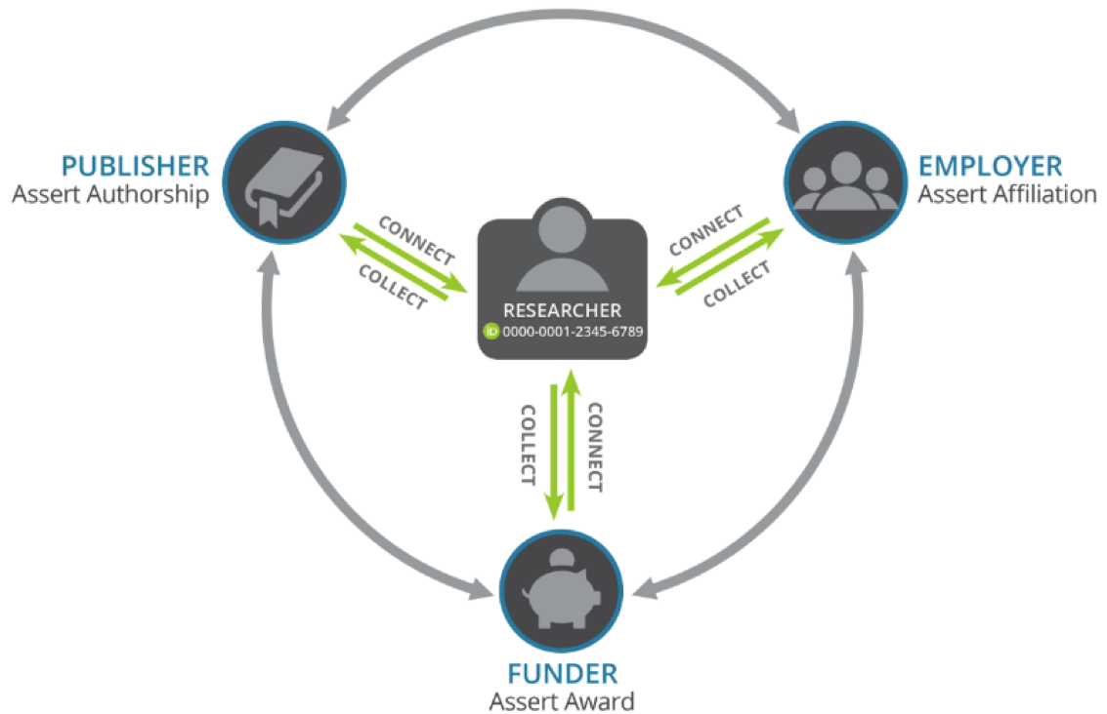
ORCID Interoperability
Notes:
What we’re trying to achieve

Slide 6
What’s next at ORCID?

Slide 7
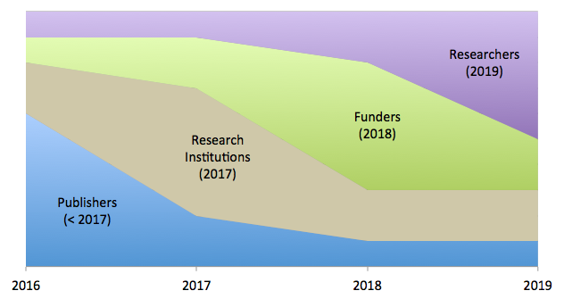
BUILDING VALUE BY SECTOR
Notes:
Change of focus over time @ORCID

Slide 8
2019: THE YEAR OF THE RESEARCHER
In 2019 we will:
Encourage the re-use of data in ORCID records by helping data “re-users” to assess the trustworthiness of assertions. (→ OBO)
Explore ways of easing reporting to funders and supporting organizations. (→ ORBIT)
Enhance ORCID records to show more activities, contributions, and affiliations. (→ UI/API updates)
Enable researchers to display richer pictures of more kinds of career. (→ UI/API updates

Slide 9
Trust & Assertion Assurance

Slide 10
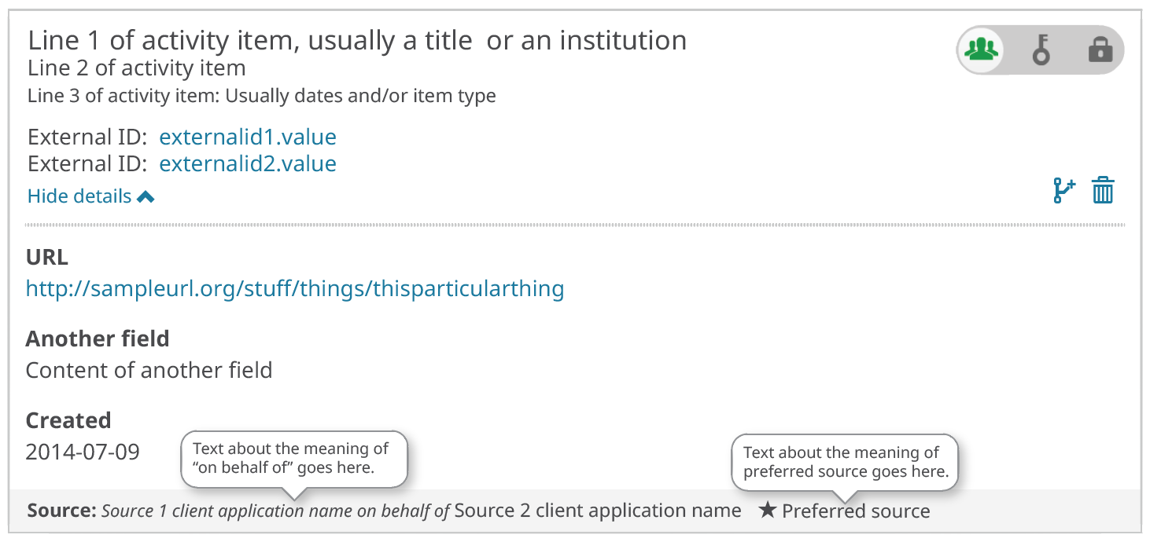
On Behalf Of User
Distinguishes between user assertions and member assertions. Improved transparency.
Client Name (item source)
Client Name 2
(assertion origin)

Slide 11
On Behalf Of Token Delegation
Enables one member to pass permissions to another member. Distinguishes which member is responsible for the assertion and which member wrote to the record.
Client Name (item source)
Client Name 2
(assertion origin)

Slide 12
How does OBO help researchers?
Transparency creates trust
Trust enables re-use and automation
Re-use and automation save researchers time and effort, leading to a better user experience.
OBO offers an assurance of trustworthy data, from trusted sources, shared by researchers.

Slide 13
ORCID
Reducing
Burden and
Improving
Transparency

Slide 14
Orbit: an overview
The project has many parts. To manage these we have divided our plan down into four linked areas of activity.
A wider Funder Working Group
Data source analysis
Building connections
Improving Persistent Identifier coverage

Slide 15
Orbit: an overview
The initial focus is on:
Automatically populating funding applications with CV and career information
Sharing grant funding information via the ORCID registry
Extending the availability of research information, and making it easier to re-use

Slide 16
What’s next?
A funders “open letter”
Quantified evidence of the benefits of identifiers in funding workflows
A long term communication strategy to share the results of the project, pathfinders, and share best practice
Engage with policy makers to ensure more consistency in ORCID adoption and use
Use ORCID iDs to make reporting and evaluation more efficient

Slide 17
Academia and beyond.

Slide 18
ACADEMIA AND BEYOND
Our vision is inclusive. We want to meet the needs of all who participate in research, scholarship and innovation.
We will:
Analyze existing uptake of ORCID across communities and disciplines.
Work with key communities and champions
Identify and tackle barriers to adoption – technical and cultural
Implement communication campaigns for our key communities

Slide 19
KEY COMMUNITIES
The initial focus is on:
Arts and Humanities – with a focus on facilities, special collections and non-publication outputs
Engineering – with a focus on certifications, affiliations, software and other outputs
Pharma – with a focus on conflicts of interest, funding and patents.

Slide 20
KEY COMMUNITIES
These will leverage new sections in the ORCID record.
See:
https://orcid.org/blog/2018/03/01/expanding-affiliations-orcid-update
And:
https://orcid.org/blog/2018/04/10/acknowledging-research-resources-new-orcid-data-model
Adoption Analysis
See: https://doi.org/10.5281/zenodo.841777

Slide 21
API 3.0

Slide 22
Pilot Programs
API 3.0_rc1 is available now and supports new affiliation types and section for research resources. Test program launched in October
API 3.0_rc2 will support On Behalf Of workflows (User and Token Delegation). Soliciting interest in pilot project Q4 2019

Slide 23
Learning Patience: Affiliation Assertion Requirements
As a result of community feedback, we will be (temporarily) rolling back our requirement for affiliation start-dates or identifiers in API 3.0
https://orcid.org/blog/2018/11/06/step-back-affiliation-reqs
Notes:
It is our mission to engage the community in working toward a vision of open and connected research information. But we need to do this at a pace that works for you, as well as for us.

Slide 24
These 2019 projects will be augmented with interface improvements and speculative work to determine our future roadmap and priorities.

Slide 25
ORCID is not ‘plug and play’, it’s ‘build and benefit’.
When our members integrate, connect, and share data, everybody wins.

Slide 26
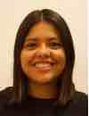
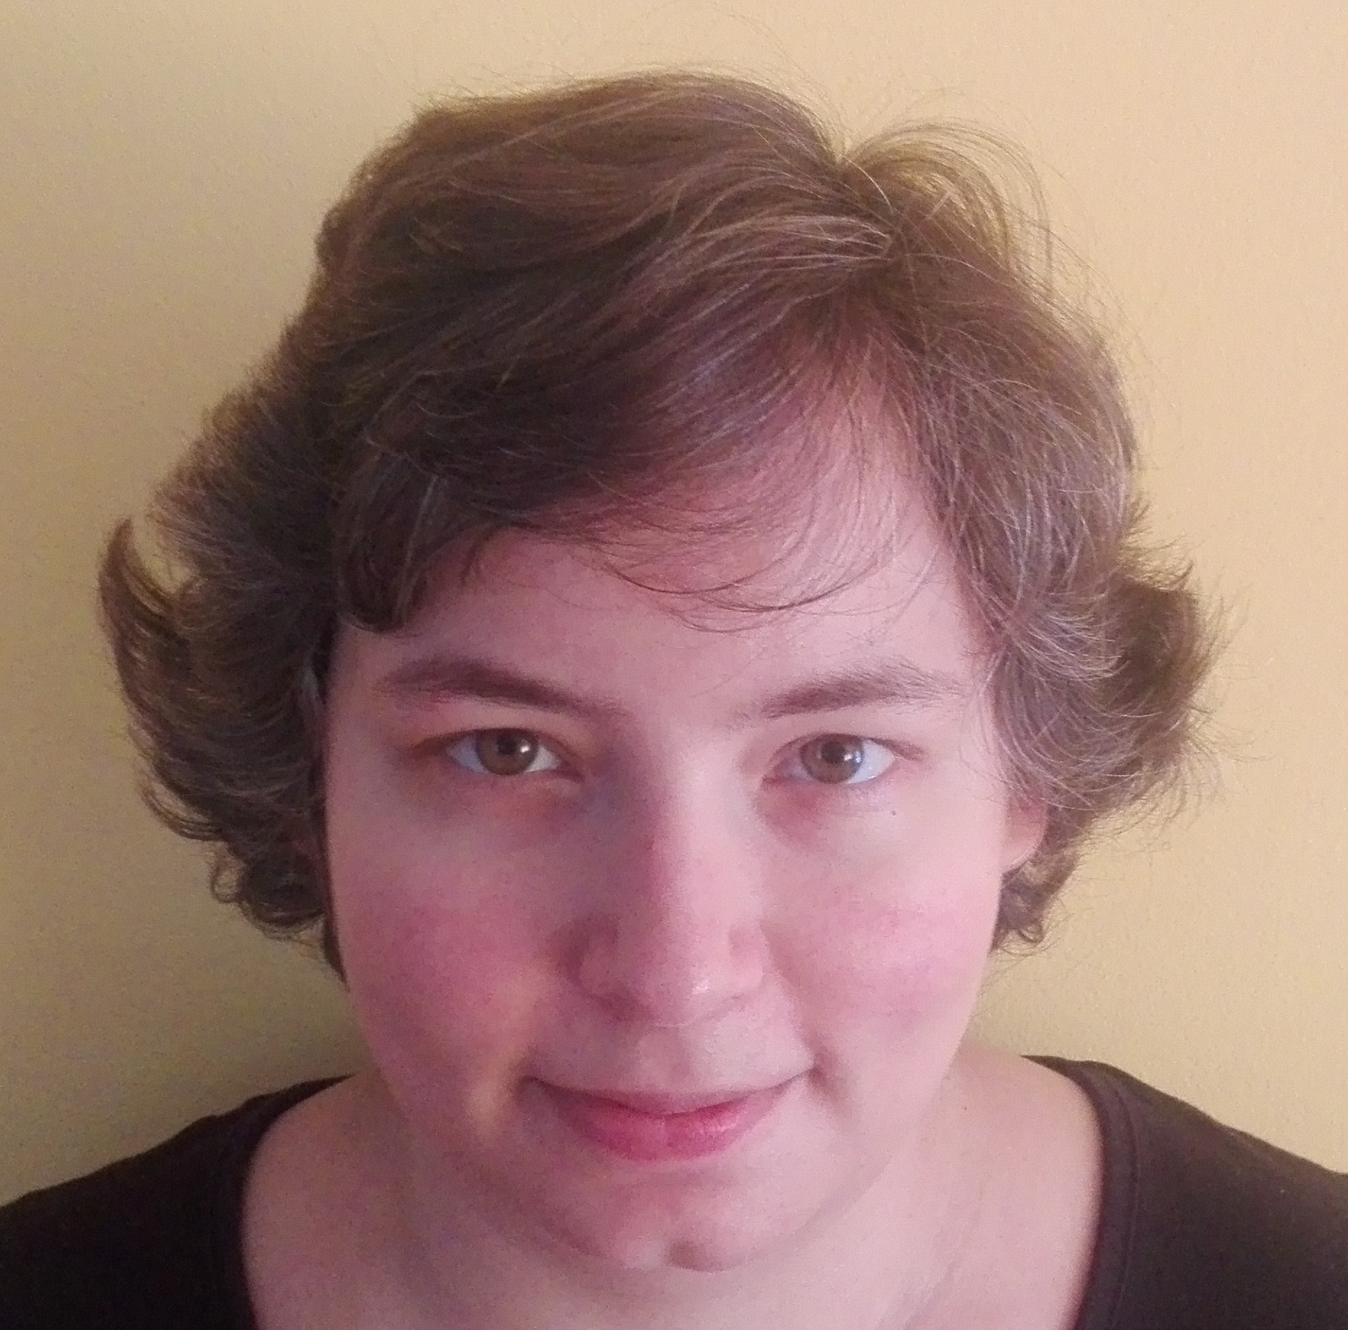
EMEA Engagement Team
Ivo Wijnbergen
Manager, EMEA
Paula Demain
Lead, UK, Italy & Northern Europe
Nabil Ksibi
Lead, MEA
Gabriela Mejias
Lead, Europe
Mitra Najafi-Gheidari
User Support Specialist
Languages spoken:
Dutch, French, Arabic, German, Spanish, Hungarian, and English
https://orcid.org/about/membership/engagement-regions
Notes:
ORCID continues to evolve and grow to meet the needs of our community. Continuing to provide a high level of support to our 900+ members and 5m+ users, in a scalable way, has led us to rethink our organizational structure. We are delighted to announce that, effective September 2018, our Community and Membership teams have combined to form a single, regionally-based Engagement team. User adoption, integrations, and membership are inextricable and all members of the team now share responsibility for ensuring that we grow and support our community.

Slide 27
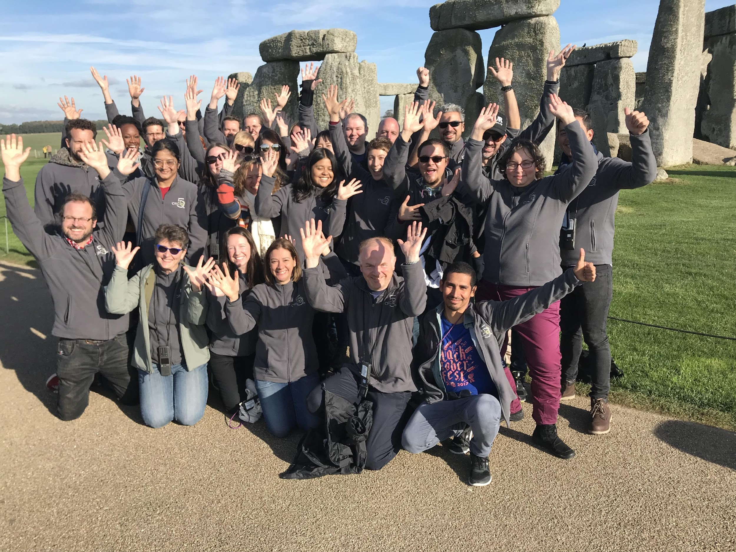
THANK YOU!
Notes:
Ending with Special thanks from all the ORCID, 30 people serving more than 5.5 million user in a way or another. So a big thank you from all the ORCID team because without the support of members and the research community ORCID would never exist.

