Slide 1
Open Educational Resources & Affordable Course Materials
A library primer
for
student academic success
UC San Diego Library
Lunch-n-Learn
March 5, 2018
Remixed by Allegra Swift, Scholarly Communication Librarian, UC San Diego, CC-BY 2018
Remixed from Allegra Swift & Jennifer Thompson’s March 29, 2017 presentation at The Claremont Colleges
Notes:
https://docs.google.com/document/d/1lEEPbiBplLSqNJ0MssqAo0b2em0UpPNZZPU6pyDn-1k/edit

Slide 2
Notes:
https://commons.wikimedia.org/wiki/File:OER-Programm-Logo.jpg

Slide 3
Notes:
Sometimes difficult to find
Whereever we get the chance, label and register

Slide 4
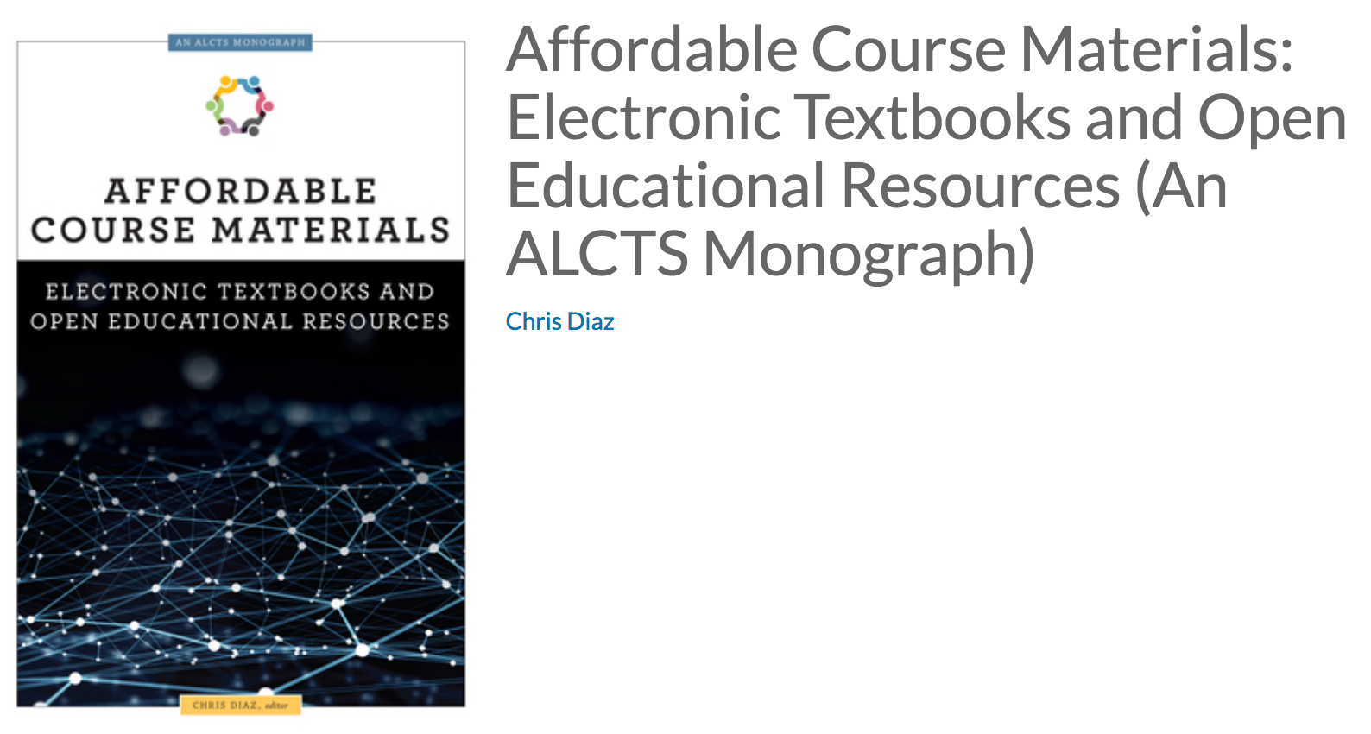
Notes:
https://www.alastore.ala.org/content/affordable-course-materials-electronic-textbooks-and-open-educational-resources-alcts
low-cost or free alternatives to expensive course materials, such as open-access scholarly resources, Library-licensed and owned resources in print or digital form, reformatted special collections items, and learning objects and texts that faculty create themselves.

Slide 5
https://www.alastore.ala.org/content/affordable-course-materials-electronic-textbooks-and-open-educational-resources-alcts
low-cost or free alternatives to expensive course materials, such as
open-access scholarly resources,
Library-licensed and owned resources in print or digital form,
reformatted special collections items, and
learning objects and texts that faculty create themselves.
http://www.library.ucla.edu/about/about-collections/open-scholarship-collections-policy/affordable-course-materials-initiative
Notes:
https://www.alastore.ala.org/content/affordable-course-materials-electronic-textbooks-and-open-educational-resources-alcts
low-cost or free alternatives to expensive course materials, such as open-access scholarly resources, Library-licensed and owned resources in print or digital form, reformatted special collections items, and learning objects and texts that faculty create themselves.

Slide 6
So, why does this matter?
Notes:
JT

Slide 7
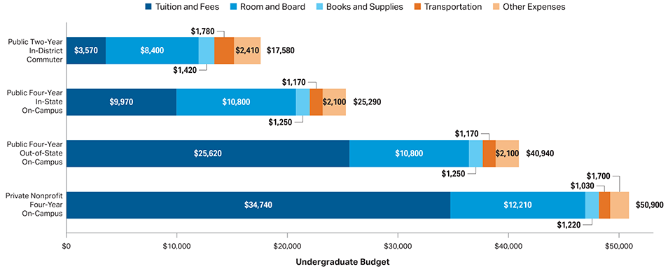
Average Estimated Undergraduate Budgets, 2017-2018
Source: Trends in college pricing – college board
Notes:
https://trends.collegeboard.org/college-pricing/figures-tables/average-estimated-undergraduate-budgets-2017-18

Slide 8
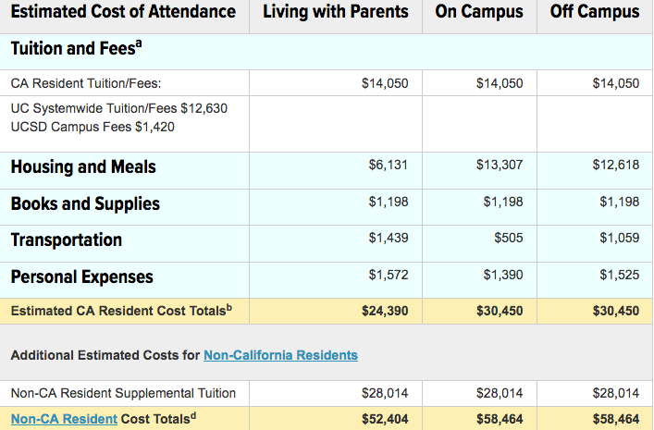
Estimated Budget/Cost of Attendance for Undergraduates 2017–2018 at UC San Diego
Source: https://students.ucsd.edu/finances/financial-aid/budgeting/undergrad-2017-18.html
Notes:
JT Frame the issue
This is the cost of college, tuition and cost of materials
Textbook publishers (access codes)

Slide 9
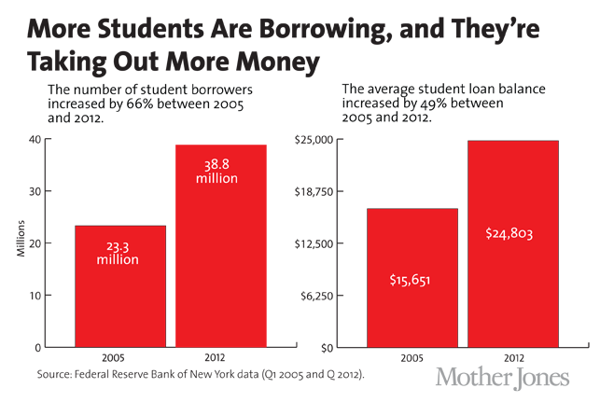
Notes:
https://www.motherjones.com/politics/2013/06/student-loan-interest-rate-plan-obama-republican-warren/

Slide 10
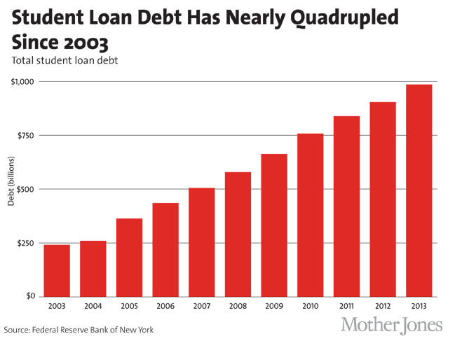
Notes:
https://www.motherjones.com/politics/2013/06/student-loan-interest-rate-plan-obama-republican-warren/

Slide 11
From: http://bit.ly/2njTcOf
https://www.nbcnews.com/business/business-news/students-are-still-saddled-soaring-textbook-costs-report-says-n516011
Notes:
https://www.nbcnews.com/business/business-news/students-are-still-saddled-soaring-textbook-costs-report-says-n516011
Studies as early as 1997
Article students are still saddled with soaring prices In this Sept. 14, 2014 photo, Priya Shivraj, 21, a student at New York University majoring in biology, Spanish and pre-med, poses with "at least" $1200.00 in text books from seven semesters of school in Queens, New York

Slide 12
Notes:
JT: Additional Information about the chart: United States; spring 2016; 854 Respondents; among full-time, four year undergraduates (representative sample of 100 campuses nationally stratified by type, size and geographic distribution)
Highlight graph and highlight course material cost
Breakdown charts from college board
High impact of costs

Slide 13
Notes:
https://dailybruin.com/2014/02/07/julia-mccarthy-ucla-should-provide-support-for-open-source-textbook-efforts/

Slide 14
Why, for the love of Pete, is this still a thing?

Slide 15
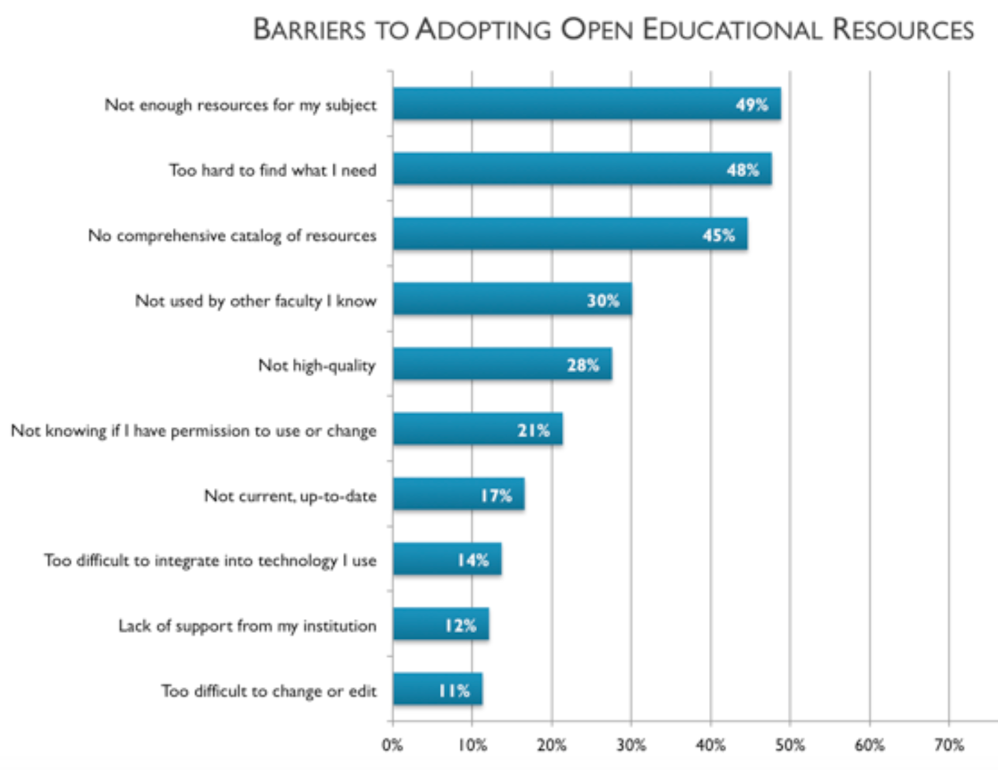
https://www.insidehighered.com/news/2016/07/26/study-finds-use-open-educational-resources-rise-introductory-courses
Notes:
https://www.insidehighered.com/news/2016/07/26/study-finds-use-open-educational-resources-rise-introductory-courses

Slide 16
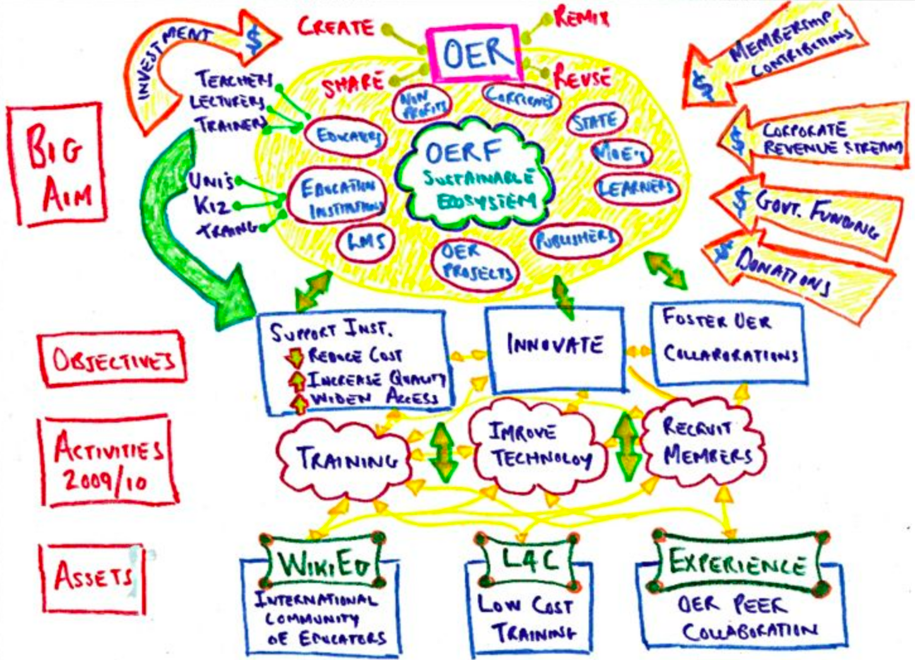

Slide 17
But really, how can the library help?
Notes:
JT: Definition what oer and OA relate / How are OERs and ACM similar or different?
Create, Adapt/Remix, Reuse

Slide 18
Here’s what is going on at UC San Diego...
Notes:
AS: Unpacking ACM in the CCL context -- CABS, ebooks (Jennifer)
Allegra - challenges with publishers, access codes, etc.

Slide 19
Bookstore – our goals
Collect and Share important and up-to-date course material information
Provide quality, accessible, and cost effective course materials
Support the creation and distribution of custom course materials
Serve our community with its ever changing needs
ASK QUESTIONS:
What course material options are there and what will work best for the course?
What course materials will students need to succeed in the class?
number of books adopted for a course
percentage of a book/reader directly used/tested on in course work
required /recommended (optional, supplemental)
How & when will the students be using their course materials?
What are the costs of the materials? Quality & Price Matter..how do we define value?)
Where are we directing students to find/purchase their materials?
TIME is always a factor
Communication ▪ Knowledge ▪ Collaboration ▪ Transparency ▪ Affordability
Notes:
Sara t

Slide 20
Bookstore – What We do
Compile and verify course material information with instructors/depts. so students can check what will be required for a class. We offer a marketplace comparison tool right on our website.
We search out and offer a wide variety of formats of required materials to give students options: USED, eBooks, Rentals, Loose-leaf, and custom versions.
Work with instructors & publishers to offer inclusive access course option (best market value digital content provided first day of class to all enrolled/waitlisted students, 2 weeks free access; then student must decide if they want to stay in or opt out.
Custom on campus publishing (digital & print) creating course materials to fit our instructors’ teaching goals so their students have exactly what they need, while saving them $.
Notes:
Sara Thoreson
MyReader Coordinator / Custom Academic Publishing
UC San Diego Bookstore / Course Materials Dept.
sthoreson@ucsd.edu /custom@ad.ucsd.edu
Phone: 858-534-7963

Slide 21
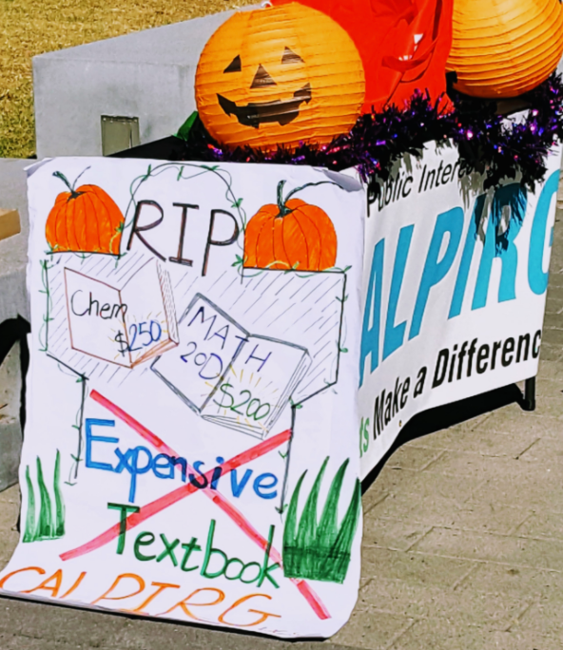
ucsD - Calpirg
“Recent updates - we passed a student government resolution in support of promoting an OER program on campus on Wednesday! Now we are going to start meeting with folks in the Academic Senate. “
-Megan Bart
Image: Allegra Swift | https://ucsd.libguides.com/OERforstudents/advocacy
Notes:
Liz de Loera Esparza

Slide 22
Library Research guides & advocacy

Slide 23
Collections – textbook purchases
Notes:
Ramirez, Alexia
I have included number of textbooks on reserves with checkouts by each quarter since Fall 2015.
From the stats above, e-books are included with textbooks on reserve.

Slide 24
Collections – textbook purchases
Ordering issues
The most common problem would be ordering expensive textbooks:
either they are not used often or
the department changes to a newer edition.
Notes:
umber of e-books that were placed on reserves.

Slide 25
What is going on out there?

Slide 26
academic libraries
“Democratizing knowledge is our professional mission and our ethical and moral obligation, and we do it in various ways. Protecting free (all kinds of free) access to information is one way we enact our collective mission, and the OER movement is part of this”
https://www.unh.edu/it/news/2015/06/oer-pilots-how-libraries-matter
List by state for OER policies, programs, and projects: https://sparcopen.org/our-work/list-of-oer-policies-projects/
Notes:
Why is this important to us:
links to be made between critical pedagogy and critical information literacy
rely on our librarians to lead us to new definitions of “content,” which focus less on “learning it” (often a euphemism for banking models that ask students to memorize bits of information) and more on sorting it, evaluating it, curating it, and contributing to it.
relationship between OER and other library materials such as e-books and databases.
Discovery
http://www.ala.org/acrl/publications/keeping_up_with/coursecontent

Slide 27
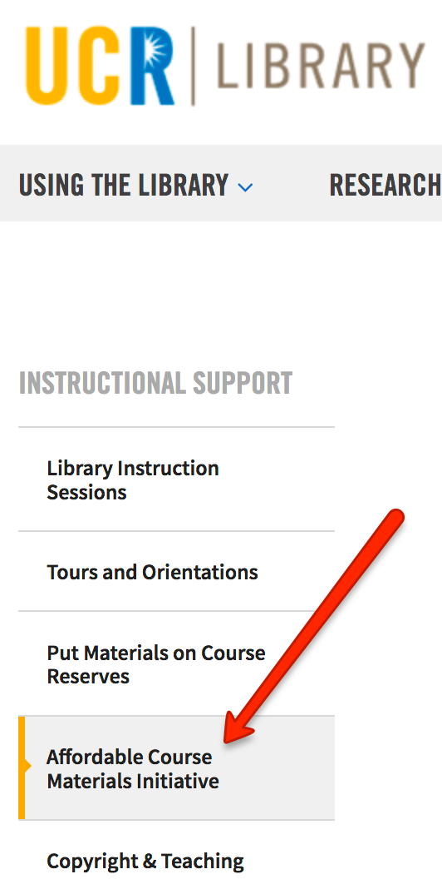
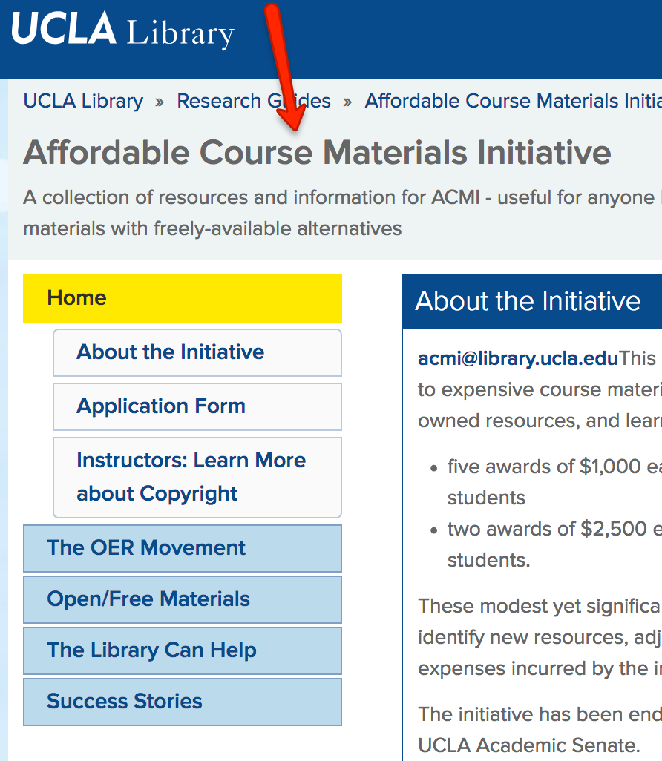
Notes:
https://library.ucr.edu/instructional-support/affordable-course-materials-initiative
Faculty incentive

Slide 28
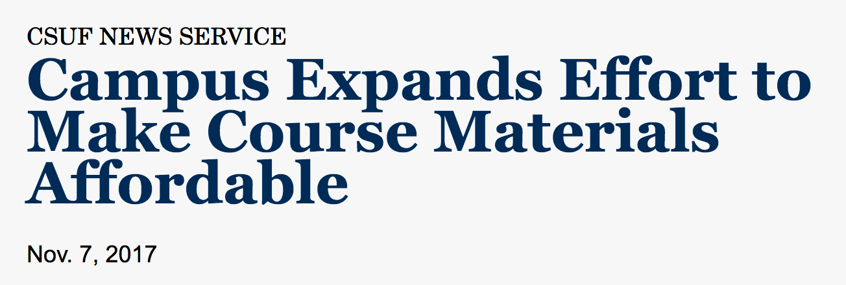
Notes:
https://als.csuprojects.org/
http://news.fullerton.edu/2017fa/Affordable-Course-Materials.aspx

Slide 29
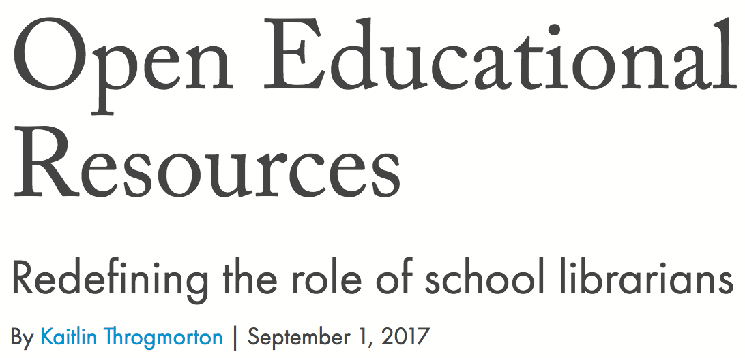
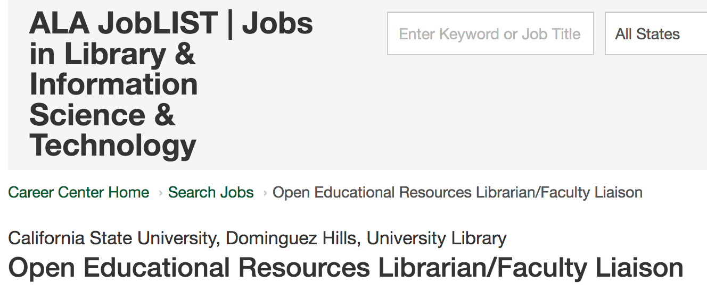
Help wanted
Notes:
https://joblist.ala.org/job/open-educational-resources-librarianfaculty-liaison/39688457/
https://americanlibrariesmagazine.org/2017/09/01/open-educational-resources/
https://libraries.psu.edu/openeducationlibrarian

Slide 30
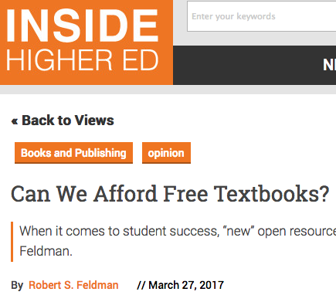
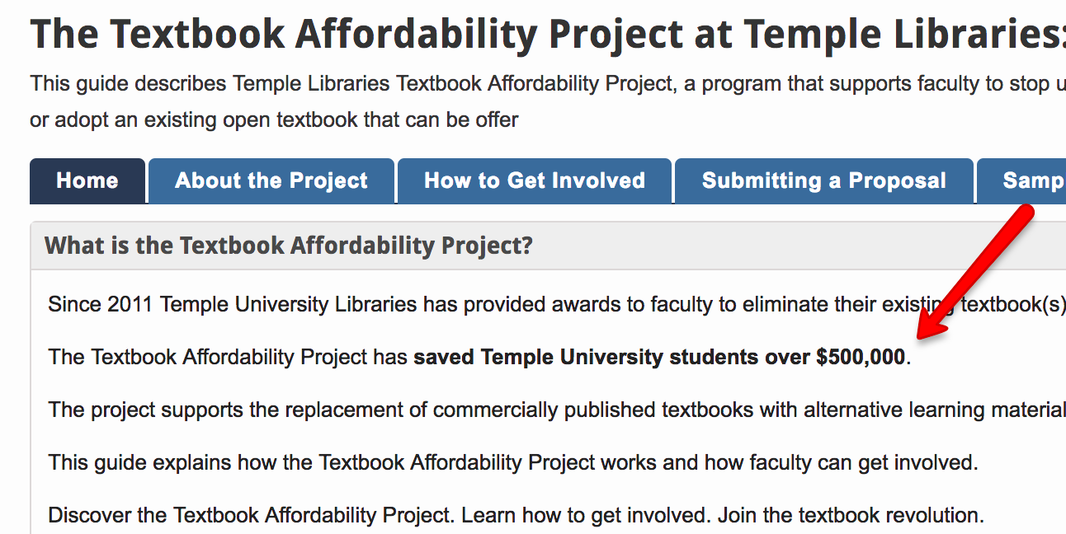
Open Textbook Initiatives
Check the comments tho’
http://guides.temple.edu/textbookaffordability

Slide 31
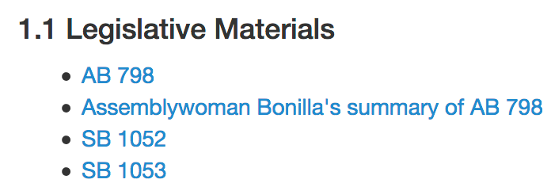
State-wide initiatives
2012: In California, Governor Jerry Brown has signed two bills (SB 1052 and SB 1053) that will provide for the creation of free, openly licensed digital textbooks for the 50 most popular lower-division college courses offered by California colleges.
Notes:
http://www.cool4ed.org/ab798_rfp.html

Slide 32
opportunities
Why the library should take action

Slide 33
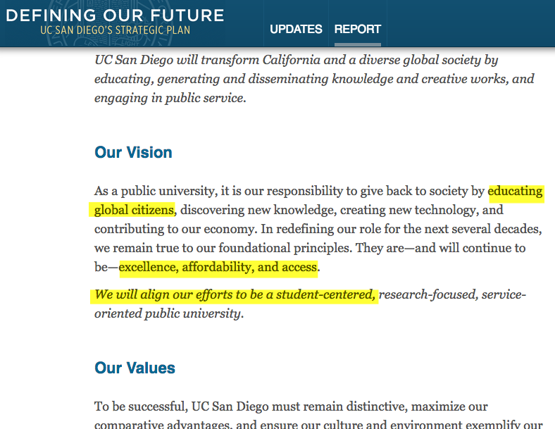
Ucsd mission – student centered
http://plan.ucsd.edu/report/mission-vision-values/
Notes:
Student success, affordability, and open access

Slide 34
get to know faculty and discipline
Copyright
Learn about the discipline needs
Dissatisfaction with available resources
Instruction in a discipline
Relationship building
Faculty request: “I was wondering if I can coordinate with you to put together a course packet for my class in lieu of a textbook. There isn’t the perfect textbook, so I have very specific chapters that I want for my students to have some certain textbook. I need help in getting the rights to copy and distribute to my class. Could you help me with this? I would love to set up a time soon and chat.”

Slide 35
Make connections in academic administration
One of the Associate Deans in the Admissions Office, sent me some information about your work with students surveying the affordability of course materials, and I was wondering if you would be available to talk more about it. I am on [the] team in the Office [Diversity], and I am very interested in students’ experiences once matriculated. If you’re interested, I would appreciate the opportunity to meet – over email, phone, or in person – to discuss the survey and the data you are collecting, to the extent that you can share.
https://facultydiversity.ucsd.edu/
Notes:
Administration

Slide 36
Student sentiment survey - results are consistent across institutions
I do what is necessary, but the cost significantly impacts my budget and life.
I skipped dinner 3 nights last week so I could afford my textbooks for module 2
I have personal expenses such as groceries and I have to decide to whether buy a textbook or purchase groceries for the next couple of weeks
Sometimes I would rather invest the money in gas for the commute than in buying course materials
In September, I didn't have enough money to pay rent and buy books, so I chose rent, and bought books in October.
Food money has to be used for books.
.

Slide 37
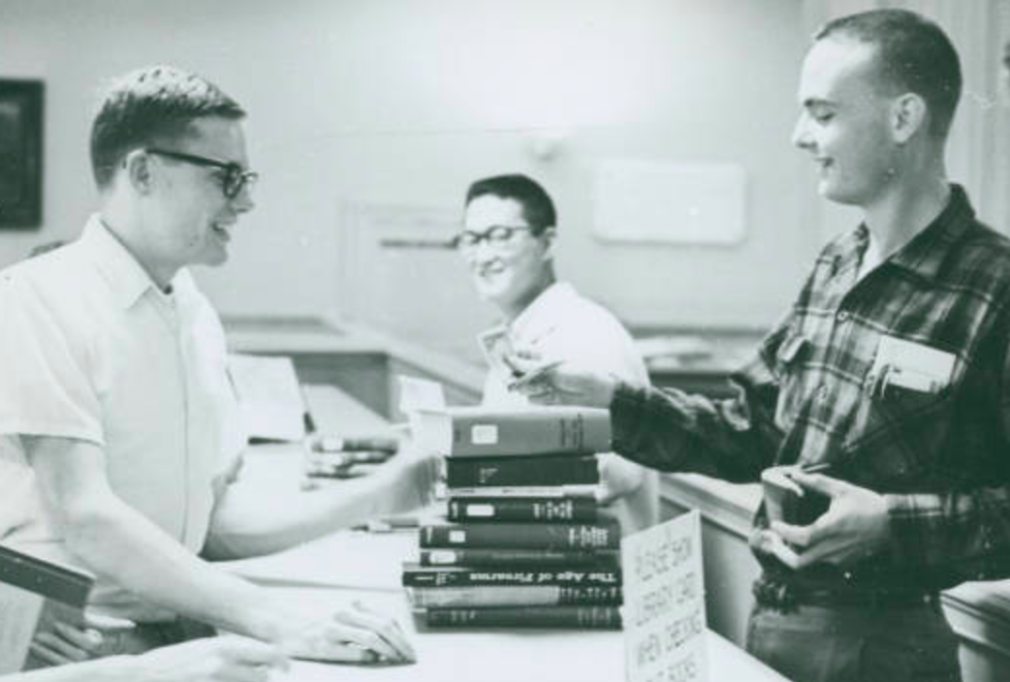
Student sentiment survey - implications for the library, for faculty, for the college ...
Student checking out books, Harvey Mudd College: ccdl.libraries.claremont.edu/cdm/ref/collection/ccp/id/7396
Notes:
students are asking for help, data show that is is necessary
Food and housing insecurity
Reflection on the insitution

Slide 38
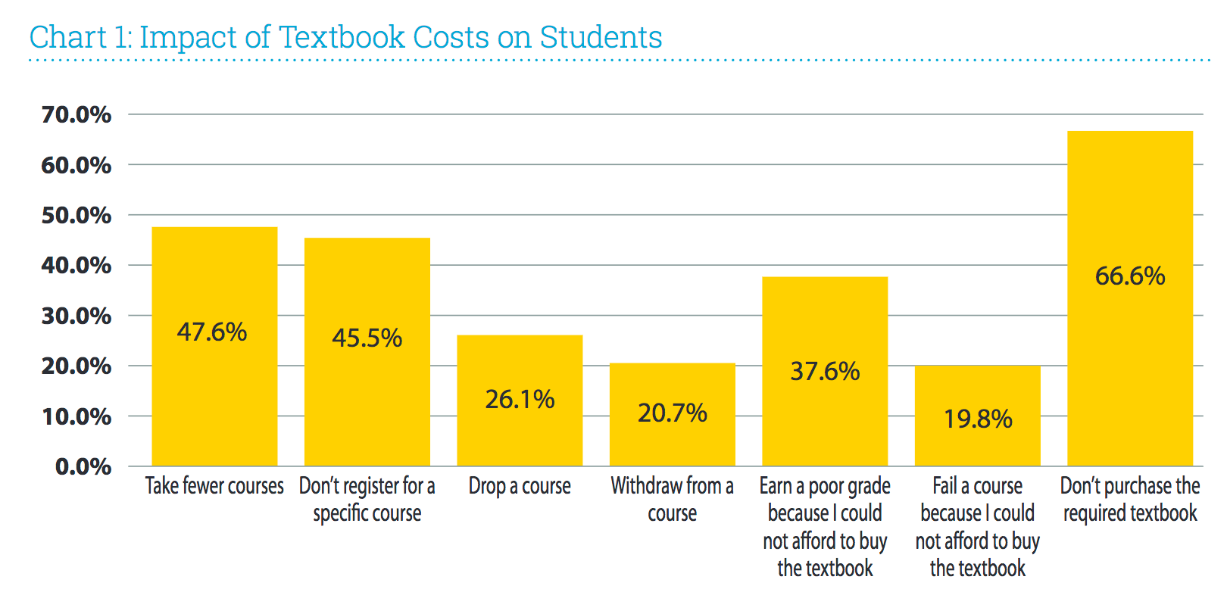
Florida Virtual Campus, Office of Distance Learning & Student Services : 2016 Student Textbook and Course Materials Survey
Notes:
https://florida.theorangegrove.org/og/file/3a65c507-2510-42d7-814c-ffdefd394b6c/1/2016%20Student%20Textbook%20Survey.pdf

Slide 39
Have any of you had similar conversations with faculty or students?

Slide 40
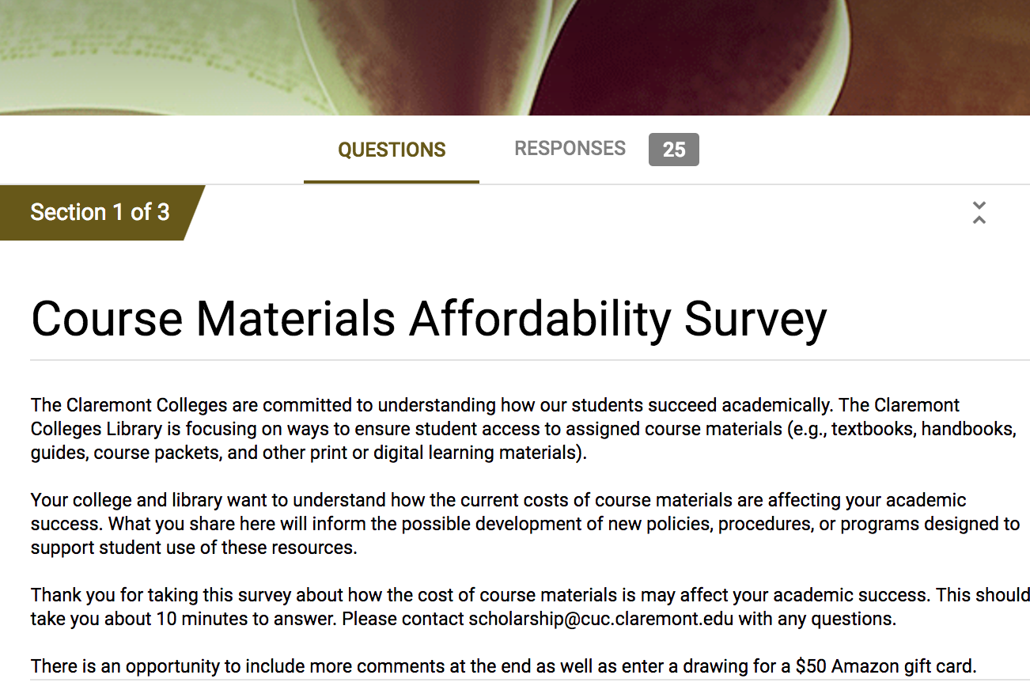
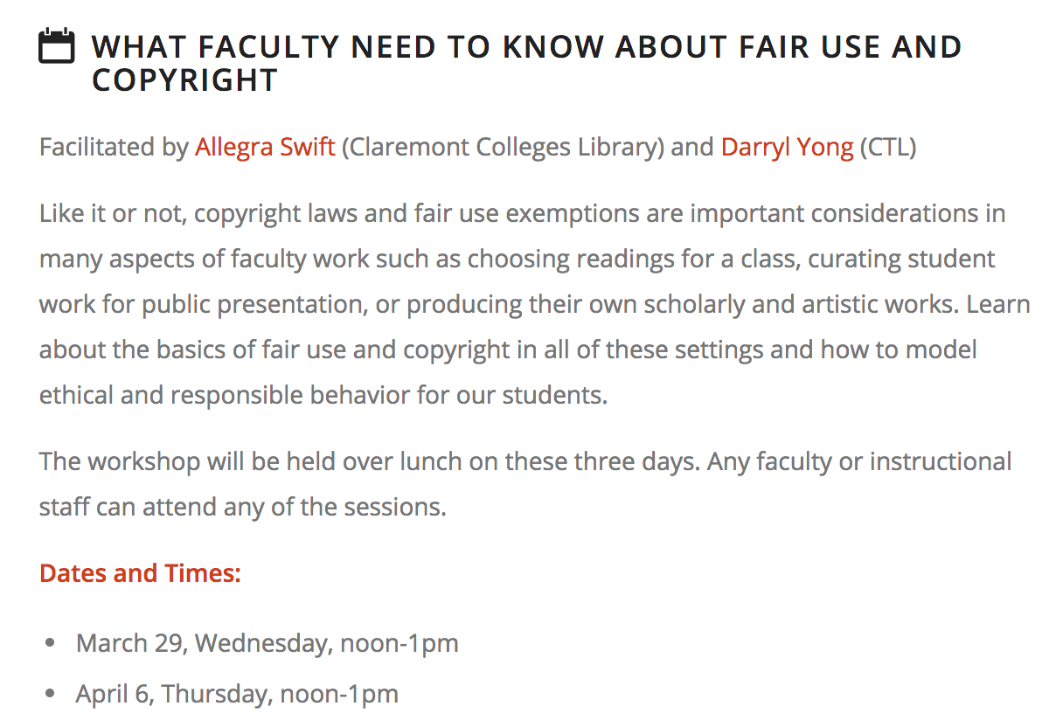
Next steps?
Student sentiment survey
Gather data & educate!
Student sentiment survey
Faculty incentive pilot
Stealth OER education
Notes:
Talk about CCL’s partnership with CTL pilot ACM program; who’s involved? Main objectives of the project?

Slide 41
Discussion:
https://www.openeducationweek.org/
Do you have burning questions or comments about anything you’ve heard during the presentation?
Any thoughts about how else we (the library) might support our students?
Do you see a role for us in this OER/Affordable Course Materials movement here at UC San Diego?
https://ucsd.libguides.com/ScholCommToolKit
OpenEd 2017 notes
Libraries & OER conference call notes
PIRGs – student debt
http://ucsd.libguides.com/OERforstudents
http://ucsd.libguides.com/OERforfaculty
https://wikieducator.org/Educators_care/Defining_OER
Notes:
Common concerns

