Slide 1
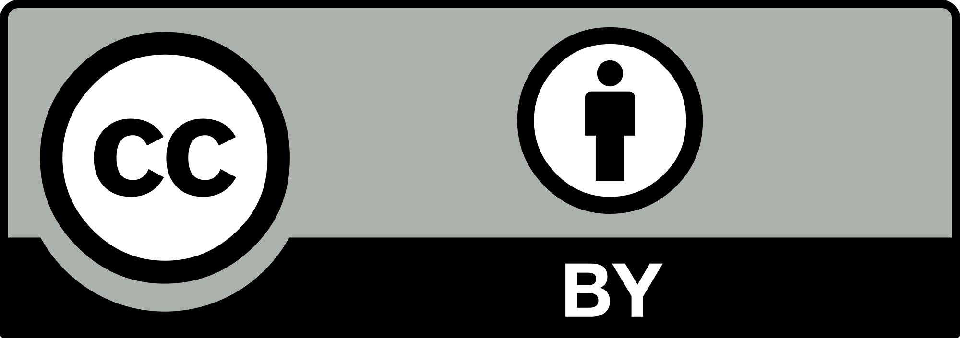
Open Science for Neuroscience
Loek Brinkman, Department of Psychology, UU
N&C Alumnus
Founder of the Open Science Community Utrecht
Github: https://github.com/LoekBrinkman
Twitter: @LoekBrinkman
Dora Hermes, Brain Center Rudolf Magnus, Department of Neurology and Neurosurgery, UMC Utrecht
N&C Alumnus
Member of the Open Science Community Utrecht
Lead of the BIDS-iEEG extension
Github: https://github.com/dorahermes
Twitter: @dora_hermes
October 2, 2018

Slide 2
Outline
11.00 Intro ~20 min
11.20 Workshops ~40 min incl. break
12.00 Presentations ~40 min
5 min presentation
3 min discussion
12.40 Wrap up ~5 min

Slide 3
Publish or perish…
scientist versus science

Slide 4
What is Open Science?
Notes:
Loek
Which of these terms do you know? What do you know? Which do you not know?

Slide 5
Changing incentives
Open assessment
Open Access
Replications
FAIR data
Preprints
Preregistration
Open Data
What is Open Science?
Open Science badges
Preprints
Registered reports
Foster collaboration
Open Materials
Open Code
Citizen Science
Open peer-review
Open Education
Notes:
Loek
Which of these terms do you know? What do you know? Which do you not know?

Slide 6
Open science and data science (Voytek, 2017, Neuron)
Year | Event
2003 | Open Access publishing is boosted with PLOS Biology launch
2004 | Google’s Dean & Ghemawat publish MapReduce in OSDI
2005 | Reproducibility goes critical with Ioannidis’s “Why Most Published Research Findings Are False” in PLOS Medicine
2006 | Facebook opens account creation to the general public
2006 | PLOS One launches with a central goal of facilitating post-publication peer review
2006 | Amazon launches Elastic Compute Cloud (EC2) as part of Amazon Web Services (AWS)
2007 | Twitter becomes independent and “debuts” at South by Southwest (SXSW)
2007 | iPhone launch sparks the “smartphone revolution”
2007 | iPython changes scientific computing when introduced in Pérez & Granger, Computing in Science and Engineering
2008 | GitHub launch makes scientific version control easier
2008 | DJ Patil (LinkedIn) and Jeff Hammerbacher (Facebook) coin the phrase “Data Science” to describe their jobs
Notes:
Dora

Slide 7
Goals of Open Science
Efficient
data reuse
collaboration
Robust
reproducible
replicable
predictive
Accessible
open access
FAIR data
Inclusive
collaboration
citizen science
Notes:
Loek: Depending on how you prioritize these ‘points for improvement’, you may put more emphasis on certain open science practices (e.g. accessibility - open access, verifiability/efficiency - open data/code/materials)

Slide 8
Why you should care
Immediate career benefits:
Your collaborators can (re)use your data and code
Build an online CV, under your own control, and get a PhD position or a job in industry
Get credit faster (prepublication on bioRxiv)
Stay ahead of the curve
Benefit from team science, community science
Other career benefits:
Data, code and methods as publication
Science that matters to other scientists, for industry or for clinical purposes
Recent new awards/grants from the Organization for Human Brain Mapping, Mozilla Open Leadership etc
Notes:
DORA

Slide 9
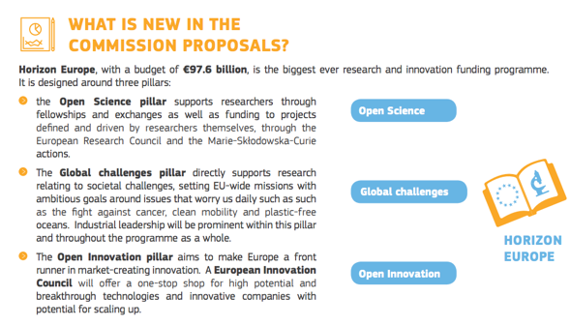
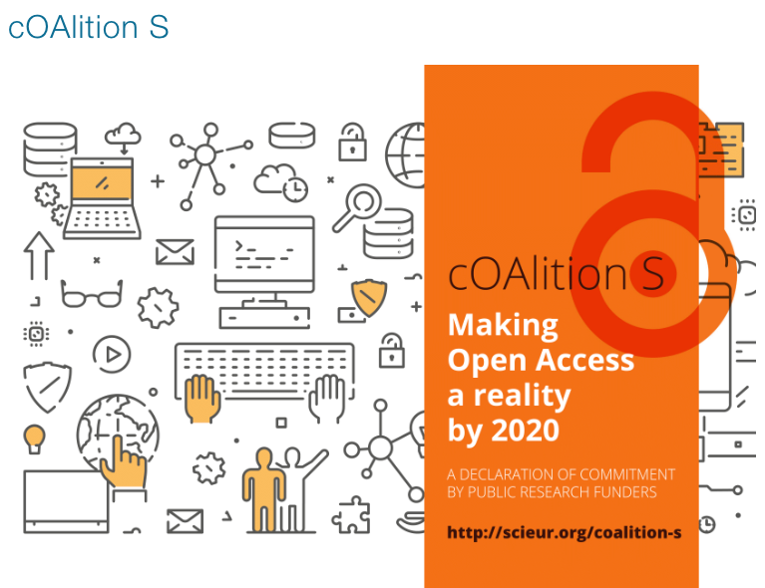
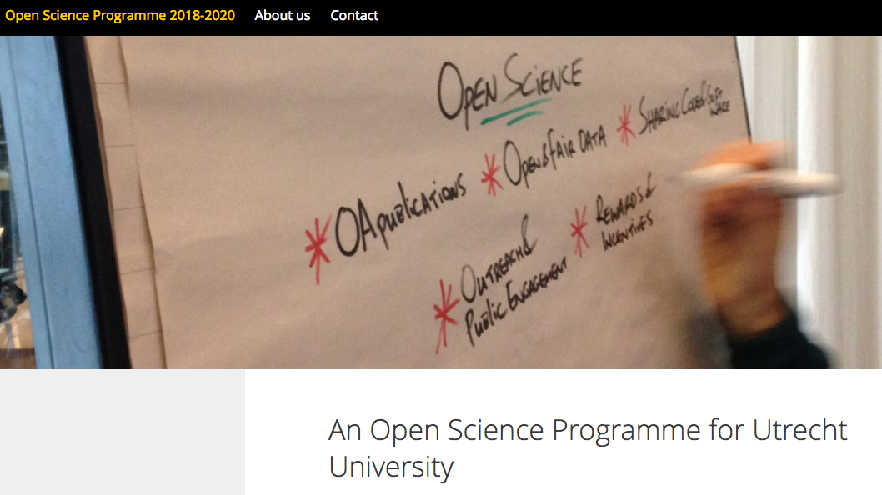
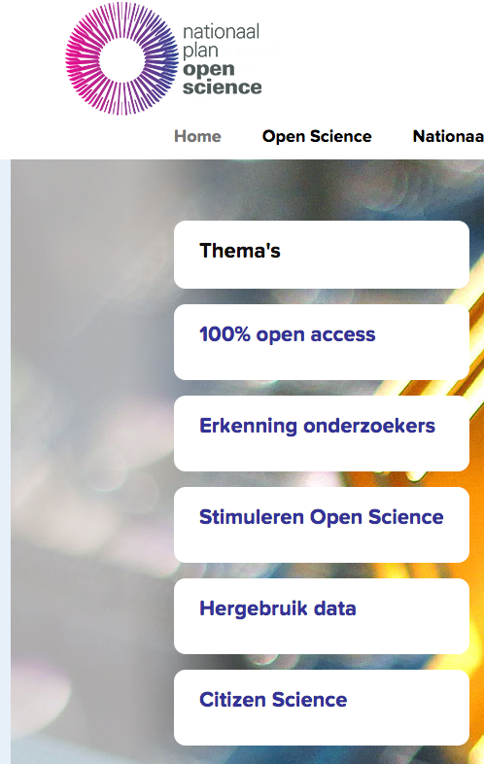
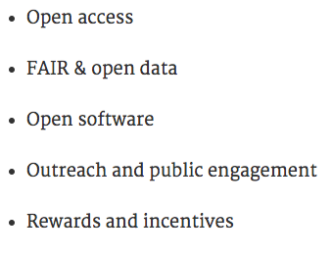
Open Science is booming!
Notes:
Loek:

Slide 10
Workshop: knowledge & skills for Open Science
Pick one of these topics:
Open Science Tools
Collaborative Science, team science, community science
Allen Brain Institute (electrophys)
Brain Imaging Data Structure
Human Connectome Project
Robust science: determinants of false positives
Is there a reproducibility crisis?
Risks of Open Science
bit.ly/NC_OpenScience2018
Notes:
http://www.pnas.org/content/early/2018/03/08/1708272114
https://www.nature.com/news/1-500-scientists-lift-the-lid-on-reproducibility-1.19970

Slide 11
Open Science Tools
Check out as many of the following tools as you like. Present to classmates:
Open Science Framework
e.g. check out the first part of this clip
https://aspredicted.org/ (preregistration)
Github (sharing code + version control)
www.curatescience.org (cumulative science)
‘FAIR’ principles for data sharing
Registered reports (novel publishing format)
e.g. check out this
Open Access Journals
e.g. PLOS

Slide 13
2. Collaborative Science
PICK ONE OF THE FOLLOWING TOPICS. IF TIME PERMITS, MOVE ON TO THE NEXT:
Allen Brain Institute (animal electrophysiology)
check out this youtube-clip and read Koch & Jones, Neuron, 2016
How ‘open’ is this initiative?
How do incentives differ for these researchers?
Do you think this is the future of science?
Brain Imaging Data Structure (BIDS, neuroimaging)
What is BIDS?
How ‘open’ is this initiative?
What is FAIR-data? Does data in BIDS adhere to these principles?
What are the pro’s and con’s of BIDS?
Human Connectome Project (HCP, neuroimaging)
What is the HCP?
How ‘open’ is this initiative?
What are the pro’s and con’s of this initiative?

Slide 15
3. Robust Science
discuss: given that a paper reports a significant result, what is the chance that this reflects a genuine effect in the population?
In other words: how likely is it to find the same results in a high-powered replication attempt?
Check out this blog-post and this web-application.
What do you think are reasonable parameter values for neuroscience?
Compute the Positive Predictive Value (PPV)
How can open science practices increase the PPV?

Slide 17
4. Is there a reproducibility crisis?
Look at this PNAS paper and this Nature discussion.
Skim the following papers:
Reproducibility in Psychology: here
Reproducibility of Nature and Science papers: here
Average power in neuroscience: here
Do you think neuroscience is facing a reproducibility crisis?
If so, how can open science practices help to mitigate the crisis?
What is p hacking, HARKING and salami slicing?

Slide 18
Notes:
pre-registration: scientists submit hypotheses and plans for data analysis to a third party before performing experiments, to prevent cherry-picking statistically significant results later.

Slide 19
5. Risks of Open Science
Look at this Scientific American article and this Nature Human Behavior Manifesto:
When should scientists make their data available? Will data sharing become the norm?
Do you risk your career by practicing Open Science?
How to promote openness:
Including vs. imposing
Why do some projects have a Code of Conduct?
Describe the use of Twitter in Open Science debates?

Slide 20
Notes:
Bioterrorism - reproduce bioengineered viruses for malicious intent
Confidentiality - reconstruct faces from fMRI, trace personal details through case studies
Dataset - should researchers have right to retain dataset until they have completed their research on it -> if published others could take advantage and perform research before original researchers have finished
Quality - quality control may be dependent on individual researchers which is time consuming, datasets published post good peer review process have quality control stamp
Take advantage - other researchers may take advantage if incentives are not there since over-competitiveness in science led to the need for Open Science
when raw data is made available it could be misinterpreted or reanalyse wrongly
years of hard work could be lost or wasted if someone else beats you to publication
Twitter could be tool for participation from multiple parties - other researchers, public interest may increase, (science) journalists able to reproduce in mainstream news
Code of Conduct protects vulnerable groups from being marginalised in science

Slide 21
Now what?
Be part of the OS movement. Join OSCU!
www.openscience-utrecht.com
NEW: student-membership!
Workshops
Open Access publishing
Career benefits of Open Science
Working with the Open Science Framework
UU Open Science Policies
Preregistration
Data Management Carousel

Slide 22
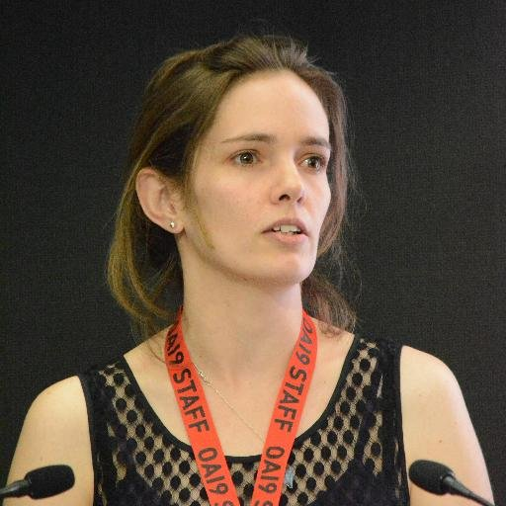
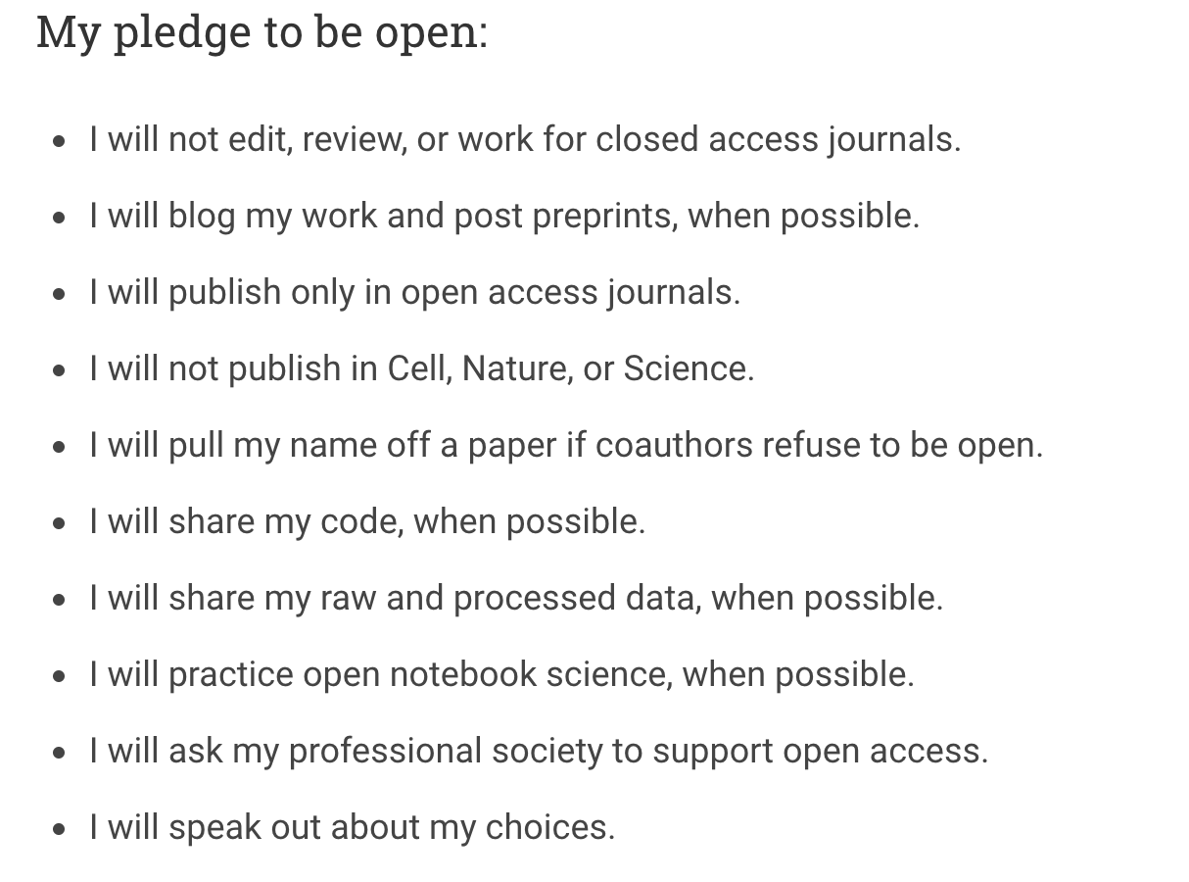
Open Science Pledge
Erin C. McKiernan

