Slide 1
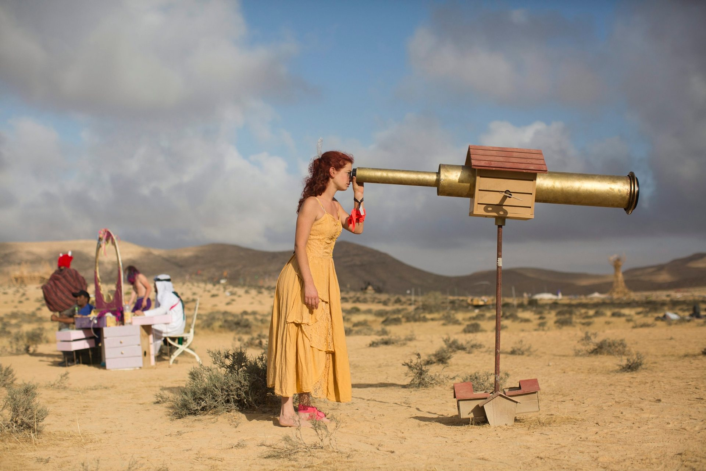
Symposium
Burning Man
& Transformational Event Cultures
Burning Progeny
Université de Fribourg
Photo: Abir Sultan

Slide 2
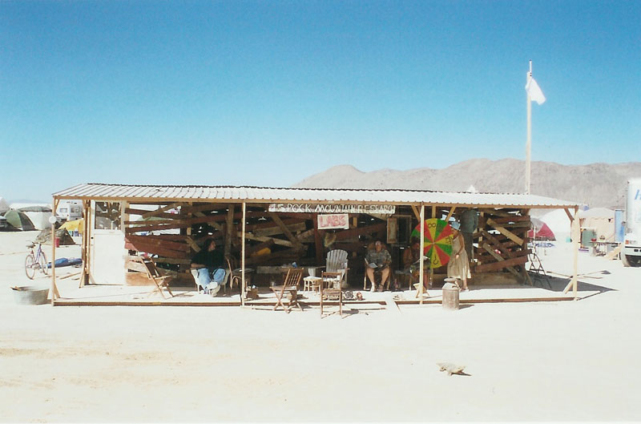
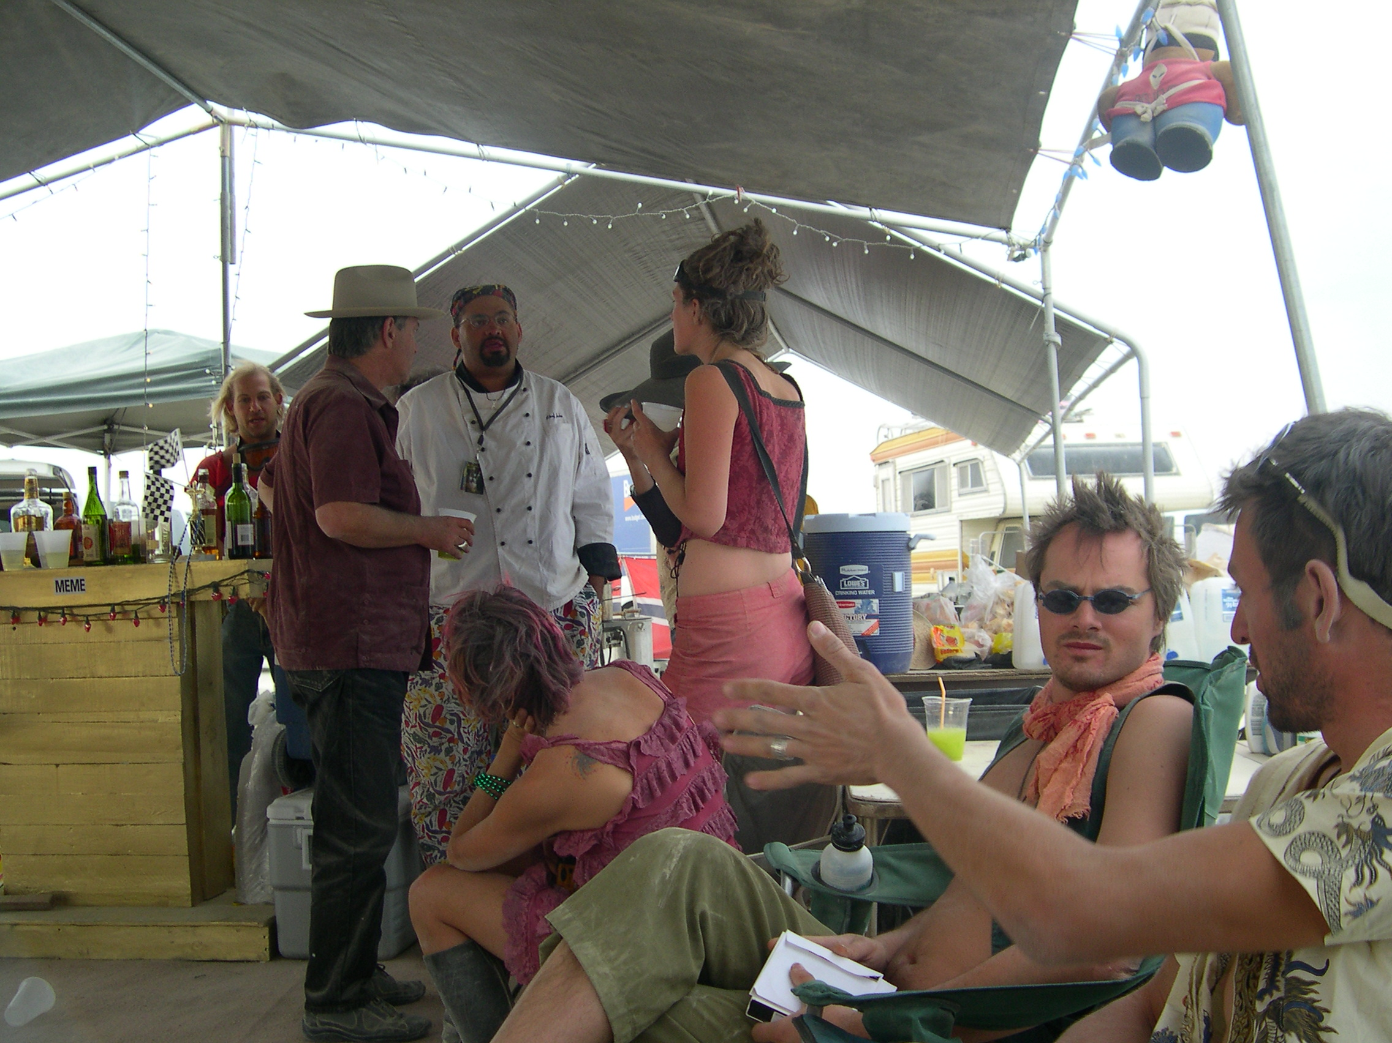
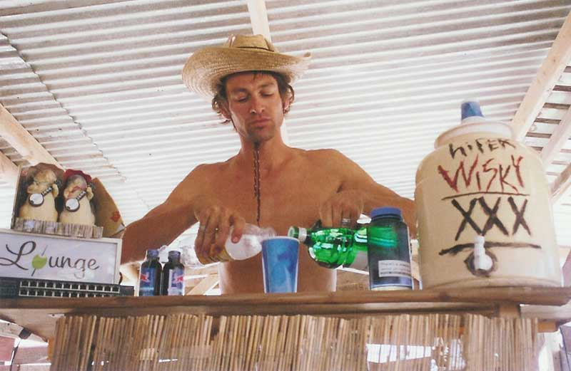
Burning Man: A Formidable Cultural Laboratory

Slide 3
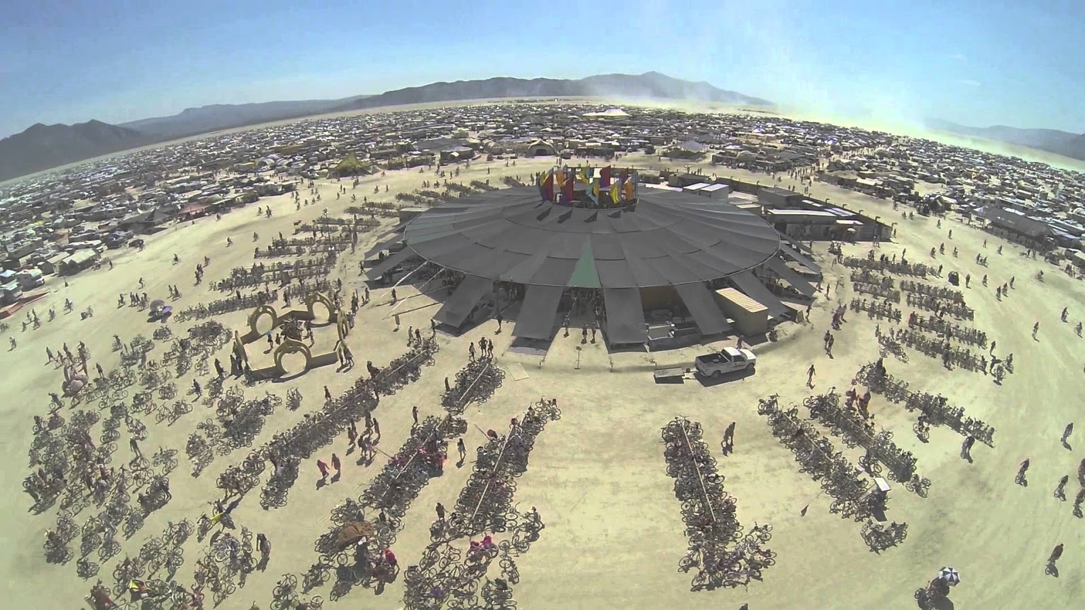
Burning Progeny
Burning Progeny: The European Efflorescence of Burning Man (2016-2019, University of Fribourg)
Field research at events in Denmark (Borderland), Spain (Nowhere), Israel (Midburn), France (Crème Brûlée), Germany (Burning Bär, Kiez Burn), BurnerCom (Zurich) and Black Rock City.
2 surveys
50 interviews

Slide 4
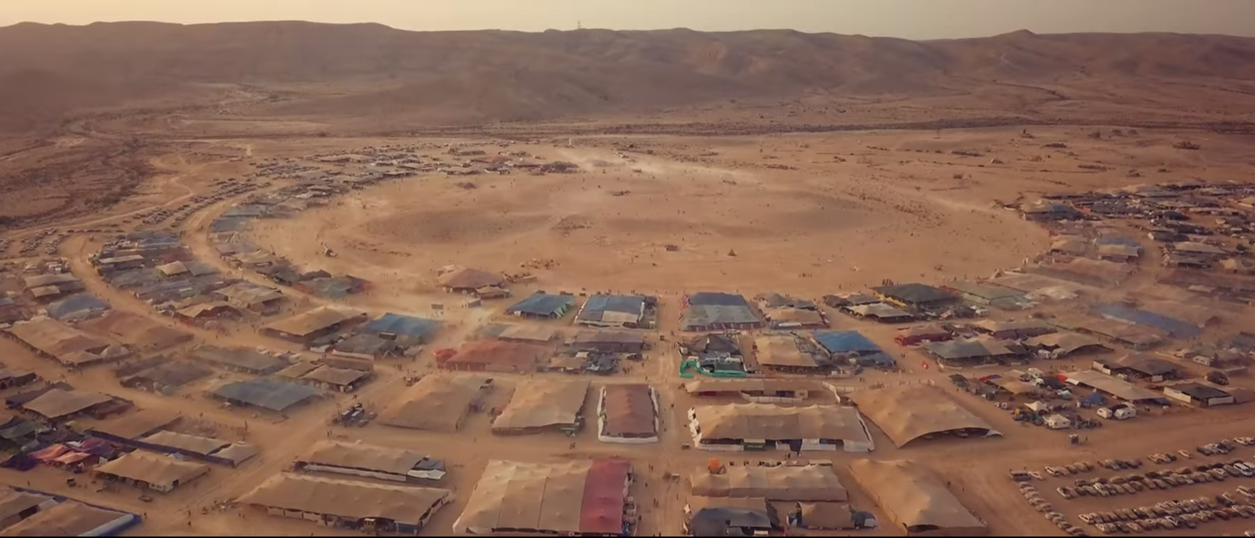
Research Questions
Is Burning Man transformational?
How has Burner culture evolved beyond Black Rock City (& specifically in Europe)?
How have the Ten Principles fared in Regional Events?
What are the internal tensions and the means of resolution?
What is the nature of gifting in Black Rock City and abroad?
Must one experience Black Rock City before becoming a Burner?
Midburn, Israel, 2018

Slide 5
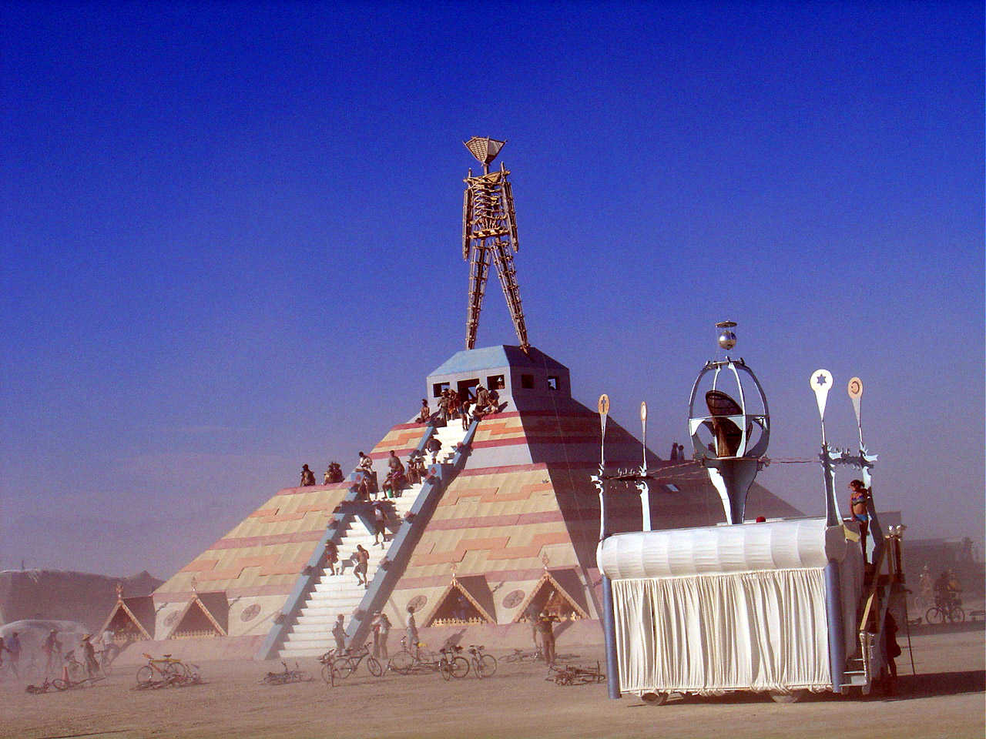
Being Through Doing
Notes:
Upon my first visit to Black Rock City in 2003, I was moved to ask questions long motivating anthropologists: what is this place, and who ARE these people? And …. who AM I, in relation to these people? What purpose do I serve? What is my impact? What can I give?
These are not questions exclusive to anthropologists…. In fact anyone who identifies as a Burner has been asking the same questions.
“Being Through doing” has essentially led to this symposium.

Slide 6
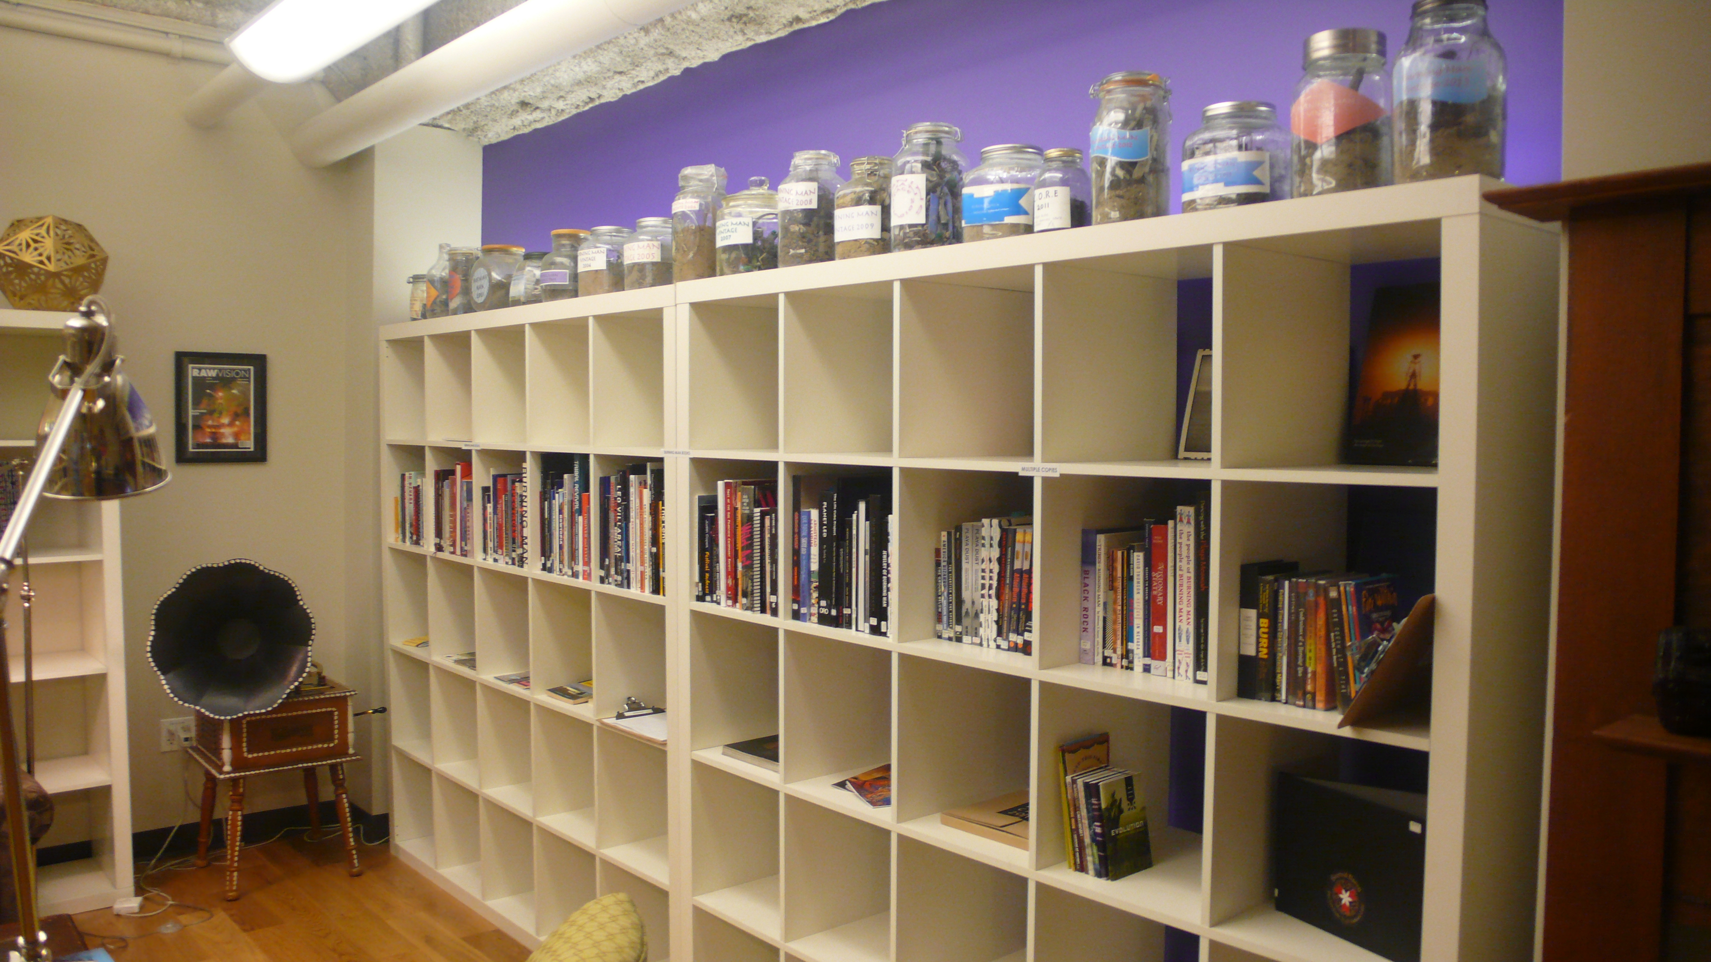
Burning Man Studies?
Notes:
Burning Man is a gravitational field for anthropologists
Burning Man is among the most researched events – appealing to students - but of the numerous studies, comparably little attention to the regional phenomenon.
Is it any wonder that there are dozens of graduate dissertations on Burning Man, but very little on the movement that is has spawned.

Slide 7
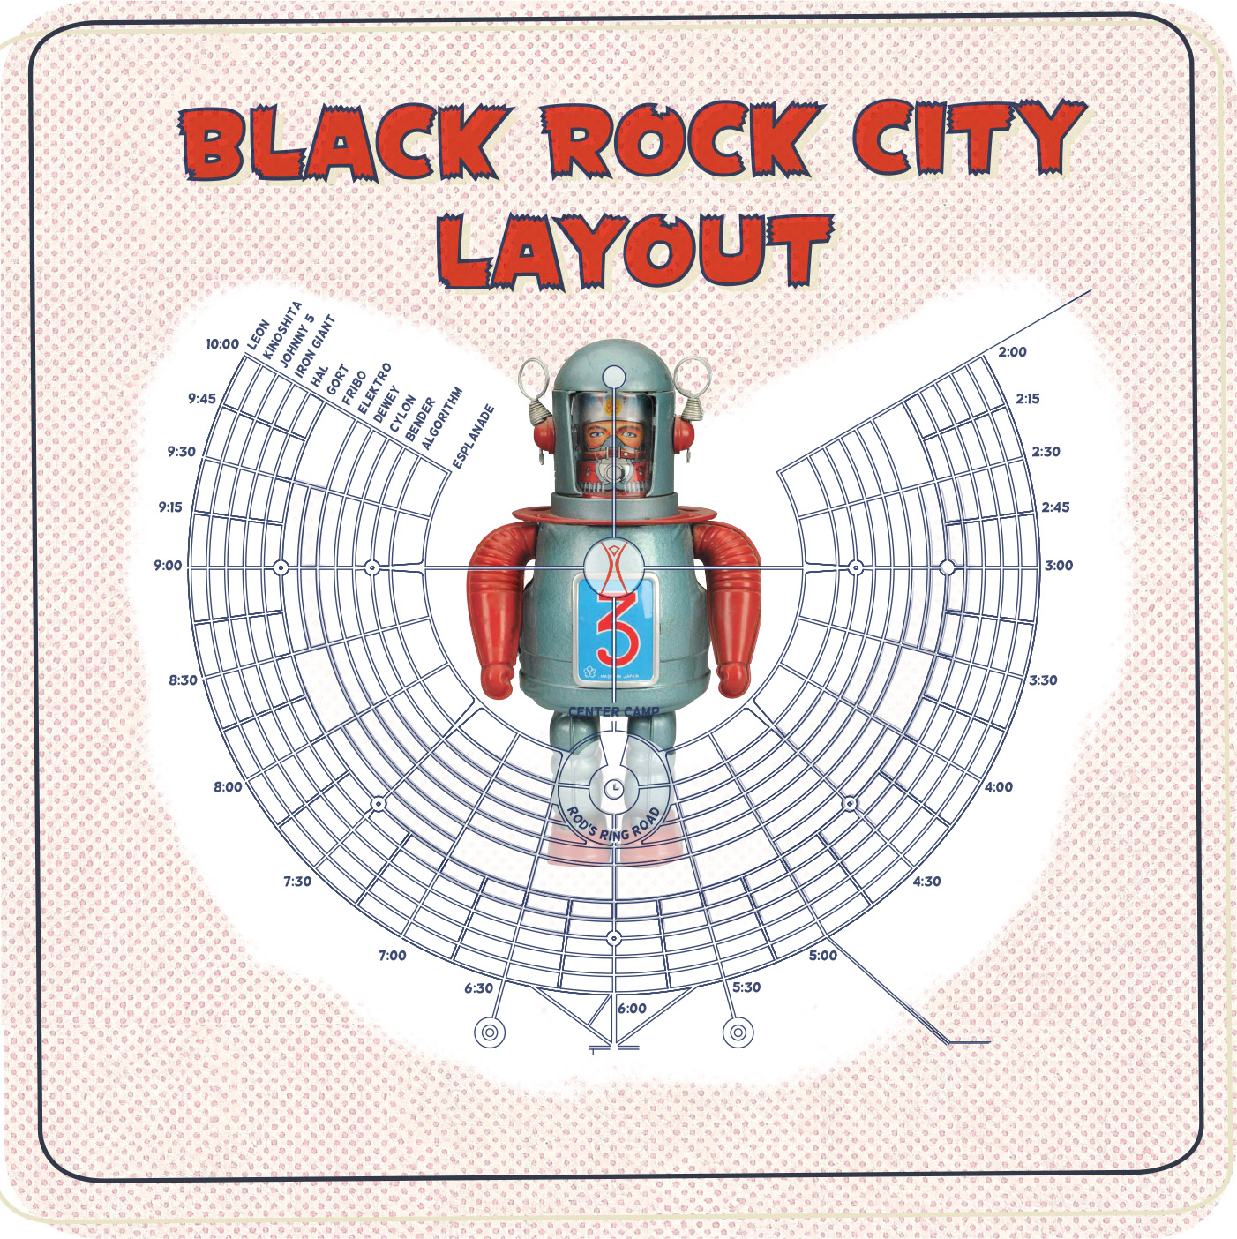

Slide 8
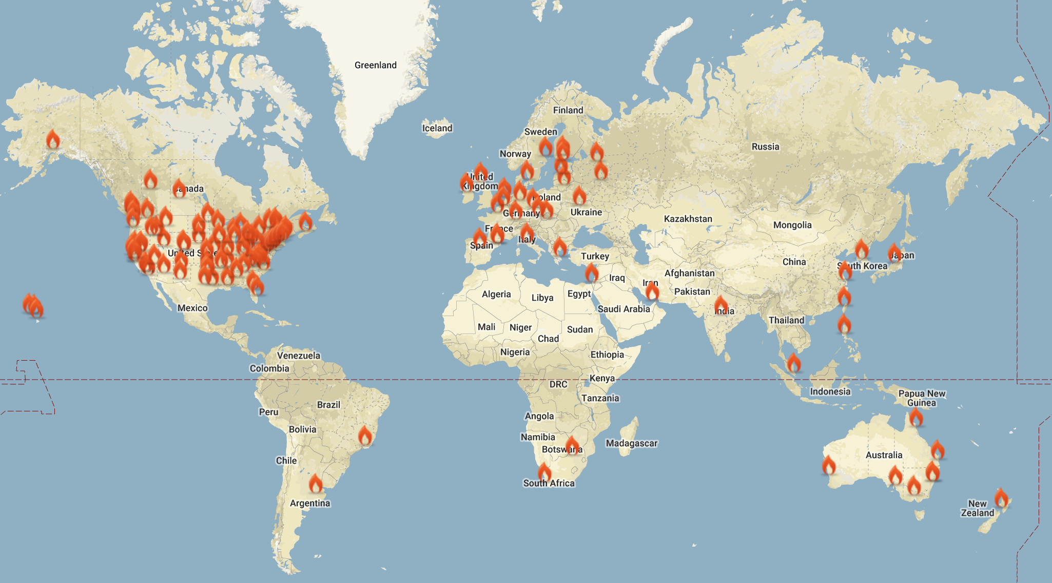
Notes:
Global movement. close to 300 Regional Contacts in 35 countries
Over 85 official regional events worldwide.
That’s a multitude of playas, effigies, temples, departments etc etc etc
It is also a multitude of interpretations of the principles:

Slide 9
What is Burning Man?
Notes:
What is Burning Man ?
This question has compelled a great many commentators (academics and journalists).
Classification is futile, and ludicrous / deserves to be satirized

Slide 10
The Burning Man Phrase Generator
A word selected from each of the four columns to the right may be strung together in a sequence. “The Burning Man Phrase Generator© is capable of generating 160,000 colorful descriptions. It has been thoroughly tested” (The Black Rock Gazette, vol 8, Sep 5, 1999).
Notes:
Indeed the commitment to capture, codify and classify Burning Man was once satirized in the “Phrase Generator” (as published in The Black Rock Gazette (vol 8, Sep 5, 1999). Said to be 160k combinations are randomly cranked out from this device – satirizing commentators entertaining the conceit of possessing the true meaning behind Burning Man.
It reveals a secret – that there is no official meaning.
The point:
No one has a commanding view over this phenomenon.
And yet we cannot abandon analysis, reflection and empirical study / comparative ethnography: multidisciplinary research.

Slide 11
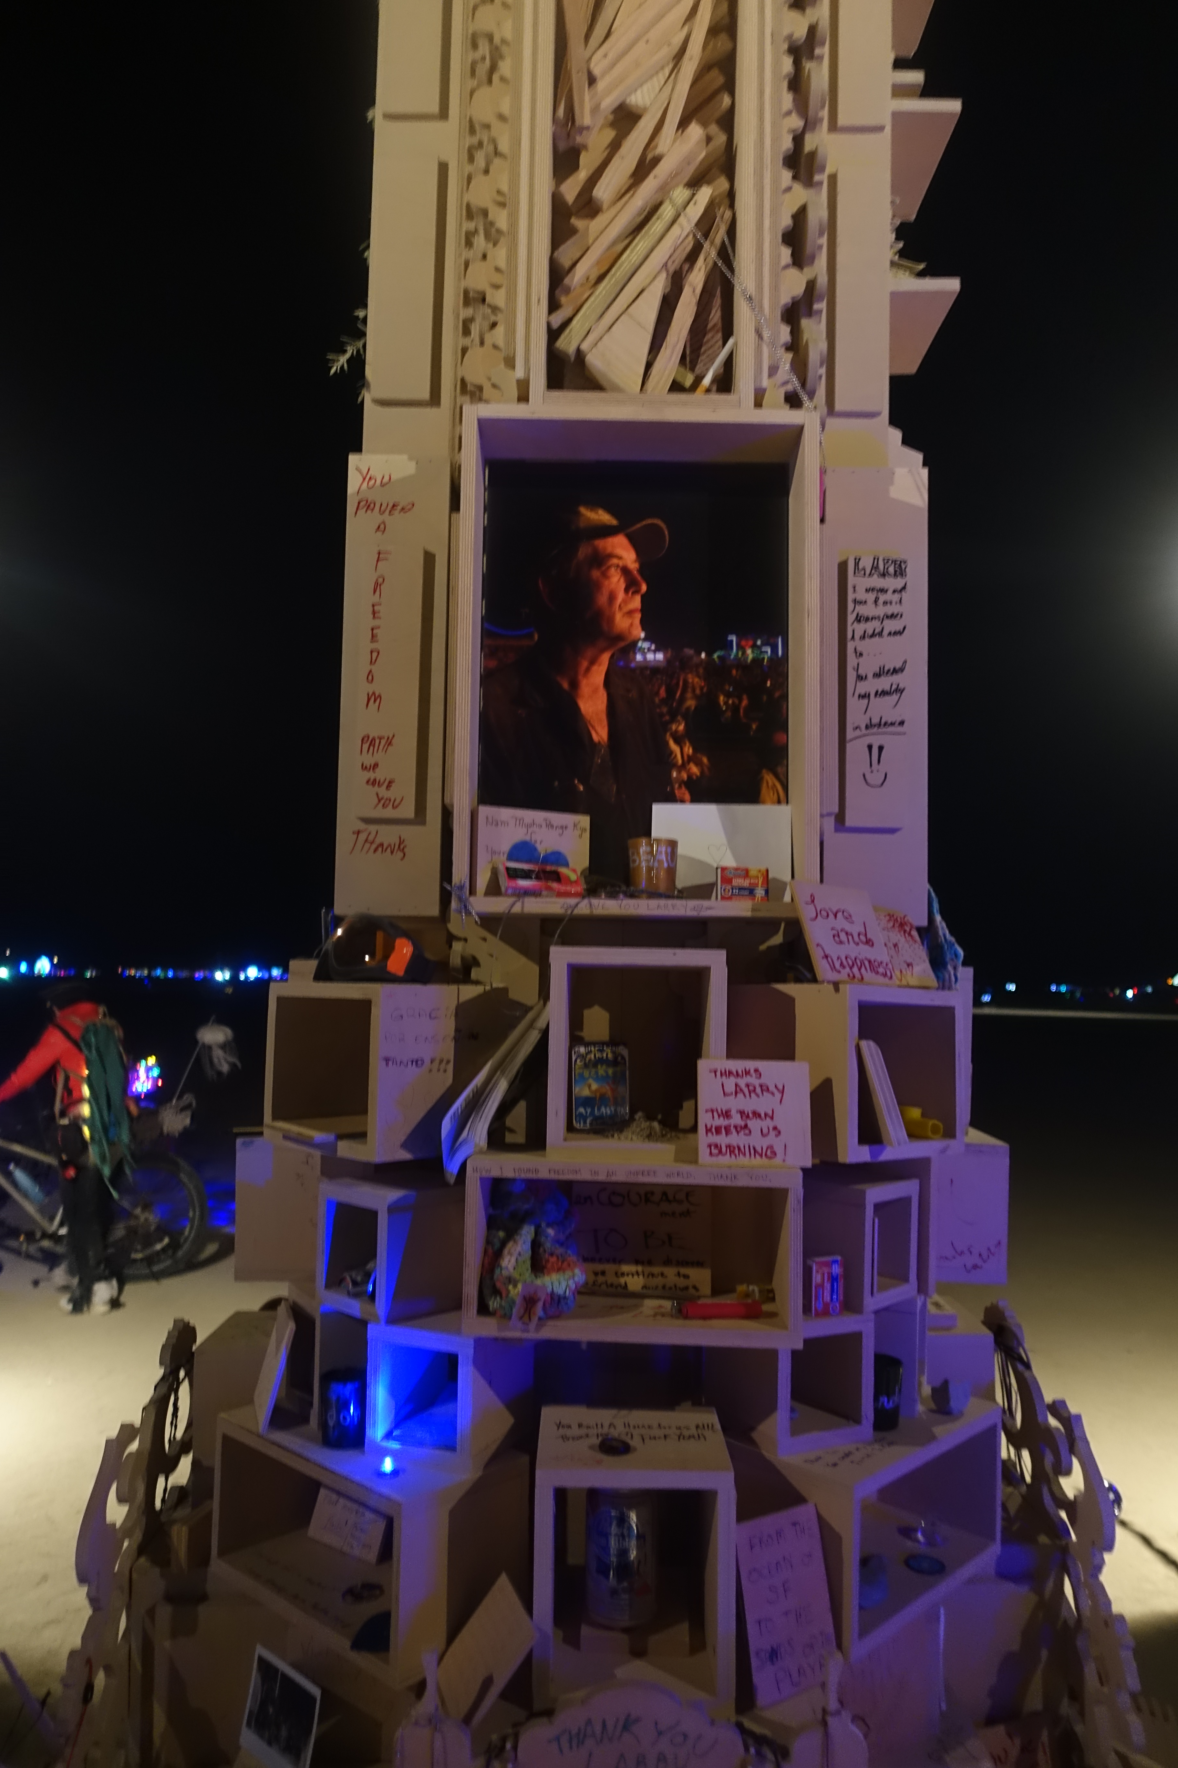
Larry Harvey
“The Ten Principles have proven to be useful, durable and productive; they have enabled us to think and communicate, they have enabled us to act, and they have helped us to project our culture into the world. However, this could cease to happen unless we remain ready to constantly exercise and examine them” (Larry Harvey, 2013).
Notes:
From the random concept generator to a more quite deliberate concept generator: named Larry Harvey (who named the Ten Principles back in 2004).
The quote is from Larry's intro to the Philosophical Center.
Burning Man does not need to rely on external agents (scholars / academics) to educate them about who /what how / where – the event birthed its philosophers and scribes, burnographers - none more important than Larry, a true essayist whose ideas are anything but random. He tended a garden of ideas which is a ripe irony given that the garden flourishes in a desolate realm.

Slide 12
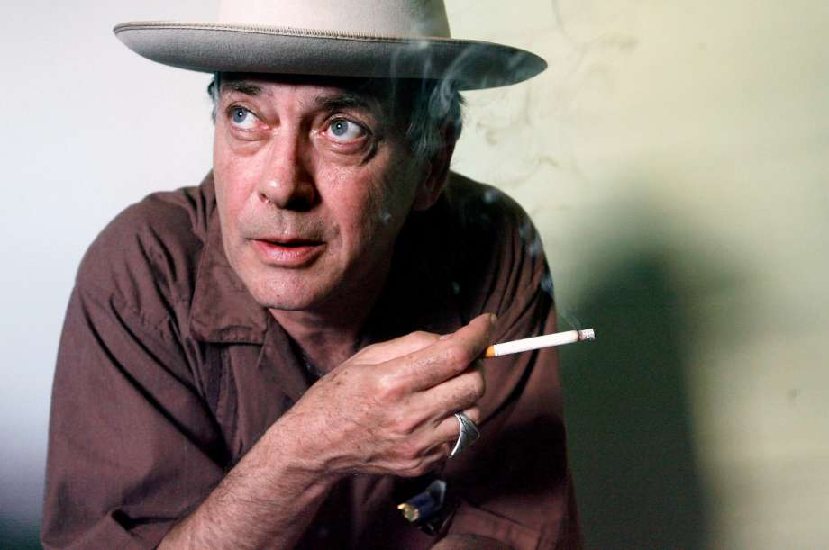
LH March 17 2018: “The commonest form of festival, at least in America, is a commercial music festival. We don’t want to be conflated with that, and most contemporary festivals are choked with commerce. We hardly fit this model, either, and it is a rare festival indeed that aspires to effect world culture, that sees itself as an agent of change. I suppose we think of our event as something more than spectacle and entertainment, and do not want to be confused with the Iowa State Hog Festival (though we do love bacon).”
Notes:
Quote from Larry in email to me 2 weeks before his stroke
On March 17 2018, Larry wrote me confirming he’d speak at this event. In that email, he addressed a word (“festival”) that has been a common descriptor of Burning Man, but from which the BMP has sought distance.
Larry was crafting the model and shaping perception right to the end. Sadly, he is not here in person, but we feel his presence.
I'd like to think of him sitting in the corner smoking, saying “philosophy occurs when principles collide” and laying fresh nomenclature.
Harvey last appeared in public March 29 at the opening of a Burning Man art exhibition at the Smithsonian in Washington, died after suffering a massive stroke on April 4. He was 70.
Leads to discussion of transformation

Slide 13
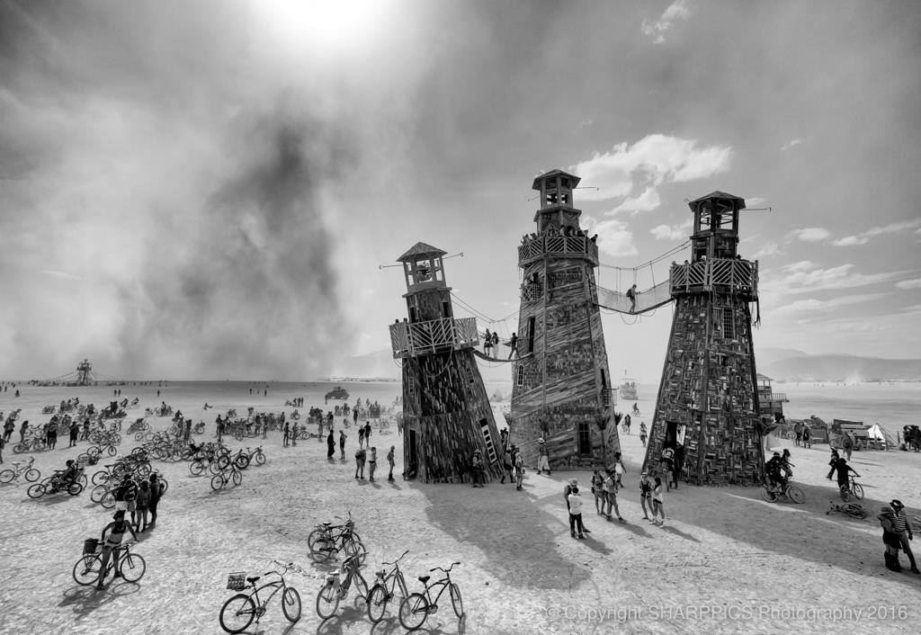
Is it Transformational?
Unique space (the Black Rock Desert playa)
Fire-arts gathering
Temporary city
Non-profit organization
Global cultural movement
Land steward (Fly Ranch, Nevada)
Notes:
Is Burning Man Transformational? The answer necessarily requires a comprehensive approach to Burning Man - which is integral to understanding its status as "transformational."
Each of these characteristics shape its status as a “transformational” event.
Return to the playa and its sublimity/ ephemerality (it transforms seasonally) as key to understanding the phenomenon.

Slide 14
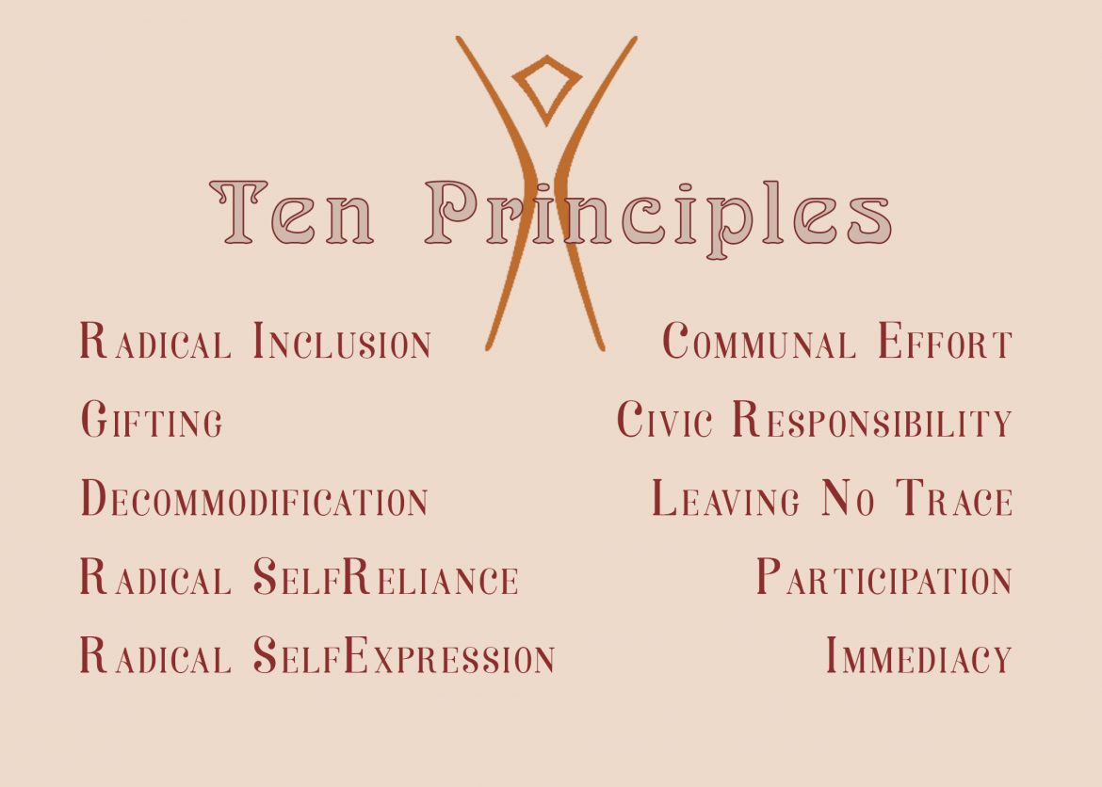
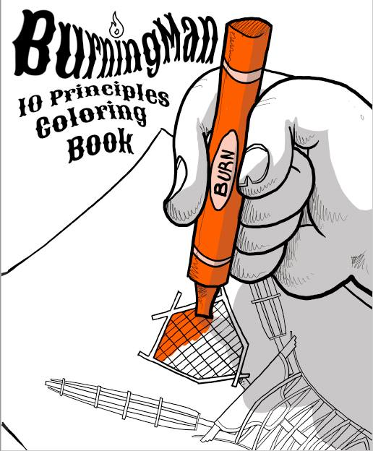
Ten Principles: More than just “hood orniments”
Notes:
Understanding the principles is integral to understanding what is transformational about Burning Man .
Principles can only be known in situ, and not in isolation – they are related ecologically.
Paradoxical. principles are the subject of sometimes heated debate in the burnerverse, not least because they tend to represent disparate and sometimes competing virtues, values and commitments.
Principles collide and mutate:

Slide 15
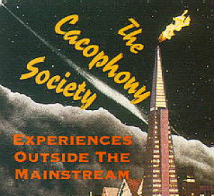
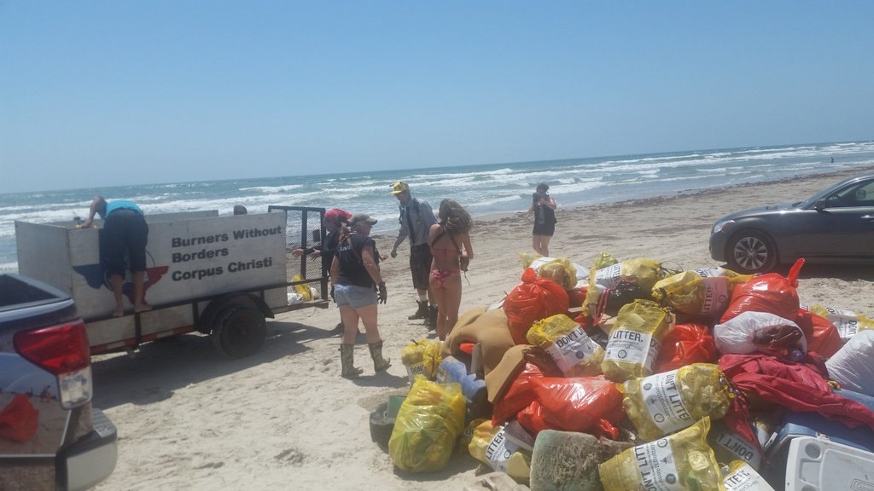
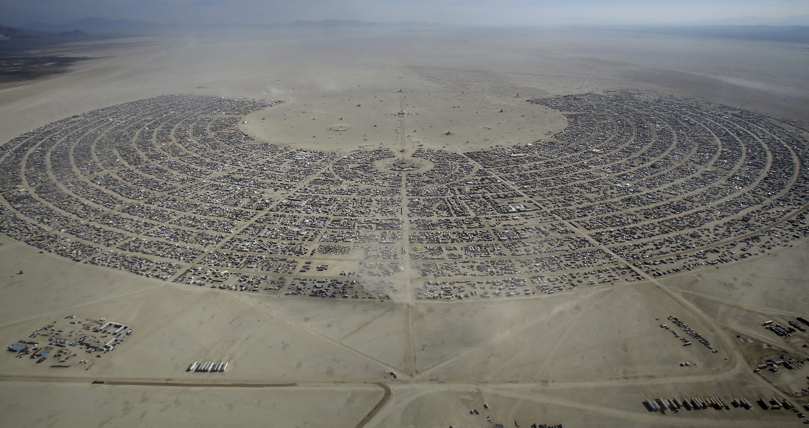

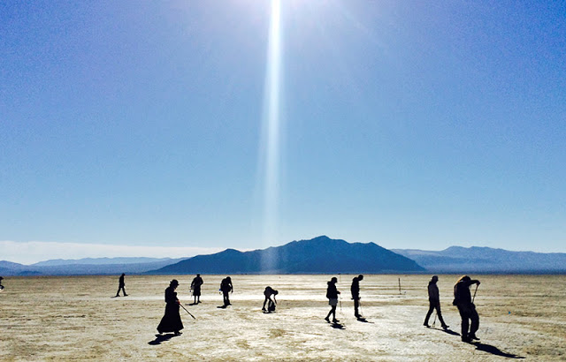
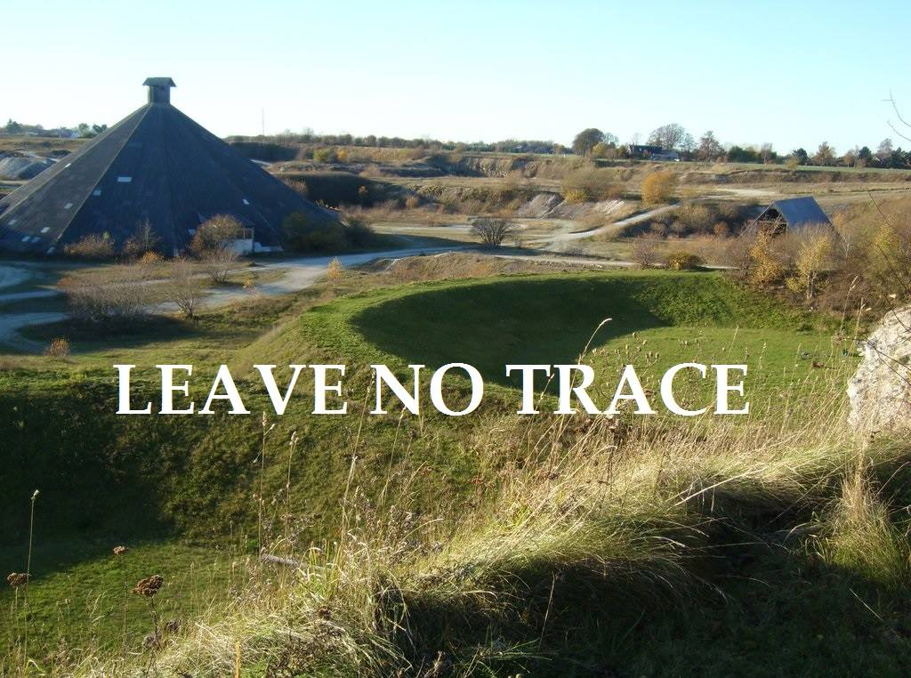
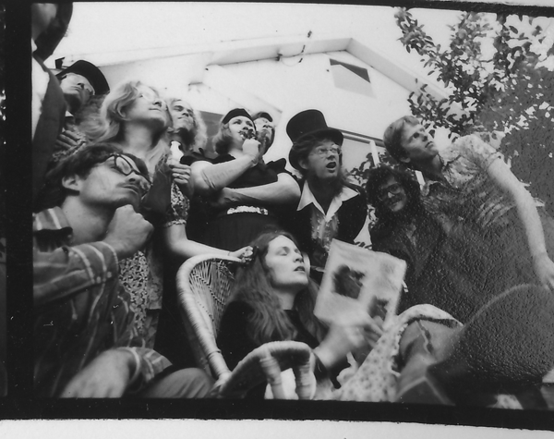
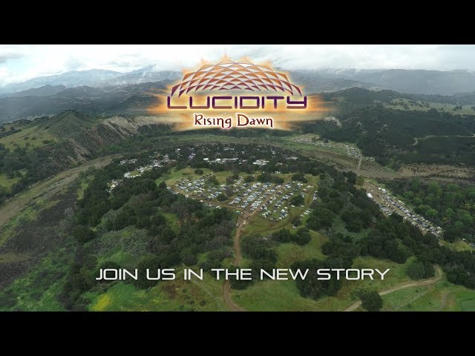
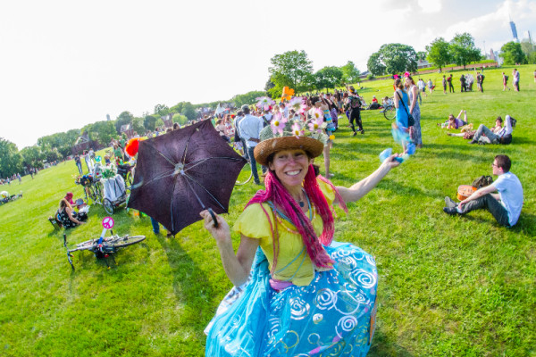
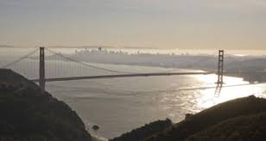
Leaving No Trace
Notes:
Focus on one principle: i.e. Leaving no Trace LNT)
The transformation - distillation - of practices into principles
The practice of LNT is a restoration ritual – restoring the blank canvas of the BRD to its pre-event status.
The process - with a set of meanings partly supplied by U.S. National Park Service – & BLM
Backwards LnT can be traced back to the Suicide Club (Gary Warne) and Cacophony Society where it had a different meaning – vanish before the authorities arrive.
Forwards
How is the principle of LNT transposed to other sites, to regionals?
Burners without Borders inflected with a commitment to clearing MOOP – as in removing trash from beaches at Corpus Christie beach burns
Leaving no Trace parties in the days after Borderland - Boesdal, Denmark
FIGMENT
Transformational festivals – Lucidity
What are the challenges of adopting/translating this practice abroad?

Slide 16
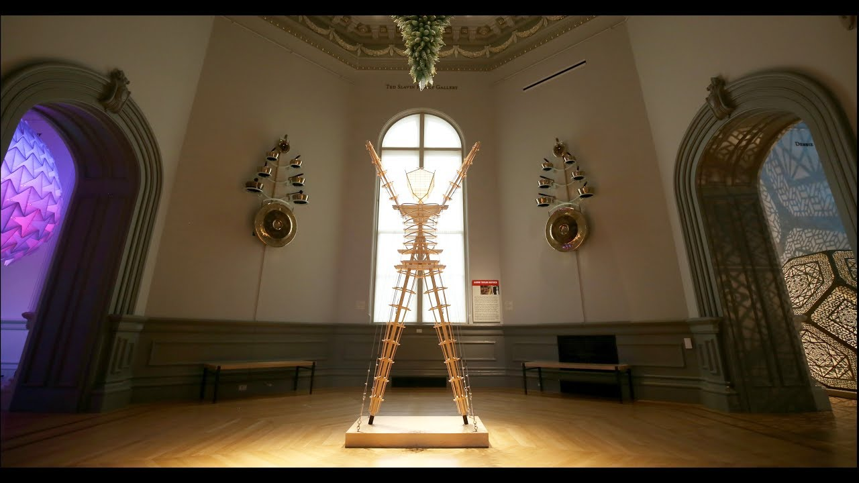
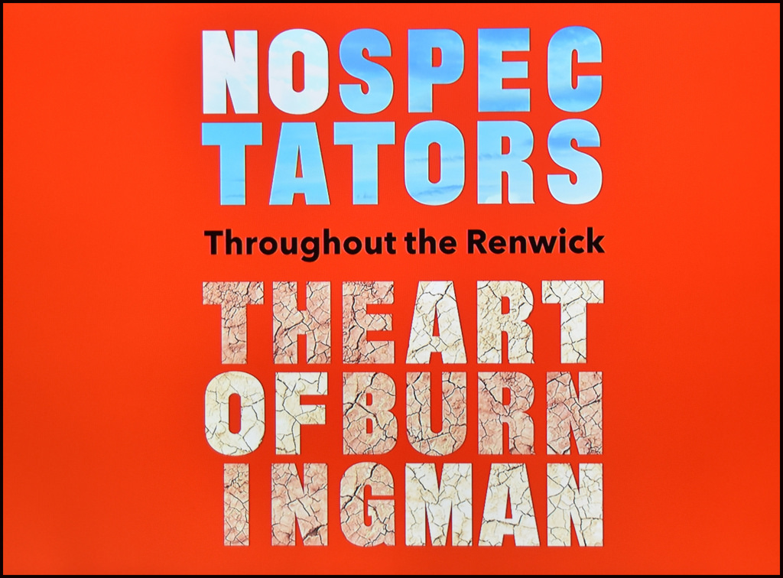
Notes:
Paradox – Burning man is leaving a trace in the world (picture of Gallery at Smithsonian)
What has become of Burning Man as its growing corolla of regional petals have blown further and further from the calyx of the playa?

Slide 17
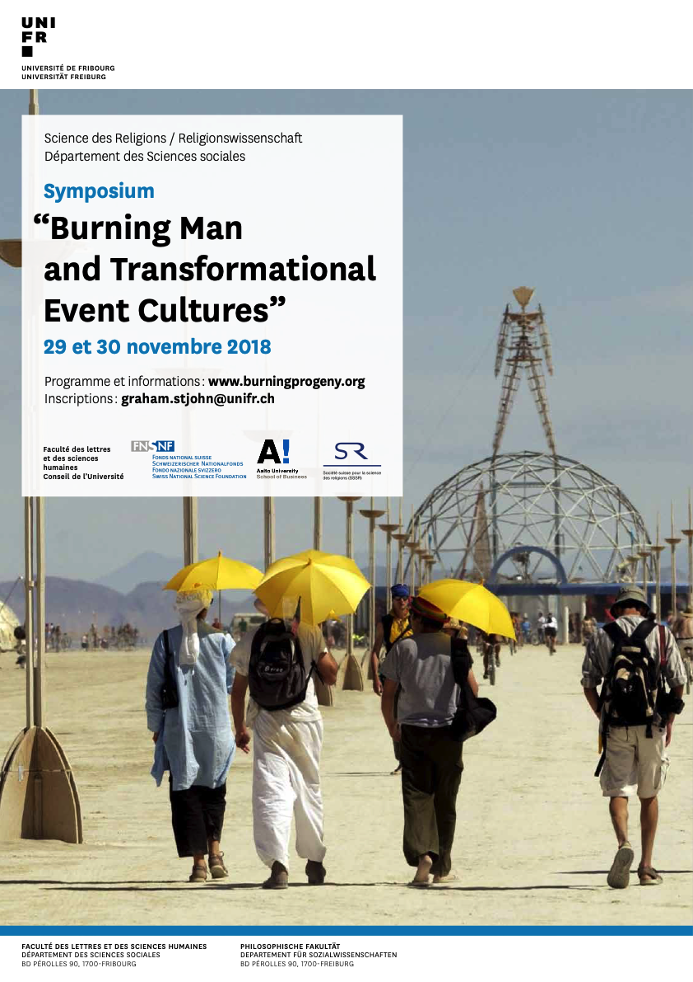
Symposium 29 – 30 Nov 2018
Thanks to our sponsors: Swiss National Research Fund (SNF), Fonds de recherche Université de Fribourg, Faculty of Arts FAF scheme, Sciences des religions UniFr, Burning Man Organisation, Aalto University School of Business (Finland), and the Schweizer Gesellschaft für Religionswissenschaft (SGR).
Thanks to all who have collaborated to make this happen: Carmen Favre, Daniela Vaucher, Magali Jenny, Flore Muguet.
Burning Progeny Team
Prof Francois Gauthier
Dr Graham St John
Dr Botond Vitos

