Slide 1
Box Braids, Buddhist Altars, and Native Headdresses: Radical Self-Expression vs. Cultural Property at Burning Man
Dr. Amanda Lucia
University of California-Riverside
November 24, 2018

Slide 2
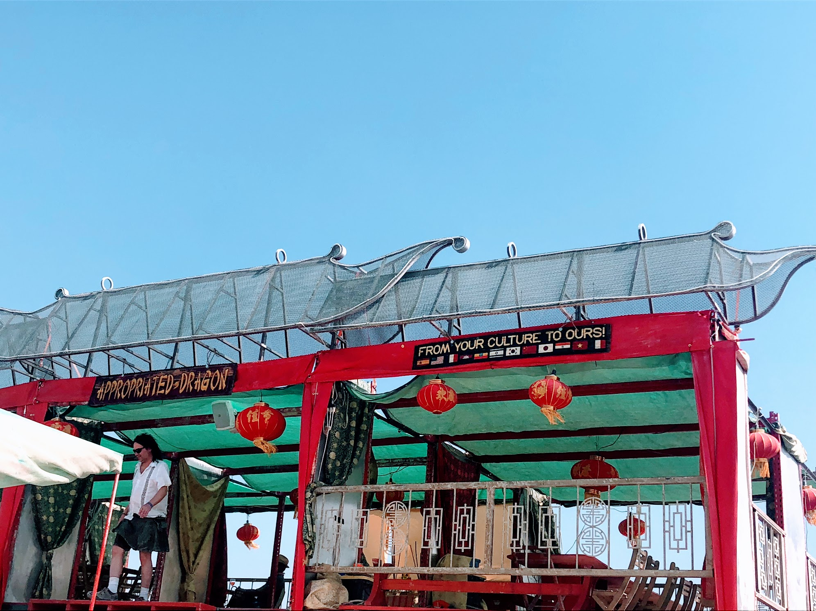
The Appropriated Dragon
Black Rock French Quarter, 2018

Slide 3
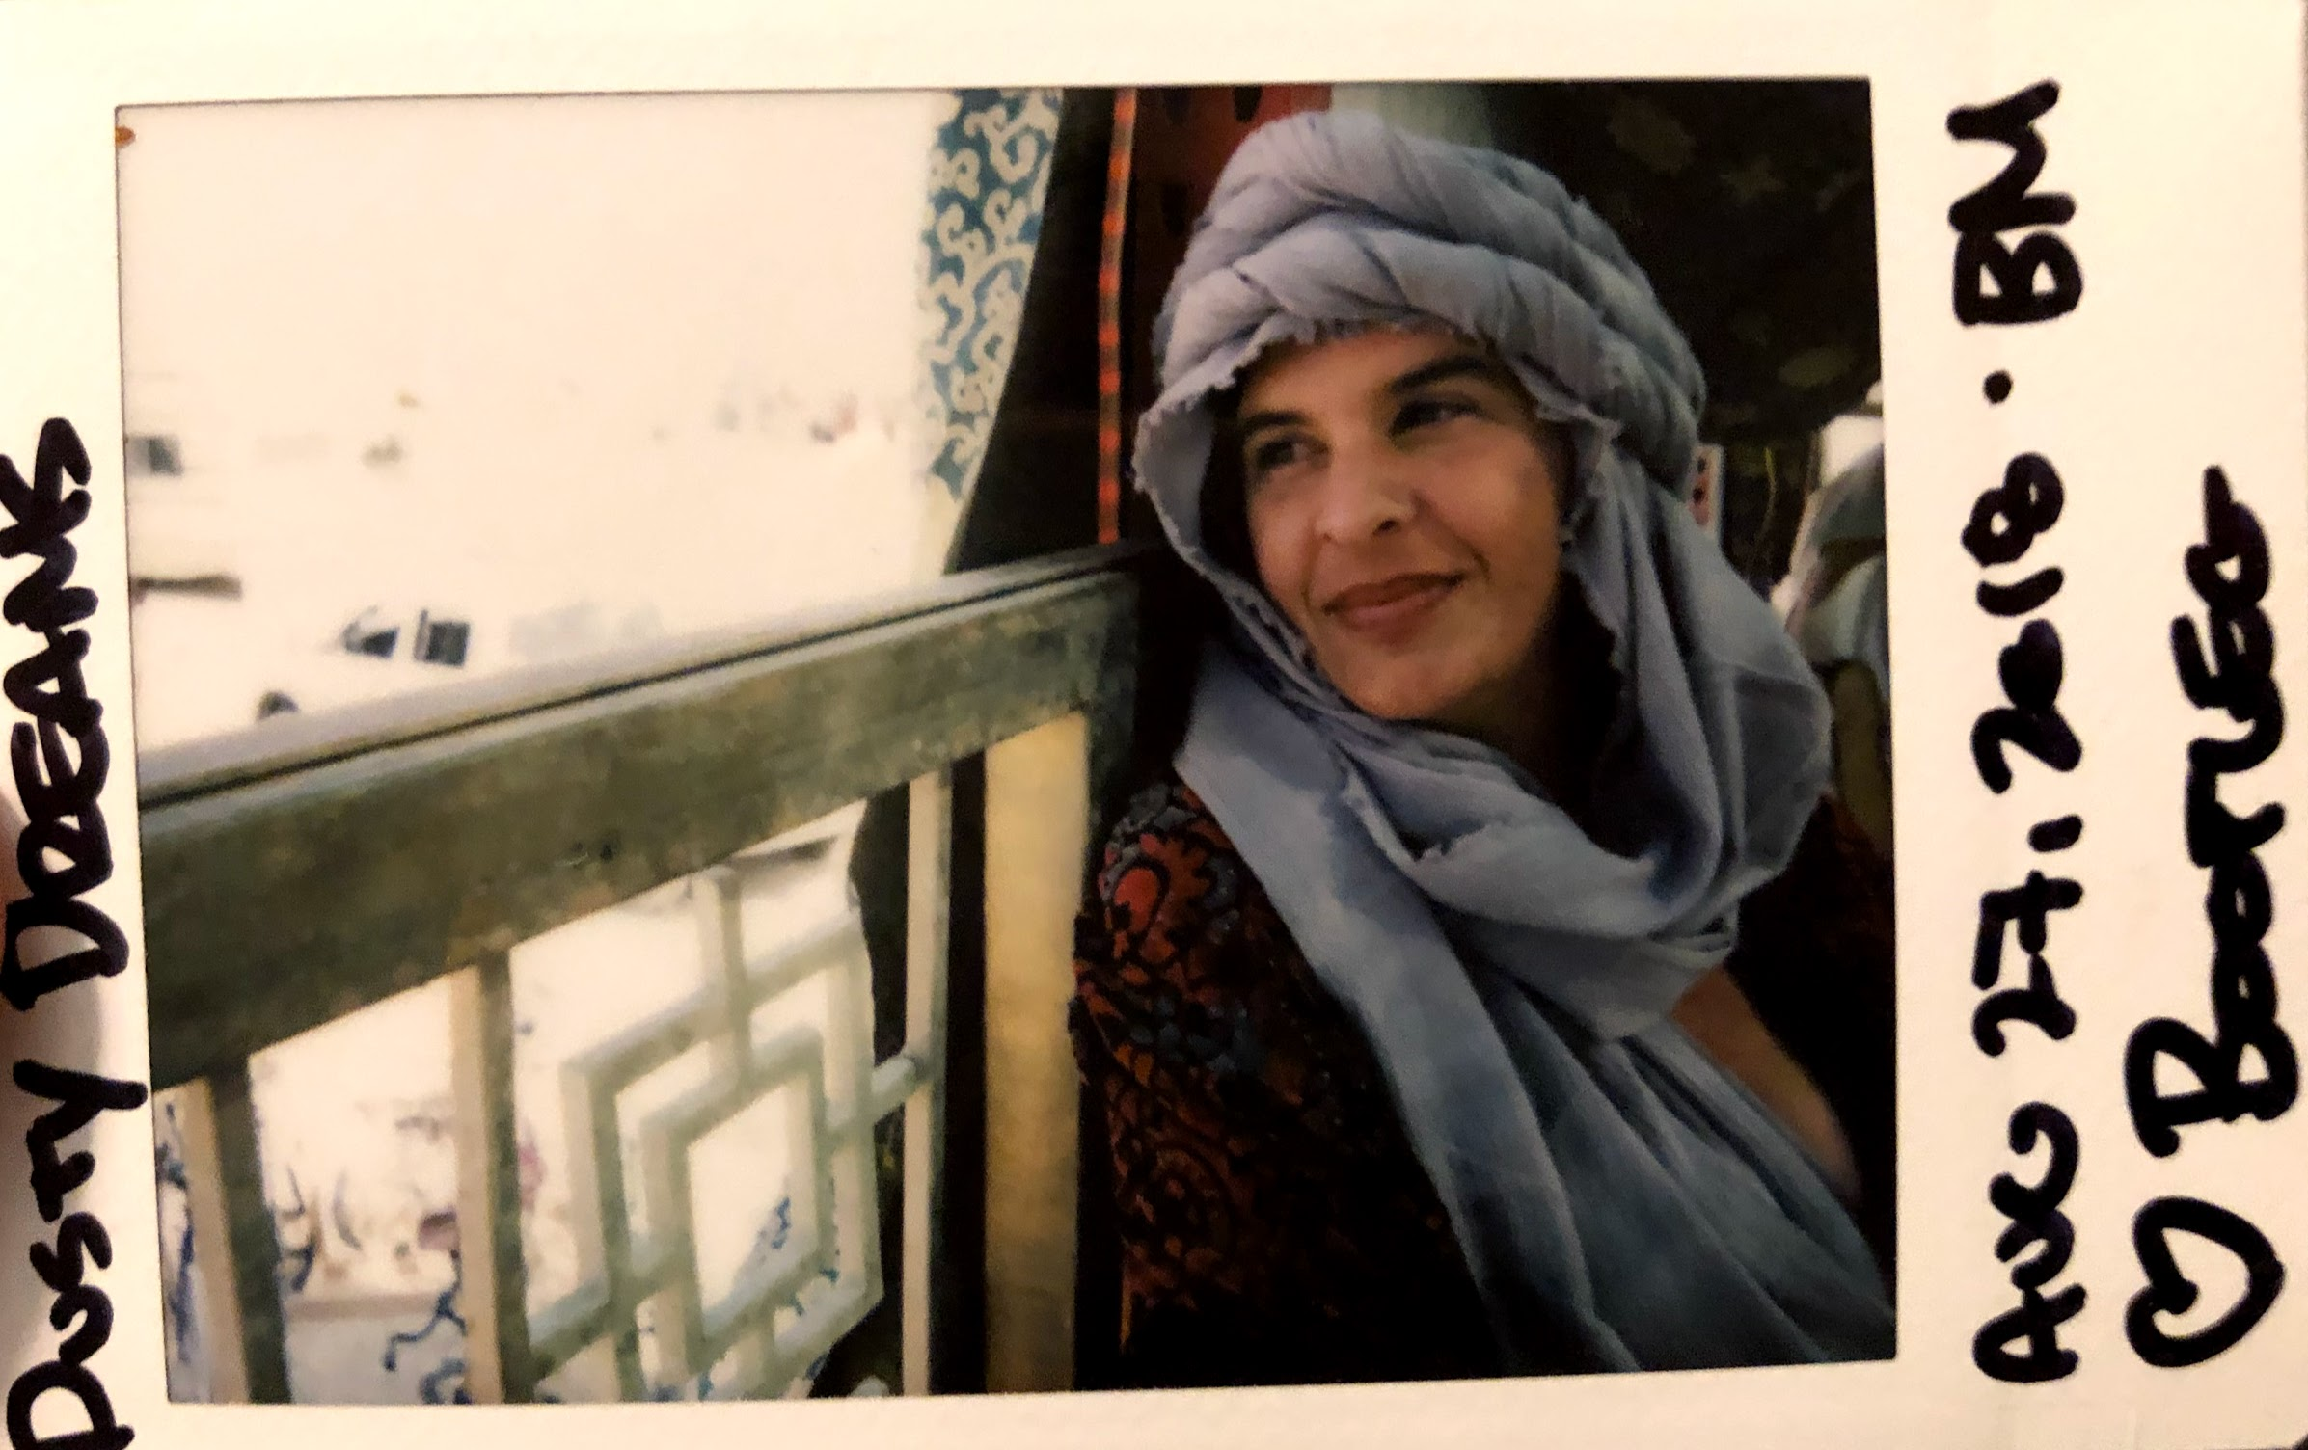

Slide 4
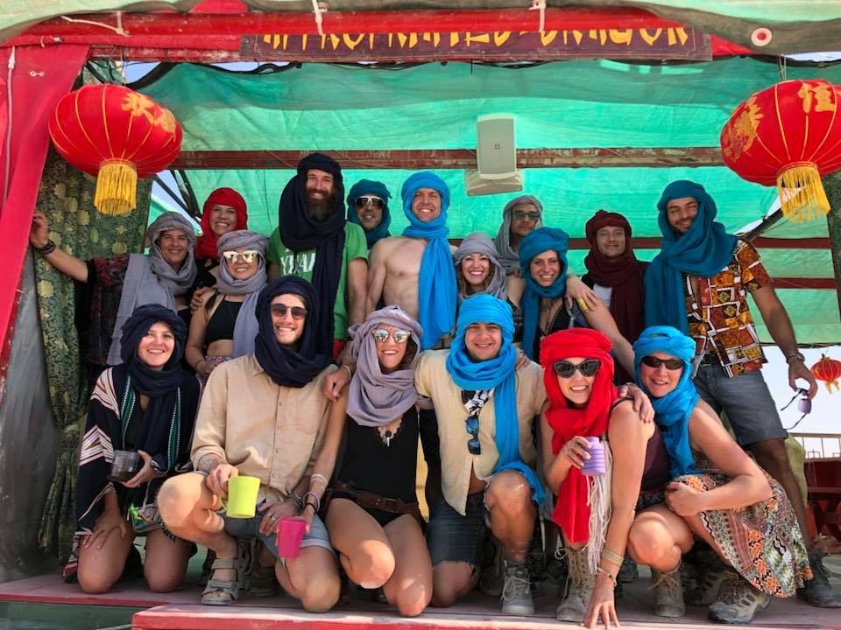
Tea and Turbans at the Appropriated Dragon

Slide 6
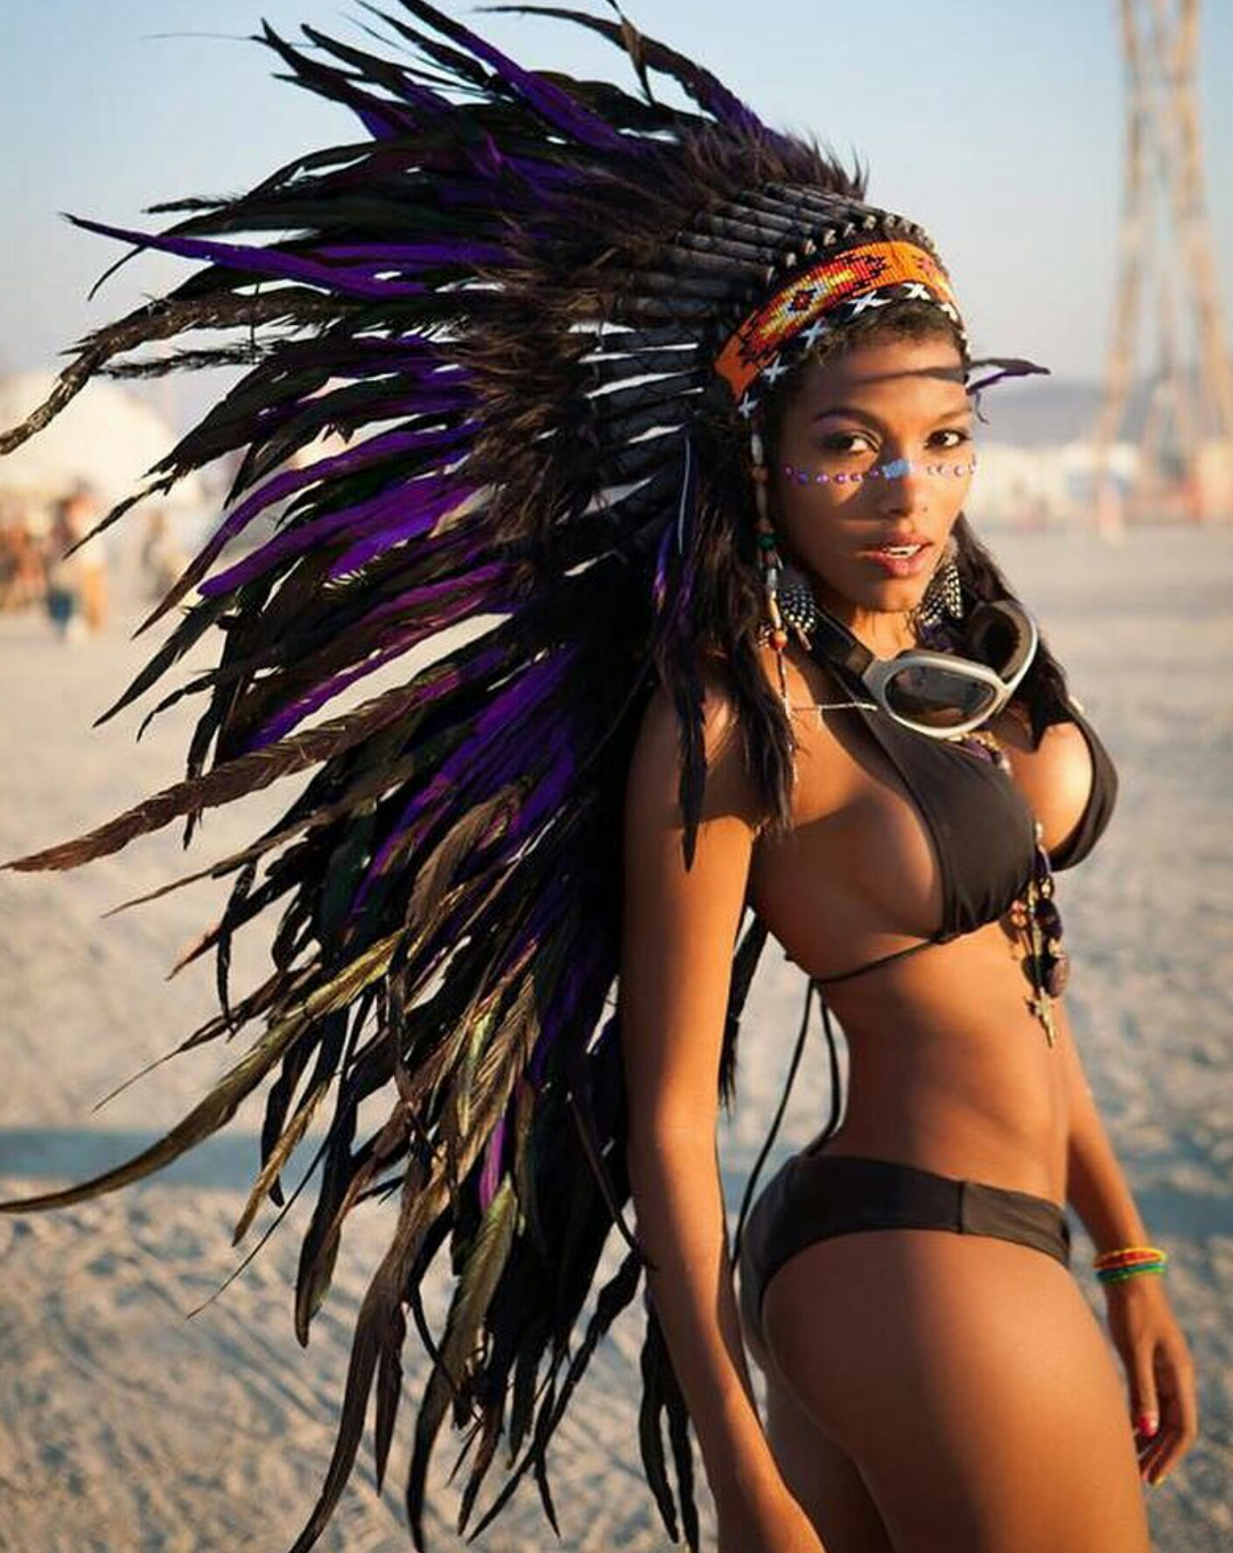
https://imgur.com/gallery/rxFVC

Slide 7
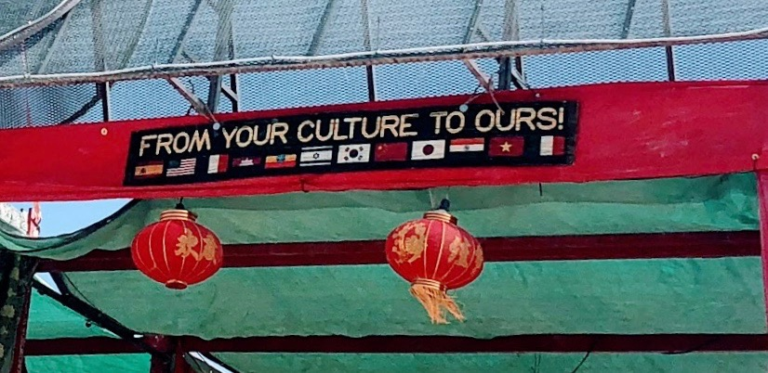

Slide 8
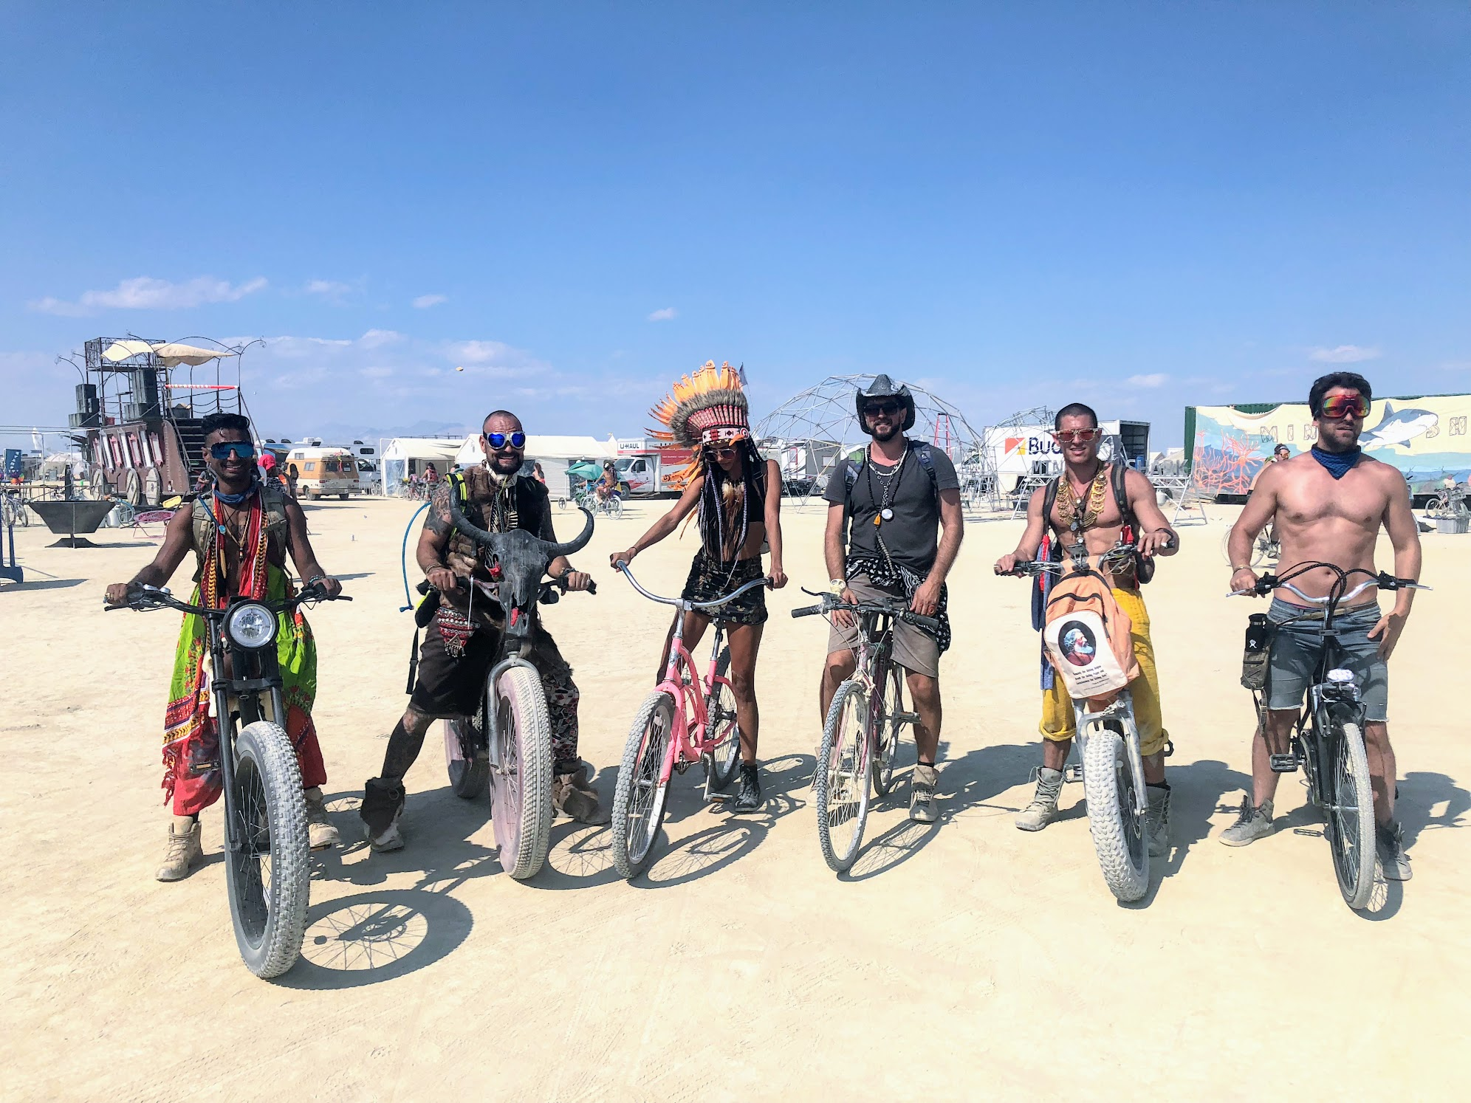

Slide 9
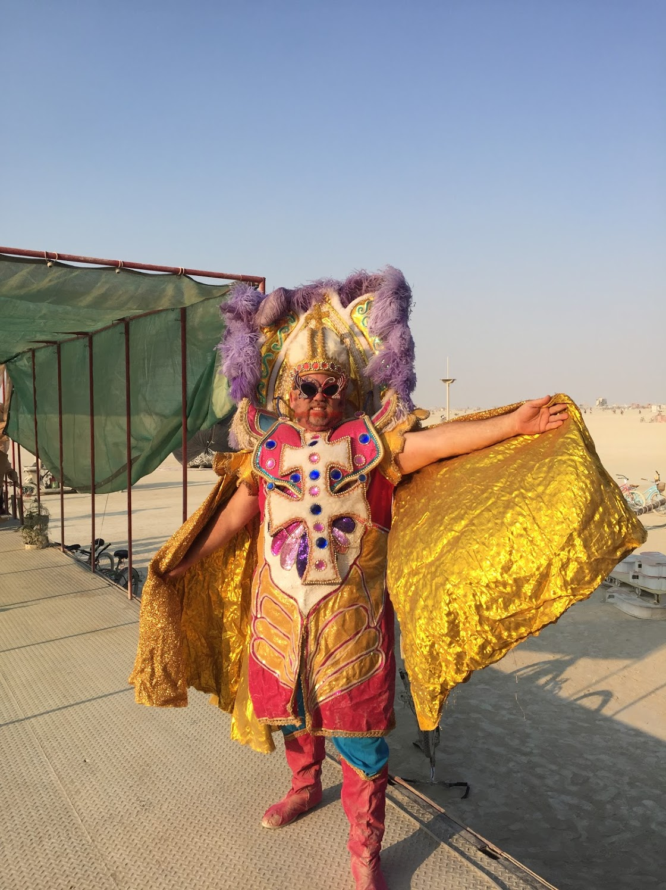
The Pope
(at the Appropriated Dragon)
Burning Man 2017

Slide 10
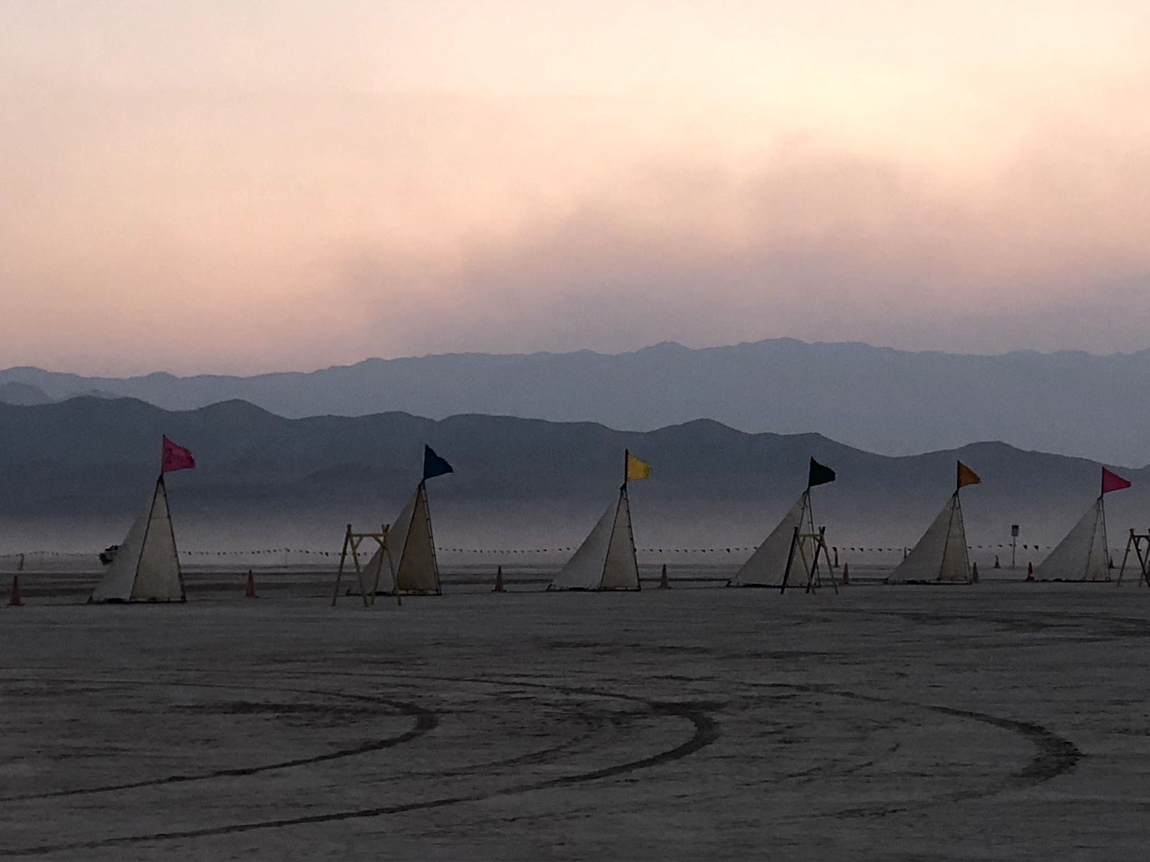

Slide 12
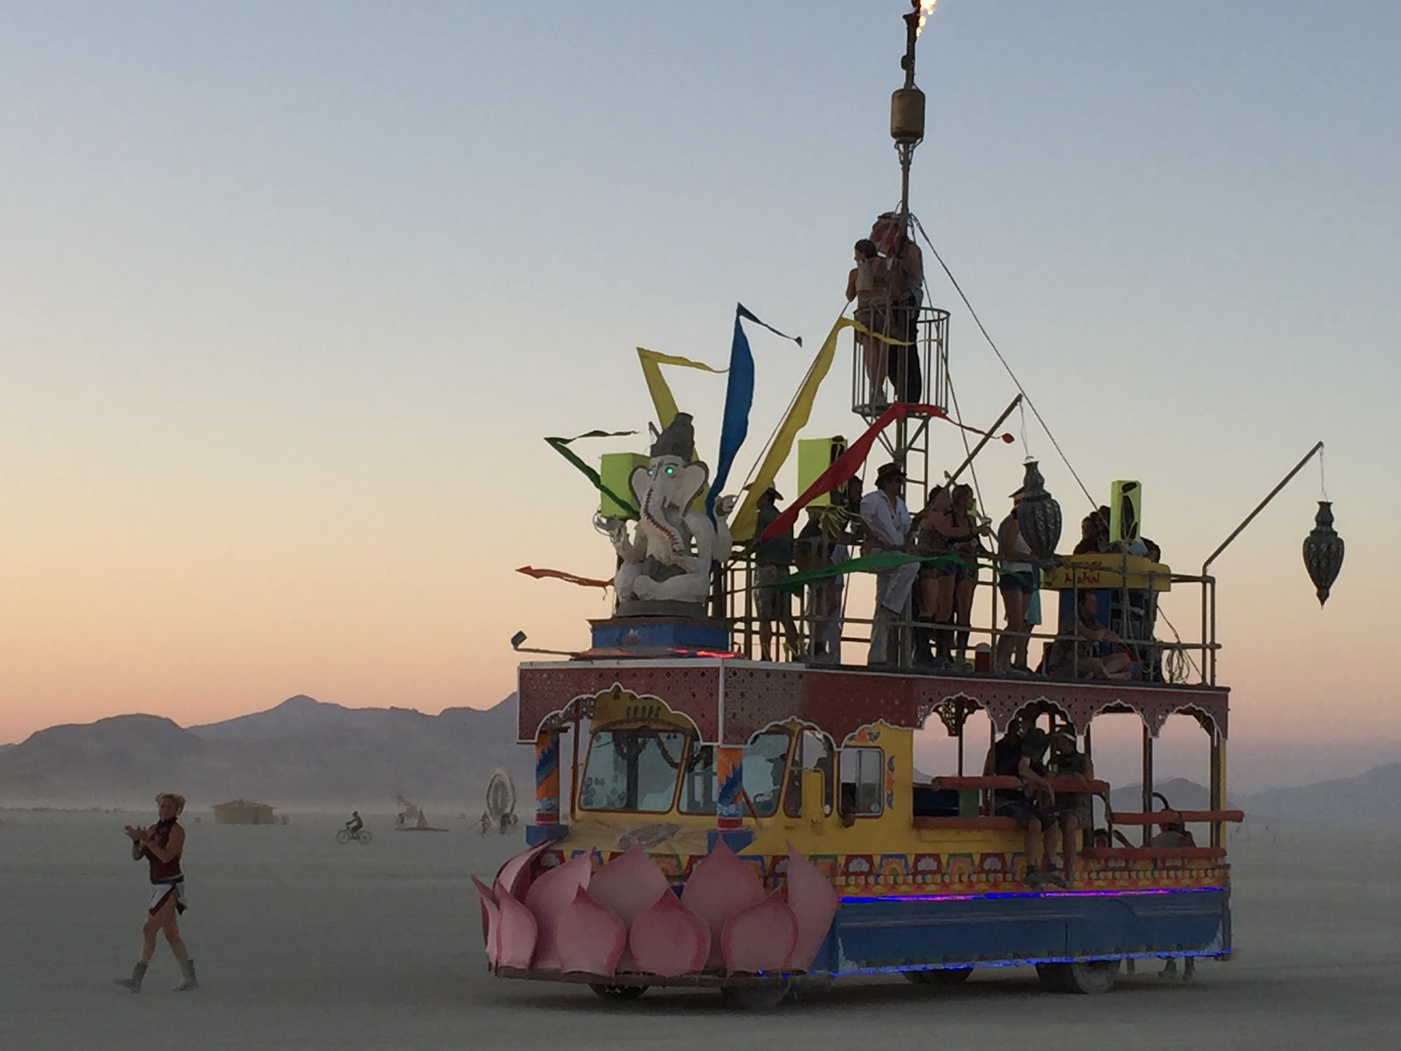

Slide 13
