Slide 1
Welcome to the webinar
Welcome to the webinar!
National Agricultural Library
Knowledge Services Division
Introduction to the Ag Data Commons
24 July 2018
The webinar will begin here momentarily
Please leave audio muted upon entering the webinar
At the end of the presentation we will open for questions
Feel free to send questions via public chat at any point during the webinar

Slide 2
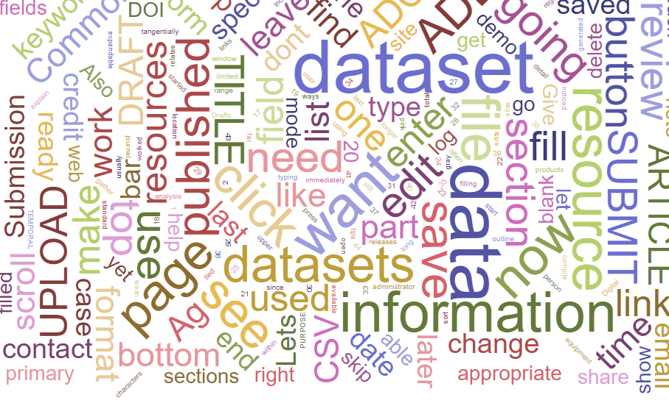
Introduction to the Ag Data Commons
Erin Antognoli, Jon Sears
US Department of Agriculture
National Agricultural Library
24 July 2018
Notes:
Hello and welcome to the Introduction to Ag Data Commons webinar!
Here at the USDA National Agricultural Library are Ag Data Commons team members
Erin Antognoli, Curator/Metadata Librarian
Jon Sears, Curator/Data Scientist

Slide 3
Outline
Overview of Ag Data Commons
Live Demo:
How to create and edit a dataset
How to add a data resource
How to submit your dataset for review
Other tips for using the Ag Data Commons for individuals and groups
Q&A
Notes:
We will present a brief overview of the Ag Data Commons, and then a live demo showing the overall submission process, followed by your questions and suggestions.
We welcome feedback on ways to make the process simpler/easier for the user.
Push to become the One-Stop-Shop for all research data funded by the USDA Research, Education, and Economics (REE) mission area, and to catalog as many such resources as we can by December 15 2017.

Slide 4
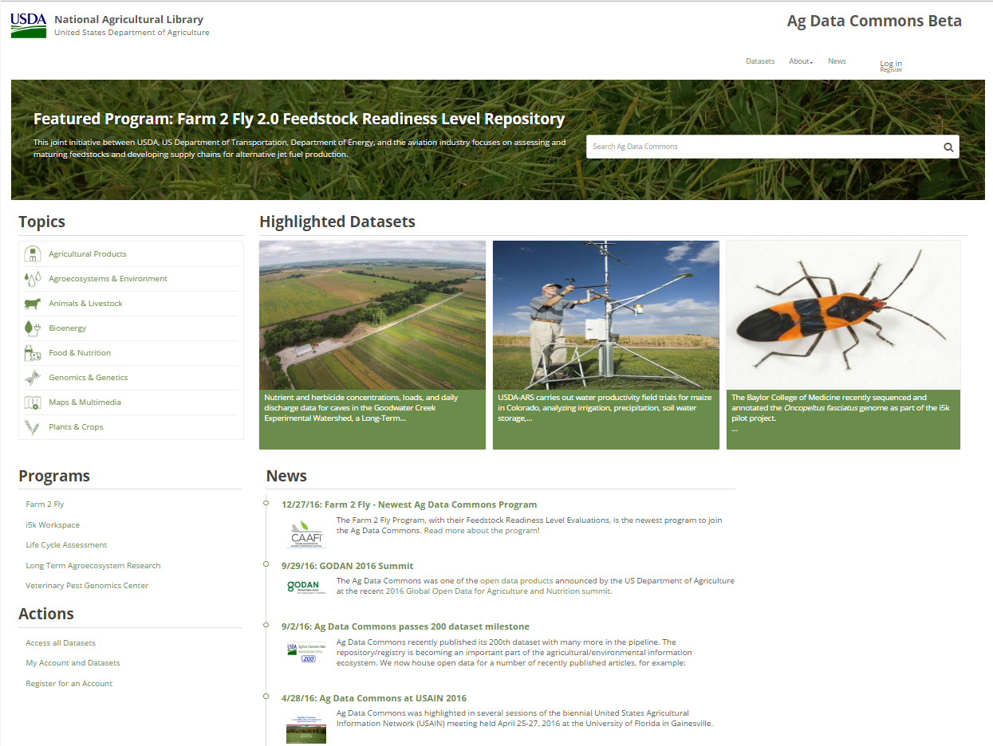
Overview of Ag Data Commons
Open data catalog for USDA-funded agricultural and related research data
Supports multiple scientific domains
Contains records describing datasets, software tools, multimedia
Notes:
Open data catalog for USDA-funded agricultural and related research data
Compliant with US Project Open Data standards and aims to support the recent FORCE11 FAIR principles, namely for data to be Findable, Accessible, Interoperable, and Re-usable
ADC supports multiple scientific domains (Circle the Topics) such as agronomy, genomics, hydrology, soils, agro-ecosystems, sustainability science, food/nutrition, and economic statistics
Contains records describing datasets, software tools, multimedia (Circle the Datasets link)
Records may describe data stored Ag Data Commons or published elsewhere <- Important takeaway
Thus Ag Data Commons can serve as both a repository/data publisher and registry as needed

Slide 5
Overview of Ag Data Commons
User accounts are not needed to find or download data
User accounts are needed to submit data
Notes:
User accounts are not needed to find or download and use data
User accounts are needed to submit data (show the login/register button)
Most government or university researchers are eligible for accounts if they have USDA funding
Records can be created manually or harvested from other repositories
Bottom line: ADC has a rich set of cataloging, publishing, and visualization features

Slide 6
General Workflow
Register for an account
Decide how to organize your research products
Prepare and save metadata and data
Submit for review by NAL curator
Revise as directed
Resubmit for review, request embargo as necessary, record will then be published
Receive DOI from NAL curator and share with journal, include in manuscripts, share on website
Notes:
For 2:
How many different files or links to web pages, and how you are going to organize them into datasets that share a description and a DOI.
For 7:
Digital Object Identifier – permanent/persistent identifier that resolves to the dataset; in general we can assign a DOI if the data are housed at ADC.

Slide 7
What research products belong in the Ag Data Commons
Raw data files and/or processed data files
Data dictionary or Readme files
Database files or web links
Links to Software tools
Links to Source code/Scripts/Workflows
Photographic or multimedia collections
User manuals
These are all handled as RESOURCES
Notes:
Examples of what to include in your dataset (i.e. “the data” = “resources”)
A data dictionary is a document, ideally in CSV spreadsheet form, that defines the variables/columns, units, data types, accepted values, etc. of the data, in order to enable a user (or machine, API) to properly understand and potentially re-use the data.
Note that we do not currently archive executable software programs and source code; these must be linked to e.g. in a GitHub repository or project website, etc.

Slide 8
What NOT to include in submission, but may link to
Manuscript or published article
Figures/tables from article
Presentations associated with the study
News articles or press releases
Related or cited data
You can provide links in the dataset metadata for all of these things
Notes:
Items such as related articles, presentations, or related data should be linked to in the relevant metadata fields, rather than uploaded as part of the ADC dataset.

Slide 9
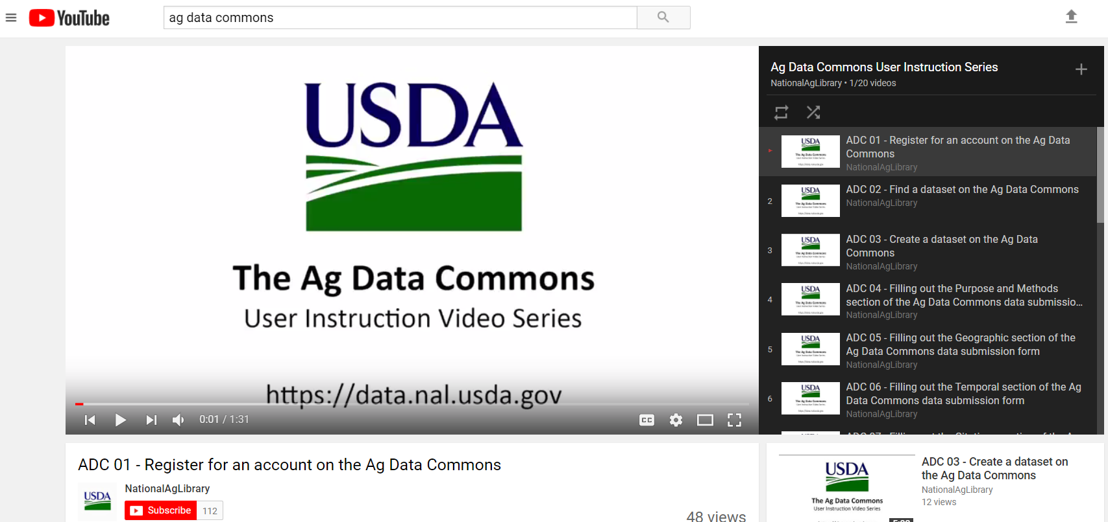
What’s New
YouTube “How To: videos: Ag Data Commons User Instruction Series
Notes:
We now have a series of 20 instructional videos on all aspects of submitting data to ADC. Search Ag Data Commons on YouTube, or follow the link on the About > Data Submission Manual page.
(We will see that shortly in the demo)

Slide 10
Our ongoing task and our philosophy
The Ag Data Commons is the “one-stop shop” for all REE databases/datasets
Many new entries added, but more to be done!
Data “owners” know where their data are and create the best metadata
NAL curators will ensure consistent, high quality records
Ag Data Commons DKAN platform is in beta, open for business
Self-submission works
Harvests also being conducted
Sensitive, proprietary, or personally-identifiable data are NOT subject to this "one-stop-shop" effort.
NEW: Data Management Planning (DMP) support
Notes:
As you may know we undertook a drive to catalog as many REE data products as we could in December.
We identified and contacted many data “owners” to create their respective entries in Ag Data Commons.
That effort produced great results, but we know there are many more “out there”.
As mentioned, in some cases we can harvest existing metadata, but others will require manual input.
We anticipate that data sharing will be expected in data management plans submitted to funding agencies,
and we are now offering a new service to review draft Data Management Plans and this will be the topic for our March webinar.
Your contribution is greatly appreciated, and the curators are here to help in any way we can.

Slide 11
In scope for NAL’s public REE data inventory
Existing ARS, NASS, ERS public databases
Significant ARS research datasets
Already available but scattered (link)
Ready for public release (upload, files can be embargoed but metadata is ready)
Obvious NIFA-funded databases and datasets
Raw and processed data as appropriate
Harvests of existing catalogs
LTAR is already mobilizing
Harvesting via GeoNetwork
Need continued data owners’ support – Thank You!
Notes:
To summarize, these are the key data products that we are looking to catalog in the NAL’s current effort.
The USDA’s Long-Term AgroEcosystem Research (LTAR) data products are being harvested via the GeoNetwork spatial data platform
Don’t have to be linked to a publication to be included in ADC, can be stand-alone data.
Again, thank you for your support.

Slide 12
Questions?
Links:
Ag Data Commons https://data.nal.usda.gov
Account registration https://data.nal.usda.gov/register
Data Submission Manual
See the About link
Contact us at NAL-ADC-Curator@ars.usda.gov

