Slide 1
Welcome to the webinar
Welcome to the webinar!
National Agricultural Library
Knowledge Services Division
Creating a Data Management Plan
20 March 2018
The webinar will begin here momentarily.
Please mute your audio upon entering the webinar.
We will then open up audio for questions, or feel free to send questions via public chat at any point during the webinar.

Slide 2
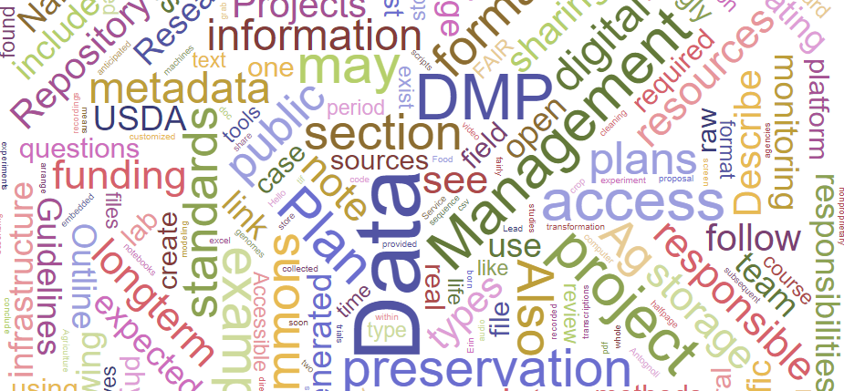
Creating a Data Management Plan
Erin Antognoli, Cyndy Parr, Jon Sears
US Department of Agriculture
National Agricultural Library
20 March 2018
Notes:
Hello and welcome to the National Agricultural Library’s Creating a Data Management Plan webinar!
My name is Erin Antognoli, Knowledge Services Metadata Librarian, and I will be presenting this webinar today.
Also with me are Jon Sears, Ag Data Commons Data Scientist, and Cyndy Parr, Project Lead for the Ag Data Commons, who will both help answer questions during the Q&A portion of the webinar.

Slide 3
Outline
What is a data management plan?
Why create a data management plan?
Overview of the components of a data management plan
Review of an actual DMP section by section
Q&A
Notes:
We will begin by explaining what a data management plan is and why it is important to create one,
review the core components of a data management plan,
at which time we will also look at a real data management plan, or DMP’s, implementation of these components,
and conclude with time for questions.

Slide 4
What is a data management plan?
A guideline for the life cycle of your data
A brief outline
Who
What
When
Where
How
Easy to understand
Notes:
First we should start out with an explanation of what a data management plan is, and conversely, point out what a data management plan is NOT.
Your data management plan should cover the basic guidelines for dealing with the DATA you will produce over its entire life cycle. This will take the form of a brief outline that covers the who, what, when, where, and sometimes the how in terms of management and preservation protocol for your data.
This document should be very easy for someone who is not familiar with your project to understand. Be clear and concise.

Slide 5
A data management plan is NOT…
An in-depth documentation of your protocol
Workflows instructions, charts, diagrams, the names of every person or company who will interact with the project, or in-depth review guidelines
The end of the conversation about data management
Concerned with paper or manuscript publication
Notes:
A data management plan is NOT an in-depth documentation of your protocol. You don’t need to include workflows, instructions, charts, diagrams, the names of every person or company who will interact with the project, or in-depth review guidelines. You DO need these in-depth project management tools for internal operation and use, but this data management plan is meant to be a brief overview with a very specific purpose.
In that vein, this plan is NOT the end of the conversation about data management, but rather the beginning. You should expect to revisit this plan and flesh out your protocol and workflow procedures after your funding comes through and you are ready to begin your research.
Finally, a data management plan is not concerned with paper or manuscript publication, or promotion strategy. This plan concerns only the data, and all points should address data management.
>>> Of course, there are always exceptions, especially if a funder requests information about a certain topic or activity. An exception might be if data storage is bundled with paper publication, in which case you should note that in the appropriate section. Also to note, if you are depositing your data in one location but cataloging it in another, such as Ag Data Commons, you should be specific with regard to who is responsible for preserving the data and who is providing access.

Slide 6
The Data Life Cycle
Assure
Preserve
Discover
Integrate
Analyze
Plan
Describe
Collect
Graphic from: https://www.dataone.org/
education-modules
Notes:
When we refer to the “Data Life Cycle”, this graphic from Data One’s education module series, which can be found at the link in the lower left, visualizes this process. Managing data is an ongoing process, and a good plan is a crucial step to ensure your data is handled properly.
>>> We are focusing on the PLAN portion of the life cycle in this webinar, which incidentally takes into account all the other steps of the life cycle, which we will look at now.

Slide 7
Why create a DMP?
Proper management of data
The FAIR data principles
Findable
Accessible
Interoperable
Reusable
Follow the US Federal public access and open data directives
Funding agency requirements
Notes:
There are many reasons why a solid data management plan is important.
Data are valuable and often unique assets that should be properly managed in order to be accessible, understandable, and re-usable into the future. Sometimes referred to as the FORCE11 open data FAIR principles, the goal of a DMP is to form a blueprint to follow in order to make data Findable, Accessible, Interoperable, and Reusable. FAIR is mostly applicable to the steps AFTER data are released, whereas a DMP also covers the part of the cycle before data are released. So, the DMP ensures that data are kept safe and understandable both during and after projects.
The guidelines we will present in this webinar follow US Federal public access and open data directives and also comply with a broad range of current funding agency requirements for DMPs.
In other words, DMPs may be more work on the front end, but a well thought out plan will save you lots of time, money, and headaches throughout the life cycle of the data.

Slide 8
Don’t reinvent the wheel!
Check to see if your organization has a DMP before creating a new one
Use guidelines already in place if creating a new DMP
Ag Data Commons (data.nal.usda.gov) will serve as the catalog for most USDA funded research data
See USDA Public Access Implementation Plan
Notes:
Before you create a new DMP, researchers should determine if a DMP specific to their organization or previous projects already exists. If a DMP does not exist, follow guidelines already in place to create yours. Don’t reinvent the wheel! Note that current guidelines for NIFA are for two pages in addition to the project proposal, which we will examine more closely during this presentation, and guidelines for ARS projects are currently for a half-page integrated within the project proposal text.
Also note that under the USDA Public Access Implementation Plan, most research data generated with USDA funding will be required to be cataloged in the Ag Data Commons. This means that whether data is deposited directly in the Ag Data Commons or linked from another repository, a record for that data must exist in the Ag Data Commons.

Slide 9
Overview of a Data Management Plan
https://www.nal.usda.gov/ks/guidelines-data-management-planning
Expected data types
Data formats and standards
Data storage and preservation of access
Data sharing and public access
Roles and responsibilities
Monitoring and reporting
Notes:
If you determine that you must create a DMP, follow this outline that can be found in more detail on the NAL Knowledge Services page linked at the top of the slide, in conjunction with your agency’s guidelines, to ensure you are covering the necessary components. Here, you see the main components of a data management plan. We will review each component and give examples of what types of information belong in each section.
These guidelines and other Data Management Resources can be found on NAL’s web site under the Knowledge Services section, linked in the bottom right of the display, and more resources will be linked at the end of the presentation.

Slide 10
1. Expected Data Types
Describe the data
Digital / non-digital?
How will data be generated?
How will metadata be generated?
Will raw or processed data be reused from other studies?
Name the anticipated sources
Notes:
We begin our plan by outlining Expected Data Types. This section covers what you will produce.
Describe the type of data – for example, digital or non-digital - and how they will be generated. Different methods include lab work, field work, surveys, custom software, and so on, and that should be specified.
What kind of metadata will be generated, and how? Will metadata be manually entered, or automatically generated by the data collection method? Following a specific community approved metadata standard consistently is encouraged to facilitate wider understanding and re-use of the data, and the specifics of the standard used will be covered in the next section.
For example, you may be collecting environmental data from real time sensors, or images from phenocams. You may be conducting interviews with digital video and audio recordings and subsequent digital transcriptions. You may have field notebooks from crop management experiments or field trials that are not "born digital." You may be generating sequence data for whole genomes or metagenomics. In the course of analysis or modeling, you may be creating customized computer code or scripts for transformation or data cleaning. Metadata describing the data you have collected should be recorded for each experiment, each physical sample, or be embedded in the files produced by the sensors or sequencing machines.
Describe whether any raw or processed data will be re-used from other studies and if so, name the anticipated sources.

Slide 11
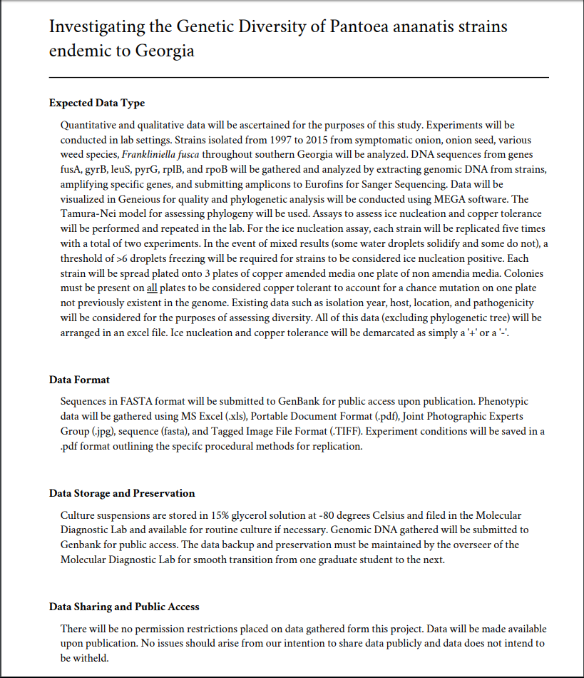
Expected Data Types
DMP for “Investigating the Genetic Diversity of Pantoea ananatis strains
endemic to Georgia” found at https://dmptool.org/plans/29159.pdf
Notes:
This is a screen shot of a DMP with a fairly comprehensive Expected Data Types section. This project gathered genetic data in multiple physical formats, and states that they will arrange the resulting data in an excel file. We will follow this example throughout the presentation, and a link to this data management plan is provided at the bottom of the display where it is shown throughout the presentation.

Slide 12
2. Data Formats and Standards
Describe the data formats
Describe for both raw and processed data
Plans to digitize non-digital data?
Machine readable?
Standards / schemas used to structure / store / share data and metadata
Community-recognized / non-proprietary standards encouraged
Name and link to published data dictionaries, data standards, or ontologies
Notes:
Next, the data formats and standards section revolves around the data and metadata formats and schemas chosen for the project.
Describe the data formats – for example, csv, pdf, doc, tif, and so on - for both raw and processed data. If data are in a non-digital format, are there plans to digitize the data? Use of machine-readable formats is strongly encouraged and will soon be required by most US federal funding agencies. To make data more machine readable, consider using CSV in place of Microsoft Excel, or TXT in place of Microsoft Word. The nature of your data will determine if this shift is possible, but planning a structure from the beginning of a project makes it easier to arrange your data to comply with these formats.
On an aside, we plan to offer a webinar at some point about the do’s and don’ts of formatting data to be machine readable, so keep an eye out for that in our monthly webinar schedule.
What standards or schemas will be used to structure, store, or share the data and metadata? Community-recognized and non-proprietary standards are strongly encouraged. Be specific when noting this information.
Name and link to any published data dictionaries, data standards, or ontologies that you are using. Examples include the ICASA Master Variable list, Gene Ontology, or Integrated Taxonomic Information System. If data will be deposited in professional databases or repositories, refer to their data and metadata standards.
There are many examples of data standards and formats on the data management guidelines planning page. Also to note for ARS researchers, sections 1 and 2 may be combined and summarized briefly, but should be in distinct sections for NIFA DMPs.

Slide 13
Data Formats and Standards
DMP for “Investigating the Genetic Diversity of Pantoea ananatis strains
endemic to Georgia” found at https://dmptool.org/plans/29159.pdf
Notes:
Following the same DMP as before, we see their Data Formats and Standards section. This project notes all the file formats data will be stored in. This is genetic data, and the FASTA format is a community standard for storing this type of research. Note they specify formats for sequence files, text files, and image files, and note how they are saving their methods for replication in addition to the data they are generating. Anyone using this data later will know exactly what to expect when they open the file packages.

Slide 14
3. Data Storage and Preservation of Access
Provisions for depositing in a trusted/certified long-term preservation and archiving environment
Storage – during and after the project
Ag Data Commons, Dryad, institutional repository, etc.
Technical infrastructure / staff expertise
Notes:
The data storage and preservation of access section revolves around provisions for depositing in a trusted long-term preservation and archiving environment. This includes backups, cloud storage, access protocols, obsolescence avoidance, data migration strategy, and so on.
Where will the data be stored during and after the life of the project? Name specific workspaces and repositories and link to them as appropriate. For example, you may initially manage data on local or network hard drives and then transfer it to a repository such as Ag Data Commons for long-term access and preservation. You may maintain it on a high-speed computing platform such as SCINet or CyVerse or on a shared workspace like Open Science Framework during analysis. You may deposit it in Dryad or an institutional repository – for example, Purdue University Research Repository - or you may maintain it using your own infrastructure beyond the life of the project.
What is the technical infrastructure and staff expertise? How and why are they qualified to preserve the data? Funders want to know that competent people with an adequate arrangement are in charge of maintaining the data. This is especially important information to include if researchers are publishing data using their own infrastructure.

Slide 15
3. Data Storage and Preservation of Access (continued)
Long-term preservation plans
How much data?
Planned retention period?
Plans to avoid data loss?
Strategies
Tools
Contingency plans
Notes:
Also in the data storage and preservation of access section, specify plans for long-term preservation.
Some items to address include:
Approximately how much data are expected to be archived? Ideally this includes raw data and/or minimally-processed data
What is the planned retention period for the data?
Outline strategies, tools, and contingency plans that will be used to avoid data loss, degradation, or damage.

Slide 16
Data Storage and Preservation of Access
DMP for “Investigating the Genetic Diversity of Pantoea ananatis strains
endemic to Georgia” found at https://dmptool.org/plans/29159.pdf
Notes:
The DMP we are following records methods for storing and preserving their original source material, which is in a physical form, and also specifies where the digital data will be deposited. In this case, they are submitting their data to Genbank for public access, which outsources much of the long-term access issues. They have also specified who will be responsible for maintaining data backup and preservation long term – in this case, the overseer of the lab, a position rather than a named individual, is responsible for maintaining the infrastructure and workflow.

Slide 17
4. Data Sharing and Public Access
Explain restrictions, embargo periods, license, or public access level decisions
Describe access and sharing procedures during and after data collection
Name specific repository / database / catalog
Outline restrictions
Indicate how funding numbers will be cited with the data
Notes:
The data sharing and public access section explains any restrictions, embargo periods, license, or public access level. Data generated by federal employees has either US Public Domain or Creative Commons CCZero status, while federally-funded data and non-federal data may vary depending on funder requirements.
Describe your data access and sharing procedures during and after the data collection process – for example, publication or public release. Name specific repositories, databases, and catalogs as appropriate. For example, data may be shared by publishing on Dryad or in a genomic database, or open source code can be shared in a public code repository such as GitHub, but should also be catalogued in the Ag Data Commons if funded by USDA.
Outline restrictions such as copyright, proprietary and company secrets, confidentiality, patent, appropriate credit, disclaimers, or conditions for use of the data.
Limiting distribution of data to project or personal websites only is strongly discouraged, and grant panels probably won’t be impressed. Similarly, in most cases it is insufficient to make data available only on request. Depositing data in a trusted or certified long-term preservation and archiving environment is preferred, and may be required by many journals before articles are published.
Indicate how you will ensure that appropriate funding project numbers will be acknowledged with the data – for example, CRIS numbers such as NIFA award numbers or ARS project numbers should be noted in a consistent way.

Slide 18
Data Sharing and Public Access
DMP for “Investigating the Genetic Diversity of Pantoea ananatis strains
endemic to Georgia” found at https://dmptool.org/plans/29159.pdf
Notes:
As we reach the bottom of the first page of the DMP we are following, we see there are no restrictions placed on the data. Because this is federally funded, this is the default expectation. However, if your project has multiple funding sources or other contingencies, note those as needed. The only thing I would change here is to add the distribution method of the data. This plan indicated Genbank in the previous section about storage and preservation, and if that repository is also their planned method for making data accessible they should note this here as well.
As with the first two sections, sections 3 and 4 can be combined for ARS DMPs, but should remain separate for NIFA DMPs.

Slide 19
5. Roles and Responsibilities
Information about project team members and tasks associated with data management activities over the course of the project
Who will ensure DMP implementation?
Define key roles of the data management team
Contingency plan if key personnel leave
Resources / funds needed to carry out the DMP
Notes:
The roles and responsibilities section provides information about project team members and tasks associated with data management activities over the course of the project.
State who will be primarily responsible to ensure DMP implementation. This is particularly important for multi-investigator and multi-institutional projects.
Define key roles of the data management team. This is especially appropriate for larger scale projects – identify who will perform which tasks. Will graduate students or postdocs or technicians have day-to-day responsibility along with their research roles, or is there a full time data manager or database administrator?
Provide a contingency plan in case key personnel leave the project. For example, if data are managed individually or collaboratively on a platform such as ARS SCINet, and an investigator leaves, who becomes responsible for the data?
What resources are needed to carry out the DMP? If funds are needed, have they been added to the budget request and budget narrative? Projects must budget for sufficient resources to implement the proposed DMP. For example, there may be data publication charges, data storage charges, or salary for data managers.

Slide 20
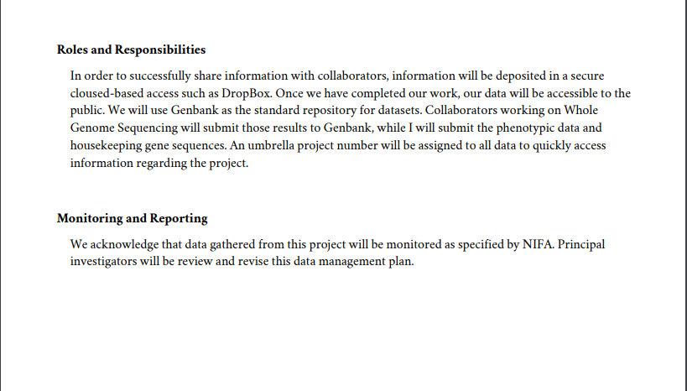
Roles and Responsibilities
DMP for “Investigating the Genetic Diversity of Pantoea ananatis strains
endemic to Georgia” found at https://dmptool.org/plans/29159.pdf
Notes:
At the top of the second page of our sample DMP, we see the roles and responsibilities clearly outlined. They specify the platform they will use to transfer data from their lab to collaborators, and again, note that they are outsourcing their access responsibilities to Genbank. Also noted is who will submit what portions of the project to Genbank.

Slide 21
6. Monitoring and Reporting
Information on how the researcher plans to monitor and report on implementation of the DMP during and after the project, as required by funder
Who will be responsible?
Progress in data sharing (publications, database, software, etc.)
Notes:
The Monitoring and Reporting section contains information on how the researcher plans to monitor and report on implementation of the DMP during and after the project, as required by the funder; this may include progress in data sharing including publications, database, software, and so on, among other information. The plan should also indicate who is responsible for this duty. Cataloging everything in Ag Data commons should help researchers easily pull together a list of data products shared from a particular project.

Slide 22
Monitoring and Reporting
DMP for “Investigating the Genetic Diversity of Pantoea ananatis strains
endemic to Georgia” found at https://dmptool.org/plans/29159.pdf
Notes:
The DMP concludes with information about the specifics of the monitoring and reporting. While it is good that it specifies principle investigators are responsible for reviewing and revising the DMP, a link to information about the specifics of NIFA’s monitoring protocol and requirements would be welcome. Always be specific when referencing a policy that you plan to use!

Slide 23
The Whole DMP
DMP for “Investigating the Genetic Diversity of Pantoea ananatis strains
endemic to Georgia” found at https://dmptool.org/plans/29159.pdf
Notes:
As you can see, this entire DMP is under 2 pages. Creating a DMP does not have to be a labor-intensive task, but it does force you to think about your project and make sure you are planning for contingencies of data gathering/formatting, access, preservation, and future use.
Consider the DMP like you would a roadmap to help you stay on track.

Slide 24
DMP Consultation at NAL
Your library may offer a one-on-one consultation service
NAL will review draft plans (subject to capacity and priorities)
Send DMP draft and Project Summary draft to NAL-ADC-Curator@ars.usda.gov
We will provide review and propose improvements
Requirements: at least 5 business days
Notes:
Your library may offer a one-on-one consultation service. If so, take advantage of the help they offer.
NAL will also review draft plans, subject to our capacity and priorities.
Send the DMP draft and a Project Summary draft to NAL-ADC-Curator@ars.usda.gov
We will provide both general review and, where possible, discipline-specific review
We will propose improvements, but you are ultimately responsible for final decisions on the content
Please plan ahead - We require at least 5 business days to complete this review process.
We are looking for examples of good DMPs to share at our website.
Please note that policies and processes are dynamic and we are open to changing our guidance. We welcome your feedback to improve this process.

Slide 25
Summary
DMPs are an important part of the data life cycle. They save time and effort in the long run, and ensure that data are relevant and useful for others.
Funding agencies are beginning to require DMPs
Major components of a DMP:
Expected data types
Data formats and standards
Data storage and preservation of access
Data sharing and public access
Roles and responsibilities
Monitoring and reporting
NAL DMP Consultation
Notes:
In summary, DMPs are an important part of the data life cycle. They save time and effort in the long run and ensure that data are relevant and useful in the future. Funders, journals and institutions are beginning to mandate data management plans, so it is important for scientists to understand what a DMP entails.
So as you plan your next project and get ready to write your DMP, consider the expected data types, data formats and standards, data storage and preservation of access, data sharing and public access, roles and responsibilities, and monitoring and reporting. And keep in mind that NAL is here to help fine tune your DMP draft to make sure it is the best it can be.

Slide 26
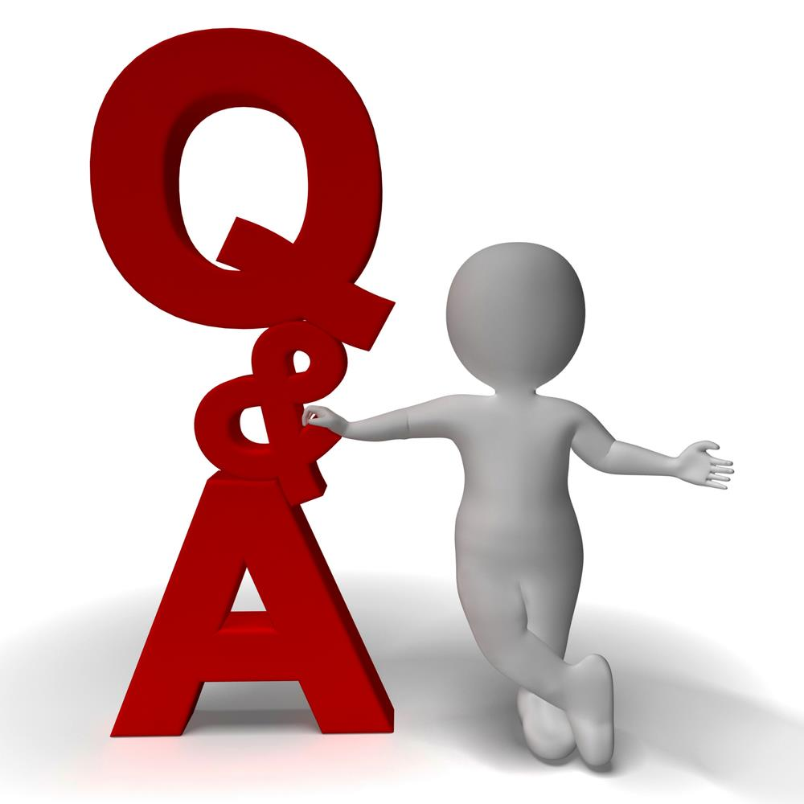
Questions?
Links:
NAL Data Management Resources: https://www.nal.usda.gov/ks/data-management-resources
https://dmptool.org/
The Ag Data Commons team: NAL-ADC-Curator@ars.usda.gov
Notes:
Before we open up for questions, I want to share a few links that will help you to complete your data management plans.
The first link is NAL’s Guidelines for Data Management Resources page, which contains a Data Management Plan Guideline, links to Data Management plans, and other resources to help you in composing your own DMP.
DMPtool.org can be found on NAL’s Data Management resources page, but I am highlighting it here because you can see samples of many types of real DMPs there, including the one we looked at throughout this webinar.
Also included is the email to the Ag Data Commons curator inbox if you have any questions for our team.
And we will now open up for questions…

