Slide 1
Welcome to the webinar
Welcome to the webinar!
National Agricultural Library
Knowledge Services Division
Making Data Machine-Readable
24 April 2018
The webinar will begin here momentarily
Please leave audio muted upon entering the webinar
At the end of the presentation we will open up audio for questions
Feel free to send questions via public chat at any point during the webinar

Slide 2
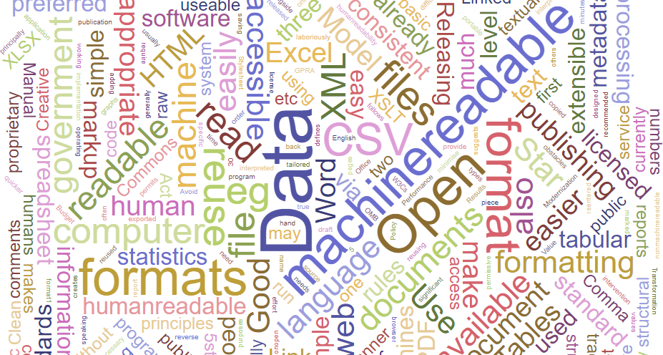
Making Data Machine-Readable
Erin Antognoli, Jon Sears
US Department of Agriculture
National Agricultural Library
24 April 2018
Notes:
Hello and welcome to the National Agricultural Library’s Making Data Machine-Readable webinar!
My name is Erin Antognoli, Knowledge Services Metadata Librarian, and I will be presenting this webinar today.
Also with me is Jon Sears, Ag Data Commons Data Scientist, who will help answer questions during the Q&A portion of the webinar.

Slide 3
Today’s Agenda
What is “Machine-Readable”?
Why is this important?
Preferred data formats
Tidy Data principles
Converting tabular data to be machine-readable
Q&A
Notes:
We will begin by examining what it means for data to be machine-readable,
Discuss why this is important,
Take a look at preferred machine-readable data formats,
Give a brief overview of the Tidy Data principles,
Walk through an example of how to convert tabular data into a machine-readable format,
and conclude with time for questions.

Slide 4
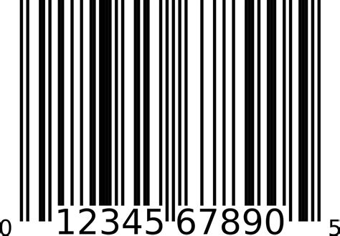
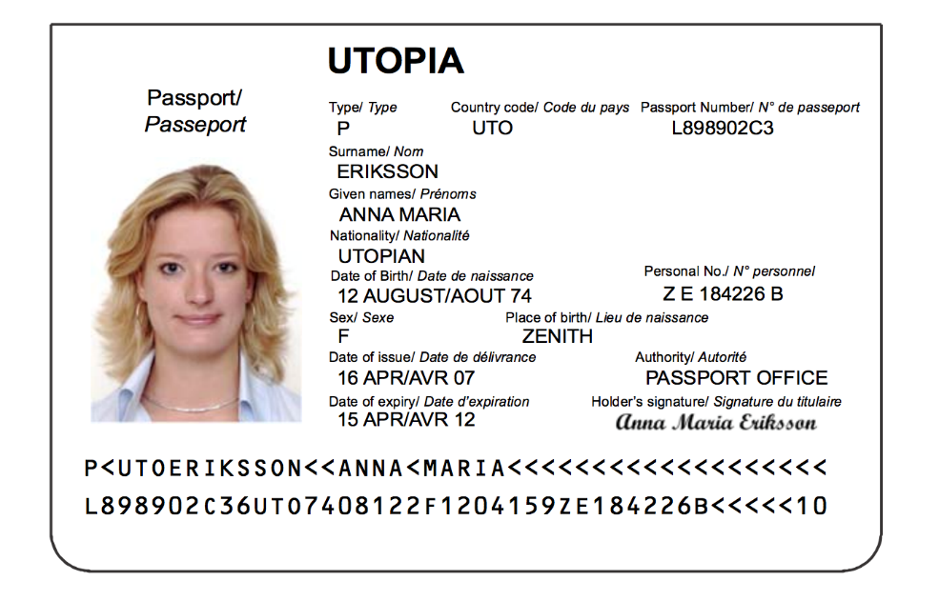
What is “Machine-Readable”?
Human-readable
Machine-readable
Notes:
When someone says data are machine-readable, what do they mean? What exactly is machine-readable?
Simply put, machine-readable data are data or metadata presented in a format that can be easily processed by a computer.
In fact, machine-readable items are all around us and in our every day use.
>>> Drivers licenses and passports all have a human-readable section, as well as machine-readable code along the bottom with strings of letters and numbers that correspond to the bearer’s name, state and country of issue, birthdate, nationality, and more. Barcodes are on nearly everything we purchase, and allow computers to automatically look up an item in their system when scanned, making both checkout lines and inventory counts more automated. QR codes can be scanned by smartphones and automatically lead users to web sites without having to type a single letter. And these are just a few examples. We increasingly rely on computers to quickly and accurately process information, but that doesn’t happen automatically. The information must be formatted and presented in a consistent manner so that the computer can understand what it is reading.

Slide 5
What is “Machine-Readable”?
A format that can be easily processed by a computer
Marked up human-readable
HTML, microformats, RDFa, etc.
Intended for machine processing
CSV, XML, JSON, RDF, etc.
Designed to be both machine and human-readable
XML
Notes:
While machine-readable products can be found in nearly all aspect of modern life, today we are concentrating on research data and files that often accompany them.
There are two types of machine-readable file formats: human-readable data that is marked up so that it can also be read by machines, and data file formats intended principally for processing by machines. Some examples of hybrid human-readable and machine-readable data include microformats, RDFa, and HTML. Formats that are intended first and foremost for machine-processing include CSV, RDF, XML, JSON.
However, Extensible Markup Language, or XML, is designed to be both human and machine-readable to someone who is used to dealing with that format, and Extensible Stylesheet Language Transformation, or XSLT, is used to improve presentation of the data for human readability. For example, XSLT can be used to automatically render XML into a PDF format.

Slide 6
Automatic Data Transformation
Machine-readable
Human-readable
Human-readable
Machine-readable
(Requires manual
modification)
Notes:
A good rule of thumb is that machine-readable data can be automatically transformed for human-readability but, generally speaking, the reverse is not true.

Slide 7
Digitally Accessible ≠ Machine-Readable
Physical Materials = Not Machine-Readable
Digital, but not Machine-Readable:
Document layouts or visual designs (PDF, Word, etc.)
Photos (JPG, TIF, PNG, etc.)
Tables, charts, graphs
Scanned materials
Microsoft XLSX spreadsheets
Notes:
I just threw a lot of format file names at you, and there’s a good chance you don’t use all of them regularly. However, it is important to remember that just because data are digitally accessible does not necessarily mean that they are machine-readable. Physical materials are obviously not machine-readable, but digital materials are not automatically machine-readable either. A digitally accessible document may be online, making it easier for humans to access using computers, but its content is much harder to extract, transform and process using computer programming logic if it is not in machine-readable format. For example, PDF and Word documents containing formatting, layouts with charts or tables of data, JPEG or TIF format images and graphics, scanned materials, and other visual designs are digital, but not machine-readable. Even a Microsoft Excel file is not necessarily machine-readable if it is not structured properly.

Slide 8
Structured Data
Structural relation between elements is explicit in the way the data is stored on a computer disk
XML and JSON allow many types of structure
Computers can’t interpret the data unless it is structured
PDF & Word docs reflect positioning of entities on the page
Do not reflect logical structure
Notes:
All data has some type of structure associated with it, but ‘structured data’ as we are examining here has a different connotation. Structured data refers to data where the structural relation between elements is explicit in the way the data is stored on a computer disk. For instance XML and JSON are common formats that allow many types of structure to be represented. These may not be the prettiest formats for a human to look at to retrieve data, but the structure is consistent, meaning the same types of values get recorded in the same place and in the same format, which is what machines need in order to interpret the data.
The internal representation of, for example, word-processing documents or PDF documents reflects the positioning of entities on the page, not their logical structure, which is correspondingly difficult or impossible to extract automatically. These types of documents rely more on human readability, and are tailored to be visual rather than reused by machines.

Slide 9
Why is Machine-Readable Desired?
FAIR Data Principles
Findable
Accessible
Interoperable
Reusable
Flexibility / Integrity
Transparency
U.S. Federal Government Executive Order
Notes:
Machine-readable data by nature adheres to the Force11 FAIR principles in a way that other non-machine-readable formats cannot. Because computers can more easily process the data, and data is recorded in a standard way, data become more findable, accessible, interoperable, and reusable. This data relies on internal structure more than visual placement of information, and this flexibility means it can potentially be interpreted by a number of computer programs in a more reliable and consistent way.
As a practical example that many of you have likely encountered, have you ever tried to open a document with an older version of the software that originally created it, only to find formatting discrepancies that skew the entire purpose of the document or even make it unusable? That scenario is eliminated with machine-readable data.
Whether the data is used for creating catalogs or for presenting research results, machine-readable data can be searched, compared, and processed more easily and accurately. For entities like governments, who have a mission to be more transparent to their citizens, more accessible data is key.
For those creating and submitting data on behalf of the US Government, in 2013 an executive order was passed to make open and machine-readable the default for government information. So moving forward, if your data and other files can be formatted in a machine-readable way, this is required! (https://obamawhitehouse.archives.gov/the-press-office/2013/05/09/executive-order-making-open-and-machine-readable-new-default-government-)

Slide 10
Preferred Data Formats
Type of Data | Use this | Instead of this
Tabular | CSV (JSON and XML also acceptable) | Microsoft Excel .xls(x)
Textual | HTML, Plain Text (.txt), PDF-A (Accessible PDF) | PDF, Microsoft Word .doc(x)
Geo-data | GeoJSON, CSV, KML, GML | Shapefile, TAB file
Combined data from multiple sources | RDF
Non-proprietary formats are preferred whenever possible
Open Data Handbook – File Formats: http://opendatahandbook.org/guide/en/appendices/file-formats/
Notes:
In the grand scheme of things, providing data in a proprietary or non-machine-readable format is better than not providing it at all, but there are steps we can take when processing data for sharing or producing new data to make it more machine-readable and stable. The method and format you choose depends on the type of data you are producing.
For tabular data, such as strings of recorded observations, financial reports, and statistics, the preferred format is CSV, which stands for Comma Separated Value, though JSON and XML may also be acceptable. Avoid the use of the proprietary Excel formats that Microsoft Excel creates by default.
For textual data, such as reports and publications, try to use HTML, plain text, or accessible PDFs, rather than regular PDF or Word documents. Where structured or tabular data exists within the textual data, it should be published separately in CSV or another appropriate format.
For data that has a geographic or location element to it, GeoJSON, CSV, KML, or GML are all good open formats for publishing. Shapefiles and TAB files should be avoided where possible due to the overly complex, proprietary, and aging nature of the formats.

Slide 11
Converting Your Data To CSV
Keep the following in mind when formatting:
No comments, metadata, or aggregate statistics
Single column header
No formatting or special characters
One cell = one piece of information
One table per document
Never modify original / raw data!
Notes:
Now that we know what machine-readable data is and why it is important, we will review how to make your data machine-readable. Again, not all data can be saved in a machine-readable format, but knowing when adjusting format is possible and acting accordingly will go a long way to making sure you are doing what you can to make your data the best it can be.
There are many ways to convert many types of files and formats into machine-readable information, but in the interest of time we will focus on the most accessible examples for the bulk of scientific researchers. In fact, you may have already formatted your data this way when you ran your stats programs as part of the process to analyze your data. We will walk through an example of how to convert tabular data in Excel format to a machine-readable CSV format. Of course, this is easier to set up if you plan to organize and save data in CSV format from the start, so if you are at the beginning of a project and formulating your data management plan please take this into consideration. But since that is not always possible, the next best thing is to make existing data as machine-readable as possible and be more mindful moving forward. We address CSV format first and foremost because it can be produced using software already available to most of us, including the Microsoft Office suite and Google docs.
A CSV document should be formatted as follows:
Remove any comments, metadata, and aggregate statistics intended to provide context or make the information easier for people to read. If you have to include this information, consider making another column for it, or include the contextual information in a data dictionary. Units, descriptions, functions, calculations, and other information about the data should not appear in the same column as the data itself, but can easily be included in a data dictionary.
The first row of the file should contain column names corresponding to the data contained in each column
Data should be free of formatting and any special characters – for instance, numeric or currency cells should just be numbers, without any formatting or non-numeric characters. This includes the use of color, bolded and italicized text, and other visual aids. Again, if you want to specify the units measured – and you SHOULD be very clear about labeling your data - place that information in a separate column labeled appropriately if possible, and consider creating a data dictionary that can summarize all of the metadata for your data files.
Each cell should have only one piece of information in it, and the format should be consistent within each column
Make a separate document file for each table of your data. Do not put multiple tables on a single worksheet or create multiple worksheets in a single file.
These rules are necessary because formatting is not carried forward into CSV files. In addition, the inclusion of extra information like metadata and human-readable comments makes it harder for computer code to parse and read the data through analysis and programming techniques.
If you want to have a working Excel document with any of the previously mentioned features, this doesn’t mean you can never use Excel functions again! Just make sure you also include a final version in CSV format that is formatted in a machine-readable way. In any case, if you are working with legacy or pre-existing data files, you should never modify the original document! Always duplicate the original and edit the new file if you want to create a machine-readable version. What’s done is done, and you want to keep the original intact in case you need to go back to verify anything.

Slide 12
Tidy Data Principles
Each variable forms a column
Each observation forms a row
Each type of observational unit forms a table
Organize variables
Fixed by design of the data collection
Measured during the course of the experiment
http://vita.had.co.nz/papers/tidy-data.pdf
Notes:
A great resource for learning about structuring machine-readable data is the Tidy Data paper, linked at the bottom of the page. The notion of tidy data outlines a standard way of mapping the meaning of a dataset to its structure. A dataset is messy or tidy depending on how rows, columns and tables are matched up with observations, variables and types. While tidy data is not exclusively machine-readable, the principles are spot on with the goal of creating a file that can be easily interpreted by machines. In tidy data:
Each variable forms a column.
Each observation forms a row.
Each type of observational unit forms a table.
Tidy data makes it easy for an analyst or a computer to extract needed variables because it provides a standard way of structuring a dataset.
While the order of variables and observations does not affect analysis, a good ordering makes it easier to scan the raw values. One way of organizing variables is by their role in the analysis: are values fixed by the design of the data collection, or are they measured during the course of the experiment? Fixed variables describe the experimental design and are known in advance. Measured variables are what we actually measure in the study. Fixed variables should come first, followed by measured variables, each ordered so that related variables are contiguous. Rows can then be ordered by the first variable, breaking ties with the second and subsequent (fixed) variables.
This is an extremely brief overview of the principles of tidy data, but I urge you to visit the paper for a more in-depth look at the intricacies of formatting data to be tidy.

Slide 13
Sample Data Formatting
http://dx.doi.org/10.15482/USDA.ADC/1411953
Notes:
Let’s try an example together! We will re-format a data file that, while accurate and contains a wealth of information, is not tidy, and is certainly not machine-readable. However, a restructure can make this data machine-readable AND compliant with US federal objectives to produce machine-readable data.
This sample is an Excel format data file from the Ag Data Commons. We will walk through how to reformat and present this data to be machine-readable and compliant with open-data policy.
>>>
>>> Starting from the top and working our way down, we can see there are multiple column headers with cell formatting on this spreadsheet. To be machine-readable, we need to have a single column header.
>>>
>>> Next, we see this file contains multiple worksheets.
All of these are fine for a working document because it is often more convenient to have everything in one place. Also, depending on whether there are any functions, macros, or other automated values being generated, an excel document may be warranted while preparing the data. However, for the final version of your data to share with others, our objective is to transform this data into a format that is machine-readable.

Slide 14
Sample Data Formatting
Notes:
First, we want to separate the worksheets into separate data files. So I will copy and paste the information on this first worksheet tab into a new document and we will go from this:
To this:

Slide 15
Sample Data Formatting
Notes:
Notice now with the new document, I only have a single worksheet in this file.
>>>
I will then have to separate out each worksheet from the original file in the same way. Because there were a lot of worksheets, this is an example of where planning on the front end can save some time when it comes time to submit your data. 10 worksheets means I have to repeat this process 10 times!

Slide 16
Sample Data Formatting
Notes:
Next I will turn my attention to the column headers.
>>>
Currently, there are 3 headers and I need to narrow this down to one. This doesn’t mean I need to lose information, but rather I need to format a little differently. The first column header looks like the one I want to keep as the final header, so I need to figure out how to account for the information in the second and third header rows.

Slide 17
Sample Data Formatting
arr
Notes:
If we zoom in a bit and expand the columns and wrap the text, we can see the
>>> second row is a description of the column, and the
>>> third row looks like it records units.
This information can’t easily be included directly in the spreadsheet, but can and should be included in a separate data dictionary, especially if many of the worksheets reuse components. Since the Ag Data Commons will soon be adding a feature to help users create data dictionaries more seamlessly, we won’t focus too much on that today, but we can take a brief look at how a data dictionary would be formatted in this case. The data dictionary is a separate document that outlines every field used in the data files, and includes descriptions, units of measurement, character types, and whether the fields are mandatory. In keeping this descriptive information separate from the data, the data is more easily machine-readable and researchers have the potential to go into even more detail about each element in their data files without impacting machine usability.
So in reformatting, we will remove the information in the second and third columns to achieve this:

Slide 18
Sample Data Formatting
Notes:
>>>
A single column header listing the variables with observation data in all the rows below…

Slide 19
Sample Data Formatting
arrow
Notes:
And the descriptive information we removed from the second and third rows of the data spreadsheet is subsequently transferred to a data dictionary.
>>> Here we can see the name of the spreadsheet in the first column,
>>>
>>>
the column headers for that spreadsheet in the second column,
>>>
>>> and the exact descriptions from the original spreadsheet transferred to the Description column here.
>>>
I have also included other information about the data in the rest of the columns. We offer guidelines and templates for creating your own data dictionary in the Ag Data Commons submission manual, which can be found under the About tab on the Ag Data Commons.
This reformatting and data dictionary creation gets that extraneous information out of the data spreadsheet and into an informative format that is itself also machine-readable if saved as a CSV.

Slide 20
Sample Data Formatting
Notes:
Back to our single-header spreadsheet… we have one last step to make this fully machine-readable. We need to save this file as a CSV.

Slide 21
Sample Data Formatting
Notes:
>>>
The default in Microsoft Office is to save spreadsheets as excel documents, but we can do a “Save As” and choose the CSV file format.

Slide 22
Sample Data Formatting
Notes:
Once you navigate to where you want to save the file, name the file using your project’s established naming convention and then in the
>>>
“Save as type” section, choose CSV – Comma delimited. Once you save, you will have a machine-readable CSV version of your data file.
You should keep track of the steps you used to format your data from start to finish so you or members of your team can repeat the process for the rest of your data and keep everything consistent.

Slide 23
Features of Machine-Readable CSVs
http://dx.doi.org/10.15482/USDA.ADC/1297868
Notes:
Machine-readable data are often and increasingly required as a final product for federal data, but they have many other benefits as well. I mentioned earlier in this presentation that machine-readable files could generally be automatically transformed into a human-readable format. Here is an example of this process in action! When researchers upload their machine-readable CSV resource files to the Ag Data Commons, for instance, they can create instant data visualizations using the built-in platform. Here we can see an example of a graph created from a CSV data file, which can be found in the dataset at the link below the chart. This chart is created on the fly using the Ag Data Commons repository software because the program can automatically extract the column headers and row values from properly formatted CSV files to visually interpret that file for the users.

Slide 24
Summary
Machine-readable data is:
Easy for machines to interpret
Interoperable
Desirable
Goes hand in hand with open data policies
Preferred formats are often non-proprietary
Tidy Data
Conversion: Excel to CSV
Notes:
In conclusion, machine-readable data is highly desired because of its ability to be more easily interpreted by machines and interoperable across many platforms and applications. Machine-readable formats go hand in hand with open data policies, and are in many cases required as the final format for U.S. Federal data. Preferred formats are generally non-proprietary, and making sure your data is tidy and well organized will help you maintain machine-readable results. And finally, we walked through a sample data format conversion from Excel to CSV, and reviewed how to put these principles to use.

Slide 25
Questions?
Links:
Open Data Handbook – File Formats: http://opendatahandbook.org/guide/en/appendices/file-formats/
Tidy Data: http://vita.had.co.nz/papers/tidy-data.pdf
The Ag Data Commons team: NAL-ADC-Curator@ars.usda.gov
Notes:
I mentioned these links in the presentation, but am including them here again for review. The first is a link to the Open Data Handbook, specifically the file formats section, and the second link is to the Tidy Data paper. Also included is the email to the Ag Data Commons curator inbox if you have any questions for our team.
And we will now open up for questions…

