Slide 1
Welcome to the webinar!
Welcome to the webinar!
National Agricultural Library
Knowledge Services Division
Data Dictionaries
26 June 2018
The webinar will begin here momentarily
Please leave audio muted upon entering the webinar
At the end of the presentation we will open for questions
Feel free to send questions via public chat at any point during the webinar

Slide 2
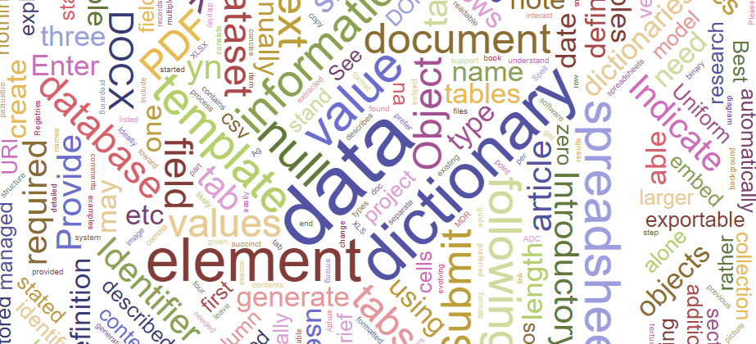
Data Dictionaries
Erin Antognoli & Jon Sears
US Department of Agriculture
National Agricultural Library
26 June 2018
Notes:
Hello and welcome to the National Agricultural Library’s Data Dictionaries webinar!
My name is Erin Antognoli, Knowledge Services Metadata Librarian, and I will be presenting this webinar today along with Jon Sears, Ag Data Commons Data Scientist, who will be here to answer questions after the presentation.

Slide 3
Outline
What is a data dictionary?
Why create a data dictionary?
Review of different types of data dictionaries
Guidelines for creating a data dictionary
Q&A
Notes:
We will begin by reviewing
What a data dictionary is,
Why someone might create a data dictionary,
Review several different types of data dictionaries,
Walk through some guidelines, instructions, and best practices for creating a data dictionary,
and conclude with time for questions.

Slide 4
What is a data dictionary?
A brief overview:
Notes:
I’m going to start off by explaining what a data dictionary is and why including one with your data is important.

Slide 5
Data dictionary = describes data
A document describing a dataset, database, or collection of databases
A centralized repository of information about data such as meaning, relationships to other data, origin, usage, and format
Names and descriptions of tables (entities) and their contents (fields)
Type and length of each data element
Relationship between tables
Notes:
A data dictionary can simply be defined as a document that describes a dataset, database, or collection of databases. Another way of looking at this is to think of a data dictionary as a centralized repository of information about data such as meaning, relationships to other data, origin, usage, and format. This can include names and descriptions of tables, or entities, and their contents, also known as fields. Other information a data dictionary might record is the type and length of each data element, and the relationship between tables if it is describing a relational database.

Slide 6
Force11 FAIR Principles
Findable
Accessible
Interoperable
Reusable
Notes:
There are many reasons why data dictionaries are important.
Data are valuable and often unique assets that should be properly managed in order to be accessible, understandable, and re-usable into the future. Sometimes referred to as the FORCE11 open data FAIR principles, data dictionaries play a crucial role in making data Findable, Accessible, Interoperable, and Reusable. I have mentioned the FAIR principles in quite a few of my past webinars, and if you have attended a webinar, talk, or other information session about data there’s a good chance you have heard this acronym mentioned before. That’s because it’s important to consider these aspects of data management throughout the data life cycle when dealing with data, and people are more actively considering these principles when dealing with data.
>>> Data dictionaries can cover all four of these principles, but focus largely on making data more Interoperable and Reusable because they provide more details and information about the entities and fields being represented in the data. Better understanding of the information contained in a dataset leads to ease of reuse and integration with other systems.

Slide 7
Consistency is key
Normalized data = consistency in fields
Recorded observations use the same:
Units of measurement
Degree of accuracy (decimal places, etc.)
Process steps
Field values use the same
Keyword taxonomies
Authority files
Formatting
Notes:
Data become more interoperable and reusable if they are normalized. Normalizing data means you are making the content of each group of fields consistent. This can take on a number of forms depending on the nature of your data.
First of all, you want everyone responsible for creating records as well as the data itself to operate using the same measures and terms. If one person uses measurements in feet, another in inches, and another in meters, the files and records can’t work together effectively until that information is all standardized. In a case like this, a data dictionary would serve as a blueprint for how data and record creators are expected to record their information so that everyone is on the same page.
Likewise, field values should be consistent. Identifying any controlled vocabularies, authority files, or formatting that should be used helps ensure that all related records look and interact the same way. Imagine everyone uses whatever terms they want to describe a specific variable. Searching could be hampered and return incomplete results if everyone applied different keywords. A user would have to search every single variation of that idea in order to retrieve all the related records. Data dictionaries can identify controlled vocabularies, but can also outline acceptable content for a given field to keep values consistent and more easily searchable.
Another example of using a data dictionary to standardize data formatting and presentation is use of decimal places in recorded observations. What if one investigator in a project installment submits data with accuracy to the 5th decimal place, but another submits data with accuracy to 3 decimal places? If the project needs a certain degree of accuracy, the data dictionary would specify this for the fields, and investigators would know how accurate their data needs to be without over or under recording. This would also ease the burden on researchers consulting the data later on, since the accuracy level needs would be standardized and spelled out in the data dictionary.
The data dictionary is helpful for facilitating reuse, but is also integral for the data creators and catalogers to ensure interoperability of records and files.

Slide 8
Data dictionaries & the Data Life Cycle
Assure
Preserve
Discover
Integrate
Analyze
Plan
Describe
Collect
Graphic from: https://www.dataone.org/
education-modules
Notes:
I have also presented this diagram of the “Data Life Cycle” in previous webinars. Managing data is an ongoing process, and metadata plays a key roll in the life cycle.
>>> The data dictionary most closely falls under the Describe section because it is most strongly associated with metadata.
>>> However, a data dictionary at a program level created prior to the data creation could also facilitate the Collection of data, since methods, measurements, and other data descriptions would be outlined ahead of time to guide data collectors in their task. In fact, looking at most of these steps in the life cycle, I could argue that the data dictionary does indeed help with some aspect of that process.
In essence, the data dictionary is metadata about metadata! But, as you can see, without good metadata and a way to decipher what has been recorded, the rest of the data life cycle will break down.

Slide 9
Don’t reinvent the wheel!
Does a data dictionary already exist?
Check to see if a data dictionary for your project exists before creating a new one
Do you need to create a data dictionary?
Use guidelines already in place
Notes:
Before you create a new data dictionary, researchers and catalogers should determine if a data dictionary specific to their organization or previous projects already exists. If a data dictionary does not exist, follow guidelines consistent with your area of research that are already in place to create yours. Some data dictionaries can be generated automatically from a databse, while others have to be created manually. Don’t reinvent the wheel as you approach this process! We will review different types of data dictionaries shortly so you have a better idea of where to begin based on your own situation.

Slide 10
Make data dictionaries machine-readable
Everyone can open the data dictionary
No special software required
Users can find the information they need
Saves users time
Data is more easily searchable
Abbreviations and codes are spelled out
Avoids obsolescence
Notes:
Data dictionaries should ideally be machine-readable. We went into more details about what machine-readable data is and how to create machine-readable data in a previous webinar that is now available as a recording, but it is especially important to make data dictionaries machine-readable. The main reason for this is that not everyone may be able to or want to open your data files depending on their size or what specialized software needs to run. But if everyone can open your data dictionary, they will at least know the contents of your data package to know if it is worth their while to make the necessary time commitment or software additions and customizations. Even if they already have the necessary software, people might not want to spend time downloading and sorting through the entire data package, which could be quite large, if there’s a chance it might not be useful to them.
In some cases, the data files themselves are not easily searchable. Even if the search tool integrates a full text search of all resource contents, column headers may be abbreviated or coded in a way that would not return in a standard search result. The data dictionary could potentially make the data more searchable.
We also talked about avoiding obsolescence in previous webinars. If data is created with proprietary software, there may not be a workaround to avoid obsolescence, which is why we advocate for using non-proprietary file formats whenever possible. However, if for whatever reason you absolutely must present your data in a proprietary format, a machine-readable data dictionary would make the descriptions of your data available long-term, and let organizations, institutions, or individuals know if the contents they hold are worth converting, or reviving through legacy software.

Slide 11
Methods of Creating a Data Dictionary
Manual
CSV
Automatically generated from a database
MS Access
Using a template
ISO 19110 Feature Catalog
Notes:
In the next portion of our webinar, we will review some different types and ways of creating data dictionaries, and where you might encounter these various documents. Data dictionaries can be created manually, and we will review how to create one in a CSV format. They can also be generated automatically through certain types of database software, and we will review how to do this using Microsoft Access. And finally, many platforms offer templates to help users create a data dictionary. This is somewhat of a cross between manual and automatic, since the fields are already provided but you need to fill them in. We will look at what a template for ISO 19110 for geospatial data looks like, and the resulting Feature Catalog XML document it produces.

Slide 12
Manual Creation - CSV
Data Dictionaries:
Notes:
First up – creating a data dictionary manually.

Slide 13
CSV Data Dictionary
Defines the elements and variables used to record data
Includes descriptions, measurements, and other information for data variables
Flexible in terms of subject and discipline
Created manually using spreadsheet software
Stored in CSV format
Machine-readable
https://www.iso.org/standard/57303.html
Notes:
If you are creating a data dictionary manually outside of a particular metadata template, CSV is likely the format you will want to use. CSV is non-proprietary and machine-readable, making it an ideal choice.
The document you create should define the elements and variables used to record data, and include descriptions, measurements, and other information for data variables.
This type of data dictionary is flexible in terms of subject and discipline, and accessible because it is created manually using spreadsheet software that most of us have available to us in the form of Microsoft Excel or Google Docs. And obviously, while the software can produce many different file formats, you want to save the finished document as a CSV so that it is machine-readable.

Slide 14
CSV formatting for machine-readability
Keep the following in mind when formatting:
No comments or aggregate statistics
Single column header
No formatting or special characters
One cell = one piece or type of information
One table per document
Tidy Data Paper: http://vita.had.co.nz/papers/tidy-data.pdf
Notes:
As I’ve mentioned several times now, creating a CSV document is one method of manually creating a data dictionary that would also be machine-readable. A CSV document should be formatted as follows – and I will show a visual of what this will look like in a minute:
No comments or aggregate statistics embedded in the document
There should be a single column header. The first row of the file should contain column names corresponding to the information contained in each column
Fields should be free of formatting and any special characters – for instance, numeric or currency cells should just be numbers, without any formatting or non-numeric characters. This includes the use of color, bolded and italicized text, and other visual aids.
Each cell should have only one piece or type of information in it, and the format should be consistent within each column
Keep everything in one table on one worksheet page. Do not put multiple tables on a single worksheet or create multiple worksheets in a single file.
These rules are necessary because formatting is not carried forward into CSV files. In addition, the inclusion of extra information like metadata and human-readable comments makes it harder for computer code to parse and read the data through analysis and programming techniques. I mentioned the Tidy Data paper in our Machine-Readable Data webinar, and want to include a link here as well because it explains a lot about keeping data neat and understandable. A lot of those same principles carry over to manually creating data dictionaries.

Slide 15
CSV Data Dictionary
Notes:
This is an example of what a CSV data dictionary might look like. Here we can see the name of the spreadsheet in the first column, the column headers for that spreadsheet in the second column,
and the exact descriptions from the original spreadsheet transferred to the Description column here.
I have also included other information about the data in the rest of the columns. We offer guidelines and templates for creating your own data dictionary in the Ag Data Commons submission manual, which can be found under the About tab on the Ag Data Commons.

Slide 16
Sample Data Formatting
Notes:
>>> Here we can see the name of the data spreadsheet in the first column,
>>>
>>>
the column headers contained in that spreadsheet recorded in the second column,
>>>
>>> and the descriptions of each field from the data resource files recorded the Description column here.
>>>
>>> If the values of a field are limited to a list of choices, those can be recorded in the Acceptable Values column. Each value should be listed, separated by a vertical pipe character.
>>>
I have also included other information about the data in the rest of the columns, including the data type accepted, character length, and whether the field is required. We offer guidelines and templates as a starting point for creating your own data dictionary, which can be found in the Ag Data Commons submission manual under the About tab on the Ag Data Commons.
During the original airing of this webinar, we had a question about whether a project where the same variables repeated needed to keep listing them multiple times, or if one entry for each repeatable variable was enough. If your project examines the same exact variable across multiple studies or even multiple observations and the nature of the variable does not change – for instance, you are always measuring rainfall in inches daily, or distance in meters, or depth in centimeters, or weight in grams, and not some other variation – you can make a master variable list of all the possible observations with the display name, description, data type, and so on. Many large projects use this approach so that each researcher can pull from the master list and be consistent with one another while at the same time customizing their experiments or setups to only include the relevant information.
In addition to providing a guide to the data, this data dictionary allows the data provider to remove any extraneous information from the data spreadsheet and instead include it in an informative format that is also machine-readable if saved as a CSV.

Slide 17
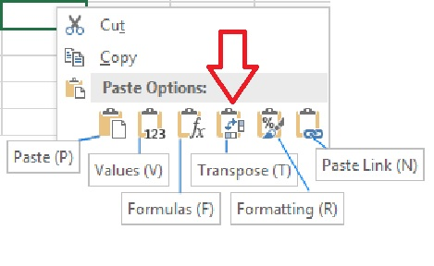
Other CSV data dictionary tips…
Use standard names for variables to support interoperability; avoid local/colloquial names
Include strong keywords in descriptions
Copy > Paste Options/Transpose to enter a horizontal row of variables/headers as a vertical column in Excel
Notes:
While formatting is a huge part of creating a CSV data dictionary, another important aspect to consider is the content itself. Some tips include using standard names for variables to support interoperability. We discussed the reasons for this earlier, and standardizing these variables now will save a lot of time and potential error that could occur if the values are normalized later on. Avoid local or colloquial names, since not everyone may use those terms or know exactly what they mean or refer to.
Include strong keyword descriptions in this data dictionary. Keep in mind the most commonly used terms, or the words users may search for most frequently for data like yours. This will help users find your data more easily.
If your data is in spreadsheet form, a quick way to copy all the variable or field names from a data file into a data dictionary is to use the Transpose tool in spreadsheet software. This tool allows you to copy a horizontal row and paste it into a vertical column. This is available in Microsoft Excel and Google Docs, and usually shows as an option in the Paste function. If the Transpose tool is not available in a regular paste menu, in some cases, a right-click will provide a Paste-Special menu where the Transpose tool will be available.

Slide 18
Automatically generated
Data Dictionaries:
Notes:
Next we will review automatically generated data dictionaries.

Slide 19
Automatically Generated Data Dictionary
Defines the variables, formatting, and other database specifications
Is not always easily human-readable
Only performed for data in certain types of databases
Created automatically using a database export function
Generally results in a Text or PDF format file
Notes:
Automatically generated data dictionaries will look and fucntion quite differently from manually created ones.
Like a CSV data dictionary, these documents define the variables, but will also define formatting and other database specifications.
Unlike a CSV, this resulting document will often not be easily human-readable.
Not every database is capable of creating an automatically generated data dictionary. While data dictionaries from databases like Microsoft Access can be generated fairly easily, or third party software might be used to generate a codebook to export in markdown format, you may need to contact your systems department to see if a record can be generated from your database and how that can be accomplished.
If you can generate a data dictionary, one huge benefit is that it is created automatically using a database export function. Less work on your part with fewer errors are always welcome!
Generally, this resulting document is in a Text or PDF format file. Text and PDF formats are generally non-proprietary. If you can generate a PDF-A document or another type of structured text-based output, then that would be machine-readable, which would be another added level of functionality to your data dictionary.

Slide 20
Access Database Data Dictionary
Notes:
This is a screen cap of what an automatically generated data dictionary might look like. This section shows the properties of the database.

Slide 21
Access Database Data Dictionary
Notes:
Again, another view of the same data dictionary that shows more of the formatting. This document will record all aspects of the database in text form so that someone could in theory recreate the look and feel, in addition to knowing what data is contained within.

Slide 22
R CodeBook Data Dictionary
## Variable Description:
| Name | Column | Description |Unit|
|:-------|:------:|--------|--------|
| Exp | 1 | experiment number |integer|
| Trt | 2 | treatment number |integer|
| Tree | 3 | Trees being treated |integer|
| Card | 4 | Water sensitive card |integer|
| DV5 | 5 | Volume median diameter in microns |integer|
| Coverage | 6 | Percent surface area coverage per cm squared |integer|
| Deposits | 7 | Number of droplets per cm squared |integer|
| Deposition | 8 | Volume in micro-liters per cm squared |double|
| Mean | 9 | average spray droplets diameter in microns |integer|
| Std | 10 | standard deviation of spray droplet diameter |integer|
| Q2 | 11 | 50 quantile of spray droplet diameter |integer|
| Q3 | 12 | 75 quantile |integer|
| Q1 | 13 | 25 quantile |integer|
| IQR | 14 | Inter Quantile ratio |integer|
| RS | 15 | Relative span Factor |double|
## Variable Origination:
| Name | origin |
| ---------- | :------------------------------------------------------- |
| Exp | Not calculated |
| Trt | Not calculated |
| Tree | Not calculated |
| Card | Not calculated |
| DV5 | Calculated by DepositScan |
| Coverage | Calculated by DepositScan |
| Deposits | Calculated by DepositScan |
| Deposition | Calculated by DepositScan |
| Mean | Calculated by SAS's JMP from DepositScan output |
| Std | Calculated by SAS's JMP from DepositScan output |
| Q2 | Calculated by SAS's JMP from DepositScan output |
| Q3 | Calculated by SAS's JMP from DepositScan output |
| Q1 | Calculated by SAS's JMP from DepositScan output |
| IQR | Calculated by SAS's JMP from DepositScan output |
| RS | Calculated from DV5, DV10 & DV90 from DepositScan output |
Markdown format (.md)
dataMaid:
https://github.com/ekstroem/dataMaid
Notes:
This is an example of a codebook, which is a document that provides both an overview and description of the variables in a dataset. In this case the original data being described is from an R database. Packages such as dataMaid can be used to generate codebooks from R data in markdown format, with information on each variable in the data frame.
The document can then be rendered to a report in HTML, PDF, or Word.

Slide 23
Generate a data dictionary from a MS Access database
Open Access DB
Find the Database Tools tab
Choose Database Documenter
Choose the tables to generate
Select All to make a complete database document
Choose Text (or PDF) file from the toolbar
Select encoding method
Save the resulting file as a text file
Notes:
There are a lot of different types of databases, and many of them have methods of generating data dictionaries without having to bother your systems department. I’m going to walk us through how to generate this document in Microsoft Access. Here are the steps listed out, but I will show them in some screen caps. This slide deck and recording will be available after the webinar for anyone who wants to go back and review later.

Slide 24
MS Access – Database Tools
Notes:
>>> With your Access database open, navigate to the Database Tools tab.
>>> From there, find the Database Documenter button in the toolbar and choose it.

Slide 25
MS Access – Database Documenter
Notes:
>>> This opens a window for the database documenter where you can choose which tables you want to include in your document. You can choose to include only certain tables, or choose them all.
>>> The Select All feature lets you grab everything fairly quickly, which is a big help if you have a lot of tables in your database.
There are a lot of other customizable settings at all stages of this process, including the queries and macros tabs, and the Options feature lets you further customize how your document is generated. However, I’m just going to stick with the defaults for the purpose of this demo.
>>> Once I have all my choices checked, I will choose OK to generate the document.

Slide 26
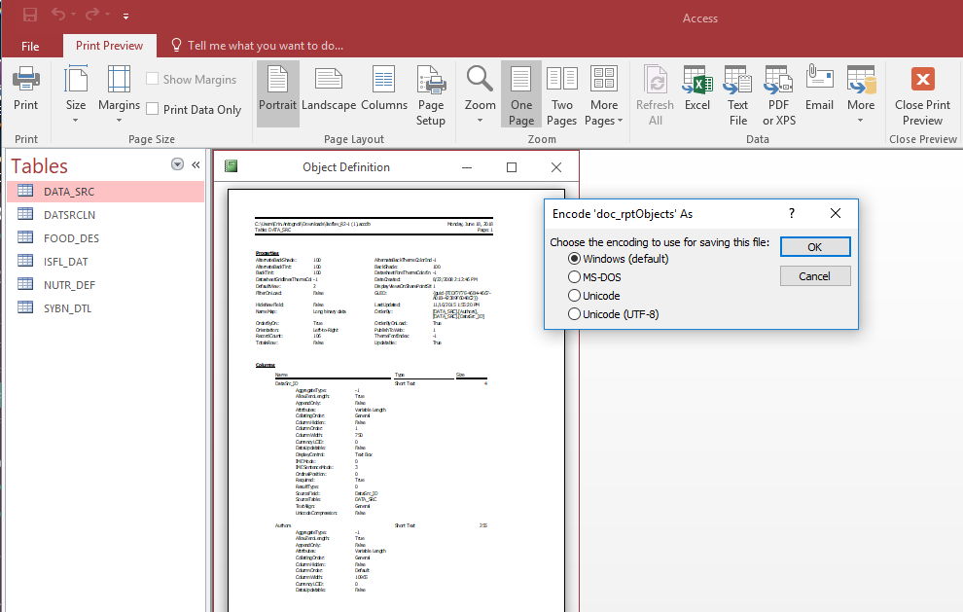
MS Access – Print Preview
Notes:
That brings up a Print Preview dialogue showing the document, and from here you can choose the format, orientation, and a lot of other customizations to make this document look the way you want it to from the toolbar at the top of the interface.
>>> When all those choices are made, choose either the Text File or PDF option from the tool bar at the top. You can export in a variety of formats including Microsoft Excel, Text, and PDF, but remember, text documents and PDF files are non-proprietary, while Excel is proprietary and less desirable for this type of document.
>>> Choosing Text File from the toolbar will bring up a dialogue asking to choose the encoding option – I have stayed with the default here - and after choosing okay in this step, you will specify a name for the file and a location to store it. Complete those steps and you will have a text format data dictionary from your database.

Slide 27
Form Generated
Data Dictionaries:
Notes:
Lastly, we will review creating data dictionaries using a web-based form.

Slide 28
ISO 19110 Feature Catalog
Notes:
Some data dictionaries can be created through a user interface that provides a form for users to fill out and complete various sections of the document. Users don’t have to worry so much about formatting column headers and rows or other setup like they do while creating a CSV data dictionary manually, since the document is generated based on the user’s input. It’s not fully automatic, since the user does need to enter the content, but the formatting aspect of the process is automatic. The Ag Data Commons is moving toward this type of setup for our own data dictionaries, so with newer versions of our platform we may see this approach become more common for data we maintain.
ISO 19110 on NAL’s GeoData platform is an example of this form-based data dictionary, or feature catalog as it is called in that standard. This data dictionary standard is used to define metadata in ISO 19115 standard, which is specific to geospatial data. Here is a little background on this particular standard as defined by the ISO 19115 and ISO 19110 standards themselves.

Slide 29
ISO 19110 Feature Catalog
Defines the methodology for cataloging feature types
Specifies how feature types can be organized into a feature catalogue and presented to the users of a set of geographic data
Applicable to the definition of geographic features at the type level
Generally created using a template
Stored in XML format
https://www.iso.org/standard/57303.html
Notes:
ISO 19110 defines the methodology for cataloguing feature types. This document specifies how feature types can be organized into a feature catalogue and presented to the users of a set of geographic data. This document is applicable to creating catalogues of feature types in previously uncatalogued domains and to revising existing feature catalogues to comply with standard practice. This document applies to the cataloguing of feature types that are represented in digital form. Its principles can be extended to the cataloguing of other forms of geographic data.
The feature catalog is applicable to the definition of geographic features at the type level. This document is not applicable to the representation of individual instances of each type. It may be used as a basis for defining the universe of discourse being modelled in a particular application, or to standardize general aspects of real world features being modelled in more than one application.
So, through all that, we see that while this standard calls its documentation a feature catalog, this serves a very similar purpose as a typical data dictionary. More often than not a template must be used to create these documents because they are more complex and follow a predetermined standard that requires validation. The final product is stored in XML format, which can be displayed on a wide variety of platforms and is machine-readable and obsolescence-proof.

Slide 30
Feature Catalog – XML format
Notes:
Here is a screen capture of a feature catalog I was creating in GeoData displayed as XML. Feature Catalogue format, like most metadata, is XML format as standard, which is machine readable.

Slide 31
Feature Catalog
Notes:
And here we can see how NAL’s GeoData interprets this feature catalog XML file. Because XML can be displayed a wide variety of ways, the way it looks will depend on the interface that is interpreting it. The information itself will never change, but will be ingested into the system and displayed according to the styling of the host system. In this case, you can see the attribute name and description, along with the list of values possible for that attribute if it is a controlled vocabulary. For instance, here we see Region has 6 possible values, all with their own codes and definitions. For attributes that can house any value, such as Identifier, a description and data type are sufficient.
With geospatial data such as maps, shapefiles, images, and other non-text based data, a robust data dictionary along with an excellent metadata record will help a dataset be more findable, accessible, interoperable, and reusable into the future. In this case, for a researcher looking for information about a particular state, a data dictionary would not only be helpful in figuring out if a found record is relevant, but would provide a key to finding more relevant information through the other variables the document outlines. In this particular case, someone who wants to find more information on Oregon would know to look in datasets that specify their Region as Pacific Northwest Region – Region 6, and we can also see this region has a code of R06 which may also lead to more results in a targeted field search.

Slide 32
Summary
We learned:
What a data dictionary is
Why data dictionaries are important
Reviewed different types of data dictionaries
Walked through methods of creating a data dictionary
Manual (Spreadsheet)
Automatic (MS Access)
Form (ISO 19110)
Notes:
In conclusion, today we learned what a data dictionary is, and why data dictionaries are important. We also reviewed different types of data dictionaries and walked through methods of creating a data dictionary manually as a spreadsheet, automatically from a MS Access database, and from a form using the ISO 19110 template.

Slide 33
Questions?
Links:
Ag Data Commons News (webinar information): https://data.nal.usda.gov/news
Data dictionary info: https://data.nal.usda.gov/data-dictionary-purpose
Frictionless Data: https://frictionlessdata.io/
The Ag Data Commons team: NAL-ADC-Curator@ars.usda.gov
Notes:
Before we open up for questions, I want to share a few links that you might find helpful regarding data dictionaries, and our contact email for any further questions.
The first link is to the Ag Data Commons News page, where we list all upcoming and past webinars. Past webinars are updated with a link and password to view recordings, so you can check out some of our other topics on Machine-readable data and Data Management Plans, among other topics that might be of interest. This is especially relevant to this webinar because some of our past webinars will give better insight into the ideas presented today.
The second link is to the Ag Data Commons submission manual, particularly the data dictionary section of our manual, where we have several chapters on data dictionaries. We also include a blank template for users to copy when creating their own CSV data dictionaries manually.
The third link is to Frictionless Data software, which Jon mentioned during the Q&A portion of the original webinar. There is a lot of information here about specifications and software to help create data in machine-readable formats that lend themselves well to data dictionaries.
The last link is the Ag Data Commons curator inbox email address where you can direct any questions.
And we will now open up for questions…

