Slide 1
Welcome to the webinar!
National Agricultural Library
Knowledge Services Division
Introduction to GeoData
25 September 2018
The webinar will begin here momentarily
Please leave audio muted upon entering the webinar
At the end of the presentation we will open for questions
Feel free to send questions via public chat at any point during the webinar

Slide 2
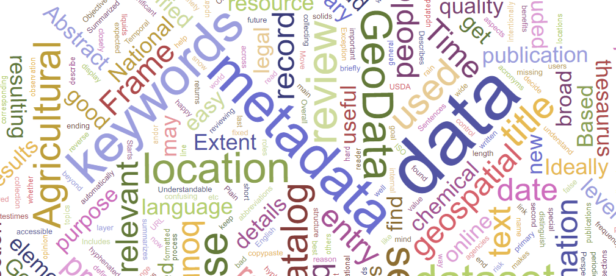
Introduction to GeoData
Erin Antognoli
US Department of Agriculture
National Agricultural Library
25 September 2018
Notes:
Hello, and welcome to the Ag Data Commons monthly webinar series. My name is Erin Antognoli, Ag Data Commons and GeoData curator, and metadata librarian. Today’s webinar, Introduction to GeoData, will begin momentarily, but first I want to go through a few minor housekeeping items. Your audio should have been muted upon entering the webinar - please leave audio muted to avoid feedback. Feel free to submit questions at any point throughout the webinar using the chat box, which should be on the right hand side of your WebEx window, and we will open for questions at the end of the presentation.
Following the presentation, providing there are no glitches or other technical issues, the webinar recording will be available through the link provided on our webinar page, which can be found in the About section of the Ag Data Commons menu.

Slide 3
Agenda
An overview of GeoData
General best practices for filling out the metadata form
Controlled vocabularies in the GeoData system
Reusable components
Submitting records for review
Live demo
Q&A
Notes:
During this webinar we will cover:
An overview of GeoData, what types of information it includes, and how to use the catalog,
General best practices for filling out the metadata form, including mandatory and preferred fields,
Controlled vocabularies, covering some of the primary thesauri and taxonomies and reviewing how they work within the GeoData system,
Reusable components, including what type of information is already in the system and how to populate the fields automatically,
And Submitting records for review and how to move through the workflow to get a record published.
We will then move into a live demo of GeoData,
And finish up with time for questions.

Slide 4
GeoData’s function within ARS
Geospatial Data
LTAR
Land Grant Universities
GeoData
Geospatial data catalog
Ag Data Commons
All USDA/REE data records
Historic aerial images
Other USDA funded geospatial data
ISO 19115 metadata
Publicly searchable
Publicly searchable
Project Open Data metadata
Data.gov
ARS Bureau Code Records
https://www.fgdc.gov/policyandplanning
Notes:
GeoData is the prototype catalog for geospatial data funded in part or full by the Agricultural Research Service. This data can include the Long Term Agroecosystem Research Network, land grant universities, and historic aerial imagery funded by the USDA.
Metadata records are either created directly in GeoData using a form for the geospatial ISO standards, or ingested in bulk from existing records stored elsewhere. GeoData houses the ISO metadata records only, and is not a data repository. The catalog is currently publicly searchable, and the URL at the bottom right of each slide will take you there [https://geodata.nal.usda.gov/geonetwork].
Geospatial metadata records from GeoData are harvested into the Ag Data Commons, which is a repository and catalog for all USDA funded research. The Ag Data Commons is searchable by filter facets as well as a text search, so users can separate out different types of data. And finally, from the Ag Data Commons, records that listed the Agricultural Research Service as their Bureau Code are harvested into Data.gov.
FGDC policy drivers provide context for this workflow, and those can be found at the link in the box on the lower left of the slide.
[https://www.fgdc.gov/policyandplanning]
PA Comments:
We may want to describe the Interagency Federal Geographic Data Committee (FGDC) policy drivers (OMB circular A-16, etc.), because they provide the context for moving data through ADC to data.gov and the imperative for ISO 19115
That said, does it make sense to present this more explicitly as a Department wide solution rather than just an ARS? Of course, I defer to you on this, but perhaps framing it as a department wide thing coming from OMB paints a more “institutional” picture…if that doesn’t resonate with you don’t worry about it.

Slide 5
GeoData Metadata Standards
ISO 19115 for geospatial data
ISO 19115 - ISO 19115
International standard
Robust, meets geospatial data needs
Over 400 fields
GeoData online metadata form
Helps simplify this process
Allows better focus on relevant information
Validate records
Notes:
We are sometimes asked why we don’t just create the records directly in the Ag Data Commons, since they eventually end up there anyway. The main reason is the metadata standards used. Ag Data Commons uses the Project Open Data standard, which is largely insufficient for geospatial data.
GeoData is based on GeoNetwork open source software, and allows users to create ISO 19115 compliant metadata as well as feature catalogs. ISO 19115 is the international standard for geospatial data, and is designed to meet the needs of the geospatial community. The standard is robust, and contains over 400 fields.
GeoData’s online metadata form helps simplify the process of creating this ISO 19115 compliant metadata. The way the form is structured helps focus attention on the relevant information, since hundreds of elements can be overwhelming. The interface provides a validation mechanism against the relevant schemas to ensure compliance with the standard. Records can also be ingested in bulk, and we have worked with transforms to convert other metadata formats to ISO 19115.
Once the metadata is ingested into Ag Data Commons, the record there is in Project Open Data, but the ISO 19115 metadata record from GeoData is also attached for those researchers who require it.

Slide 6
GeoData Metadata Best Practices
Descriptive title
Brief but descriptive abstract
Who, what, when, where, why, how
Describes the data, not the paper
Plain language, text formatted for display
Assign a point of contact – data and metadata
Correct extent
Temporal: Time has beginning and end date (or ongoing)
Geographic: Reasonable bounding box
Keywords represent significant aspects of data
Use reusable components where possible
Notes:
In addition to providing a way to create valid ISO metadata, we encourage best practices for geospatial metadata records. This list contains some key best practices, and we will review them more in the actual form, which we will jump to shortly.
Your title should be descriptive and should briefly summarize the dataset. Make this title something that distinguishes this dataset from others. A data description, location name, time frame, and other characteristics are good starting points for formatting a title. Make sure the title is not too broad, because otherwise it won’t be very useful to someone searching for data.
Your abstract should summarize the who, what, when, where, why, and how of the data. Start with the most important information. Move any information relating to the purpose of collecting the data to the purpose field. Make sure you describe the data and not the publication. Publications have their own fields and can be linked to separately.
Assign at least one point of contact for your data. The record won’t validate without this information. Also make sure the metadata record author is credited.
Make sure the temporal extent is correct by filling in both a beginning and end date. Ongoing data collection should be marked as such, rather than leaving the field blank.
The location, or geographic extent, should contain a bounding box that closely corresponds to the location where the data were collected. A box that is too large is not useful, does not represent the data well, and creates false positives for search and discovery.
Keywords should represent the significant aspects of the data, and also be applied appropriately for administrative purposes.
And finally, reusable components should be used whenever possible.
This was a very quick rundown, but all of this information and more is included in a Review section in the user manual on the GeoData site. We provide a checklist for reviewing metadata before submission that we encourage everyone to follow when completing their records.

Slide 7
Controlled Vocabularies
& more!
Notes:
I mentioned keywords in the last slide, and I want to go into a little more depth about controlled vocabularies. GeoData employs a variety of controlled vocabularies to help standardize keywords and descriptive information.
Controlled vocabularies incorporated into GeoData include
GCMD keywords, which are products of NASA,
FIPS codes, or Federal Information Processing Standards, a product of the National Institute of Standards and Technology,
Hydrologic Unit Codes, which are products of USGS,
FundRef, which is a product of Crossref,
ISO topic category codes,
Creative Commons Licenses,
OMB Bureau Codes,
Ag Data Commons keywords,
National Agricultural Library Thesaurus terms,
And more
which are supported through the metadata form interface.
Most of these vocabularies are common in the geospatial community, but some, like the Ag Data Commons keywords, benefit record search and retrieval once it is ingested into that system.

Slide 8
Keywords for Findability and Function
Controlled vocabularies serve a variety of purposes
Search & discovery
Standardized information (i.e. licenses, funding)
Filters (i.e. what gets forwarded to data.gov)
Keywords should represent the significant aspects of the data
What terms would someone use when searching?
Notes:
Controlled vocabularies serve a variety of purposes. They enable records to be more easily findable through both a text search and through facet searches. As stated in the best practices, choose keywords that help people find or discover the data. Keywords should represent the significant aspects of the data, and consist of words that someone searching for the data might use.
Certain controlled vocabularies also serve as filters for action. For example, the Program Affiliation vocabulary causes a data record to show up with the rest of its program on the Ag Data Commons, and the OMB Bureau code determines what records are forwarded to data.gov. If your data is ARS and part of a national program, entering a NP and then the 3 digits of your National Program Number as a free-text keyword gives credit to your national program and associates your data with that initiative.

Slide 9
GeoData Controlled Vocabularies
Controlled vocabularies standardize descriptive information and aid in search and discovery
Methods:
Drop-down choice
Free-text entry of controlled terms
Free-text entry of any term
Notes:
GeoData’s keyword application falls into several categories.
First, we offer keywords in the form of controlled vocabularies where free text is not an option. These will appear as drop down menus where users can begin typing to narrow down their choices. Some of the vocabularies that use this method are the GCMD keywords, FIPS codes, Ag Data Commons keywords, OMB Bureau Codes, and Program Affiliation.
We also have the metadata information for a variety of other controlled vocabularies but do not maintain the actual vocabulary list in the system. In these cases, you would designate which vocabulary you are drawing from using reusable components, but type the actual terms into the free-text fields. These vocabularies include NALT terms, HUC codes, License, and Funder. If you enter a term that is not included in the official vocabulary, the curator will remove or alter the field content as needed.
The last option is a true free-text keyword addition, where users can add whatever keywords they want providing they do not appear in any of the other controlled vocabularies we support.

Slide 10
Reusable Components
Contact information
People
Organizations
Agencies
Used for
Resource point of contact
Metadata contact
Creators, Authors, Primary Investigators, etc.
Processors
Distributors
Notes:
Whenever possible, users should draw from reusable components when creating their metadata records. These components are mainly used for contact information. People, organizations, and agencies responsible for or connected to the data are, for the most part, are created as reusable components that are used for the resource point of contact, metadata point of contact, creators, authors, primary investigators, and processors, among other applications.
We encourage reusable components for a few reasons. These components save time, cut back on errors, and make it easier to update large groups of records at once if information changes or needs to be updated. We will look at how these components work during the demo.

Slide 11
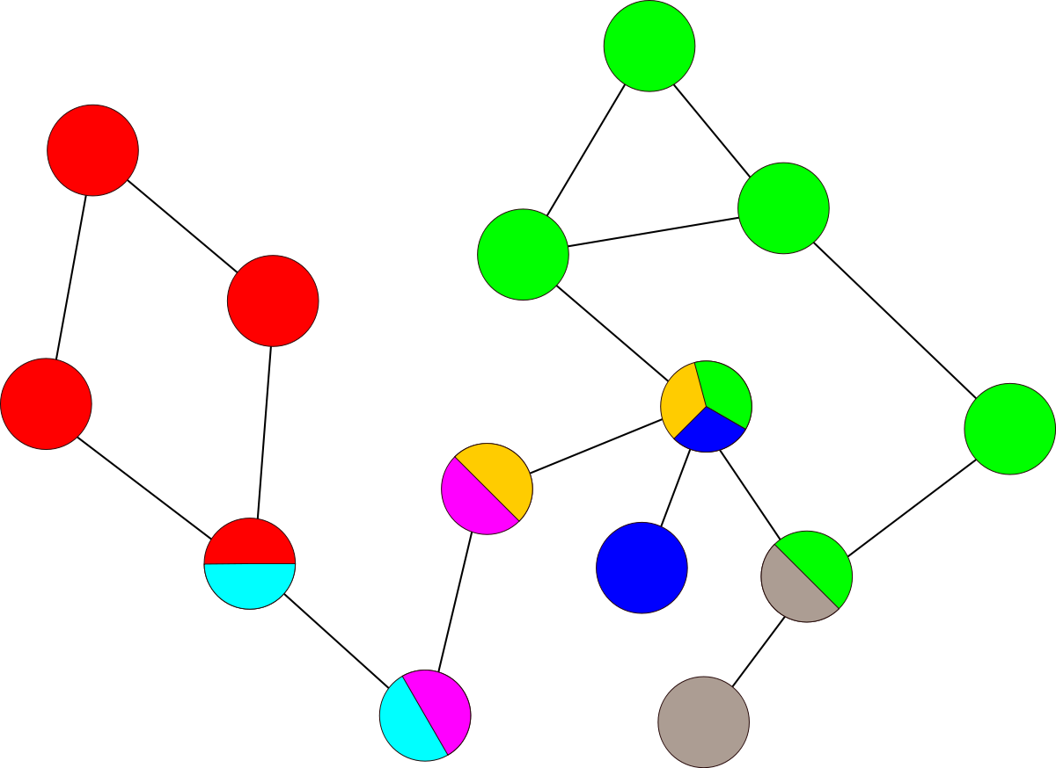
Other Components
Process steps
Parent records
Linking to data
Linking to web sites, journals, and other resources
Validating records
GeoData manual and review checklist
Notes:
We will also review process steps, parent-child relationships, linking to external data and resources, validating records, and more in a minute during the demo, because these components are also important parts of the ISO 19115 metadata creation.
If at any point you have questions about any aspect of GeoData, visit the user manual and review checklist by choosing the Help button in the menu bar of the GeoData site. That documentation goes into much more depth than I can cover in an hour.

Slide 12
GeoData Workflow
All records start out as Draft status
Use the Manage Record button to update the record status
Draft button will be checked
Check the Submitted button
Leave a Status message with any notes for the curator
Choose Update record status
The curator is notified and will review the record
Notes:
One last thing to mention before we jump to the demo is the workflow process. Users have the ability to edit their record drafts prior to publication, and there is now a workflow in place to move completed drafts from hidden to published. I want to list the steps here for future reference for anyone out there who is ready to submit records, but we will look at this process more closely during the demo.
And now we will jump to GeoData to look at some of these features in the actual interface.

Slide 13
Questions
?
NAL GeoData:
NAL GeoData
ISO 19115-3:
ISO 19115-3
GeoNetwork:
GeoNetwork
Ag Data Commons:
Ag Data Commons
GeoData email:
NAL-GeoData@ARS.USDA.GOV
?
?
https://geodata.nal.usda.gov/
Notes:
Here are a few links you might find helpful, including the URLs to NAL GeoData [https://geodata.nal.usda.gov/geonetwork/], the ISO 19115 standard [https://www.iso.org/standard/32579.html], GeoNetwork [https://www.geonetwork-opensource.org/], and the Ag Data Commons [https://data.nal.usda.gov/]. If you have any questions or comments, please contact us at NAL-GeoData@ars.usda.gov. We are still developing GeoData and would very much like to know how this might fit with your own workflows if you are a USDA researcher. Let us know what features and functionality are important to you, and we will take that feedback into consideration moving forward.

