Slide 1
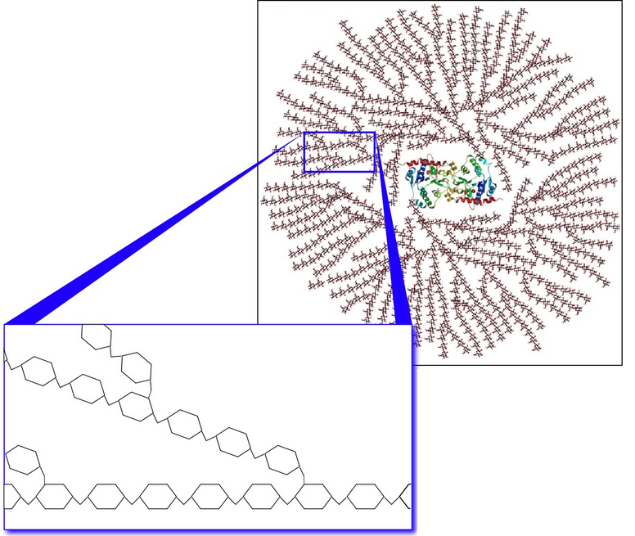
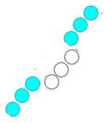
Lactobacillus crispatus growth on glycogen is dependent on its type 1 pullulanase gene variant
Rosanne Y. Hertzberger^{1,2}, Alicia Brandt ³, Charlotte van der Veer⁴, Jorne Swanenburg^{1,5}, Remco Kort¹
1 VU University Amsterdam, Netherlands, 2 REBLAB, Netherlands, 3 University of Groningen, Netherlands, 4 GGD, Public Health Service, Amsterdam, Netherlands, 5 TNO, Zeist, Netherlands
Find more at www.reblab.org, contact: rosanne.hertzberger@gmail.com
Background
Most Lactobacillus crispatus genomes have a type 1 pullulanase gene.
Glycogen is an abundant glycan in the vagina of reproductive age women.
Glycogen is a polymer of α1,4 and α1,6 linked glucose units. Its accumulation is stimulated by estrogen.
Glycogen levels are lower in women that have low Lactobacillus levels.
Pullulanase activity
Type 1 pullulanase gene of Lactobacillus crispatus DSM20584
Vaginal lactobacilli genomes encode few genes known to be involved in glycogen metabolism (no amylase or gluco-amylase genes). Most L. crispatus genomes have a type 1 pullulanase gene, predicted to encode an s-layer associated enzyme acting on α1,6-linked maltotriose units (Møller et al. 2017). The gene is absent from ST1, 125-2-CHN and 214-1 genomes.
.
Can vaginal lactobacilli utilize glycogen as a source to colonize and acidify the vagina?
Results
Growth on glycogen
N-terminal region of type 1 pullulanase gene
Putative transcription start-site
Growth on glycogen was tested in a set of L. crispatus isolates. Strains were inoculated in glucose-free NYCIII medium supplemented with 0,5% glycogen (shown). glucose (+ control, not shown) or water (- control, not shown) and incubated anaerobically (48h, 37ºC).
Optical cell density at 600nm was measured as a marker for growth. Every datapoint in the graph represents a biological replicate
6 out of 20 strains tested were unable to grow on glycogen (non growers indicated with red, growers with blue).
All 6 strains that did not grow on glycogen carried a mutation in the N-terminal signal peptide sequence of the type 1 pullulanase gene. The red boxes indicates putative transcription start sites (Image adjusted from Clustal Omega).
Starch degradation activity after growth of Lactobacillus crispatus DSM20584
Conclusions
Can vaginal lactobacilli utilize glycogen for growth?
Yes! Our results show that most vaginal isolates of Lactobacillus crispatus are capable of metabolizing glycogen -one of the most abundant vaginal carbohydrates- and use it for colonization and acidification. We identify a type 1 pullulanase that may be essential for this activity.
Is glycogen metabolism a prerequisite for vaginal colonization?
No! Several vaginal isolates of Lactobacillus crispatus did not show growth on glycogen. Previously it was shown that Lactobacillus gasseri and jensenii are incapable of growth on glycogen (Spear et al. 2014). More research is needed to understand if and how these lactobacilli contribute to acidification.
The amylopectin moiety of starch consists of α1,4 and α1,6 linked glucose units that are comparable to glycogen.
After growth of L. crispatus DSM20584 starch-degradation activity was detected in the supernatants (shown) as well as associated to the pellet (not shown). Residual starch after 24 hours of incubation is shown as well as the start concentration.
This activity was not detected after growth on glucose indicating differential regulation of this enzyme.
This is an Open Kitchen Science project, aimed at maximizing transparency and collaboration. This poster is available online at FigShare.com findable with #Ksgtmicrobiome #reblab. Datasets and protocols can also be found there.

