Slide 1
Entering the realm of Avalon at Whirl-y-Fayre: myth, magick and the micro-festival
Professor Alice O’Grady
University of Leeds, UK
Notes:
Introduce self and thank Graham and organisers
Introduce topic

Slide 2
Notes:
Whirl-y-Fayre is a tiny festival that takes place in Somerset, South of England.
Specifically in the Vale of Avalon which is near Glastonbury – festival you’re more likely to have heard of.
Been running since 2013 but has a much longer history.

Slide 3
Notes:
WG began in 1981 and was initially run by a voluntary organisation called the Association of Humanistic Psychology – reached its 50th anniversary this year – broad belief in the principles of human rights, freedom of choice, wisdom of the self, development of communities and spiritual growth. It gave up involvement with WG after the first couple of years but its ethos still underpins it in many ways.
WG carries the title of being one of London’s longest running night clubs (if not the longest) and celebrated its 37th birthday this year.
Two flyers – one on the left is from 1983/4, one on the right is for the next event in December. Flyer gallery on their website is worth looking at as a piece of historical documentation.
It’s run by Mary and Richard (DJ Monkey Pilot), a couple based in London who have been involved with it from the start. Moved around a lot and changed venues, often favouring community centres, church halls and so on. Operated without security. Volunteers instead. Originally open to children too – didn’t serve alcohol. Scheduled early so that families could attend.
Now runs 11- 6 at Bloc, a warehouse space in Hackney Wick.
World beats with trance feel but resist genre lables – acts such as Dreadzone, Loop Guru, Banco da Gaia, System 7, Astralasia, Eat Static are all long time associates of WG.
Appeared at Womad 1994 – my first encounter with them. ‘Beyond the disco, there was rave, beyond the rave, there’s WG’ (Womad flyer)

Slide 4
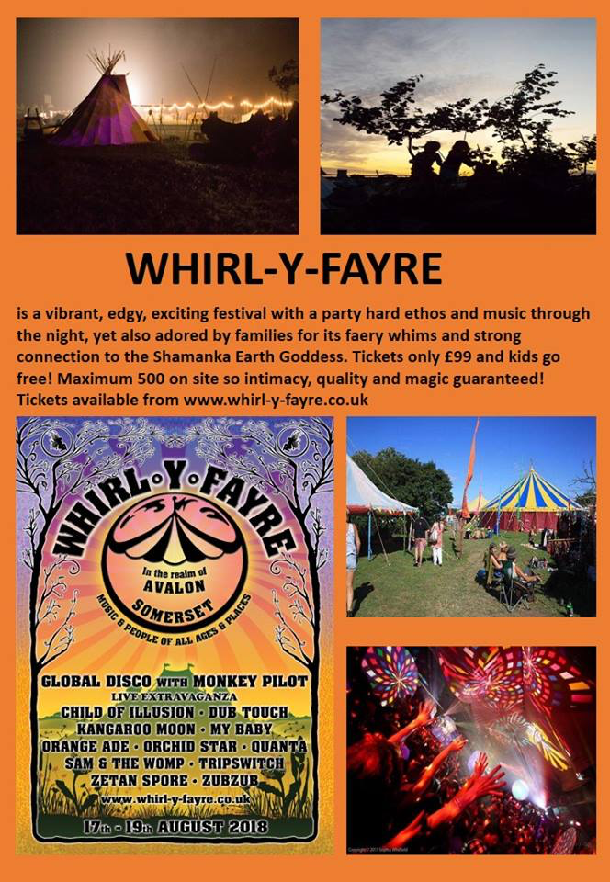
Notes:
The history of WG is central to understanding WF. WG has a rich and well established back story and has something of a mythic status on the UK dance scene. Both myth and magic are two aspects that circulate around the event in interesting ways – try and signal where and how that happens today.
The commitment to humanistic principles, spiritual growth, family values is embedded in the organisation – not just lip service/branding.
Two founding members still head up the organisation – family structure with Mary very much as the matriarch (or Goddess) – sets the tone for the event and the values that underpin it.
‘At WF that special ‘something in the air’ is tangible and felt by all. It binds everything together to produce a complete experience for everyone.’ (WF website) The magical quality of the event is placed first and foremost in the publicity.
WF describes itself as a Global Dance Festival.
It has a 24 hour licence and provides a mixture of electronic music, live music, chill out areas, cafes as well as meditation and healing areas, stalls and workshops, a tipi lodge, a shamanic sweat lodge and a goddess temple (run by Mary).

Slide 5
Mary the Faery and the Goddess Temple
Notes:
This is Mary

Slide 6
Monkey Pilot
Notes:
This is Richard

Slide 7
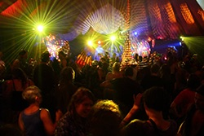
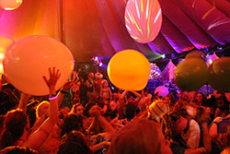
Global Disco and the Party Parlour
UNADJUSTEDNONRAW_thumb_3923.jpg
Notes:
Dance as a core expressive art is at the heart of the event – great deal of attention goes into decoration, lighting and visuals.

Slide 8
Underneath the parachute
Notes:
WF has playfulness at its core too. One of the key elements to all Whirly events is the rolling out of a huge parachute silk over the heads of the crowd at the end of the night.
Everyone sits down together as the parachute gets wafted over them while projections and lights dance over the material. Its a unique (if somewhat odd experience) at the close of each night but Whirly regulars race to the dance floor to be part of it.

Slide 9
Size is everything
Notes:
In 2016 Voted ‘Best Family Festival’ by readers of Green Parent magazine and was finalist in the NOEA (National Outdoor Events Association) Small Event of the Year Awards
Whirly is tiny – capacity of 499
This is the extent of the site.
Scale of the festival is critical to understanding how it works its magic.

Slide 10
Notes:
With only 500 people there over a weekend, the event is extremely intimate. It has the feel of a party organised by and for friends rather than a festival per se and that’s what attracts people.
At Whirly it is very possible to feel part of something, included, supported. It’s possible to make multiple and meaningful connections, to feel part of something that feels like a family. The phrase ‘Whirly changed my life’ is something you hear a lot.
Connectivity central ethos.
‘WF is a place to feel free and connected, to each other and to the magic of life. It is an event difficult to describe and a moment impossible to miss.’ (website)

Slide 11
Notes:
As well as size, the set is also critical.
The event has the look and feel of a traditional English country fayre.
Easy to see how it taps into the image of the English pastoral idyll.
It offers a cosy world cider, home made cakes, ice cream, log fires and long summer days that is the antidote to the experience of living in London and attending WG in disused warehouses.
Mention Brexit?

Slide 12
Notes:
It also taps into the bucolic imagery of free parties and gatherings of yesteryear

Slide 13
The Vale of Avalon
Notes:
The third key element is site. WF takes place in the vale of Avalon, Somerset, near Glastonbury.
This is Glastonbury Tor rising out of the mist – appears as an island. Can see distant views of the Tor from WF. Together with Stonehenge, Glastonbury Tor deemed to be the most sacred site in England.
Glastonbury is believed to be the outer realm of the sacred isle of Avalon.
Avalon itself has fluid boundaries – both physically and spiritually. In ancient times, Avalon’s inland streams were flooded by an inland sea lake at high tide, thus creating an island – separating it off from the rest of the land.
As well as a physical place, it’s believed to be a place within the heart and the soul – a place of inspiration and sanctuary.

Slide 14
The Isle of Avalon
Notes:
This is how the isle of Avalon is often depicted.
In mythical terms, the Isle of Avalon (also known as Lady of Avalon and associated with Arthurian legend) is recognised as the entrance to the underworld or faery otherworld. In this world hidden realities become visible and breakthroughs occur. In this place, we are encouraged to connect with the earth in order to find truth.
Avalon has always been associated with creativity and free thinking. This goes back to ancient times and people’s connection to the land expressed through Pagan worship. Goddess worship in Avalon goes back 3000 years and is experiencing something of a resurgence.
Glastonbury town has a higher than average ratio of artists, musicians, druids, shamans, healers and sorcerers. There are meetings and conferences all year on spiritual and magical topics.
The myth of Avalon sets the scene for WF and imbues it with a magical spirituality where freedom to be and believe is highly prized and where deep connection to the sacred land is encouraged.

Slide 15
Glastonbury Festival
Notes:
The same was once true of another festival that takes place down the road.
Obviously this is the antithesis to what WF offers.

Slide 16
The magic of the micro
Notes:
Something really important here about scale and the experience a micro event can afford.
Micro-festival is a term associated with contemporary theatre that came into common parlance a number of years ago (and has slipped out of usage again).
Is used to refer to a curated programme of works that are usually shorter or smaller than conventional theatre.
These works are focussed on audience-performer relationships – might be described as intimate or confessional performance.
As Lorne Campbell of Greyscale Theatre once said, the impulse behind much of this work is to ask two of the most important questions in theatre:
What are you doing sitting there looking at me?
What on earth am I doing standing here with you looking at me?
Micro-theatre invites the audience to become aware of each other, to renegotiate their relationship with production and consumption, to re-evaluate their understanding of spectatorship and to become more aware of their place within and contribution to an event.
The same is true of WF as an example of a micro-festival.
In an event created for 500 people, your role/place within it as a participant is fore grounded.
You have a role to play in the event and that role is relational. In other words, you matter.
A 2015 article in Spin by Harley Brown, had the headline “You and 500 friends: how micro festivals are doing more with less.” The article is US focussed but nonetheless flags up the rise in festivals for 3000 people in recent years.
Other examples – Micro-festival (Belgium) and also Cumbria (festival + retreat)

Slide 17
Whirl-y-Fayre is a place to feel free and connected, to each other and to the magic of life. It is an event difficult to describe and a moment impossible to miss.
www.whirl-y-fayre.co.uk
Notes:
Borrowing terms from contemporary theatre, provides a useful way of understanding how WF works.
It is intimate, site specific, participatory, community arts practice. This is its appeal and its magic.

