Slide 1
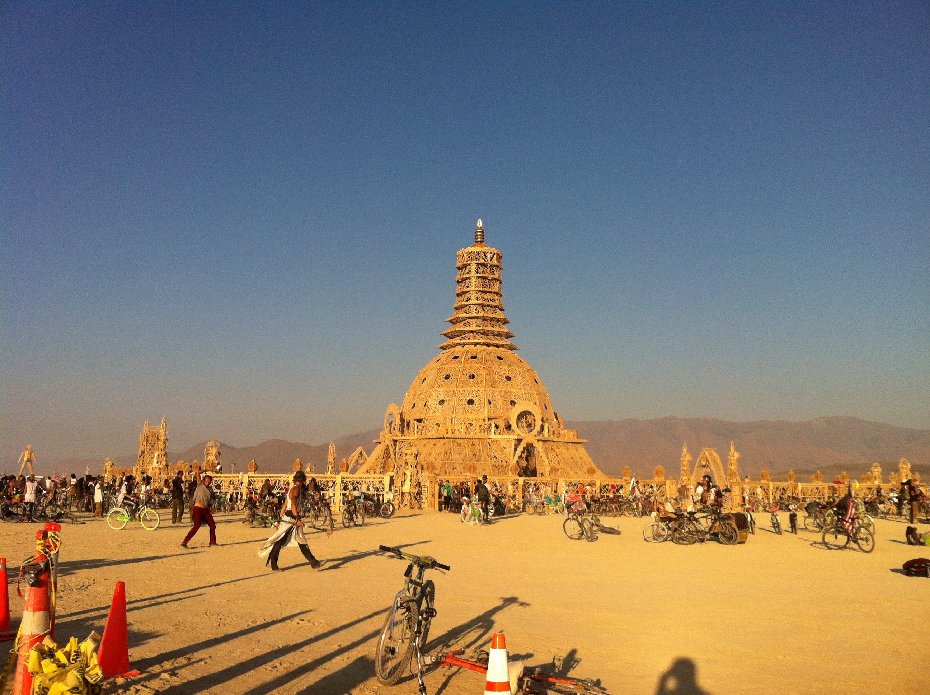
Altars to Ashes: Transfiguration and the Material Culture of Grief at Burning Man Dr. Sarah M. Pike California State University, Chico
Notes:
2014 Temple. Burning Man’s Temple emerges out of dust and ends in dust and ash that travel home with participants. Dust plays a central role in making and remaking Burning Man participants into “Burners”. It is the most universal experience at the event. Smoke and ash play a role too, but a more limited one. Burners breathe in the smoke from the Temple burn and all the altars and objects that composed the temple may enter their bodies in that way. During the ritual acts of mourning performed at the temple, and the physical experience of dust, wind and fire at the Temple Burn, the bodies of the living come together with the absent bodies of the dead.

Slide 2
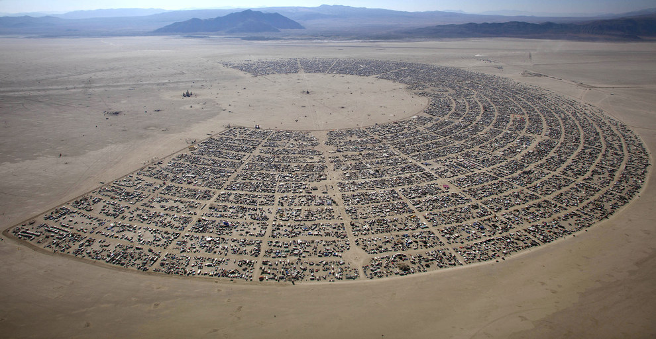
Notes:
Blank canvas, pilgrimage destination, place apart. Burners embark on a kind of pilgrimage as they leave behind the ordinary world and travel to the desert to be transformed— “As pilgrims to a new land, each of us becomes a founder” according to Larry Harvey (“The Year of Community—You Are a Founder,” 8/7/97). For more about these themes, see Sarah M. Pike, "Desert Goddesses and Apocalyptic Art: Making Sacred Space at the Burning Man Festival" in God in the Details: American Religion in Popular Culture, edited by Katherine McCarthy and Eric Mazur. New York: Routledge, Inc., 2010 [2001].

Slide 3
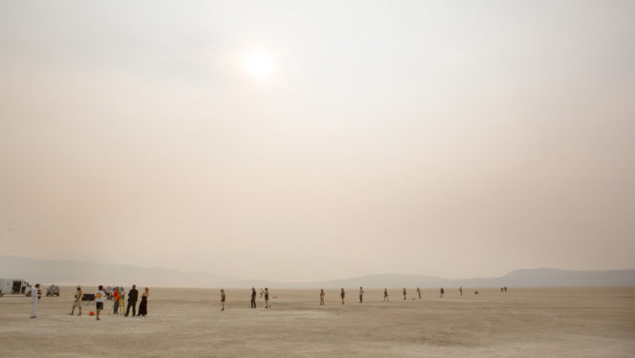
Notes:
John Curley, “Now What Do We Do?” in The Burning Man Journal: https://journal.burningman.org/2018/07/black-rock-city/building-brc/now-what-do-we-do/. But of course the Black Rock Desert is not really blank and it’s not a new land to its many past, previous and present inhabitants, both human and nonhuman. It is in the ancestral lands of the Paiute. The black rock itself is part of an ancient island chain and is made of volcanic rocks and limestone (with its marine fossils). The playa where the event takes place is a prehistoric lake bed, where woolly mammoth and other fossils have been found there, where petrified wood is a common fossil. Gypsum and silica are also in the dust. So we might imagine that Burners are breathing in the tiniest fragments of ancient fossils along with the dust, the traces of all those who have come before, the traces of many kinds of plants and animals and peoples who have passed through or lived in the area over time.

Slide 4
Notes:
The Temple emerges out of dust. Temple of Joy 2002: http://octopup.org/burning-man/2002/temple. The desert shaped Burning Man’s development in part because it could both be conceived as a “blank canvas,” defined in some sense by its absence of meaning and it is intensely present in the dust and the rocks/mountains that are always visible.

Slide 5
Permeable bodies
Notes:
Reuters photo: https://www.dailymail.co.uk/news/article-4835434/Over-70-000-brave-fierce-dust-storm-Burning-Man.html. In other contexts we might think of dust as an inert substance, but in most Burners’ experience it’s “vibrant matter,” to borrow political scientist Jane Bennett’s term: it has life and agency. It marks participants as Burners, but it also makes them into participants in the deep geological and cultural history of the Black Rock Desert. Immersed in dust, Burners also become the Desert. The persistence of dust, especially in dust storms: it may be the only experience all Burners have in common. Burning Man and its Temple are temporary in one sense, but in another they are not. Their elements do not all disappear when the event is over; Burners’ continue to have bodily experience of the desert and the event after they leave and return home.

Slide 6
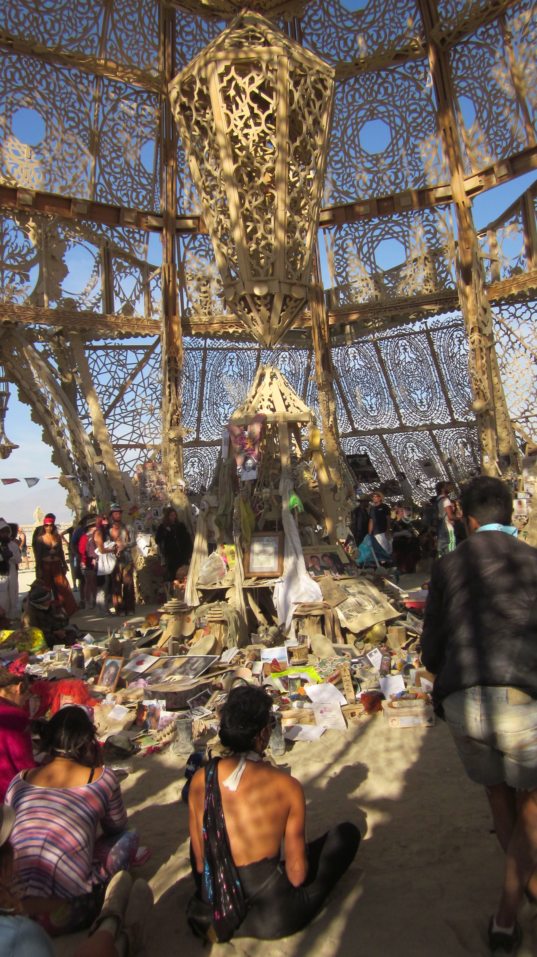
Notes:
The Temple is always filled with memorial offerings brought from home or assembled on site. Photos of parents, children, lovers, friends, dogs, cats, horses, lizards, birds, rock stars, the suicides, the murdered, the massacred. Messages of love and loss are written on every inch of the temple walls, doorways, stairs, railings, satellite shrines. The accumulation of stuff, powerful stuff, also with agency to act on mourners, to change them, to change their bodies and minds.

Slide 7
Ritual at the temple
Ritual contagion (practices spread), ritual empathy (we weep for the loss of strangers), and Mimesis (imitating what others do at the Temple)
Formal and informal ritualizing (the week-long informal activities and the final Temple Burn)
Altars and the material culture of death: making hidden death and loss visible
Notes:
Sarah M. Pike, “Performing Grief in Formal and Informal Rituals at the Burning Man Festival,” in: Weinhold, J. & Samuel G. (eds.) "The Varieties of Ritual Experience," in Ritual Dynamics and the Science of Ritual. Volume II - Body, Performance,Agency and Experience, ed. by Axel Michaels et al. Wiesbaden, Germany: Harrassowitz, 2010; Sarah M. Pike, “No Novenas for the Dead: Ritual Action and Communal Memory at the Temple of Tears,” in Afterburn: Reflections on Burning Man, edited by Lee Gilmore and Mark Van Proyen. University of New Mexico Press, 2005

Slide 8
A set of tensions and contradictions embodied by dust and ashes
interiorization of others’ beloved dead/externalization of one’s own personal grief
remembering and forgetting
Presence and absence
the impermanence of everything that is burned and yet the ongoing existence of temple relics through space and time, on the Internet, and in my talk here today
Notes:
Derrida: keep talking to the dead, or Freud: release of emotion and “resolution” of grieving.
There is a powerful ambiguity in Burners’ desire for impermanence, but also their desire to hold on to the experience with photos, ashes, pieces of the Temple. Things continue to have a life after the Burn too

Slide 9
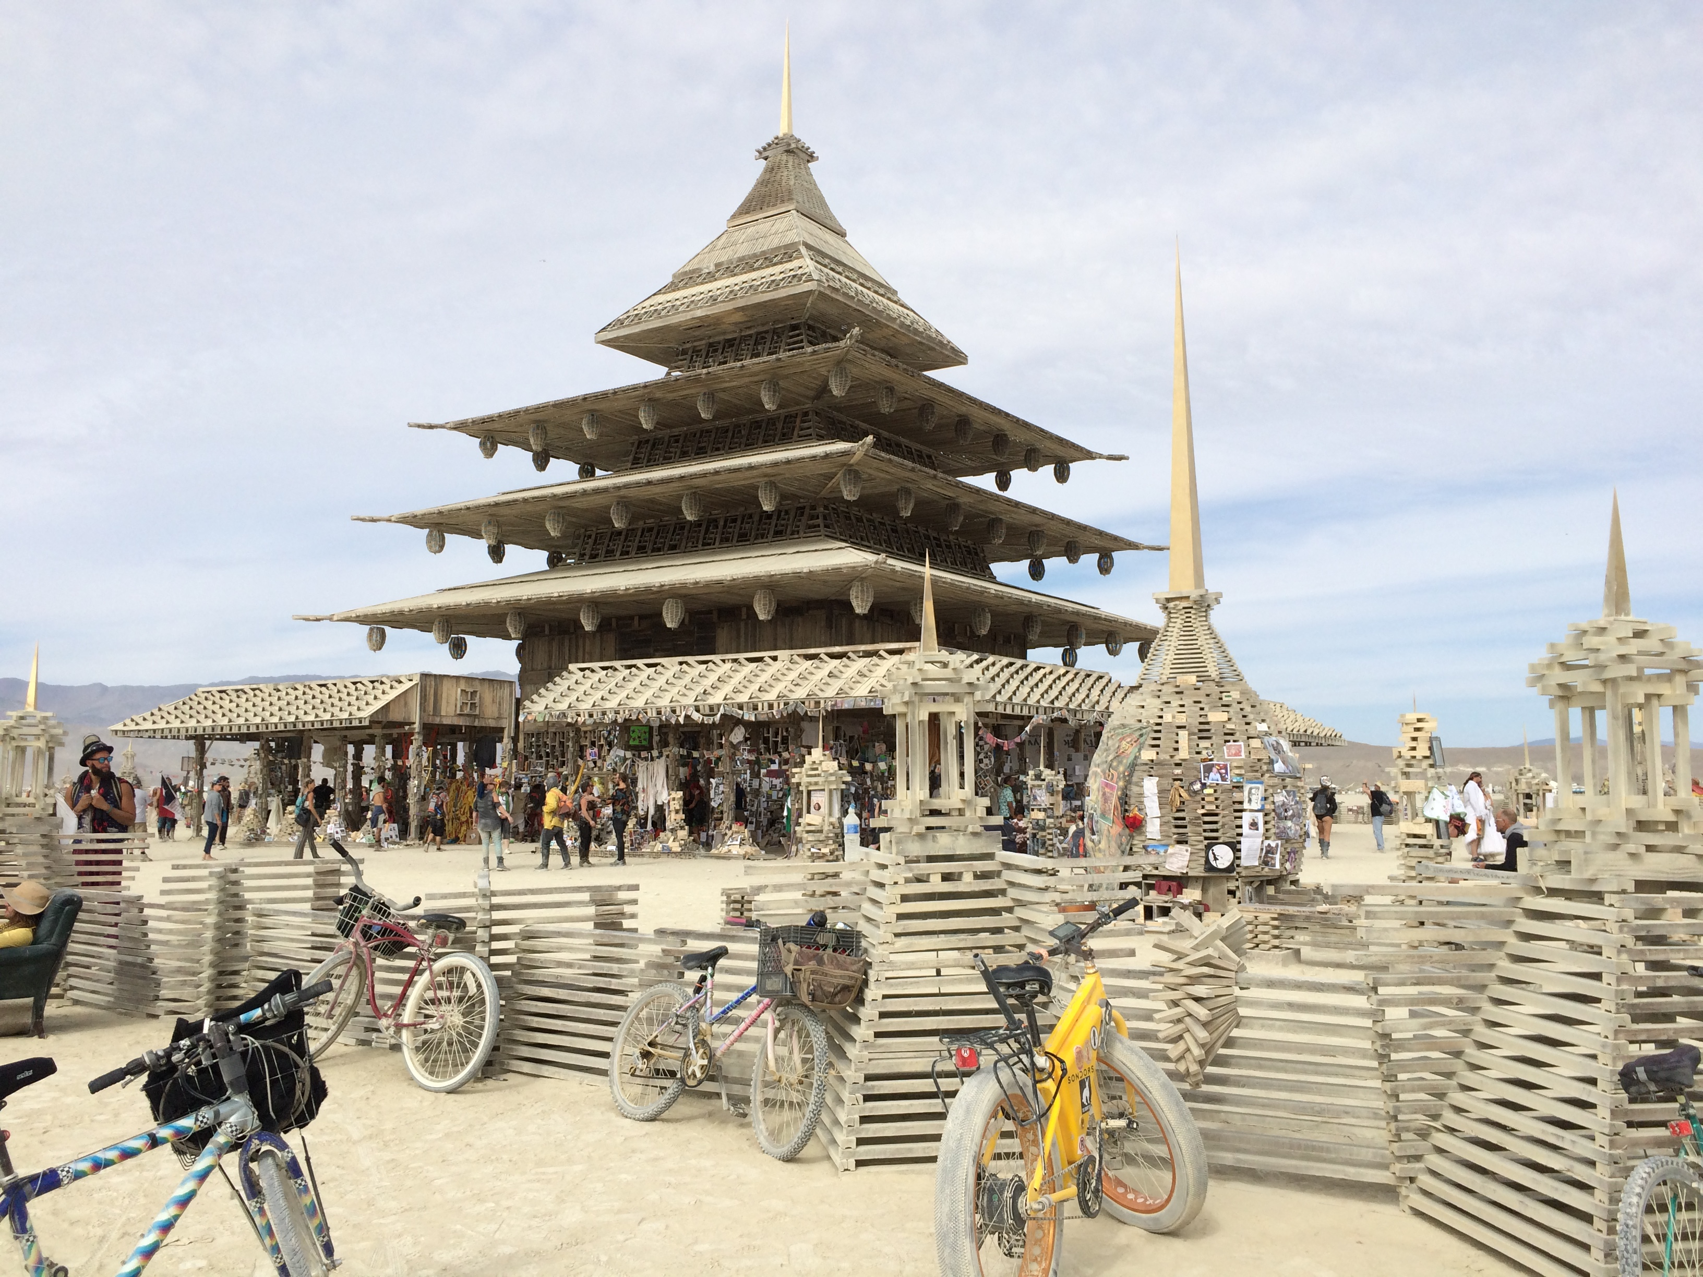
Notes:
2016. Ephemeral altar building: Burners bring items to the Temple that will all eventually be burnt. The Temple offers for a time a “material culture of grief,” but only for a short time before it all goes up in smoke. In her work on the material culture of grief, Erica Doss highlights “the faith that Americans place in things to negotiate complex moments and events.” Doss argues that contemporary memorials in the U.S. embody “increasingly accepted contemporary understandings of continued, rather than severed bonds between the living and the dead” (2005: 301). Burning Man’s Temple offers the opportunity for both severing and continuing those bonds: the Temple can work in both ways for participants.

Slide 10
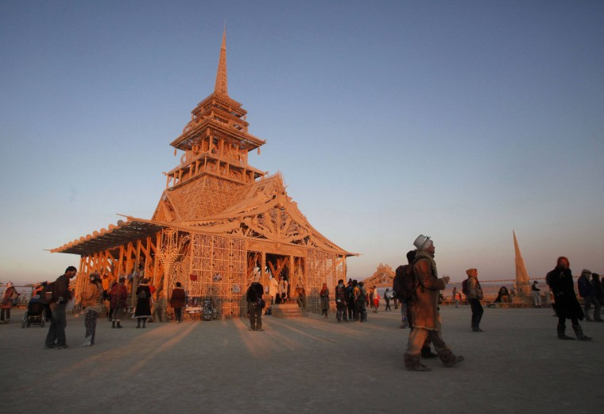
Notes:
Temple of juno 2012

Slide 11
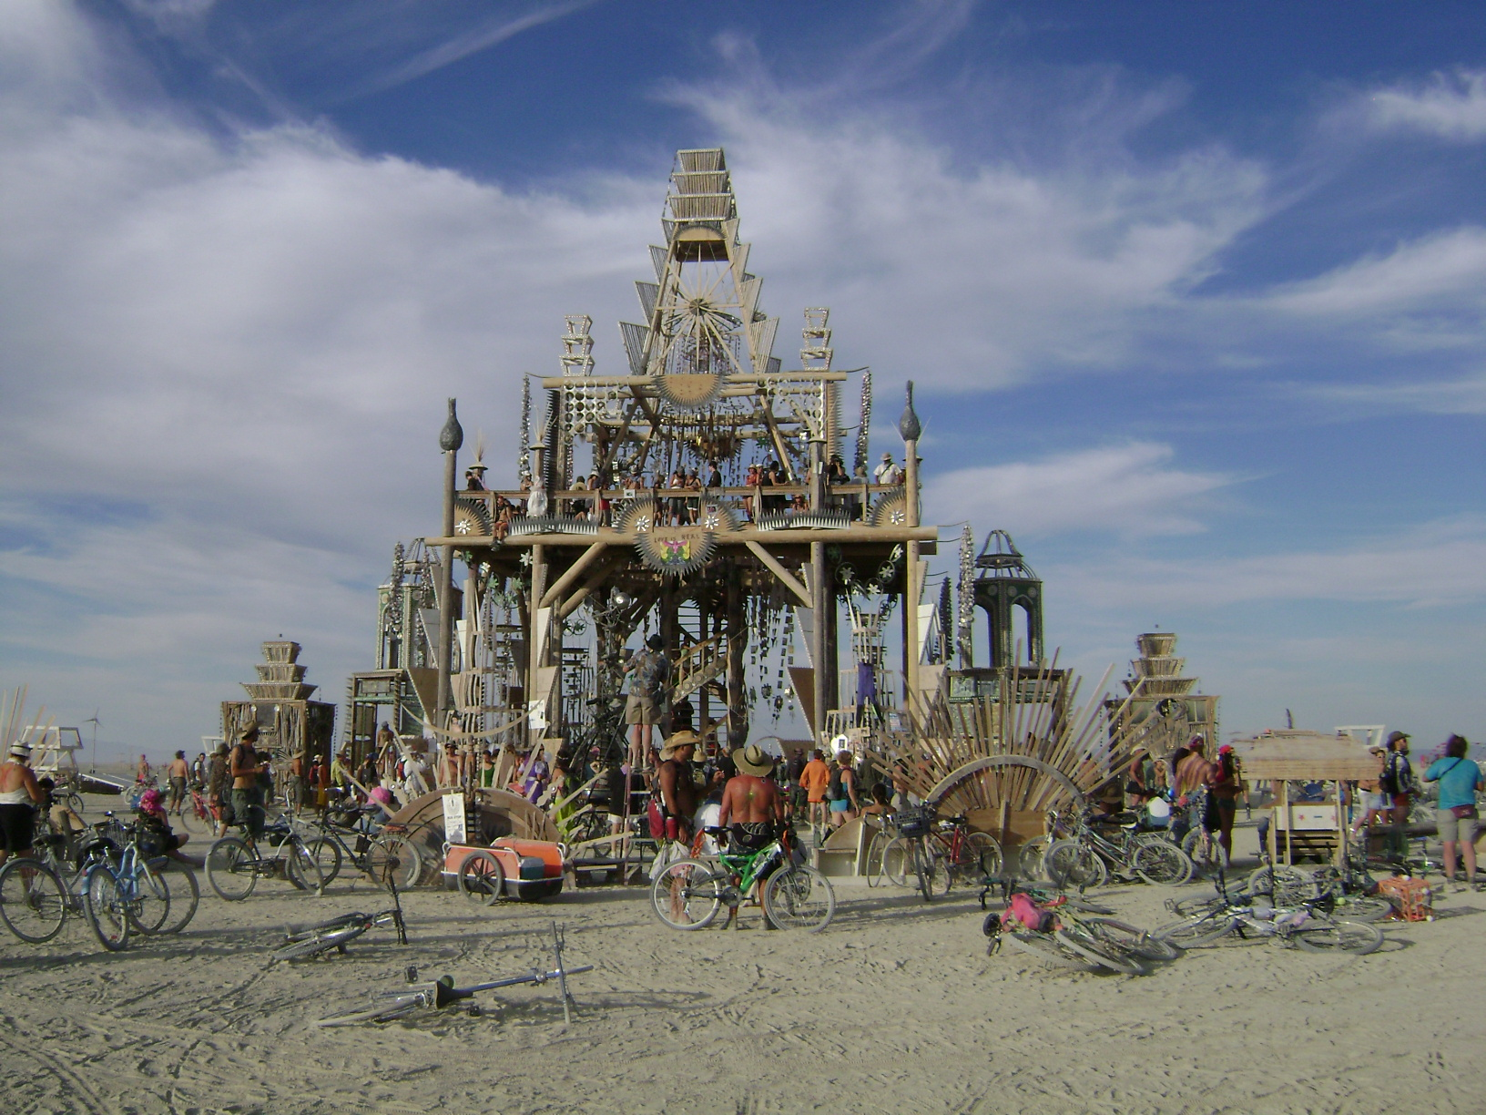
Notes:
2008

Slide 12
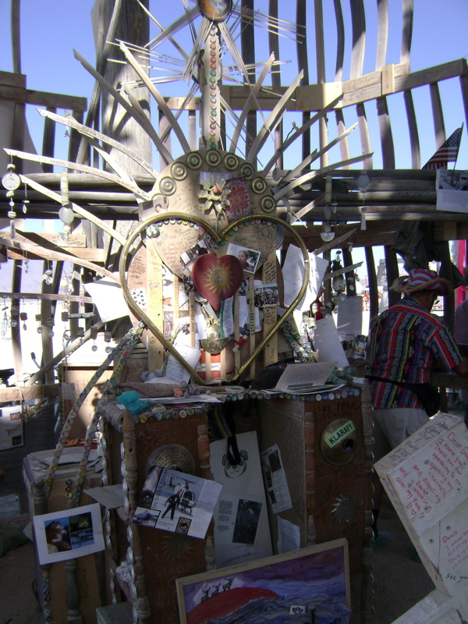
Altars: sites of contagion, mimesis, and accumulation
Notes:
At altars and in all the accumulated items in the Temple, no boundaries or borders distinguished one person’s grief from another’s. Mourning becomes contagious at the Temple, afflicting us as we look on the thousands of photos, mementos, of dead sons, mothers, lovers, and pets, a three-dimensional collage of collective loss.

Slide 13
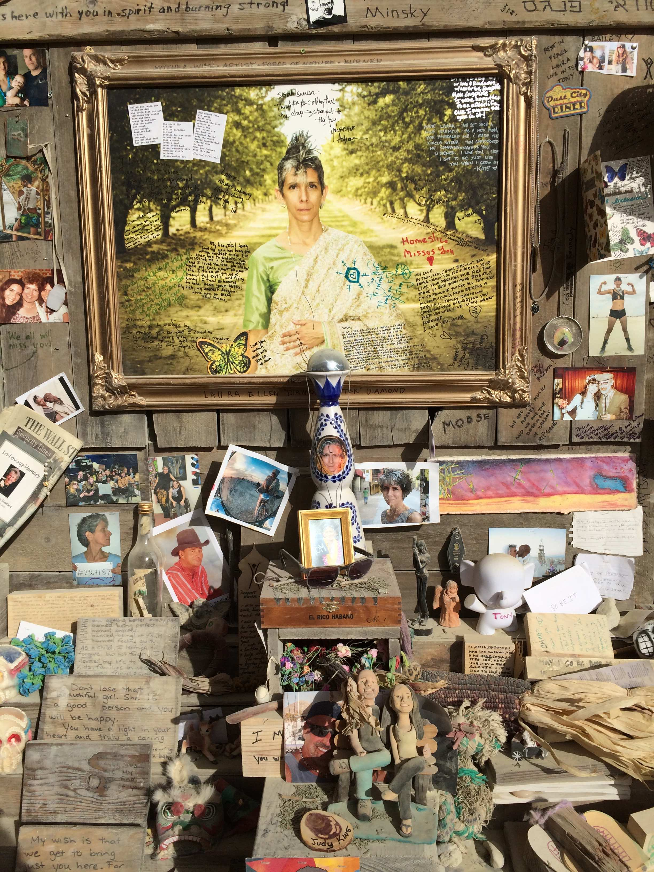
Notes:
Like much collective ritualized mourning, the Temple transforms private grief into a public rite. For many Americans (my research is focused on the U.S.), modern death rites have become privatized, shifting the emphasis from the community to the private world of the individual and the family. The Temple at Burning Man reverses this process, making grief and mourning public and shared between intimate strangers. Studies by Philippe Ariès, Peter Homans, and other scholars suggest that death and loss become more bearable when the burden of mourning is taken on by a community rather than left to the individual. Collective rites of passage around death and grief are designed to allow for the dead to move on and for the living to let the dead go, and yet at the same time continue conversations with them.

Slide 14
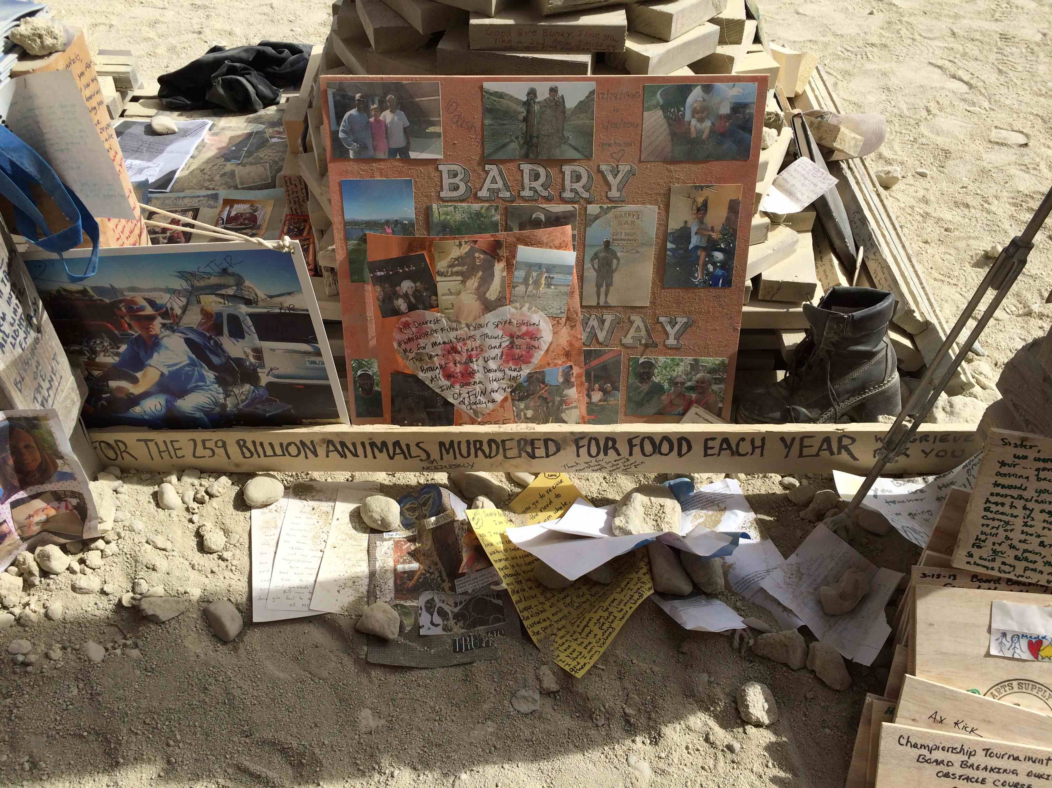

Slide 15
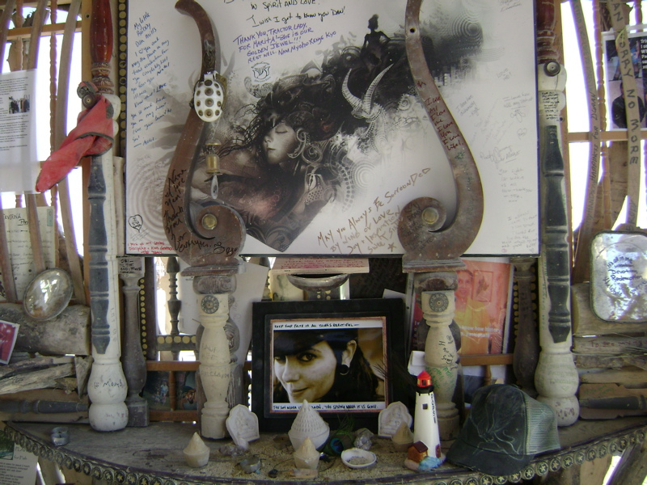
Ongoing conversations with the dead

Slide 16
Notes:
The Temple also allows for mourning what often can’t be mourned elsewhere, equally with humans (pet deaths).

Slide 17
Notes:
All the letters, photos, and other mementos have held power over Burners at the Temple throughout the week. During the Temple Burn they will become ash and smoke that we will also take into our bodies so that the vibrant matter of the Temple continues to act on us.

Slide 18
Temple Burn: the closing ritual of Burning Man
Notes:
Troy Dayton, “5 Ways to Make Life More Like Burning Man”: http://burnerlove.com/. My field notes: Dust devils spun out from the fire as the spirits of the Temple carried messages to the dead and released mourners’ grief into the dark landscape all around. As the glowing embers of the Temple faded into dust and ashes, we returned to our camps, packed up our belongings and headed home. The desert had served its purpose and our mourning was done (or was it?).

Slide 19
Mementos: transfiguration and the movement of ashes and dust
Notes:
Reuters: https://www.dailymail.co.uk/news/article-2034587/Burning-Man-festival-big-seen-space.html. The next day when I went to look at where the Temple had burnt, people were picking up objects from the ashes. We took home our dusty, smoky clothes, and pieces of the Temple. The material culture of the Temple lived on, the lives of its objects did not end when it burned. It traveled home through the smoke and ash absorbed by our bodies and through the fire forged objects everything in the Temple became.

Slide 20
Ashes are both endings and continuings. Burning Man is situated ambiguously in relation to the site where it is created, as both an extraordinary place apart from the “default world” and in continuity with the vibrant things that make up the world in and outside of the event’s boundaries. Burning Man is temporary and yet always ongoing in its transfigured forms. While “Leave No Trace” is a central theme of the event, many, many traces are left: the tiny bits of ash now settled and become part of the Black Rock Desert dust, part of the mountains. The dust, smoke and ash continue on in all of us who have been immersed in it.
We take it home, we wash it down the drain, it sits in our lungs, in our clothes and in our cars. It has been years since I took my own car to the event, yet still, when I first turn on the air conditioner, I smell the playa and am transported back there. In these ways, it is clear that ashes from the Temple Burn and dust from the Black Rock Desert have remade us. We carry them home after being transfigured by them, just as we take home objects from the ashes and photos of the altars in an ongoing cycle of creation, destruction, and remembrance.

