Slide 1
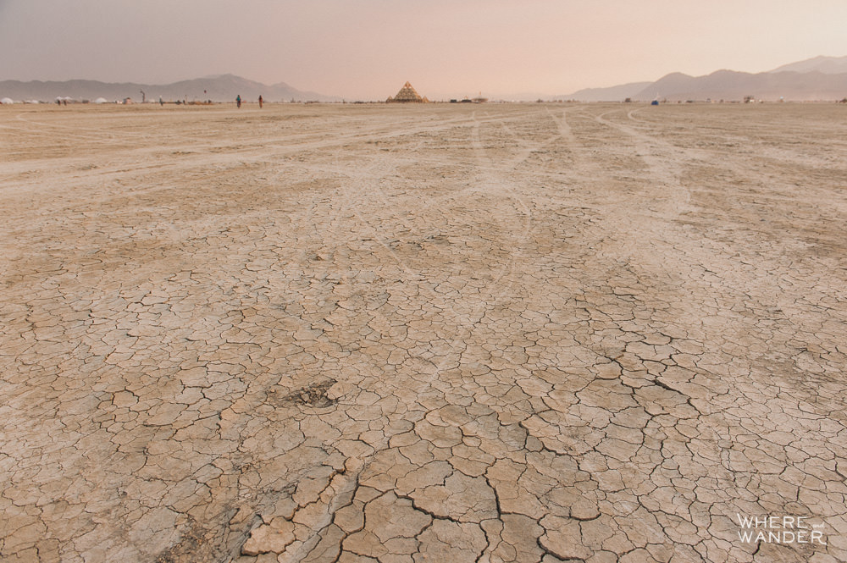
Art, Drama & Redress in Burner Culture
Graham St John
Université de Fribourg
Notes:
Draws on some of the work in progress – studying the evolving / mutating status of BM culture. We’re interested both in how the culture’s principles have been challenged, and the artful solutions to redress the discord. I’ll address the so-called “sherpagate” controversy that highlights the tension between artists and tourists in Black Rock City and regional events.
Victor Turner’s “social drama” to help explain this process and explore how an artistic heterotopia — an artopia? — enables the dissolution of complex differences in-situ.
Various projects demonstrate that collaborative and interactive art is the redressive weapon in the Burner arsenal.
It also begins to show how an artistic heterotopia enables the dissolution of complex differences.

Slide 2
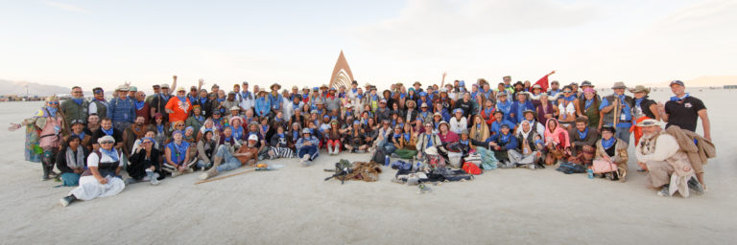
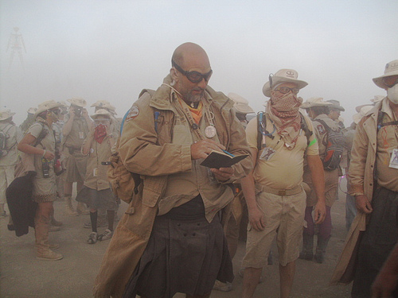
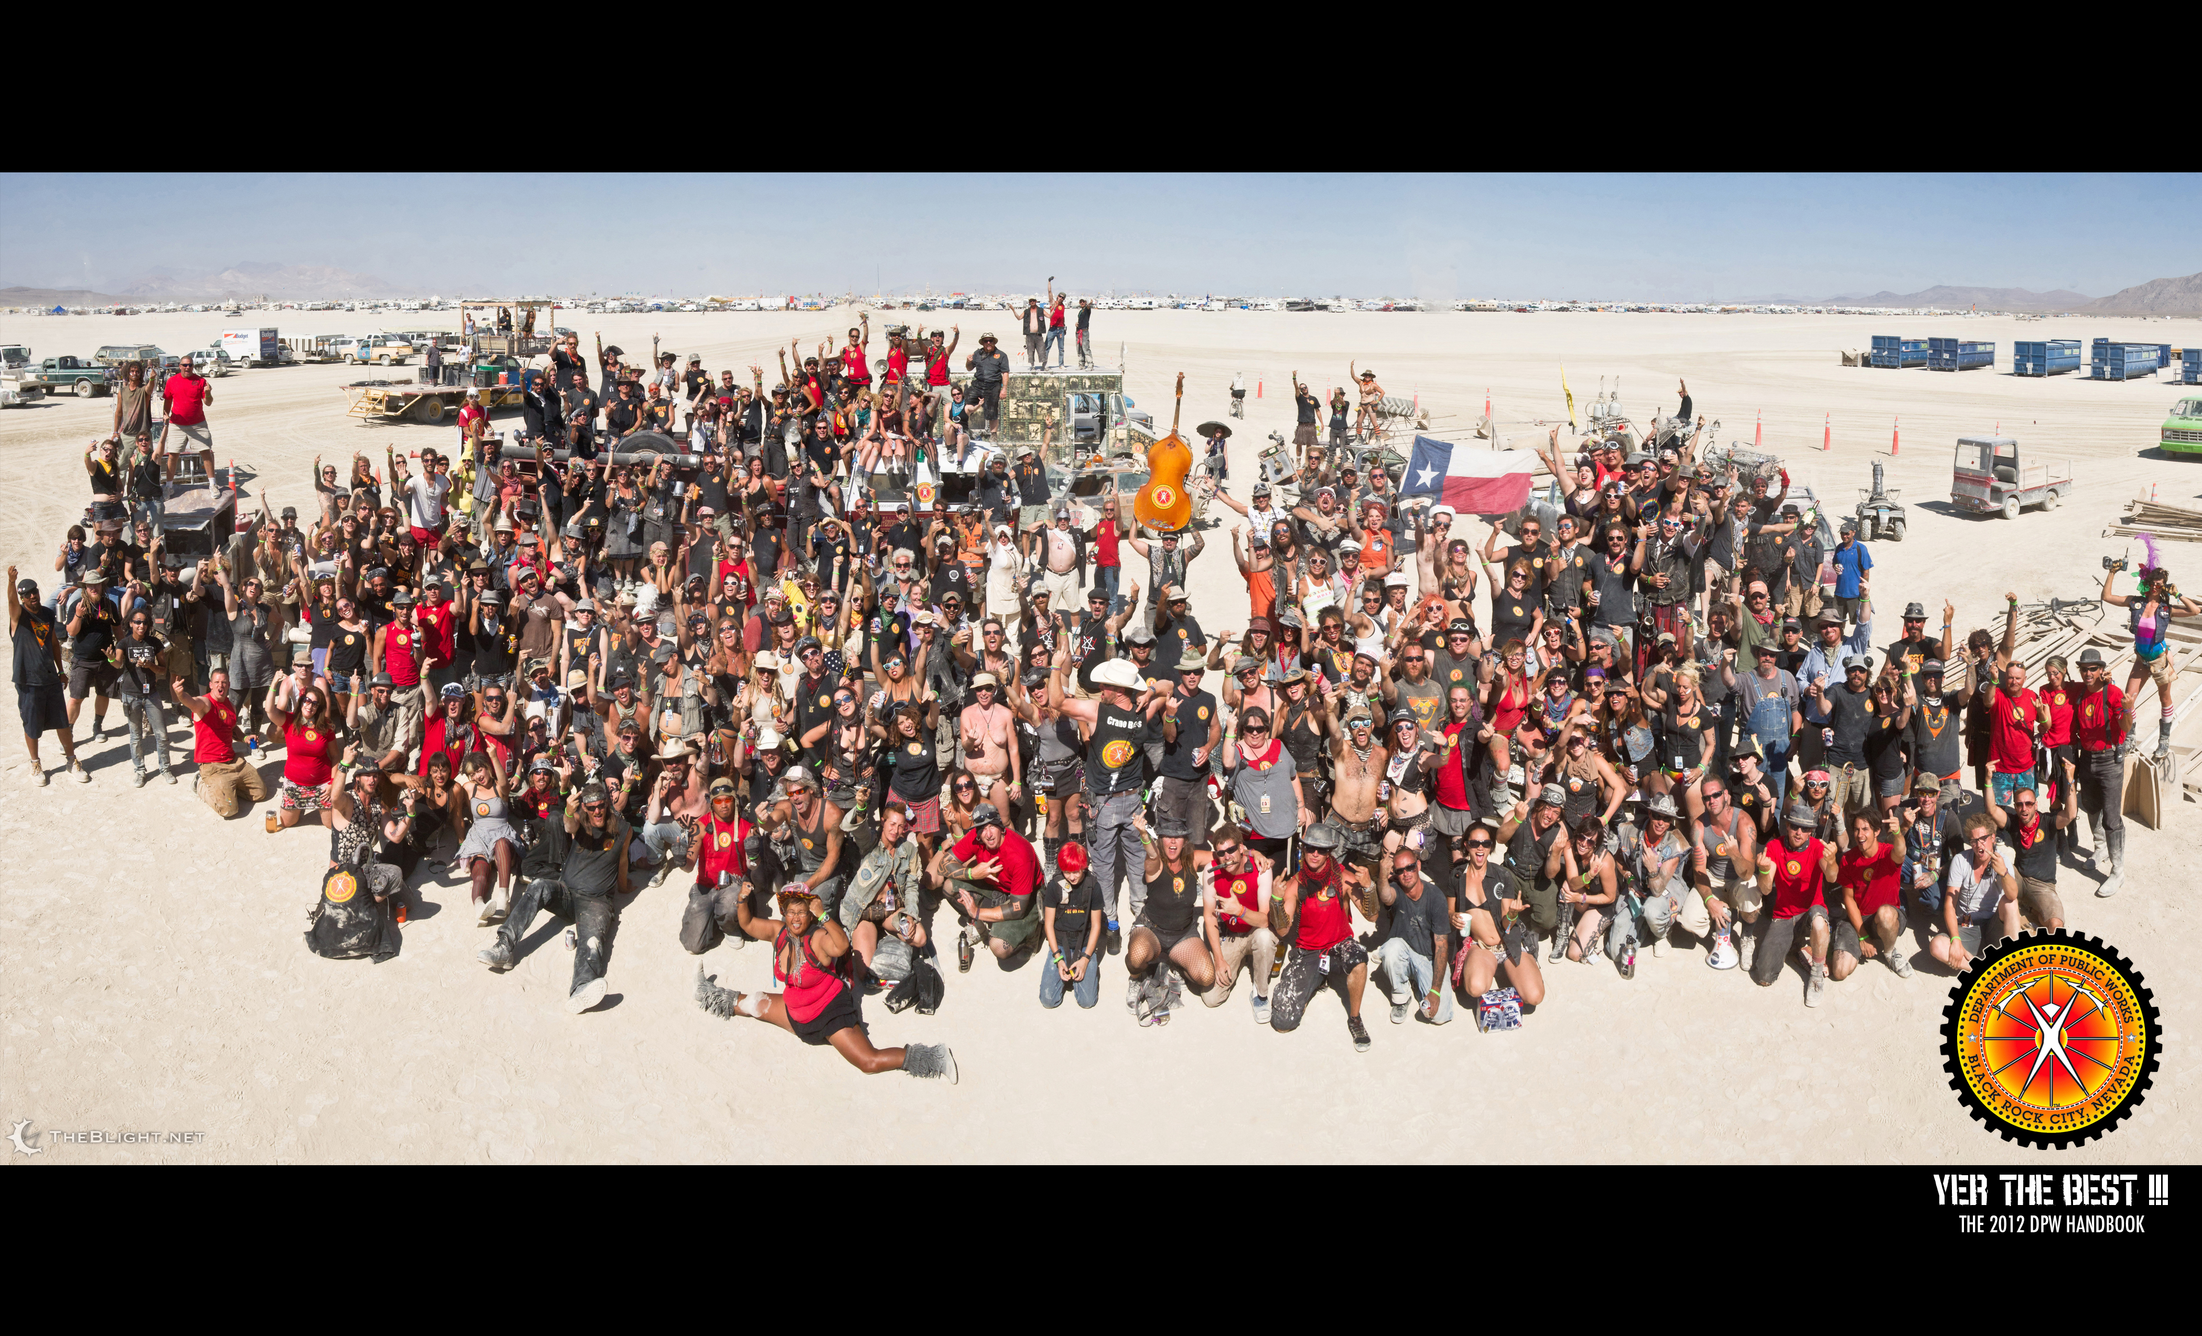
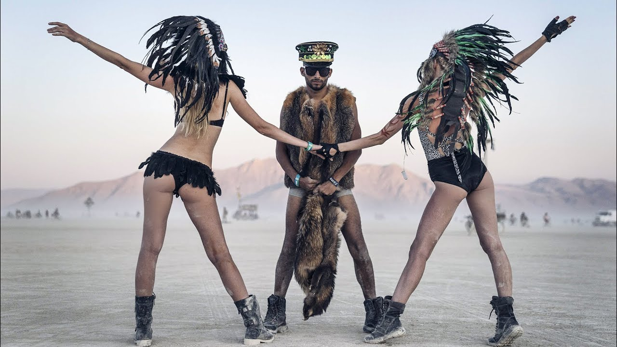
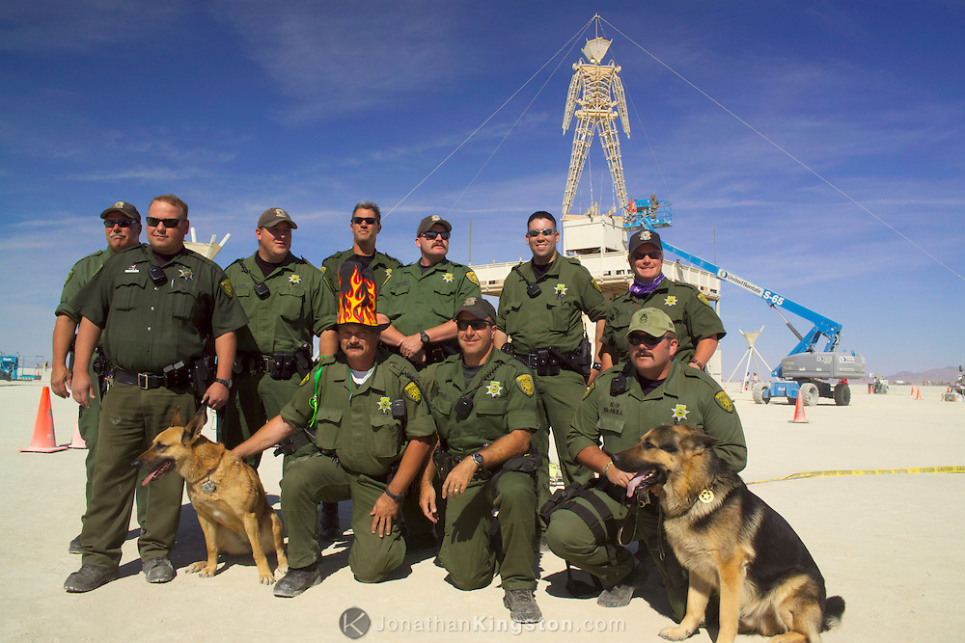
Notes:
Burning Man is a highly contested event
Participants arrive with disparate expectations, motivations, intentions, roles, practices….
The principles do rub up against each other, collide and mutate

Slide 3
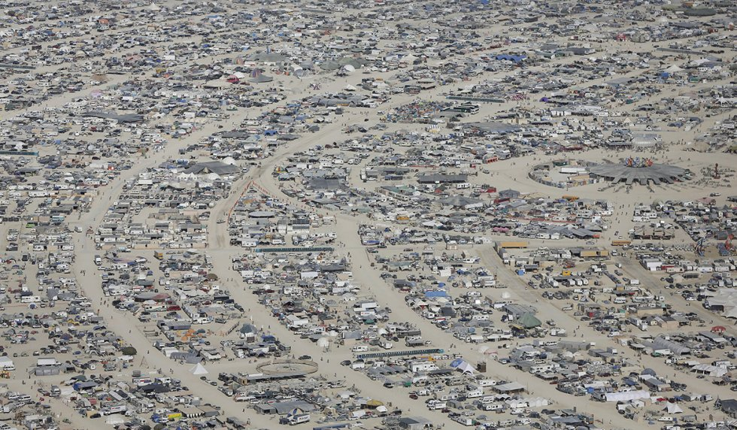
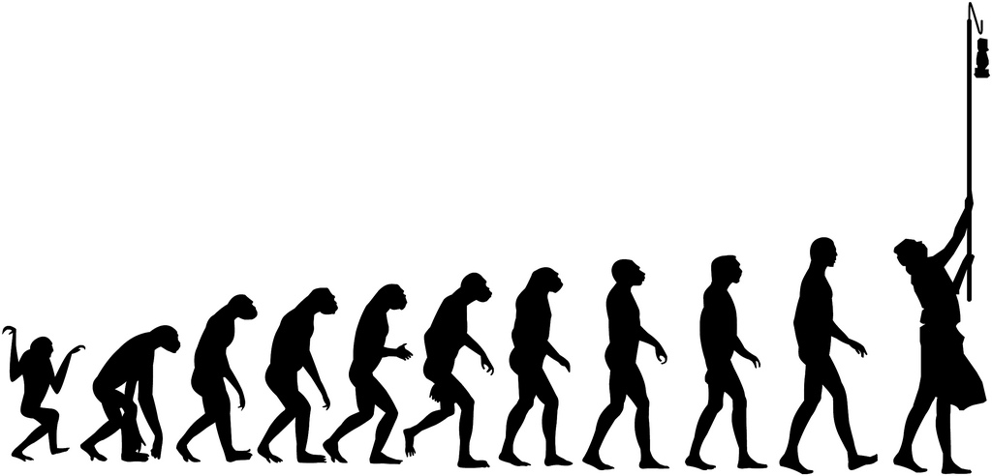
Notes:
Evolution. From outlaw / anarchist into a city and an organisation.
This “evolution” is subject to much internal debate

Slide 4
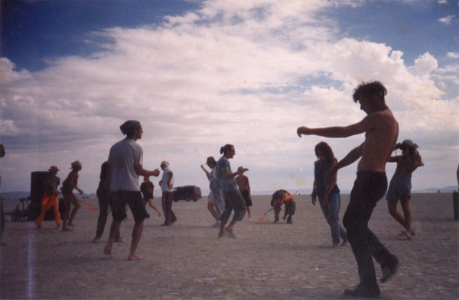
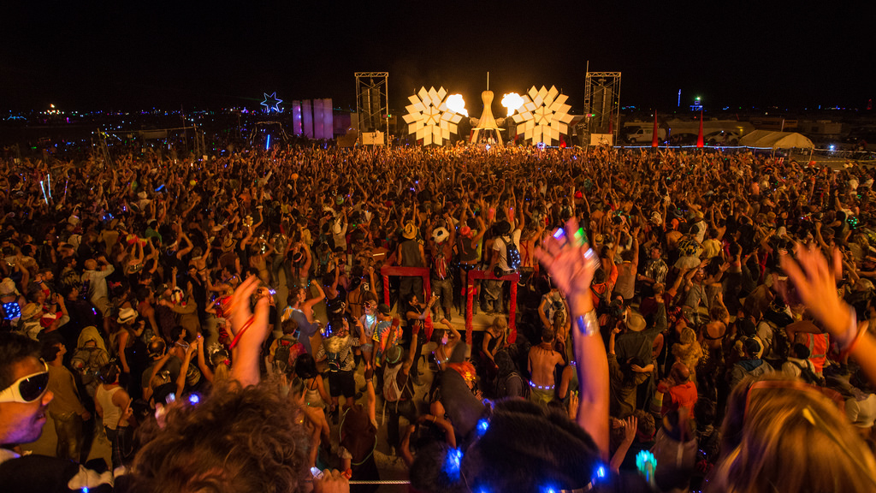
1994
2014

Slide 5
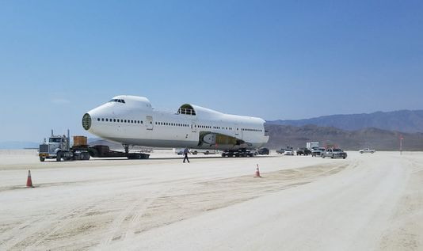

Slide 6
Notes:
What is the impact of more and more new participants desiring to see their favourite DJs performing before the sickest backdrop ever?

Slide 7
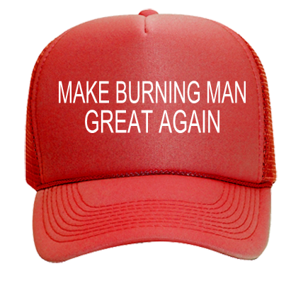
Notes:
Do rules, regulations, and organisational management ruin the immediacy and spontaneity integral to the early event?
Was Burning Man better last year?

Slide 8
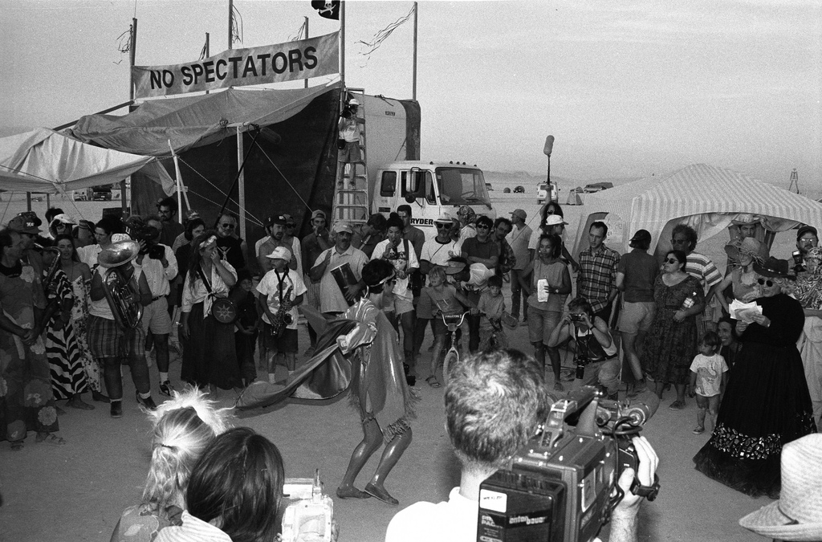
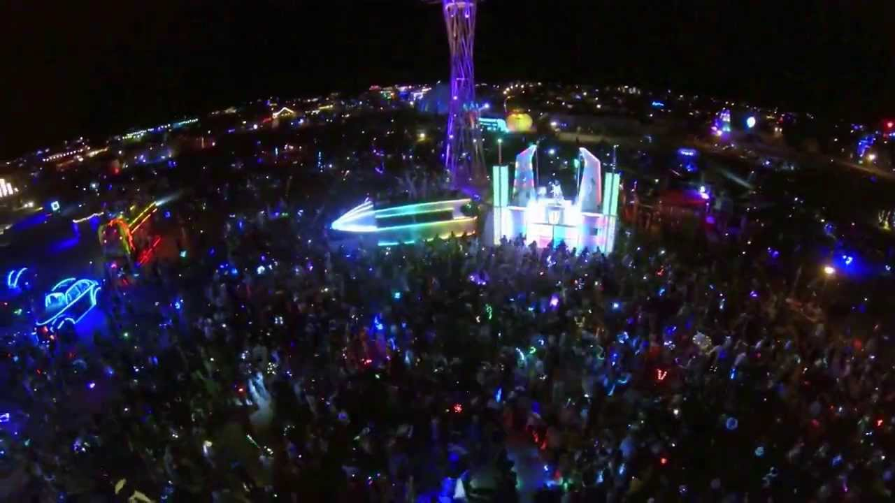
“No Spectators”
Dancetronauts, 2013
Burning Man 1993: David Thompson
Notes:
Wind back - The scourge of the spectator - Spectacle controversy

Slide 9
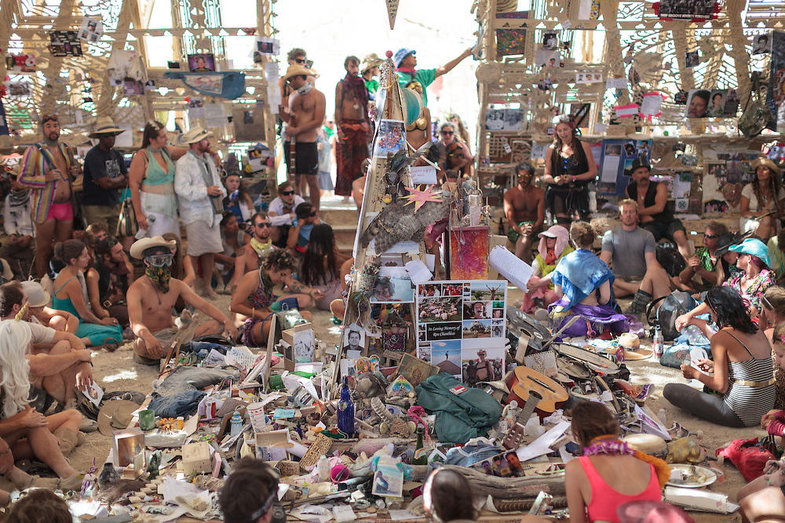
Notes:
Temple. Are they spectating or participating?

Slide 10
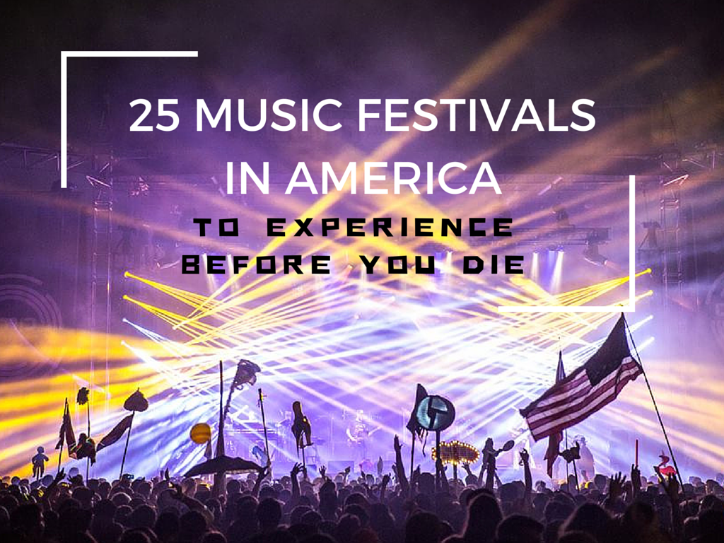
Notes:
“Jones Around the World”: BM came in at number five after Coachella, EDC, Bonaroo, and Ultra

Slide 11
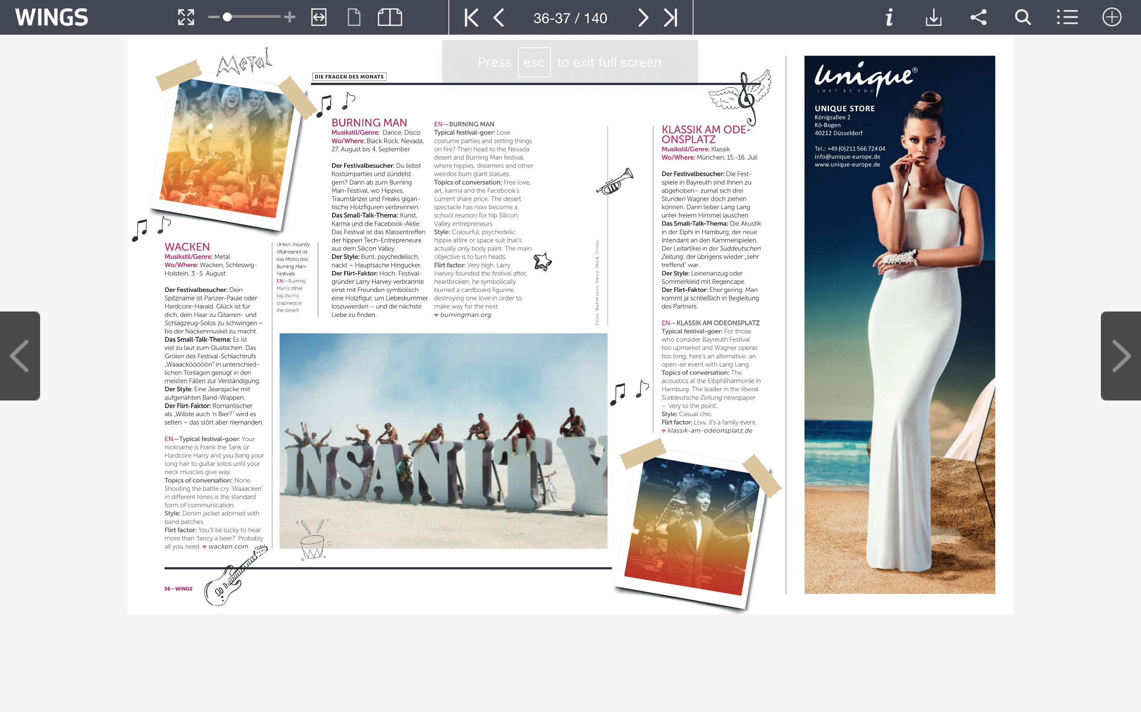
2017 Eurowings inflight magazine
“What festival should I go to this year?”
Notes:
As I have observed on several flights, Burning Man is regularly showcased inside in-flight magazines, like the May 2017 edition of Wings, on Eurowings flight from Cologne to Zurich. “What festival should I go to this year?” is the question. Adjacent promotions for Ultra Europe, an electro festival near Split, Croatia, or Wacken, the Metal festival in Schleswig-Holstein, in-flight customers are presented with the possibility of landing at a place “where hippies, dreamers and other weirdos burn giant statues.” A place where the “main objective” is to “turn heads” and where the “flirt factor” is “very high” (p. 36.) “Welches Festival passt zu mir?” pp 34-37. [When the event had already achieved maximum capacity for 5 years!] See http://edition.pagesuite-professional.co.uk/html5/reader/production/default.aspx?pubname=&edid=2ebb6938-dec1-4ad1-8151-41c67eb45112

Slide 12
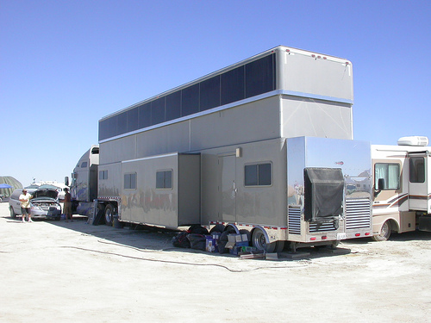
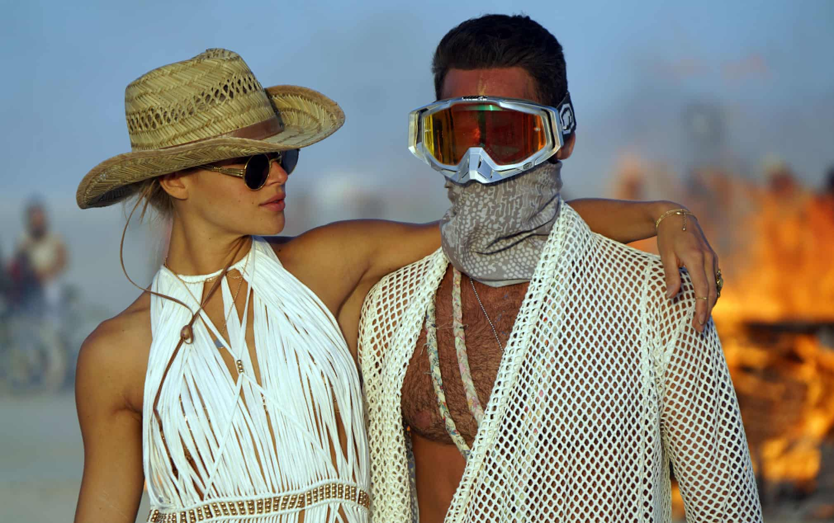
Tourists
Tourists – the standard myth is that tourists are ravenous consumers of the spectacle, gawkers, drainbows, unprincipled actors, holding parity with the flâneur.
Exclusivity - Did Burning Man become a carnival for elites, a playground for the wealthy, luxury hedonism on demand?
Notes:
So who are tourists?
Tourists – if we follow the mythology, tourists are consumers of the spectacle, gawkers, drainbows, unprincipled actors,
holding parity with the flâneur.
Many have grown distraught that BM and regionals have become carnival for elites, a playground for the wealthy, luxury hedonism on demand.
clients of service professionals in the experience industry.
Growing evidence of extravagance, excesses and exclusivity

Slide 13
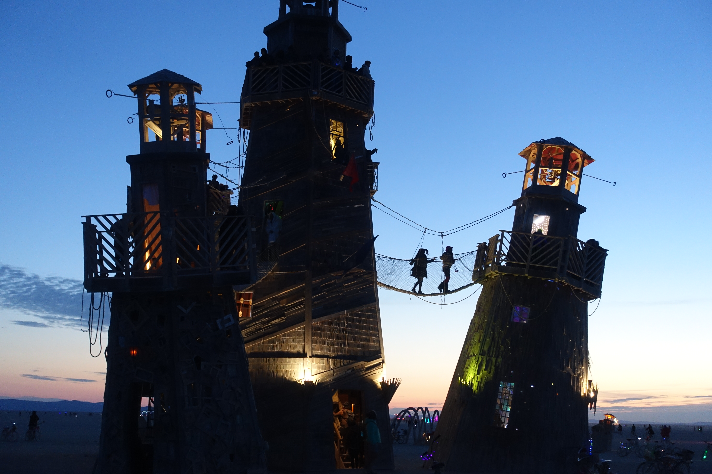
Artists
The tourist is imagined as the absolute other to the artist, the pilgrim, the maker, participant, the volunteer, the Burner.
Notes:
The individual who is afflicted with gratitude.

Slide 14
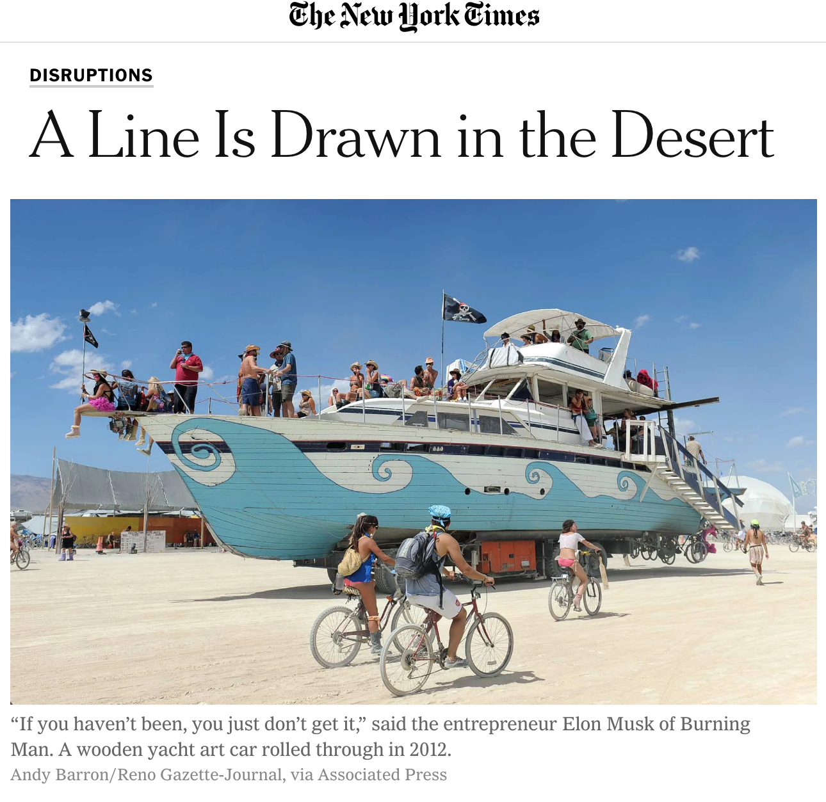
Plug n Play
NYT 2014 reports on RV enclaves, with $25K per head services, including private jets, luxury trailers and “sherpas
“Burnerprenuers”: service professionals in the experience industry, and the outsourcing of principles.
Notes:
The situation was heating up by 2014, with some high profile exposes.
Was BM crumbling under the weight of its own contradictions?
Plug n Play : adventure tourism style theme camps
Caveat wrote in the BMJ in his “A Brief History of Who Ruined Burning Man” that the concern over Plug n Play camps from 2014 was just the latest in a long serious of incursions ruining Burning Man, the first of which might have been those strangers who appeared before an 8 foot effigy raised on Baker Beach in 1986.

Slide 15
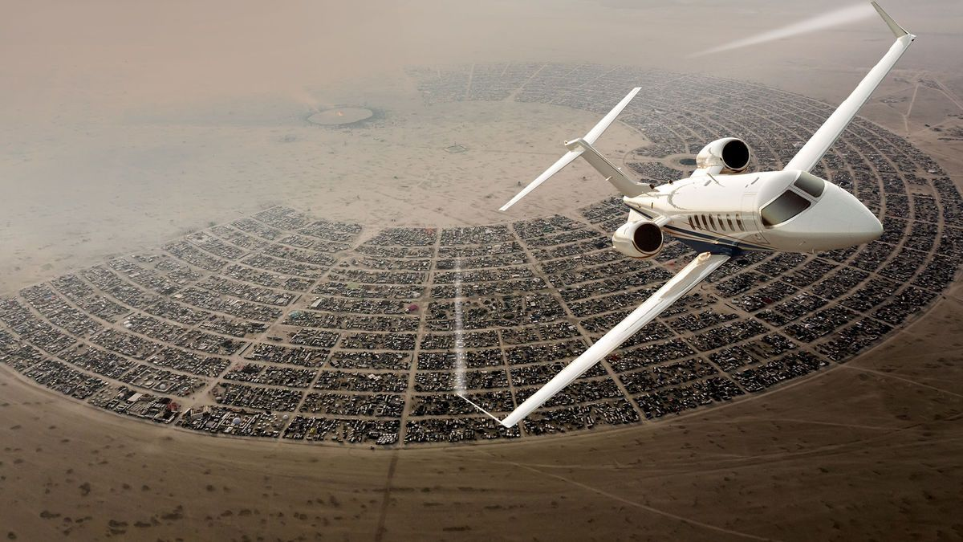
“Sherpagate”: Social Drama (Victor Turner)
Social Drama a process of conflict resolution, with 4 phases:
Breach. Conflict begins with a breach of rules, norms or principles. [NYT exposes of luxury concierge services ]
Crisis. The situation escalates into a controversy involving the wider community [camp placement “scandal” → “sherpagate”]
Redress. The building crisis triggers redressive mechanisms, “ranging from informal arbitration to elaborate rituals, that result either in healing the breach or public recognition of its irremediable character” (Turner 1985: 74). Turner explored the reflexive value of cultural performances. [art themes and art projects interrogate values and acculturate]
Resolution. Either in the form of reintegration (a return to pre-breach values) or schism (e.g. splinter or breakoff groups).
From the cover of Bloomberg Businessweek, "The Billionaires at Burning Man," 5 Feb 2015.

Slide 16
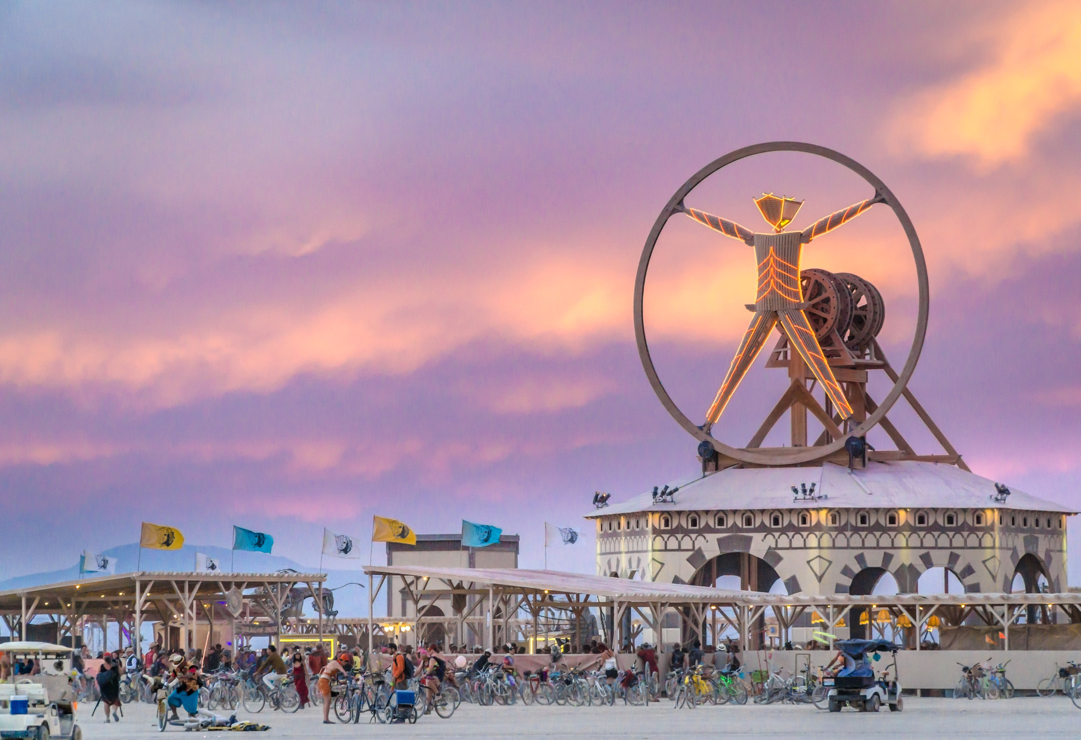
Da Vinci’s Workshop
2016. Da Vinci’s Workshop. Art theme partly responsive to the “Plug N Play” controversy.
Meditation on the role of entrepreneurs / philanthropy at Burning Man. (interrogating Decommodification).
Drew parallels with Italian renaissance arts patronage in an elaborate attempt to Illustrate how the Burning Man Project funds artists through its grant / honorarium programs.
Notes:
Da Vinci’s Workshop – 2016 Art theme. Featured a Vitruvian Man with a piazza
The theme was partly responsive to the Plug N Play controversy and interrogated Decommodification and the role of entrepreneurs / philanthropy.
Drew on renaissance arts patronage and guild systems in an elaborate attempt to Illustrate how Burning Man operates to fund art through its grant / honorarium programs.
Reflexively reaffirm the value of beleaguered principles.

Slide 17
The Bleachers
Notes:
Ultimately art is redressive mechanism. Use examples .
The Bleachers, an art car built in Vancouver. Its principle creators behave like sportscasters radio DJ passing commentary on BRC.
Eric Holt: "making people think a little bit about the paradox of Spectating and Creating, and the interplay between the two.”

Slide 18
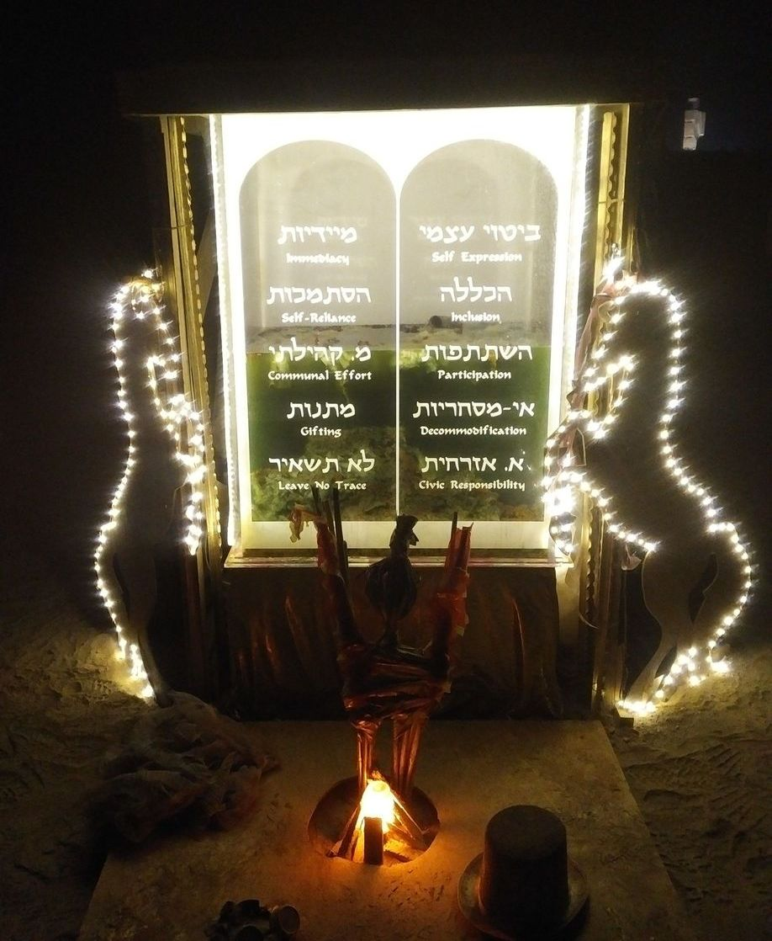
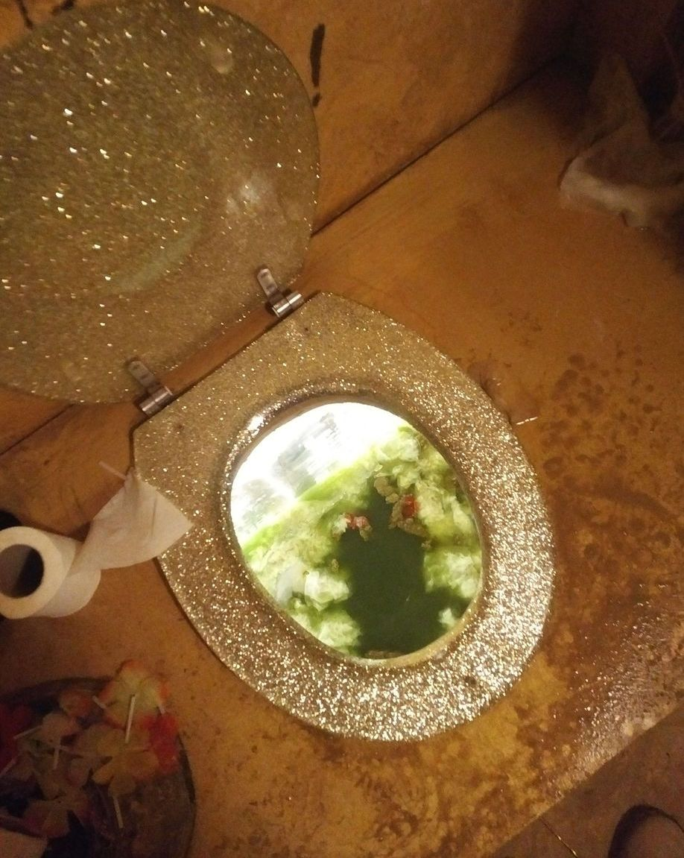
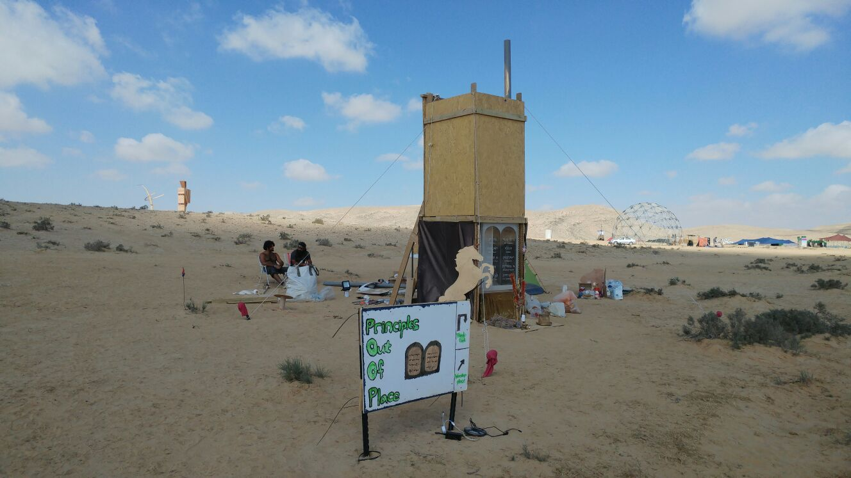
Principles Out Of Place (POOP) @ Midburn 2018
Abject interactive art.
The POOP project defiles the principles (framed as Ten Commandments) while at the same time upholding them.
Notes:
POOP Principles out of Place (POOP).
In deep playa Midburn 2018. Abject interactive art.
The POOP project defiles the principles (framed as Ten Commandments) while at the same time upholding them.
A unique art project: an absurd combination of a dark altar and a public toilet.
lower and an upper compartments. The upper part is a toilet accessible by ladder. In the lower part, the human waste is collected and put on display in a large plexiglass container, onto which the names of the Ten Principles are printed, with a layout resembling the two Tables of the Law. The project features a soundtrack: Leonard Cohen’s farewell song You Want It Darker (a track with Biblical references) is played softly on repeat (thanks to B Vitos)

Slide 19
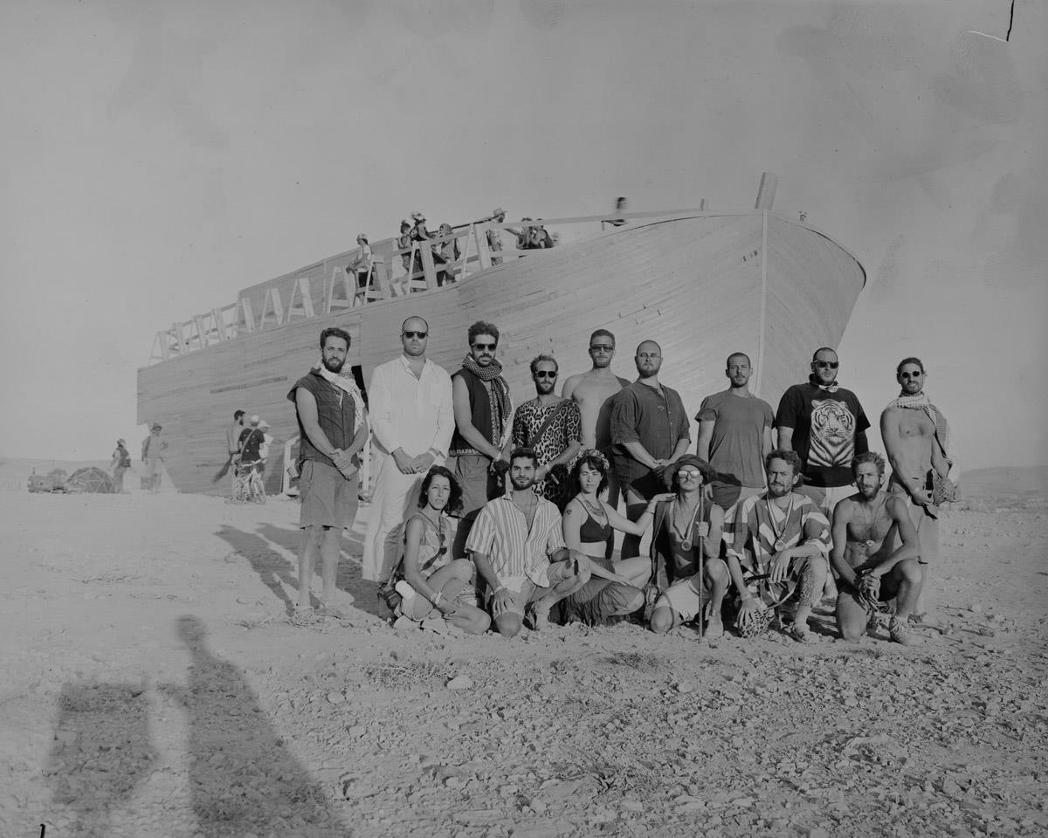
“No-One’s Ark” (Midburn 2016)
Lead engineer Alon Halamit.
First Midburn (in 2015) “opened my eyes to a different world, a different way of thinking”. Says he was truly “enlightened”
Alon was compelled to give back to the community, to “ignite” others. “Let your internal fire Burn. Believe in yourself. Dream. Believe you can fulfill your dreams."
Notes:
No-One’s Ark (Midburn 2016)
Lead engineer Alon Halamit. Civil engineer
Alon’s first Midburn was 2015. He had never been to BM or any festival – “I came to consume, I didn't come with anything. I didn't even have a tent, I came with half bottle of rum.”
Alon was compelled to give something back to the community, to “ignite” others. “Let your internal fire Burn. Believe in yourself. Dream. Believe you can fulfill your dreams.”

Slide 20
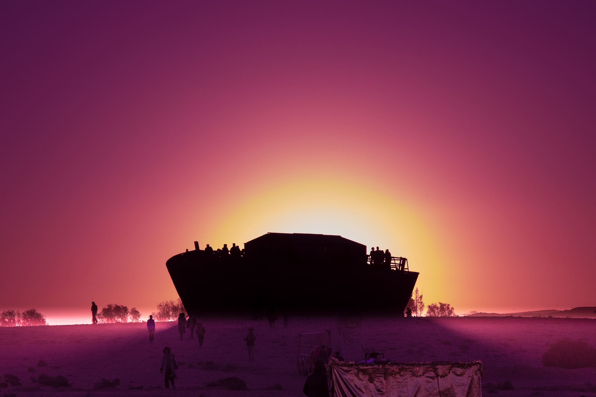
An exemplary gift is “property that perishes” (Lewis Hyde’s The Gift: Imagination and the Erotic Life of Property). A true gift is that which is consumed in practices that ensure that its spirit remains in circulation.
The project celebrated & subverted Jewish heritage (possessed by no-one, it belonged to everyone).
Photo: Samuel

Slide 21
Notes:
Conclude
Burning Man is a culture where collaborative and interactive art converts outsiders into insiders.
Where the distinction between “spectators” and “artists” / “consumers” and “makers” becomes fuzzy.
As these examples illustrate, at Burning Man, collaborative and interactive art reaffirms the cultural worth of its beleaguered principles.
We return to the paradox mentioned in the opening remarks. The principles are paradoxical.
“Philosophy occurs when principles collide, and we should allow these Principles to interpret and interrogate one another.” (LH)
The garden of ideas Larry was tending was one of paradox. And when you consider that these ideas have flourished in an absolute desert you are closer to recognising the paradox that is fundamental to the entire enterprise. (abundance in a void)

