Slide 1
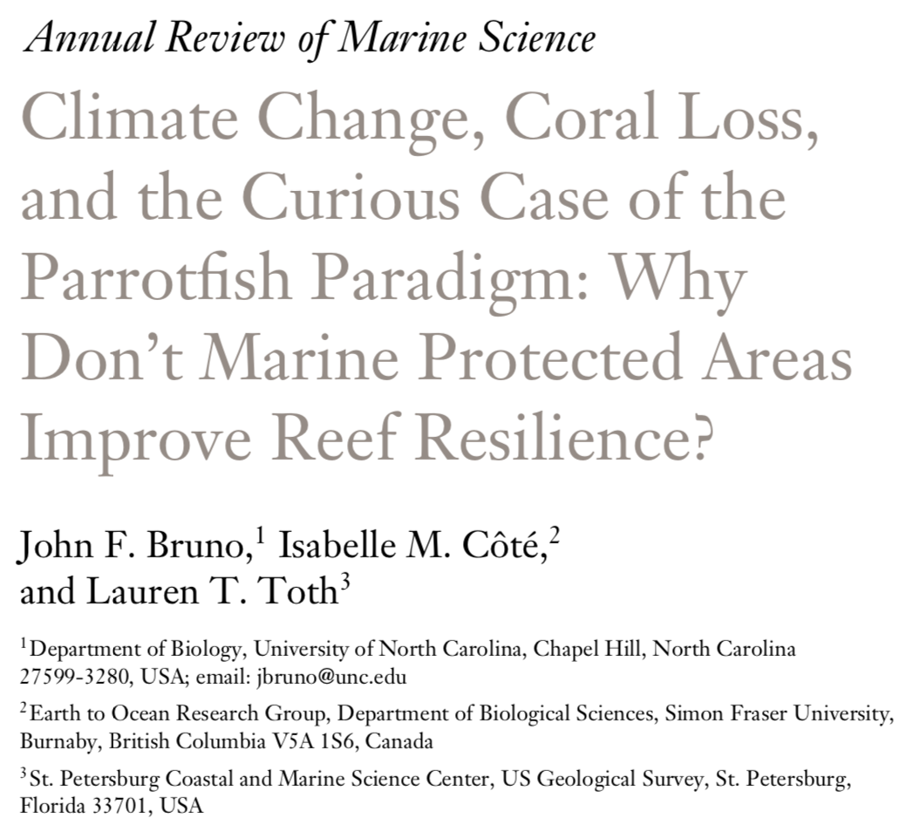

Slide 2
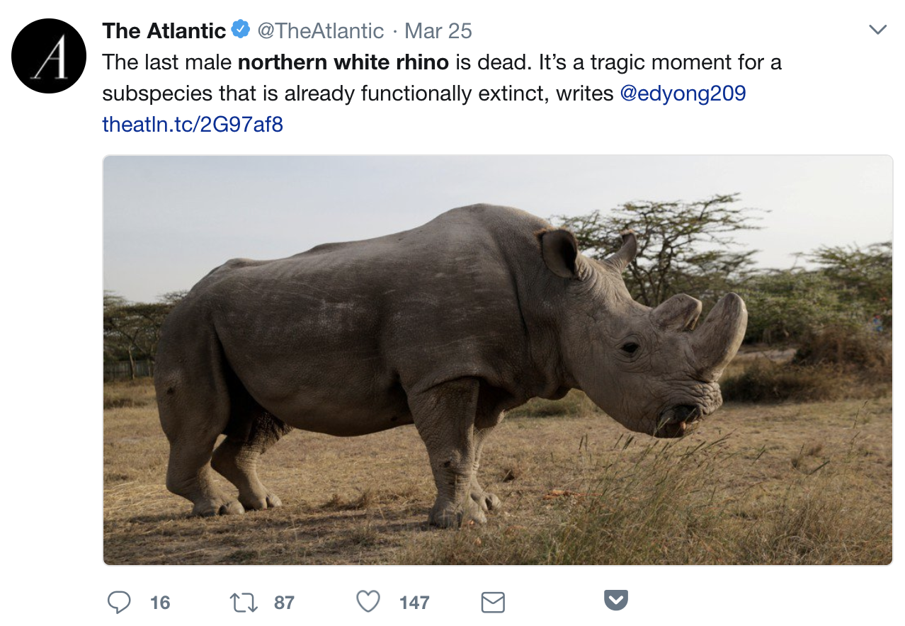

Slide 3
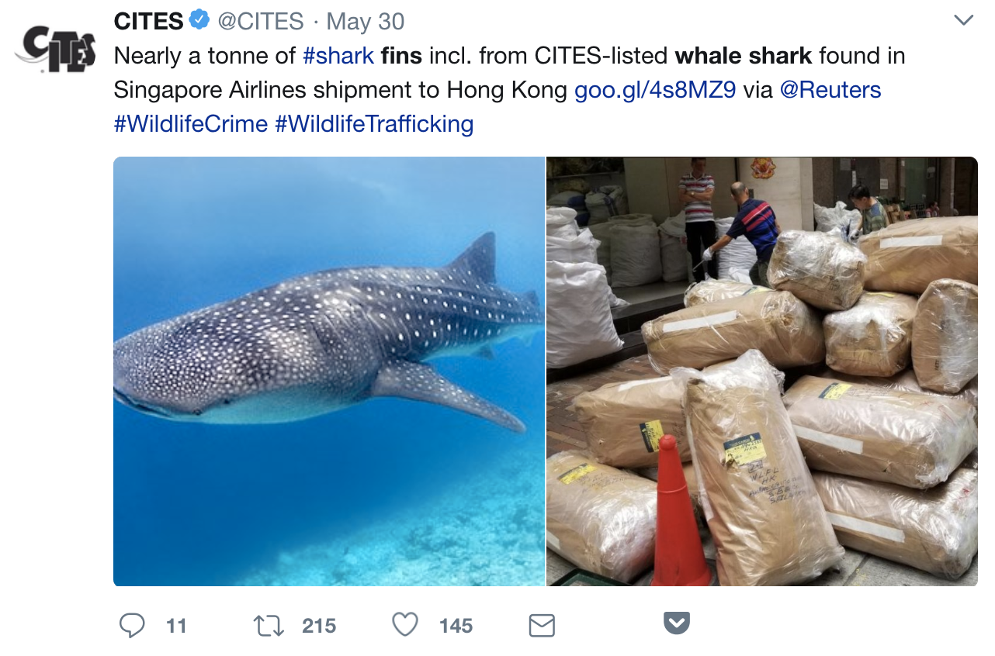
Notes:
We are really screwing things up

Slide 4
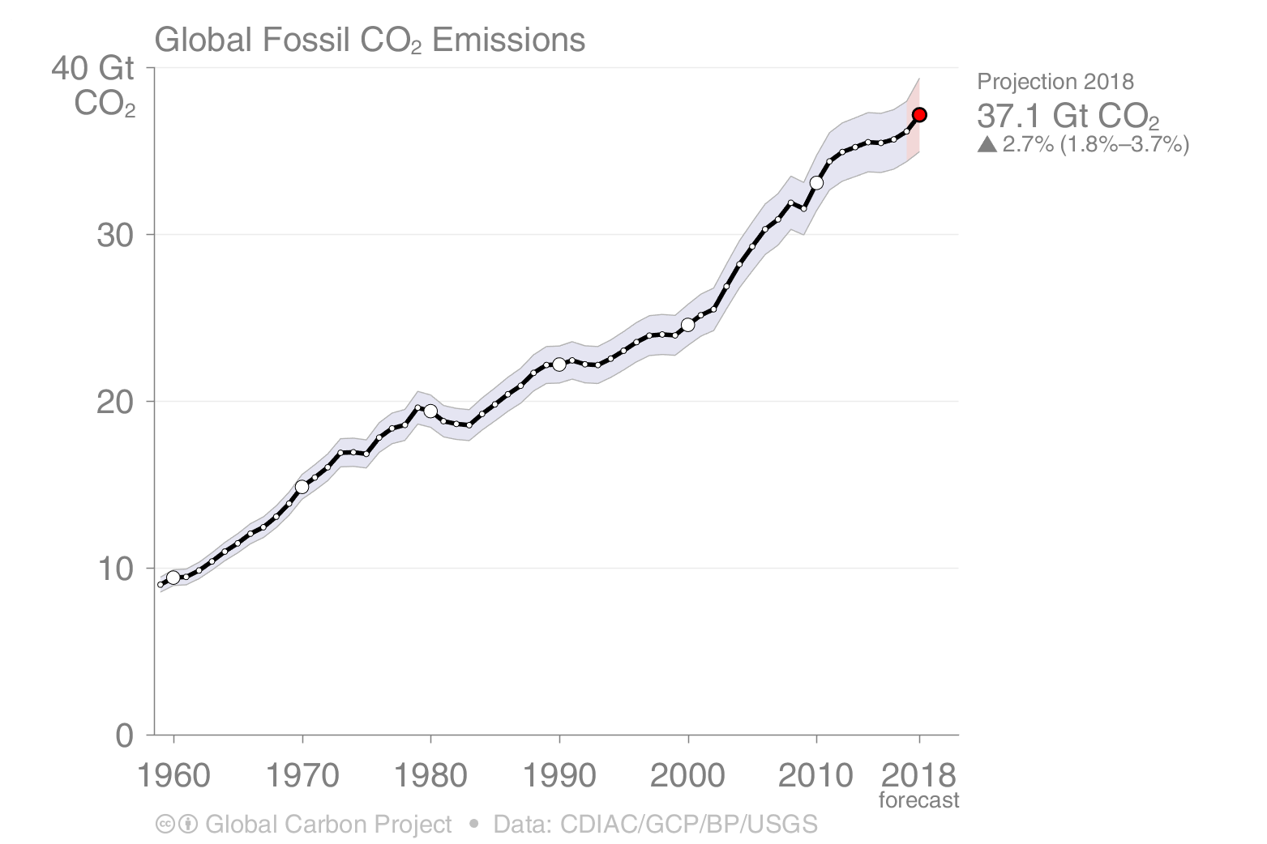
The rate of global CO₂ emissions increased in 2018
Estimates for 2015, 2016 and 2017 are preliminary ; 2018 is a projection based on partial data.
Source: CDIAC; Le Quéré et al 2018; Global Carbon Budget 2018

Slide 5
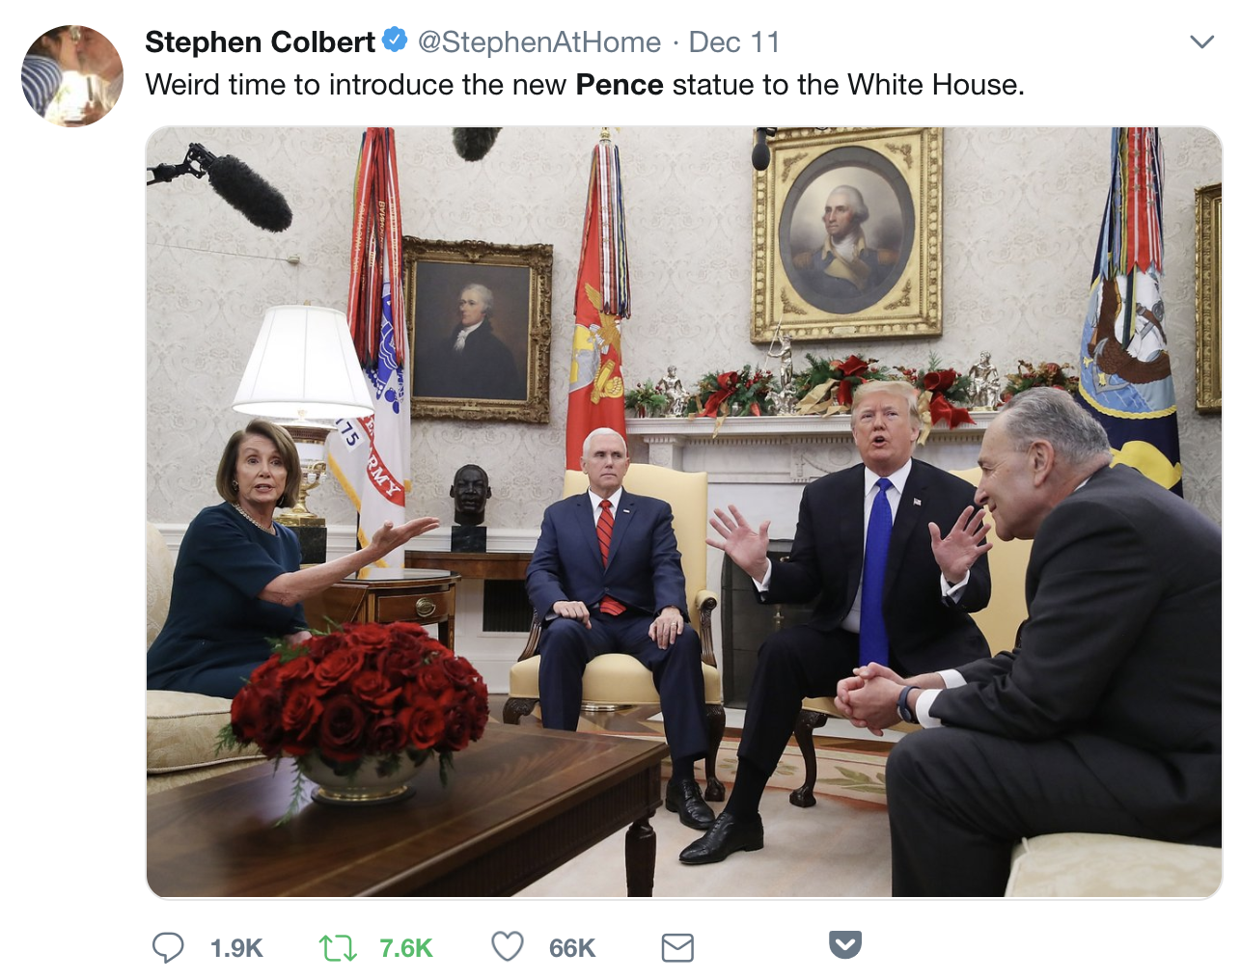

Slide 6
What can I / we do?
1) Identify mechanisms, causes of change
2) Quantify population, community, ecosystem change
3) Develop solutions
4) Test policy efficacy: what works?
5) Outreach and advocacy
Notes:
How can ecologists be useful?

Slide 7
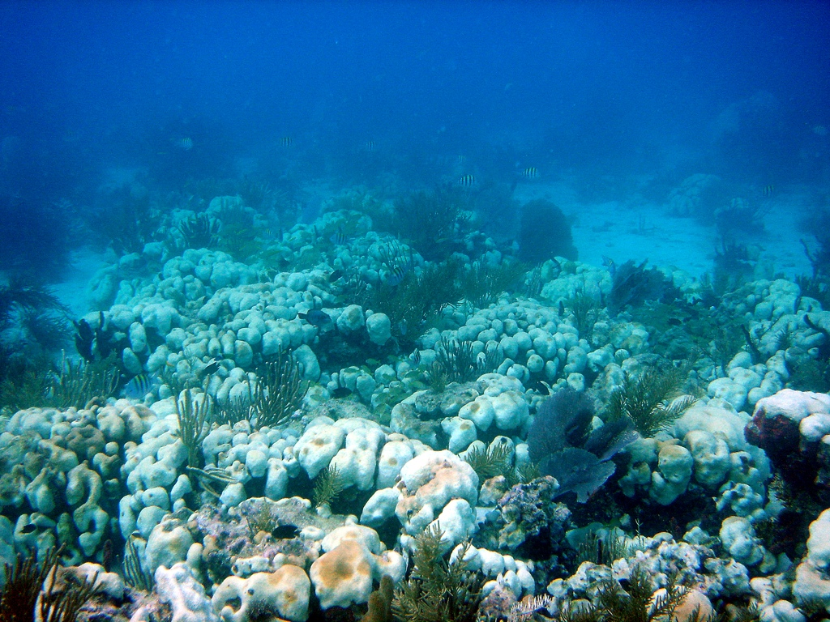
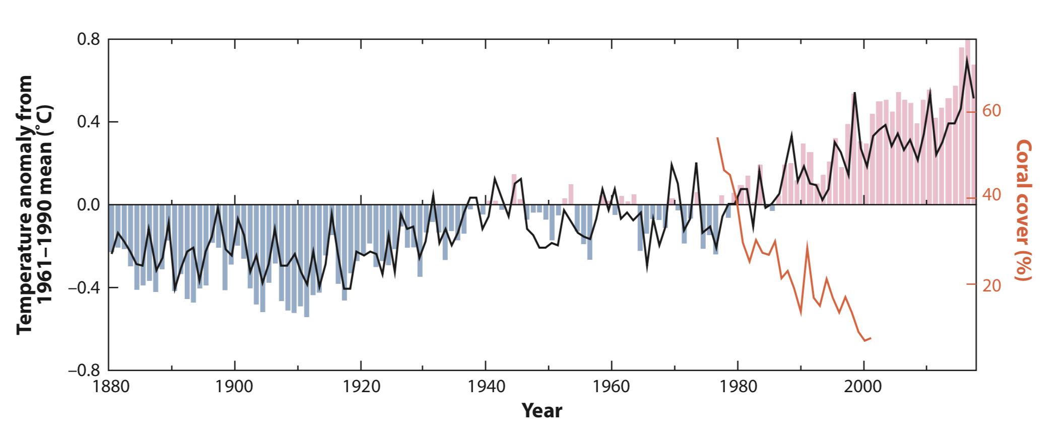
Lough et al 2018
Gardner et al 2003

Slide 8
Coral reefs are being devastated by ocean warming and we all want solutions: but what's really effective?

Slide 9
"local protection can make reefs resilient to the impacts of global change"
"when the ecosystem structure is intact, the corals appear to bounce back better from previous warm water events that have killed coral."

Slide 10
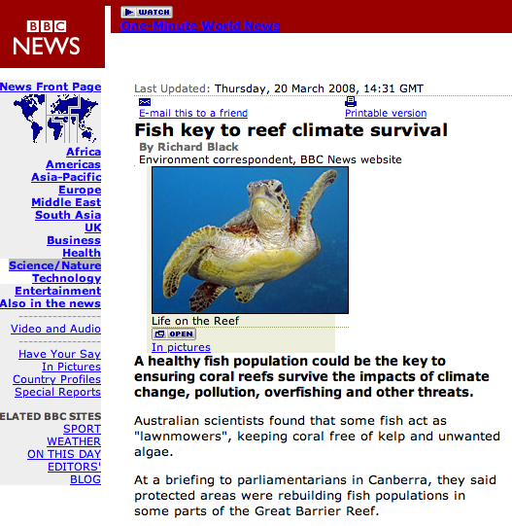

Slide 11
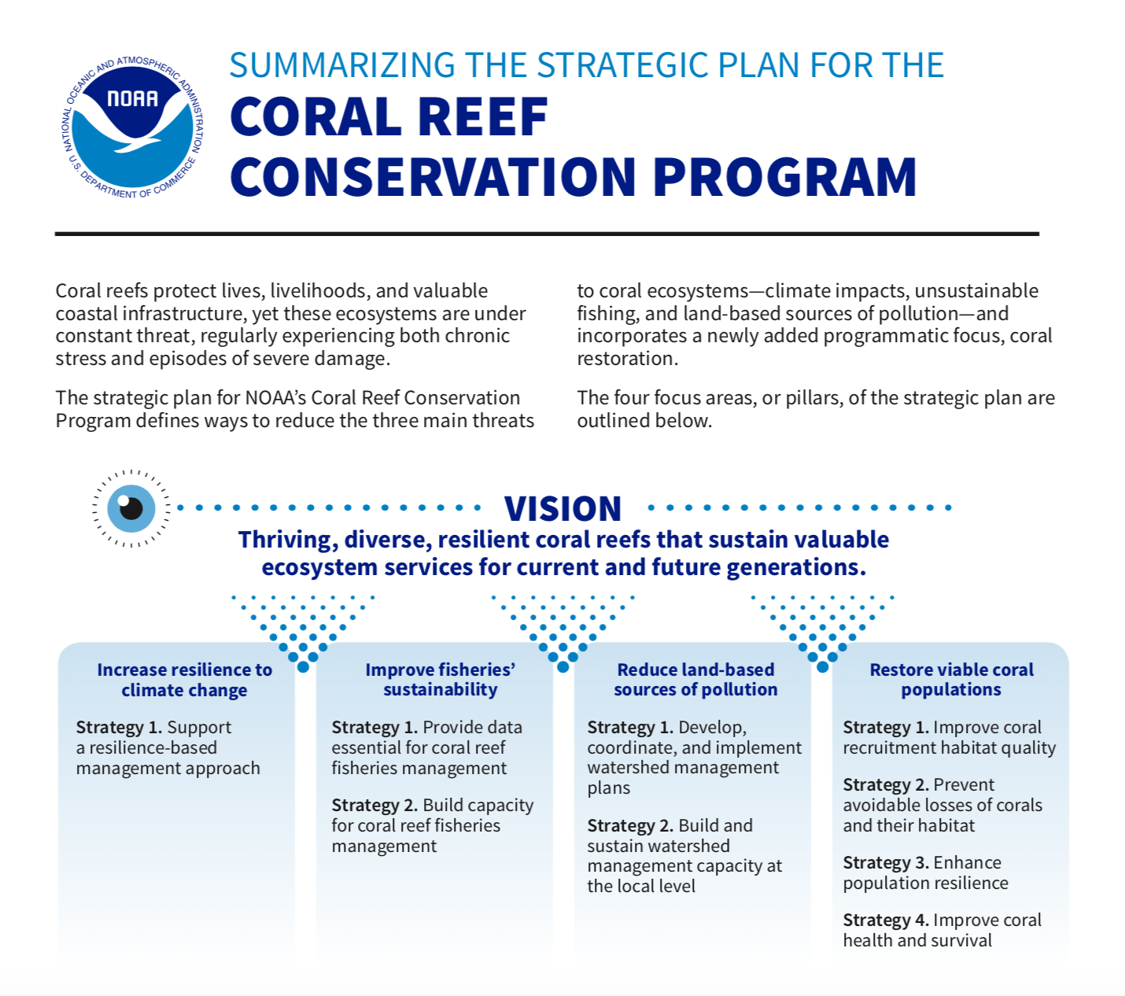
Managed resilience: assumes local stressors are an important cause of reef degradation and that they interact additively or synergistically with global warming

Slide 12
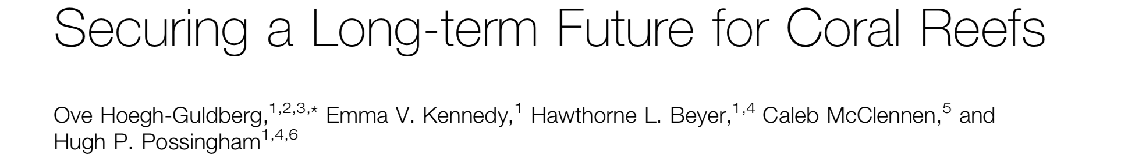
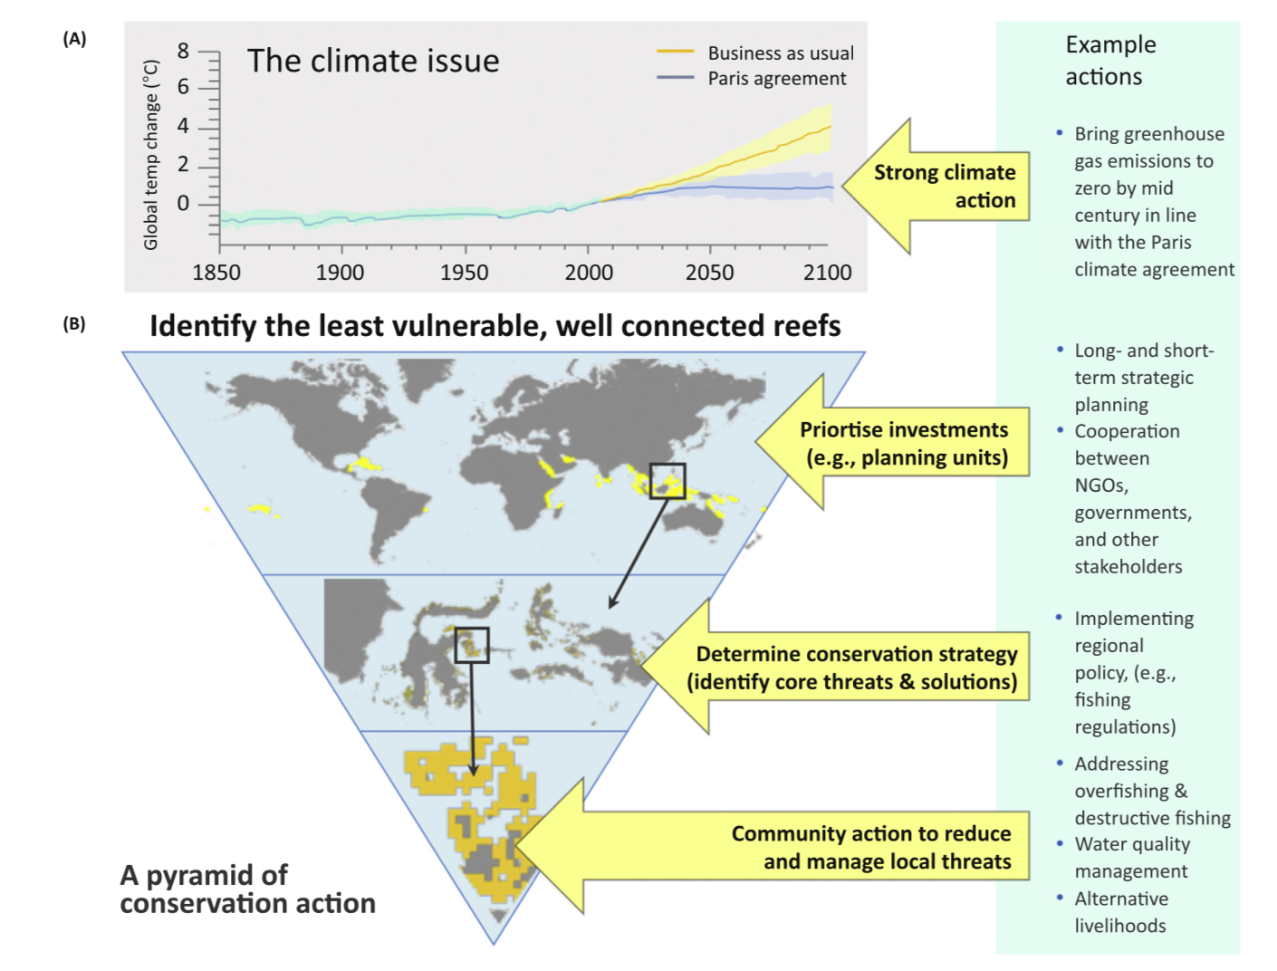

Slide 13
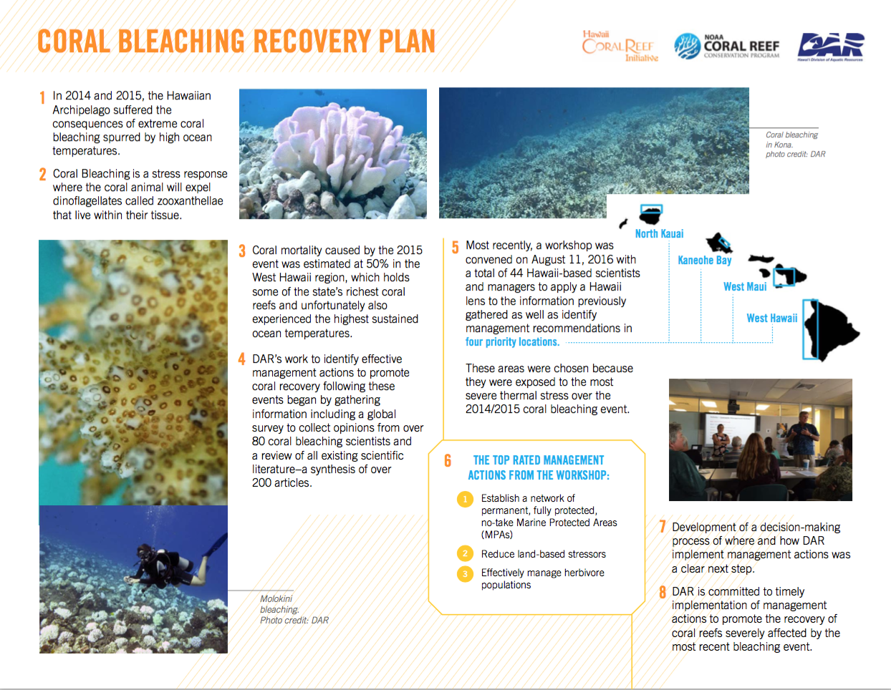

Slide 15
75% of coral-bleaching experts believe parrotfish protection is somewhat or very effective in promoting coral reef recovery and resilience. 94% believe MPAs are effective in achieving these goals. (Rosinski & Walsh 2016)

Slide 16
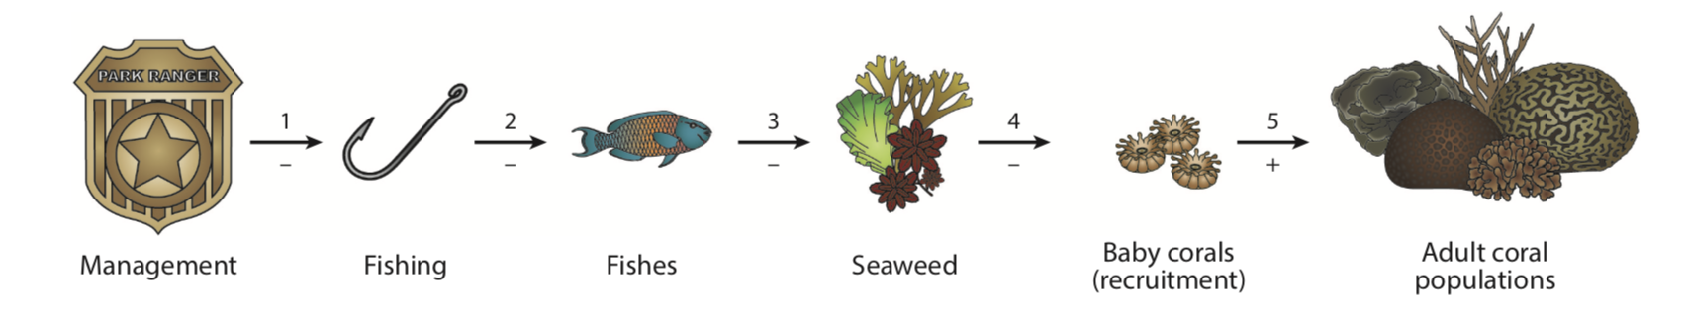

Slide 17
Do marine protected areas increase the resilience of coral communities to global stressors?

Slide 18
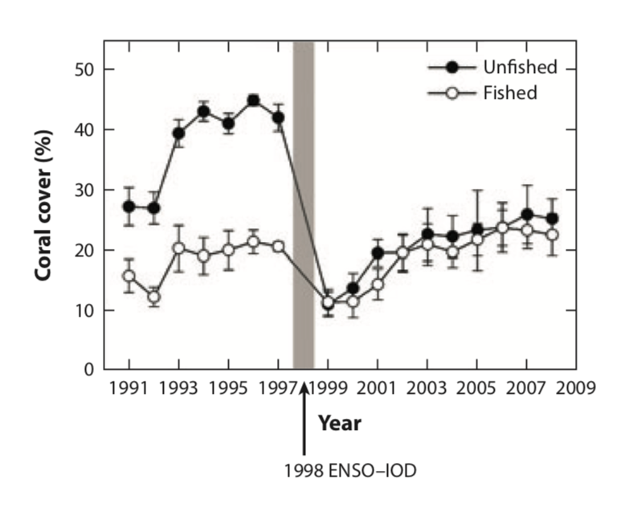
Darling et al. 2010 Cons Letters

Slide 19
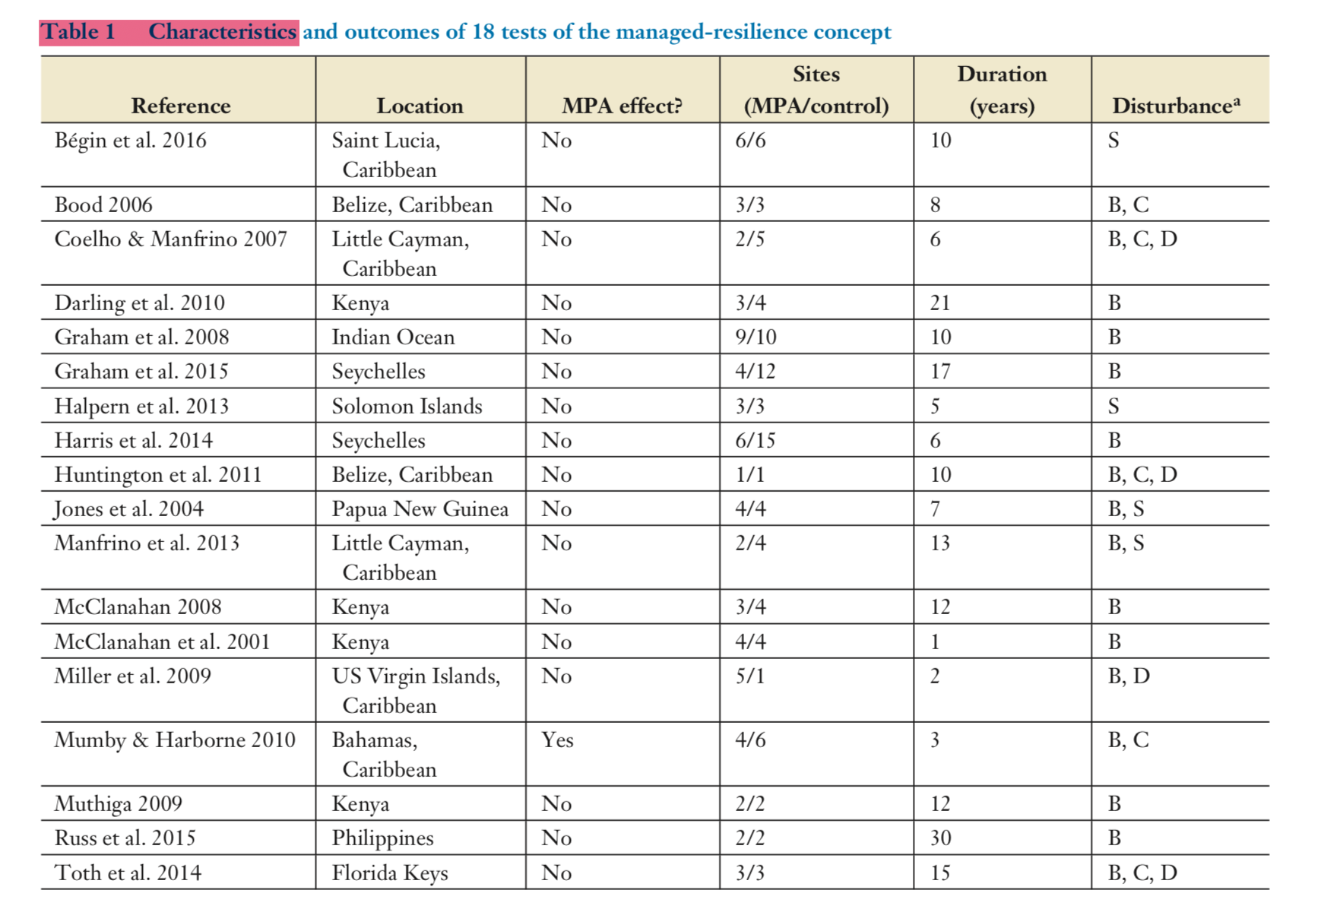
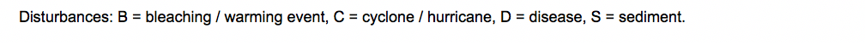
Marine protected areas do not increase the resilience of coral communities to global stressors
18 studies, 15 countries, 66 MPAs, 89 control sites
Bruno, Côté, and Toth in press ARMS
Notes:
Characteristics and outcomes of 18 tests of the managed resilience concept. We considered only direct empirical field tests that measured change in absolute coral cover within at least one protected area (MPAs and “fully-protected” or “no-take” marine reserves) and one control area. We searched for articles using the search terms "coral reef + resilience OR recovery OR resistance" via Web of Science. The tests measured resistance (as change in coral cover before versus immediately after a disturbance) and / or recovery (as rate of coral cover change over time after a disturbance) to disturbances potentially caused by or exacerbated by human activities. The MPAs come from 15 countries (and two regions of the United States: the Florida Keys and the United States Virgin Islands) and a wide range of reef types and biogeographic realms. The average study duration was 10 years and one study is an unpublished MS thesis (Bood, 2006).
We found 18 studies (not including prior synthetic studies and meta-analyses) that measured the effect of 66 MPAs (and 89 unprotected control sites) on coral resistance to and/or recovery from large-scale disturbance (Table 1). Study outcomes have been remarkably consistent: no significant effect of protection on total coral cover loss (11 out of 11 studies, Table 1) or on the rate of post-disturbance coral cover gain (15 out of 16).
18 studies, 66 MPAs, 89 control sites

Slide 20
Marine protected areas do not increase the resilience of coral communities to global stressors
Increase of 0.5% per year
coral cover = 8.5%

Slide 21
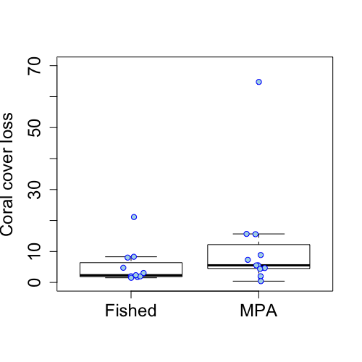
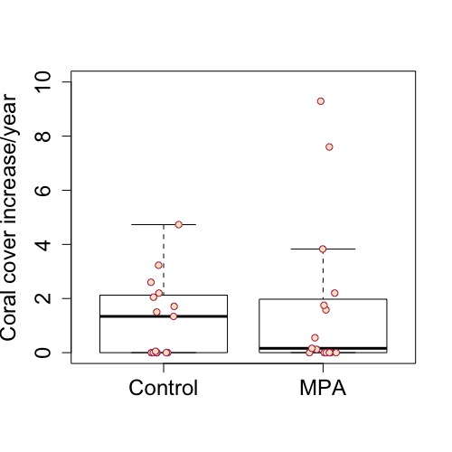
Marine protected areas do not increase the resilience of coral communities to global stressors
Impact / Resistance
Recovery
11 studies, p=0.08
15 studies, p=0.43
Bruno, Côté, and Toth in press ARMS

Slide 22
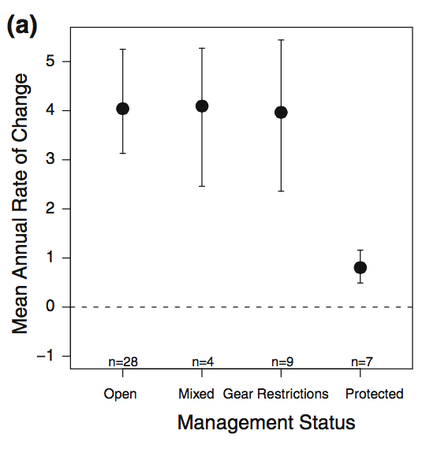
Recovery from disturbance was slower in marine reserves
48 sites, 7 MPAs
Graham et al. 2011 Coral Reefs

Slide 23
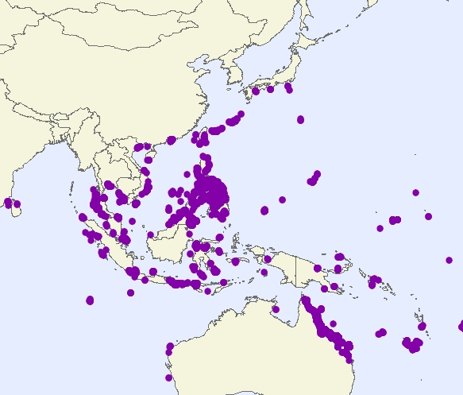
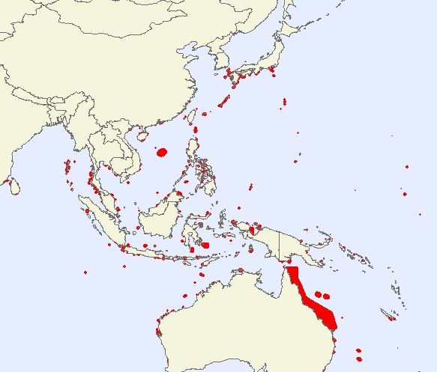
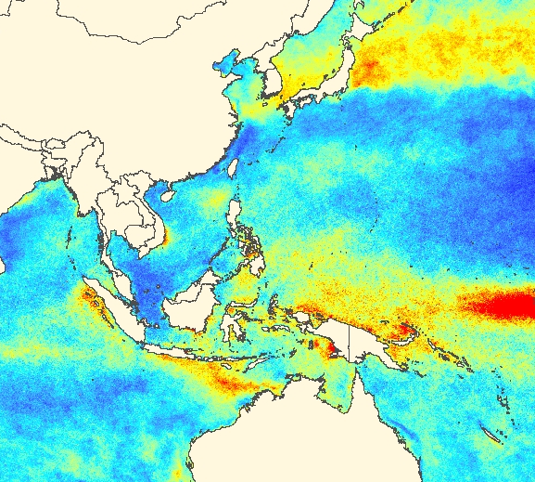
Do MPAs increase resilience to climate change?
+
+
Coral cover surveys
MPAs
TSAs = number of
temperature
anomalies
4456 sites, 310 MPAs
Selig et al. 2012 GCB

Slide 24
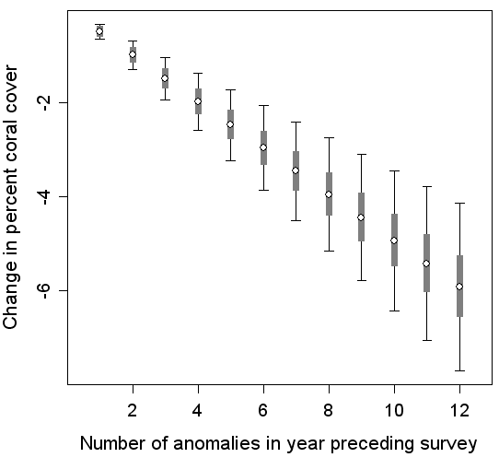
Relationship between thermal stress and coral loss
Coral cover loss (annual %)
Thermal stress (# weekly anomalies)
*loss at initial cover of 50%
Selig et al. 2012 GCB

Slide 25
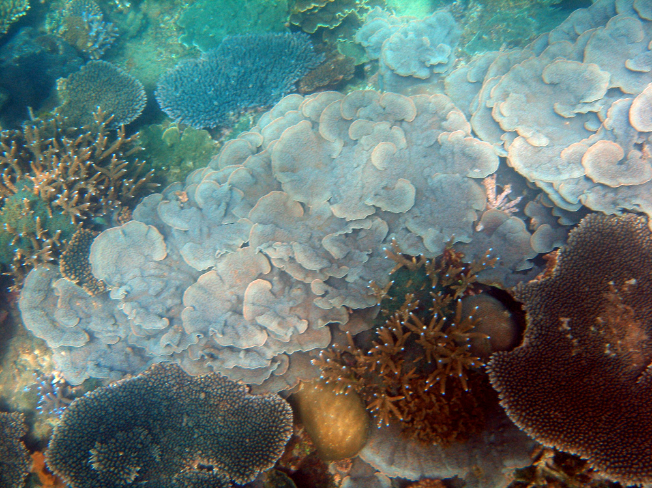
Dr. Andy Bruckner

Slide 26
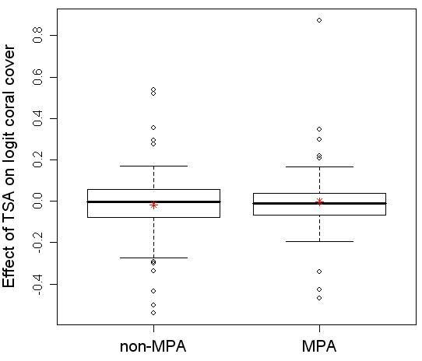
Protection did not moderate the effect of temperature anomalies on coral loss
Non-reserve
Reserve
Selig et al. 2012 GCB

Slide 27
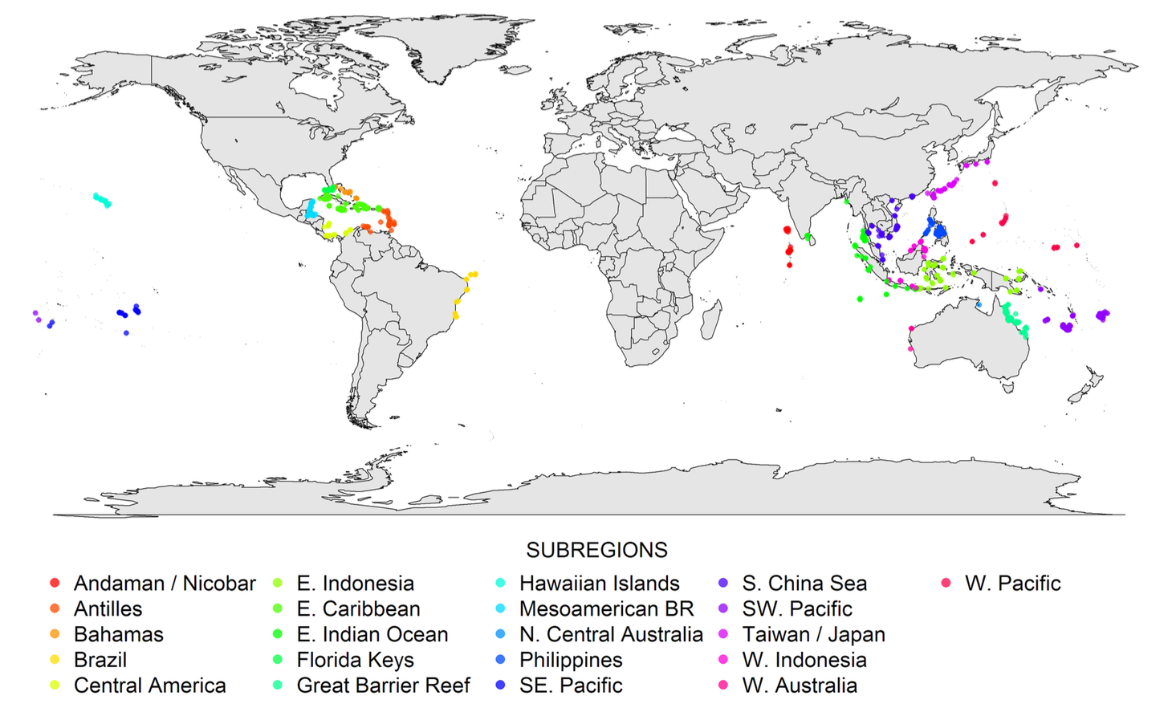
Is reef degradation related to human population density?
(and the magnitude of local stressors?)
Bruno and Valdivia 2016 Scientific Reports

Slide 28
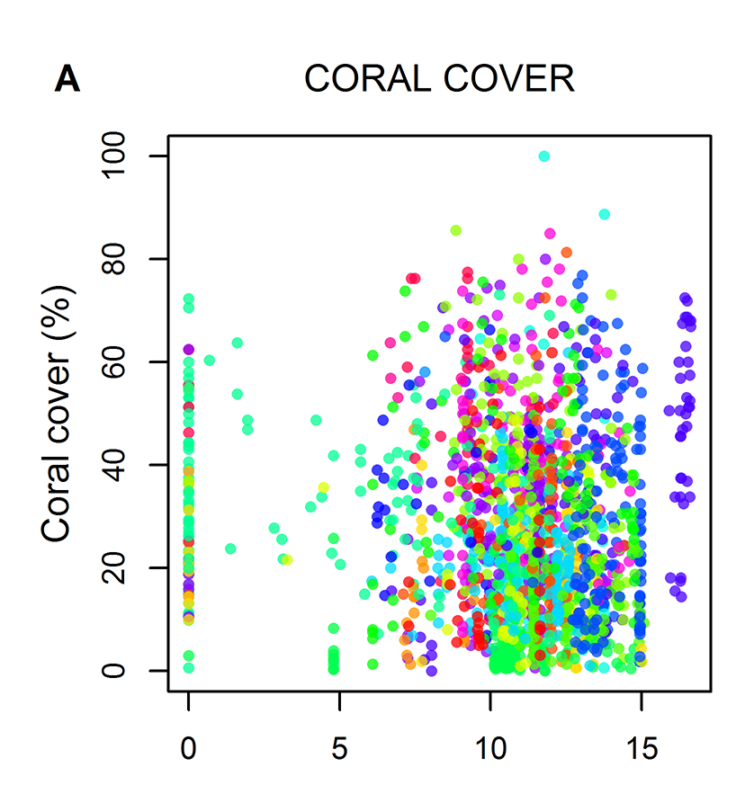
1) Some isolated reefs* do have exceptionally high coral cover
2) But so do many reefs adjacent to very densely-populated coastal communities
3) And just as many isolated reefs have very low coral cover
Log Human population density
*no human inhabitants within 50km
Notes:
Bruno and Valdivia in press (hopefully)

Slide 29
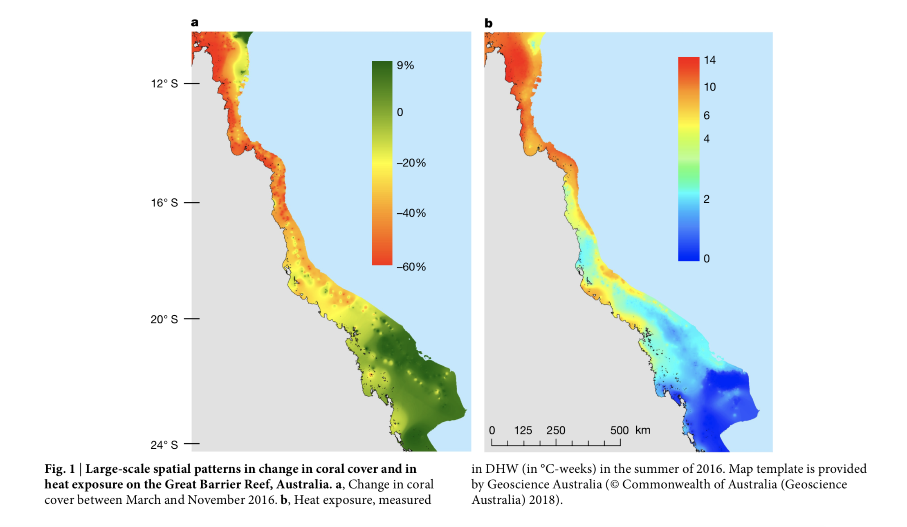
Warming (DHW)
Coral loss (% cover)
Hughes et al. 2016 Nature

Slide 30
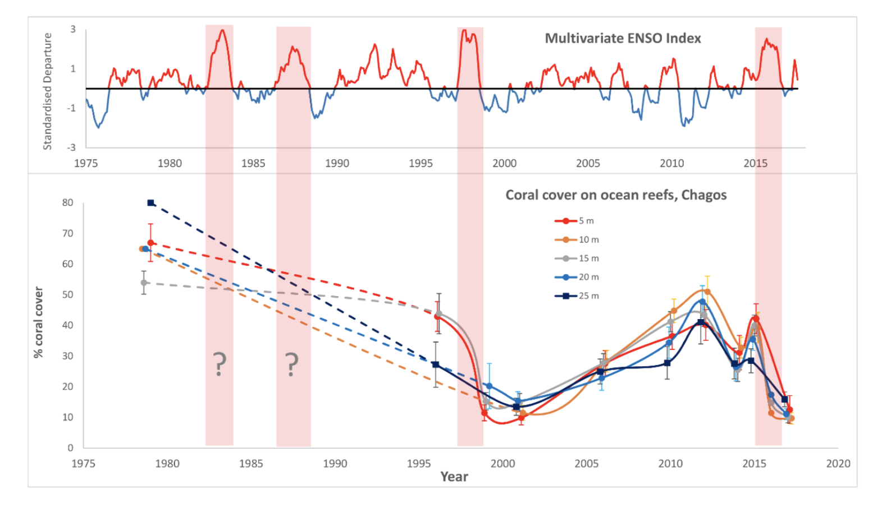
Chagos Archipelago
Sheppard et al. 2017

Slide 31
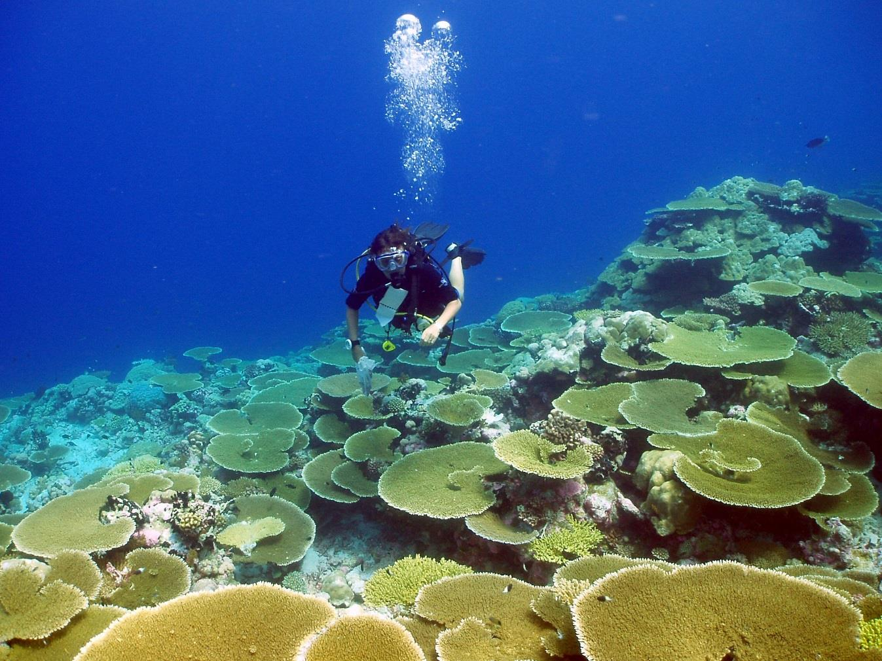
Sheppard et al. 2017

Slide 32
Sheppard et al. 2017

Slide 33
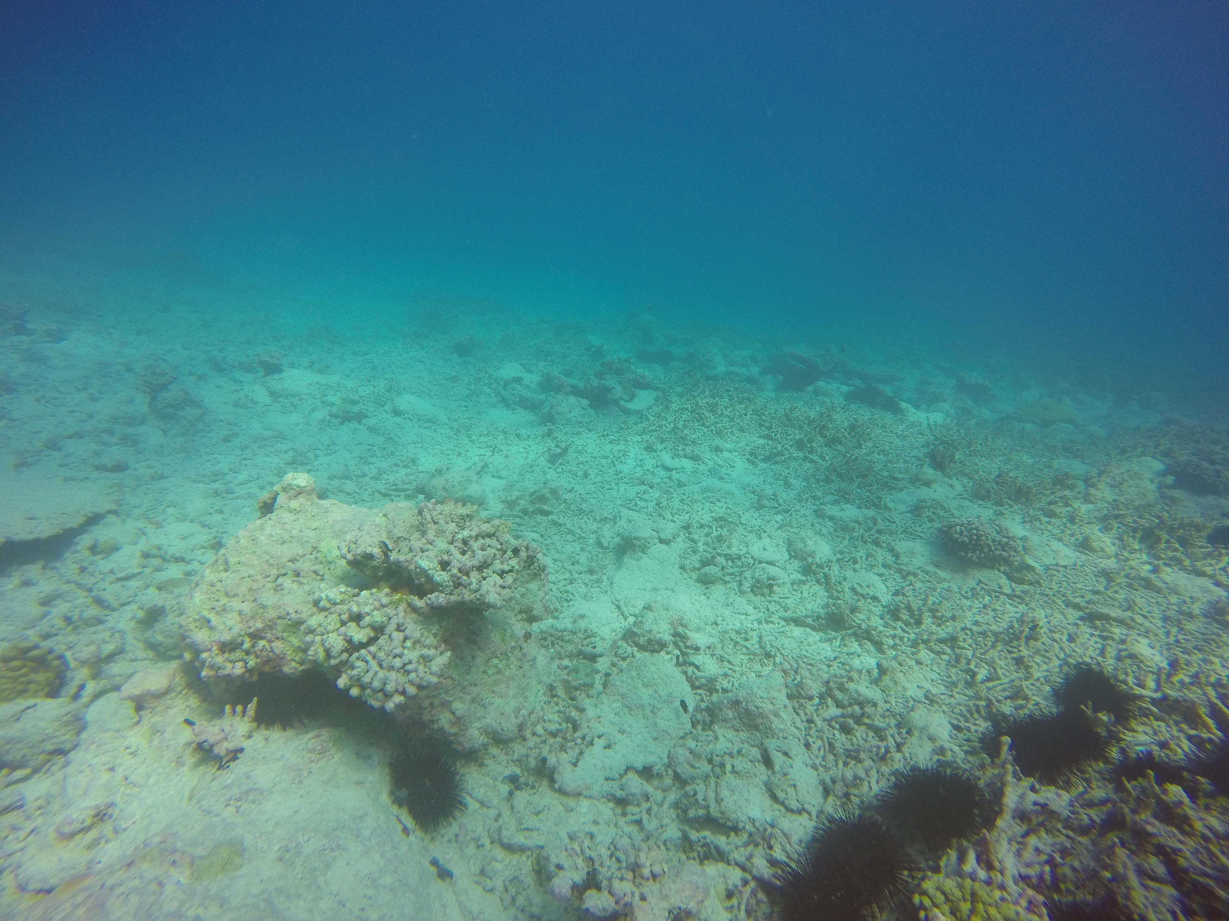
Credit: Gareth Williams

Slide 34
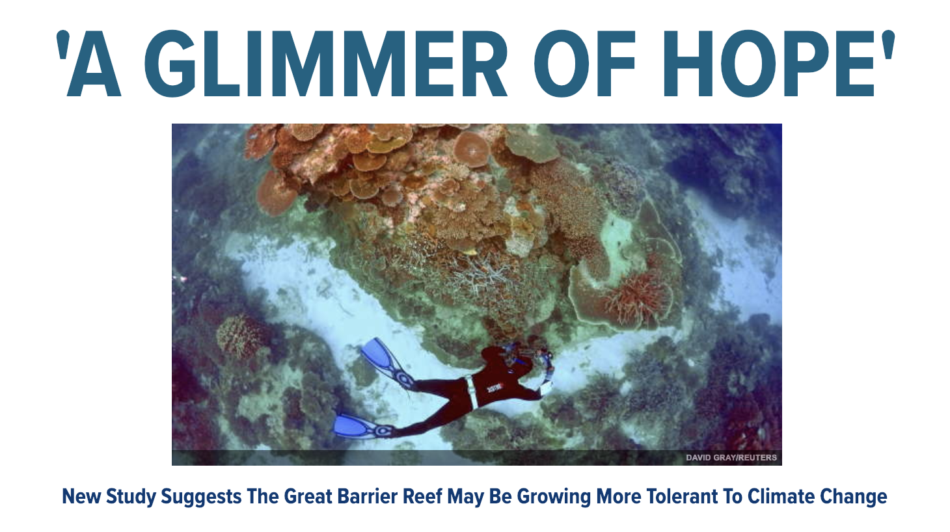

Slide 35
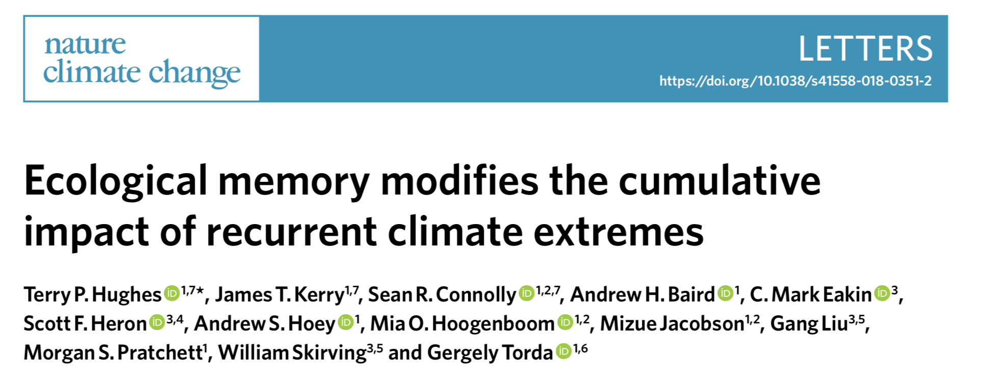
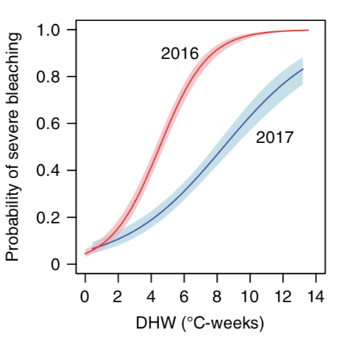

Slide 36
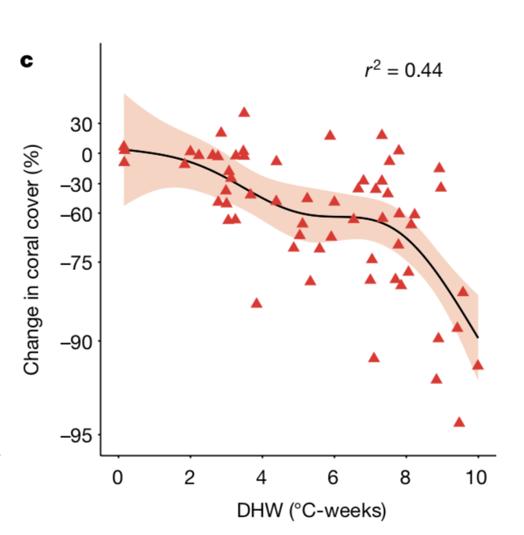
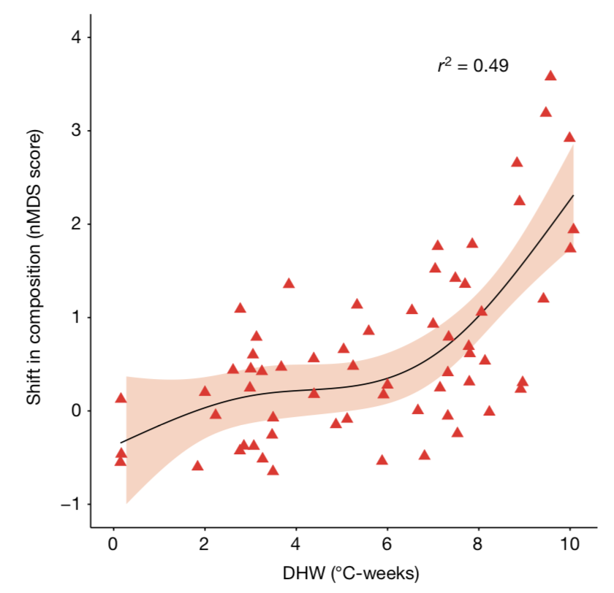
In 2016 ocean warming on the GBR caused:
And species composition to change
Coral cover to decline…
Hughes et al. 2018 Nature

Slide 37
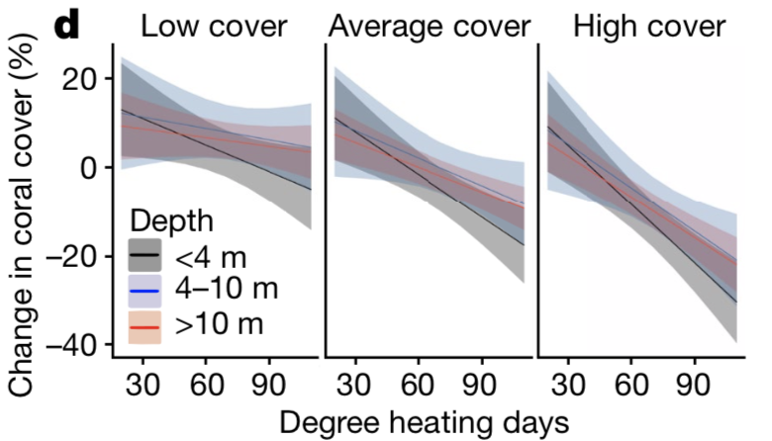
But this was already the case during the 2016 event:
Stuart-Smith et al 2018 Nature

Slide 38
But this was already the case during the 2016 event:
Stuart-Smith et al 2018 Nature

Slide 39
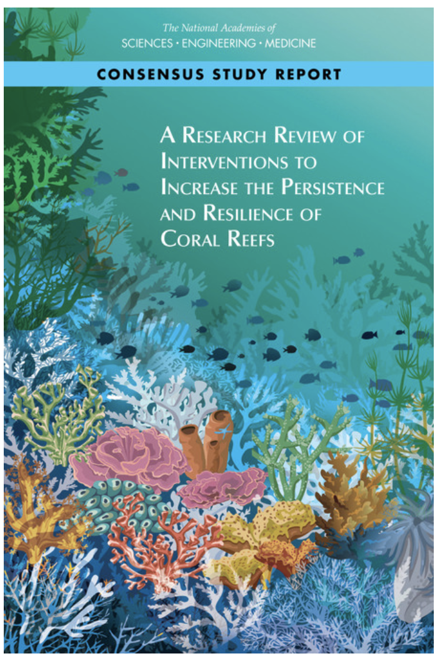
Managed selection/breeding
Gamete and larval capture
Genetic manipulation
Algal symbiont manipulation
Microbiome manipulation
Phage therapy
Managed relocation
Shading of coral reefs
Cool water mixing

Slide 40
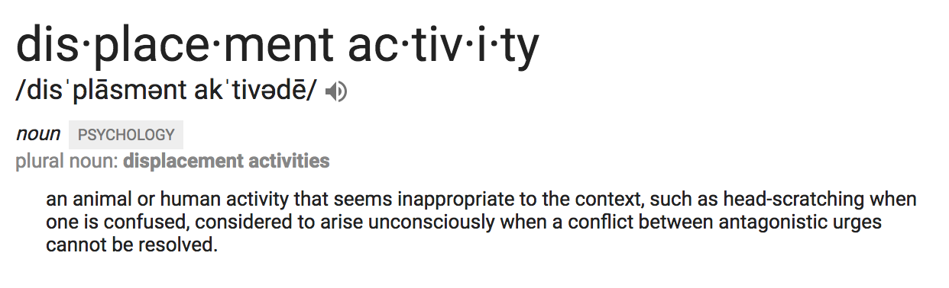
Displacement Activities

Slide 42
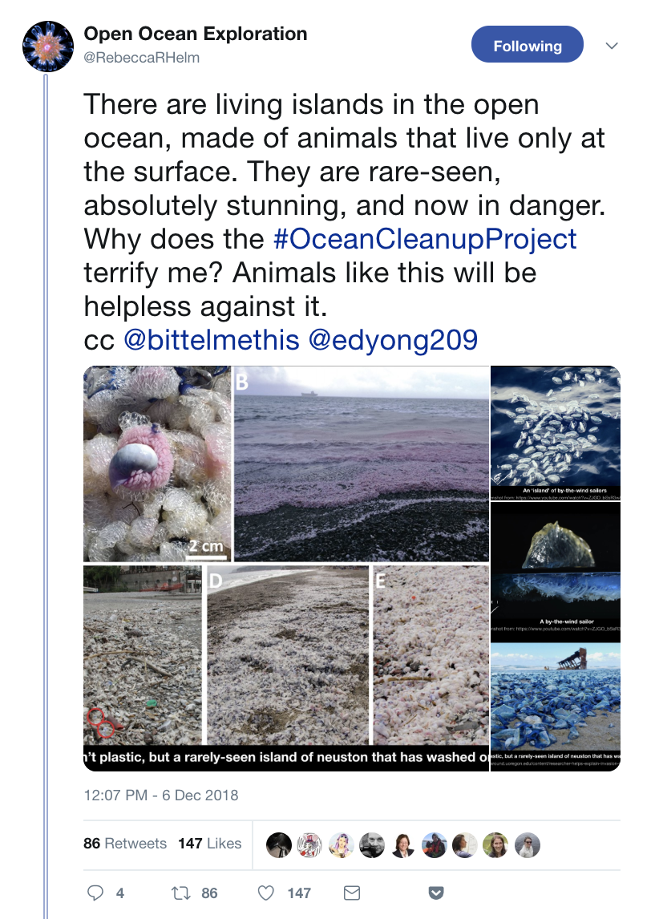

Slide 43
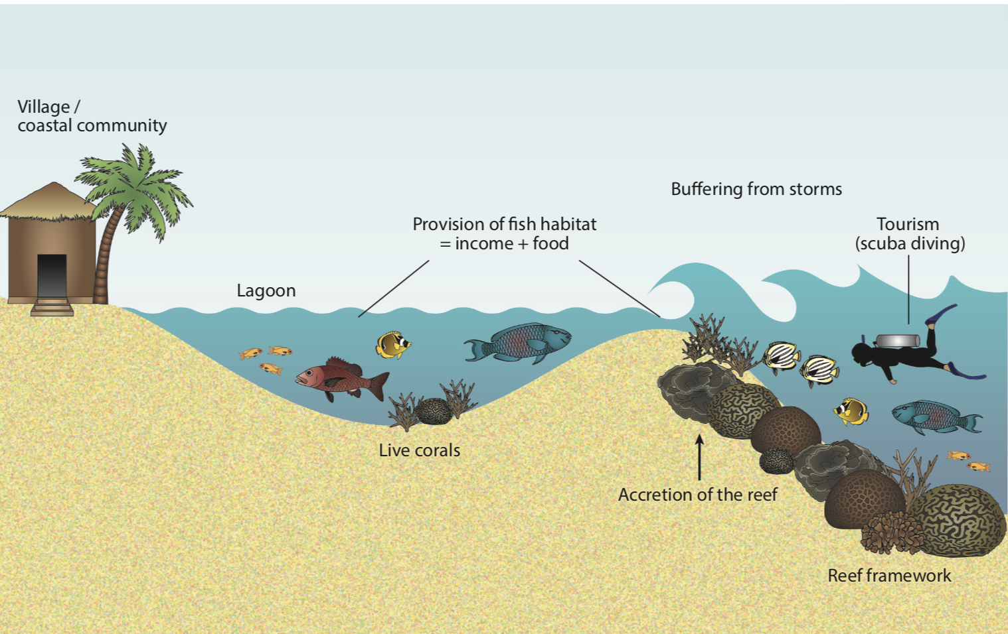
Loss of ecosystem services provided by reefs
as coral populations decline in abundance / cover

Slide 44
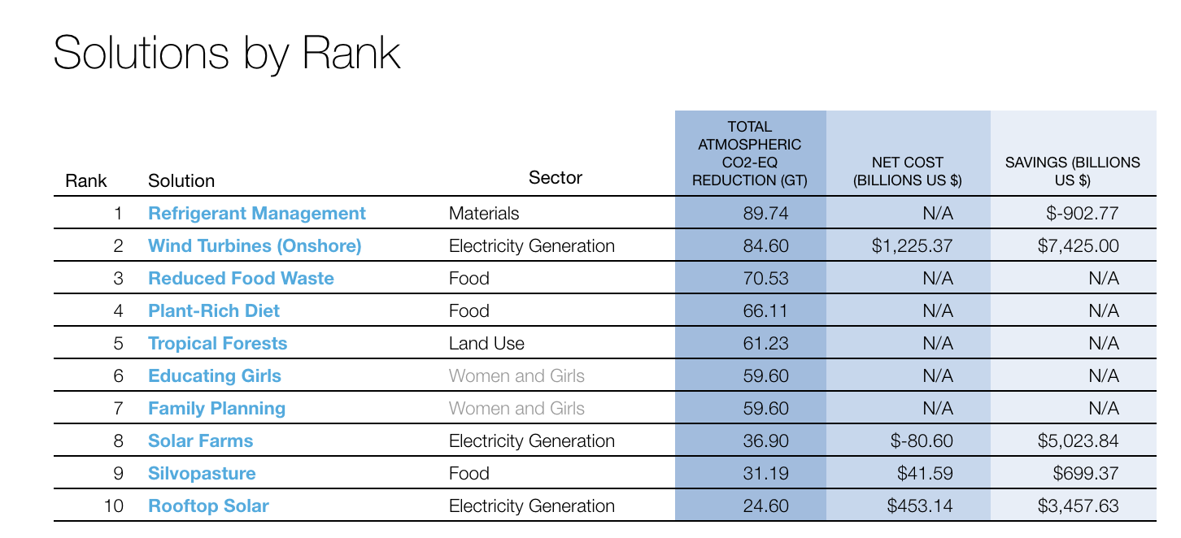
Drawdown.org

Slide 45
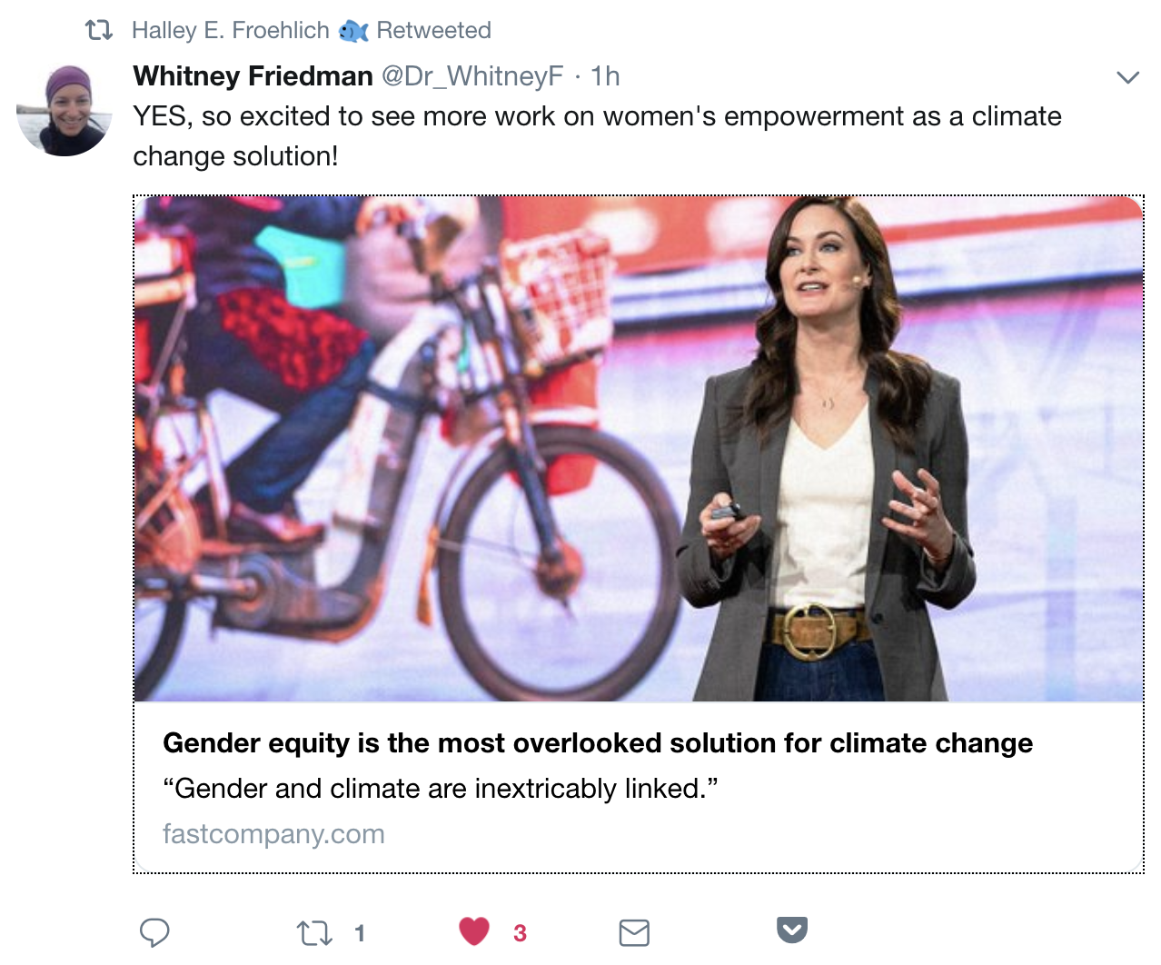

Slide 46
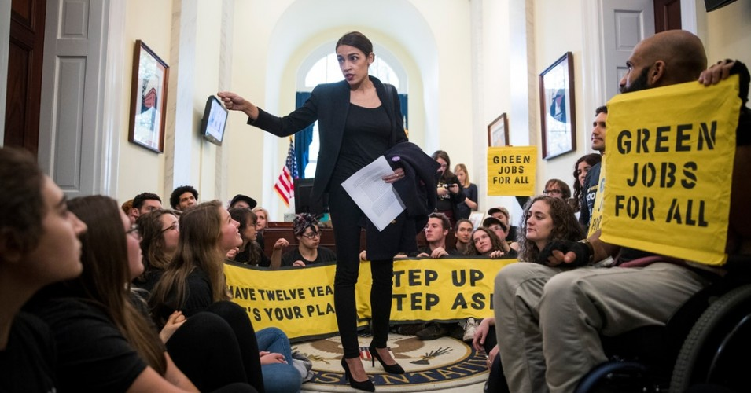

Slide 47
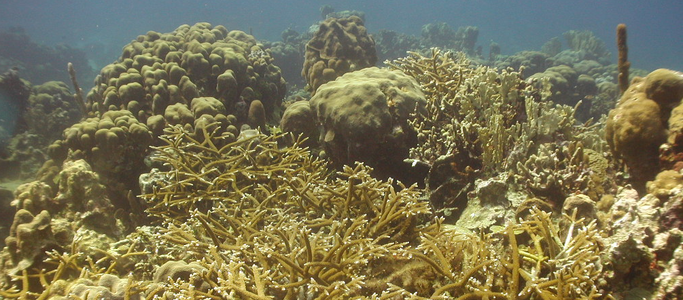



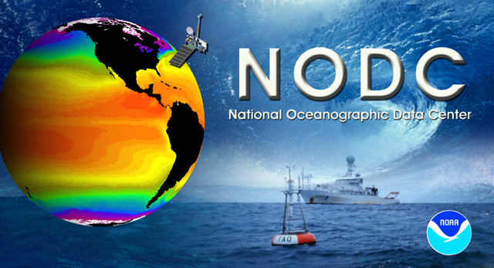




Thank you!

Slide 48
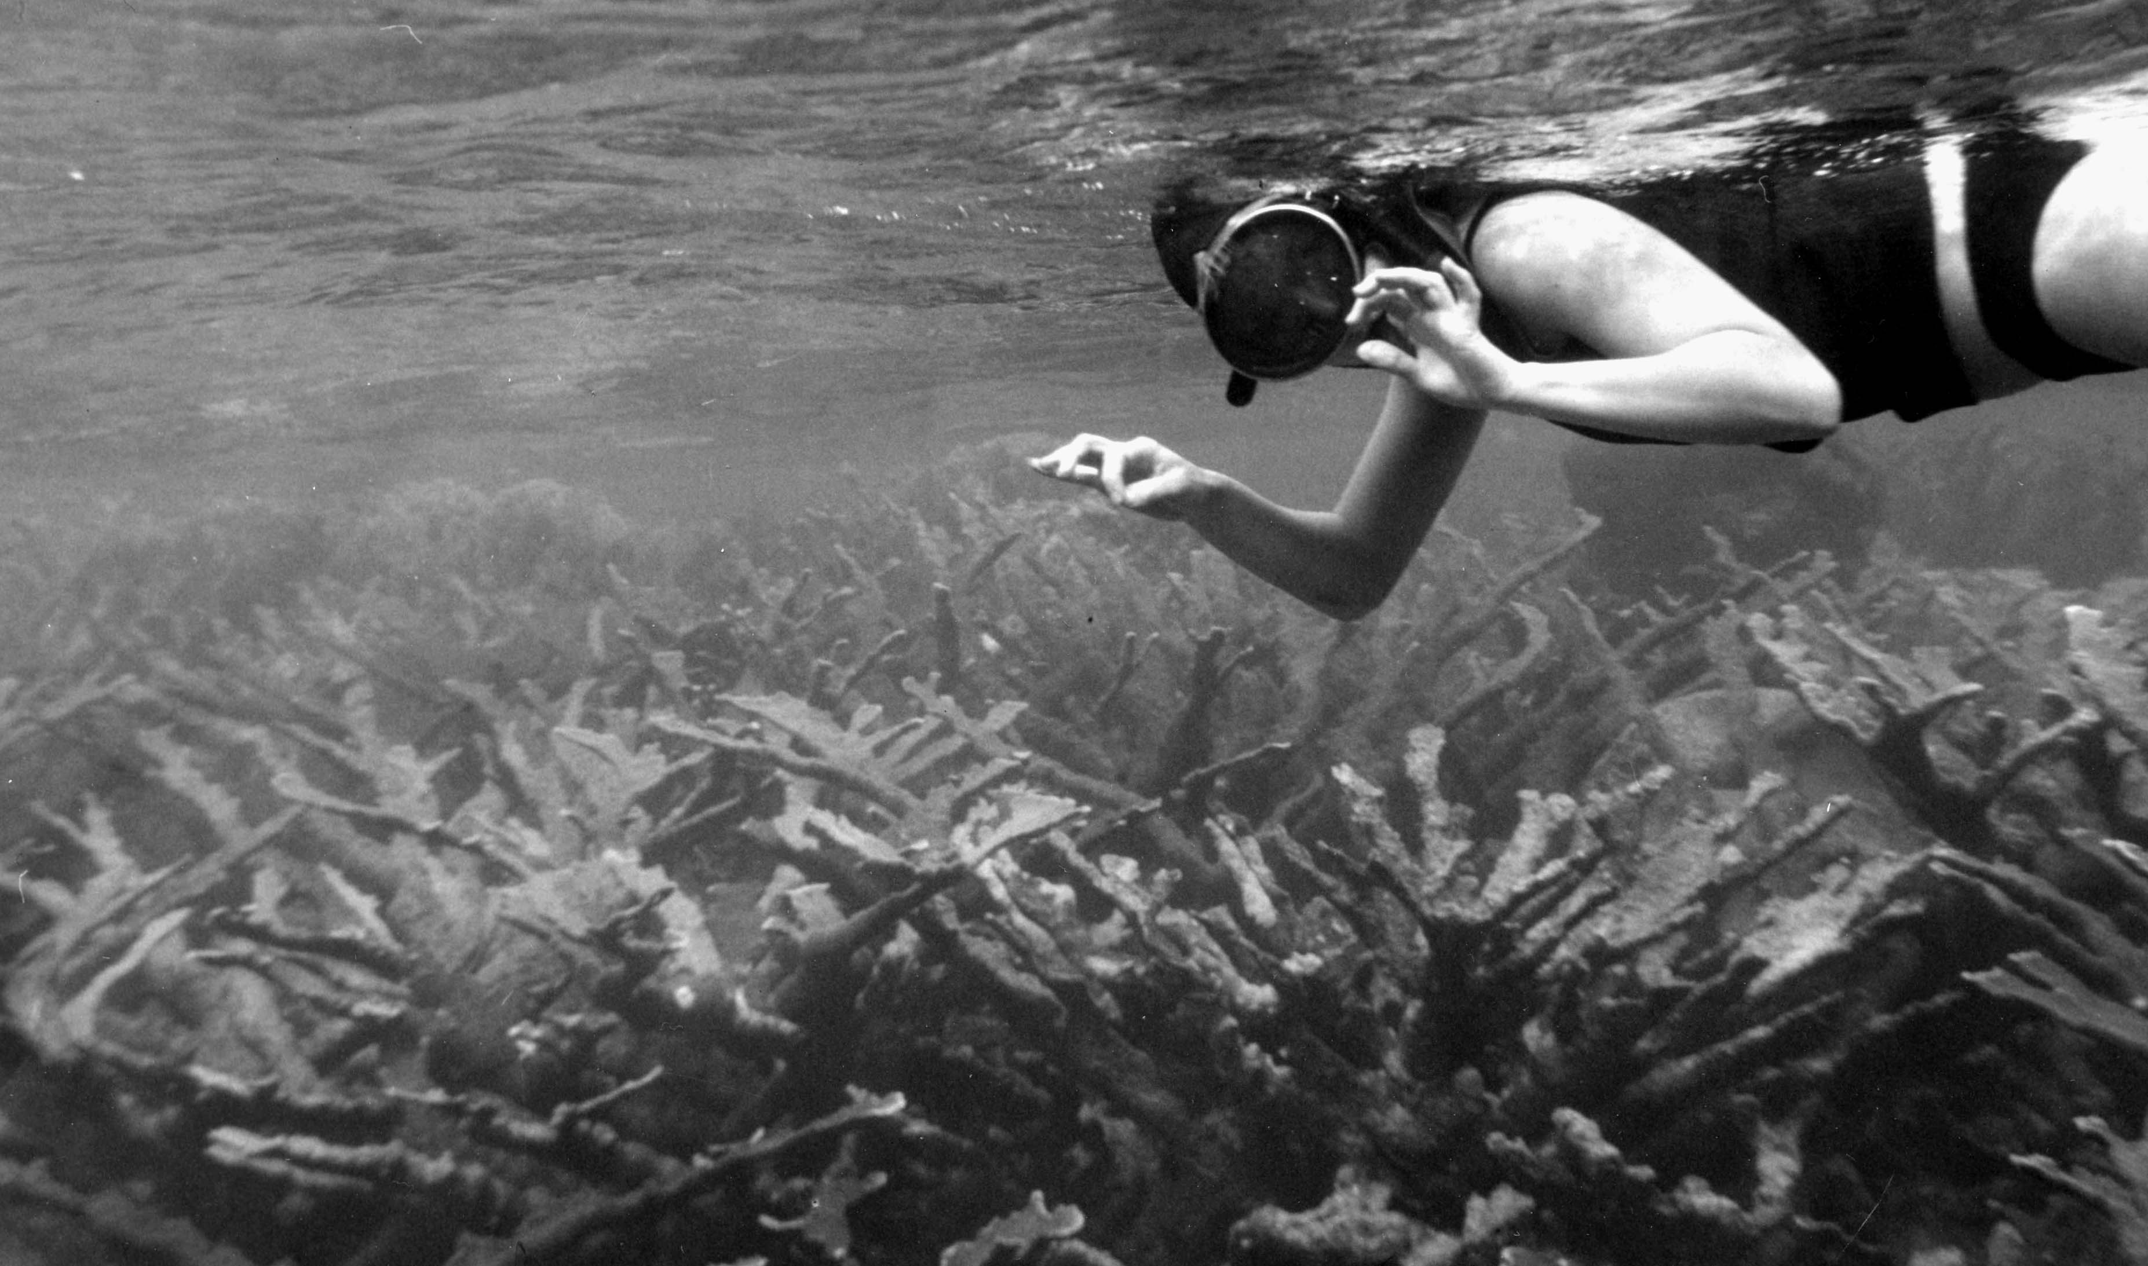

Slide 49
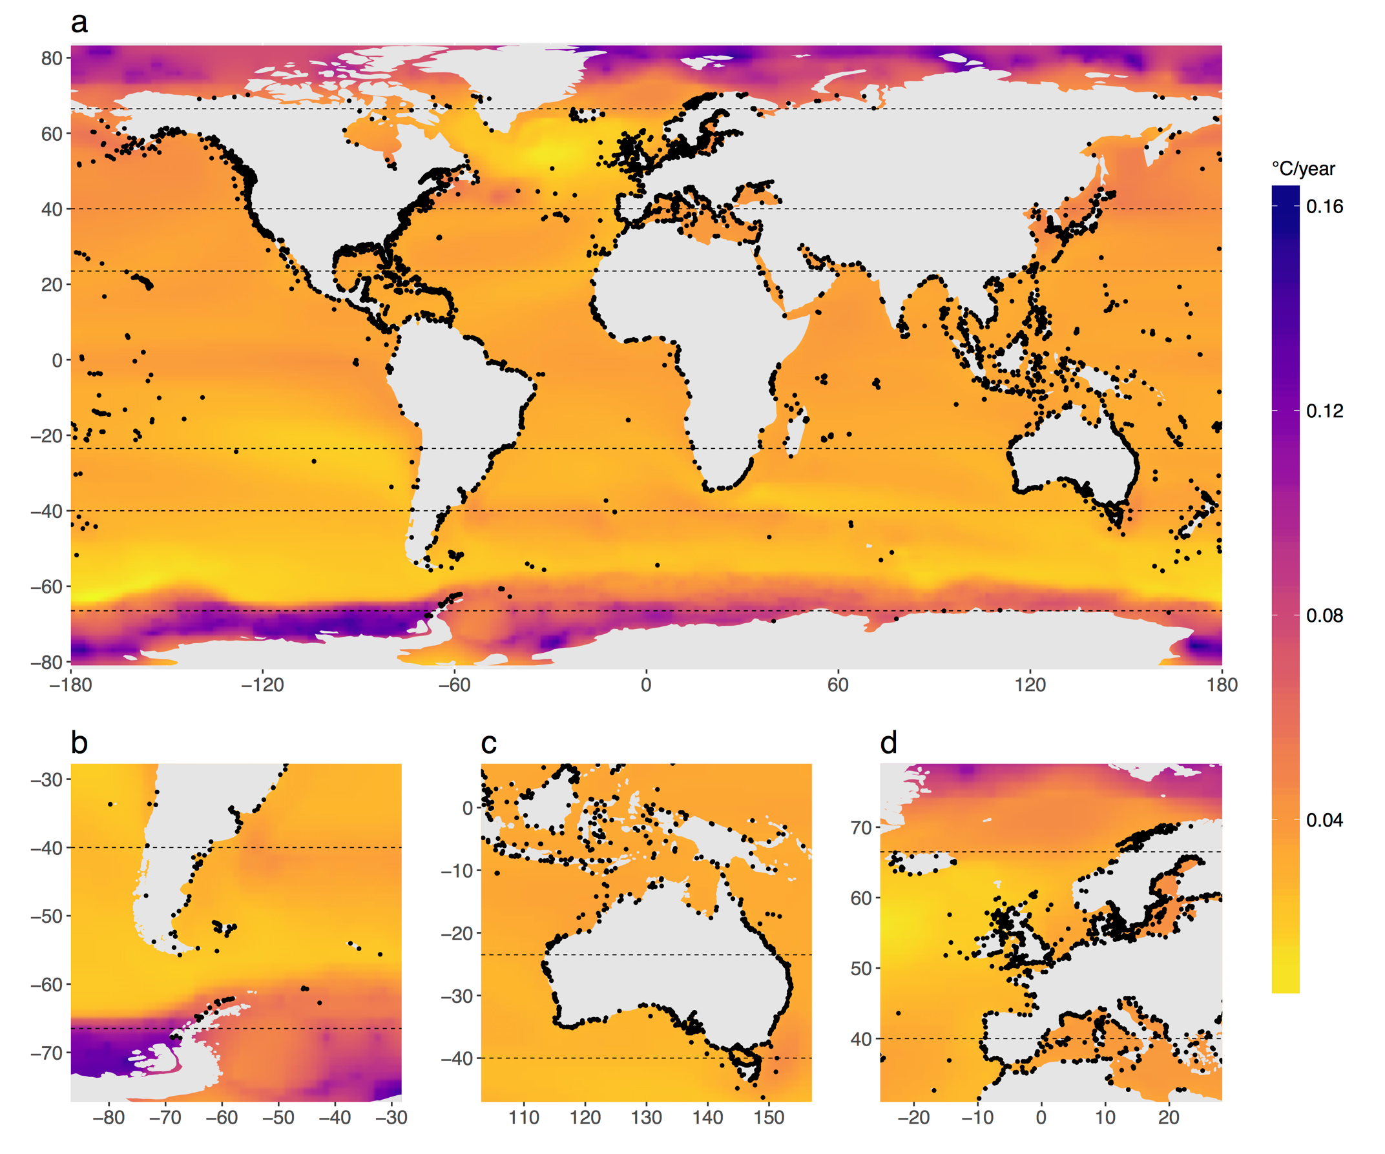
MPAs are warming rapidly
CMIP5 simulation (2006-2100), RCP 8.5:
0.034 °C/year
2.8 °C more warming by 2100
99% of all MPAs predicted to warm by at least 2 °C
Rates are substantially lower under RCP 4.5
Bruno et al. 2018 Nature Climate Change
Notes:
Projected rates of increase of ocean temperature (mean SST °C / year ± 1 SD = the SD of estimates of warming rates across MPAs) based on CMIP5 simulation ensembles (2006-2100). Tropical MPAs, RCP 8.5: 0.032±0.002
Remarkably, under RCP 8.5, 99% of the world’s MPAs are forecasted to warm ≥2°C by 2100.

Slide 50
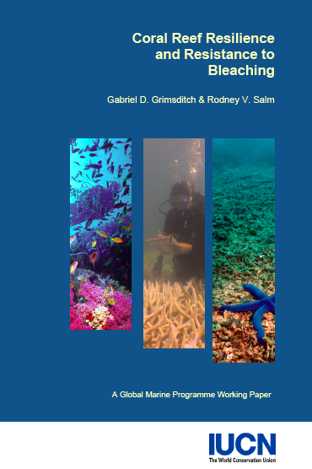
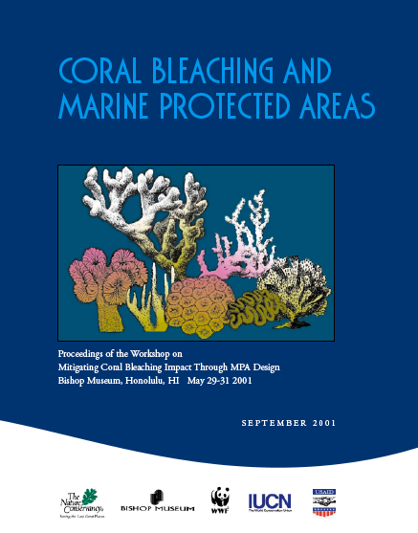


Slide 51
So why not? Why don’t MPAs increase coral community resilience to global stressors?
MPA design (size, enforcement, etc.)

Slide 52
So why not? Why don’t MPAs increase coral community resilience to global stressors?
MPA design (size, enforcement, etc.)
Our assumptions about underlying mechanisms are wrong

Slide 53



Unpublished reanalysis of data in Jackson et al 2014

Slide 54
So why not? Why don’t MPAs increase coral community resilience to global stressors?
MPA design (size, enforcement, etc.)
Our assumptions about underlying mechanisms are wrong
Interactions between stressors: antagonistic rather than synergistic

Slide 55


Slide 56
So why not? Why don’t MPAs increase coral community resilience to global stressors?
MPA design (size, enforcement, etc.)
Our assumptions about underlying mechanisms are wrong
Interactions between stressors: antagonistic rather than synergistic
Effects of warming is simply swamping that of local threats
Lough et al 2018
Gardner et al 2003

