Slide 1
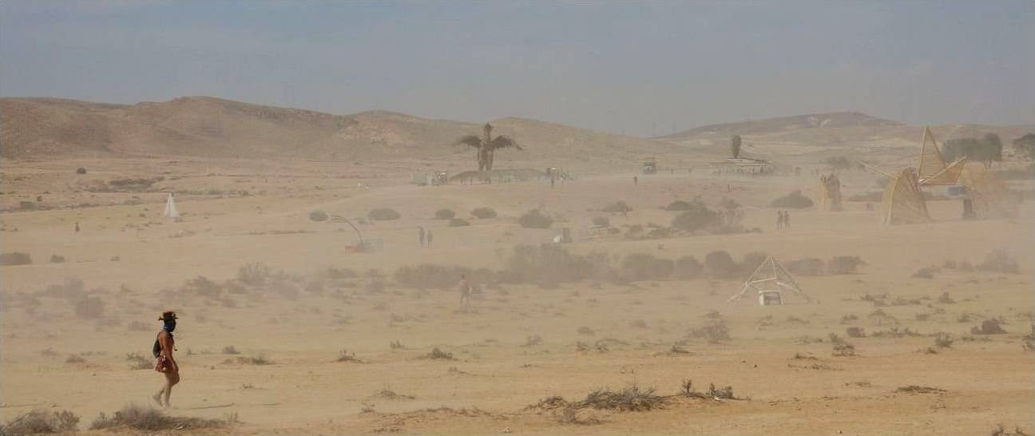
Surveying EuroBurners: Regionals, Values & Motivations
Botond Vitos
Université de Fribourg
Social Science
Notes:
The Burning Progeny project is a four-year collaborative multisited ethnography focused on the European adaptation of Burning Man, which also includes two mixed-methods (quantitative and qualitative) surveys conducted among Euroburners in 2014 and 2017. I will report some of the findings from the qualitative survey components measuring Burner values and motivations. I will also connect these findings to field examples from my ethnographic fieldwork conducted this year in Germany and Israel. As the evaluation of our findings is still underway, my presentation aims to provide an empirical snapshot of the current phase of our research.

Slide 2
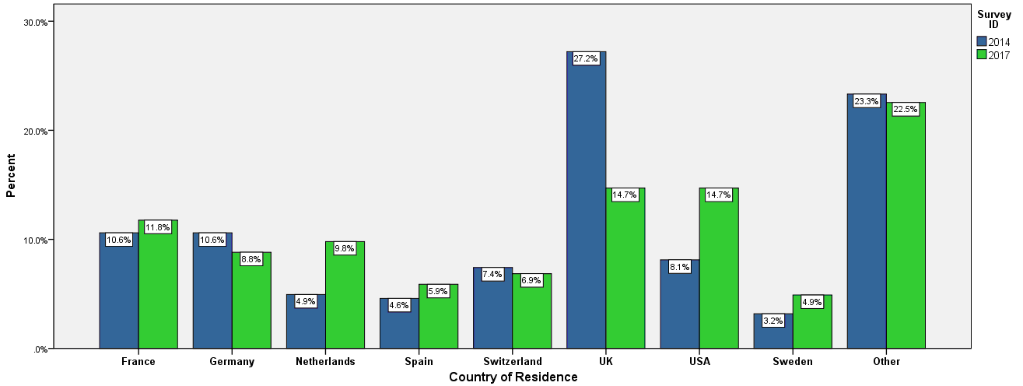
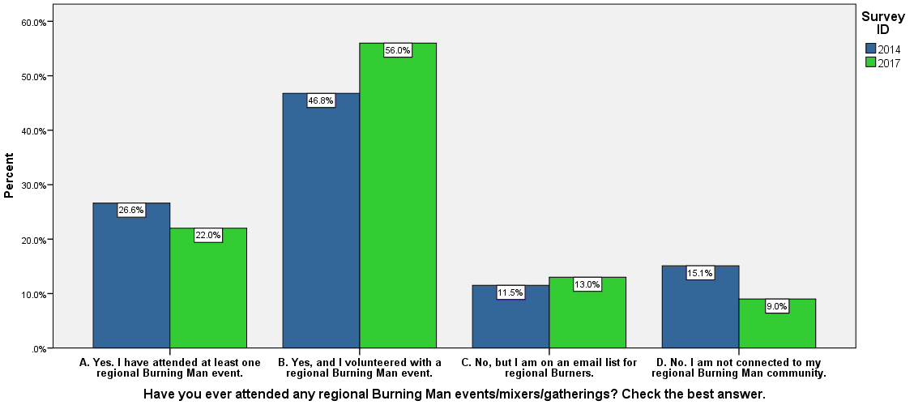
Surveying EuroBurners
S1: 283 responses (254 in the qualitative section)
S2: 102 responses (94 in the qualitative section)
Recruitment: call for EuroBurners at European Leadership Summits (ELS) and through invitations promoted on Burning Man media (Jackrabbit Speaks and Burning Man Journal)
“Community Leaders” or “Regional Contacts”: 17% of S1 respondents; 11% of S2 respondents
Three-fourths of S1 and S2 respondents confirm that they attended at or volunteered with a regional BM event
60% of S1 and S2 respondents name at least one European Regional event they attended
Summary of results: https://www.burningprogeny.org/surveys
Notes:
Some methodological remarks:
The Surveys were designed in cooperation with the BRC Census team. The summary of our results are available online on our website https://www.burningprogeny.org/.
We received valid 283 responses in S1 (the 2014 Survey), with 254 in the qualitative component.
102 valid responses were given in S2 (2017 Survey), with 94 in the qualitative section.
The quantitative component featured mainly sociodemographic questions, enabling comparison with the Black Rock City Census.
The qualitative component measured the motivations of participants and their views on the Ten Principles. Ten open-ended questions were posed in S1 and eight in S2 (with a significant overlap between the questions).
Who were the respondents?
Both surveys were directed towards “EuroBurners” or “European Burners”, but they were not designed to be a “census” of EuroBurners. The sample was not randomly selected. Respondents were comprised of European Leadership Summit (ELS) participants and those responding to invitations promoted on Burning Man media (newsletter and blog).
Most respondents are from UK, France, Germany, USA, Switzerland, Netherlands, Spain and Sweden (in this order).
A minority of survey participants identify as “Community Leaders” or “Regional Contacts”. The majority of our respondents confirm their participation in European Regional Events.
However, a minority of the respondents note that they are not connected to Burning Man communities in their region, although most of them went to BRC at least once.
Those who consider themselves “EuroBurners” arrive from a loosely defined spectrum, with Burners or Burner-friendly respondents of European descent on one end of the scale, and those who are deeply involved in European Regionals on the other.

Slide 3
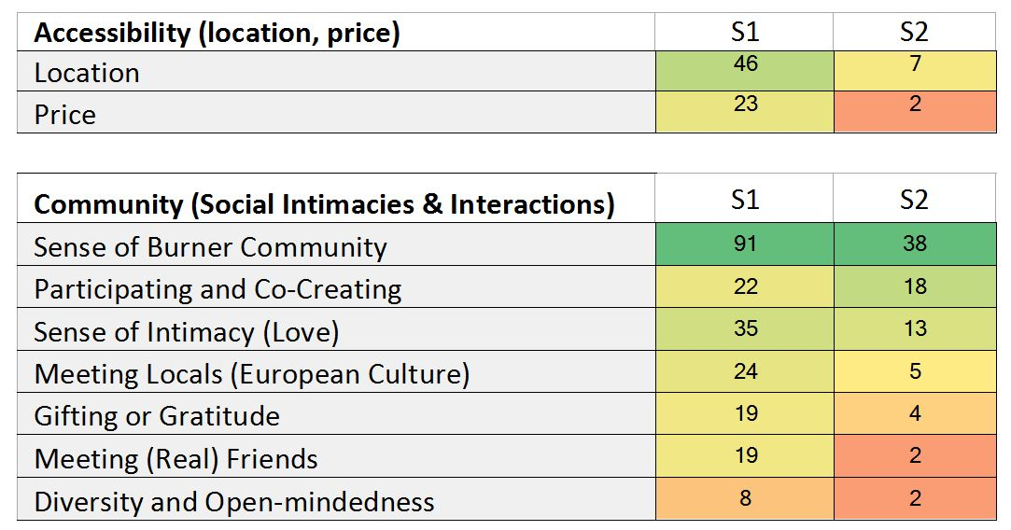
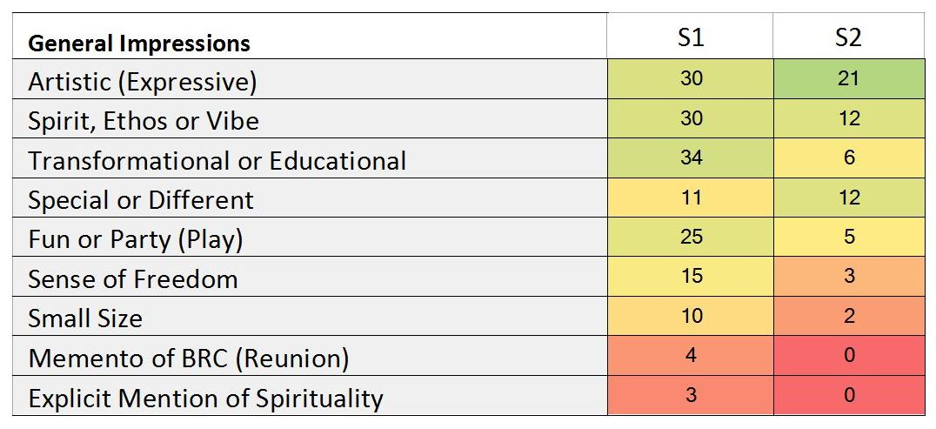
Motivations to Participate in European Events
Participating and Co-Creating
“Co-create the amazing community feeling.”
Artistic (Expressive)
“Community, a place to express myself, the events are like a canvas to create art."
Notes:
I will now get into the qualitative results. A few methodological remarks here:
Although I was not yet part of our project when the surveys were designed and conducted, I did the bulk of the coding work early this year. I coded all responses manually to identify the recurring categories and themes in our data.
I treated each valid response as a single unit of data and linked with one or more codes emerging progressively from the text. I then identified themes among the codes.
I sorted the categories according to the frequency of their occurrences among the responses given in S1 and S2. So the numbers here show the number of survey responses implicitly or explicitly related to a particular category. This is meant to provide a general idea of the magnitude of our observations.
In both surveys, respondents were asked to name their Motivations to participate in Regional Events in Europe with the same question.
Based on the answers, I identified these categories (characteristics or factors) that encourage attendance at Regionals. Most respondents mentioned several factors.
Unsurprisingly, convenience and accessibility is frequently mentioned: European events are easier to access and cheaper than BRC.
The other categories can be distributed into two thematic groups: community; other (general) impressions.
Community (Social Intimacies and Interactions)
Being part of the Burner community is the key motivation to attend Regionals. The sense of this shared identity is evident in the use of expressions such as “Burners”, “tribe”, “the people”, “community” or “family”.
What are the various aspects of this group membership? In many cases, the Burner identification is associated with a strong emotional affection and sense of intimacy. Participation, or the urge to contribute and co-create, is also often emphasised. Some respondents mention that it is easier to be involved in event organisation and to “make a difference” at Regionals than at BRC. Participation is sometimes coupled with a gratitude that is expressed through gifting. Quite a few respondents are keen to meet local, European members of the Burner community. Other motivations include: encountering friends and forging long-lasting friendships, and being part of a diverse, tolerant and non-judgemental community.
General Impressions is the other thematic group that includes other general – and attractive – characteristics of European events. Many respondents commend the possibilities of (artistic) expression ranging from producing artworks to other ways of self-expression and social experimentation. For many, participation has a transformational or educational potential, be it “personal growth” or educating others. A similar number of respondents praise the presence of a Burner spirit or vibe at Regionals, which is kept alive by acting in accordance with the Ten Principles. Some respondents claim that the event’s environment is special or different from the “default world”. Another incentive to participate is the expectation of fun and play. Other attractions include: the powerful sense of freedom gained at Regionals and the small size of European events.

Slide 4
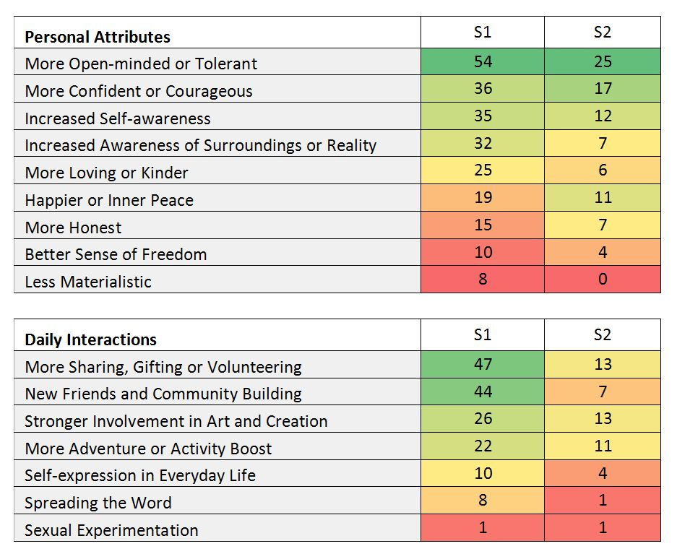
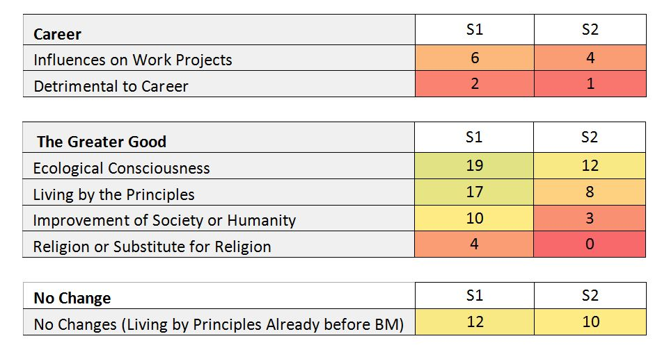
Transformation in the Default World
More Open-minded or Tolerant
“[Burning Man] has changed my aspirational values in terms of seeking out and appreciating different types of people. It has helped me to open up and enjoy diverse experiences more as well, to be a bit more adventurous, even though I already was strongly so already.”
More Sharing, Gifting or Voluntering
“Most importantly I learned how to give without expecting anything back and how to accept help of others/material things without feeling guilty about not being able to help or give back.”
Notes:
The principles of Burning Man can be integrated into the “default world” in various ways, igniting changes in the way of life of the participants. Here I looked at the responses to the following question:
Has Burning Man inspired you to change or modify your behaviour, or otherwise change the way you live, in the “default” world? If so, how?
The first thematic group is Personal Attributes
Here the responses include a number of personality changes. Open-mindedness is the most common response: more empathy towards other people, feeling less judgemental, or being more open towards new ideas. Many respondents claim that Burning Man has given them confidence and courage in life, and they are now less shy, more social or more self-reliant. An increased awareness of oneself or one’s goals in life is frequently mentioned. This is sometimes coupled with an increased awareness or understanding of one’s immediate surroundings and the social world one inhabits. Being more open towards others often leads to being a “nicer person”. Respondents also report improved emotional wellbeing or happiness, which is sometimes transmitted to others. Other changes include: being more honest with others and oneself; a general sense of personal freedom; and money no longer playing a central role in one’s life.
Daily interactions
Many respondents note that Burner culture has inspired profound alterations in their daily interactions. The most common response involves gifting or helping others, sharing resources or volunteering in community projects. Others mention the widening of friend circles and connections with new people and communities. An increase in creativity is often experienced and channelled into art projects, crafting workshops, DIY activities or hobbies. An increase in energy, motivations or curiosity is frequently mentioned, which may result in a more active, intense or adventurous lifestyle. Other changes include: better self-expression in daily life and the promotion of Burner culture, typically as an example of better living.
Career
Some respondents report that Burning Man and the Burner spirit provided inspiration for their professional activities, positively affecting their work projects or processes. For three respondents Burning Man ignited changes that, although regarded as positive, were detrimental to their career.
The Greater Good
Certain changes concern processes or principles that transcend the level of the individual and possess a universal significance. Participants may witness an increased ecological or environmental awareness. Some respondents report an intention to live according to the Principles or follow the general ethos of Burning Man. Others note that Burner culture provides inspiration for social activism and may thus contribute to the improvement of wider society. A few respondents claim that they have discovered spirituality at Burning Man, or feel that its ethos may provide a substitute for religion.
No Change
Several respondents note that they had been living close to the principles before encountering Burner culture.

Slide 5
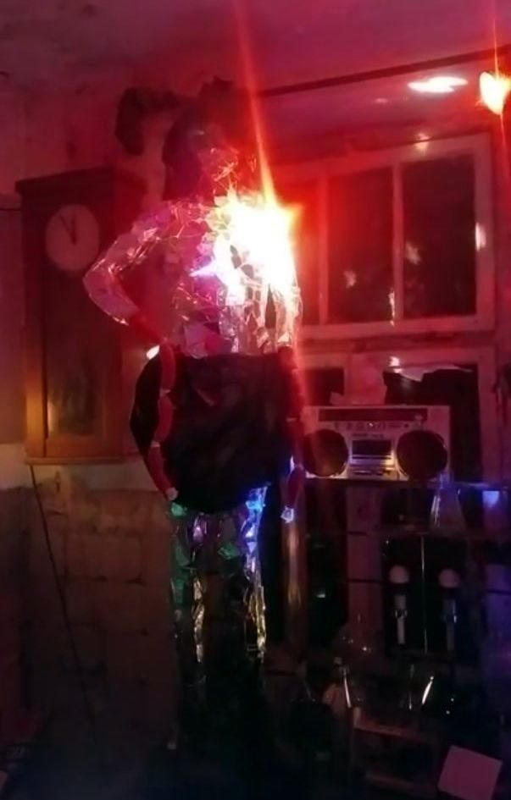
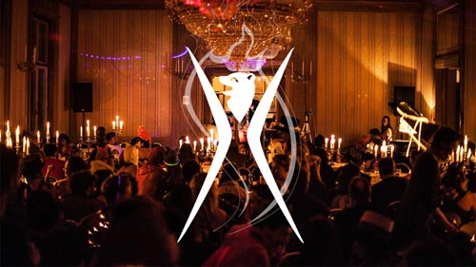
Field Example: Artistic (Expressive)
Burn events promoting and enabling (artistic) expression
Example form Germany: indoor winter event Burning Baer (Burning Bear)
2018 Theme: Extrawurst (Extra Sausage = Special Treatment)
Mutant Disco Ball / Extrawurst project
Notes:
In the remainder of the presentation I will provide some field examples from the ethnographic component of my research that tie to these categories.
Artistic Expression – Burning Baer in Germany
Listed among the main motivations in the survey is that Burner events enable artistic expression.
I will provide an auto-ethnographic example from my fieldwork at an event called Burning Baer in Germany. This was a weekend-long winter event, taking part within a 19th century castle, where food, drinks and accommodation is provided for the participants.
This year’s theme was Extrawurst: a very German expression with the literal meaning of “special sausage” or and the figurative meaning of “special treatment”. So receiving the Extrawurst means receiving an extraordinary or special treatment. As I was informed by one of the core organisers of the event:
“We played around [with what the] art theme might be, and I think that Extrawurst was something everyone could relate to, you know, in a way. And also I think because Burning Baer compared to the other events is always a little bit special because . . . you get everything, you just need yourself and your creativity, and everything else is provided. So that’s an Extrawurst for everybody.”
We can see that artistic expression is strongly emphasised by the organisers, although the principle of self-reliance seems less important here than at outdoor burns. In Germany, another event called “Kiez Burn” near Berlin can be regarded, in the words of an organiser, as the “classical outdoor, blank slate event”. However, Burning Baer is still a Burn event based on the Ten Principles, where participation and co-creation is encouraged.
I was able to “test” this by applying for an art grant that was eventually accepted by the org. I proposed to construct a rotating mirror lady with Extrawurst arm attachments composed of toy sausage strings. She performed as a life-size, mutant disco ball illuminating one of the dance floors. She was eventually fitted behind a bar located in the basement of the castle.

Slide 6
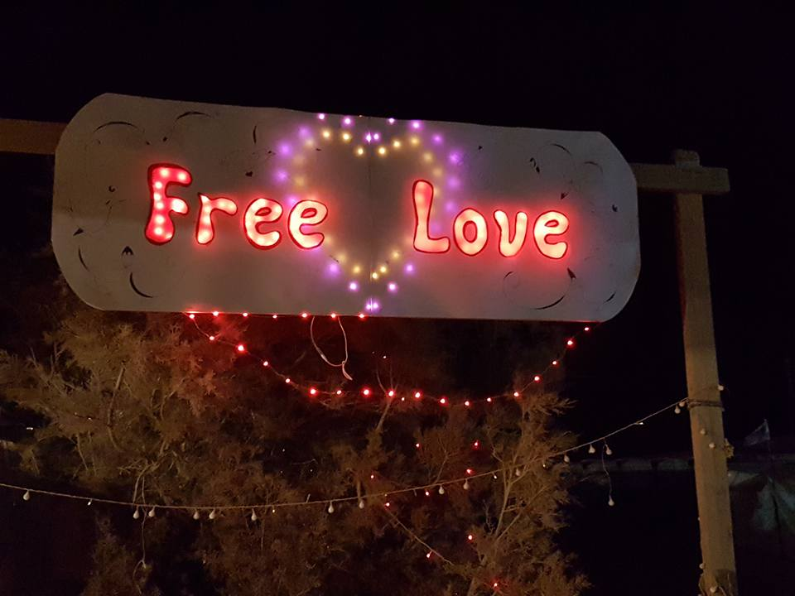
Field Example: Participating and Gifting
Nera (41): Burner in Midburn’s Free Love camp
In 2018 Nera organised workshops on sexuality and self-expression at Midburn and Nowhere
“take out your inner voice”
Notes:
Midburn – Participation, Gifting, Sexuality
Let’s jump to a very different field environment. Midburn, as we already now, is the main Israeli Burner Event.
The example is provided here by an interviewee, Nera. She is a 41 years-old, female Burner who was part of the Free Love camp at Midburn. The camp featured workshops and activities encouraging sexual exploration. They had a Pleasure Dome for sexual activities equipped with mattresses and red lighting.
When I asked about co-creation and gifting, Nera mentioned a workshop she organised on sexuality and self-expression. The workshop took place first at Midburn, and she also took it to Nowhere in Spain.
Nera: Gifting workshops and all this stuff. Yes, I did also a workshop in my camp. . . And I’m gonna do it also—gifting [i]t at Nowhere. . . . My workshop is about—how I call it—take out your inner voice. When you are in a sexual intercourse, people are not really making noises, and they are really quiet. . . I’m gonna do a workshop to make them a little bit louder. . . It really worked in Midburn with the Israelis. . . . . The people were getting naked . . . touching each other in the intimate areas. Also they didn’t fear about [what] they first thought uncomfortable: to be in the [Pleasure] dome with naked people. I do it with couples [who are in a long-term relationships]. . . because it will be much more intimate and opened.
According to Nera, the workshop is a gift for the community, which may potentially enrich and improve the sex life of established couples. Besides gifting, some other Principles that come into play in this fragment are: Radical Self-expression (in terms of sexual self-expression) and Communal Effort (being together with other naked Burners in the Dome proves to be a comfortable experience).

Slide 7
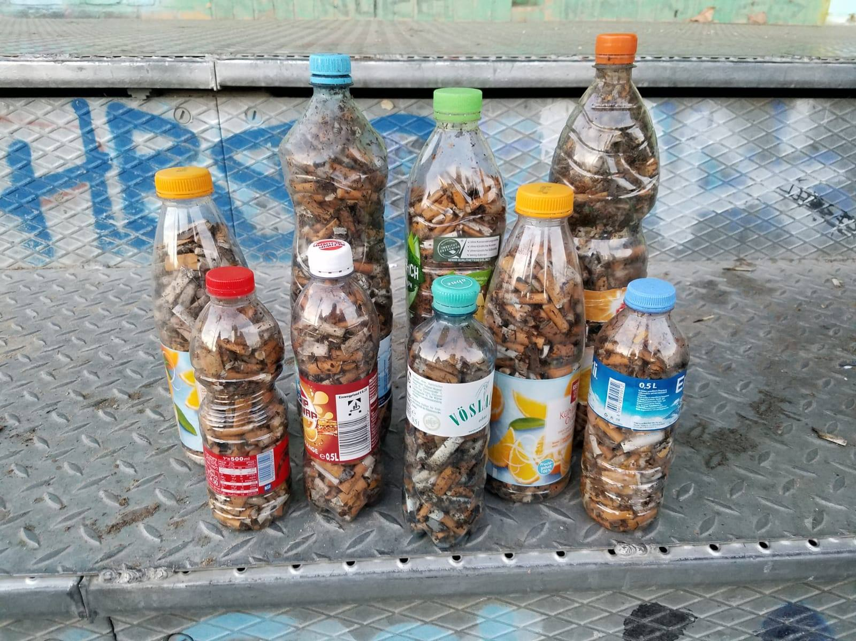
Field Example: Leaving No Trace in Daily Life
De-MOOPing daily life
David (31): Integrating the Principles into daily life and educating others as well (“It's not that we go and clean after the people. We should educate the people not to make it dirty and not to leave a trace.”)
Kick Butts #1 and #2 events in November –
cleaning up cigarette butts in the parks of Berlin
Kick Butts results (photo taken from FB event page)
Notes:
Berlin – Principles in Daily Life
Finally, my last example relates to environmental responsibility and de-mooping in daily life.
David (31) is one of the respondents of my fieldwork in Germany. He noted the following when I talked with him in July:
“Just last week I was [at] the lake, and I went outside of the water to talk on the phone, with headphones. And while I was talking . . . I just saw all kind of trash, so I just started to pick it up. So I’m not saying that the Burner’s job is to pick up trash, to make it clean. . . . It's not that we go and clean after the people. We should educate the people not to make it dirty and not to leave a trace. . . . Maybe we can go to the park, have a team that [cleans cigarette butts for example], but also as a little demonstration we give flyers to the people and explain it to them.”
Kick Butts Event
The interviewee has recently organised two events based on these ideas. These were called Kick Butts #1 and #2, focused on cleaning up cigarette butts and raising awareness to MOOP in Berlin parks. At the second edition, in the words of David:
“There were like 10 people, one of them was a person who simply saw us during our first event, that was really cool, and we received a lot of other positive responses.”
Here again we can relate back to the survey results, in particular to categories such as “Ecological Consciousness”, “Spreading the Word” and “Improvement of Society”.
------------------------------------
These are only a few examples from my field material that relate back to the survey results. Together they compose the empirical element of our ongoing research.

