Slide 1
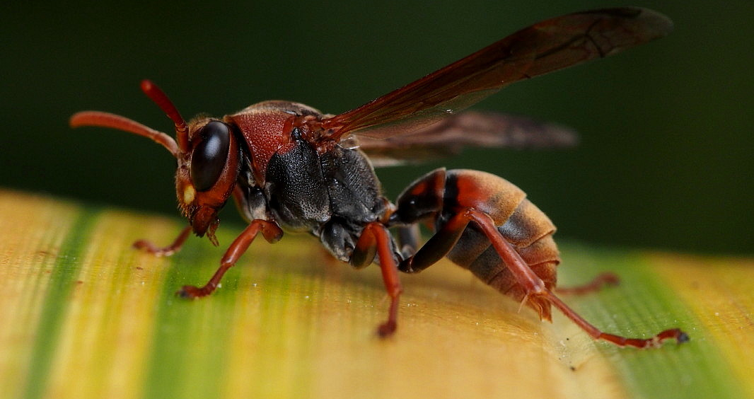
A new DNA sampling method to describe the diet of social wasps and evaluate their impact on native biodiversity
Image © flossiepip via iNaturalistNZ (CC-BY-NC)
Marie-Caroline Lefort, Thomas E. Saunders, Jacqueline Beggs, Travis Glare & Stéphane Boyer
@TomSaundersNZ | tomsaunders.co.nz

Slide 2
Acknowledgements

Slide 3
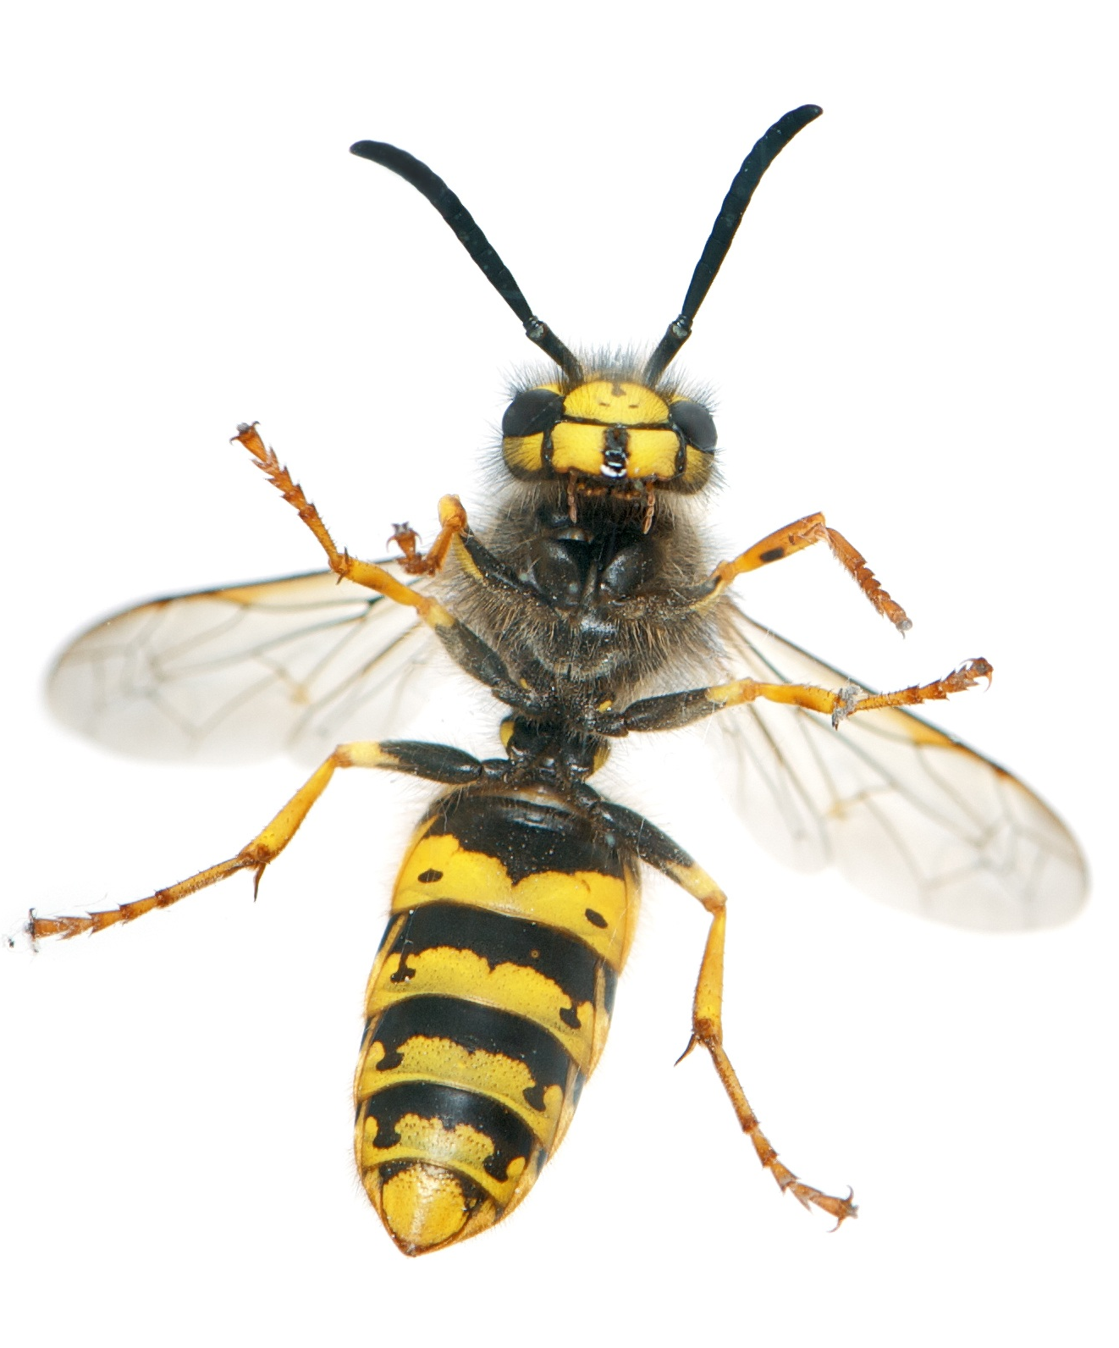
Social Wasps
Highly invasive pests around the world
NZ: 2 Vespula + 3 Polistes spp
- Stings cause a nuisance and fatalities
- Economic impacts e.g. apiculture
- Multitrophic ecological impacts
In order to better understand their impacts we need to know what they are eating.
Difficult to measure over an entire nesting season.

Slide 4
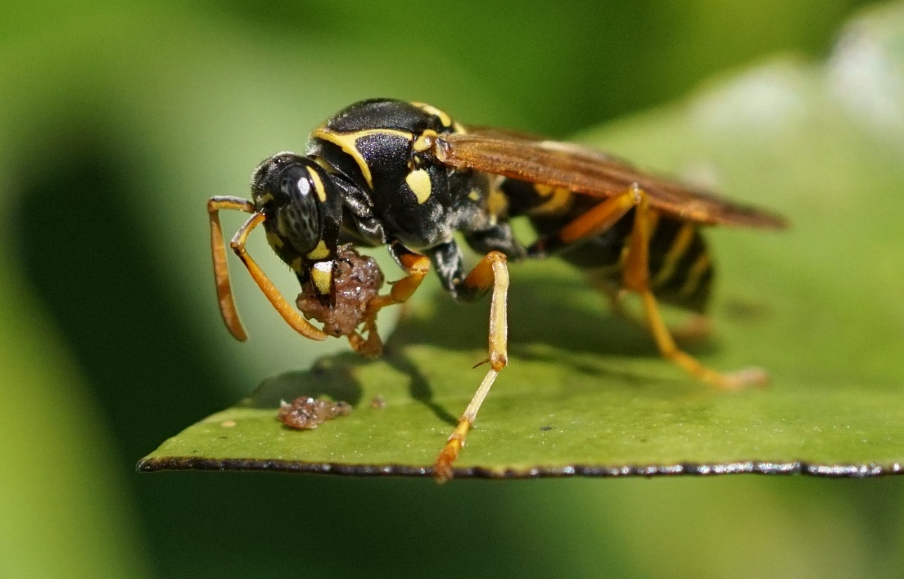
Detecting Interactions
How do we measure interactions between invasive wasps and prey species?
Intercepting foraging adults
Sequencing eDNA associated with predator:
- Regurgitates
- Gut content
- Faeces
Limitations
- Only a snapshot of recent prey
- What about a whole season?
(c) Catherine Beard via iNaturalistNZ (CC BY-NC)

Slide 5
Research Aims
Develop and test a new molecular method to study the diet of social wasps
- Extract prey DNA from the larval meconium of Polistes spp.
Document prey range of Polistes wasps in Auckland
- Assess their potential ecological impact
Image © givernykate via iNaturalistNZ (CC-BY-NC)

Slide 6
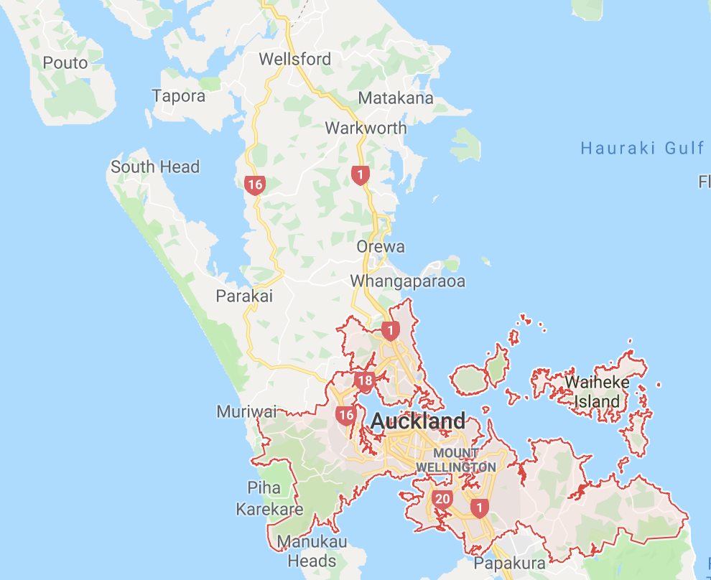
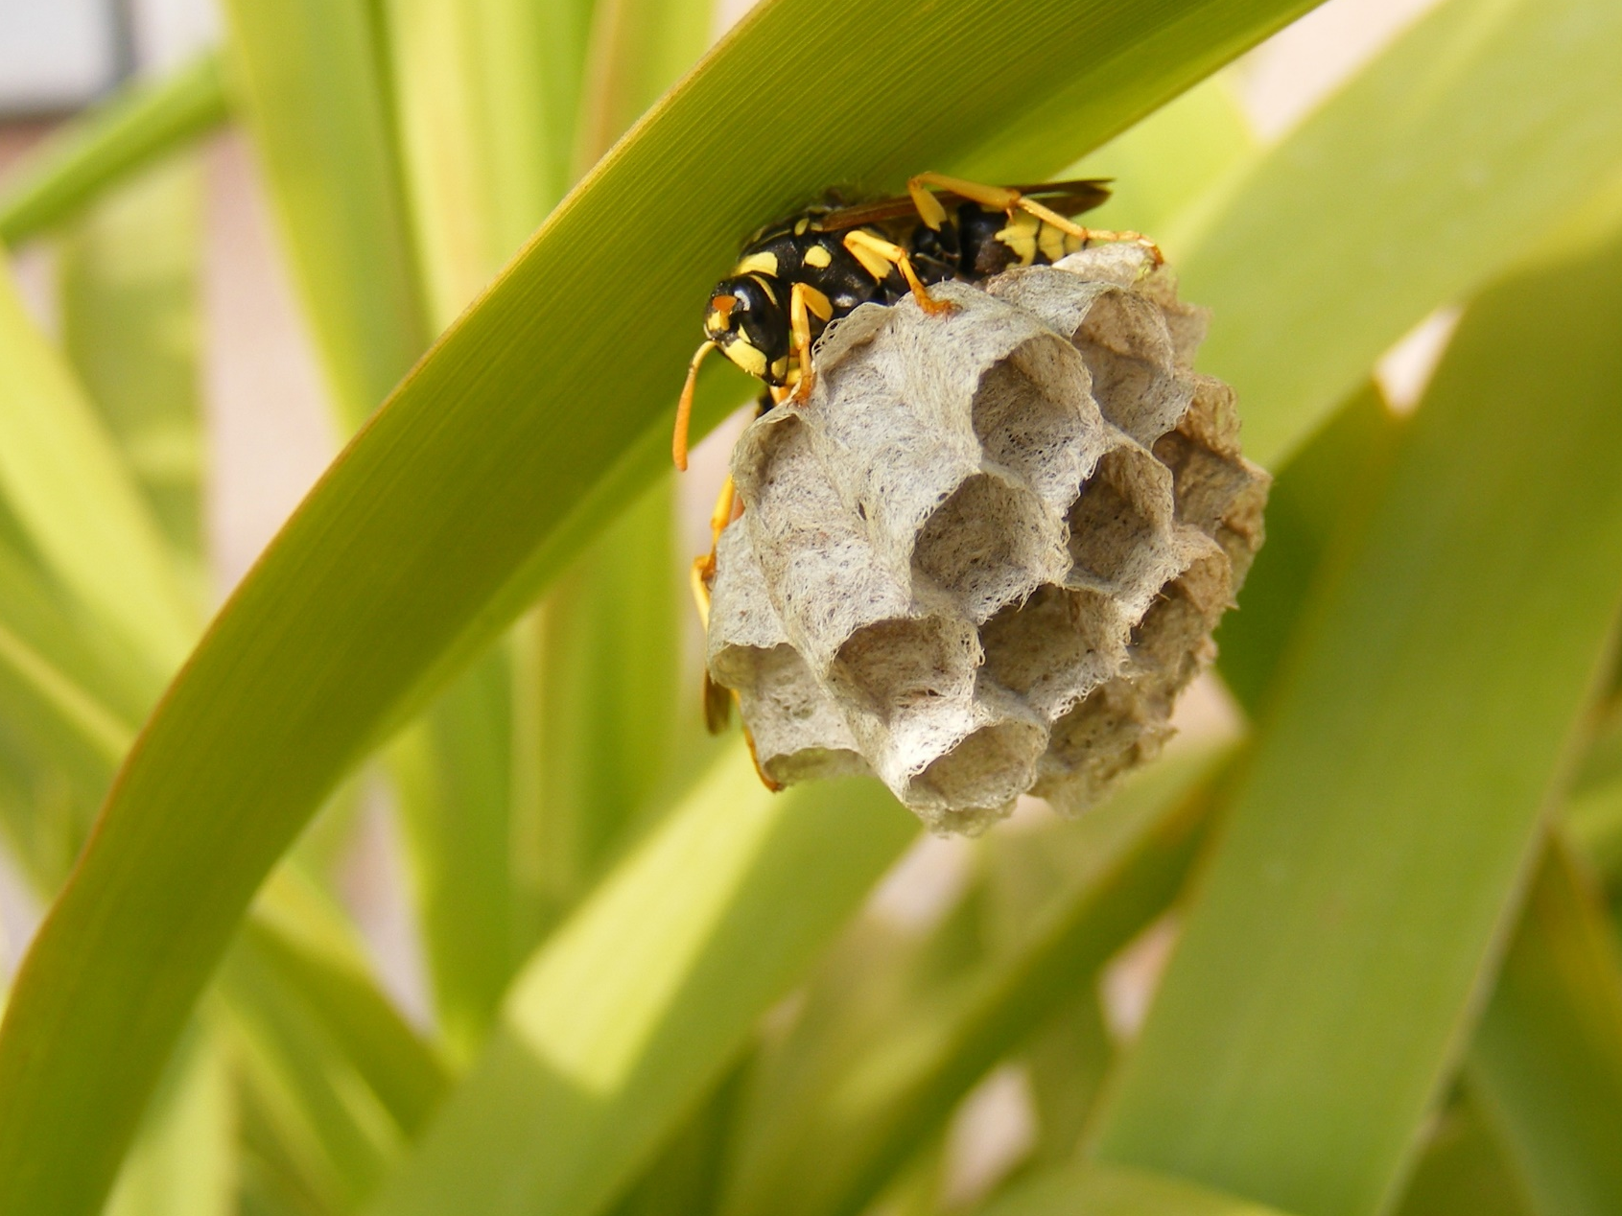
Methods: Sites
10 Auckland sites
48 active nests
- P. chinensis (n=44)
- P. humilis (n=4)

Slide 7
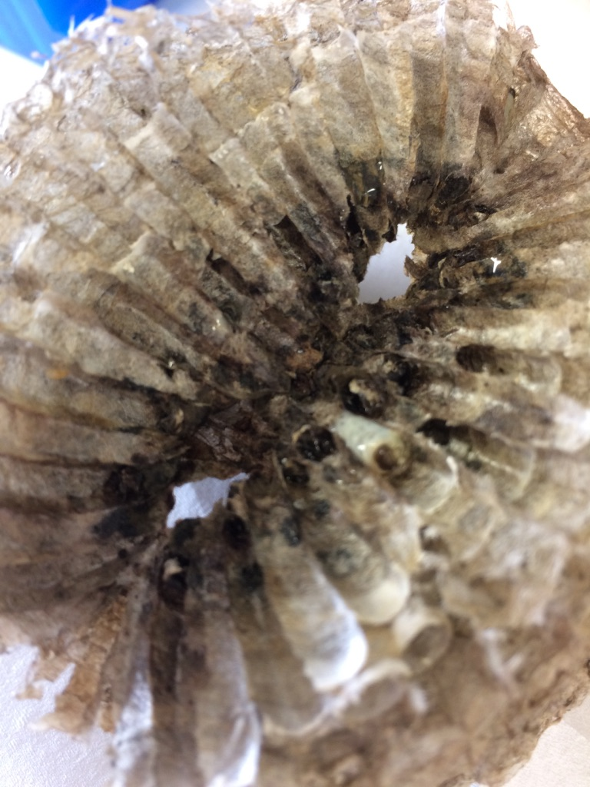
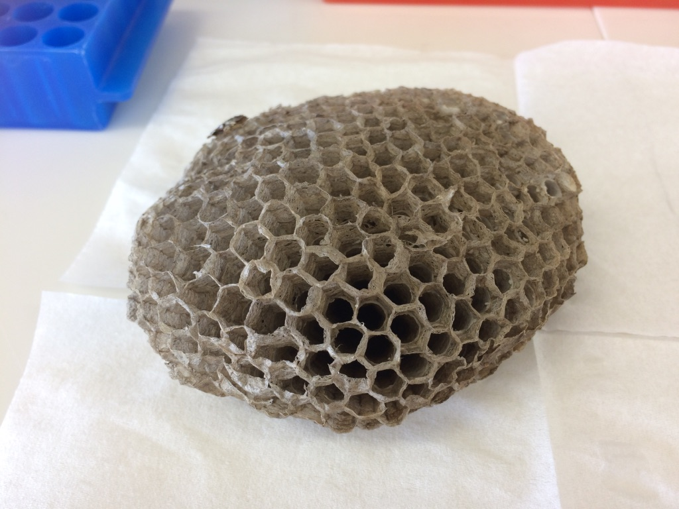
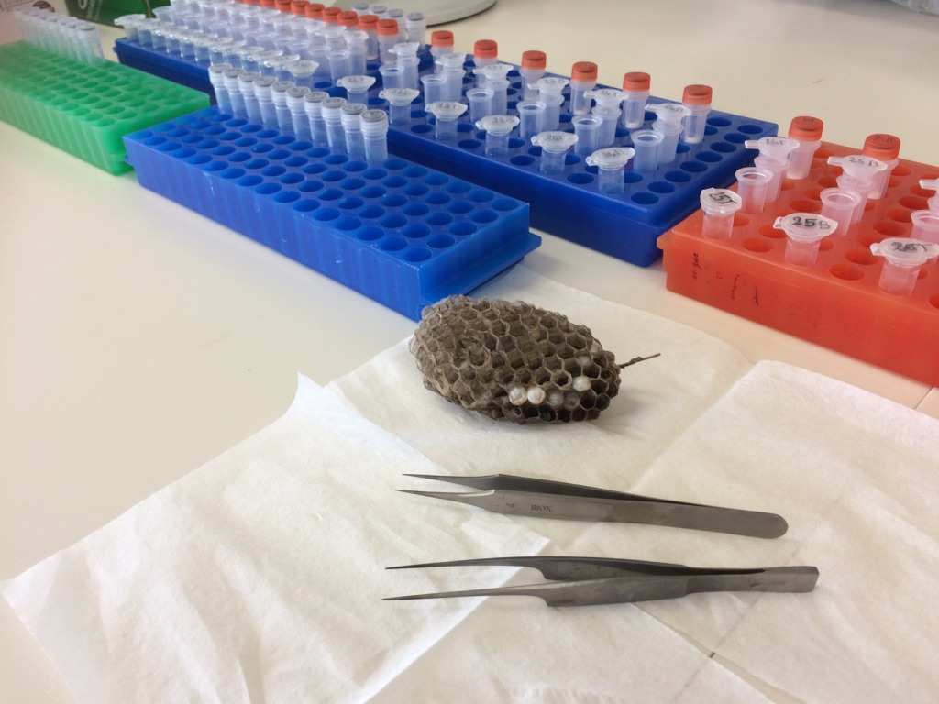
Methods: Nest prep
Meconium provides historical record of diet through development
Multi-layered nests provide a record of prey over weeks or months
Sampled meconium from inner and outer cells

Slide 8
Methods: DNA Seq
Extraction: ZR Tissue & Insect DNA MicroPrep extraction kit
Amplification: (MLepF1-LepR1 primers) of 450bp region of COI
Sequencing: Illumina MySeq technology
Reads organised in MOTUs and BLAST’d against Genbank database
(c) Pete McGregor via iNaturalistNZ (CC BY-NC-ND)

Slide 9
Results: Method
Analysis quality: All samples successfully amplified, on average 80,334 DNA reads (±6,435 sem) per sample
Of these, an average of 11,181 reads (±2,145 sem) per sample corresponded to prey DNA
Figure removed

Slide 10
Results: Method
Strongest identification at order or family level
Asian sp.
Aussie sp.
Figures removed

Slide 11
Results: Impact
Lepidoptera and thrips together contribute over 75% of prey diversity
Other work shows prey diversity roughly correlates with prey abundance
No diff in prey composition between outer/inner layers (ANOSIM, R=-0.007, P=0.703).
Figures removed

Slide 12
Results: Impact
Among the lepidopteran prey identified to species level:
- Several sequences belonging to pest species
- Several sequences belonging to native/endemic lepidopterans
Ctenopseustis obliquana
Declana floccosa
Planotortrix notophaea
Images © Landcare Research (CC-BY 4.0)

Slide 13
Conclusion
eDNA from the larval meconium provides a molecular inventory of prey MOTUs. These inventories cover an entire nesting season, rather than showing only a snapshot in time of prey diversity.
Most prey diversity was represented by lepidoptera, a finding in line with other types of work in this area. Thrips were also well represented.
No difference in prey diversity between older/younger cells: Nests may not have been old/large enough to observe a difference.
This method will now be applied to Vespula species, and could be applied to other invasive species.

Slide 14
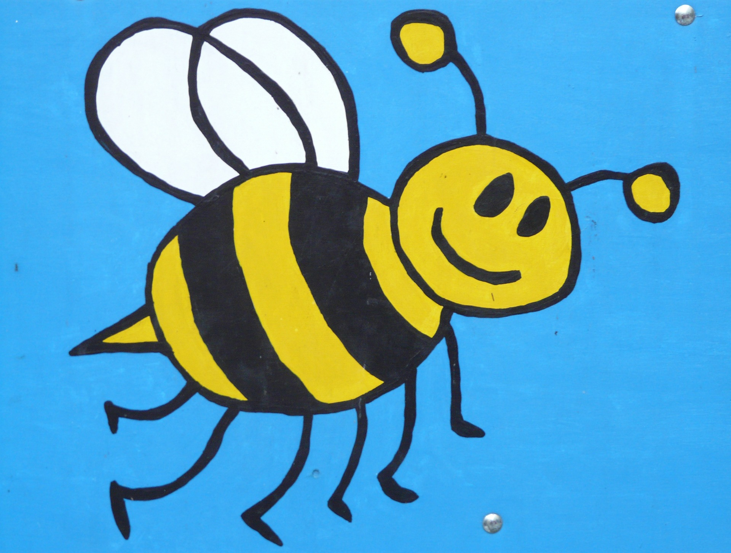
Thank you
TomSaunders.co.nz
@TomSaundersNZ

