Slide 1
FAIR enough? Can we (already) benefit from applying the FAIR data principles to software? Slides: https://doi.org/10.6084/m9.figshare.7449239 13th December 2018, AGU Fall Meeting. Washington DC Neil P. Chue Hong (@npch), Software Sustainability Institute ORCID: 0000-0002-8876-7606 | N.ChueHong@software.ac.uk with Daniel S. Katz (@danielskatz), NCSA / U. Illinois
Supported by
Project funding from
Slides licensed under CC-BY where indicated:
Notes:
The FAIR Guiding Principles were published to improve the reuse of scholarly data by making it findable, accessible, interoperable and reusable. The intent of the authors was that ”the principles apply not only to ‘data’ in the conventional sense, but also to the algorithms, tools, and workflows that led to that data”. Certainly, each of the four foundational principles make sense for research software: but can we apply them in such a way as to be useful? Can the training and guidance that has been developed to support FAIR data be repurposed easily for software? Can this provide an incentive that improves research software publishing more generally? How does FAIR for software relate to software management plans? This talk will discuss how the FAIR principles can be put into action for research software, why this is important and useful for research, and what this means for the transparency, reproducibility, and reusability of research software.

Slide 2
“The intent is that [the FAIR guiding principles] may act as a guideline for those wishing to enhance the reusability of their data […] specific emphasis on enhancing the ability of machines to automatically find and use the data, in addition to supporting its reuse by individuals.” - The FAIR Guiding Principles for scientific data management and stewardship, Scientific Data (2016), https://doi.org/10.1038/sdata.2016.18

Slide 3
What is FAIR
Findable: Easy to locate, using a unique and persistent identifier. Descriptive metadata to enable discovery.
Accessible: Easily retrieved by machines and humans using standard protocols, with metadata archived long-term.
Interoperable: Available in formats that can be exchanged, interpreted and combined, including metadata.
Reusable: Metadata ensures re-use for future research, with clear license and provenance, following community standards.
Adapted from: The FAIR Data Principles for Research Data
https://blogs.tib.eu/wp/tib/2017/09/12/ the-fair-data-principles-for-research-data/

Slide 4
FAIR Data Principles
FINDABLE:
F1. (meta)data are assigned a globally unique and persistent identifier.
F2. data are described with rich metadata.
F3. metadata clearly and explicitly include the identifier of the data it describes.
F4. (meta)data are registered or indexed in a searchable resource.
ACCESSIBLE:
A1 (meta)data are retrievable by their identifier using a standardized communications protocol.
A1.1 the protocol is open, free, and universally implementable.
A1.2 the protocol allows for an authentication and authorization procedure, where necessary.
A2 metadata are accessible, even when the data are no longer available.
INTEROPERABLE:
I1. metadata use a formal, accessible, shared, and broadly applicable language for knowledge representation.
I2. metadata use vocabularies that follow FAIR principles.
I3. metadata include qualified references to other metadata.
REUSABLE:
R1. metadata are richly described with a plurality of accurate and relevant attributes.
R1.1. metadata are released with a clear and accessible data usage license.
R1.2. metadata are associated with detailed provenance.
R1.3. metadata meet domain-relevant community standards.
The FAIR Guiding Principles for scientific data management and stewardship, Scientific Data (2016),
https://doi.org/10.1038/sdata.2016.18

Slide 5
Making software FAIR
“All scholarly digital research objects—from data to analytical pipelines—benefit from application of these principles, since all components of the research process must be available to ensure transparency, reproducibility, and reusability.”
FAIR Guiding Principles (2016), https://doi.org/10.1038/sdata.2016.18
How might we apply FAIR “broadly to all objects (including metadata, identifiers, software and DMPs) that are essential to the practice of research” and ensure that “guidelines for the implementation of FAIR in relation to [code] should be developed and followed”?
FAIR Data Action Plan (2018), https://doi.org/10.5281/zenodo.1285290
DOI: 10.6084/m9.figshare.7449239
Notes:
“Importantly, it is our intent that the principles apply not only to ‘data’ in the conventional sense, but also to the algorithms, tools, and workflows that led to that data. All scholarly digital research objects—from data to analytical pipelines—benefit from application of these principles, since all components of the research process must be available to ensure transparency, reproducibility, and reusability.”

Slide 6
Findable and Accessible
Software can be easily assigned persistent and unique identifiers, for products and versions
E.g. by depositing source code in repository like Zenodo to get a DOI but also PURLs, handles
Many metadata formats for describing software exist
Including community standards and crosswalks like CodeMeta
Well understood APIs for searching and retrieving software from code repositories, digital repositories, package / library archives
With metadata archived long-term in some of them
DOI: 10.6084/m9.figshare.7449239

Slide 7
Interoperable and Reusable
Software increasingly interoperable
Use of open, community-standard formats for data
Greater use of platform/plugin architectures
Use of common libraries and package managers
Community developed guidance / standards to improve re-use
for documentation, licensing, formats
For software development (improving provenance)
DOI: 10.6084/m9.figshare.7449239

Slide 8
Checklist for FAIR software
Write a Software Management Plan
Choose a license and make it clear (R1.1)
Use version control and follow good commit practice (R1.2)
Publish metadata to describe your software, and keep it updated (F2, F3, I2, R1.3)
Use open, community-standard file formats (I1, I2, I3)
Re-use well-maintained libraries / packages rather than reimplementing (I1, I3, R1.3)
Provide enough documentation to promote discovery and re-use (F4, R1)
Create releases, assign them identifiers, distribute via a repository or package library (F1, A1)
Deposit your software releases in an archival repository, along with metadata (F1, F4, A1, A2)
Publish citation for your software, including identifier, for others to use (F3, F4, R1.3)
DOI: 10.6084/m9.figshare.7449239

Slide 9
Checklist for FAIR software
Write a Software Management Plan
Choose a license and make it clear (R1.1)
Use version control and follow good commit practice (R1.2)
Publish metadata to describe your software, and keep it updated (F2, F3, I2, R1.3)
Use open, community-standard file formats (I1, I2, I3)
Re-use well-maintained libraries / packages rather than reimplementing (I1, I3, R1.3)
Provide enough documentation to promote discovery and re-use (F4, R1)
Create releases, assign them identifiers, distribute via a repository or package library (F1, A1)
Deposit your software releases in an archival repository, along with metadata (F1, F4, A1, A2)
Publish citation for your software, including identifier, for others to use (F3, F4, R1.3)
What do people find difficult? It’s the metadata – much easier to write software than to describe it for machines and humans
DOI: 10.6084/m9.figshare.7449239
Notes:
What do people find difficult? It’s the metadata – much easier to write software than to describe software for machines and humans

Slide 10
A lot of FAIR is already there
For software, we can achieve most of the spirit of FAIR through implementing better community software development practices
Still challenges, but they are mostly social or tooling
Guidelines for writing metadata and documentation to promote discovery and reuse by machines and humans
Searching for software across different repositories using a common API and metadata format
Software Management Plans / Research Output Management Plans becoming commonplace and machine-checkable
DOI: 10.6084/m9.figshare.7449239

Slide 11
Further reading
The FAIR Guiding Principles for scientific data management and stewardship, Scientific Data (2016), https://doi.org/10.1038/sdata.2016.18
The FAIR Data Principles for Research Data https://blogs.tib.eu/wp/tib/2017/09/12/the-fair-data-principles-for-research-data/
Implementing FAIR Data Principles: The Role of Libraries, https://libereurope.eu/wp-content/uploads/2017/12/LIBER-FAIR-Data.pdf
Cloudy, increasingly FAIR; revisiting the FAIR Data guiding principles for the European Open Science Cloud (2017), https://doi.org/10.3233/ISU-170824
FAIR Data Action Plan. Interim recommendations and actions from the European Commission Expert Group on FAIR data (2018), https://doi.org/10.5281/zenodo.1285290
Software citation principles. PeerJ Computer Science 2:e86 https://doi.org/10.7717/peerj-cs.86
CodeMeta: an exchange schema for software metadata. Version 2.0. KNB Data Repository. doi:10.5063/schema/codemeta-2.0
ESIP Software Guidelines: https://esipfed.github.io/Software-Assessment-Guidelines/
ESIP Software Citation guidelines
DOI: 10.6084/m9.figshare.7449239

Slide 12
Acknowledgements
The SSI team/alumni:
Aleksandra Nenadic
Aleksandra Pawlik
Alexander Hay
Arno Proeme
Carole Goble
Claire Wyatt
Clem Hadfield
Dave De Roure
Devasena Prasad
Giacomo Peru
Graeme Smith
Iain Emsley
James Graham
John Robinson
Les Carr
Malcolm Atkinson
Malcolm Illingworth
Mario Antonioletti
Mark Parsons
Mike Jackson
Olivier Philippe
Priyanka Singh
Raniere Silva
Rob Baxter
Robin Wilson
Shoaib Sufi
Simon Hettrick
Stephen Crouch
Tim Parkinson
Toni Collis
Plus the SSI Fellows and RSE community
Scientific software:
Dan Katz
Heather Piowowar
James Howison
Jeff Carver
Jennifer Schopf
Jessica Hausman
Kaitlin Thaney
Martin Fenner
Shelley Stodden
Victoria Stodden
WSSSPE community
Software/Data Carpentry
Greg Wilson
Jonah Duckles
Tracy Teal
Instructor Community
Supported by EPSRC Grant EP/H043160/1 + EPSRC/ESRC/BBSRC grant EP/N006410/1

Slide 13
Find out more about the SSI
Community Engagement (Lead: Shoaib Sufi)
Fellowship Programme & Events and Workshops
Consultancy (Lead: Steve Crouch)
Open Call for Projects / Collaborations
Online Software Evaluation & Software Management Planning
Policy and Publicity (Lead: Simon Hettrick)
Case Studies / Policy Campaigns
Software and Research Blog
Training (Lead: Aleksandra Nenadic)
Software Carpentry and Data Carpentry
Guides and Top Tips
Journal of Open Research Software (Editor: Neil Chue Hong)
Collaboration between universities of Edinburgh, Manchester, Oxford and Southampton Supported by EPSRC Grant EP/H043160/1 + EPSRC/ESRC/BBSRC grant EP/N006410/1

Slide 14
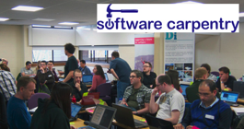
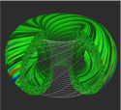
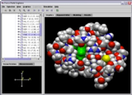
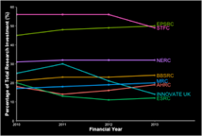
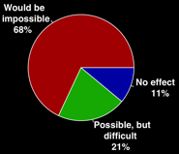
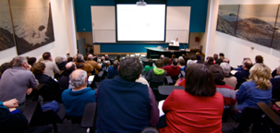
Software
Training
Helping the community to develop software that meets the needs of reliable, reproducible, and reusable research
Delivering essential software skills to researchers via CDTs, institutions & doctoral schools
Outreach
Exploiting our platform to enable engagement, delivery & uptake
Collecting evidence on the community’s software use & sharing with stakeholders
Bringing together the right people to understand and address topical issues
Policy
Community

Slide 15
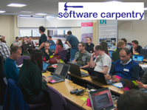
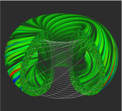
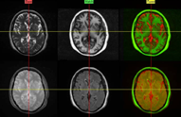
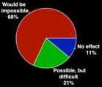
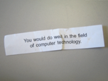
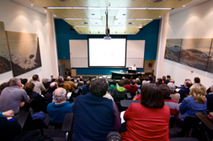
Software
Training
Advice
Courses
35+ UK SWC workshops
1000+ learners
Consultancy
50+ projects
130+ evaluations
4 surgeries
Guides
Outreach
80+ guides
50,000 readers
Website & blog
150+ contributed articles
20,000 unique visitors per month
3,000 Twitter followers
Research
740 researchers 50,000 grants analysed
Campaigns
Workshops
Fellowship
100+ domain ambassadors
300+ RSEs engaged
2100 signatures
13 issues highlighted
Policy
Community
20+ workshops organised

