Slide 1
ORCID Infrastructure for Facilitating Data Sharing Attribution
Eric Olson
Engagement and Partnerships Lead, North America
e.olson@orcid.org
https://0000-0002-5989-8244
AGU Fall meeting| 11 December 2018

Slide 2
Names are messy!

Slide 3
Pids for people, places, & things
Coming soon…
Onyar!

Slide 4
ORCID’s vision is a world where
all who participate in research, scholarship, and innovation are uniquely identified
and connected to their contributions and affiliations across time, disciplines, and borders.

Slide 5
These connections matter because research progress, programs, and careers and based on the communication of ideas.
The connections are made possible by a network of partners working together with the purpose of improving how we share research information.

Slide 6
Connections for culture change

Slide 7
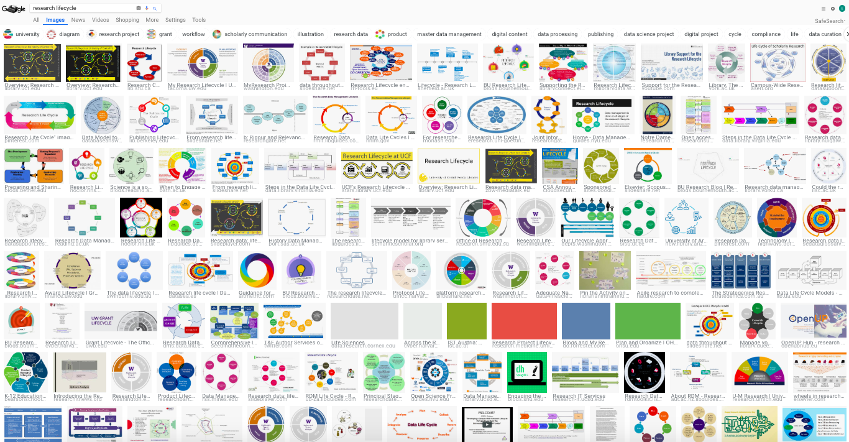
The research whirlpool

Slide 8
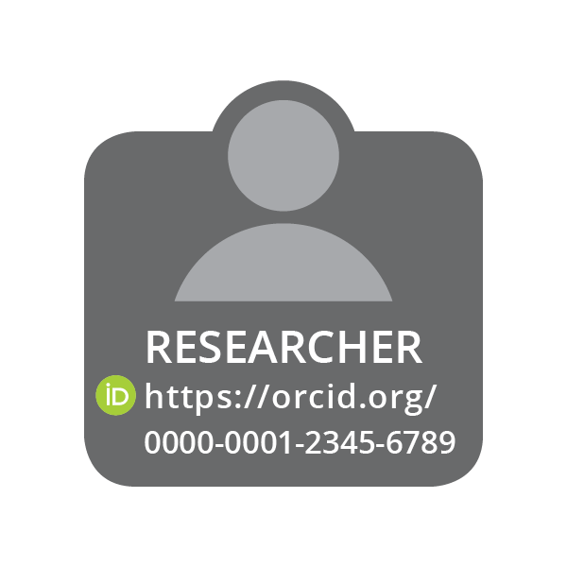
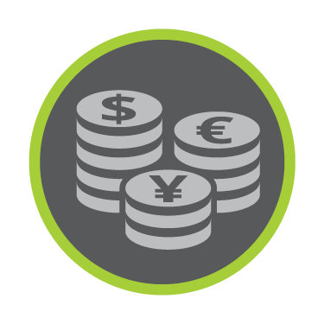
Cross-sector Partner Network
PUBLISHER
&
REPOSITORY
Assert authorship & data contributions
Universities and Labs
Assert faculty or staff affiliation
CONNECT
COLLECT
COLLECT
CONNECT
COLLECT
CONNECT
FUNDER
&
FACILITATOR
Assert grant, facilities, and equipment award

Slide 9
OUR GLOBAL COMMUNITY
5.6m researchers have registered for an iD. 2.3m have connected their iD with other information: 35m works, ~600K grants, ~600K reviews, ~2.9m education and 2.0m employment items
933+ member organizations in 47 countries have built ORCID into more than 500 system integrations across all sectors of the research community
18 national ORCID consortia in the UK, Finland, Sweden, Norway, Denmark, Netherlands, Belgium, Germany, Italy, South Africa, Taiwan, Australia, New Zealand, Brazil, Canada, and US
https://orcid.org/statistics

Slide 10
Build habits - build trust

Slide 11
RESEARCHER control and the ORCID record
The ORCID record lists information that the researcher has chosen to connect to their iD. The researcher owns the record, and decides how (or if) it is shared.
Researchers add their iD using an electronic “handshake”, as they interact with research systems.
The iD is embedded in the researcher’s contribution by the publisher or funder system, creating a provenanced connection.

Slide 12
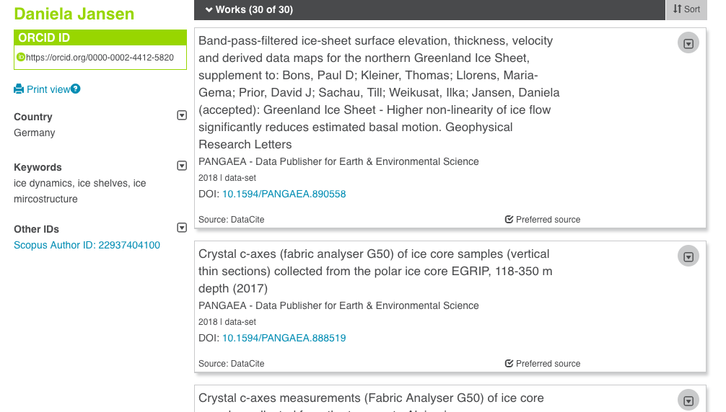
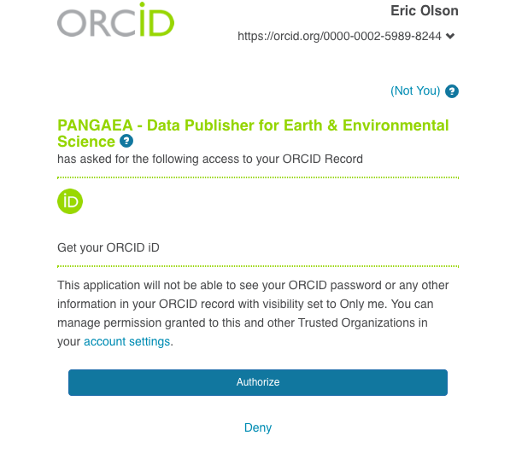
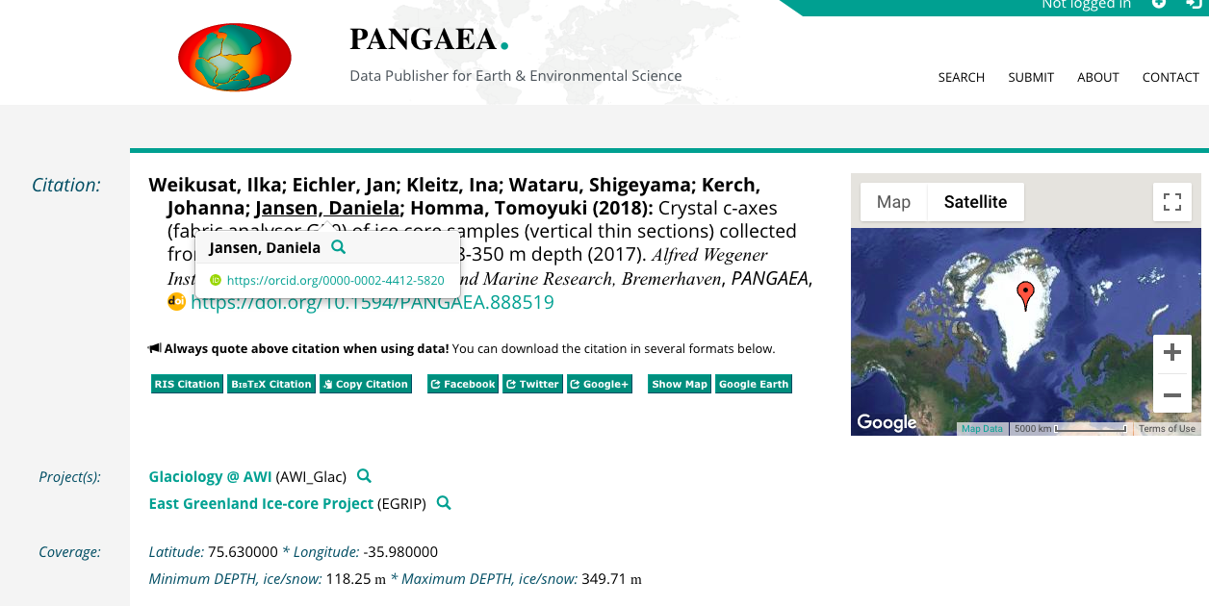
Habits + Trust

Slide 13
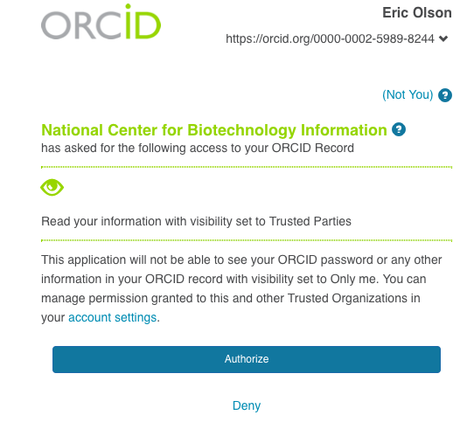
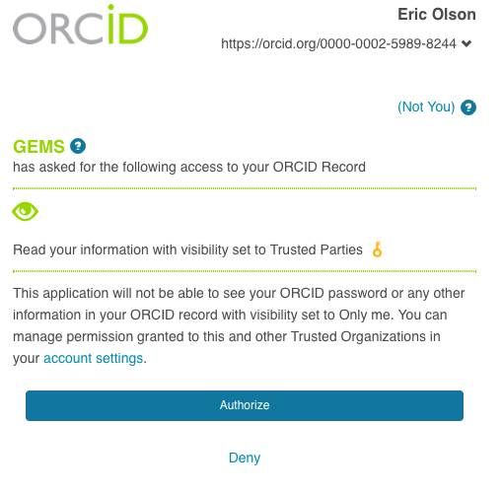
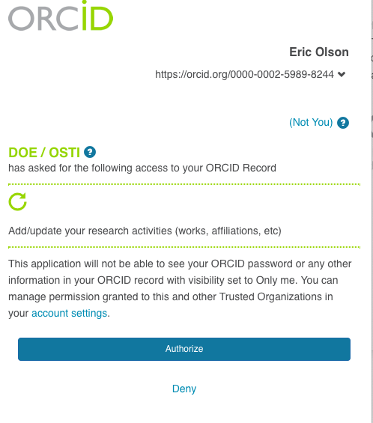
Habits + Trust

Slide 14
Find the bright spots

Slide 15
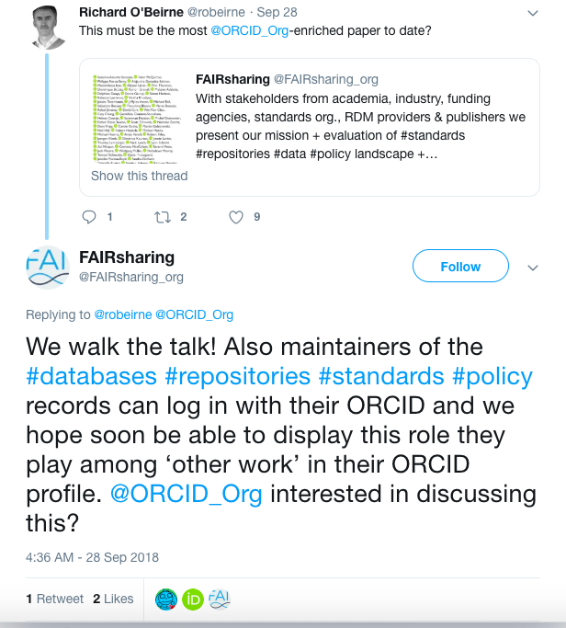
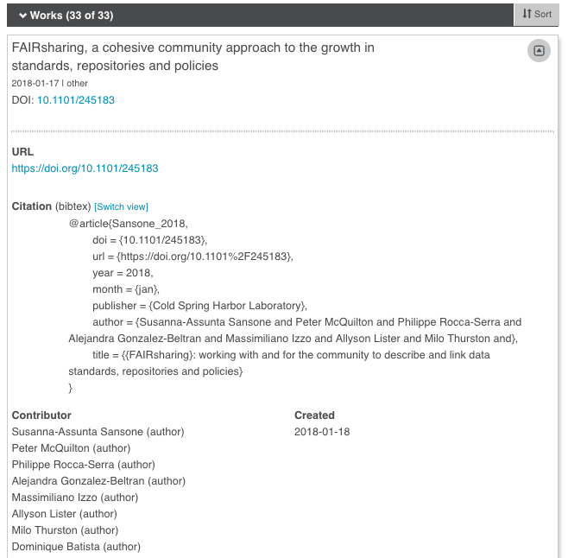
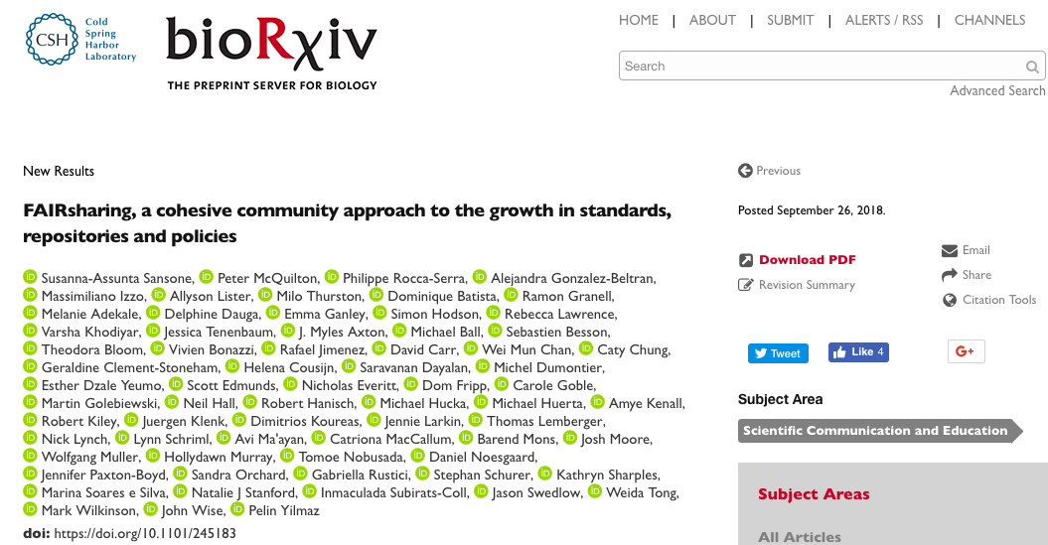
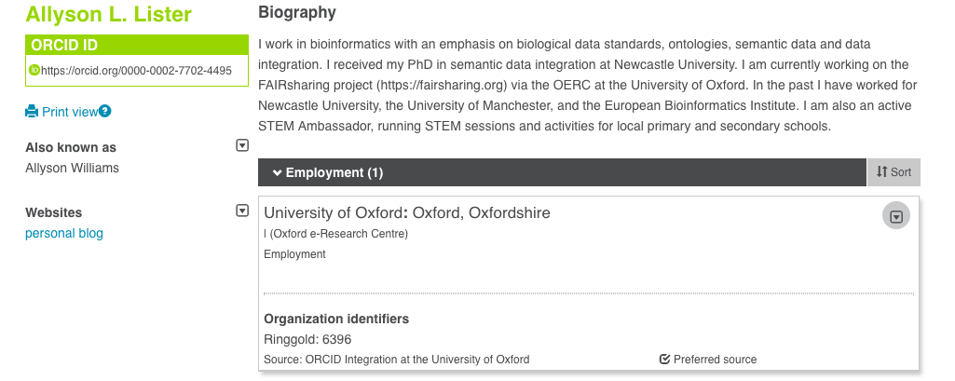
Find the bright spots

Slide 16
Tweak the environment

Slide 17
Tweak the environment
Sometimes appeals directly to the researchers won’t be effective.
However, we can work to understand their behaviors and shape the workflows to make FAIR compliance easier and more appealing.
ORBIT Project – Funders, Research Institutions, Publishers
User Facilities and Publications Working Group – Facilities, Publishers, Research Institutions
ORCID in Publishing Working Group – Publishers
ORCID in Repositories Task Force – Repositories, Research Institutions
Trust Working Group – Research Institutions, Publishers
And Many More!

Slide 18
So how does orcid help fair?
Researchers can easily share their affiliations, contributions, and resources used (Researcher value added)
Transparent assertions are created in a robust machine and human readable and interoperable manner and with researcher permission (Community value added)
Assertions underpin an open graph of connections between people, places, and things, enabling tracking and reporting through article and/or ORCID record metadata (Institution/project value added)

Slide 19
So how does orcid help cultivate culture change?
Connecting and collaborating with research organizations across all sectors and across the globe.
Building trust through responsible data management and sharing practices.
Highlight the work of our exceptional partners.
Listen to the community and build based on their needs!

