Slide 1



Activating carbon dioxide on metal oxide (CrO_{x}, CuO_{x}, CeO_{x}) nanocluster modified TiO₂
Michael Nolan, Stephen Rhatigan
Tyndall National Institute, University College Cork, Cork, Ireland
michael.nolan@tyndall.ie
SusChem Project (Ulster, Northwestern): Science Foundation Ireland/DEL/NSF US-Ireland R&D Partnership

Slide 2
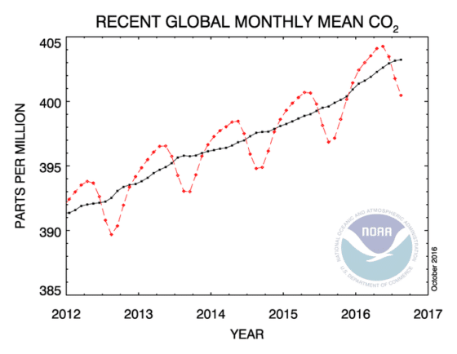
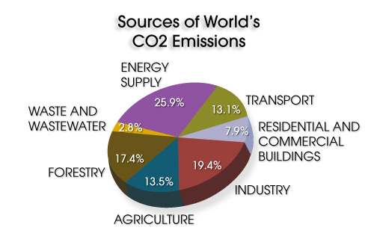
Introduction
Human society is dependent on burning cheap fossil fuels – release CO₂
Are there technologies to re-use this otherwise wasted CO₂ to produce high value chemicals/fuels?

Slide 3





Introduction
  SusChem Project (Ulster, Northwestern): Science Foundation Ireland/DEL/NSF US-Ireland R&D Partnership
  CO₂ conversion using combined photo/thermochemical process on modified oxides
  BIOGO project (EU Framework 7 NMP-2013-Large)
  CO₂ conversion on metal-modified metal oxides

Slide 4
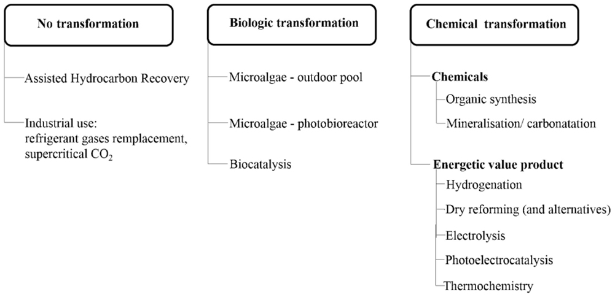
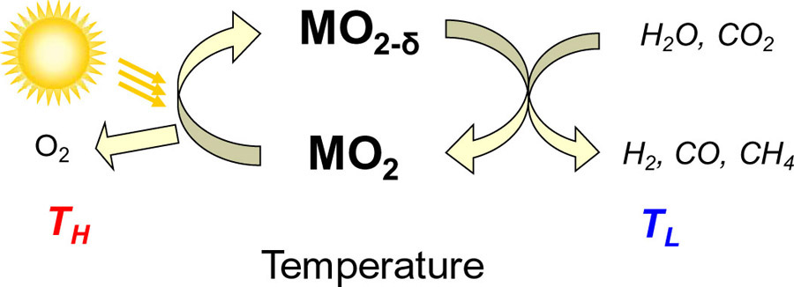
Introduction
Solar-thermal
  Use a high temperature cycle to reduce a metal oxide
  Concentrated solar energy
  Low(er) temperature chemistry to convert CO₂ over reduced metal oxide into chemicals
Front. Energy Res., 02 October 2015 |

Slide 5
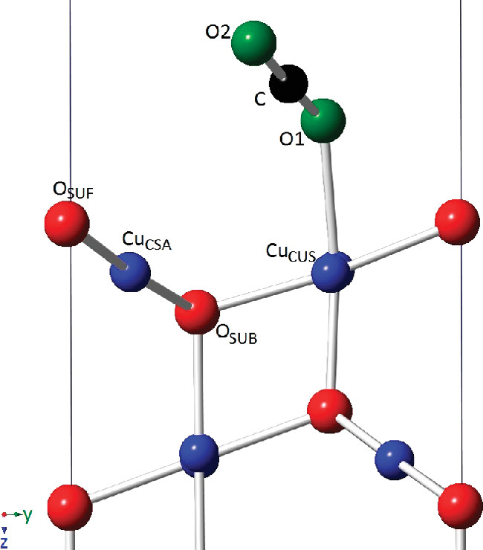
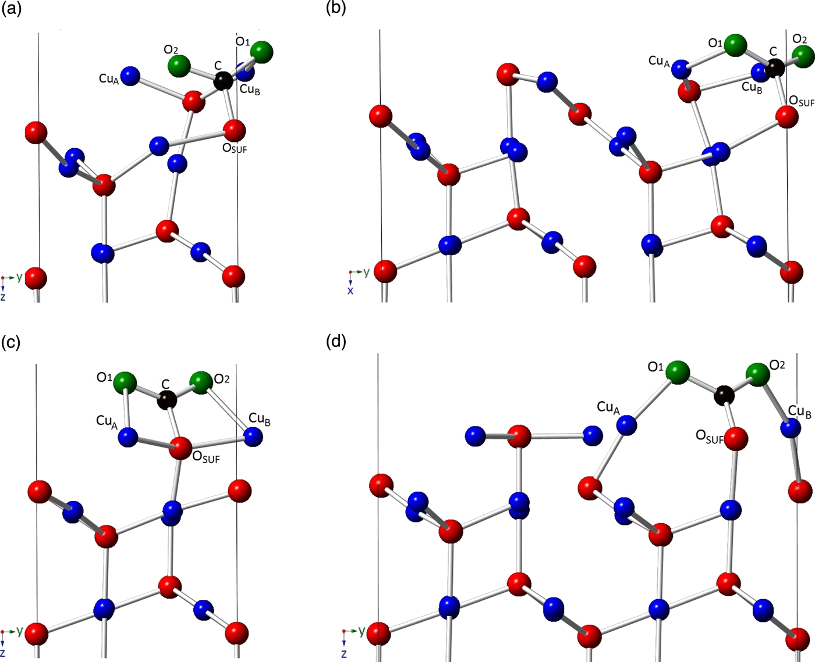
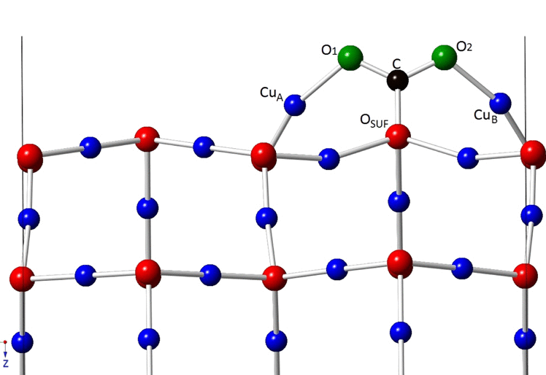
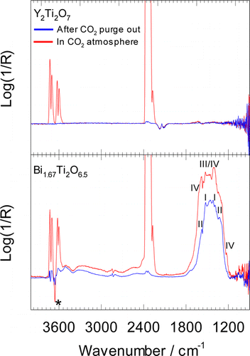
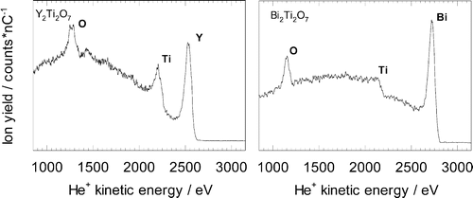
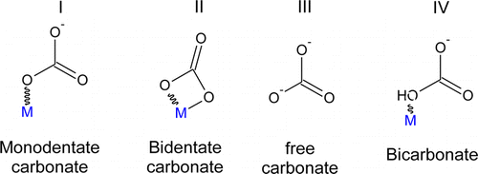
Introduction
CO₂ interaction at Cu₂O Surfaces (de Leeuw JCP 2016)
High energy surfaces
Low energy surface
CO₂@Cu₂O(111):O
-0.51 eV
CO₂@Cu₂O(111):Cu
-1.17 eV -0.97 eV
CO₂@Cu₂O(110):Cu
-1.17 eV
Bi-pyrochlore (Walker et al. Chem Mat 2016)
Bi-rich surface layer

Slide 6
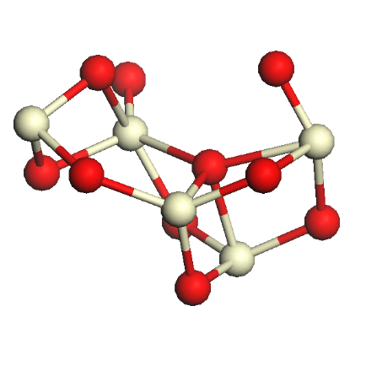
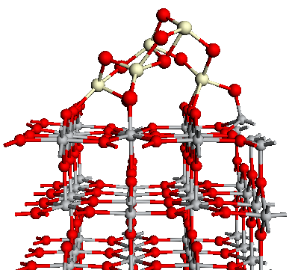
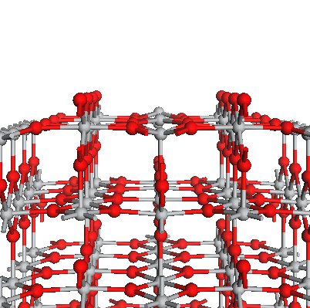
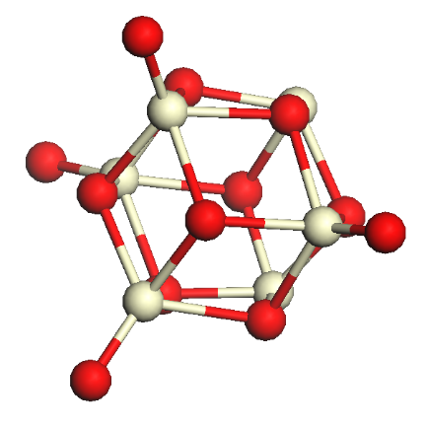
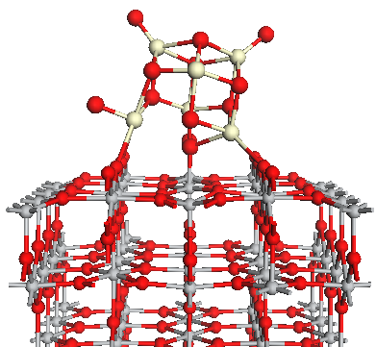
CeO₂-modified Rutile TiO₂
CO₂ interaction at Surface Modified TiO₂: CeO₂-modified Rutile (110)
Ce₅O₁₀
E_{ads} = -4.75 eV
Clean Rutile (110)
Ce₆O₁₂
E_{ads} = -2.47 eV

Slide 7
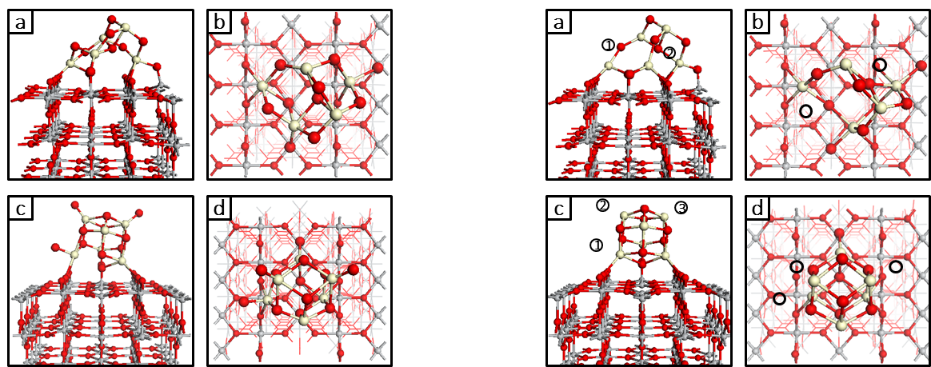
Oxygen Vacancy Formation in CeO₂-modified Rutile TiO₂
Stoichiometric and reduced CeO₂ NCs on (110) surface of rutile TiO₂

Slide 8
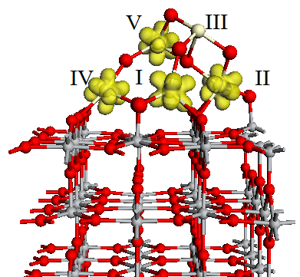
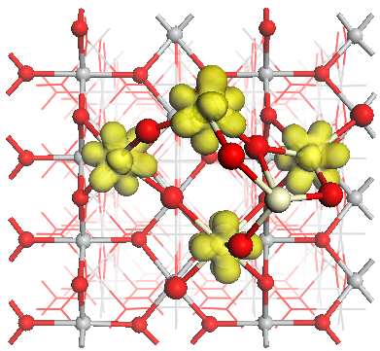
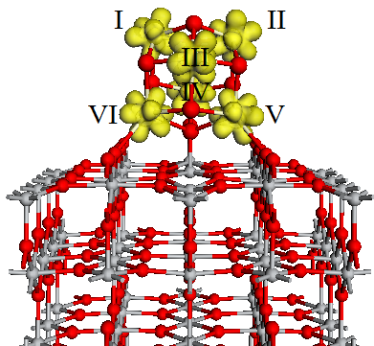
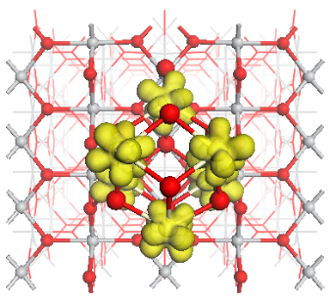
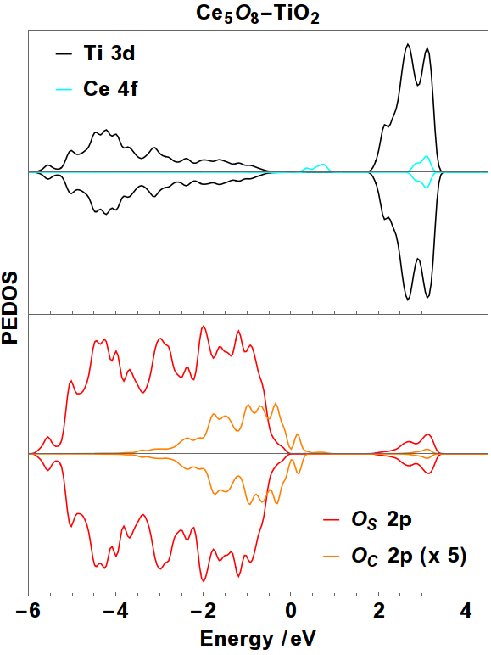
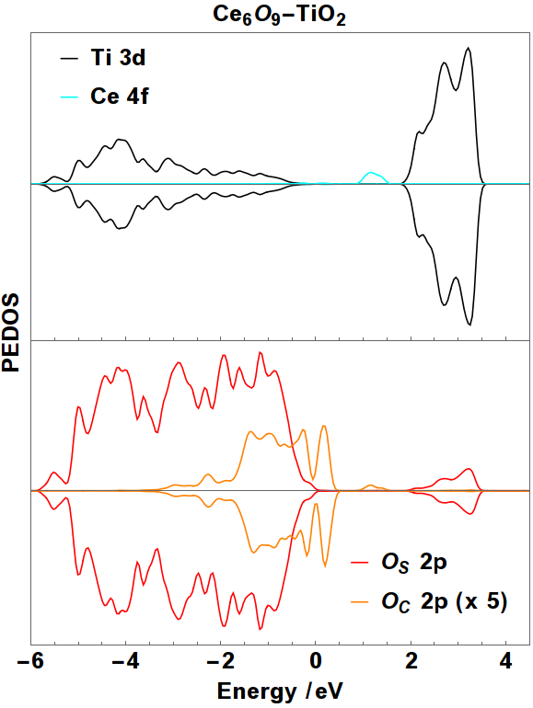
Reduced CeO_{2-x}-Modified TiO₂
Reduced NCs: charge localisation and DOS plots

Slide 9
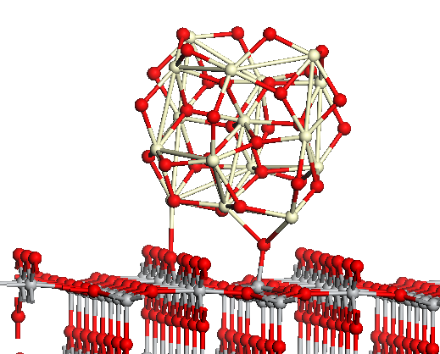
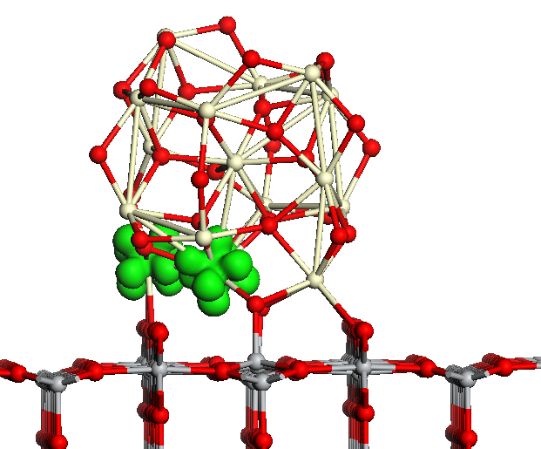
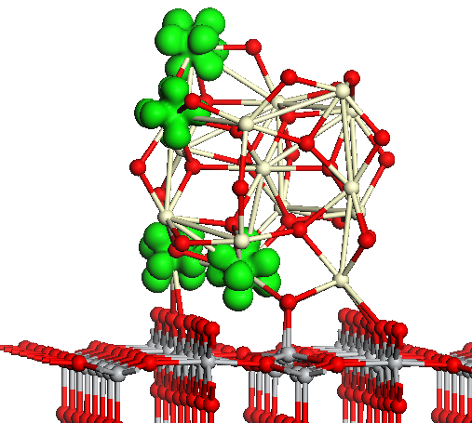
Larger CeO_{2-x}-Modified Rutile TiO₂
E^{vac} = -1.59 eV – non-stoichiometric ground state
(Ce₁₆O₃₂)-modified TiO₂
E^{vac} = +1.23 eV
Moderate cost for reduction
Reduced Ce³⁺present

Slide 10
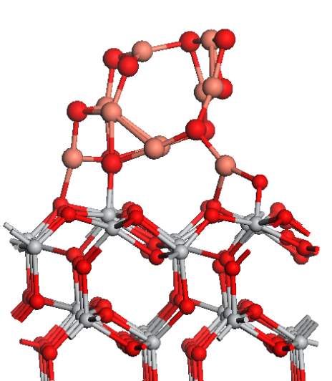
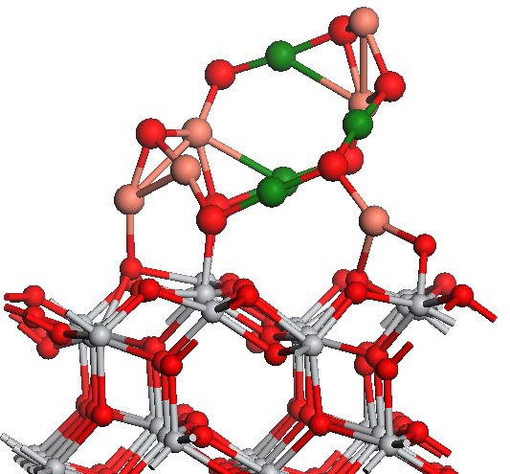
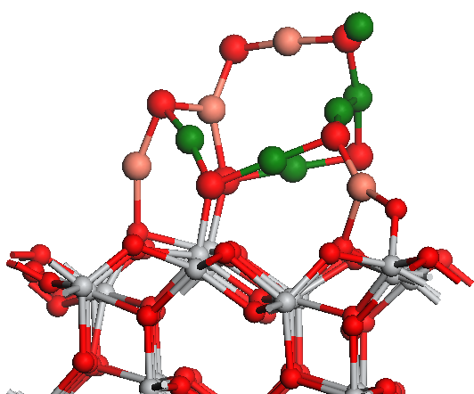
CuO_{x}-nanocluster modified Anatase (101)
CuO-anatase(101) TiO₂
First O vacancy:
Energy cost of -0.13 eV
Second O vacancy:
Energy cost of +0.06 eV
Highly defective CuO:
Mix of Cu⁺ and Cu²⁺ species
Third O vacancy
E = + 1.2 eV Reducing
Formation of active defect where CO₂ could interact
Mix of Cu⁺ and Cu²⁺ species

Slide 11
CuO-anatase(101) TiO₂
CuO-anatase(101) TiO₂
2 O vacancies
CuO-anatase(101) TiO₂
3 O vacancies

Slide 12
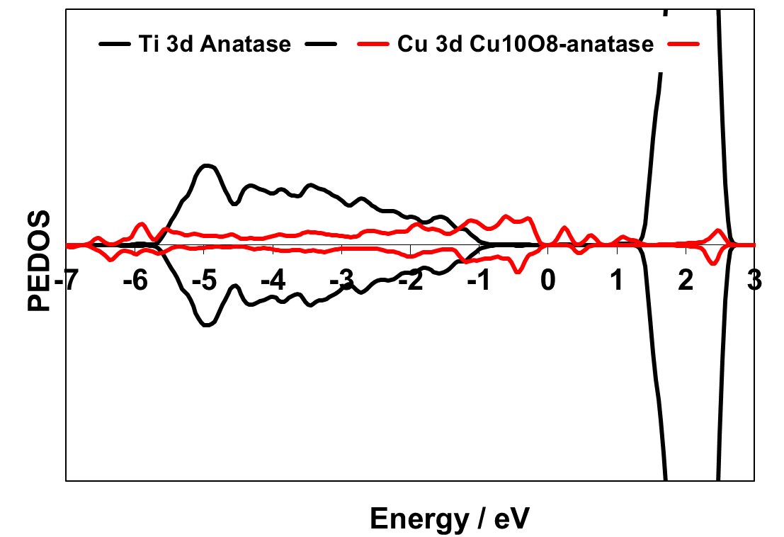
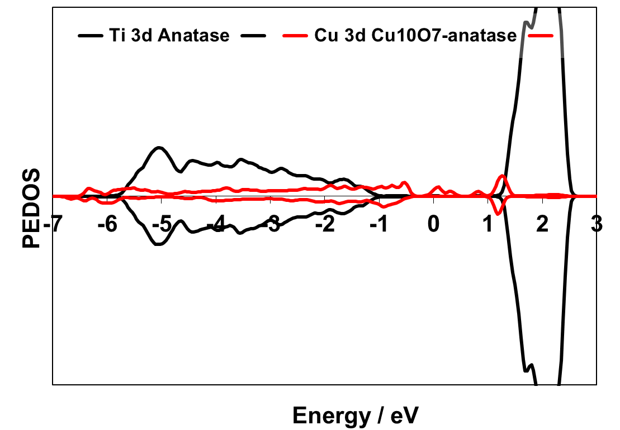
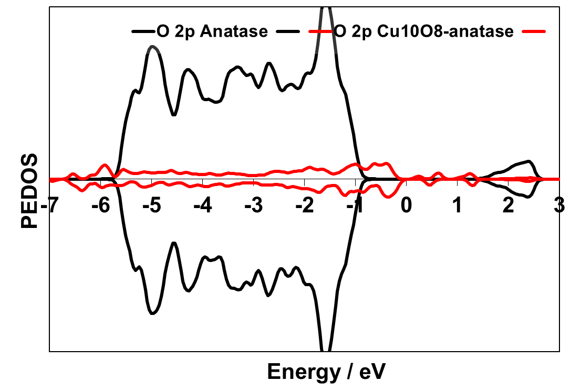
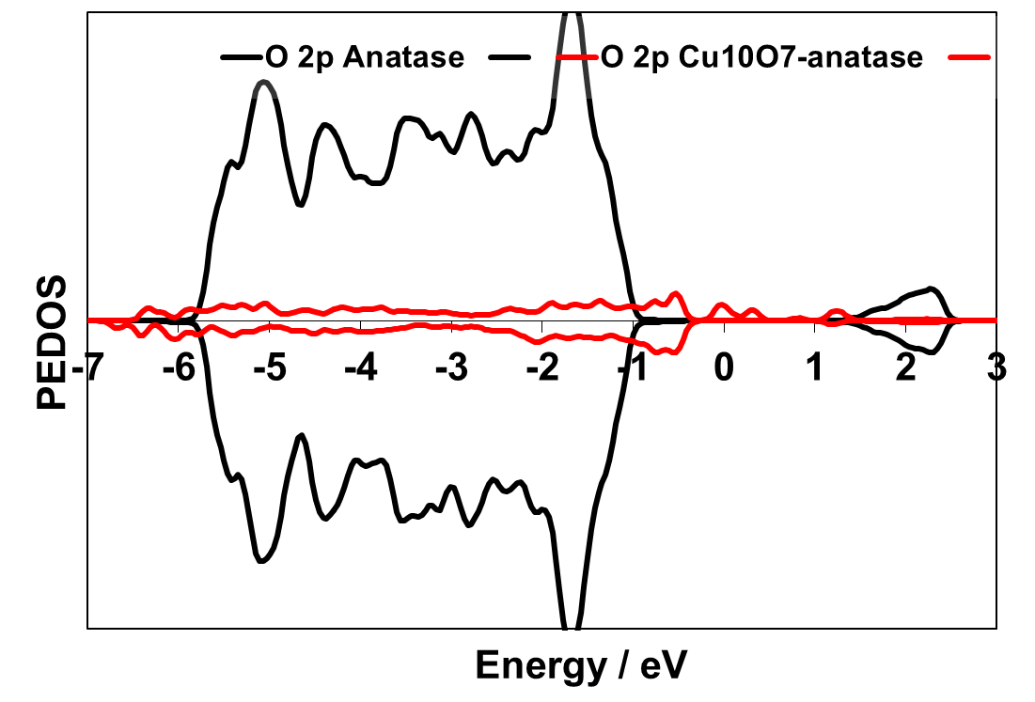
CuO_{x}-nanocluster modified Anatase (101)
CuO electronic states in the anatase(101) TiO₂ Energy gap

Slide 13
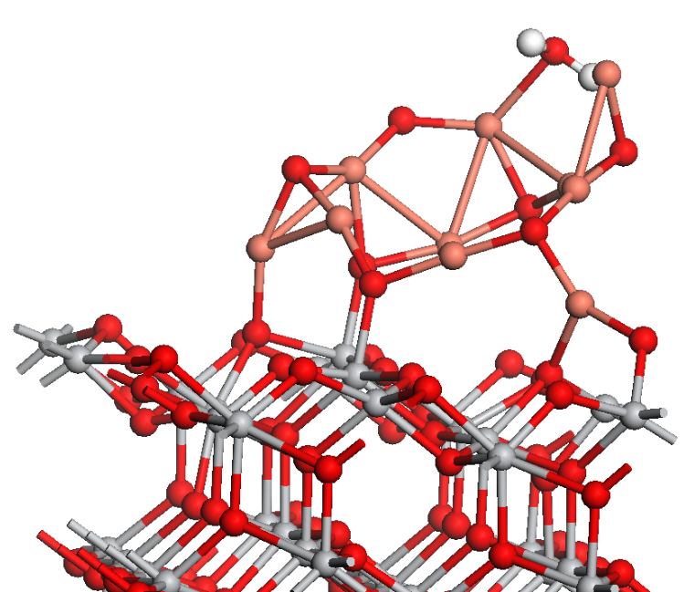
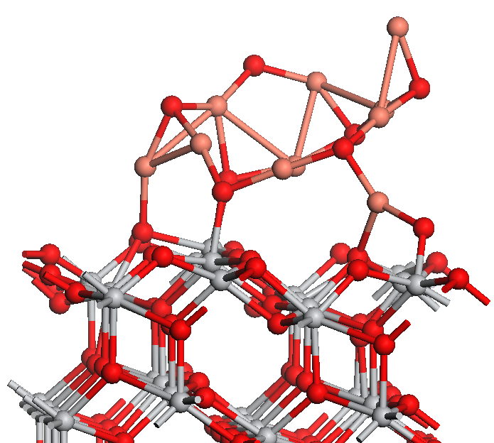
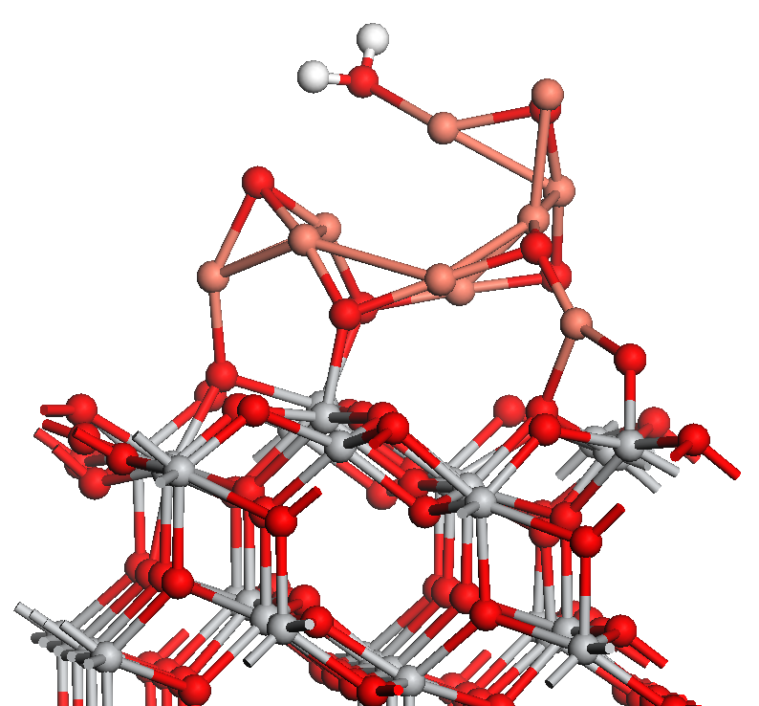
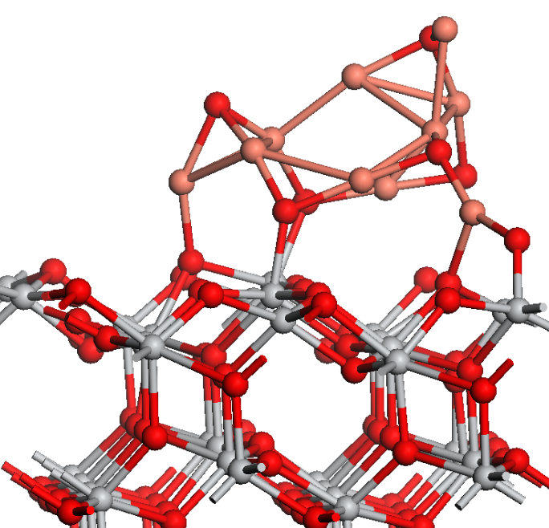
CuO_{x}-nanocluster modified Anatase (101)
(a)
(b)
E^{ads} = -2.22 eV
E^{desorb} = 0.42 eV
Reduction by interaction with H₂
Oxygen vacancy produced by water formation and desorption
Similar to extended CuO (111)
MN PCCP 2014
(c)
(d)
E^{ads} = -2.78 eV
E^{desorb} = 0.42 eV

Slide 14
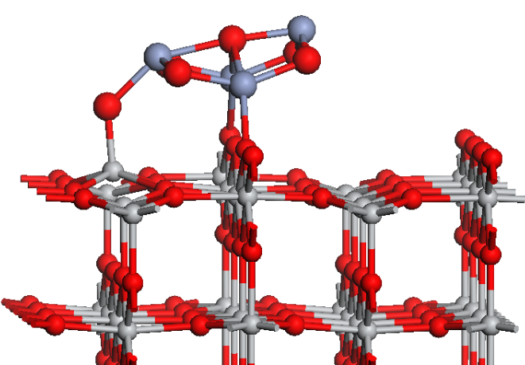
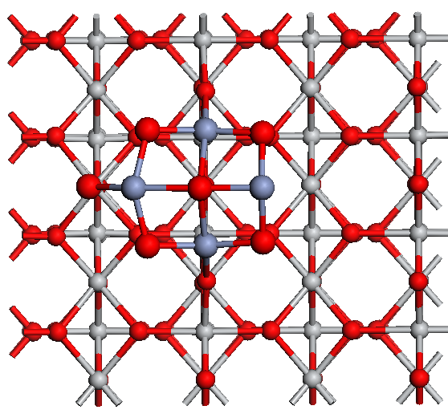
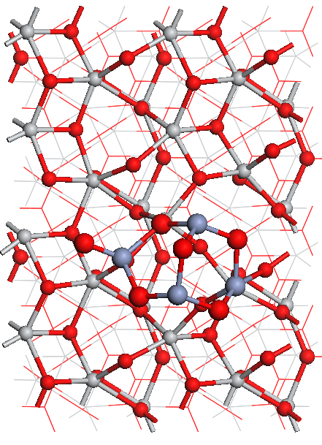
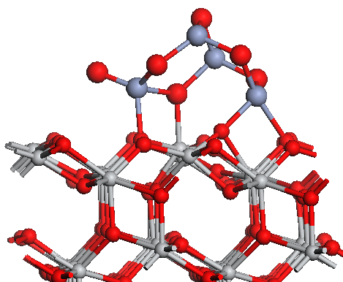
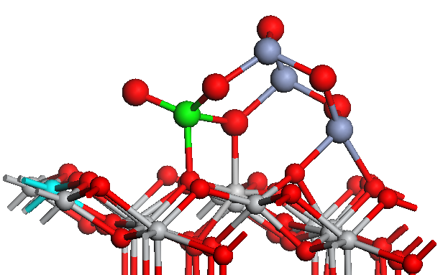
Cr₂O₃-nanocluster modified Rutile and Anatase
Cr₄O₆-rutile (110)
Cr₄O₆-anatase (101)
Cr⁴⁺
Ti³⁺

Slide 15
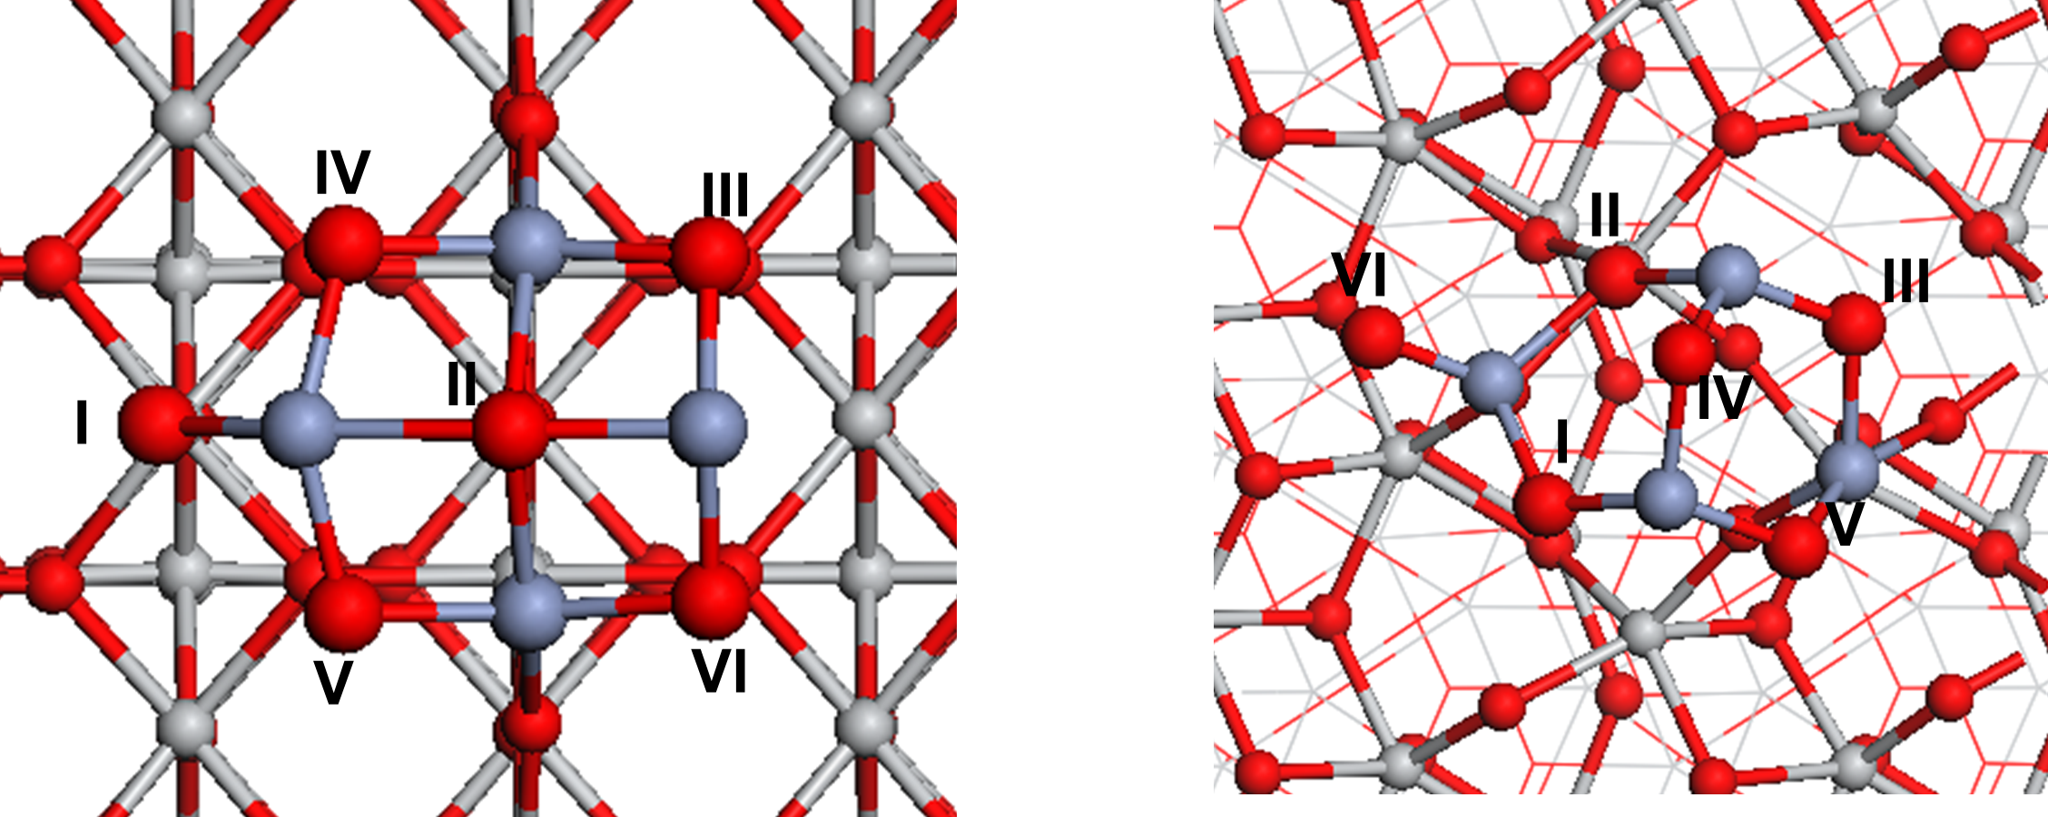
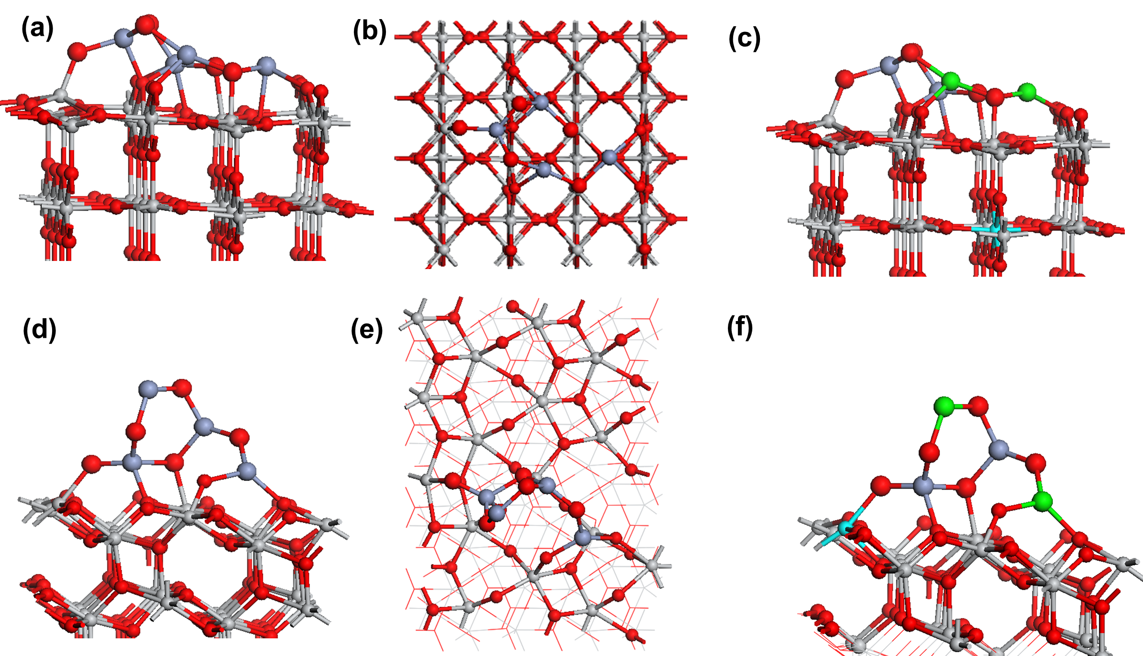
Cr₂O₃-nanocluster modified Rutile and Anatase
Cr₄O₆-rutile (110)
Cr₄O₆-anatase (101)

Slide 16
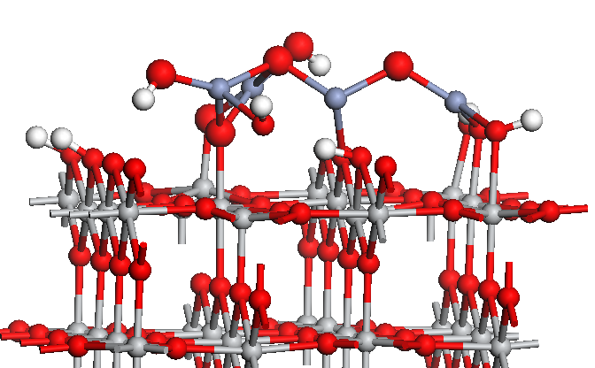
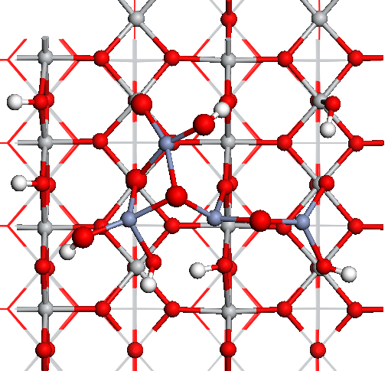
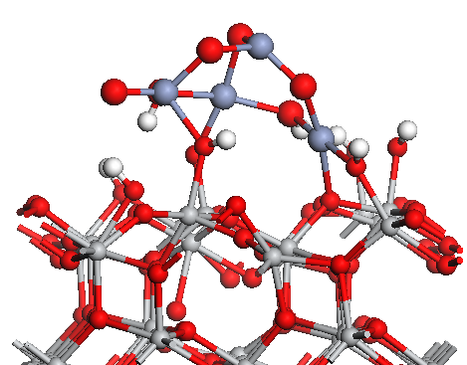
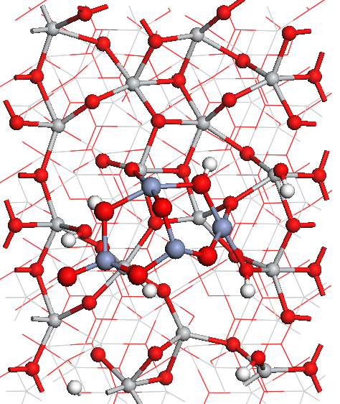
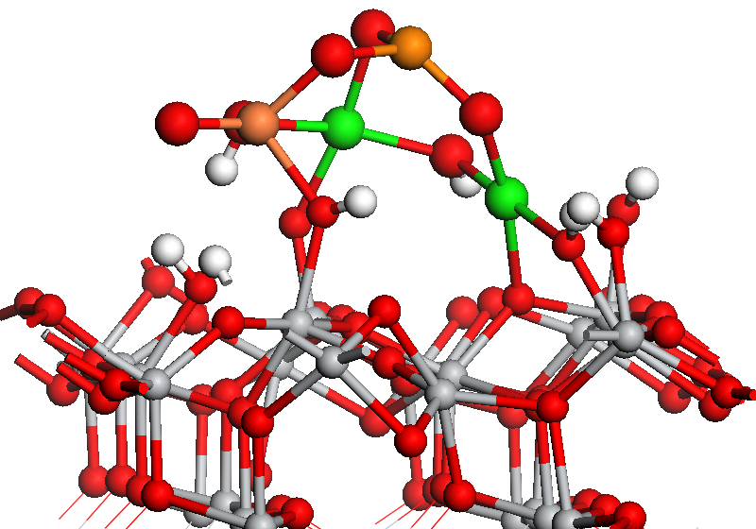
Cr₂O₃-nanocluster modified Hydroxylated Rutile and Anatase
(a)
(b)
(c)
(d)
(e)
Cr²⁺
Cr⁴⁺

Slide 17
Cr₄O₆-OH-rutile (110)
Cr₄O₆-OH-anatase (101)
Cr²⁺
Cr⁴⁺

Slide 18
CO₂ Interactions at metal oxide nanocluster modifier Rutile and Anatase TiO₂

Slide 19
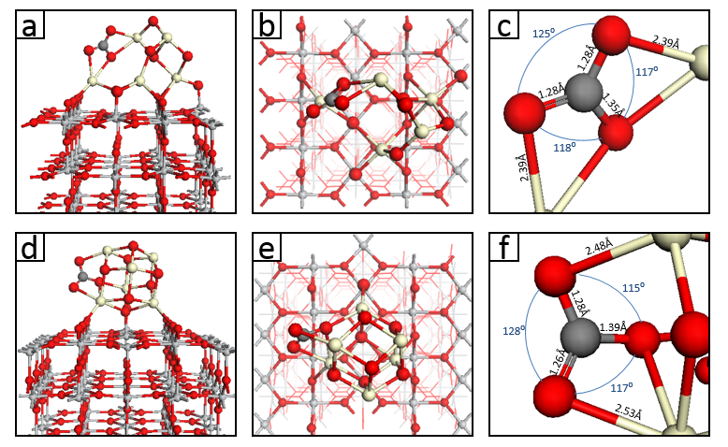
CO₂ adsorption and activation at CeO_{x}-Rutile
CO₂ adsorption at oxygen vacancy sites
  Adsorption energies Up to -0.9 eV (Ce₅O₈)
  Up to -1.7 eV (Ce₆O₁₀)
  C-O bonds elongated by up to 10%
  O-C-O bending

Slide 20
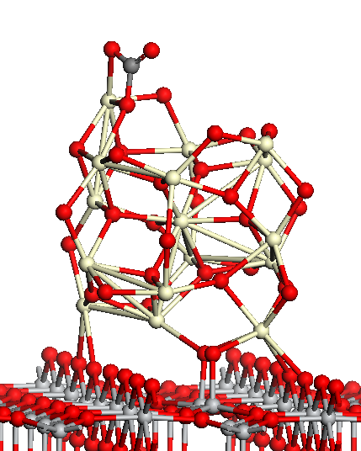
CO₂ adsorption and activation at CeO_{x}-Rutile
(Ce₁₆O₃₂)-modified TiO₂
CO₂ adsorption at oxygen vacancy sites:
  Adsorption energy -2.65 eV
  C-O bonds elongated by 0.10 → 0.12 Å (10%)
  O-C-O bending

Slide 21




CO₂ adsorption and activation at CuO_{x}-Rutile
CO₂@Cu₁₀O₈-anatase
III E = -2.42 eV
CO₂@Cu₁₀O₈-anatase + H₂
II E = -0.70 eV
Cu₁₀O₈-anatase

Slide 22


Cu₁₀O₈-anatase
Cu₁₀O₇-anatase

Slide 23


CO₂ adsorption and activation at CuO_{x}-Rutile
CO₂@Cu₁₀O₇-anatase
on TiO₂ E = -1.75 eV
CO₂@Cu₁₀O₇-anatase II
E = -1.00 eV
Cu₁₀O₇-anatase
Cu₁₀O₇-Anatase (101)
Cu₁₀O₇-Anatase (101) + CO₂ CO₂ vibrational modes / cm⁻¹ | 1622, 1266, 623, 603
Free CO₂ vibrational modes / cm⁻¹ | 2354, 1325, 632 (degenerate)

Slide 24




CO₂ adsorption and activation at Cr₂O₃ -Rutile
Cr₄O₆-Rutile (110) CO₂ I
E^{ads} = -0.63 eV
Cr₄O₆-Rutile (110) CO₂ II
E^{ads} = -0.91 eV
Cr₄O₆- Rutile (110)
Cr₄O₆-Rutile (110) + CO₂ CO₂ vibrational modes / cm⁻¹ | 1589, 1226, 921, 803
Cr₄O₆-H₂O-Rutile (110) + CO₂ CO₂ vibrational modes / cm⁻¹ | 1774, 1152, 899, 796
Free CO₂ vibrational modes / cm⁻¹ | 2354, 1325, 632 (degenerate)
Cr₄O₆-H₂O-Rutile (110) CO₂ I
E^{ads} = -0.92 eV
Cr₄O₆-H₂O-Rutile (110) CO₂ II
E^{ads} = -0.31 eV

Slide 25


Cr₄O₆-rutile (110)
Cr₄O₆-antase (101)
Cr₄O₆-OH-rutile (110)
Cr₄O₆-OH-anatase (101)

Slide 26


CO₂ adsorption and activation at Cr₂O₃ -Anatase
Cr₄O₆-Anatase (101) CO₂ I
E^{ads} = -2 eV
Cr₄O₆-Anatase (101) CO₂ II
E^{ads} = -0.1 eV
CO formed directly
Cr₄O₆-H₂O-Anatase (101) CO₂ I
E^{ads} = -0.71 eV
Cr₄O₆-H₂O-Anatase (101) CO₂ II
E^{ads} = -1.11 eV
Cr₄O₆- Anatase (101)
Bi₄O₆-Anatase (101) + CO₂ CO₂ vibrational modes / cm⁻¹ | 1617, 1210, 915, 906
Cr₄O₆-H₂O-Anatase (101) + CO₂ CO₂ vibrational modes / cm⁻¹ | 1642, 1243, 959, 777
Free CO₂ vibrational modes / cm⁻¹ | 2354, 1325, 632 (degenerate)

Slide 27
Summary
DFT studies of oxide nanocluster modified rutile/anatase TiO₂ for CO₂ activation
Supported CeO₂ is off-stoichiometric with Ce³⁺
Supported CuO is off-stoichiometric with mixed Cu⁺/Cu²⁺
All supported oxide clusters adsorb and activate CO₂
Bending of O-C-O angle to ~127-130º; elongation of C-O distances
Strong red shift in C=O stretch of up to 750cm⁻¹ and lift O-C-O bend degeneracy

Slide 28





CO₂ adsorption and activation at CuO_{x}-Rutile
COOH + OH
E = -1.73 eV
COOH + OH
CO₂@Cu₁₀O₇-anatase II + H₂ III
E (H2) = - 3.85 eV
Form H₂O

Slide 29



CO₂ adsorption and activation at CuO_{x}-Rutile
COOH + OH
COOH + OH
E = 0 eV
Iso-energetic
Form H₂O
CO₂@Cu₁₀O₇-anatase II + H₂ on TiO₂ II
E (H2) = - 4.46eV
Relax to COOH + OH

