Slide 2
Exploring doping in bulk chromia: Effects of dopant oxidation state on composition, vacancy defects and vacancy migration
John J. Carey and Michael Nolan
Tyndall National Institute, University College Cork, Cork, Ireland
michael.nolan@tyndall.ie

Slide 3
Introduction
Chromium oxide is a reducible oxide with oxidation states from Cr(II) to Cr(VI)
Crystallises in different phases: CrO, Cr₂O₃, Cr₂O₅, and CrO₃
Hexagonal corundum structure (α-Cr₂O₃) the most thermodynamically stable at low temperatures and pressures.
Dielectric material with wide band gap ~ 3eV
Valence band maximum (VBM) and conduction band minimum (CBM) are a mix of Cr 3d states and O 2p states
Anti-ferromagnetic material with alternating “-+-+” Cr layers

Slide 4
Introduction
While not as widely used as TiO₂ or CeO₂ chromia finds many applications
Oxygenation catalysis, methanol synthesis, anode material for Li-ion batteries, gas sensors, solid oxide fuel cells, protective coatings, adhesion promotors
Defect formation key to properties
p-type TCO materials: Mg/Ni:Cr₂O₃ – important role of defects in promoting TCO characteristics
Dielectric material with wide band gap ~ 3eV
Valence band maximum (VBM) and conduction band minimum (CBM) are a mix of Cr 3d states and O 2p states
Anti-ferromagnetic material with alternating “-+-+” Cr layers
O vacancy formation – 4.11 eV
Cr vacancy – 4.59 eV

Slide 5
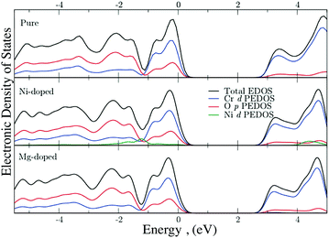
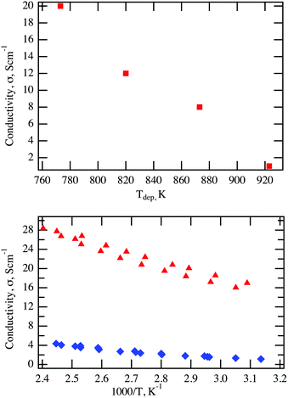
Example of p-type Doping
p-type TCO materials: Mg/Ni:Cr₂O₃ – important role of defects in promoting TCO characteristics
Conductivity of Ni-doped Cr₂O₃ prepared with 7% Ni function of deposition temperature
Comparison between the Arrhenius plot of a Ni-doped (red triangles) and a Mg-doped (blue diamonds) Cr2O3 thin films.
Ni doping introduces new states near VB edge which contributes to hole localisation
p-type defects favourable to form and under growth conditions not compensated

Slide 6
Monovalent Dopants in Bulk Cr₂O₃

Slide 7
Monovalent Dopants in Bulk Cr₂O₃
System | E[active Ov] (eV)
Cr₂O₃ | 4.11
Li-Cr₂O₃ | 2.71
Na-Cr₂O₃ | 2.27
K-Cr₂O₃ | 2.14
Rb-Cr₂O₃ | 1.09
System | PBE+U (eV) | HSE (eV)
Li-Cr₂O₃ | +0.71 | -2.78
Na-Cr₂O₃ | +0.68 | -2.49
K-Cr₂O₃ | -0.04 | -4.51
Rb-Cr₂O₃ | +0.13 | -3.82
Charge Compensation

Slide 8
Oxygen Migration in Bulk Cr₂O₃
[010]
[110]
[100]
Initial State
Transition State
Final State

Slide 9
Oxygen Migration in Doped Bulk Cr₂O₃
[010]
Li
K
Na
Rb
Initial State
Transition States
Final State
Initial State
Transition States
Final State

Slide 10
Oxygen Migration in Doped Bulk Cr₂O₃
[100]
Li
K
Na
Rb
Initial State
Transition States
Final State
Initial State
Transition States
Final State

Slide 11
Oxygen Migration in Doped Bulk Cr₂O₃
[110]
Li
K
Na
Rb
Initial State
Transition States
Final State
Initial State
Transition States
Final State

Slide 12
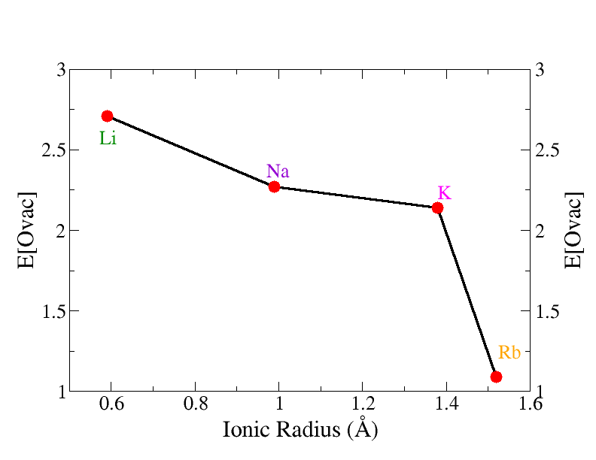
Monovalent Doped Bulk Cr₂O₃
 | E^{act} [010] direction (eV) | E^{act} [100] direction (eV) | E^{act} [110] direction (eV)
Cr₂O₃ | +3.30 | +3.30 | +3.30
Li-Cr₂O₃ | +1.59 | +3.14 | +3.99
Na-Cr₂O₃ | +2.83 | +2.77 | +4.41
K-Cr₂O₃ | +3.04 | +3.64 | +3.06
Rb-Cr₂O₃ | +4.52 | +3.30 | +4.34

Slide 13
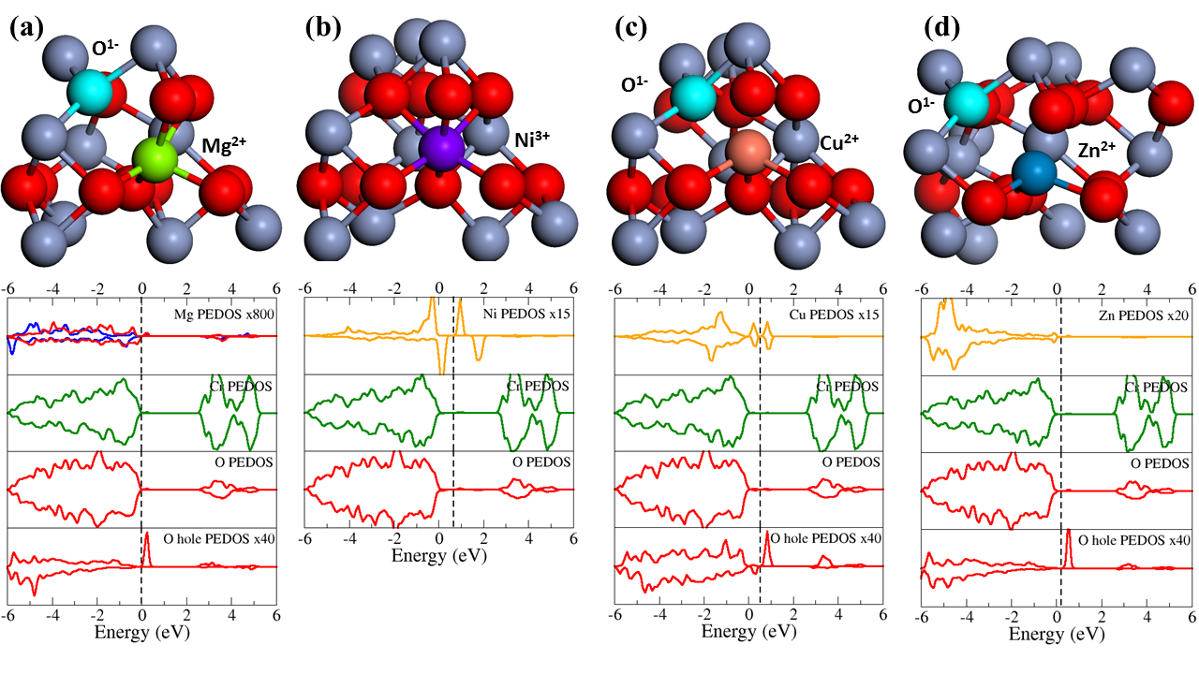
Divalent Doped Bulk Cr₂O₃

Slide 14
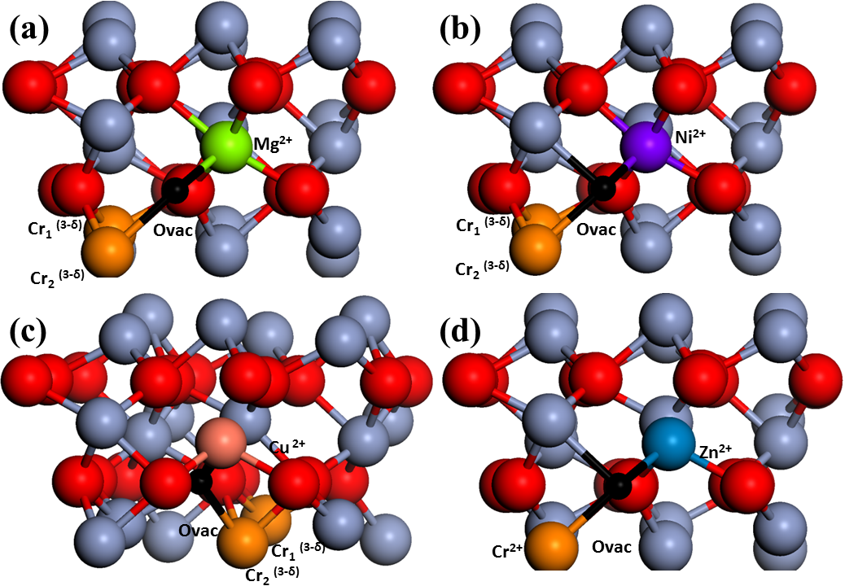
Divalent Doped Bulk Cr₂O₃
 | E[Ovac] (eV)
Undoped Cr₂O₃ | 4.11
Mg-Cr₂O₃ | 2.53
Ni-Cr₂O₃ | 2.45
Cu-Cr₂O₃ | 1.87
Zn-Cr₂O₃ | 2.86
2 electrons released: 1 fills oxygen hole, one partially reduces 2 Cr sites
This may result in too favourable oxygen vacancy formation

Slide 15
Divalent Doped Bulk Cr₂O₃
2 Mg + O vacancy to compensate holes
E = +1.43 eV (PBE+U)
E = -2.07 eV (HSE06)
Reducing oxygen vacancy
E = +2.38 eV

Slide 16
Divalent Doped Bulk Cr₂O₃
2 Cu + O vacancy to compensate holes
E = +0.84 eV (PBE+U)
E = -2.31 eV (HSE06)
Reducing oxygen vacancy
E = +2.86 eV

Slide 17
Divalent Doped Bulk Cr₂O₃ – Reducing Oxygen Vacancy
 | M-Cr₂O₃ E[Ovac] (eV) | 2M-Cr₂O₃ E[active] (eV)
Undoped Cr₂O₃ | 4.11 | 4.11
Mg doped | 2.53 | 2.38
Ni doped | 2.45 | 2.53
Cu doped | 1.87 | 2.86
Zn doped | 2.88 | 3.21
Clearly more favourable to for Ov to fill oxygen holes
Charge balanced composition promotes formation of reducing Ov compared to undoped Cr₂O₃
For Ni the energies are the same – no oxygen holes in both compositions
Possible concentration effect on Ni oxidation state?
Mg/Zn – O vacancy reduces two Cr cations to Cr³⁺
Ni/Cu – Reduction of Cr and dopant

Slide 18
Higher Valent Doping of Bulk Cr₂O₃
High valance dopants can introduce excess electrons:
$${Cr}_{Cr}^{x}+\frac{1}{2}O_{2}+{Cr}_{Cr}^{x}+MO_{2} →M_{Cr}^{∙}+ {Cr}_{Cr}^{′}+ {Cr}_{2}O_{3}$$
Which compensation processes will charge balance?
formation of negatively charged defects such as Cr vacancies ($V_{cr}^{′′′}$)
${3Cr}_{Cr}^{x}+{Cr}_{Cr}^{x}+{3MO}_{2} →{3M}_{Cr}^{∙}+V_{Cr}^{′′′}+2{Cr}_{2}O_{3}$
oxygen interstitials ($O_{i}^{′′})$
$$2{Cr}_{Cr}^{x}+∅+{2MO}_{2} →2M_{Cr}^{∙}+O_{i}^{′′}+ {Cr}_{2}O_{3}$$
Both defects produce hole states that are filled by electrons from the dopant

Slide 19
Higher Valent Doping of Bulk Cr₂O₃
High valance dopants
Ti³⁺, Ti⁴⁺
Ce³⁺, Ce⁴⁺
V³⁺, V ⁴⁺, V⁵⁺
Zr⁴⁺ - non-reducible
One HV dopant: Ti³⁺, Ce³⁺, V³⁺
Bader charge: 9.9 e⁻, 9.9e⁻, 11 e⁻
One Zr dopant: Zr⁴⁺, Cr²⁺
Bader charges:
9.4 e⁻, 4.6 e⁻
 | E_{f} [Cr vac] (eV)
Cr₂O₃ | 4.59
Ce – Cr₂O₃ | 2.60
Ti – Cr₂O₃ | 2.56
V – Cr₂O₃ | 3.65
Zr – Cr₂O₃ | 1.70
Ti/Ce/V: 2 O holes + dopant oxidation to +4
Zr: 2 O holes + Cr²⁺ → Cr³⁺
 | E_{f} [O vac] (eV)
Cr₂O₃ | 4.11
Ce – Cr₂O₃ | 3.89
Ti – Cr₂O₃ | 4.09
V – Cr₂O₃ | 4.45
Zr – Cr₂O₃ | 3.50
Ti/Ce/V: 2 Cr²⁺
Zr: 3 Cr²⁺

Slide 20
Higher Valent Doping of Bulk Cr₂O₃
Compensate HVD with $3M_{Cr}^{∙}+V_{Cr}^{′′′}$
 | E_{f} [3Cr vac] (eV)
3Ce – Cr₂O₃ | -0.18
3Ti – Cr₂O₃ | -0.64
3V – Cr₂O₃ | +0.81 (-1.35 eV HSE)
3Zr – Cr₂O₃ | -2.02

Slide 21
Higher Valent Doping of Bulk Cr₂O₃
 | E_{f} [O vac] (eV)
Cr₂O₃ | 4.11
Ce – Cr₂O₃ | 2.83
Ti – Cr₂O₃ | 3.04
V – Cr₂O₃ | 3.83
Zr – Cr₂O₃ | 3.14
Large ionic radius and favourable Ce³⁺ formation in Ce-Cr₂O₃

Slide 22
Higher Valent Doping of Bulk Cr₂O₃
Undoped Bulk Chromia has high cost for reducible oxygen vacancy (although similar to CeO₂).
Monovalent dopants charge compensated and can tune the migration of O vacancies
Anisotropic O migration – may retard Cr oxidation in stainless steel
Divalent dopants charge compensated
Can enhance formation of reducing oxygen vacancies
Higher valent dopants – depends on their reducibility: M³⁺ or M⁴⁺
Compensated by Cr vacancies
Ce doping can promote reducibility

