Slide 1
Investigating the difference in nucleation during Si-based ALD on different surfaces (Si, SiC, SiO₂ and SiN_{x}) for future area-selective deposition (AS-ALD)
E. A. Filatova^{*a}, A. Mameli^{b}, A. J. M. Mackus^{b}, F. Roozeboom^{b},
W.M.M. Kessels^{b}, D. Hausmann^{c}, S.D. Elliott^{a,d}
ª Tyndall National Institute, University College Cork, Ireland
^{b} Eindhoven University of Technology, The Netherlands
^{c} Lam Research Corporation, USA
^{d} currently at Schrödinger Inc, Ireland
24.07.2018
Notes:
Please use the title from the abstract

Slide 2
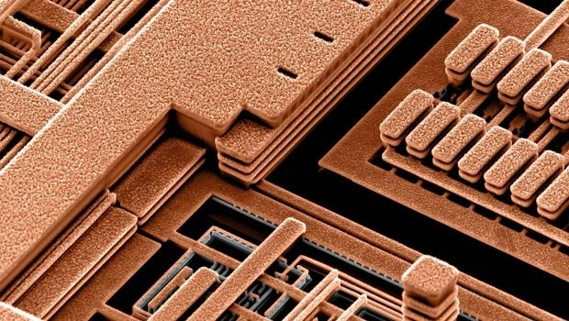
Microchip
Deposition of materials on high-aspect-ratio surfaces
source: Fundamentals of Semiconductor Devices, 2004, Betty Anderson, Richard Anderson

Slide 3
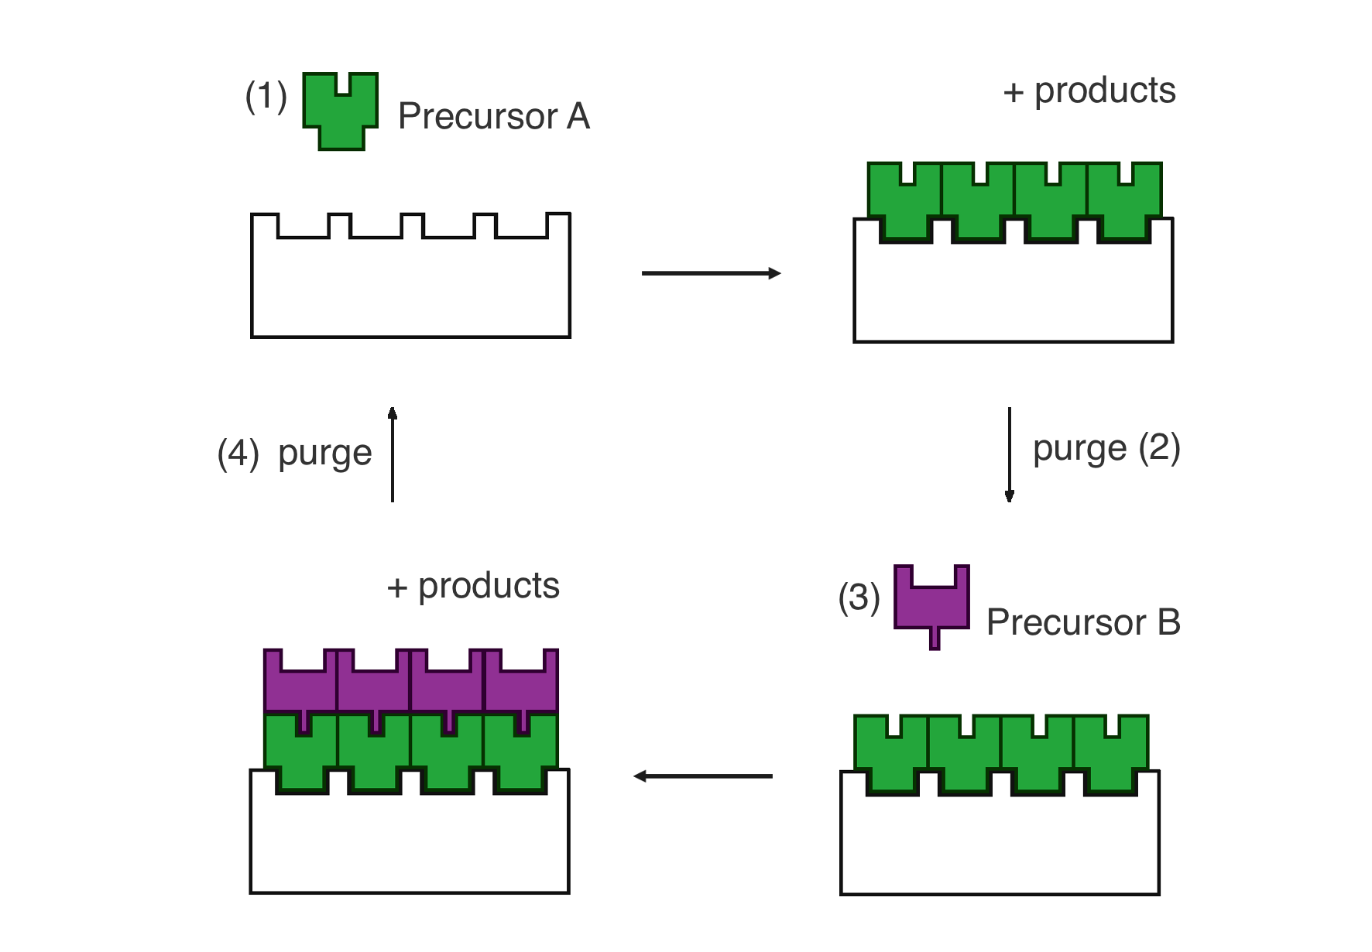
Atomic layer deposition (ALD)
precursor A
+ by-products
Low temperature
Conformal
on high-aspect-ratio surfaces
Precise thickness control
purge
precursor B
+ by-products

Slide 4
Conventional lateral dimension control Lithography
Removal of excess material using etching
Resist film patterned
by lithography
Misalignment error!
4
Notes:
Something seems to be missing here. I don’t see a misalignment error in the figure.

Slide 5
Alternative: self-aligned fabrication
area-selective ALD
Different surface chemistry
5
Notes:
You can refer here to self-aligned fabrication.

Slide 6
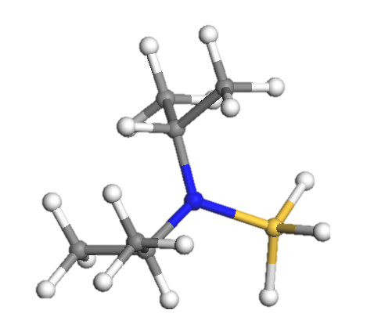
Theoretical modelling
for area-selective deposition
> 0 thermodynamically unfavorable
DFT:
ΔE
< 0 thermodynamically favorable
6
Notes:
Alfredo: Great! What about kinetics? Maybe you can also mention that in words

Slide 7
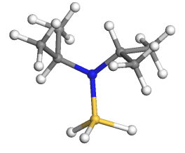
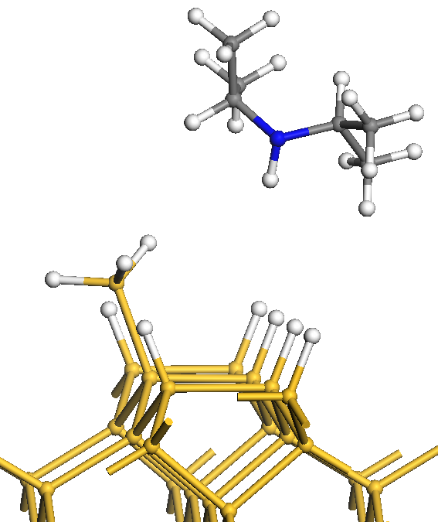
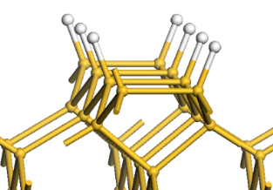
Theory: DFT Adsorption of Si precursor and elimination of one ligand
VASP software
ΔE = E _{(slab + precursor)} + E _{(by-products)} – E _{(slab)} – E _{(precursor)}
before reaction
after reaction
8

Slide 8
Goal: investigating the difference in nucleation during Si-based ALD for future area-selective deposition for electronic devices
SiC
Si₃N₄
Excellent barrier
Low-k
Low wet etch rate
SiO₂
Si
2
Notes:
About which material is the description at the right?

Slide 9
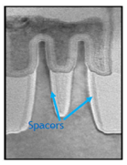
Si-based thin films for electronic devices: Applications
Low-k spacers/liners
Air gap liners for interlayer dielectric
3
Notes:
The reference is missing

Slide 10
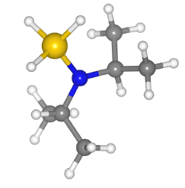
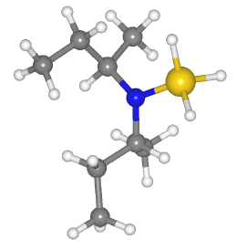
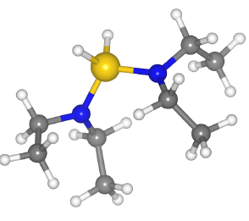
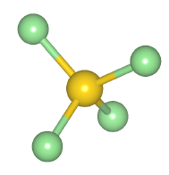
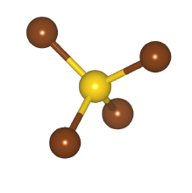
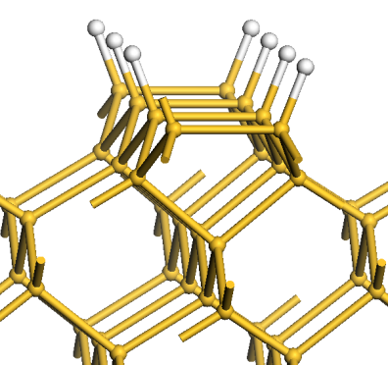
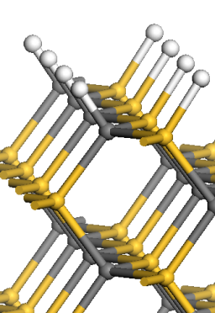
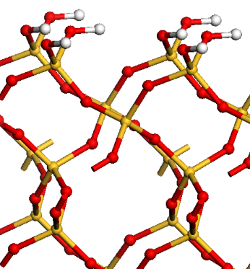
Investigating area-selective ALD
of Si-based materials
Precursors:
Aminosilanes
Halides
DIPAS
DSBAS
BTBAS
SiCl₄
SiBr₄
Surfaces:
Si:H
β-3C-SiC:H
α-quartz-SiO₂:OH
(0 0 1) 1X2
(0 1 1)
(0 0 1)
Side view
“Slab” – surface model (periodic in x and y, vacuum in z)
7

Slide 11
DFT results First precursor adsorption step
at T = 0 K
DIPAS
Precursors | ΔE, eV
 | Si:H | SiC:H | SiO₂:OH
DIPAS | 0.10 | 0.49 | -0.19
DSBAS | 0.08 | 0.46 | -0.21
BDEAS | -0.01 | 1.04 | -0.18
SiCl₄ | 0.64 | 1.17 | 0.35
SiBr₄ | 0.58 | 1.12 | 0.28
DSBAS
BDEAS
Aminosilane precursors:
Si
SiC
SiO₂
Halide precursors:
Si
SiC
SiO₂
9

Slide 12
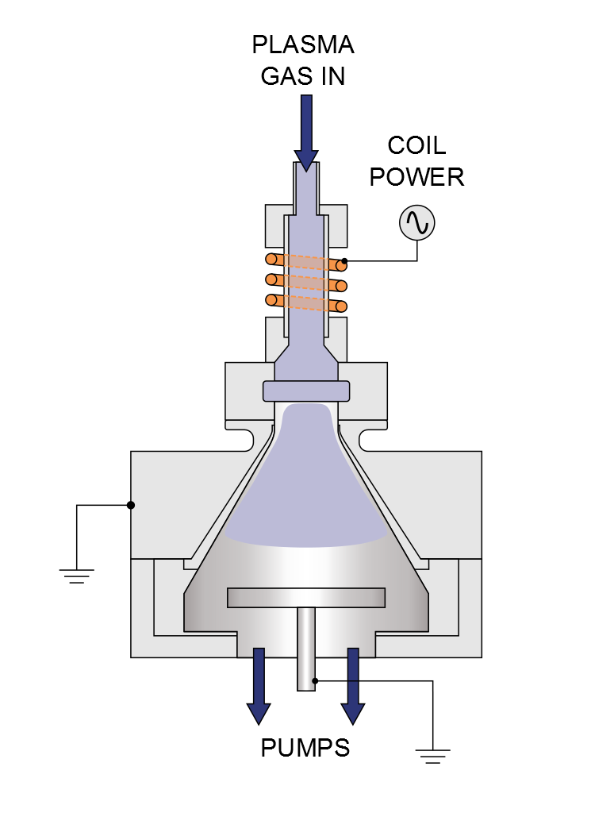
ALD experiment SiN_{x} PEALD
Precursor: DSBAS
N₂ plasma
150 ^{O}C
Flexal system, Oxford Instruments
Dr. Alfredo Mameli
Notes:
Flexal system from Oxford Instruments which is equipped with a turbo pump a load-lock 300 mm surstrate table and ICP plasma source

Slide 13
ALD experiment SiN_{x} PEALD
Surfaces:
Si:H
β-3C-SiC:H
α-quartz-SiO₂:OH
(0 0 1) 1X2
(0 1 1)
(0 0 1)
HF last c – Si:H
(HF 4 min on Si wafer)
H₂ plasma
SiC wafer
c - Si:OH
(native oxide on Si wafer)
10
Notes:
You should mention a bit more about the experimental details (e.g. refer to the use of ellipsometry, etc.). Please let me know if you need specific figures.

Slide 14
Spectroscopy ellipsometry (SE)
every half cycle
1 DSBAS dose
2 DSBAS dose
3 DSBAS dose
(SE)
(SE)
(SE)
(SE)
N₂ plasma dose

Slide 15
ALD experiment SiN_{x} PEALD
SE every half cycle
N₂ plasma modifies Si:H and SiC:H surface to SiN_{x},
allowing the growth on all of the surfaces
First DSBAS adsorption step:
Si
SiC
SiO₂
ΔE:
0.46 eV
0.08 eV
-0.21 eV
Selectivity
DFT predicts results right
12
Notes:
Especially this slide requires more explanation about how it is measured…
Please change ‘SiN thickness’ to ‘Apparent thickness’. After just dosing the precursor, it’s not SiN yet.
Including the reference data is confusing, since it should be a straight line if you measure after every SE halfcycle.
Alfredo: the reference is SiNx thickness grown on similar substrates after 5 cycles. The SiNx layers were grown for 200 cycles and measured in situ every 5 cycles. The thickness after the first 5 cycles is taken as a reference and to model the half-cycles data. But I agree that it can be confusing to the scope of the ppt. (so removed)
I sent you some literature on N2 plasma modification of Si surfaces, you can maybe cite one of those papers.

Slide 16
Conclusions
None of halide precursors SiCl₄, SiBr₄ adsorb on Si-based surfaces at 0K
Selectivity! Aminosilane precursor DSBAS adsorbs selectively on SiO₂ and Si₃N₄ not on Si and SiC
N₂ plasma modifies Si and SiC surface to SiN_{x},
allowing the growth on all of the surfaces
DFT predicts the experiment right
13
Notes:
It would be good to also refer to the modelling results for the other precursors here.
“Selective growth” should be “Selective adsorption”.
Si:H and SiO2 instead of Si:H twice

Slide 17
Acknowledgements

Slide 18
Ekaterina Filatova Email: ekaterina.filatova@tyndall.ie
Theoretical modelling of area-selective atomic layer deposition (AS-ALD) Si-based materials
Notes:
Please use the title from the abstract

