Slide 1
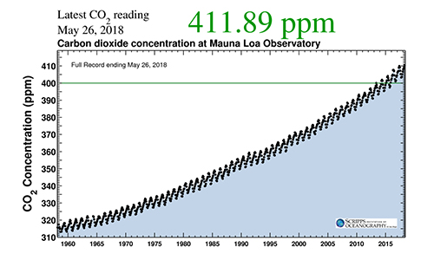
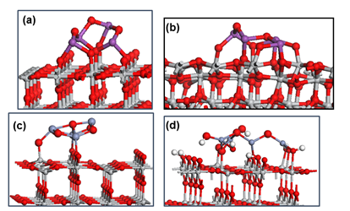
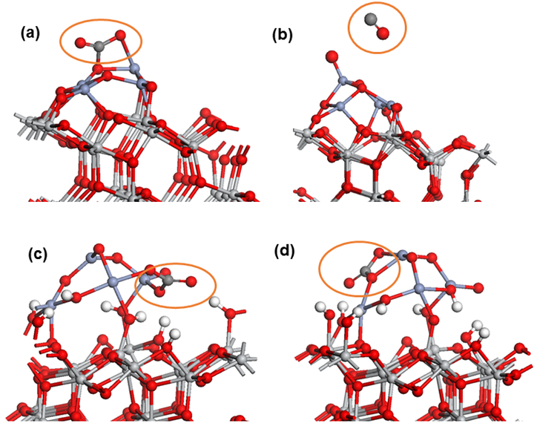
Design of Photocatalysts for CO₂ Reduction from First Principles
Michael Nolan
Tyndall National Institute, University College Cork, Cork, Ireland
1. Research Challenge & Solution
CO₂ emissions show atmospheric
concentrations ~410 ppm
Caused primarily by burning of fossil fuels
Require: emissions reductions, capture and use of emitted CO₂ are required
Two technologies: CO₂ capture + storage (CCS) and CO₂ capture + use (CCUS)
We have explored, using materials modelling, materials based on modifying TiO₂ with metal oxides
The ability of these heterostructures to adsorb CO₂ is examined for both capture and activation/conversion
We propose for CO₂ capture the modification of TiO₂ with alkaline earth oxide nanoclusters
For conversion we propose the modification of TiO₂ with Bi₂O₃ or Cr₂O₃ nanoclusters
2. Outputs & Results
Nanocluster modified TiO₂ heterostructures
High-lying Bi₂O₃/Cr₂O₃ states@VB edge
Reducible through loss of oxygen
High-lying O2p states from alkaline earth oxide – enhanced basicity
Bi₂O₃-rutile
Bi₂O₃-anatase
Cr₂O₃-rutile
Cr₂O₃-anatase
1a
1b
MgO-rutile
CaO-rutile
3
2. Outputs & Results
Reduced Bi₂O₃-TiO₂
Chromia-anatase
MgO-rutile
3. Conclusions
DFT modelling of rutile and anatase TiO₂ modified with metal oxide nanoclusters
CO₂ adsorption with moderate adsorption energies is possible
On alkaline earth oxides, strong CO₂ adsorption suggests possibility for CO₂ capture
Presence of reduced species can promote CO formation or electron transfer
9
CO₂ adsorption Direct CO formation COO⁻ formation
CO₂ adsorption
Direct CO formation
4. Methods
Plane wave density functional theory in 3-dimensional periodicity; VASP.5.3 code
400 eV plane wave cut off energy, PW91 XC functional
DFT+U – U = 4.5 eV on Ti 3d
Relax nanoclusters in the gas phase and adsorb in multiple configurations on rutile (110) and anatase (101)
Adsorb CO₂ in multiple configurations on modified TiO₂ heterostructures and relax
Surface hydroxyls:
CO₂ adsorption
Upright CO₂ adsorption
Carbonate adsorption
5. Acknowledgements
Science Foundation Ireland, Grant 14/US/E2915
Northwestern University, University of Ulster
Stephen Rhatigan, Marco Fronzi, William Daly
ICHEC – HPC resources

