Slide 1
BEST PRACTICES FOR ORCID IN JOURNAL MANUSCRIPT SUBMISSION AND REVIEW
ORCID IN PUBLISHING WEBINAR|DECEMBER 11, 2018
ALICE MEADOWS
DIRECTOR OF COMMUNICATIONS
https://orcid.org/0000-0003-2161-3781

Slide 2
AGENDA
Welcome, introductions
Collect & Connect in publishing workflows: Alice Meadows, ORCID
Single Sign On, Best Practices and More: Christopher Heid, Clarivate
A Day in the Life of an F1000 Article: Michael Markie, F1000
Spreading the ORCID Word to Authors and Reviewers: Katrina Newitt, SAGE
ORCID in Journal Article Publishing User Journey: Alice Meadows
Q&A: All
NOTE: this image is much larger, so used crop tool to move it around and position in the frame here. May need to do some adjusting to this high res image in terms of contrast etc. if it looks too ”dark”

Slide 3
Alice Meadows, ORCID
Chris Heid, Clarivate
Michael Markie, F1000
Katrina Newitt, SAGE

Slide 4
POLL: WHAT DO YOU USE ORCID FOR AT PRESENT?

Slide 5
Together, we can make this vision a reality

Slide 6
COLLECT & CONNECT
GOAL: Assert reliable information to your researchers’ records (publications, peer review, etc) so they can share it with others
USER EXPERIENCE: Follow our best practice guidelines
TRUST: Display your organization as data source
EFFICIENCY: Learn from others, share your experiences
VISION: We all benefit from everyone playing their part
RECOGNITION: Qualify for C&C badges
NOTE: this image is much larger, so used crop tool to move it around and position in the frame here. May need to do some adjusting to this high res image in terms of contrast etc. if it looks too ”dark”

Slide 7
ORCID IN PUBLISHING WORKFLOWS
Journal manuscript submission
At submission
At acceptance
Corresponding author or all authors?
During peer review process
Individual peer review activities
Peer review service over time
Books submission process
Editorial Board onboarding

Slide 9
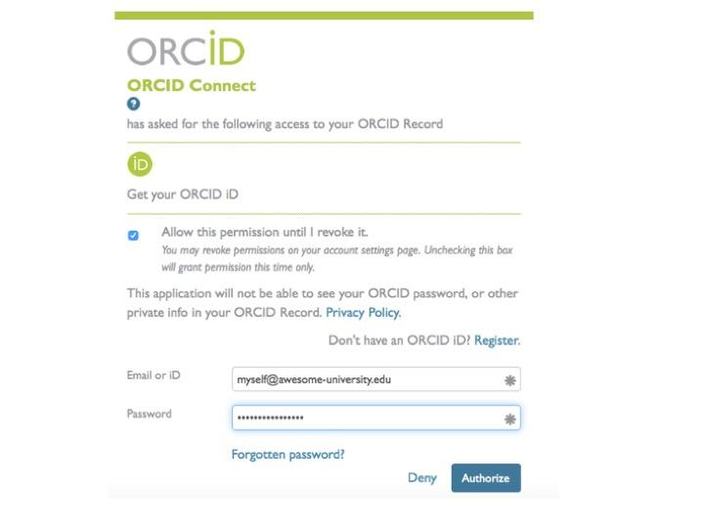
AUTHENTICATE
Authenticate ORCID iDs to ensure individuals are correctly identified in your systems
Provide an ORCID-branded
button or link for collecting iDs
AUTHENTICATE iDs during
collection
Explain why you collect
authenticated iDs

Slide 10
AUTHENTICATE
[ORGANIZATION] is collecting your ORCID iD so that we can [ADD PURPOSE]. When you click the “Authorize” button, we will ask you to share your iD using an authenticated process: either by registering for an ORCID iD or, if you already have one, to sign in to your ORCID account. We do this to ensure that you are correctly identified and securely connecting your ORCID iD. Learn more in What’s so special about signing in.

Slide 11
DISPLAY
Display iDs to signal to researchers that your information systems are plumbed to support ORCID
Store and publicly DISPLAY iDs
DISPLAY the authenticated ORCID iDs in metadata
Explain why you display iDs

Slide 12
DISPLAY
To acknowledge that you have used your iD and that it has been authenticated, we display the ORCID iD icon alongside your name in our publications. Learn more in How should an ORCID iD be displayed.

Slide 13
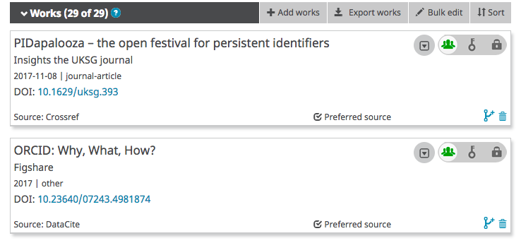
CONNECT
Connect information to ORCID records for trusted sharing with others
CONNECT information from your system to ORCID records
Include assertion metadata for each item
Explain your system connections with ORCID and benefits to researchers

Slide 14
CONNECT
By sharing your iD with [ORGANIZATION NAME], and giving us permission to read and update your ORCID record, you enable us to help you keep your record up-to-date with trusted information about your publications. Learn more in Six ways to make your ORCID iD work for you!

Slide 15
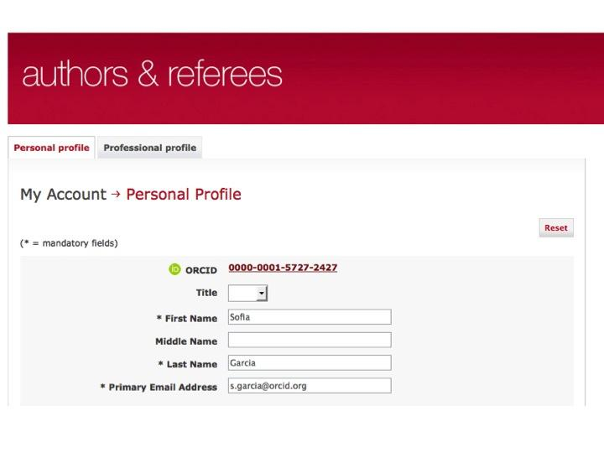
COLLECT
Collect information from ORCID records to fill forms and support research reporting
COLLECT information from ORCID records
Use the data COLLECTED in your system, eg to complete online m/s forms
Explain why you collect
ORCID information

Slide 16
COLLECT
Filling in the same information about yourself over and over again is frustrating. That’s why we let you choose information from your ORCID record to populate our online [NAME] form [MEMBER TO ADD SPECIFIC USE CASE]. Learn more in Enter once, reuse often.

Slide 17
SYNCHRONIZE
Synchronize information between ORCID records and your systems to improve reporting accuracy and speed
Make CONNECTions and COLLECTions over time using long-lasting permissions, updating information as it changes
Provide a mechanism to accept and act on correction requests from ORCID users
Explain the benefits for researchers of SYNCHRONIZATION

Slide 18
SYNCHRONIZE
[ORGANIZATION] is making it possible for you to easily share your research information and keep it up-to-date. With your permission, we will synchronize information between [SYSTEM NAME] and your ORCID record, every X days/weeks. Learn more in Enter once, reuse often.

Slide 19
COLLECT & CONNECT BADGES
Displayed on your own website
Highlighted on ORCID member integration page
Announcement in ORCID member newsletter
Monthly Collect & Connect blog post
Featured on members.orcid.org
Included in ORCID presentations, etc
Annual datestamps (no review unless best practices change)

Slide 20
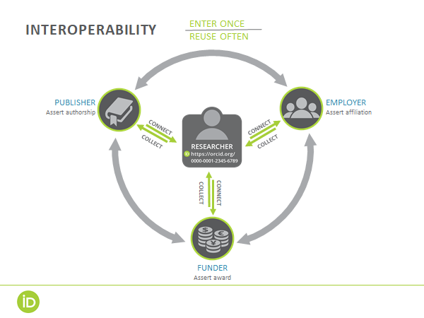

Slide 21
COLLECT & CONNECT RESOURCES
Best practices for publishers: https://orcid.org/organizations/publishers/best-practices
Collect & Connect workflows for publishers: https://members.orcid.org/cc-publishers
Collect & Connect video: https://vimeo.com/272353600
Questions? Contact support@orcid.org

Slide 22
POLL: HAS YOUR ORGANIZATION BEEN AWARDED ANY COLLECT & CONNECT BADGES?

Slide 23
ORCID in Publishing
Features and Best Practices
Chris Heid
christopher.heid@clarivate.com
Product Lead, ScholarOne
11 December 2018

Slide 24
ScholarOne and ORCID
Clarivate Analytics, a founding member of ORCID
ScholarOne, an early adopter and proponent of ORCID
ScholarOne, Publons and Clarivate remain strong ORCID supporters.

Slide 25
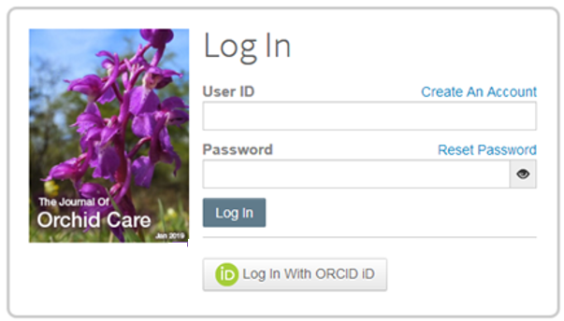
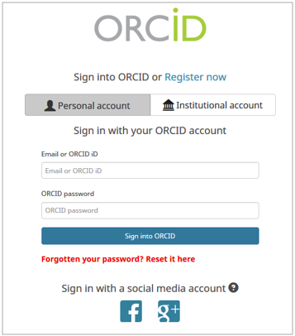
ORCID Sign On
Included in the S1M January 2019 release

Slide 26
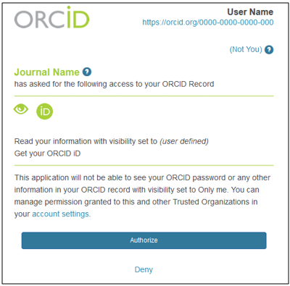
Best Practices for Member Credentials and Scopes
ORCID User Authorizes Permissions
Confirm ORCID integrated systems are using your ORCID member or ORCID public credentials
Request only the scopes you need to completed the immediate action
Gain explicit permission for updates made to researchers’ ORCID records.

Slide 27
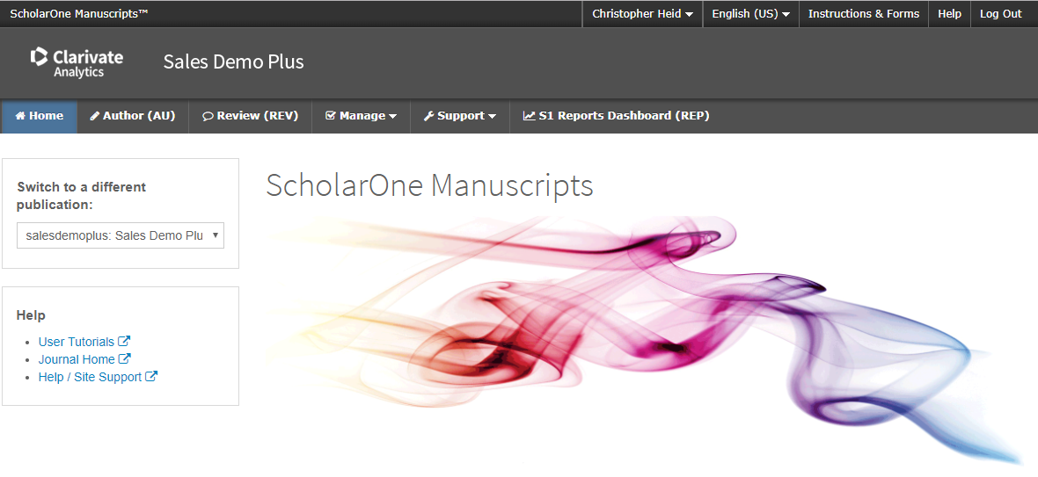
Logged Into ScholarOne

Slide 28
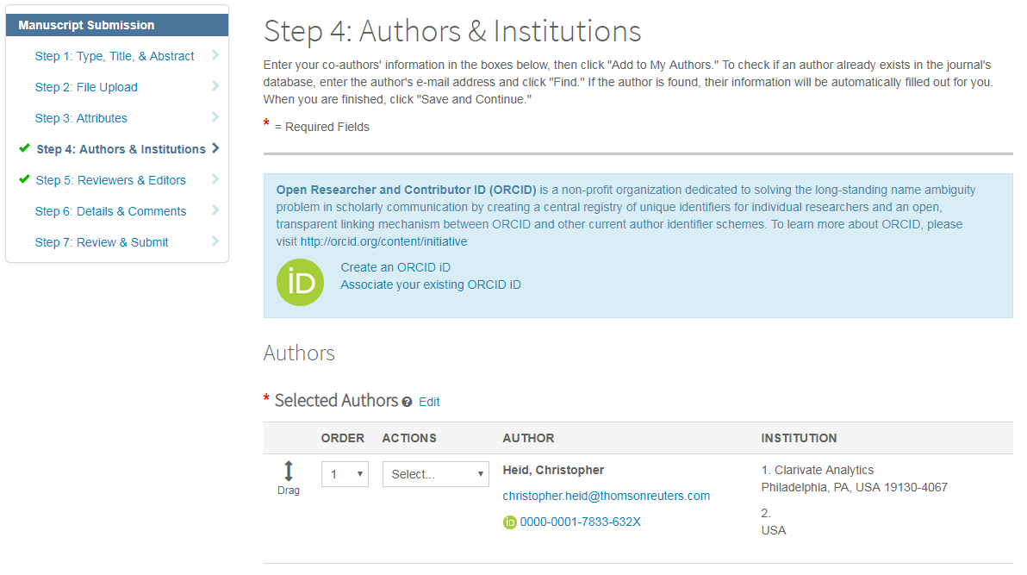
Request/ Require ORCID of Submitting Authors

Slide 29
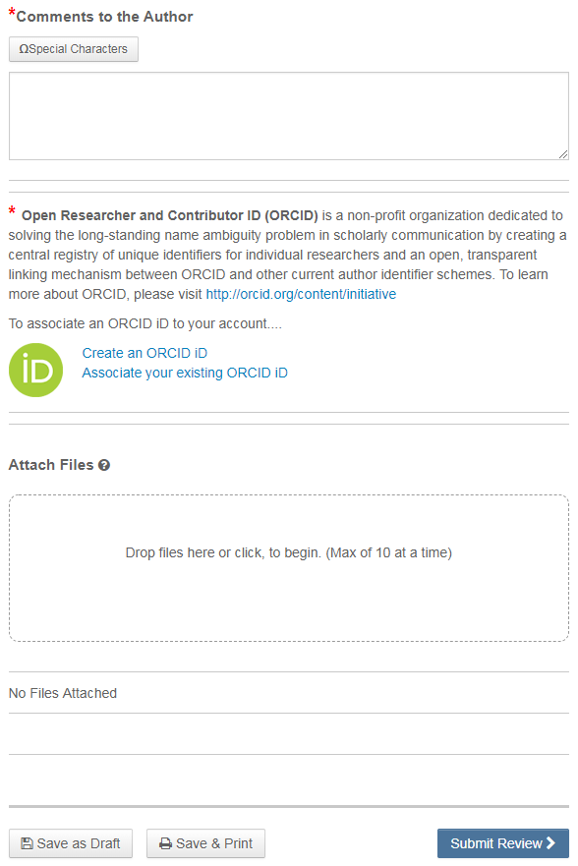
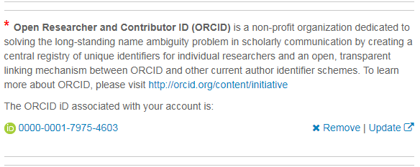
Request/ Require ORCID of Reviewers
Included in the S1M January 2019 release

Slide 30
A day in the life of an article published on an F1000 Platform
11th December 2018
Michael Markie
@mmmarksman
Publishing Director, F1000

Slide 31
F1000 and ORCID
History:
Member Organisation
Partnered to pioneer peer review activity with ORCID (2015)
Signatory of the Publisher’s Open Letter (2015)
Part of ORCID’s integration and engagement program; Collect & Connect

Slide 32
Authors
Article Submission:
Article submission page - Explanation of ORCID: What, why and how.
Article submission form – Mandatory ORCID integration for submitting author

Slide 33
Authors
After publication:
All linked ID’s are displayed on the article and link to the individuals ORCID ID
Co-authors sent a link via email to connect their ORCID (on publication confirmation)
Since August 2018 on WOR we’ve sent additional email to co-authors to connect – article with co-authors connecting now up to 45% from 35%.

Slide 34
Reviewers
Reviewers can link ORCID ID when submitting the review from the editorial system
Reviewers that have not connected are encouraged to do so when the review has been published (in the confirmation email)
55% of published referee reports have linked their ORCID IDs to their report.

Slide 35
Spreading the ORCID Word to Authors and Reviewers
Katrina Newitt
Executive Peer Review Manager
@KatrinaNewitt
SAGE Publishing

Slide 36
Mandating collection of ORCIDs from SAGE submitting authors
March 2017: 19 journals
March 2018: 78 journals
End of 2018: 494 journals

Slide 37
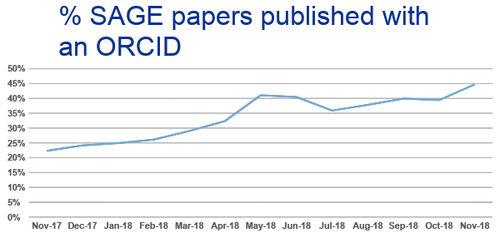

Slide 38
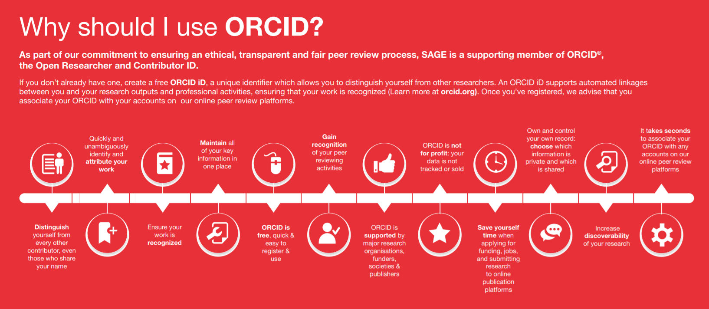
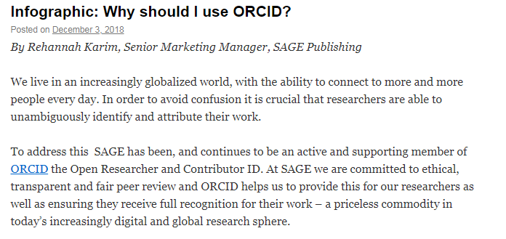
Promoting the use of ORCID

Slide 39
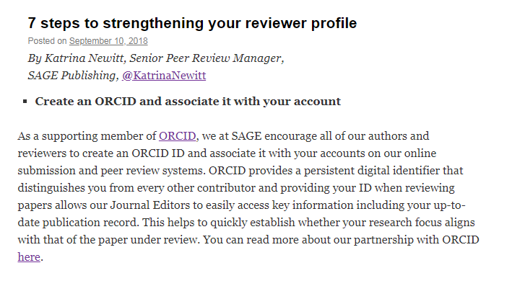
Promoting the use of ORCID

Slide 40
Editor feedback
We have embraced ORCID wholeheartedly and I have been encouraging all authors to sign up!
ORCID is an important step in improving our journal and promoting its success

Slide 41
ORCID IN PUBLISHING UI/UX
We want to develop specific recommendations for consistent and engaging ORCID experiences for end users within publishing workflows. This work will be done through the exploration of specific user journeys placed within the context of both current and target workflows.
Phase 1: Scope/framing (IN PROGRESS)
Phase 2: Challenges/assumptions (Q1 2019)
Phase 3: Design document (Q2 2019)
Phase 4: Wireframes (Q2-3 2019)
Phase 5: Final recommendation (by end 2019)

Slide 42
POLL: WHICH OF THE FOLLOWING TOPICS WOULD YOU MOST LIKE TO HEAR ABOUT IN A FUTURE WEBINAR?

Slide 43
QUESTIONS, DISCUSSION,
NEXT STEPS!
Join the ORCID in Publishing User Community Group: https://community.orcid.org/c/publishingcommunityusers
Share your success stories (and challenges!)
Ask questions
Suggest future topics for discussion
Follow us! @ORCID_Org and orcid.org/about/blog
Look out for us at publishing and other industry meetings

