Slide 1

Towards Interoperable and Equitable Scholarly Communications Ecosystems: Values-based Questions to Ask Infrastructure Providers
Allegra Swift, Scholarly Communications Librarian
David Minor, Director, Research Data Curation Program
UC San Diego Library
@UCSDScholCom
@cni_org #cni18f
© 2018-12-10 Swift & Minor
CC-BY 4.0 except where otherwise credited
Notes:
Allegra https://www.cni.org/events/membership-meetings/upcoming-meeting/fall-2018/schedule-f18
Allegra Swift and David Minor, both at UC SD
We are the first in positions that were newly created at UCSD Library
I was hired 18 months ago, and David started the RDCP 6 years ago. The creation and support of these positions speak to efforts by libraries to be more proactive partners in the rapidly changing scholarly communications environment
We’ll take questions at the end but
at one point during the presentation I’m going to mention some of the related projects and scholarship (slide 5), but if you know of others, please tweet away!

Slide 2
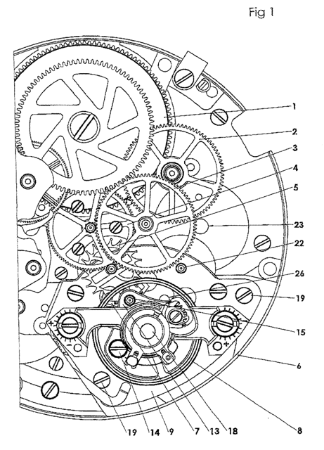
The brief
Describe, share, and get input on a pair of workshopped tools that are:
  intended to raise awareness of an issue among campus stakeholders.
  guide campus stakeholders to make more intentional, values-based, and economical infrastructure decisions
What is the issue?
Background to the project
The tools
Clock movement patent https://patents.google.com/patent/US20120092969
Notes:
Allegra
We’re here, not to talk about our positions but to brief you on an ongoing project to create two tools at varying degrees of completion.
The 1st , a visualization that is intended to frame a complex issue and build an understanding among the people on campus who are vended to and/or who advocate for scholarly communications infrastructure. This part of the project is still very much in the concept wrestling stage.
The 2nd is a checklist or series of questions that are in a completed draft form but are meant to be adapted and built upon
So I’ll get on to describing the issue we are trying to frame and communicate
Then we’ll give the background that was the impetus for embarking on this project
Then we’ll describe, share and hopefully get your input on these two tools

Slide 3
The issue- commodification
“The current scholarly communication landscape is populated by a variety of actors and powered by an ever-increasing array of complementary and competitive systems for the production, publication, and distribution of scholarship.”
Clement, G., Agate, N., Searle, S., Kingsley, D. and Vandegrift, M., 2018.
JLSC Board Editorial 2018. JLSC, 6(1), p.eP2261. DOI: http://doi.org/10.7710/2162-3309.2261
Actors [Stakeholders]: Operating in silos and unaware of the connections across the ecosystem
Landscape [ecosystem]: Includes all of the products and processes that result in tenure and promotion or winning grant funding
Notes:
Allegra:
The issue is that the scholarly communications ecosystem is rapidly being commodified and sold back to the institutions who pay for the scholarship and research to be done and the people who create the scholarship and research.
These people and institutions are focused in their respective lanes and largely unaware that by engaging with a tool that purports to make work easier, save time, and reputations glorious, they are, in fact, losing control and access that they may not know that they had or what it is that they stand to lose
The Stakeholders we are talking about are faculty/researchers, students, libraries, offices of academic affairs and research offices, research and educational IT, teaching and learning, the infrastructure providers both open source and for profit, really anyone who has a stake in the scholarly and research enterprise.
Depictions of the scholarly communication landscape are usually confined to just research and publication workflows but the ecosystem includes every other process that feeds into getting paid and/or recognized. So drivers for funding, tenure and promotion which include teaching and learning,
stakeholders are largely unaware of the needs and drivers happening around them in the rest of the ecosystem and this results in costly duplication, inefficient systems, and expensive dependencies.

Slide 4
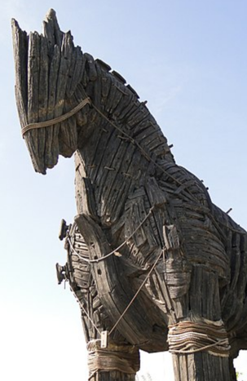
The background
Scholarly communication ecosystem has become a battleground
The big infrastructure providers are intent on owning the entire ecosystem
Conversations and actions are mostly concentrated on values statements or publishing negotiations
How do we make principles and statements actionable? How can we help our institutions benefit more and buy-back less?
By Adam Jones from Kelowna, BC, Canada - Replica of Trojan Horse –
Canakkale Waterfront – Dardanelles - Turkey, CC BY-SA 2.0,
https://commons.wikimedia.org/w/index.php?curid=64144380
Notes:
Allegra
While we see the publishing and licensing end of the ecosystem being hotly contested, it is hard to find academy owned infrastructure that supports the entire or at least, more than one part of what the academy needs
While we’re busy on the battle field of journal licensing, the vendors have infiltrated the ramparts
So how are we to we break out of our respective lanes and guide our campuses towards a more open and information rich institution?

Slide 5
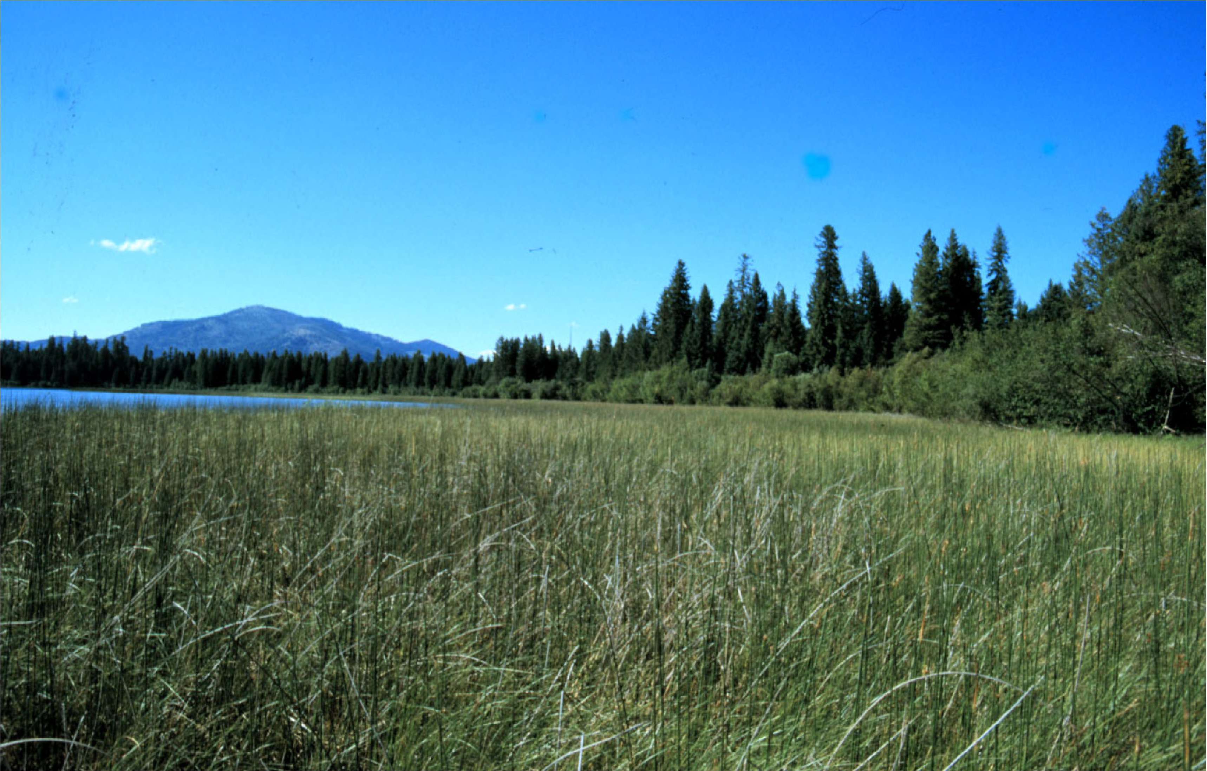
Of Vendors and Values
CP2OA18
Outsource infrastructure?
@UCSDScholCom
Image from page 19 of "Ecological inventory of wetland sites in the Thompson Chain of Lakes and vicinity " Internet Archive Book Images. https://flic.kr/p/rmj863
Notes:
Allegra –
In the interest of time, I’ll just make quick mention a few others who are addressing the issue through writing, discussions, tools, we have links at the end or in the slides that we’ve posted to figshare. Plug for the group talking about academy owned publishing infrastructure tomorrow at 1pm (Catherine Mitchell, Joshua neds-fox, melanie scholsser, and charles Watkinson)
1. THE KNOWLEDGE G.A.P. Geopolitics of Academic Production: PUBLISHERS ARE INCREASINGLY IN CONTROL OF SCHOLARLY INFRASTRUCTURE AND WHY WE SHOULD CARE A CASE STUDY OF ELSEVIER by: Alejandro Posada and George Chen, University of Toronto Scarborough – paper and diagram influenced us
2. Roger C. Schonfeld of Ithaka S+R’s Library and Scholarly Communication program. Big Deal: Should Universities Outsource More Core Research Infrastructure?
3. Emma Molls – David will talk about how we incorporated
4. Defining RIM and the Library’s Role.: OCLC Research. just out on the 4th oclc-research-eurocris-release-report-international-research-information-management-practices - Rebecca Bryant worked with us on the initial design of the course that spawned the tools we’re about to talk about. And the UC OSC RIMs project
5. cp2oa – while mostly focused on licensing, there was an infrastructure group break out
6. David Lewis of 2.5% fame has commented on this tool called the commons compliant tools/platform worksheet, toggles to apply facets for open source scholar led infrastructure - also a work in progress https://docs.google.com/spreadsheets/d/1h0Aq6NYIeVnLDw33vx1SGnv1jbE2B7widbHhU7tpiUw/edit#gid=2141288902

Slide 6
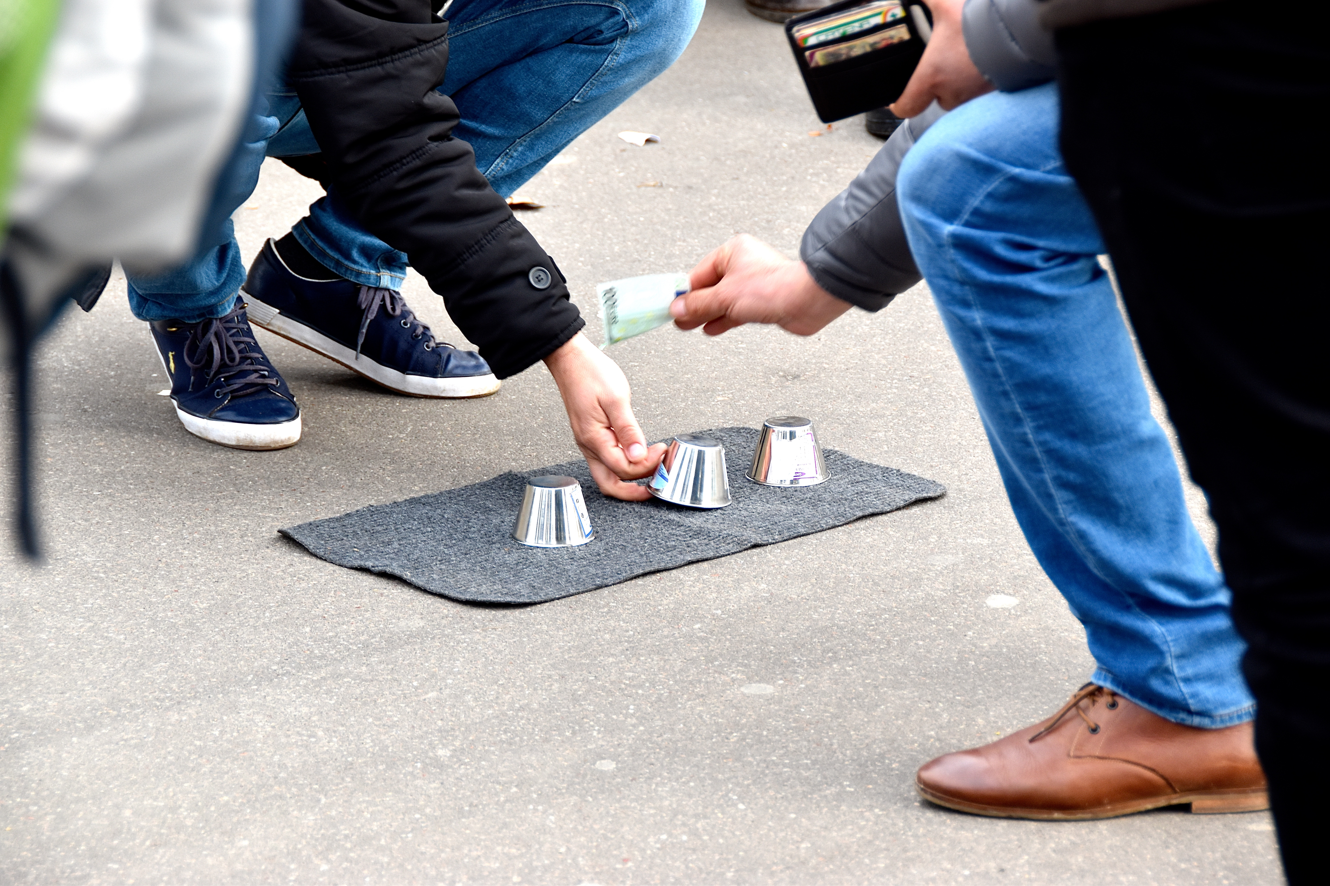
Meanwhile at UC San Diego
'Balletje balletje' Parijs on flickr https://flic.kr/p/Qkpvf9 CC-BY 2.0
Notes:
David
Noticed this abundance of platforms and systems of scholarly communications, Interfolio asking for library data on faculty RI,
Profiles, RIMs, IR, analytics tools, publisher siloing their content in education products, Sage Researcher education modules
'Balletje balletje' Parijs on flickr https://flic.kr/p/Qkpvf9 CC-BY 2.0

Slide 7
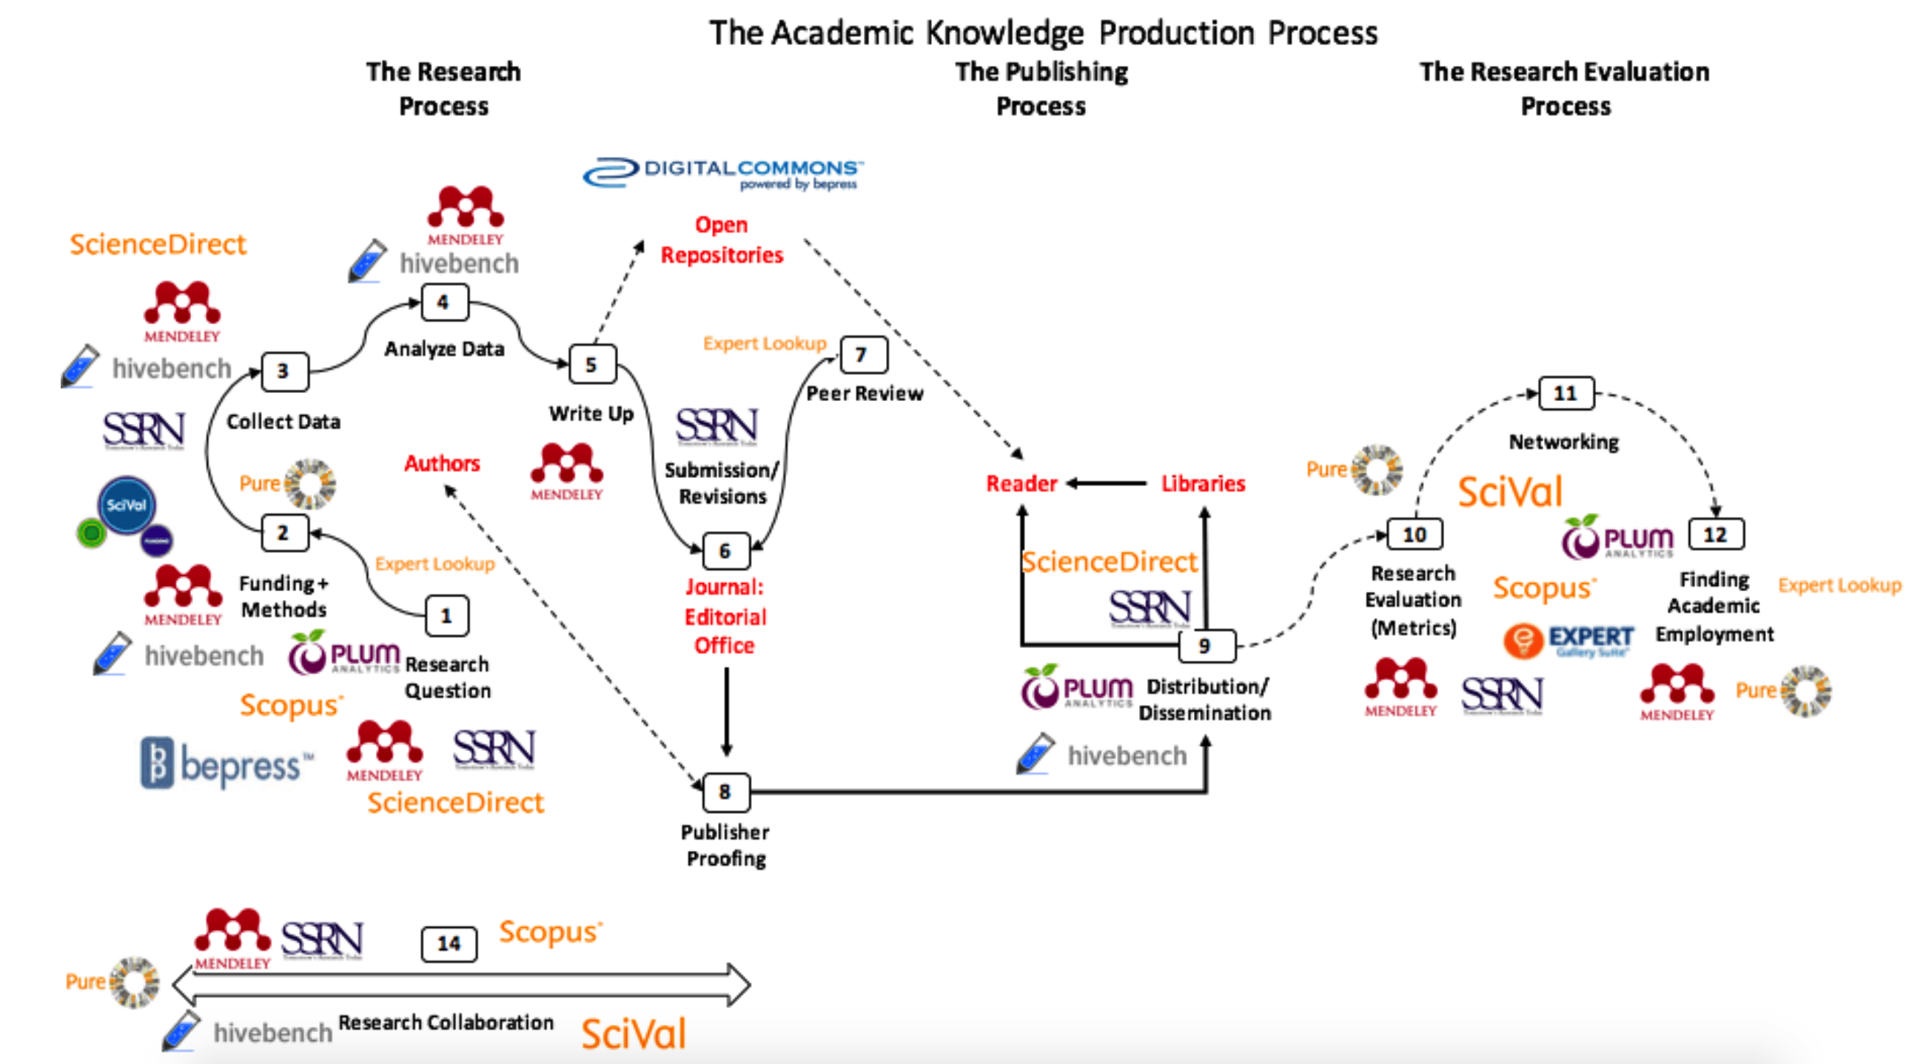
Vertical integration resulting from Elsevier’s acquisitions, from Alejandro Posada and George Chen, (2017) Rent Seeking and Financialization strategies of the Academic Publishing Industry - Publishers are increasingly in control of scholarly infrastructure and why we should care- A Case Study of Elsevier http://knowledgegap.org/index.php/sub-projects/rent-seeking-and-financialization-of-the-academic-publishing-industry/preliminary-findings/
Notes:
David
The cycle as it relates to infrastructure – Elsevier. Add to this funding, teaching, data, preservation, other stakeholder needs and perspectives - what was missing
http://knowledgegap.org/index.php/sub-projects/rent-seeking-and-financialization-of-the-academic-publishing-industry/preliminary-findings/
the diagram shows the vertical integration resulting from Elsevier’s acquisitions. Elsevier has acquired and launched products that extend its influence and its ownership of the infrastructure to all stages of the academic knowledge production process.

Slide 8
Fundamental Truth: If we do not create the open scholarly commons, Elsevier, Springer, Wiley, et. al. will own the scholarly record and continue to exploit the academy. What should be a public good will be used for private gain.
David Lewis and Mike Roy
https://www.slideshare.net/DuraSpace/51718-the-25-commitment-investing-in-open-presentation-slides
Notes:
David
Towards end of the presentation when we are restating the point?
https://www.slideshare.net/DuraSpace/51718-the-25-commitment-investing-in-open-presentation-slides

Slide 9
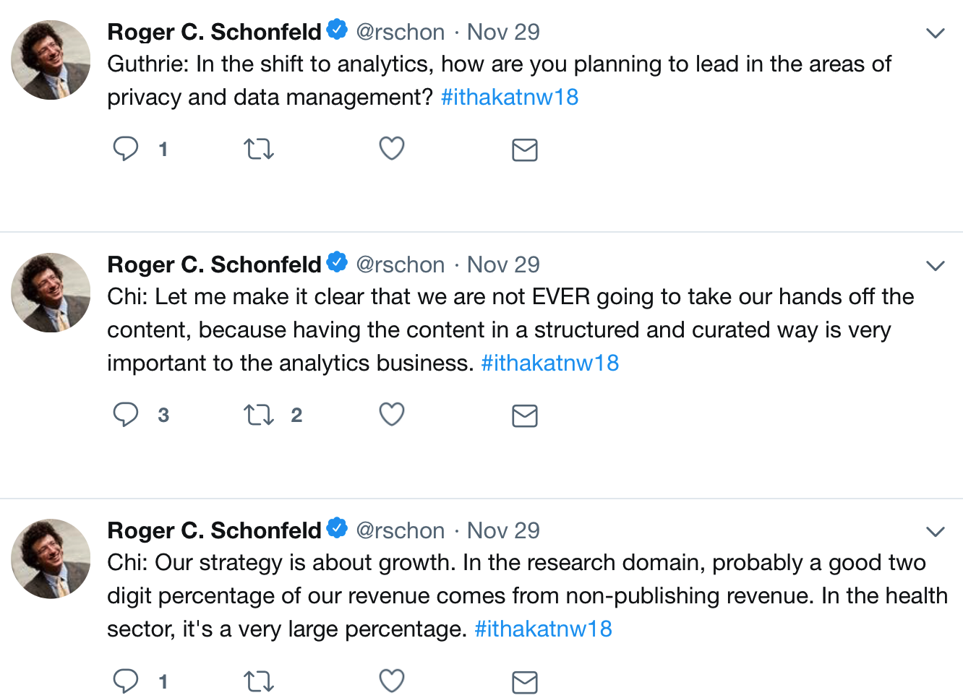
“Let me make it clear that we are not EVER going to take our hands off the content,”
- Youngsuk ‘YS’ Chi
Chairman, Elsevier
Notes:
David
Towards end of the presentation when we are restating the poiint?
https://twitter.com/rschon/status/1068162500707971072
Elsevier interview

Slide 10
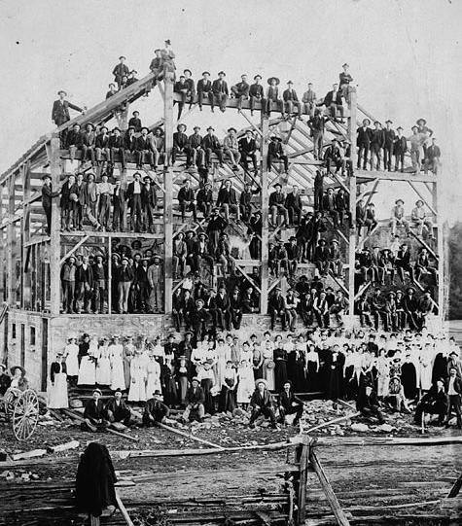
Our humble project - how can we begin to address all of these issues in a community?
Barn raising / Construction d'une grange https://flic.kr/p/g937bF
Notes:
David

Slide 11

Elsevier acquisition of Bepress
2017:
UC San Diego environmental scan
FSCI’17:
Building an Open and Information-Rich Institution
- Sarah Shreeves and Danny Kingsley
Happened the same week!
FSCI’18:
Building an Open and Information-Rich Institution
- Allegra Swift and David Minor
Notes:
David -
Sarah and danny’s course, elsevier buying bepress was announced
Scnap was scholcom librarian, program directors for metadata, liaison librarians, research data curation, library IT, and campus Research IT (Valerie) to get at campus research and publishing needs and practices and where we need to adjust to fill gaps and support

Slide 12
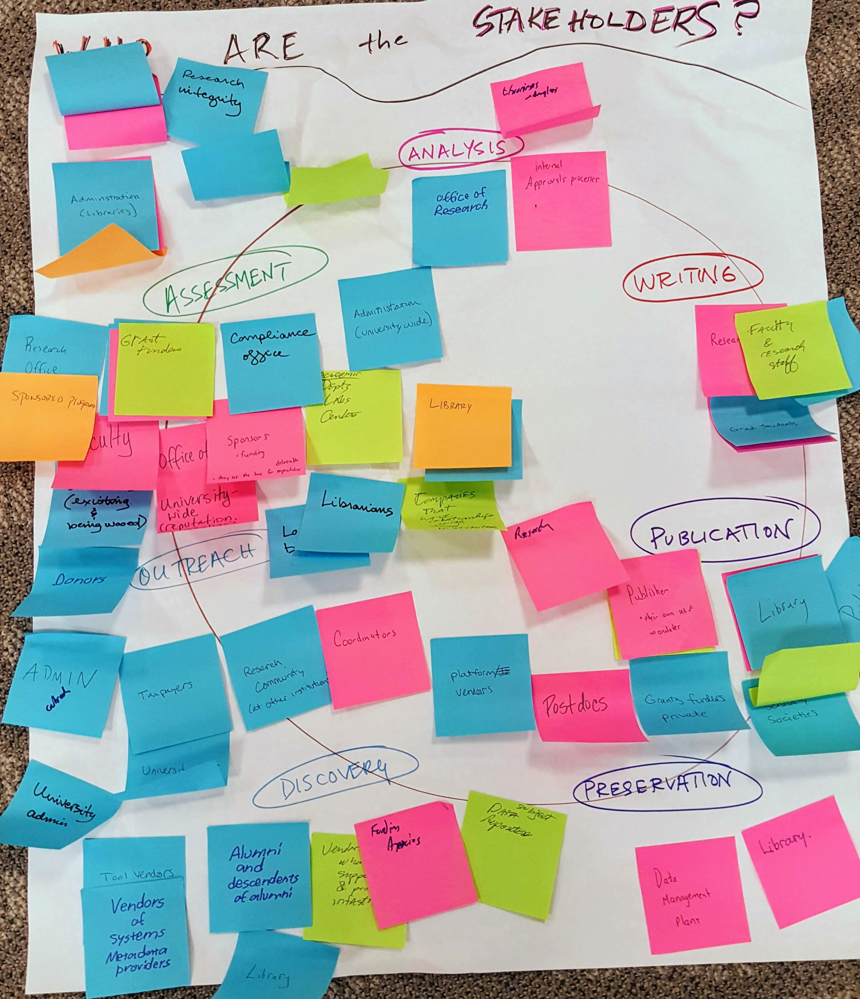
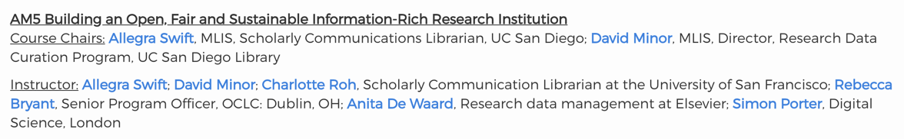
The project
Using the Force(11) for Good – FSCI’18
Multi-institutional (mostly librarians)
Brought in speakers (trouble finding academic/open source)
  Guided work through two tools
    Infrastructure checklist
    Visualization
Notes:
Allegra -
David and I facilitated a weeklong course at last summer’s force 11 FSCI. We had three days in the middle where we invited infrastructure providers to address how they keep things open and sustainable.
Really difficult to find an open source infrastructure that covered the entire ecosystem or at least a great deal of it and was open to all
wiley and springer both pulled out, but taylor&francis’s Carolyn Kirby did a conference call (she’s not listed in the screenshot of the course description
charlotte roh talked about the inequities in the publication system,
we brainstormed the outcomes based on what we heard and some of the readings we assigned
No grants, no big players just a bunch of people asking what can we do right now
https://docs.google.com/spreadsheets/d/1BQ-t_4RVFRGrqvpHqgGZzl0XeDO7--iKp4XlGusYG1U/edit#gid=1220204708

Slide 13
AM5 Part Deux
The teams:
Elena Feinstein - Duke University
Emily Frank - Louisiana State University
Vanessa Gabler - University of Pittsburgh
Robyn Hall - MacEwan University
Claudia Holland - Mississippi State University
Allison Langham-Putrow - University of Minnesota
David Minor - University of California, San Diego
Charlotte Roh - University of San Francisco
Allegra Swift - University of California, San Diego
Two teams,
two tools:
- Infrastructure checklist
- Visualization
Notes:
Allegra
Shout out to the crew who stayed on and had a hand in the checklist. there were a lot of iterations and emails back in forth.
As with any group volunteer project, there is a lot of drop-off after the initial burst of enthusiasm
This is where the vendors have the advantage, they are paying people to build, execute, promote their products. They have the infrastructure to create the infrastructure and this affects how we think of school led/academy owned infrastructure projects

Slide 14
What we wanted to do
Approach the issue with a values-based intention
Approach the issue holistically addressing the ecosystem
Approach the issue with the bigger picture in mind, reach the multiple stakeholders on our campuses
Create practical simple tools that can actually be used
Answer the question, “I get it, now what do I do?”
Notes:
Allegra
Bottom line, our intention is to be able to hand our campus stakeholders a guide, a tool so that when we do get the concept across that our research and research information is being repackaged and resold back to us, that we have something actionable that they can latch on to

Slide 15
Infrastructure checklist
Notes:
David

Slide 16
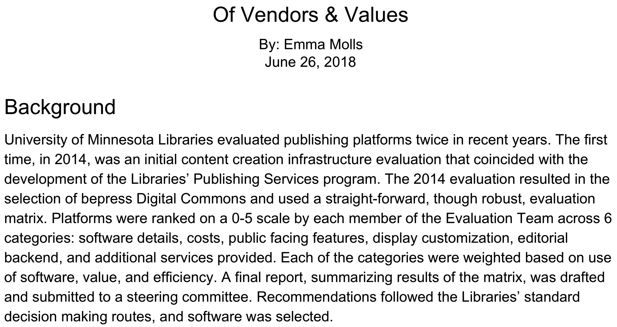
https://doi.org/10.6084/m9.figshare.7416278.v1
Notes:
David
https://docs.google.com/document/d/1q8v5-wUeWTZPI7GrEeXzHGSDUKeEOApq4vUHQRjlcOo/edit
https://figshare.com/articles/Of_Vendors_Values/7416278

Slide 17
Institutional
self reflection,
to expose values
Values-based questions to ask the vendor
Notes:
David
https://docs.google.com/document/d/1q8v5-wUeWTZPI7GrEeXzHGSDUKeEOApq4vUHQRjlcOo/edit

Slide 18


The Checklist:
please adapt and use!
https://doi.org/10.6084/m9.figshare.7406849.v1
goo.gl/VewvdB
Notes:
David
https://figshare.com/articles/Scholarly_Communications_Infrastructure_Checklist/7406849
Add google doc link to figshare for comments

Slide 19
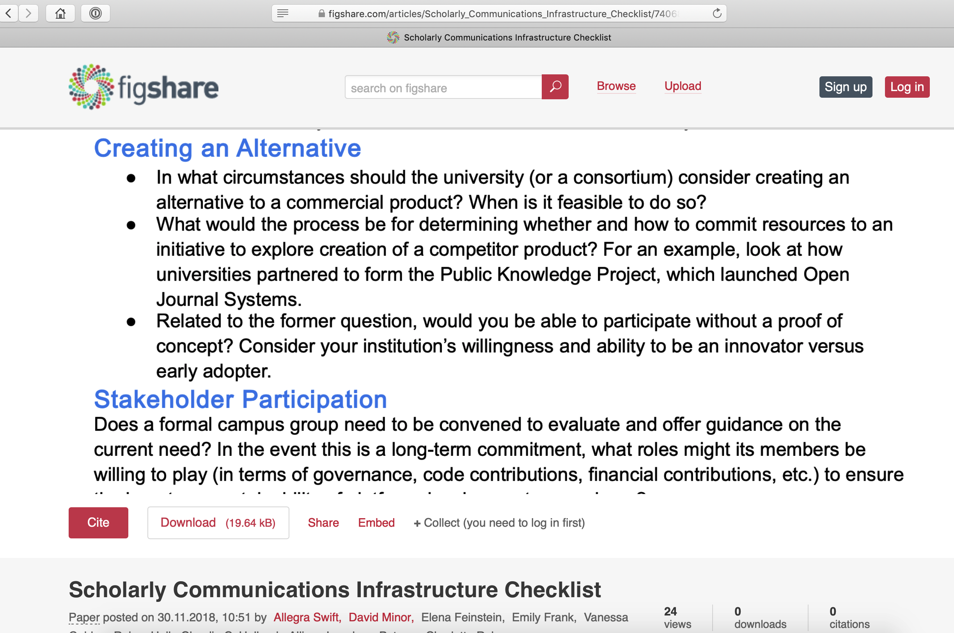

Slide 20
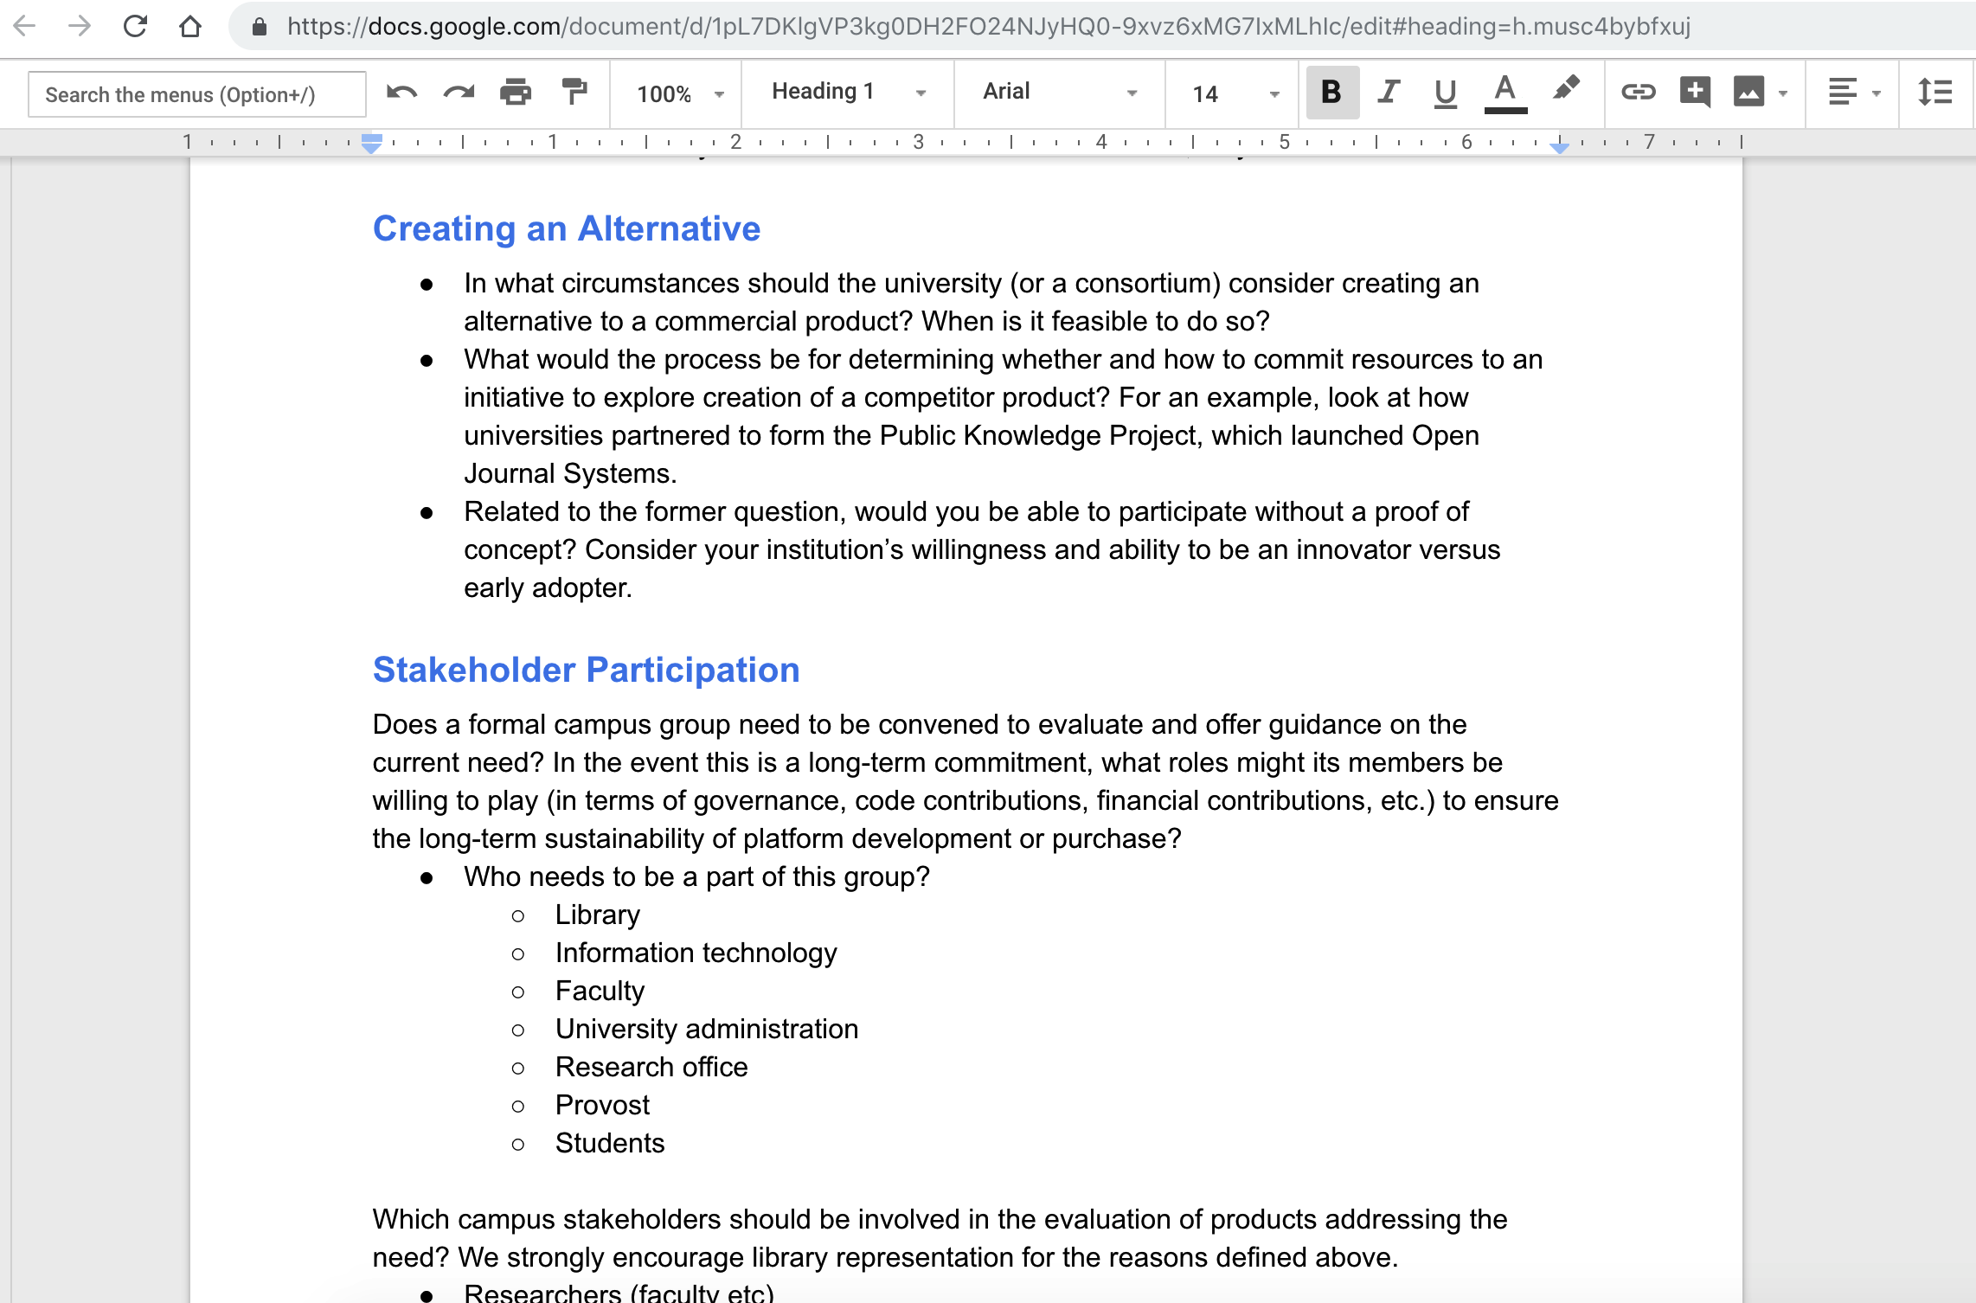

Slide 21
Application at UC San Diego
Actual Stakeholder: new interdisciplinary faculty, tenure-track
Valuable content: assembling a database of assessment tools that have been developed, adapted, and/or validated in low-income settings accompanied by publications on those tools
Values: understands the value of open access and anticolonial practices of research production and dissemination
Wished-for Stakeholder: Office of Academic Affairs
Valuable content: faculty data, research information generated at UCSD
Values: “UC San Diego will transform California and a diverse global society by educating, generating and disseminating knowledge and creative works, and engaging in public service.”
https://plan.ucsd.edu/report/mission-vision-values/
Notes:
David – also applied to an open access textbook where an established tenured faculty wanted more control of authoring a textbook. Value: Student success because they can access info for free

Slide 22
The
Visualization
Notes:
David

Slide 23
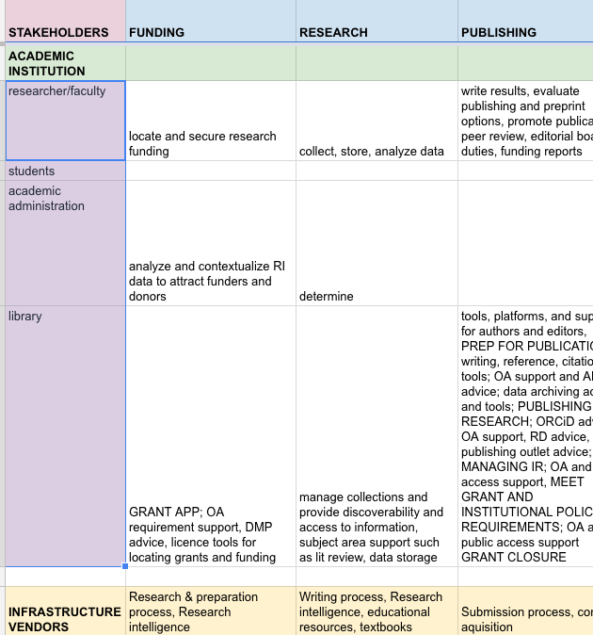
The Visualization
PROCESS
Funding
Research
Publishing
Teaching
Evaluation
Research intelligence
Preservation
Messaging/promotion
Education/consultation
STAKEHOLDERS
NEEDS/DRIVERS
TOOLS/SYSTEMS
Notes:
Allegra
Purpose - shows the gaps, to look critically at the entire ecosystem and where we should be paying attention
This a small corner of the spreadsheet where we are gathering the data points that will become a visualization
We’re looking for collaborators
https://docs.google.com/spreadsheets/d/1up_VJkfh7gtKzq18eYDVDlv02ZGPa4lP1lVqI7pHdIA/edit#gid=0

Slide 24
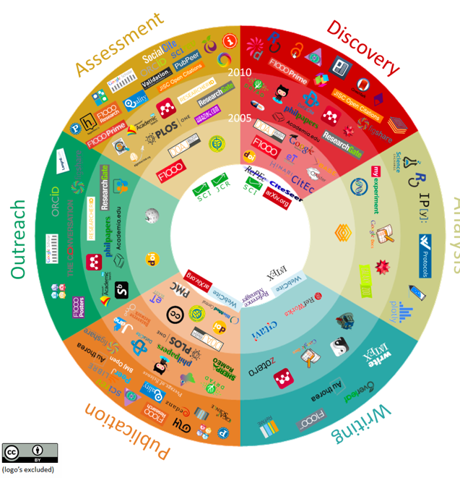
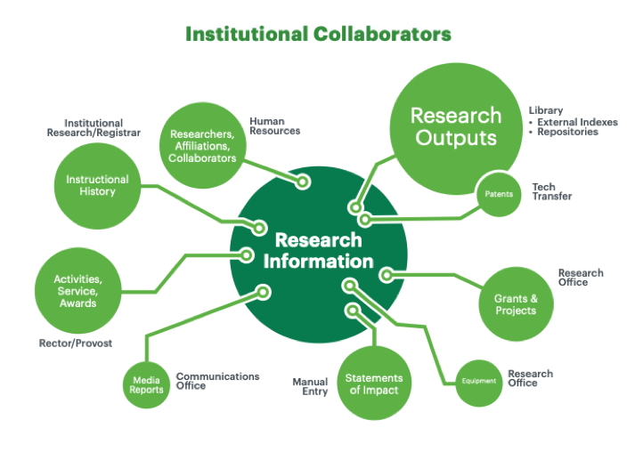
The Visualization
Notes:
This is where we are still wrestling with how much to include to get the point across with out it becoming completely illegible
These diagrams are from some of the background resources we’ve mentioned and not really part of our visualization
https://www.openuphub.eu/component/k2/item/610-101-innovations-in-scholarly-communications
Publishers are Increasingly in Control of Scholarly Infrastructure and Why We Should Care: A Case Study Of Elsevier
Defining RIM and the Library’s Role.: OCLC Research.
Help? Is it necessary
Looking for collaborators

Slide 25
Lessons learned
Lack of concrete holistic academic-owned/open source/scholar-led options
Commercial dollars vs. academic
Dispersion of energy, lack of funds and ongoing communication after events
“This is new terrain for academia, but the ground is shifting rapidly. If academia can organize its work and develop a strategic vision for research workflow, there is yet an opportunity to avoid the negative consequences of outsourcing core scholarly infrastructure.” Roger C. Schonfeld
Notes:
David
Why we should attempt:
This is new terrain for academia, but the ground is shifting rapidly. If academia can organize its work and develop a strategic vision for research workflow, there is yet an opportunity to avoid the negative consequences of outsourcing core scholarly infrastructure.
https://sr.ithaka.org/publications/big-deal-research-infrastructure/

Slide 26
Questions?
David Minor
dminor@ucsd.edu
Allegra Swift
akswift@ucsd.edu
@allegraswift
@UCSDScholCom
Notes:
David

Slide 27
References
Publishers are Increasingly in Control of Scholarly Infrastructure and Why We Should Care: A Case Study Of Elsevier
Whose Infrastructure? Towards Inclusive and Collaborative Knowledge Infrastructures in Open Science
Inequality in Knowledge Production: The Integration of Academic Infrastructure by Big Publishers
Of Vendors & Values
Defining RIM and the Library’s Role
Balancing influence in a shifting scholarly communication landscape: Creating library-owned, community-aligned infrastructure through individual, local, and community action
JLSC Board Editorial 2018
Big Deal: Should Universities Outsource More Core Research Infrastructure?
Workflow Lock-in: A Taxonomy
Commons compliant tools/platform worksheet
Notes:
David

