Slide 1
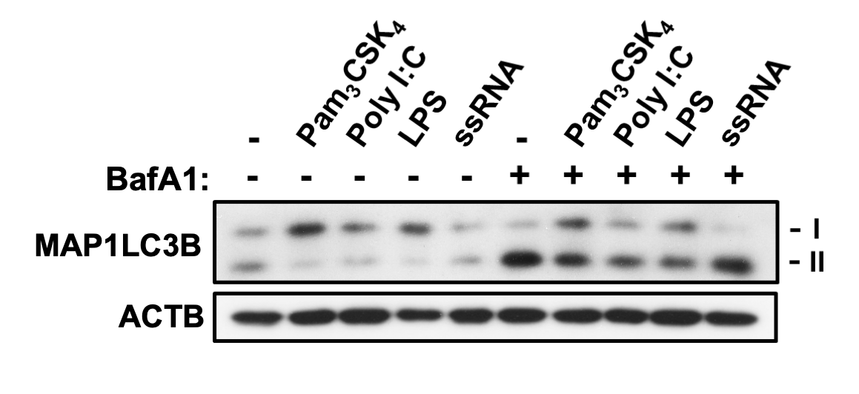
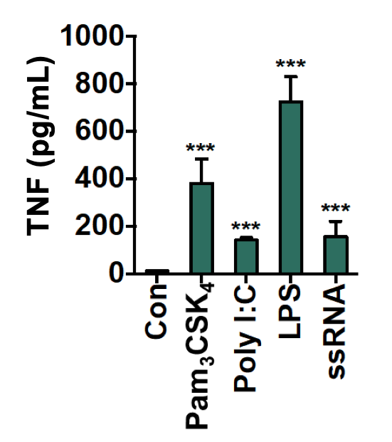
Figure S1.
A
B
Figure S1. Autophagy is suppressed by proinflammatory TLR ligands in primary microglia. (A) Suppression of MAP1LC3B turnover by TLR ligands. Blots shown are representative of 3 experiments with similar results. Primary microglia were treated with TLR ligands for 24 h; Pam3 N-palmitoyl-S-dipalmitoylglyceryl Cys-Ser-(Lys)₄ (Pam₃CSK₄; 100 ng/mL) for TLR1/2, Poly I:C high molecular weight (1 μg/mL) for TLR3, LPS (1 μg/mL) for TLR4, or single-stranded RNA (ssRNA; 1 μg/mL) for TLR7. (B) Secretion of TNF measured by ELISA 24 h after treatment of TLR ligands (n = 3). All data are mean ± SEM. ***P<0.001 versus control (Con).

Slide 2
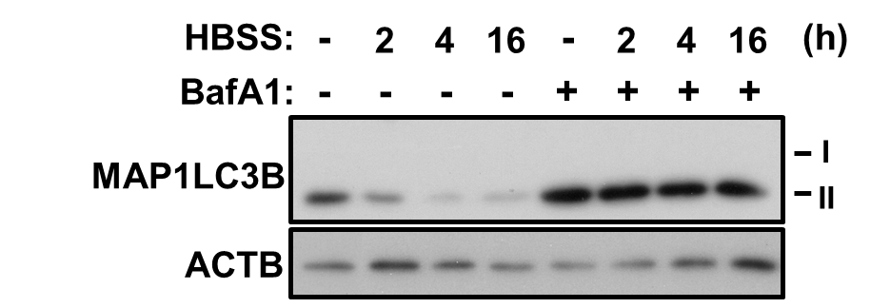
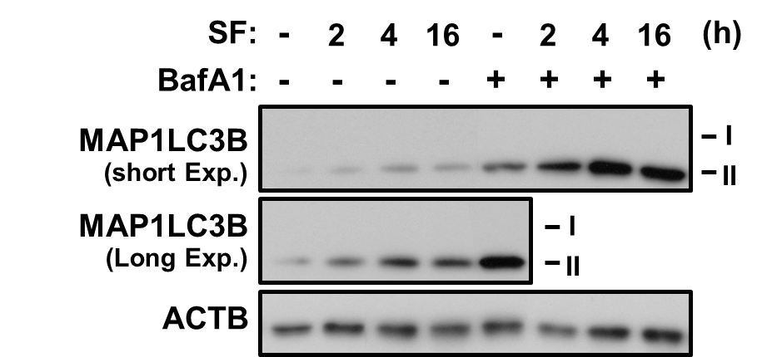
Figure S2.
A
B
Figure S2. Nutrient starvation increases autophagy flux in primary microglia. (A, B) Cells were starved in HBSS (A) or DMEM without serum (SF). (B) BafA1 (20 nM) was added 2 h before sampling. All western blots shown are representative of 3 experiments with similar results.

Slide 3
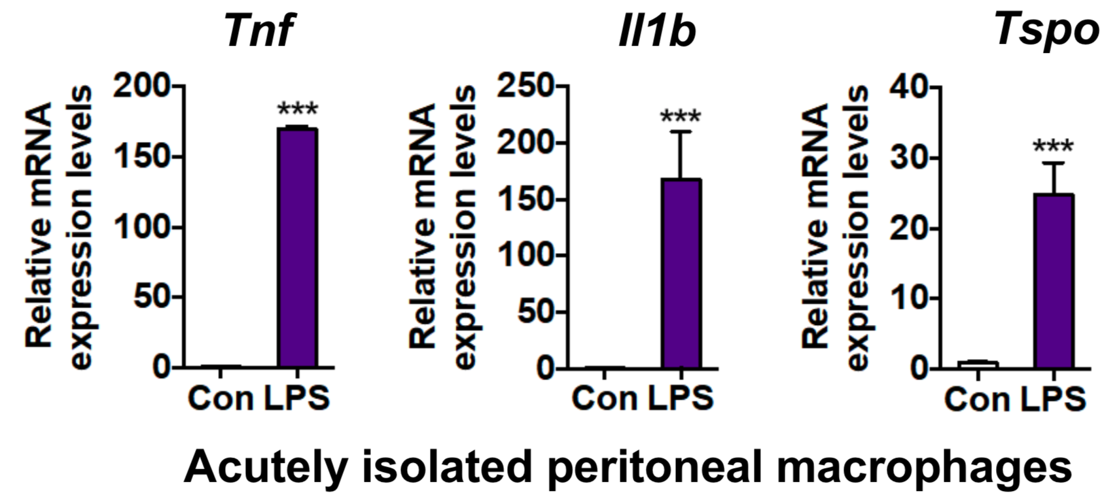
Figure S3.
A
B
Figure S3. Systemic LPS injection activated microglia and peritoneal macrophages. (A, B) mRNA expression of Tnf, Il1b and Tspo were increased in microglia (A) and peritoneal macrophages (B) acutely isolated from intraperitoneally LPS-injected mice. Cells were prepared, as in Figure 2C (n = 3). In all experiments, mRNA levels were normalized to Actb/β-actin (Actb). All data are mean ± SEM. *P< 0.05, **P< 0.01 and ***P< 0.001 versus control (Con).

Slide 4
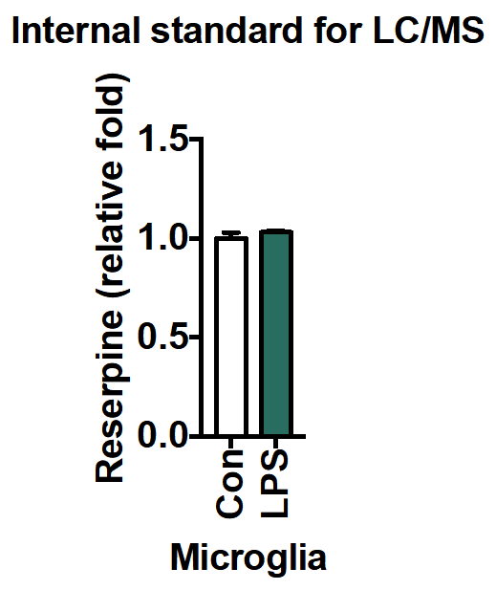
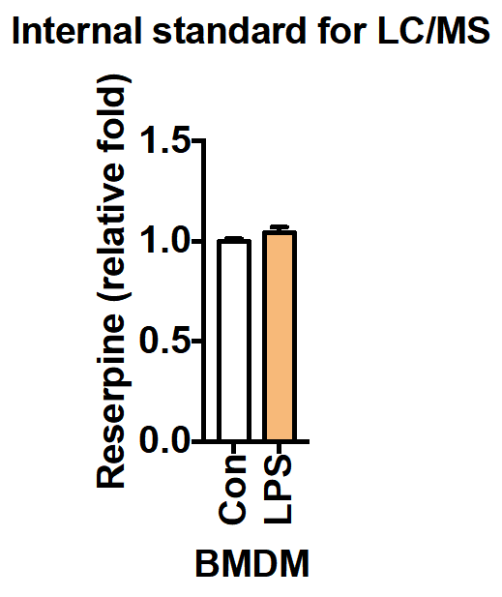
Figure S4.
A
B
Figure S4. Reserpine as an internal standard. (A, B) Reserpine amounts were measured by LC/MS 16 h after LPS treatment in primary microglia (A) and BMDM (B) (n = 3). All data are mean ± SEM.

Slide 5
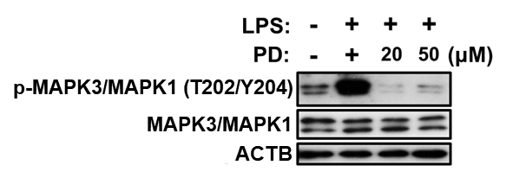
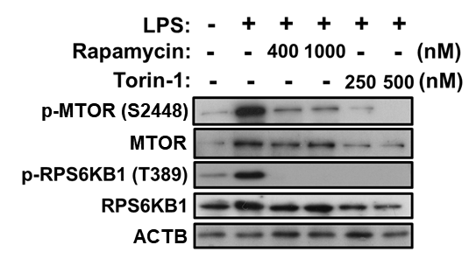
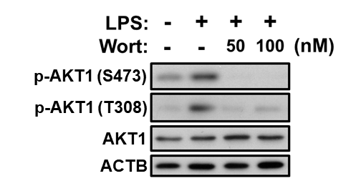
Figure S5.
A
B
p-MAPK1/MAPK3 (T203/Y205)
p-MAPK1/MAPK3
C
p-AKT1 (S473)
p-AKT1 (T308)
p-AKT1
ACTB
Figure S5. Pharmacological inhibition of MAPK1/3, MTOR, and PI3K. (A) MAPK1/3 phosphorylation at T203/Y205 is inhibited by PD98059 (PD). (B) Treatment with rapamycin or Torin-1 resulted in dephosphorylation of MTOR at S2448 and RPS6KB1 at T289. (C) LY294002 (LY) or wortmannin (Wort) blocked LPS-induced phosphorylation of AKT1 at S473 and T308. Samples were harvested 12 h after LPS treatment. Inhibitors were administered 1 h prior to LPS treatment. All western blots shown are representative of 3 experiments with similar results.

Slide 6
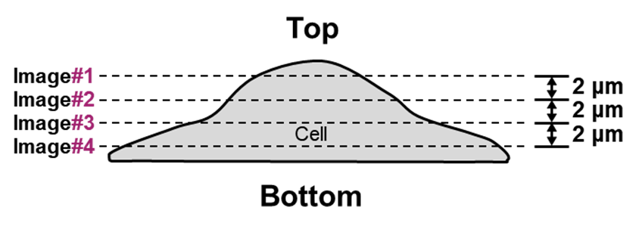
Figure S6.
A
B
Figure S6. Quantitative analysis of nuclear location of FOXO3 in primary microglia and BMDM. (A) Four confocal images were taken from different layers at 2-μm intervals. (B) Nuclear and cytosol green signal intensities were measured using Zen software (Carl Zeiss).

Slide 7
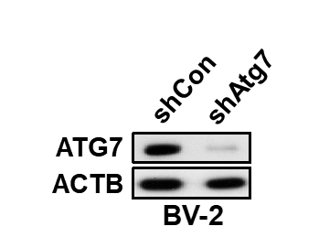
Figure S7.
shAtg7
Figure S7. ATG7 knockdown in BV-2 cells. ATG7 was successfully knocked down (shAtg7) compared to control (shCon) cells.

Slide 8
Supplementary Table S1. PCR primer list
Genes | Gene reference number | 5’- Sense primer sequence -3’ | 5’- Antisense primer sequence -3’
Map1lc3b | NM_026160.4 | GATAATCAGACGGCGCTT | ACTTCGGAGATGGGAGTG
Actb | NM_007393.5 | AGAGGGAAATCGTGCGTGAC | CAATAGTGATGACCTGGCCGT
Atg3 | NM_026402.3 | ACACGGTGAAGGGAAAGGC | TGGTGGACTAAGTGATCTCCAG
Atg4a | XM_017318603.1 | GCTGGTATGGATTCTGGGGAA | TGGGTTGTTCTTTTTGTCTCTCC
Atg4b | XM_006529793.2 | CGGCACTTAGGTCGAGATTGG | ACTCCCATTTGCGCTATCTGA
Atg4c | XM_006503073.3 | GATGAAAGCAAGATGTTGCCTG | TCTTCCCTGTAGGTCAGCCAT
Atg4d | XM_017313301.1 | AGGGGACAAACCCGTATCC | CCATACTTGACGTTGTTCCAGG
Atg5 | XM_017313783.1 | TGTGCTTCGAGATGTGTGGTT | ACCAACGTCAAATAGCTGACTC
Becn1 | NM_019584.3 | ATGGAGGGGTCTAAGGCGTC | TGGGCTGTGGTAAGTAATGGA
Atg7 | XM_006506710.3 | TCTGGGAAGCCATAAAGTCAGG | GCGAAGGTCAGGAGCAGAA
Atg9a | XM_011238690.2 | CCGAGGGGAGCAAATCACC | TAGTCCACACAGCTAACCAGG
Atg10 | XM_011244552.2 | TTCTGAAGTGACGAGACCTGC | AGCCTCGGCTTATAGCACTCA
Atg12 | NM_026217.3 | TGAATCAGTCCTTTGCCCCT | CATGCCTGGGATTTGCAGT
Atg13 | XM_017319122.1 | CCAGGCTCGACTTGGAGAAAA | AGATTTCCACACACATAGATCGC
Atg14 | XM_021181632.1 | GAGGGCCTTTACGTGGCTG | AATAGACGAAATCACCGCTCTG
Atg16l1 | XM_021155819.1 | GCCCAGTTGAGGATCAAACAC | CTGCTGCATTTGGTTGTTCAG
Il1b | XM_021156585.1 | AGGCCACAGGTATTTTGT | GCCCATCCTCTGTGACTC
Tnf | NM_013693.3 | CATCTTCTCAAAATTCGAGTGACAA | TGGGAGTAGACAAGGTACAACCC
Tspo | XM_021183504.1 | CATGGGGTATGGCTCCTA | AGACCCAAGGGAACCATA

