Slide 1
Dr Elizabeth Gadd
@lizziegadd
How to change the world with your responsible metrics policy

Slide 2
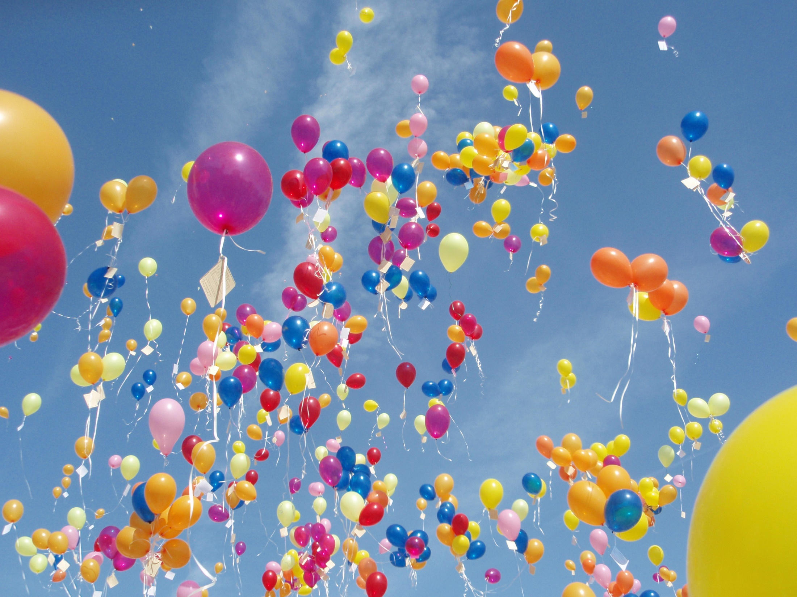
Congratulations!!!
This Photo by Unknown Author is licensed under CC BY

Slide 5
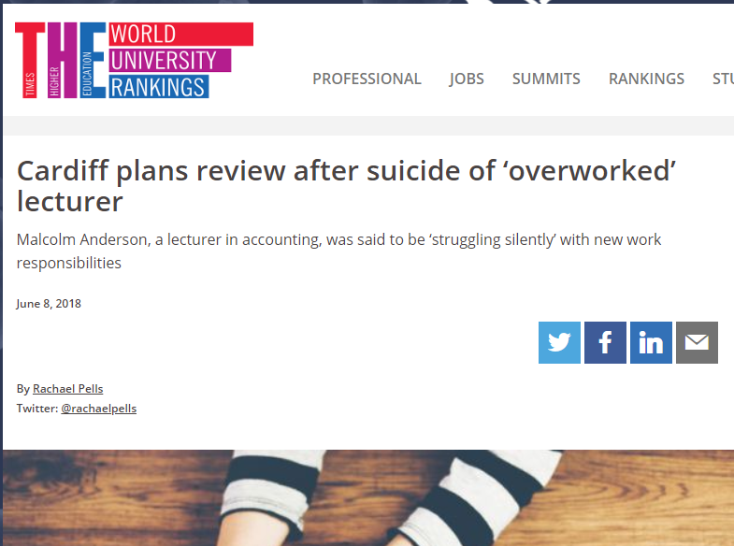
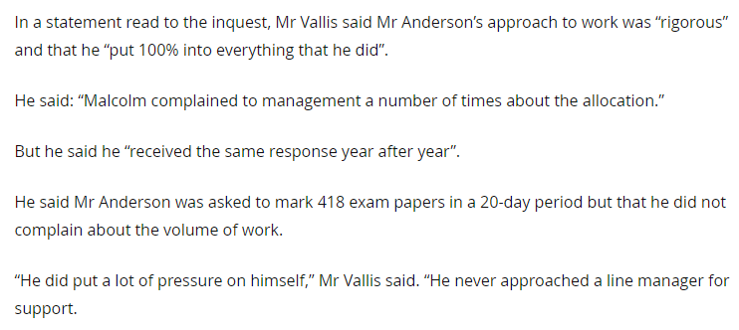

Slide 7
Responsible metrics lead to better decisions
Comparing SSH with STEM on citation counts…
Comparing early & late-career academics on h-index…
Judging anyone by their ResearchGate score…
…just isn’t going to lead to a sensible decision, let alone a fair one.

Slide 8
6 success factors

Slide 9
1. Recognise this is the beginning not the end of your responsible metrics journey

Slide 10
2. Skill up responsible people

Slide 11
Responsible metrics requires responsible people
Robust
Humble
Transparent
Diverse
Reflexive

Slide 12
A lack of formal training
29%
The proportion of Librarians surveyed whose
LIS degree included bibliometrics

Slide 13
Gunashekar, S., Wooding, S. & Guthrie, S., 2017. How do NIHR peer review panels use bibliometric information to support their decisions? Scientometrics, 112(3), pp.1813–1835.

Slide 15
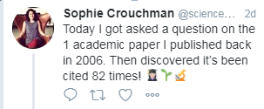
One day on Twitter:
Notes:
…

Slide 19
Notes:
(see the legend at play there?)

Slide 22
3. Build the legend

Slide 23
You mean I’ve got 5 Nature papers this year and it counts for nothing?
You mean she’s got 5 Nature papers this year and I can’t reward that?

Slide 24
4. Welcome whistle-blowers

Slide 25
5. Keep it under review

Slide 26
Growth of bibliometric indicators

Slide 27
Three new tools THIS YEAR
Dimensions
1Finder
Wizdom.ai

Slide 28
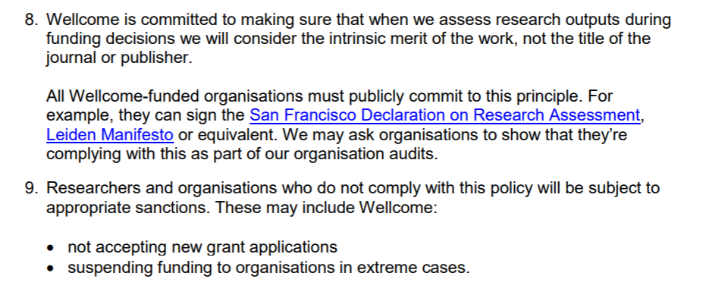

Slide 29
6. Lend your voice to the wider responsible metrics lobby

Slide 30
University rankings

Slide 31
Funders

Slide 32
Other universities
University of Cardiff Promotions Form 2017/18

Slide 33
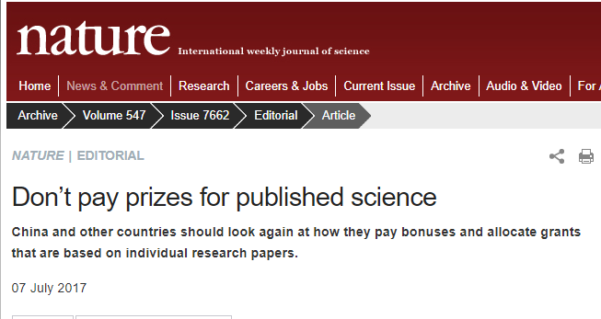

Slide 34
Citation benchmarking tools

Slide 35
Summary
This is the beginning not the end…
Skill up responsible people
Build the legend
Welcome whistle-blowers
Keep it under review
Lend your voice to the wider responsible metrics lobby

Slide 36
Thank you for listening
Dr Elizabeth Gadd
Research Policy Manager (Publications)
Loughborough University
Twitter: @lizziegadd
Email: e.a.gadd@lboro.ac.uk
http://orcid.org/0000-0003-4509-7785
http://about.me/elizabeth.gadd
Adult Ladybird books were originally created by Jason Hazeley and Joel Morris; the images are by a selection of talented artists whose identity is not easy to ascertain and are the copyright of Ladybird Books. They are reproduced here under s30(a) and s32 of UK CDPA88

