Slide 1
Architecture for the harmonization of clinical cohort data in the IMI EMIF project
Rudi Verbeeck
11th International SWAT4HCLS Conference
December 3-6 2018, Antwerp, Belgium

Slide 2
EMIF: Secondary use of health data to enrich research
  Hospital data
Pharma-owned highly controlled clinical trials data
Clinical practice, patients, payers and providers own the data
  Regional record-linkage systems
1 million
100,000
#Patient Experiences / Records
Product
Launch
  Biobanks
10,000
1,000
R&D
Phase IV
  Registries and cohorts (disease specific)
1
2
3
4
5
6
7
8
9
Years
The value of healthcare data for secondary uses in clinical research and development - Gary K. Mallow, Merck, HIMSS 2012
Notes:
CER = comparative effectiveness research

Slide 3


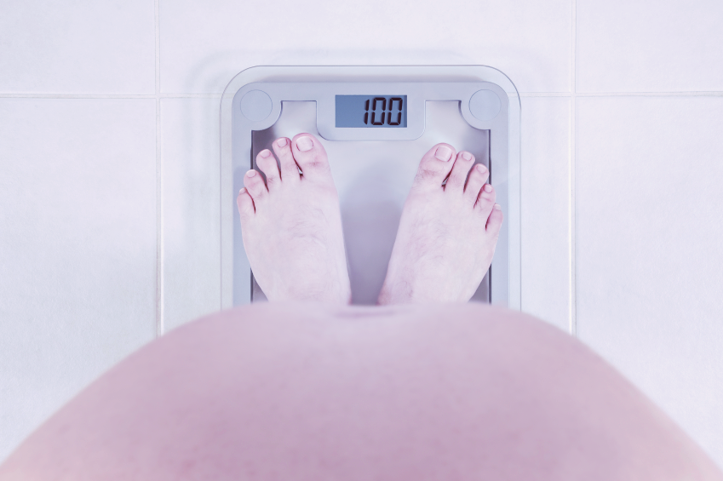
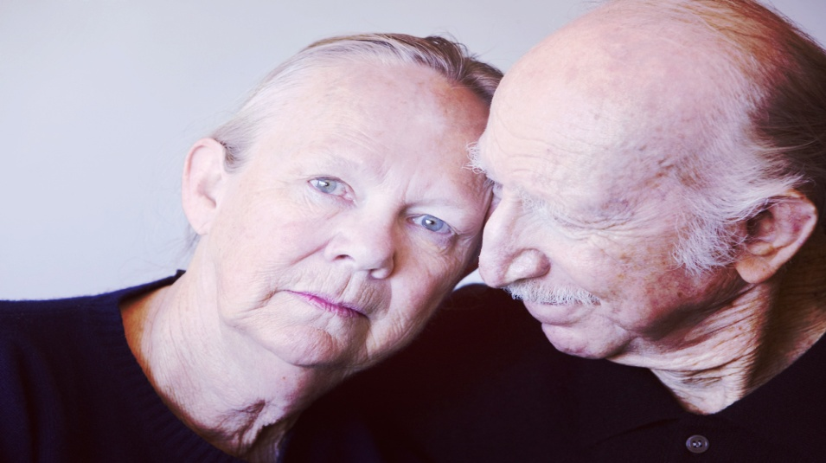



EMIF consortium
ACADEMIC PARTNERS
56 partners from 14 European countries
€56 million worth of resources
Five year project (2013 – 2017, extension 2018)
Three projects in one
EMIF-Platform
Develop a framework for evaluating, enhancing and providing access to human health data across Europe
SME PARTNERS
EFPIA PARTNERS
EMIF-Metabolic
EMIF-AD
Identify predictors of metabolic complica-tions in obesity
Identify predictors of Alzheimer’s Disease in the pre-clinical and prodromal phase
PATIENT ORGANISATION

Slide 4
EMIF workflow: drill down to the data
Cohort selection
Source metadata
Aggregated, precomputed statistics & profiles
Participant selection
Aggregated results
Combinations of variables
Variable selection
PRRE
Harmonized subject level data
Data sharing agreements, ethical approval
Limited availability
Descriptive stats
Aggregated results
User
 | C1 | C2 | … | Cm
V1
V2
⁞
Vn

Slide 5


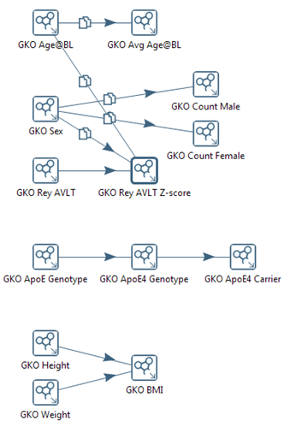


Harmonizing variables: dependency graph
Distribute ownership
knowledge = responsibility
Build library of reusable objects
Technical ≠ semantic harmonization
Security
Set local, propagate to global
Fine grained
Use groupings
Use reasoner
Efficiency
Allow traceback to source data
Allow complex mappings
Cohort 1
Cohort 2
Cohort n
Global library

Slide 6
Harmonizing variables: ontology
Global library

Slide 7
Harmonizing variables: mapping rules
Raw data
Local knowledge object
(data owner standards)
Global knowledge object
(EMIF standards)
Patient
011_S_0002
Patient
011_S_0002
Visit_code
bl
Data source
AD Dream
Visit_code
Baseline_visit
Data source
AD Dream
PTID | VISCODE | AGE
011_S_0002 | bl | 74.3
Observation
LKO_Age
Observation
GKO_Age
Obs_code
AGE
Obs_origin
Local
Obs_code
Loinc:30525-0
Obs_origin
Global
Measurement
Measurement
Measurement_value
74.3
Measurement_units
Years
Measurement_value
74
Measurement_units
CDISC:C29838
Global library

Slide 8
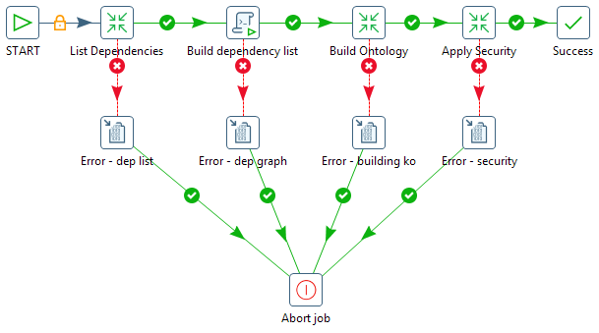
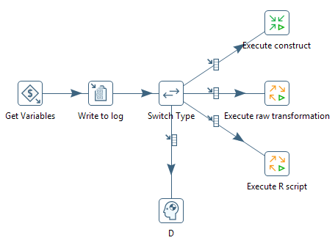
Harmonizing variables: mapping rules execution in Pentaho
Global library

Slide 9
Architecture
Cohort selection
Participant selection
Variable selection
Analysis
global library
3
3
…
source
data
Semantic ETL
Harmonized triples
source
data
Semantic ETL
Harmonized triples
Data source 1
Data source n

Slide 10
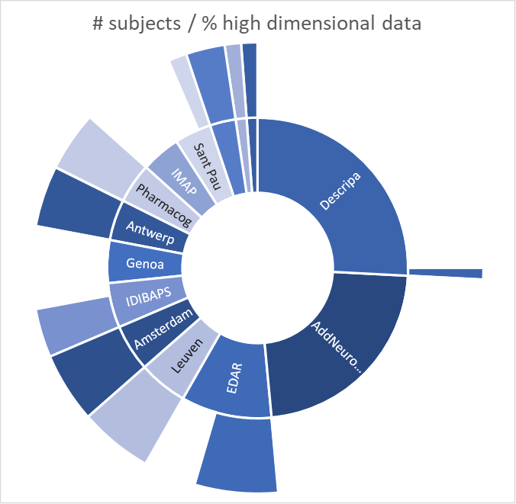
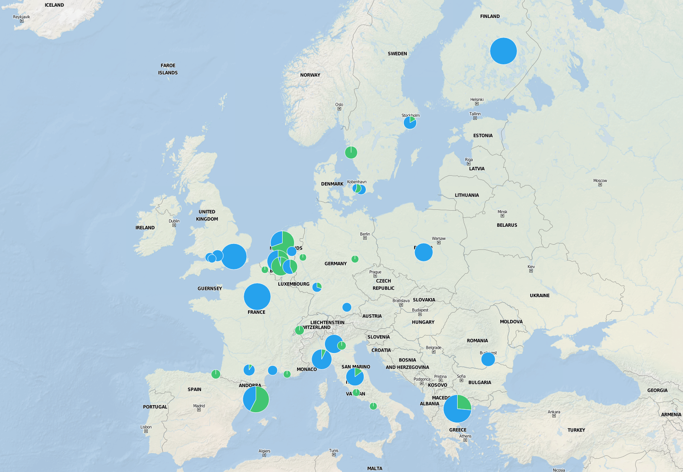
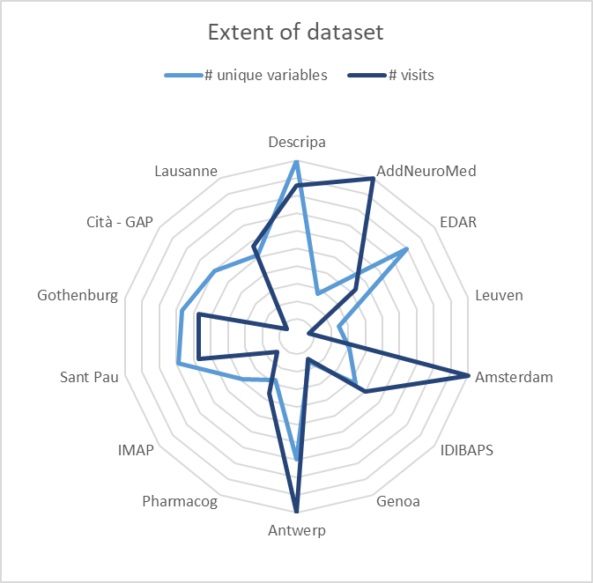
Alzheimer cohort results
# cohorts
14
# subjects
# subjects
3411
% subjects
high dim data
# subjects high dim data
1221
# variables
318
Imaging: 189
max # visit
14

Slide 11
Conclusion
Data custodians - Supply
Empower data owners and SMEs to collaborate on data
  Metadata
  Mappings
Specify minimum info for unambiguous interpretation of metadata & mappings, generate the data
Build library to encourage reuse
Control access
Researchers - Demand
Progressive protocol refinement and drill down to the data
  Data discovery
  Suitability
  Feasibility
  Data analysis
Tools
  Cohort selection tool
  Patient selection tool
  Variable selection tool
  PRRE

Slide 12
Acknowledgements
Cohort selection tool: José Luis Oliveira, Univ. Aveiro, PT
PST / VST: Michel van Speybroeck
Cohort contacts: Jelle Praet
Data harmonization framework
  Janssen: Luiza Gabriel, Alvaro Cortes-Callabuig, Michel van Speybroeck, Rudi Verbeeck
  U. Manchester, UK: James Cunningham
Tools and scripts
  Know.Bi: Bart Maertens
Library
  ITTM (LU): Serge Eifes, Adriano Barbosa, Kavita Rege
PRRE data load (tranSMART)
  Maastricht U., NL: Isabelle Bos, Stephanie Vos
  The Hyve, NL: Janneke Schoots – van der Ploeg, Olaf Meuwese, Andy Sewgobind, Stefan Payralbe

Slide 13

Thank you
rverbeec@its.jnj.com

